Slide 1


ITU - EACO
WORKSHOP ON EMERGING TECHNOLOGIES
SESSION 4: INTRODUCTION TO AI

Slide 2
OBJECTIVES
DECIPHER WHAT IS AI BEYOND MEDIA HYPE
A MOMENTUM FOR WIDE SCALE AI IMPLEMENTATION
OPPORTUNITIES AND CHALLENGES
OVERVIEW OF FORTHCOMING SESSIONS

Slide 3
WHAT IS I(NTELLIGENCE)?
CONTROVERSIAL AND VAST SUBJECT …

Slide 4
SOME QUOTES
“Intelligence is the ability to adapt to change” – Stephen Hawking
“Intelligence is the ability to avoid doing work, yet getting the work done” – Linus Torvalds
“The true sign of intelligence is not knowledge but imagination” – Albert Einstein
“The intelligent man who is proud of his intelligence is like the condemned man who is proud of his large cell” – Simone Weil

Slide 5
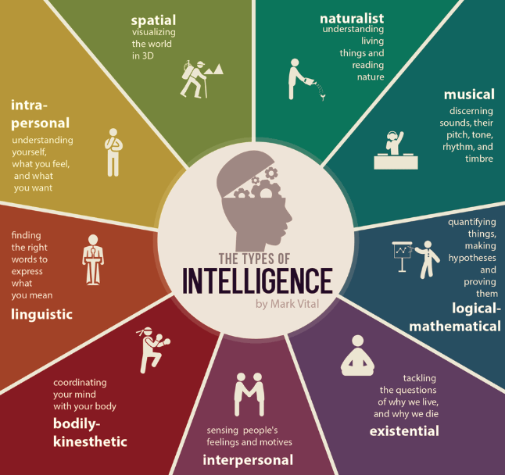
Source: https://blog.adioma.com/9-types-of-intelligence-infographic/

Slide 6
WHAT IS I[NTELLIGENCE]? REDUX DIVIDE AND CONQUER

Slide 7
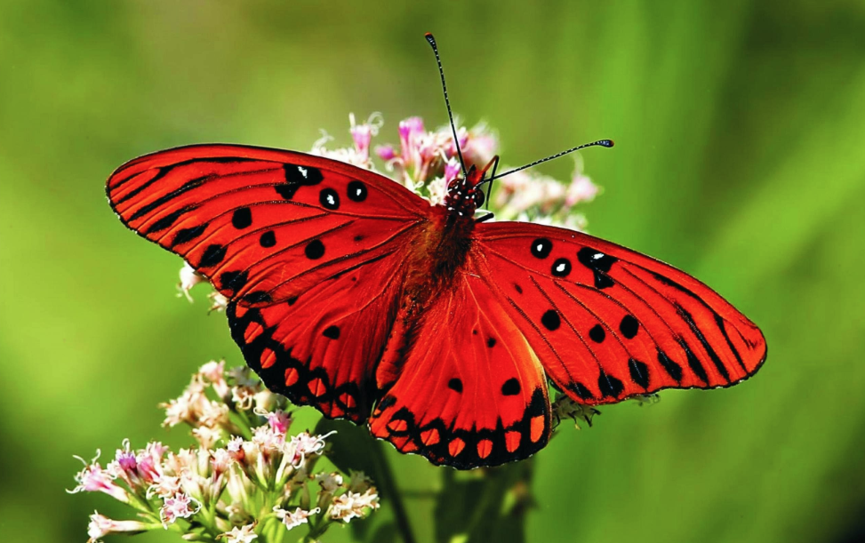
A STORY OF A BUTTERFLY AND …

Slide 8
DECISION MAKING UNDER UNCERTAINTY
PREDICTIONS AFFECT BEHAVIOUR
PREDICTIONS AFFECT DECISIONS
PREDICTIONS ARE SOMETIMES BIASED
AI IS REALLY REALLY GOOD AT IT

Slide 9
IDENTIFY 10 AI APPLICATIONS
WHAT DOES IT PREDICT?

Slide 10
WHAT IS ARTIFICIAL INTELLIGENCE (AI)
NOT MUCH SIMPLER OR CLEARER …
Notes:
Supposed to define intelligence! Hum, quite embarassing

Slide 11
PRELIMINARY QUIZ
AI WAS INVENTED 10 YEARS AGO
AI RESEARCH ACHIEVES MAJOR BREAKTHROUGHS EVERY 6 MONTHS
AI WILL REPLACE 50% OF ALL JOBS IN 10 YEARS
US LEAD IN AI IS ABSOLUTELY UNDENIABLE
AI IMPLEMENTATION AT LARGE SCALE IS WELL MARKED OUT

Slide 12
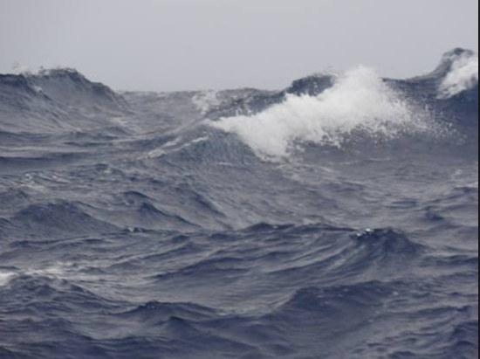
BRIEF OVERVIEW OF AI HISTORY
BOOM AND BUST CYCLES
Notes:
Supposed to define intelligence! Hum, quite embarassing

Slide 13
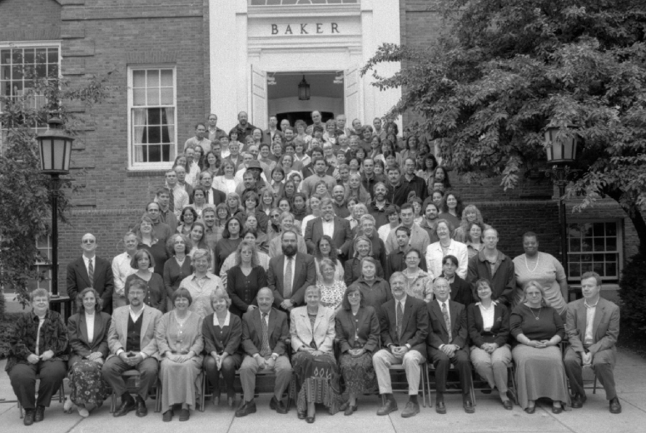
DARTMOUTH SEMINAL WORKSHOP [1956]
Marvin Minsky
John McCarthy
Claude Shannon
Herbert Simon
John Nash
Arthur Samuel
…
Notes:
Marvin Minsky, John MacCarthy, Claude Shannon, Herbert Simon, John Nash, Arthur Samuel

Slide 14
THE PROPOSAL
« An attempt will be made to find how to make machines use language, form abstractions and concepts, solve kinds of problems now reserved for humans, and improve themselves.
…
For the present purpose the artificial intelligence problem is taken to be that of making a machine behave in ways that would be called INTELLIGENT IF A HUMAN WERE SO BEHAVING. »

Slide 15
THE PROMISED RESULTS
« We think that a significant advance can be made in one or more of these problems if a carefully selected group of scientists work on it together for a summer »
UNDERESTIMATED DIFFICULTY

Slide 16
TWO MAIN SCHOOLS OF THOUGHTS [1950s - 60s]
RULE-BASED – SYMBOLIC EXPERT SYSTEM
NEURAL NETWORKS AS AN ATTEMPT TO MIMIC BRAIN
Notes:
Logic based – domain knowledge of prime importance – Series of logical rules – Solving toy problems
Neural Networks – agnostic/learn by itself

Slide 17
THE FIRST AI WINTER [1970s]
LACK OF PRACTICAL RESULTS
EXPECTATIONS RAISE TO HIGH
CONTROVERSY BETWEEN DIFFERENT SCHOOLS OF THOUGHT

Slide 18
STINTS OF PROMINENCE [1980s]
RISE OF EXPERT SYSTEMS FOLLOWED BY
NEAR TOTAL ABANDONMENT

Slide 19
PROLONGED ICE IN THE [1990s] DESPITE
MORE DATA
MORE COMPUTING POWER

Slide 20
THE AI CONSPIRACY [MID-2000s]
HINTON, BENGIO, LECUN, …
HOW TO BEST USE/TRAIN NEURAL NETWORKS (NN)
RE-BRANDED NN AS DEEP LEARNING
Notes:
Logic based – domain knowledge of prime importance
Neural Networks – agnostic/learn by itself

Slide 21
EVERYBODY BUZZING ABOUT [2010s]
MAJOR BREAKTHOUGHS – IMAGE NET CONTEST
USE OF GPUs
HUGE AMOUNT OF DATA HARNESSED
OPTIMIZATION TRICKS
…

Slide 22
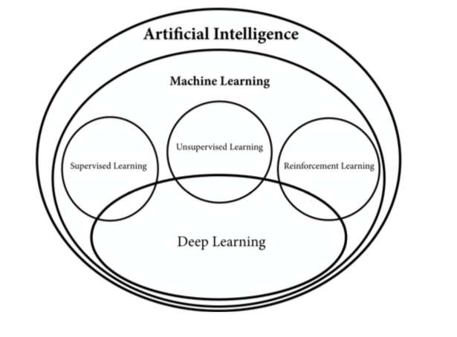
DECYPHERING AI JARGON
Source: https://www.manning.com/books/grokking-deep-reinforcement-learning

Slide 23





SUPERVISED LEARNING
MODEL
NEW RESPONSE
KNOWN DATA
?
THESE ARE CATS
KNOWN RESPONSE
NEW DATA
Notes:
https://www.quora.com/What-is-the-difference-between-supervised-and-unsupervised-learning-algorithms

Slide 24

UNSUPERVISED LEARNING
I CAN SEE A PATTERN
MODEL
INPUT DATA
Notes:
https://www.quora.com/What-is-the-difference-between-supervised-and-unsupervised-learning-algorithms

Slide 25


REINFORCEMENT LEARNING
ENVIRONMENT
STEP 2: OBSERVE ITS STATE &
GET REWARD
STEP 1: ACT
AGENT
Notes:
https://www.quora.com/What-is-the-difference-between-supervised-and-unsupervised-learning-algorithms

Slide 26
WHAT ARE AI KEY ENABLERS?
HOW DOES IOT FIT INTO THE OVERALL PICTURE?

Slide 27
THE RACE FOR AI
A WORLD TOUR OF RECENT PUBLIC AI STRATEGIES/POLICIES
ON WHICH ASPECTS?
US vs. CHINA vs. ALL

Slide 28
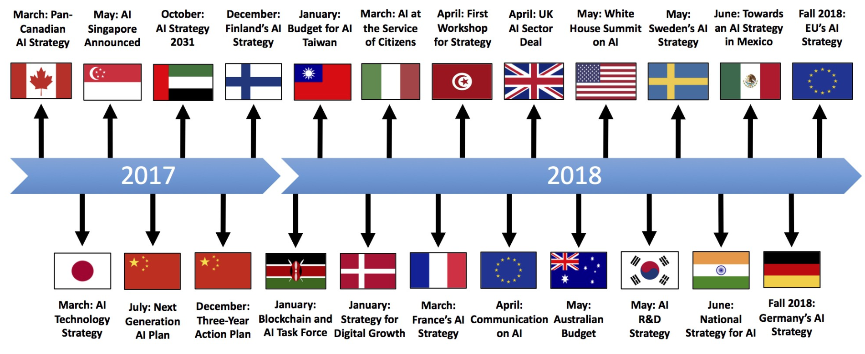
AN IDEA OF THE RUSH …
Source: https://medium.com/politics-ai/an-overview-of-national-ai-strategies-2a70ec6edfd

Slide 29
THE STUFF OF AN AI SUPERPOWER
ABUNDANT DATA
TENACIOUS ENTREPRENEURS
WELL-TRAINED AI SCIENTISTS
SUPPORTIVE POLICY ENVIRONMENT
https://aisuperpowers.com/

