Slide 1


ITU - EACO
WORKSHOP ON EMERGING TECHNOLOGIES
SESSION 4: INTRODUCTION TO AI

Slide 2
OBJECTIVES
DECIPHER WHAT IS AI BEYOND MEDIA HYPE
A MOMENTUM FOR WIDE SCALE AI IMPLEMENTATION
OPPORTUNITIES AND CHALLENGES

Slide 3
WHAT IS I(NTELLIGENCE)?
CONTROVERSIAL AND VAST SUBJECT …

Slide 4
SOME QUOTES
“Intelligence is the ability to adapt to change” – Stephen Hawking
“Intelligence is the ability to avoid doing work, yet getting the work done” – Linus Torvalds
“The true sign of intelligence is not knowledge but imagination” – Albert Einstein
“The intelligent man who is proud of his intelligence is like the condemned man who is proud of his large cell” – Simone Weil

Slide 5
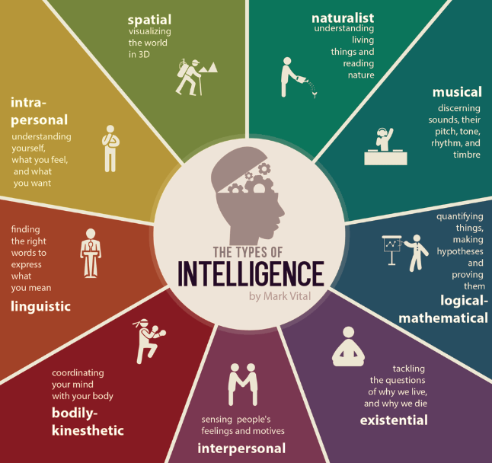
Source: https://blog.adioma.com/9-types-of-intelligence-infographic/

Slide 6
WHAT IS I[NTELLIGENCE]? REDUX
DIVIDE AND CONQUER

Slide 7

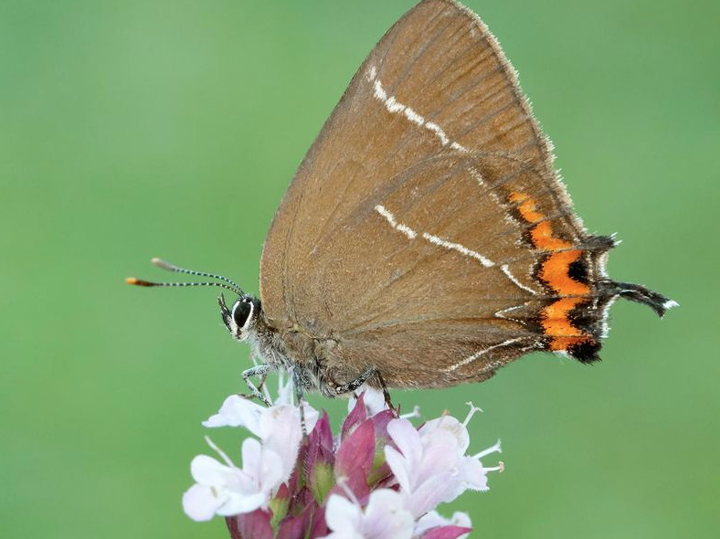
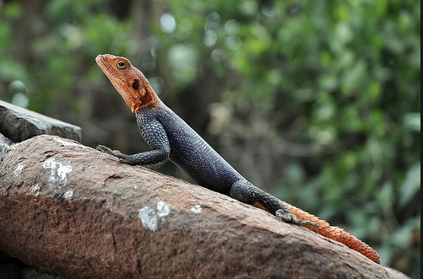
A STORY OF A BUTTERFLY AND …
Source: https://www.smithsonianmag.com/smart-news/ butterfly-recently-returned-scotland-now-its-laying-eggs-180968195/
Source: http://reptile-database.reptarium.cz
Notes:
Faulty reasoning, objective, state prediction, long/short horizon, assumptions, question of perspective
Lizard

Slide 8
DECISION MAKING UNDER UNCERTAINTY
PREDICTIONS AFFECT BEHAVIOUR
PREDICTIONS AFFECT DECISIONS
PREDICTIONS ARE SOMETIMES BIASED
AI IS REALLY REALLY GOOD AT IT

Slide 9
IDENTIFY 5 AI APPLICATIONS
WHAT DOES IT PREDICT?

Slide 10
WHAT IS ARTIFICIAL INTELLIGENCE (AI)
NOT MUCH SIMPLER OR CLEARER …

Slide 11
PRELIMINARY QUIZ
AI WAS INVENTED 10 YEARS AGO
AI RESEARCH ACHIEVES MAJOR BREAKTHROUGHS EVERY 6 MONTHS
AI WILL REPLACE 50% OF ALL JOBS IN 10 YEARS
US LEAD IN AI IS ABSOLUTELY UNDENIABLE
AI IMPLEMENTATION AT LARGE SCALE IS WELL MARKED OUT

Slide 12
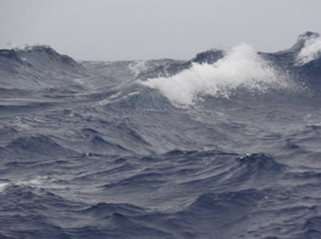
BRIEF OVERVIEW OF AI HISTORY
BOOM AND BUST CYCLES

Slide 13
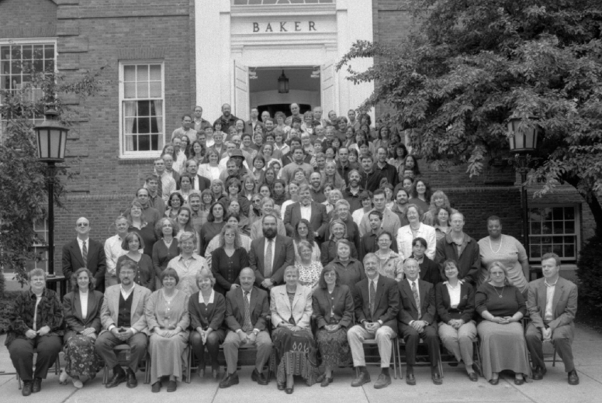
DARTMOUTH SEMINAL WORKSHOP [1956]
Marvin Minsky
John McCarthy
Claude Shannon
Herbert Simon
John Nash
Arthur Samuel
…
Notes:
Marvin Minsky, John MacCarthy, Claude Shannon, Herbert Simon, John Nash, Arthur Samuel

Slide 14
THE PROPOSAL
« An attempt will be made to find how to make machines use language, form abstractions and concepts, solve kinds of problems now reserved for humans, and improve themselves.
…
For the present purpose the artificial intelligence problem is taken to be that of making a machine behave in ways that would be called INTELLIGENT IF A HUMAN WERE SO BEHAVING. »

Slide 15
THE PROMISED RESULTS
« We think that a significant advance can be made in one or more of these problems if a carefully selected group of scientists work on it together for a summer »
UNDERESTIMATED DIFFICULTY

Slide 16
TWO MAIN SCHOOLS OF THOUGHTS [1950s - 60s]
RULE-BASED – SYMBOLIC EXPERT SYSTEM
NEURAL NETWORKS AS AN ATTEMPT TO MIMIC BRAIN
Notes:
Logic based – domain knowledge of prime importance – Series of logical rules, ifs – Solving toy problems
Neural Networks – agnostic/learn by itself

Slide 17
THE FIRST AI WINTER [1970s]
LACK OF PRACTICAL RESULTS
EXPECTATIONS RAISE TO HIGH
CONTROVERSY BETWEEN DIFFERENT SCHOOLS OF THOUGHT

Slide 18
STINTS OF PROMINENCE [1980s]
RISE OF EXPERT SYSTEMS FOLLOWED BY
NEAR TOTAL ABANDONMENT

Slide 19
PROLONGED ICE IN THE [1990s] DESPITE
MORE DATA
MORE COMPUTING POWER

Slide 20
THE AI CONSPIRACY [MID-2000s]
HINTON, BENGIO, LECUN, …
HOW TO BEST USE/TRAIN NEURAL NETWORKS (NN)
RE-BRANDED NN AS DEEP LEARNING
Notes:
Logic based – domain knowledge of prime importance
Neural Networks – agnostic/learn by itself

Slide 21
EVERYBODY BUZZING ABOUT [2010s]
MAJOR BREAKTHOUGHS – IMAGE NET CONTEST
USE OF GPUs
HUGE AMOUNT OF DATA HARNESSED
OPTIMIZATION TRICKS
…

Slide 22
DECYPHERING AI JARGON
SUPERVISED, UNSUPERVISED, REINFORCEMENT LEARNING, …

Slide 23




SUPERVISED LEARNING
MODEL
NEW RESPONSE
KNOWN DATA
?
THESE ARE CATS
KNOWN RESPONSE
NEW DATA
Notes:
https://www.quora.com/What-is-the-difference-between-supervised-and-unsupervised-learning-algorithms

Slide 24


UNSUPERVISED LEARNING
I CAN SEE A PATTERN
MODEL
INPUT DATA
Notes:
https://www.quora.com/What-is-the-difference-between-supervised-and-unsupervised-learning-algorithms

Slide 25


REINFORCEMENT LEARNING
ENVIRONMENT
OBSERVE ITS STATE
GET REWARD
ACT
AGENT
Notes:
https://www.quora.com/What-is-the-difference-between-supervised-and-unsupervised-learning-algorithms

Slide 26
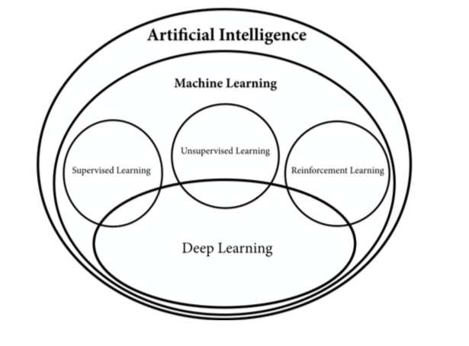
REBRANDING & CONFUSION
DIFFERENCE BETWEEN AI & MACHINE LEARNING?
WHAT IS DATA SCIENCE?
DEEP LEARNING OR DEEP NEURAL NETWORKS?
Source: https://www.manning.com/books/grokking-deep-reinforcement-learning

Slide 27
WHAT ARE AI KEY ENABLERS?
TECHNOLOGY, SCIENCE, BUSINESS, SOCIAL, POLICY, …

Slide 28
ON TECHNOLOGICAL SIDE
COMPUTING POWER (GPU)
OPTIMIZATION OF LEARNING ALGORITHMS
MAJOR BREAKTRHOUGHS

Slide 29
ON SCIENTIFIC SIDE
EXTREMELY ACTIVE SCIENTIFIC RESEARCH WORLDWIDE
DEMOCRATIZATION / OPEN SOURCE / EDUCATION / SaaS
MAJOR BREAKTRHOUGHS

Slide 30
ON BUSINESS SIDE
FROM INNOVATION TO IMPLEMENTATION “ERA”
HARNESSING THE “NARROW” AI
INFINITE DOMAIN APPLICATIONS
INDUSTRIALIZATION

Slide 31
ON SOCIETAL & POLICY SIDES
PUBLIC AWARENESS THROUGH MEDIA HYPE
RACE FOR AI AS A GEOPOLOTICAL STAKE
DIGITALIZATION OF THE SOCIETY ALREADY STARTED IN MANY COUNTRIES

Slide 32
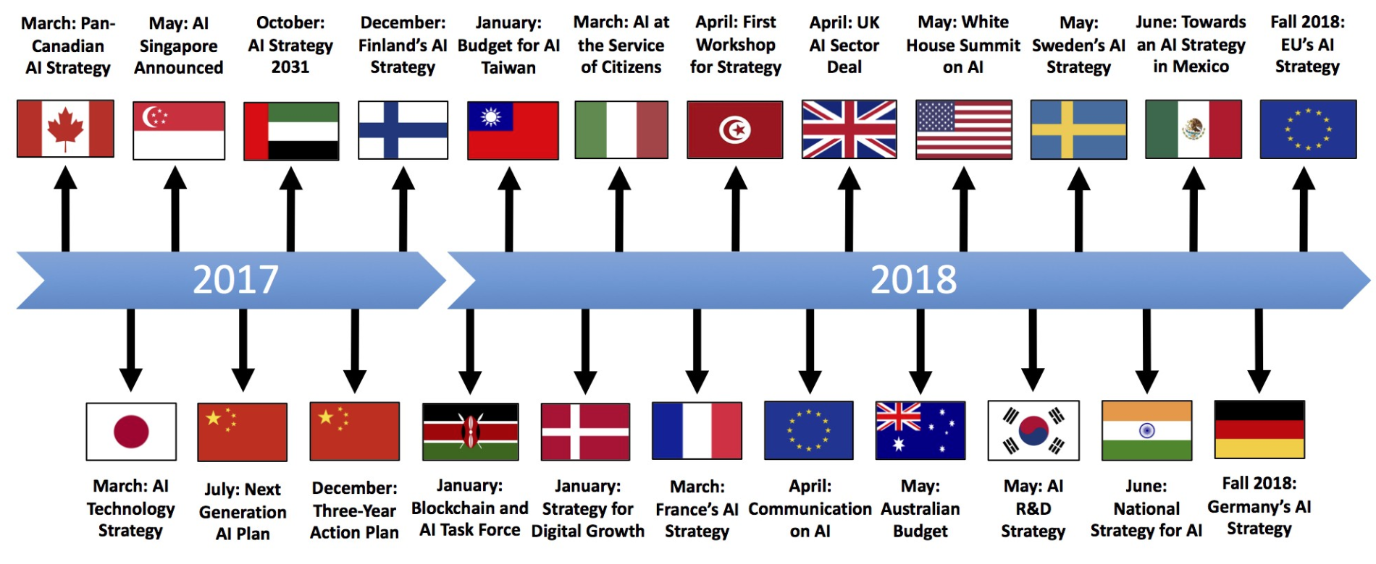
AN IDEA OF THE RUSH …
Source: https://medium.com/politics-ai/an-overview-of-national-ai-strategies-2a70ec6edfd
Notes:
Own strong strategy otherwise risk of becoming a Cyber-colony

Slide 33
THE STUFF OF AN AI SUPERPOWER
ABUNDANT DATA
TENACIOUS ENTREPRENEURS [ON STRATEGIC SECTORS]
WELL-TRAINED AI SCIENTISTS
SUPPORTIVE POLICY ENVIRONMENT [ON STRATEGIC SECTORS]
https://aisuperpowers.com/
Notes:
Strategic sectors may vary according to the country/region: healthcare in France, Manufacturing in China, …

Slide 34
WHAT ARE AI CHALLENGES?
ETHICS, SOCIETAL, TECHNOLOGY, …

Slide 35
TECHNOLOGICAL/SCIENTIFIC SIDES
UNDERSTAND WHY DOES IT WORK SO WELL !!
PREDICTION ON LONG TERM HORIZON
UNSUPERVISED LEARNING -> BUILD A MODEL OF THE WORLD FROM SCRATCH

Slide 36
ON BUSINESS SIDE
TRANSITION TO INDUSTRIALIZATION
EAGER ENTREPRENEURS

Slide 37
ON SOCIETAL & POLICY SIDES
MANY ETHICAL CONSIDERATIONS
INFORMED AND AMBITIOUS POLICIES
HUGE SOCIAL IMPACT TO ANTICIPATE
Notes:
Policy on data, entrepreneurship, delegation, multidisciplinary research, education, public awareness, ethical committees, …

Slide 38
AI IS A MATTER OF TRADEOFFS
MORE DATA => LESS PRIVACY
MORE AUTONOMY => LESS CONTROL
MORE SPEED => LESS ACCURACY

Slide 39
AI IN AFRICA
FOR A PAN-AFRICAN STRATEGY SETTING UP ROADMAP ?

Slide 40
NO EXCEPTION PAN-AFRICAN STRATEGY
TO ENCOURAGE AI EDUCATION
TO INCENTIVIZE ENTREPRENEURSHIP [STRATEGIC SECTORS?]
TO FACILITATE COOPERATION
TO MOBILIZE HUMAN & FINANCIAL RESOURCES
Notes:
More than 1.2 billion people
Median age is 19 while in Europe 43 (me)
What are strategic sectors in Africa for AI
US$560 million VC in 2017 (60 of them through Google Launchpad accelerator)

Slide 41
RECENT INITIATIVES IN EDUCATION & RESEARCH
AFRICAN MASTER IN MACHINE INTELLIGENCE (AMMI), AIMS KIGALI, RWANDA
DEEP LEARNING INDABA GATHERINGS
GOOGLE RESEARCH LAB IN ACCRA, GHANA
ZINDI (KAGGLE FOR AFRICA)
https://aims-ammi.com/
http://www.deeplearningindaba.com/
https://zindi.africa/competitions
Notes:
African Institute for Mathematical Science (African Master of Machine Intelligence) – Google, Facebook sponsorship
Exemple of applications but will be shown on later presentations

Slide 42
FORTHCOMING SESSIONS

Slide 43
AI APPLICATIONS ETHICS OF AI
OPEN ISSUES
BUSINESS MODEL
&
WORKING GROUP SESSIONS

