Slide 1


ITU - EACO
WORKSHOP ON EMERGING TECHNOLOGIES
SESSION 10: IoT - AI BUSINESS MODELS

Slide 2
OBJECTIVES
RECAP. OPEN ISSUES SEEN SO FAR
PROVIDE AN OVERVIEW OF OPEN ISSUES BEYOND ETHICAL ONES

Slide 3
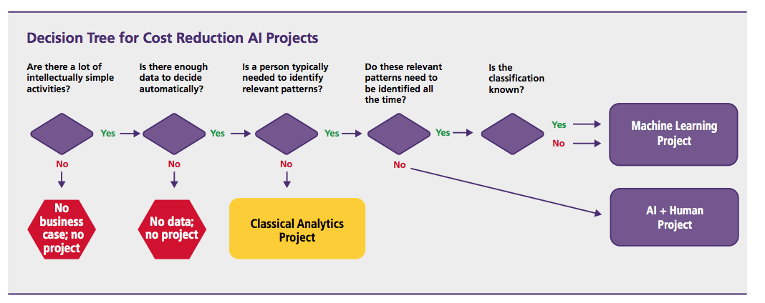
Decision tree for cost reduction AI projects. Source IBM

