Slide 1


ITU - EACO
WORKSHOP ON EMERGING TECHNOLOGIES
SESSION 6: ETHICS OF AI

Slide 2
OBJECTIVES
PROVIDE AN OVERVIEW OF ETHICAL IMPLICATIONS OF AI
INTRODUCE WORKING GROUP SESSION

Slide 3
LIST AI ETHICS IMPLICATIONS YOU CAN THINK OF
HOW TO ADDRESS POTENTIAL ISSUES?

Slide 4
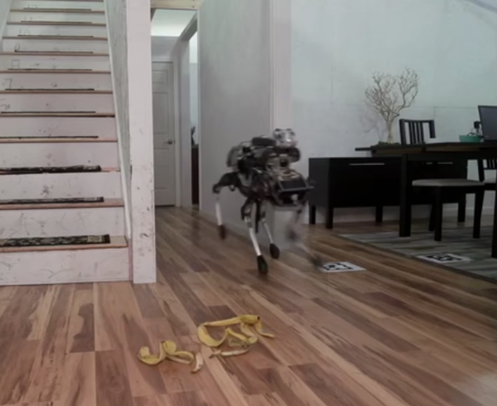
THE EXISTENTIAL THREAT …
https://www.youtube.com/watch?v=3BlYq3jO6xw

Slide 5
RATHER FOCUS ON ALREADY PRESENT ISSUES
LACK OF TRANSPARENCY & TRUST
DELEGATE JUDGEMENT IN SENSITIVE AREAS
INJECTING HUMAN BIAS
COMPLIANCE WITH SOCIAL AND VALUE NORMS
…

Slide 6
LACK OF TRANSPARENCY

Slide 7
THE BLACK-BOX PHENOMENON
SIMPLE MODELS LIKE DECISION TREE ARE EASY TO EXPLAIN
STATE-OF-THE ART ENSEMBLE METHODS INCREASED PERFORMANCE OBSCURE …
IDEM WITH DEEP NEURAL NETWORKS
UNABLE TO JUSTIFY/EXPLAIN THE PREDICTION
DEMOCRATIC ISSUE

Slide 8
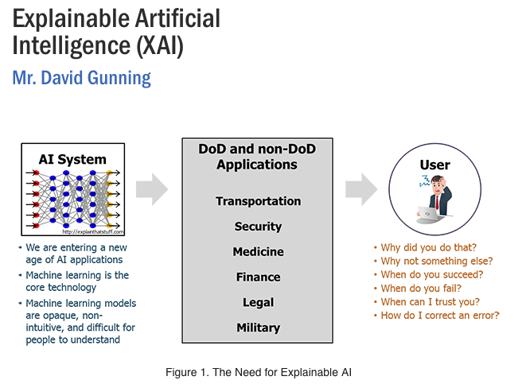
EXPLAINABLE AI
https://www.darpa.mil/program/explainable-artificial-intelligence

Slide 9
JUDGMENT DELEGATION

Slide 10
WHAT ARE SENSITIVE AREAS?
COURTS
DEFENCE
INSURANCE
POLICING
BANKING
…

Slide 11
ACCOUNTABILITY & FALLABILITY
HUMAN RESPONSIBILITIES
FALLABLE THOUGH IT IS JUDGEMENT SHOULD NOT BE REPLACED BY MACHINE IN SOME AREAS

Slide 12

HUMAN BIAS AND WoMD

Slide 13
SOME COMMON ISSUES
USING PROXY VARIABLE AS PREDICTORS
NOT ENOUGH DATA OR NOT REPRESENTATIVE
PREDICTOR CHOICES BIASED BY IDEOLOGY, CONFIRMATION BIAS
…

Slide 14
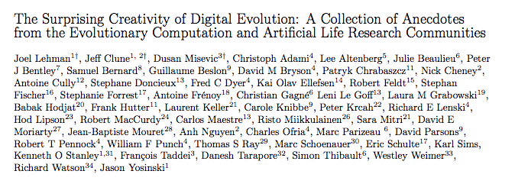
SURPRISING CREATIVITY
https://arxiv.org/abs/1803.03453
https://www.youtube.com/watch?v=GdTBqBnqhaQ&feature=youtu.be

Slide 15
PUBLIC DEBATES NEED TO RALLY

Slide 16
SOCIETY AT LARGE & RISK AWARENESS
EDUCATION
PUBLIC AUTHORITIES [CERTIFIED PUBLIC EXPERT AUDIT …]
SCIENTIFIC COMMUNITY
INDUSTRY: ETHICS BY DESIGN [RIGHT QUESTION RIGH TIME]
BUSINESS OWNERS
CIVIL SOCIETY
…

Slide 17
WORKING GROUP SESSION
TO BE CONTINUED

