Slide 1


ITU - EACO
WORKSHOP ON EMERGING TECHNOLOGIES
SESSION 6: MACHINE LEARNING IN ACTION

Slide 2
OBJECTIVES
SURVEY OF ONLINE DEMO OF DEEP LEARNING IN THE FIELD OF IMAGE RECOGNITION, GENERATIVE DEEP LEARNING, …
DEMO. LIVE CODING OF DEEP LEARNING IN ACTION USING JUPYTER NOTEBOOK: IMAGE RECOGNITION, REINFORCEMENT LEARNING, …

Slide 3
EXPERIMENT AI ONLINE

Slide 4
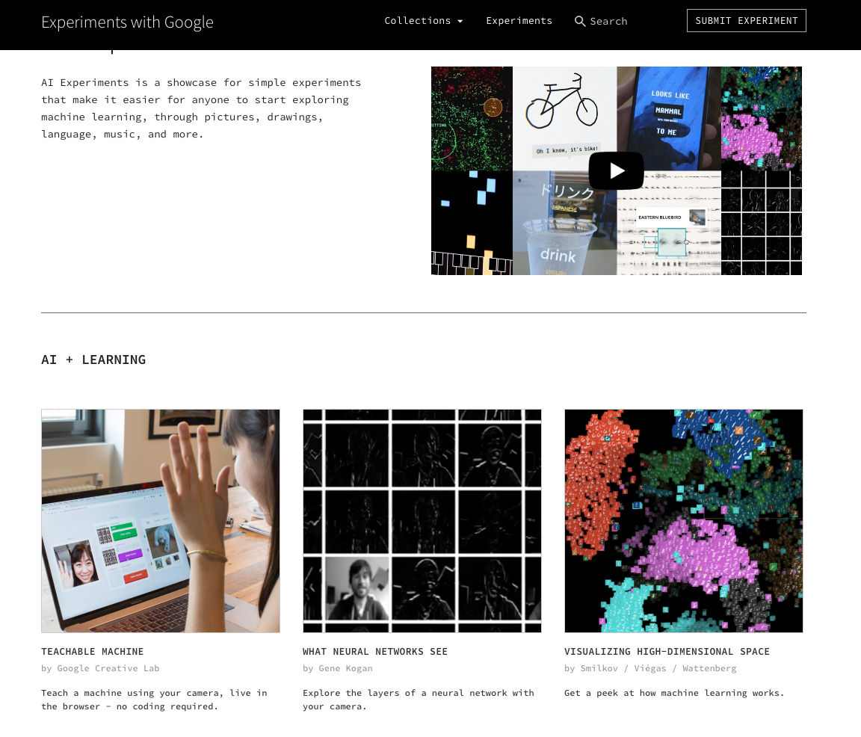
EXPERIMENTS WITH AI
https://experiments.withgoogle.com/collection/ai
https://teachablemachine.withgoogle.com/
https://quickdraw.withgoogle.com

Slide 5
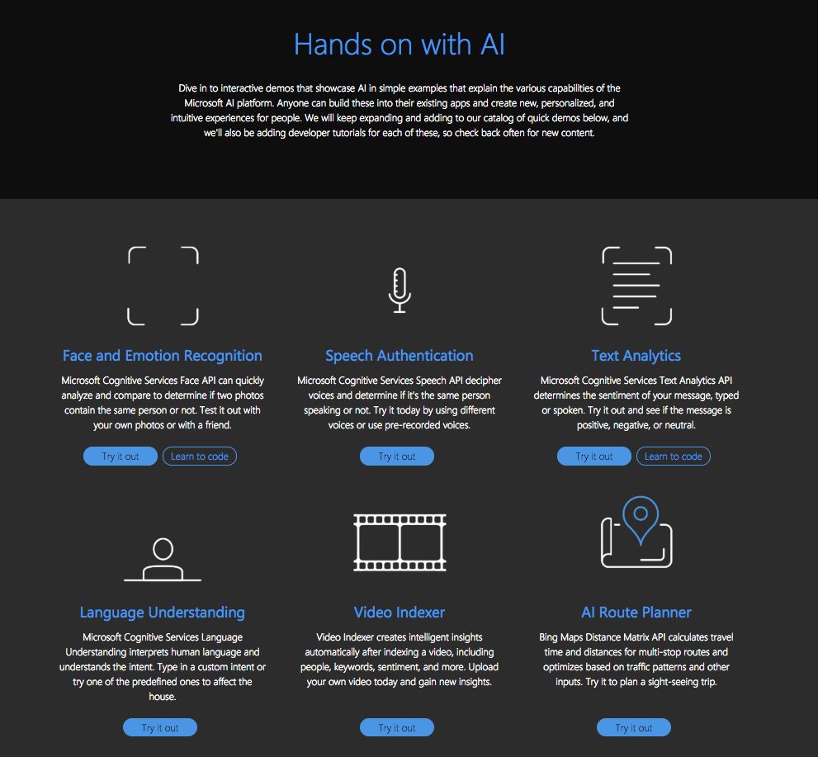
AI DEMOS
https://aidemos.microsoft.com/
https://aidemos.microsoft.com/face-recognition

Slide 6
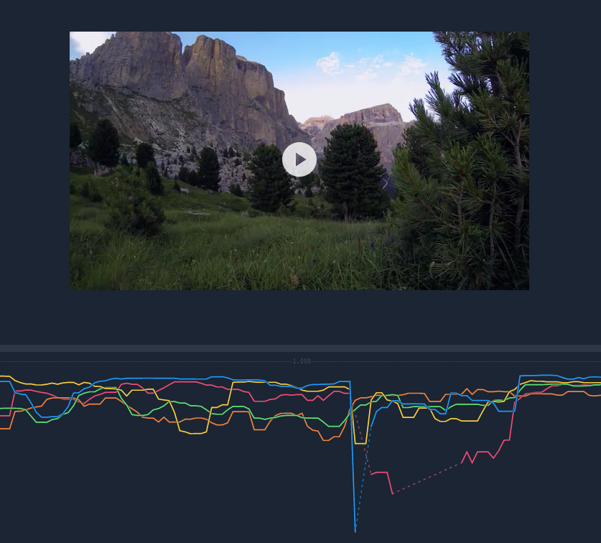
OBJECT DETECTION
https://clarifai.com/demo

Slide 7
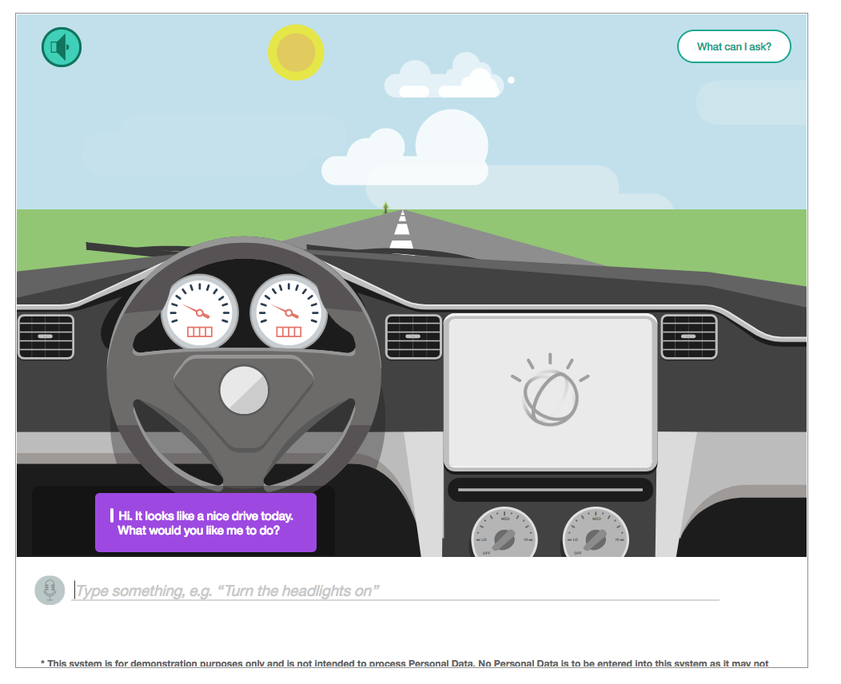
AI VIRTUAL ASSISTANT
https://watson-assistant-demo.ng.bluemix.net/

Slide 8
AI VIRTUAL ASSISTANT
https://watson-assistant-demo.ng.bluemix.net/

Slide 9
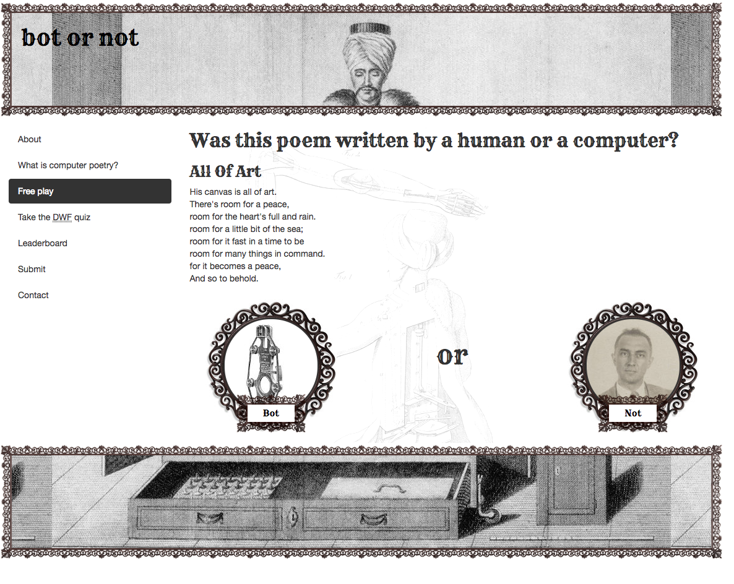
BOTS OR NOT BOTS
http://botpoet.com/vote/all-art/

Slide 10
DEEP LEARNING IN ACTION: LIVE CODING SESSION DEMO

