Slide 1


ITU - EACO
WORKSHOP ON EMERGING TECHNOLOGIES
SESSION 6: ETHICS OF AI

Slide 2
OBJECTIVES
PREPARE WORKING GROUP SESSION WITH AN OVERVIEW OF AI ETHICAL IMPLICATIONS
BE JUDGE & JURY DURING WORKING GROUP SESSION

Slide 3
ETHICAL IMPLICATIONS
OF AI

Slide 4

LIST AI ETHICS IMPLICATIONS YOU CAN THINK OF
HOW TO ADDRESS POTENTIAL ISSUES?

Slide 5
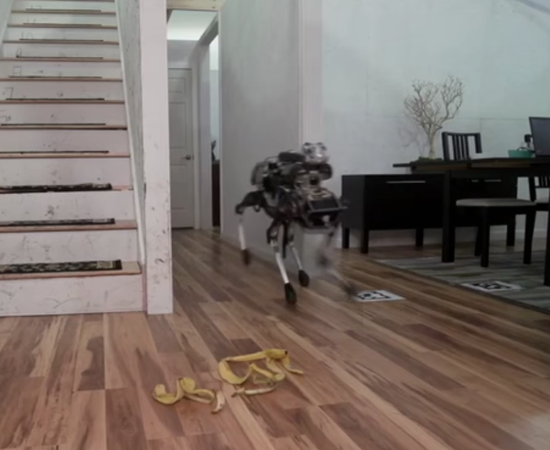
EXISTENTIAL THREAT
WIDELY DEBATED SCENARIOS …
https://www.youtube.com/watch?v=3BlYq3jO6xw

Slide 6
THE CATCHING HUMANITY BY SURPRISE SCENARIO
SUPERINTELLIGENCE IS PHYSICALLY POSSIBLE
TOWARDS CREATIVITY, STRATEGIC PLANNING, SOCIAL SKILLS
RECURSIVE AUTO-IMPROVEMENT
LOOK AT GAME OF GO RECENT BREAKTHROUGH …
REALLY ??
Notes:
Game of Go taken as example: this is clearly an overstatement !! Very narrow field but Deepmind breakthrough captured the imagination

Slide 7
TOWARDS PHILOSOPHICAL DEBATES
THE OBJECTIVE/UTILITY FUNCTIONS & CONTROL PROBLEM
WHAT DRIVES HUMAN/MACHINE?
INTELLIGENCE – MORALITY
CASSANDRA, TECHNO-OPTIMISM & SCEPTICISM
TIMEFRAME ??
Notes:
Cassandra was cursed to utter prophecies that were true but that no one believed, troy war and Agamemnon going back home.

Slide 8
FOCUS ON ALREADY CURRENT ISSUES INSTEAD

Slide 9
RATHER FOCUS ON ALREADY PRESENT ISSUES
LACK OF TRANSPARENCY & TRUST
DELEGATE JUDGEMENT IN SENSITIVE AREAS
INJECTING HUMAN BIAS
COMPLIANCE WITH SOCIAL AND VALUE NORMS
DATA PRIVACY
SOCIAL INEQUALITIES

Slide 10
LACK OF TRANSPARENCY

Slide 11
THE BLACK-BOX PHENOMENON
SIMPLE MODELS LIKE DECISION TREE ARE EASY TO EXPLAIN
STATE-OF-THE ART ENSEMBLE METHODS INCREASED PERFORMANCE OBSCURE …
IDEM WITH DEEP NEURAL NETWORKS
UNABLE TO JUSTIFY/EXPLAIN THE PREDICTION
DEMOCRATIC ISSUE

Slide 12
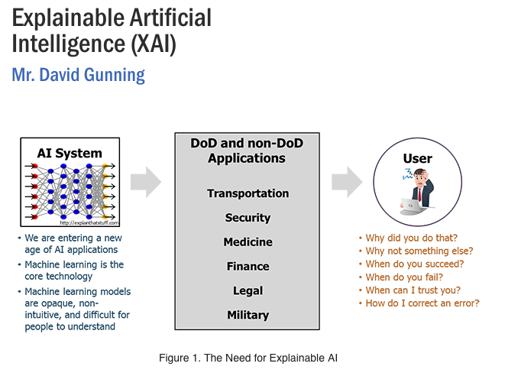
EXPLAINABLE AI
https://www.darpa.mil/program/explainable-artificial-intelligence

Slide 13
JUDGMENT DELEGATION

Slide 14
WHAT ARE SENSITIVE AREAS?
COURTS
DEFENCE
INSURANCE
POLICING
BANKING
…

Slide 15
ACCOUNTABILITY & FALLABILITY
HUMAN RESPONSIBILITIES
FALLABLE THOUGH IT IS JUDGEMENT SHOULD NOT BE REPLACED BY MACHINE IN SOME AREAS

Slide 16
BIAS REPRODUCTION

Slide 17

HUMAN BIAS AND WoMD

Slide 18
SOME COMMON ISSUES
USING PROXY VARIABLE AS PREDICTORS
NOT ENOUGH DATA OR NOT REPRESENTATIVE
PREDICTOR CHOICES BIASED BY IDEOLOGY, CONFIRMATION BIAS
…

Slide 19
CONTROL & VALUE ALIGNEMENT PROBLEM

Slide 20
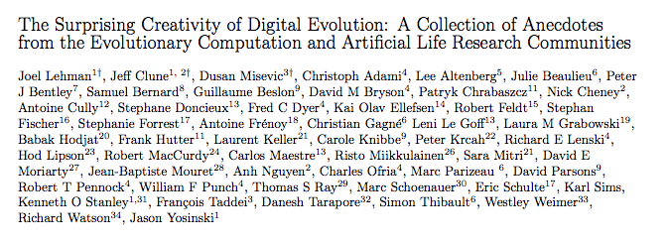
SURPRISING CREATIVITY
https://arxiv.org/abs/1803.03453
https://www.youtube.com/watch?v=GdTBqBnqhaQ&feature=youtu.be

Slide 21
PUBLIC DEBATES NEED TO RALLY

Slide 22
SOCIETY AT LARGE & RISK AWARENESS
EDUCATION, SCIENTIFIC COMMUNITY
PUBLIC AUTHORITIES [CERTIFIED PUBLIC EXPERT AUDIT …]
INDUSTRY: ETHICS BY DESIGN [RIGHT QUESTION RIGH TIME]
BUSINESS OWNERS
CIVIL SOCIETY
…

Slide 23
WORKING GROUP SESSION
Notes:
Medium-to-long term likely scenarios

Slide 24
WORKING GROUP SETUP
CHOOSE A CASE STUDY FOR YOUR TEAM
WHAT TYPE OF DATA, WHAT WOULD YOU MEASURE?
WHAT TYPE OF PREDICTION?
HOW WOULD YOU MONITOR SUCCESS/FAILURE?
EXPOSE AND PROMOTE YOUR APPROACH
OTHER TEAMS ACT AS ETHICAL AUDITING COMMITEE

Slide 25
CASE STUDIES PROPOSAL
CRIME PREDICTION/PREVENTION [CITY OF YOUR CHOICE]
TEACHER ASSESSMENT SYSTEM [COUNTRY SCALE]
“WORKFORCE READY HR” SYSTEM
ELECTION CAMPAIGN AI SYSTEM

Slide 26

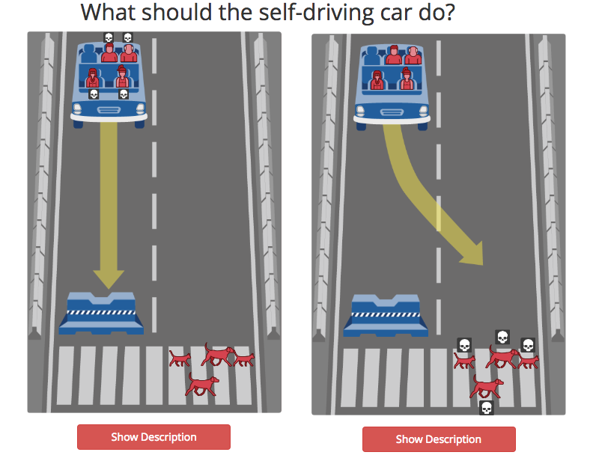
ASSIGNMENT: EXPERIMENTING MORAL DILEMNA
http://moralmachine.mit.edu/
Notes:
Not new: second world war Alan Turing and Enigma

