Slide 1


ITU - EACO
WORKSHOP ON EMERGING TECHNOLOGIES
SESSION 9: OPEN ISSUES IN AI

Slide 2
OBJECTIVES
PROVIDE A BROAD OVERVIEW OF OPEN ISSUES
RE-FOCUS DEBATE ON ALREADY CURRENT ISSUES
HIGHLIGHT THE IMPORTANT DIFFERENCE BETWEEN NARROW VS. GENERAL ARTIFICIAL INTELLIGENCE
GENERATE DEBATE ON ISSUES RELATED TO JOBS REPLACEMENT RISKS

Slide 3

LIST OPEN ISSUES SEEN SO FAR
WHAT ABOUT TECHNICAL, BUSINESS BASED OPEN ISSUES AND SOCIAL IMPACT?

Slide 4
DISCOVERY VS. IMPLEMENTATION

Slide 5


FAST-PACED RESEARCH
https://arxiv.org/
http://www.arxiv-sanity.com/
Notes:
Also allow to time-stamp research papers without delay and risky …

Slide 6
ASSESSING SCIENTIFIC PAPERS
FLOOD OF MEDIA ATTENTION MIGHT DISTORT REALITY
CAREFULLY ASSESS ACHIEVEMENTS, HYPOTHESIS, TRICKS, …
REPRODUCIBILITY?

Slide 7
INDUSTRIALIZED AI
STILL MAINLY ARTISANAL & HAND-CRAFTED
REPRODUCIBILITY/STANDARDIZATION FOR INDUSTRIAL DEPLOYMENT
TOOLS, METHODOLOGIES AND HR
https://medium.com/@Petuum/what-is-industrialized-ai-and-why-is-it-important-42c0ee652113
Notes:
The example of https://landing.ai/ initiative

Slide 8
REPRODUCIBILITY OF AI RESEARCH PAPERS
THE NOW PERVASIVE JUPYTER NOTEBOOKS
OPEN-SOURCE AND GITHUB-LIKE CODE REPOSITORIES
COMPUTING ENVIRONEMENTS AND POWER
https://www.nature.com/articles/d41586-018-07196-1
https://colab.research.google.com/
Notes:
+ Virtual environments

Slide 9
AI DEMOCRATIZATION
ONLINE COURSES
BEST PRACTICES: STRATEGY FOR AI ENGINEERS
COMPETITIONS
https://www.deeplearning.ai/
https://www.fast.ai/
https://eu.udacity.com/
http://www.mlyearning.org/
https://www.kaggle.com/competitions
https://challenger.ai/

Slide 10
ARTIFICIAL
NARROW | GENERAL INTELLIGENCE

Slide 11
NARROW AI 1/2
SELF-DRIVING CARS
INTERPRETING MEDICAL IMAGES
BEATING WORLD CHAMPION GO
…

Slide 12
NARROW AI 2/2
DOMAIN SPECIFIC
LOTS OF TRAINING DATA
NO MODEL OF THE WORLD

Slide 13

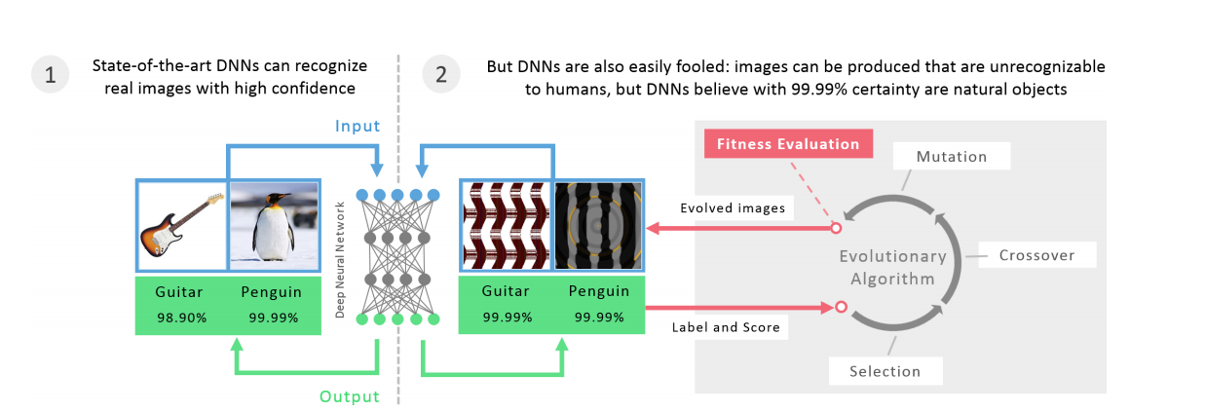
http://www.evolvingai.org/files/DNNsEasilyFooled_cvpr15.pdf

Slide 14
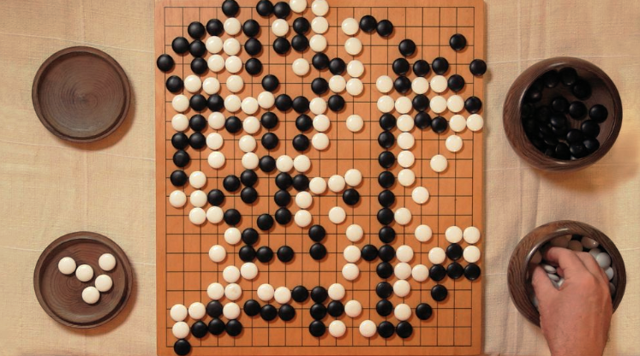
ALPHAGO ZERO
MILLIONS OF GAMES
VERY SIMPLE ENVIRONMENT
THOUSANDS OF FRAMES PER SECOND ON MULTIPLE COMPUTERS
“… you cannot run the real world faster than real time” – Yann LeCun
https://www.theverge.com/2017/10/26/16552056/a-intelligence-terminator-facebook-yann-lecun-interview
Notes:
if you use a pure reinforcement learning technique, and train a system to drive a car with a simulator, it’s going to have to crash into a tree 40,000 times before it figures out it’s a bad idea. So claiming that somehow just reinforcement learning is going to be the key to intelligence is wrong.

Slide 15
ARTIFICIAL GENERAL INTELLIGENCE
LONG WAY TO GO BEFORE APPROACHING NEAR THE INTELLIGENCE OF A BABY, OR EVEN AN ANIMAL
HOW TO GET MACHINES TO LEARN HOW THE WORLD WORKS BY OBSERVATION – UNSUPERVISED LEARNING
CONTINUOUS PROGRESS …
https://www.theverge.com/2017/10/26/16552056/a-intelligence-terminator-facebook-yann-lecun-interview
Notes:
Forget Terminator
Yoshua Bengio: “Less urgent to anticipate AGI and singularity than overpopulation on Mars”

Slide 16
UNFRIENDLY AI SCENARIO: DYSTOPIA
“I don’t work on preventing AI from turning evil for the same reason that I don’t work on combating overpopulation on the planet Mars” – Andrew Ng
https://www.lesswrong.com/posts/3ZyEC2vagoePPcj3o/andrew-ng-dismisses-ufai-concerns
THIS, SAID, POTENTIAL CONTROL & VALUE ALIGNMENT PROBLEMS
Notes:
Example of global warning reduction… There is a simple straightforward solution.
Reward shaping and sparse rewards in Reinforcement learning example

Slide 17
SOCIAL IMPACT

Slide 18
SOME AI-INDUCED JOB LOSSES FORECASTS
47% OF U.S JOBS COULD BE AUTOMATED WITHIN THE NEXT DECADE OR TWO (Frey & Osborne, 2013)
JUST 9% OF JOBS IN THE U.S WERE AT HIGH RISK OF AUTOMATION (OECD report, 2016)
https://www.oxfordmartin.ox.ac.uk/downloads/academic/The_Future_of_Employment.pdf
http://www.ifuturo.org/sites/default/files/docs/automation.pdf
Notes:
Bullet 1: dire prediction
Why such a huge gap? OECD focused on a task-based approach rather than entire occupation

Slide 19
THE END OF BLIND OPTIMISM
TECHNO-OPTIMISM: “JUST ANOTHER INDUSTRIAL REVOLUTION … COMMUNICATING VESSELS”
UNIQUE NATURE GENERAL PURPOSE TECHNOLOGY (GPT): ”BETTER, FASTER, STRONGER”
http://secondmachineage.com/about-2ma/

Slide 20
WORKING GROUP SESSION

Slide 21
WORKING GROUP SETUP
IDENTIFY A BROAD RANGE OF JOBS/PROFESSIONS
CLASSIFY THEM AS MORE LABOUR/COGNITIVE LABOUR INCLINED
POSITION THESE JOBS INTO THE TWO DIAGRAMS PROVIDED
PRESENT TO YOUR PEERS WHERE THERE IS A RISK OF REPLACEMENT BY AI OR HOW AI COULD COMPLEMENT THEM

Slide 22
COGNITIVE LABOR
SOCIAL
Teacher
CEO
OPTIMIZATION-BASED
CREATIVITY- OR STRATEGY-BASED
Scientist
ASOCIAL

Slide 23
PHYSICAL
LABOR
SOCIAL
LOW DEXTERITY AND
STRUCTURED ENVIRONMENT
HIGH DEXTIRITY AND UNSTRUCTURED ENVIRONMENT
ASOCIAL

