Slide 1


ITU - EACO
WORKSHOP ON EMERGING TECHNOLOGIES
SESSION 5: APPLICATIONS OF AI

Slide 2
OBJECTIVES
PROVIDE KEYS TO NAVIGATE AI APPLICATIONS UNIVERSE
EXEMPLIFY STATE-OF-THE-ART AI APPLICATIONS
DEMYSTIFY AI TECHNICAL JARGON AND APPROACHES

Slide 3
NAVIGATE AI APPLICATIONS
A FULL UNIVERSE

Slide 4

LIST AI APPLICATIONS YOU CAN THINK OF
HOW COULD YOU GROUP THEM?

Slide 5
BY “TECHNOLOGY“ TYPE
IMAGE RECOGNITION
OBJECT DETECTION
NATURAL LANGUAGE PROCESSING, SPEECH RECOGNITION
TIME SERIES PREDICTION
ROBOTIC
GAMES & SIMULATION

Slide 6
BY ACTIVITY SECTORS
HEALTH
AGRICULTURE, ENVIRONMENT
EDUCATION & SCIENCE
INDUSTRY
DEFENCE
FINANCE (ATS)
...

Slide 7
BUT MANY ARE TRANSECTORAL
TRANSPORTATION
LOGISTICS - Ex. of O2O (Online to Offline services)
ENERGY
VIRTUAL ASSISTANT
...

Slide 8
QUICK TOUR OF SOME AI
APPLICATIONS

Slide 9
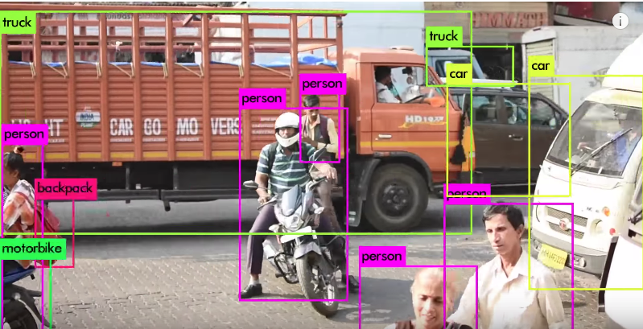
REAL TIME OBJECT DETECTION
https://pjreddie.com/darknet/yolo/

Slide 10
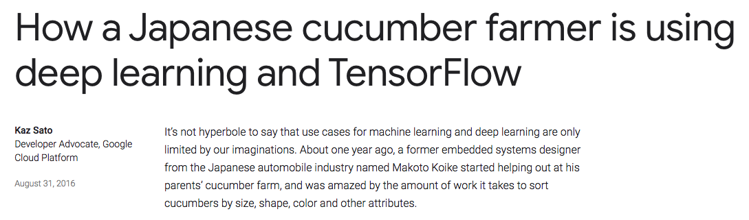
SMART FARMING
https://tinyurl.com/y7js7scm

Slide 11
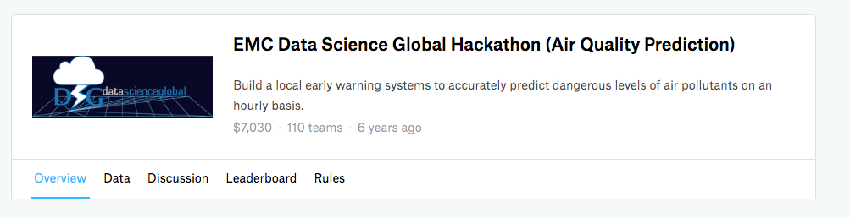
AIR QUALITY PREDICTION
https://www.kaggle.com/c/dsg-hackathon

Slide 12
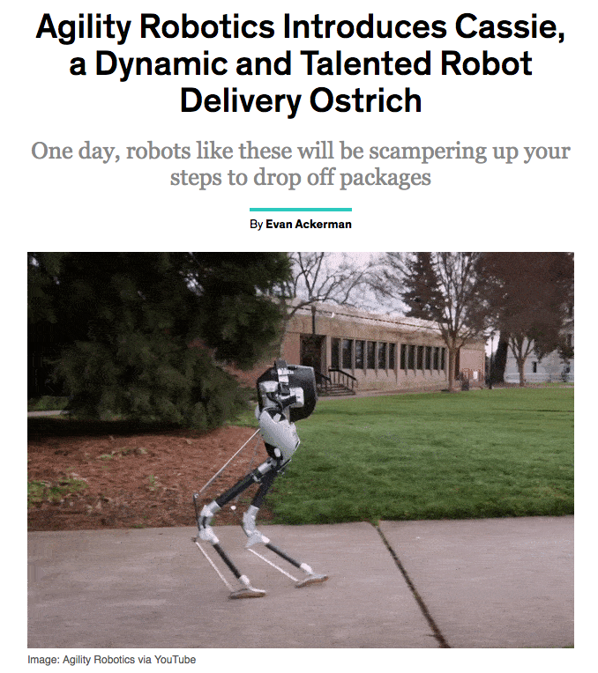
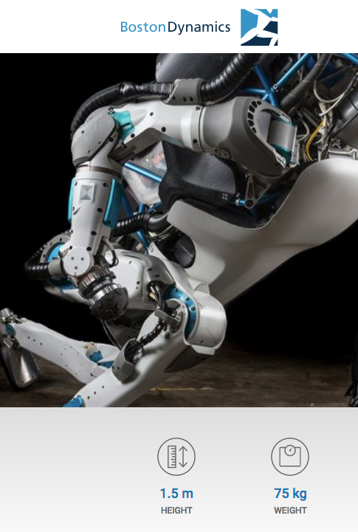
ROBOTICS
…
https://tinyurl.com/y7v433fs
https://www.bostondynamics.com/atlas
Notes:
But as well multi-agent, competitive, collaborative, mix

Slide 13
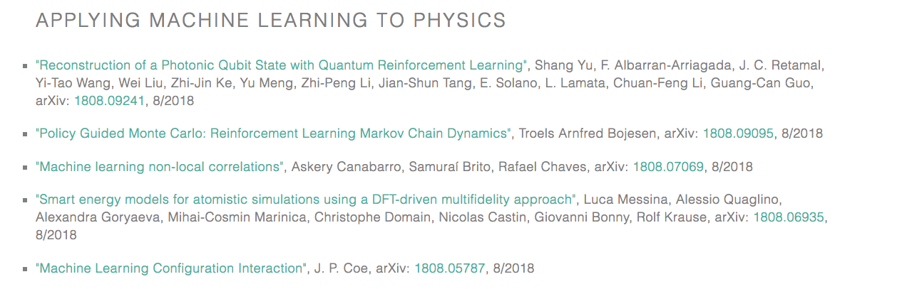
PHYSICS
https://physicsml.github.io/pages/papers.html

Slide 14

MUSIC
https://magenta.tensorflow.org/

Slide 15
AN ENDLESS LIST …
VIRTUAL ASSISTANT
AUTONOMOUS VEHICLES
…

Slide 16
EXAMPLES OF AI APPLICATIONS
IN AFRICA?

Slide 17
BY SECTORS
BANKING: M-Pesa (Kenya, Tanzania, SA),
LOGISTICS: Zipline (Rwanda, Tanzania, Ghana)
AGRICULTURE: Traceability, Twiga, Aerobotics (SA, Malawi, Zimbabwe), …
HEALTH: Sophia Genetics (Morocco, Cameroon)
…
Notes:
Konza Technology City, Kenya (Smart City, …)
https://www.mpesa.in/portal/
https://twiga.ke/twiga-story/
https://www.sophiagenetics.com
https://about.aerobotics.io/
http://frequentz.com/4319/traceability-brings-more-profits-and-more-stability-to-coffee-growers/
http://www.flyzipline.com/

Slide 18
AI NUTS AND BOLTS DEMYSTIFIED

Slide 19
AI & DEEP LEARNING IS MIMICING WORKING OF THE HUMAN BRAIN?

Slide 20
CLASSICAL STATISTICS MINDSET
ASSUME THAT MODELS WITH HIGH EXPLANATORY POWER ARE INHERENTLY OF HIGH PREDICTIVE POWER

Slide 21
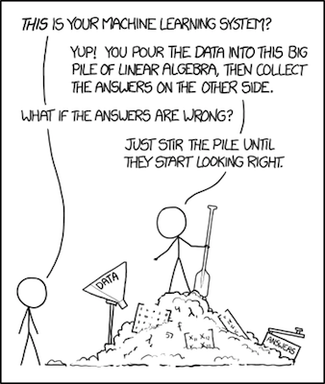
MACHINE LEARNING MINDSET
FOCUS IS GIVEN ON PREDICTIVE POWER BASED ON MONITORED/CHOSEN EVALUATION METRICS

Slide 22
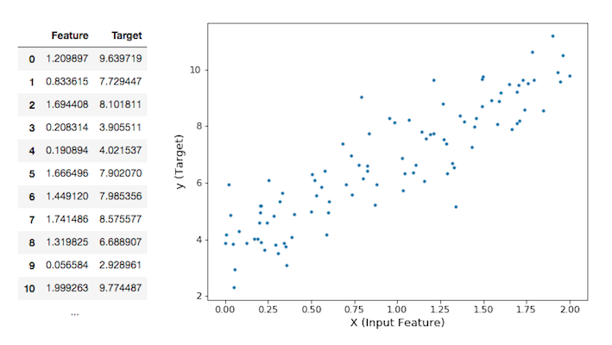
IS THERE ANY PATTERN IN YOUR DATA?
Notes:
Ex: soil moisture (target) given temperature, distance from river, ... (features)

Slide 23
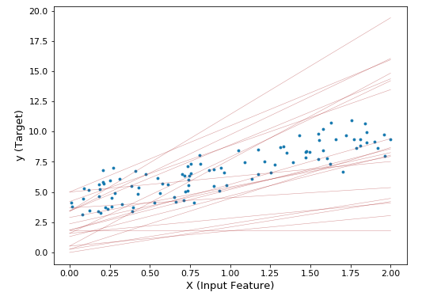
BUT WHICH LINE?

Slide 24
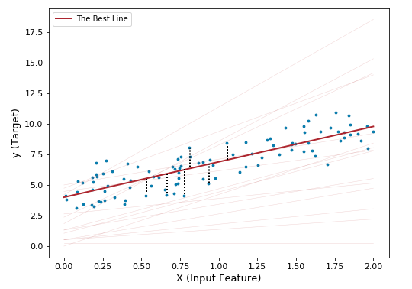
DEFINE AN EVALUATION METRIC?

Slide 25
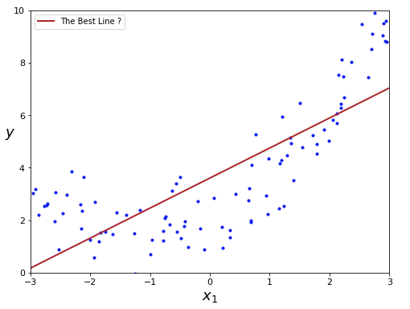
BUT NOW WHICH BEST LINE?

Slide 26
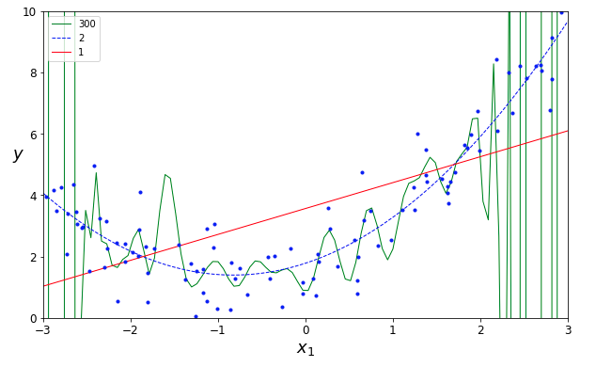
MODEL CAPACITY: WHICH ONE IS BEST?

Slide 27
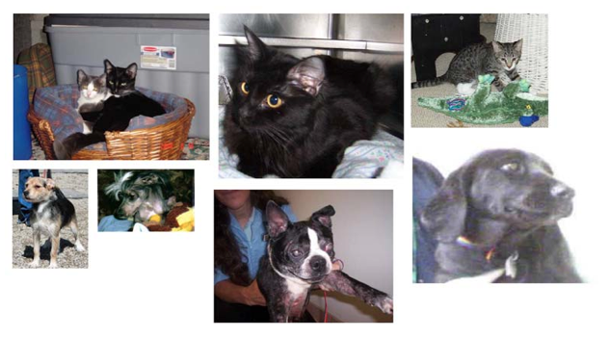
DEEP LEARNING AND CLASSIFICATION

Slide 28
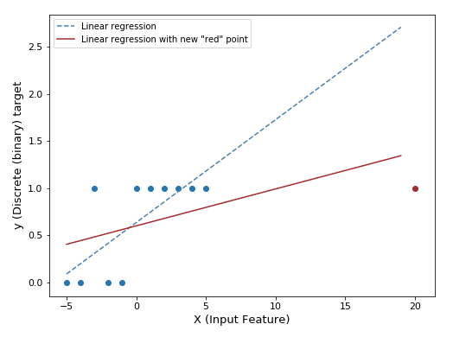
LOGISTIC REGRESSION 1/4

Slide 29
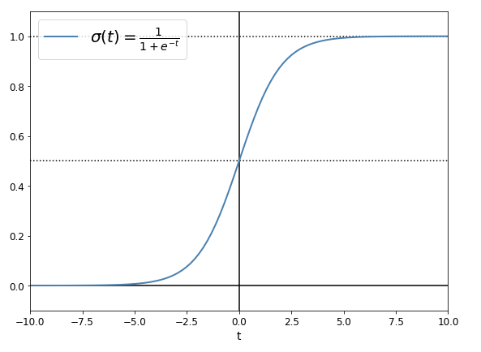
LOGISTIC REGRESSION 2/4: SIGMOID FUNCTION

Slide 30
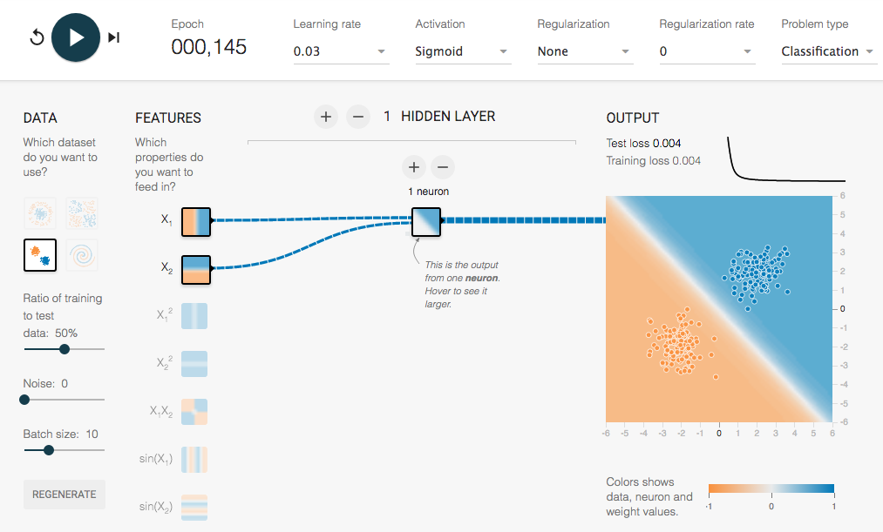
LOGISTIC REGRESSION 3/4: AT CRUISING SPEED
http://playground.tensorflow.org/
https://goo.gl/d5wwH3

Slide 31
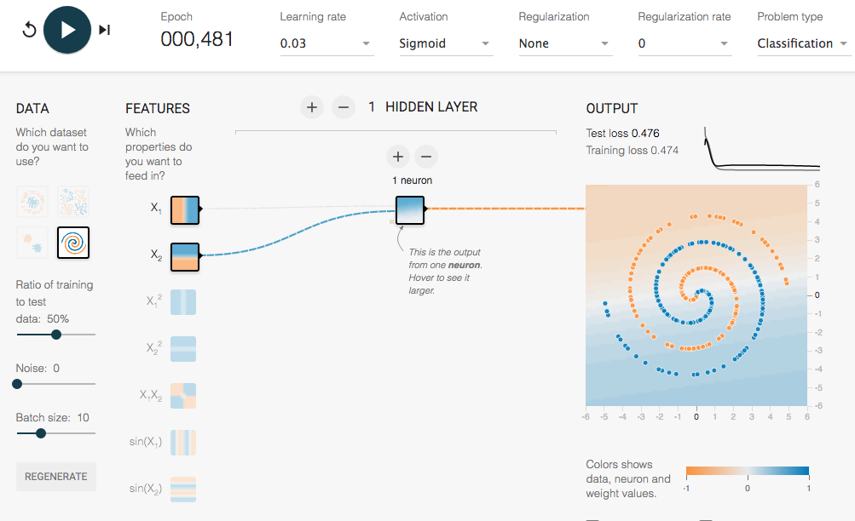
LOGISTIC REGRESSION 4/4: IN TROUBLE

Slide 32
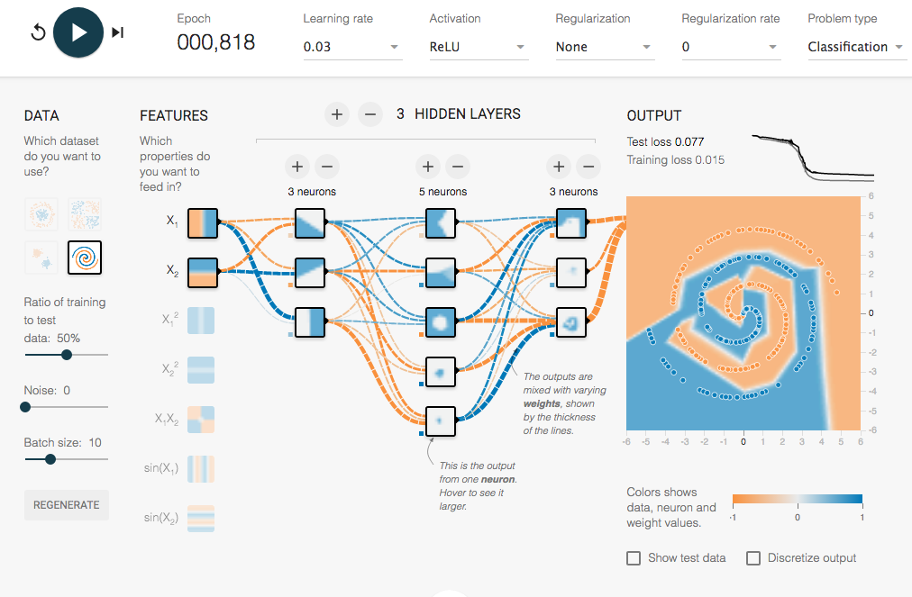
NEURAL NET COMES ON STAGE
https://goo.gl/ngcvpV

Slide 33
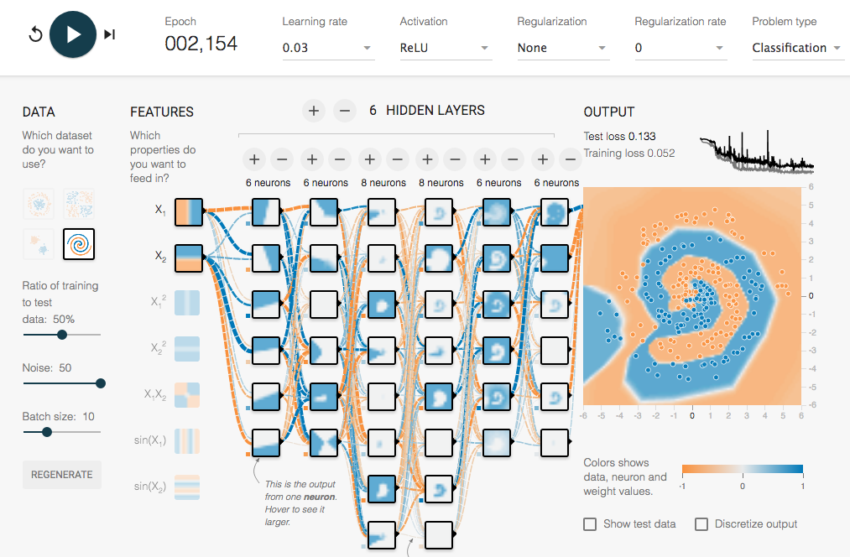
A “DEEP” NEURAL NET COMES ON STAGE
https://goo.gl/6BJ83E

Slide 34
A “DEEP” NEURAL NET COMES ON STAGE
https://goo.gl/6BJ83E

Slide 35
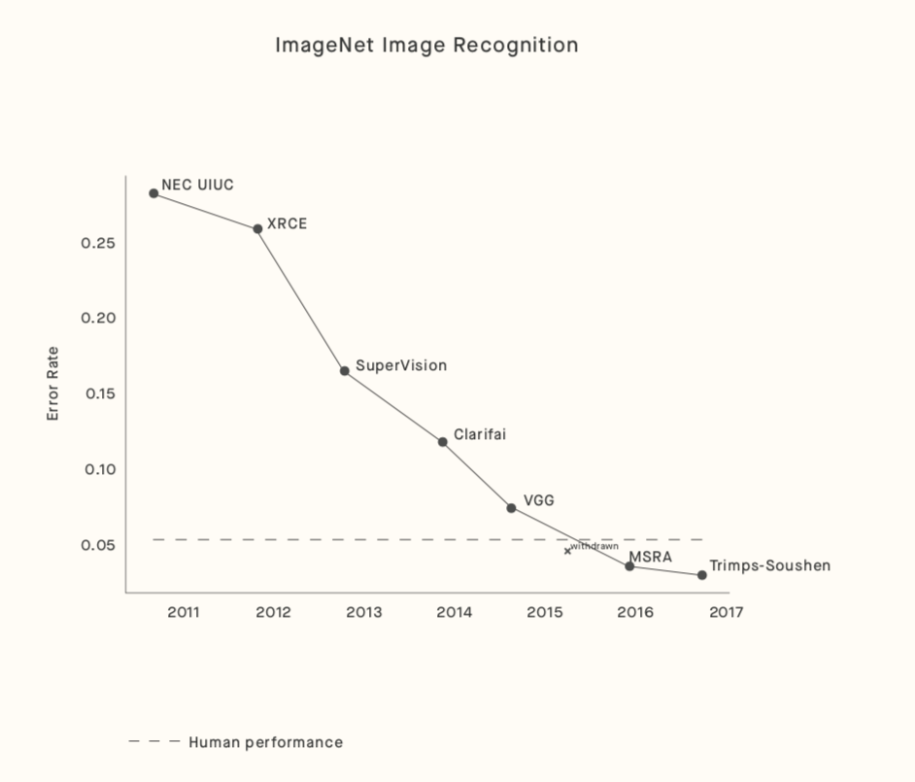
AI VS. HUMAN
DEEP LEARNING > HUMAN-LEVEL PERFORMANCE
BUT IN PARTICULAR DOMAINS (IMAGE RECOGNITION, …)
BUT ON VERY SPECIFIC/NARROW TASKS [FOR NOW]
https://arxiv.org/pdf/1802.07228.pdf
http://www.image-net.org/
Notes:
To be discussed in further session

