Slide 1


NBTC – ITU Training
on Building IoT solutions for e-applications
Session 3: Building an IoT product Programming aspects

Slide 2
RAPID PROTOTYPING | IN PRODUCTION TRADEOFF
WHAT IS THE USE CASE ?
IS/WHEN OPTIMIZATION REQUIRED ?
ITERATE OVER IDEAS / CLIENT REQUIREMENTS / QUICK FEEDBACK?
NEED FOR LOW ENTRY BARRIERS ?
WHAT ARE THE WHOLE TECHNOLOGICAL STACK & DATA/WORKFLOWS?
WHAT ARE THE HUMAN RESOURCES ?
A SINGLE LANGUAGE CONVENIENT BUT OFTEN A NON ISSUE ?

Slide 3
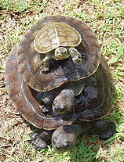
PYTHON[S]
TURTLES ALL THE WAY DOWN!
https://en.wikipedia.org/wiki/Turtles_all_the_way_down

Slide 4
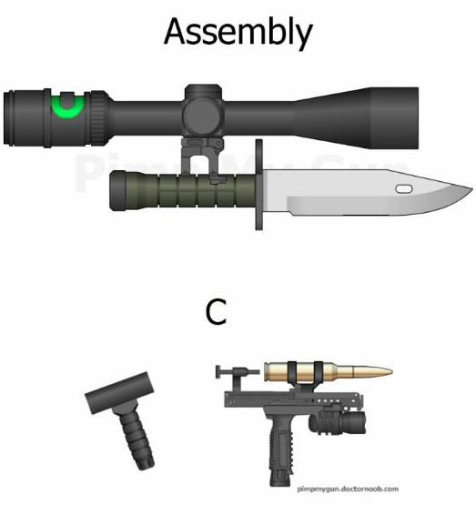

Slide 5
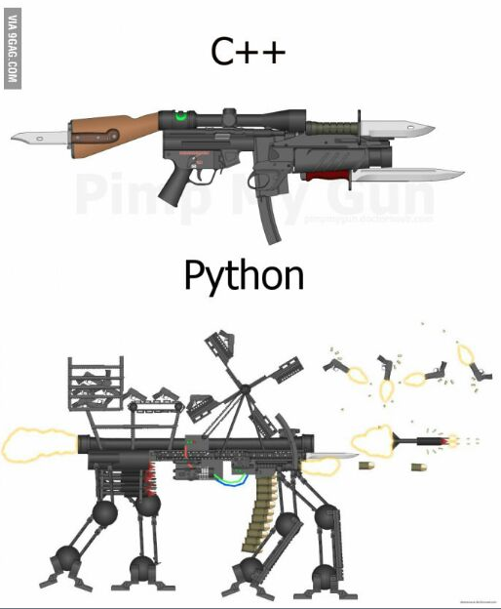

Slide 6



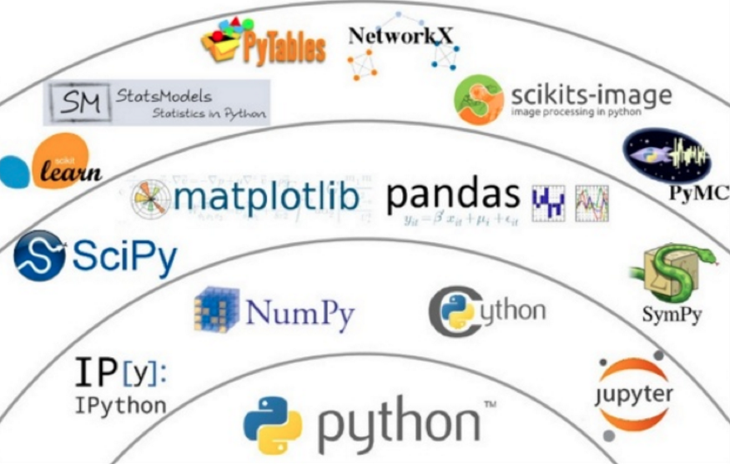


Slide 7
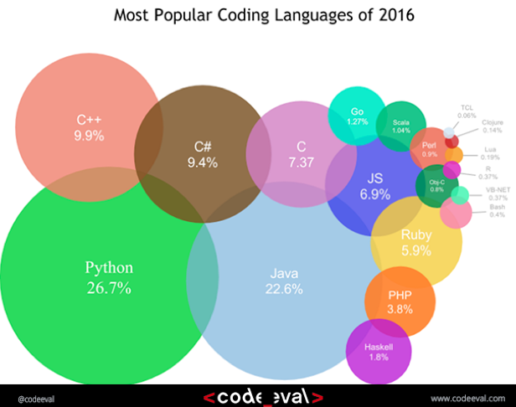

Slide 8
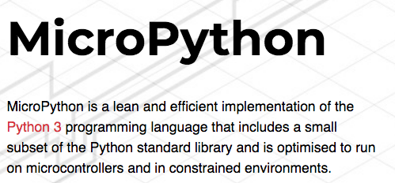
https://micropython.org/

Slide 9

IoT RAPID PROTOTYPING & TRAINING

Slide 10
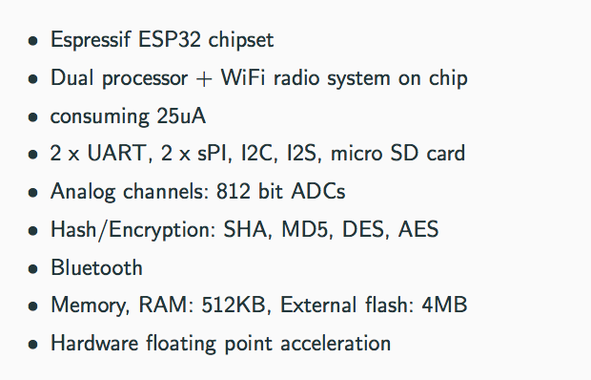
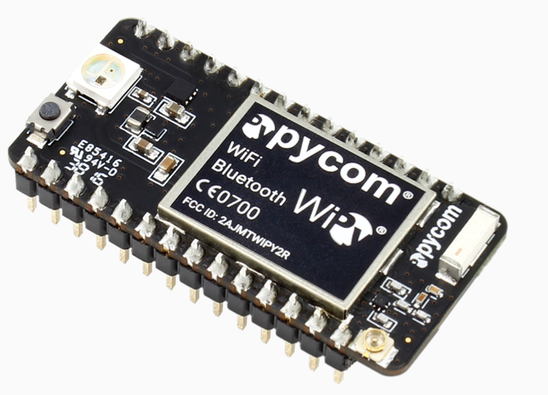

Slide 11
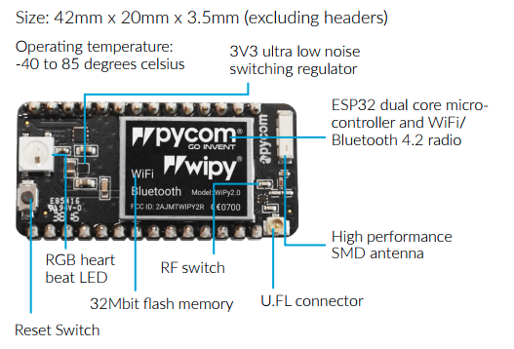
https://pycom.io/wp-content/uploads/2017/08/wipySpecsheetAugust2017.pdf

Slide 12
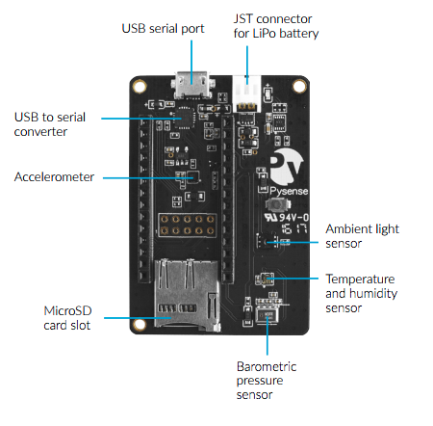
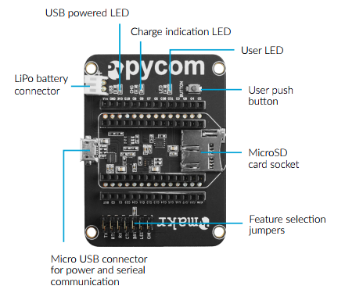
EXPANSION BOARDS

Slide 13
TYPICAL WORKFLOW

Slide 14
http://fr.anckalbi.net/iot-nbtc-itu/

Slide 15
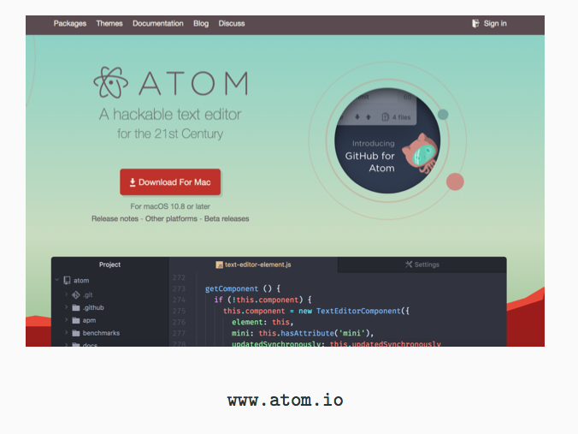
1. INSTALL ATOM IDE

Slide 16
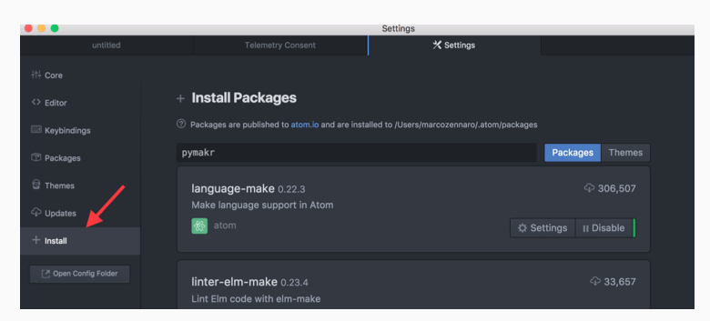
2. INSTALL “PYMAKR” PLUGIN

Slide 17
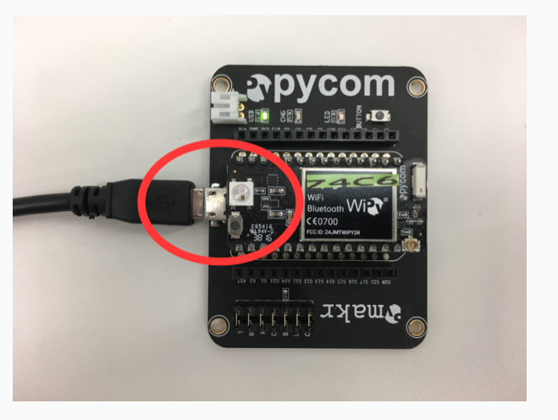
3. CONNECTION VIA USB

Slide 18
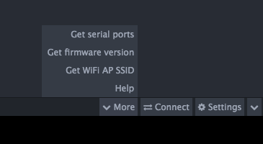
4. GET ID OF YOUR SERIAL PORT

Slide 19
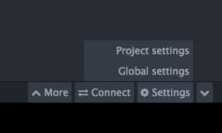
4. ACCESS GLOBAL SETTINGS

Slide 20
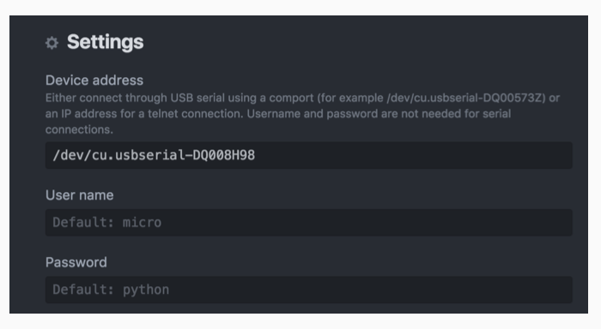
5. UPDATE GLOBAL SETTINGS

Slide 21
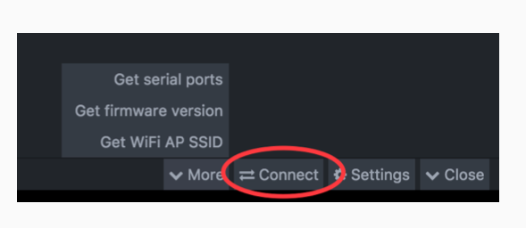
6. CONNECT

Slide 22
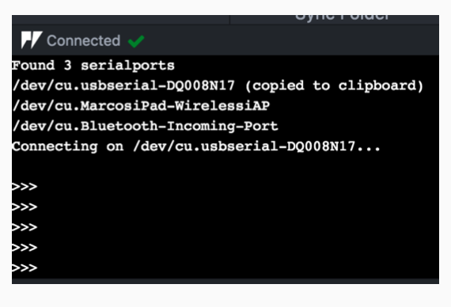
7. READ EVAL PRINT (REPL)

Slide 23
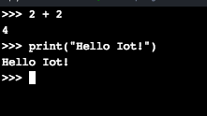
7. READ EVAL PRINT (REPL)
write 2+ 2 after the >>> sign and press Enter Key
write print(“Hello IoT!”) after the >>> sign and press Enter Key

Slide 24
7. READ EVAL PRINT (REPL)

Slide 25
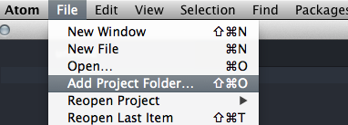
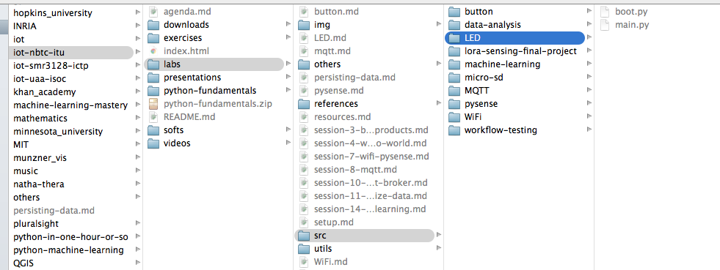
8. OPEN A PROJECT | LED

Slide 26
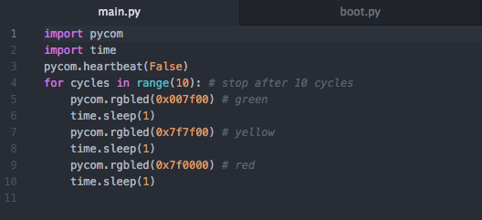
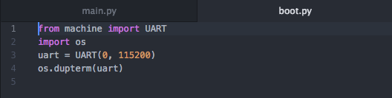
9. WRITE CODE (main.py, boot.py, …)
“main“ code to be run and uploaded to the board.
Here the “Hello world” of IoT
First Python code executed
during boot. Here setup the REPL
https://github.com/franckalbinet/iot-nbtc-itu/blob/gh-pages/labs/LED.md

Slide 27
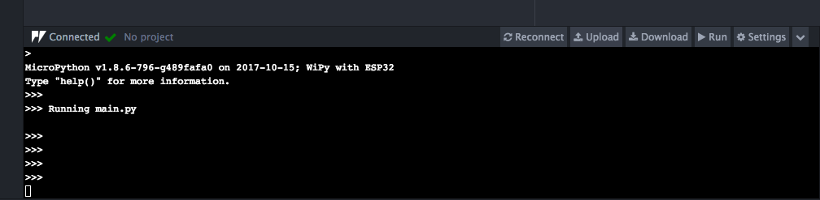
10. RUN FOR DEBUGGING PURPOSE

Slide 28
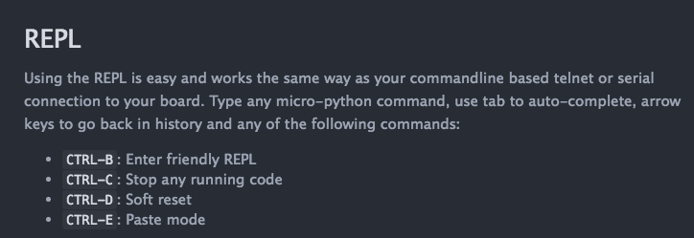
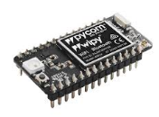
11. HALTING EXECUTION, RESETTING
In Atom |Global settings
Hard reset button

Slide 29
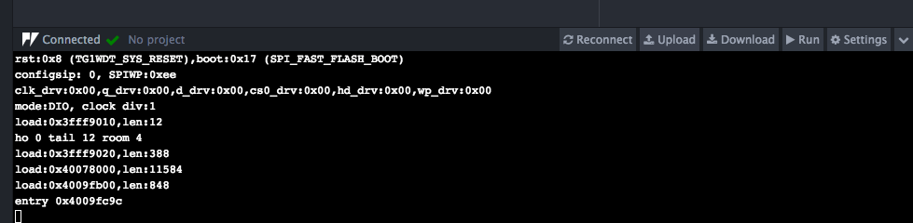
12. SYNC/UPLOADING CODE TO THE BOARD

Slide 30
THANK YOU

