Slide 1


ITU - EACO
WORKSHOP ON EMERGING TECHNOLOGIES
SESSION 5: APPLICATIONS OF AI

Slide 2
OBJECTIVES
PROVIDE KEYS TO NAVIGATE AI APPLICATIONS UNIVERSE
EXEMPLIFY STATE-OF-THE-ART AI APPLICATIONS
DEMYSTIFY AI TECHNICAL JARGON AND APPROACHES

Slide 3
NAVIGATE AI APPLICATIONS
A FULL UNIVERSE

Slide 4

LIST AI APPLICATIONS YOU CAN THINK OF
HOW COULD YOU GROUP THEM?

Slide 5
BY “TECHNOLOGY“ TYPE
IMAGE RECOGNITION
OBJECT DETECTION
NATURAL LANGUAGE PROCESSING, SPEECH RECOGNITION
TIME SERIES PREDICTION
ROBOTIC
GAMES & SIMULATION

Slide 6
BY ACTIVITY SECTORS
HEALTH
AGRICULTURE, ENVIRONMENT
EDUCATION & SCIENCE
INDUSTRY
DEFENCE
FINANCE (ATS)
...

Slide 7
BUT MANY ARE TRANSECTORAL
TRANSPORTATION
LOGISTICS - Ex. of O2O (Online to Offline services)
ENERGY
VIRTUAL ASSISTANT
...

Slide 8
QUICK TOUR OF SOME AI
APPLICATIONS

Slide 9
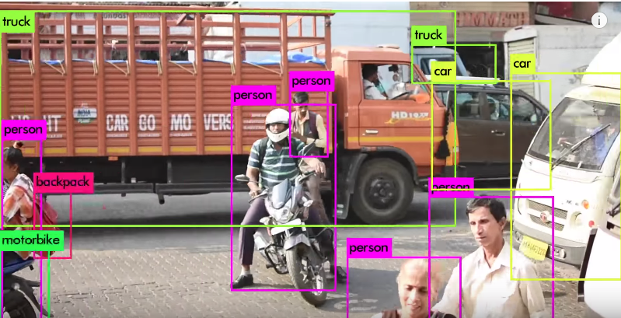
REAL TIME OBJECT DETECTION
https://pjreddie.com/darknet/yolo/

Slide 10
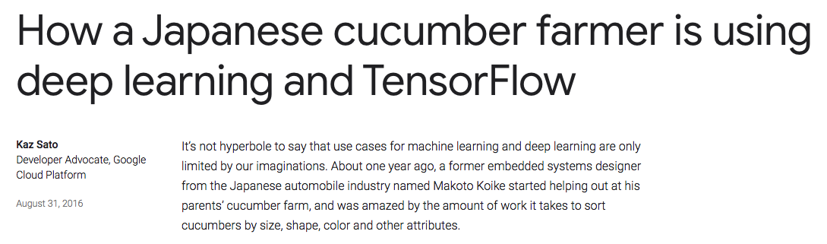
SMART FARMING
https://tinyurl.com/y7js7scm

Slide 11
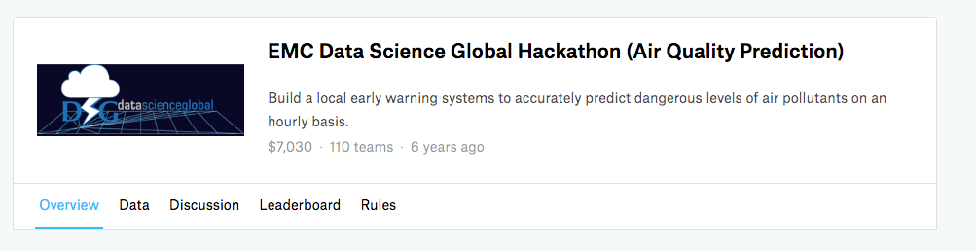
AIR QUALITY PREDICTION
https://www.kaggle.com/c/dsg-hackathon

Slide 12
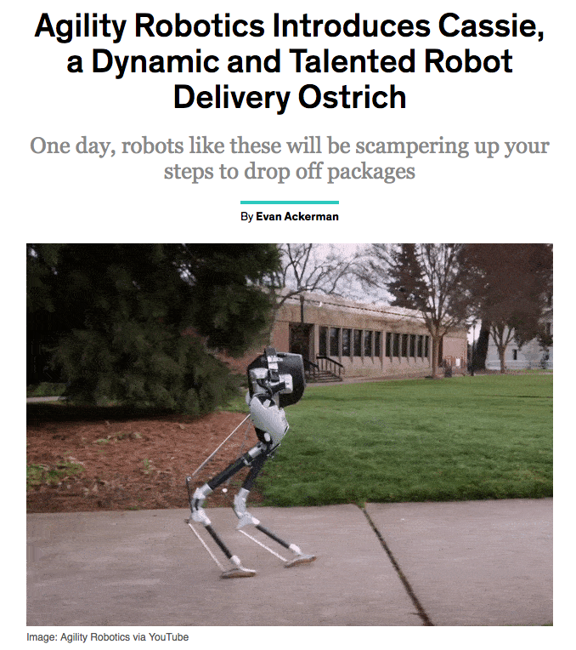
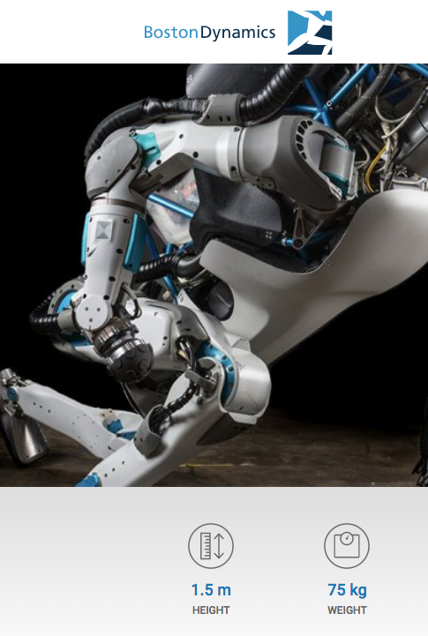
ROBOTICS
…
https://tinyurl.com/y7v433fs
https://www.bostondynamics.com/atlas

Slide 13
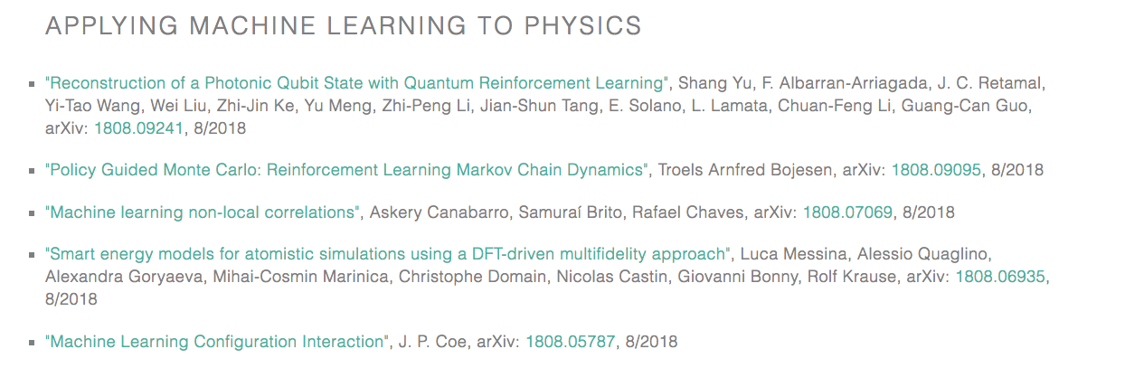
PHYSICS
https://physicsml.github.io/pages/papers.html

Slide 14

MUSIC
https://magenta.tensorflow.org/

Slide 15
MULTI-AGENT
Swarm of drones, …

Slide 16
AN ENDLESS LIST …
VIRTUAL ASSISTANT
AUTONOMOUS VEHICLES
…

Slide 17
THE HUMAN-LEVEL PERFORMANCE BENCHMARK
WHERE AI BEATS HUMAN
ARTIFICIAL GENERAL INTELLIGENCE vs. NARROW AI

Slide 18
DEPLOYING AI AT THE EDGE

Slide 19
AI NUTS AND BOLTS DEMYSTIFIED

Slide 20
AI & DEEP LEARNING IS MIMICING WORKING OF THE HUMAN BRAIN!

Slide 21
CLASSICAL STATISTICS MINDSET
ASSUME THAT MODELS WITH HIGH EXPLANATORY POWER ARE INHERENTLY OF HIGH PREDICTIVE POWER

Slide 22
CLASSICAL STATISTICS MINDSET
ASSUME THAT MODELS WITH HIGH EXPLANATORY POWER ARE INHERENTLY OF HIGH PREDICTIVE POWER

Slide 23
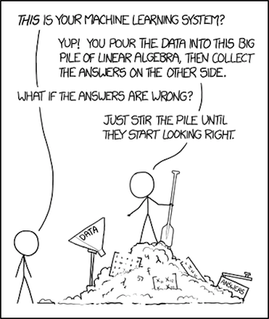
MACHINE LEARNING MINDSET
FOCUS IS GIVEN ON PREDICTIVE POWER BASED ON MONITORED/CHOSEN EVALUATION METRICS

Slide 24
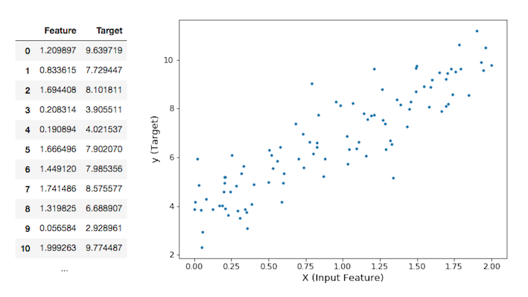
IS THERE ANY PATTERN IN YOUR DATA?
Notes:
Ex: soil moisture (target) given temperature, distance from river, ... (features)

Slide 25
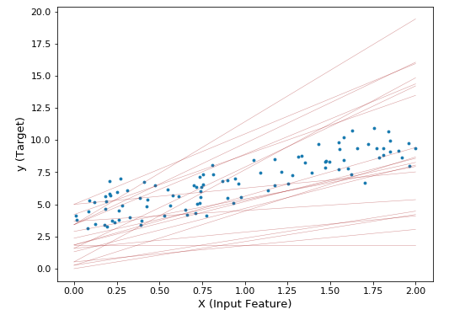
BUT WHICH LINE?

Slide 26
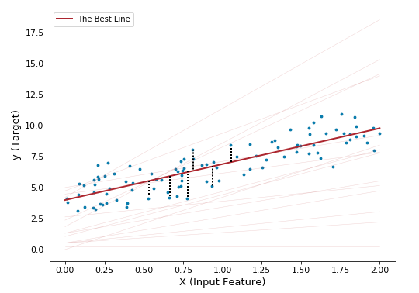
DEFINE AN EVALUATION METRIC?

Slide 27
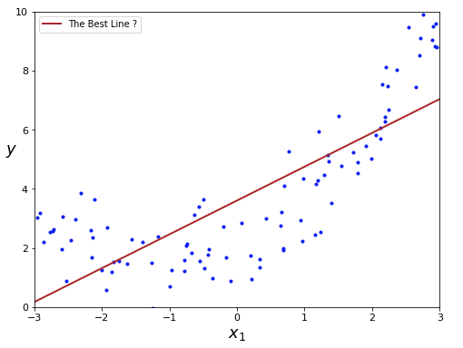
BUT NOW WHICH BEST LINE?

Slide 28
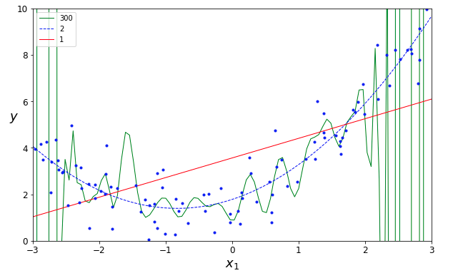
MODEL CAPACITY: WHICH ONE IS BEST?

Slide 29
QUICK ML NOMENCLATURE
SUPERVISED
UNSUPERVISED
SEMI-SUPERVISED
REINFORCEMENT LEARNING

Slide 30
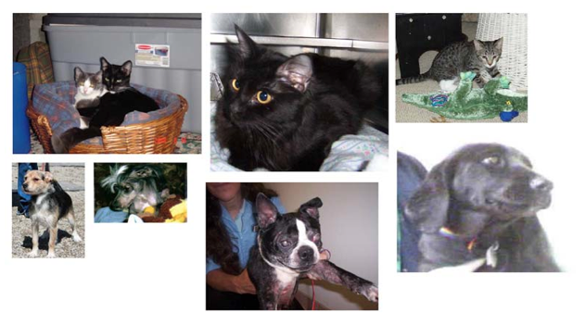
DEEP LEARNING AND CLASSIFICATION

Slide 31
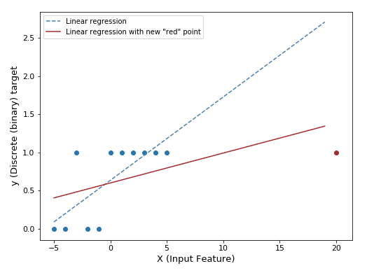
LOGISTIC REGRESSION 1/4

Slide 32
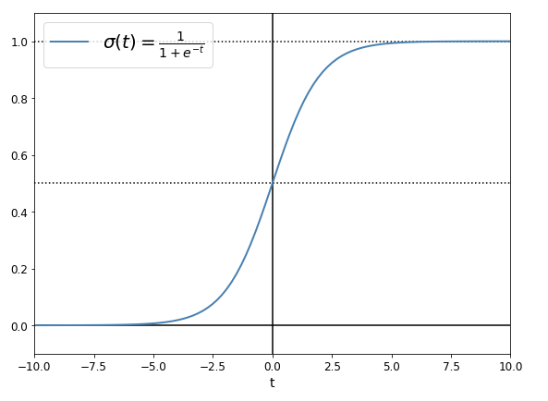
LOGISTIC REGRESSION 2/4: SIGMOID FUNCTION

Slide 33
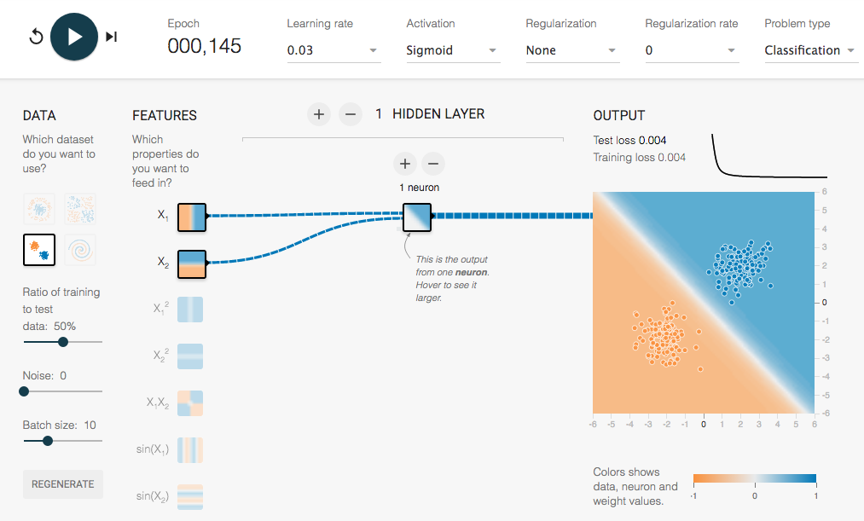
LOGISTIC REGRESSION 3/4: AT CRUISING SPEED
http://playground.tensorflow.org/
https://goo.gl/d5wwH3

Slide 34
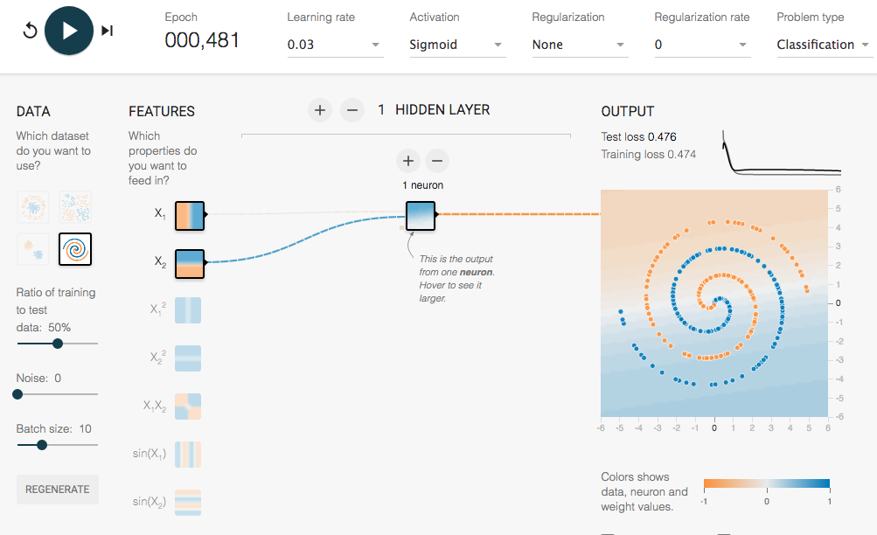
LOGISTIC REGRESSION 4/4: IN TROUBLE

Slide 35
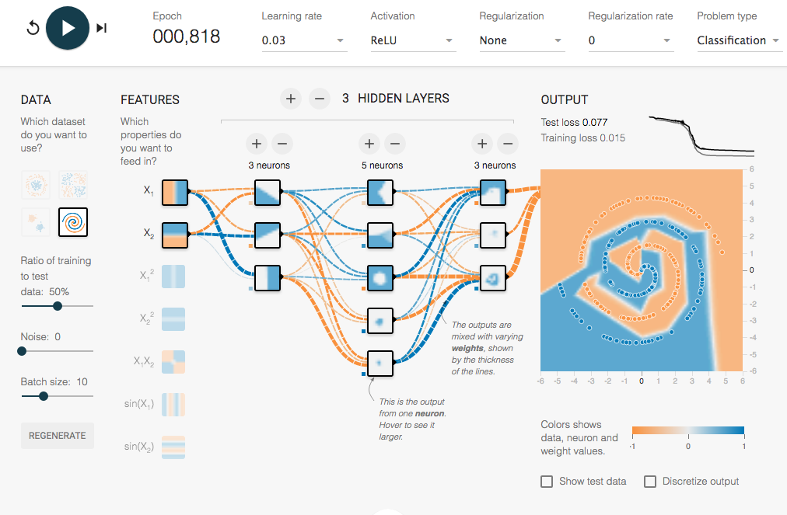
NEURAL NET COMES ON STAGE
https://goo.gl/ngcvpV

Slide 36
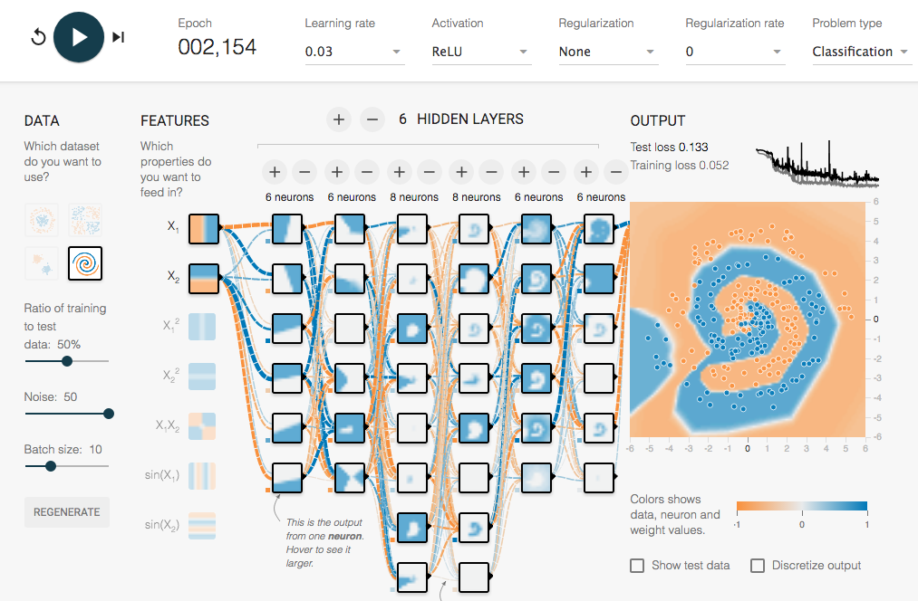
A “DEEP” NEURAL NET COMES ON STAGE
https://goo.gl/6BJ83E

