Slide 1


ITU - EACO
WORKSHOP ON EMERGING TECHNOLOGIES
SESSION 6: ETHICS OF AI

Slide 2
OBJECTIVES
PROVIDE AN OVERVIEW OF ETHICAL IMPLICATIONS OF AI
INTRODUCE WORKING GROUP SESSION

Slide 3
ETHICAL IMPLICATIONS
OF AI

Slide 4

LIST AI ETHICS IMPLICATIONS YOU CAN THINK OF
HOW TO ADDRESS POTENTIAL ISSUES?

Slide 5
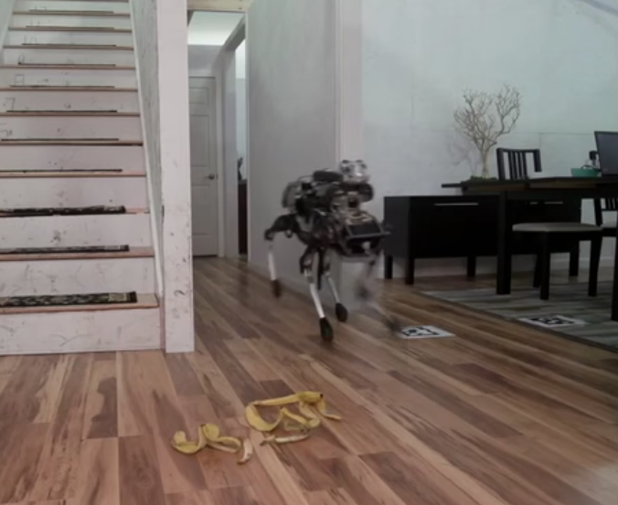
THE EXISTENTIAL THREAT …
https://www.youtube.com/watch?v=3BlYq3jO6xw

Slide 6
RATHER FOCUS ON ALREADY PRESENT ISSUES
LACK OF TRANSPARENCY & TRUST
DELEGATE JUDGEMENT IN SENSITIVE AREAS
INJECTING HUMAN BIAS
COMPLIANCE WITH SOCIAL AND VALUE NORMS
…

Slide 7
LACK OF TRANSPARENCY

Slide 8
THE BLACK-BOX PHENOMENON
SIMPLE MODELS LIKE DECISION TREE ARE EASY TO EXPLAIN
STATE-OF-THE ART ENSEMBLE METHODS INCREASED PERFORMANCE OBSCURE …
IDEM WITH DEEP NEURAL NETWORKS
UNABLE TO JUSTIFY/EXPLAIN THE PREDICTION
DEMOCRATIC ISSUE

Slide 9
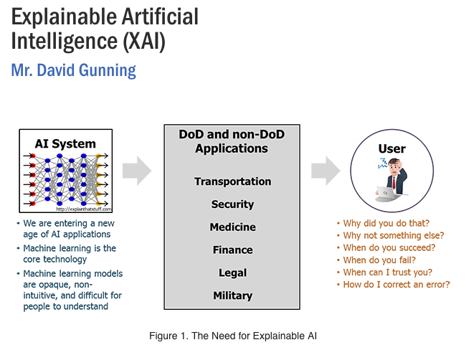
EXPLAINABLE AI
https://www.darpa.mil/program/explainable-artificial-intelligence

Slide 10
JUDGMENT DELEGATION

Slide 11
WHAT ARE SENSITIVE AREAS?
COURTS
DEFENCE
INSURANCE
POLICING
BANKING
…

Slide 12
ACCOUNTABILITY & FALLABILITY
HUMAN RESPONSIBILITIES
FALLABLE THOUGH IT IS JUDGEMENT SHOULD NOT BE REPLACED BY MACHINE IN SOME AREAS

Slide 13
BIAS REPRODUCTION

Slide 14

HUMAN BIAS AND WoMD

Slide 15
SOME COMMON ISSUES
USING PROXY VARIABLE AS PREDICTORS
NOT ENOUGH DATA OR NOT REPRESENTATIVE
PREDICTOR CHOICES BIASED BY IDEOLOGY, CONFIRMATION BIAS
…

Slide 16
CONTROL & VALUE ALIGNEMENT PROBLEM

Slide 17
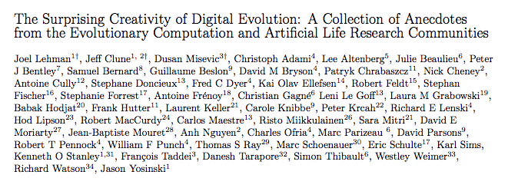
SURPRISING CREATIVITY
https://arxiv.org/abs/1803.03453
https://www.youtube.com/watch?v=GdTBqBnqhaQ&feature=youtu.be

Slide 18
PUBLIC DEBATES NEED TO RALLY

Slide 19
SOCIETY AT LARGE & RISK AWARENESS
EDUCATION, SCIENTIFIC COMMUNITY
PUBLIC AUTHORITIES [CERTIFIED PUBLIC EXPERT AUDIT …]
INDUSTRY: ETHICS BY DESIGN [RIGHT QUESTION RIGH TIME]
BUSINESS OWNERS
CIVIL SOCIETY
…

Slide 20
WORKING GROUP SESSION

