Slide 1
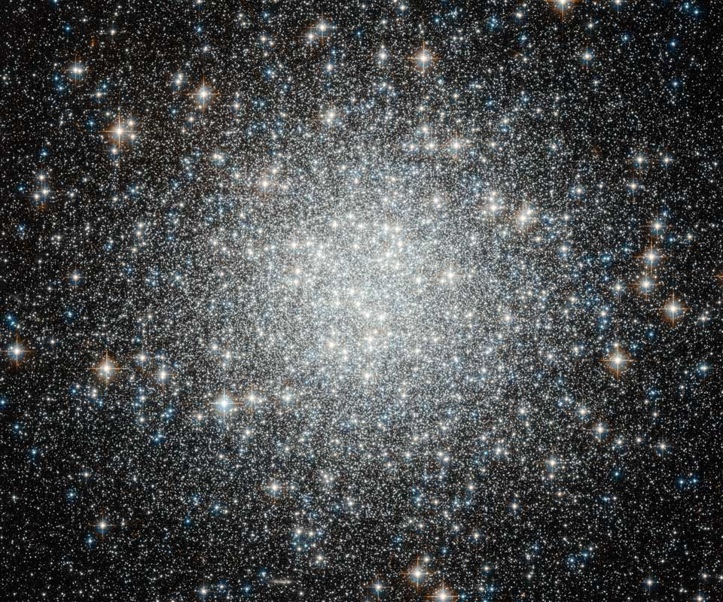
Is there a Size Difference between Red and Blue Globular Clusters?
J.M.B. Downing, arXiv:1204:5363v1
Submitted to MNRAS
Source: Hubble Legacy/Subaru

Slide 2
Observations
R_hl: Should remain Constant throughout its lifetime.
R_hm: Stand-in for R_hl in simulations
Blue(low met.),Red(high metal)
End result: Blue ~20% larger

Slide 3
Previous Studies
Larsen & Brodie: Cluster size related to galactocentric distance in MW, projection effect
Jordan: Size difference the result of luminosity function and evolutionary processes
Schulman et al. 2012: N-Body simulations

Slide 4
Simulation
5x10⁵ particles (stars) in a Monte Carlo simulation (faster than N-body)
-Takes ~1 day per simulation instead of months
-Not originally designed for GC Evolutionary simulations
-IMF from Kroupa et al. 1993 from 0.1 to 150 M_{sun} with 10% binaries
Insert Table 1

Slide 5
Results
Insert Figure 1

Slide 6
Results
Insert Figure 2

Slide 7
Black Hole Interactions
Different BH numbers in Red and Blue Populations

Slide 8
Black Hole Interactions
Without BH interactions, negligible size difference.

Slide 9
Results

