Slide 1
Recall the discussion of the spatial distribution of sources:
  log(N)-log(S) does not make use of positional information
  Positional information gives extra clues
  Other effects like extinction due to dust can cause problems
Sample biases…

Slide 2
Observations: spatial distribution
BUT the spatial distribution is inhomogeneous
Intensity distribution: log N – log P
P: peak flux; N(P): number of bursts brighter than P
For an homogeneous distribution:
V ∝ r³; Flux ∝ r⁻² => N ∝ V ∝ F^{-3/2} => log N= - 3/2 log F + ct.
expected slope of log N – log P curve : - 3/2
Segre.ieec.uab.es/AAE_UAB/2003-04

Slide 3
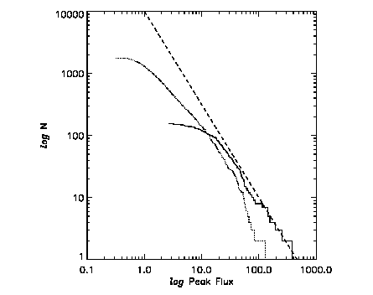
- 3/2 slope
Peak flux in phot/cm²/s
Segre.ieec.uab.es/AAE_UAB/2003-04

Slide 4
Observations: spatial distribution
BUT the spatial distribution is inhomogeneous:
Intensity distribution: log N – log P
P: peak flux; N(P): number of bursts brighter than P
For an homogeneous distribution:
V ∝ r³; Flux ∝ r⁻² => N ∝ V ∝ F^{-3/2} => log N= - 3/2 log F + ct.
expected slope of log N – log P curve : - 3/2
Lack of faint sources (P<10) is observed: inhomogeneous distribution => cosmological effects if sources of weak bursts are located at large redshifts
Segre.ieec.uab.es/AAE_UAB/2003-04

Slide 5
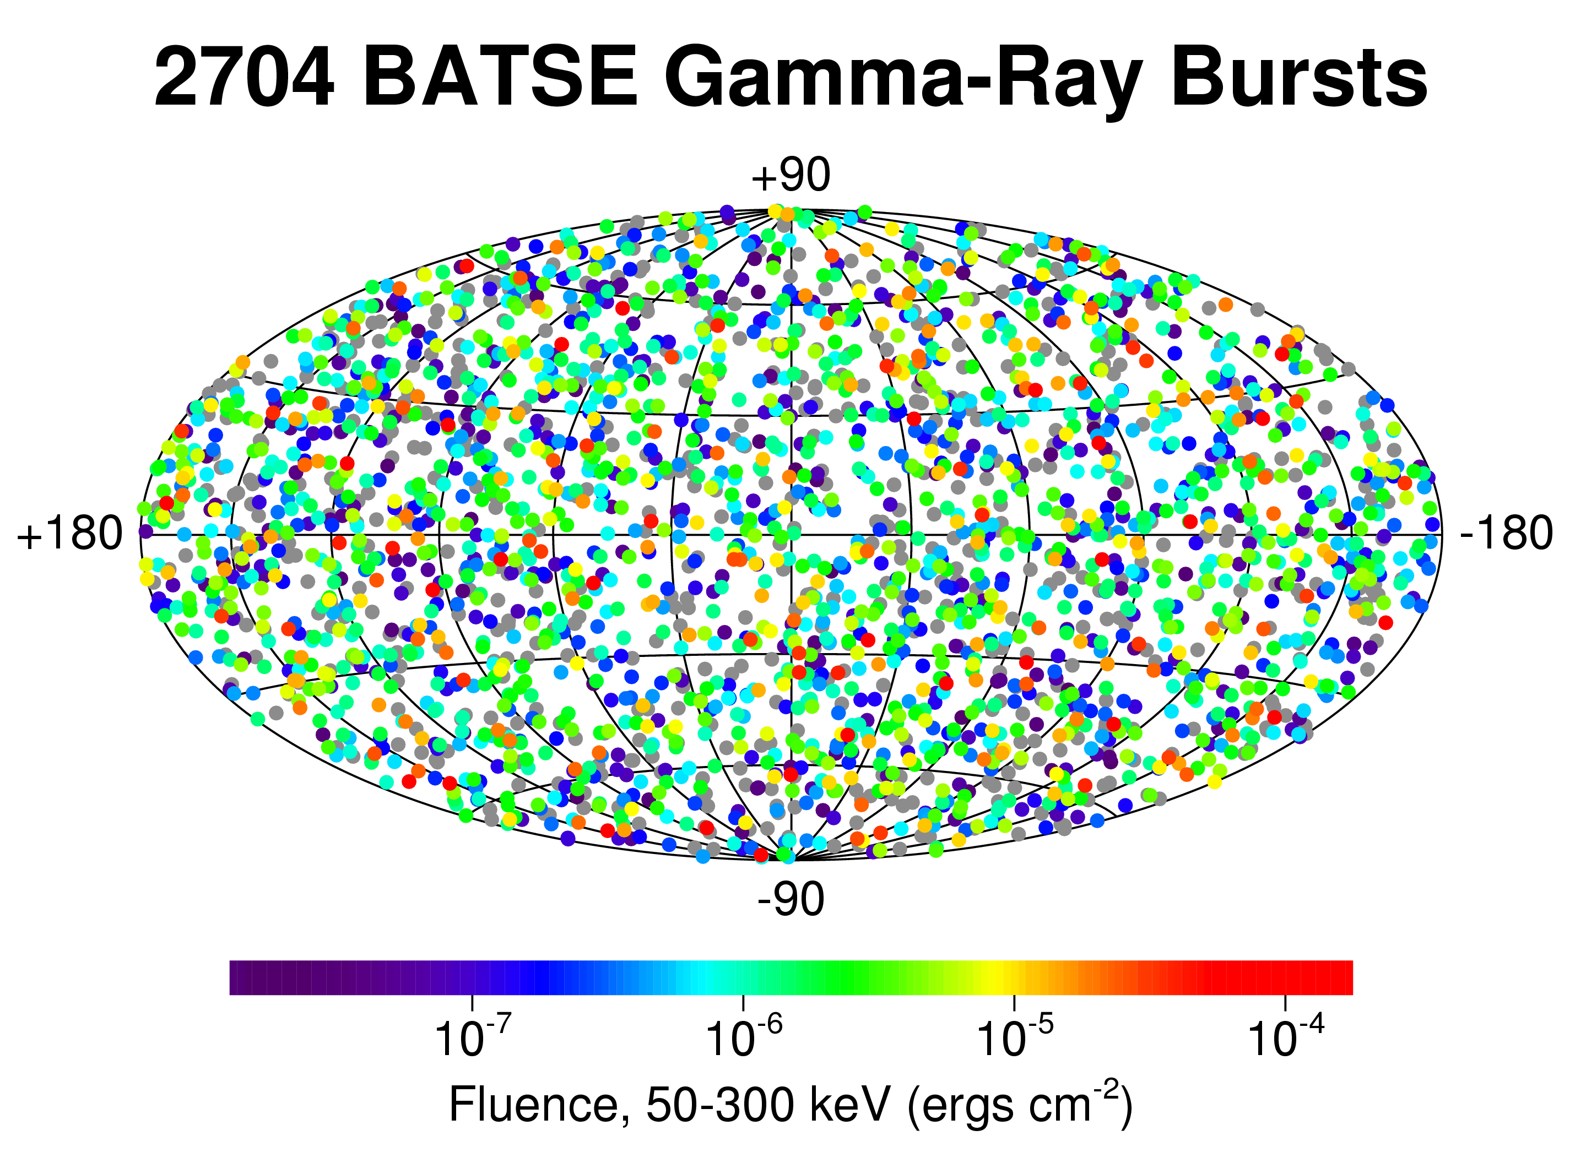
Observationsspatial distribution
Observed burst rate with BATSE: ~1 burst/day => one event/10⁶yr/galaxy
Locations of a total of 2704 GRBs recorded with BATSE onboard CGRO during 9 years of operation: burst spatial distribution is isotropic
Segre.ieec.uab.es/AAE_UAB/2003-04

Slide 6
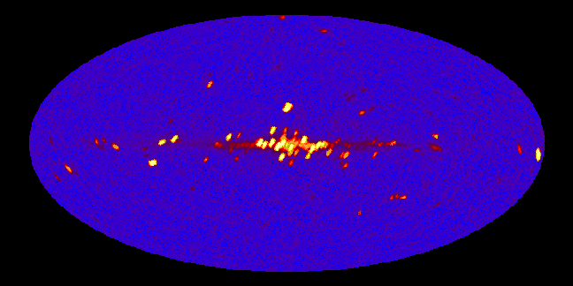
Observationsspatial distribution
Locations of bright X-ray binaries

Slide 7
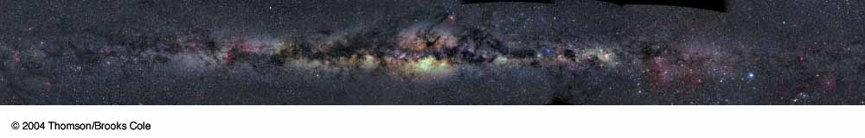
Observationsspatial distribution
Locations of stars

Slide 8
Using star counts to determine the shape of the “universe”

Slide 9
Finding the Structure
We are inside a large collection of stars. How do we make sense of the structure of this system from the inside? It is not easy…

Slide 10
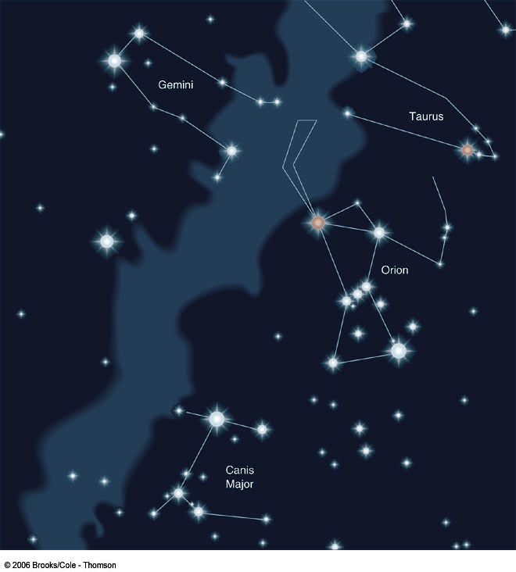
Finding the Structure
A band of diffuse light going around the sky can be seen from a dark location. This band was known to the ancient Greeks and Romans and was called the “Milky Way”.

Slide 11
Finding the Structure
Using a telescope Galileo discovered that the Milky Way is actually made up of millions of stars, each individually too faint to see without a telescope.
Away from this band, fewer stars are seen.

Slide 12
Finding the Structure
Relatively large numbers of stars are seen in a band cutting across the sky. This band was known to the ancient Greeks and Romans and was called the “Milky Way”.
Away from this band, fewer stars are seen.

Slide 13
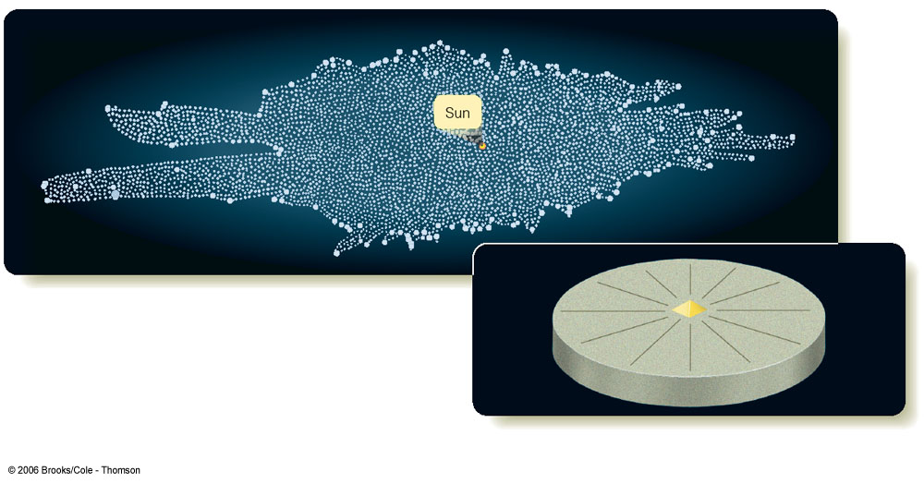
Finding the Structure
From the star counts, it was concluded that the “Universe” is a flattened structure (aspect ratio of 5:1) with a diameter of about 8000 light years. The Sun was essentially at the center.

Slide 14
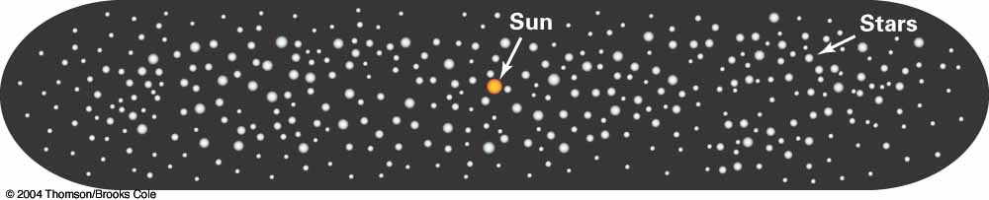
Finding the Structure
From the star counts, it was concluded that the “Universe” is a flattened structure (aspect ratio of 5:1) with a diameter of about 8000 light years. The Sun was essentially at the center.
Either we are at a very special place, or something is wrong. Interstellar dust was not accounted for.

Slide 15
Interstellar Dust
The space between the stars often contains lots of gas (e.g. hydrogen, oxygen, etc) and dust particles. This interstellar dust can inhibit our ability to observe at certain wavelengths. This point was not fully understood or appreciated until the mid 1930s.

Slide 16
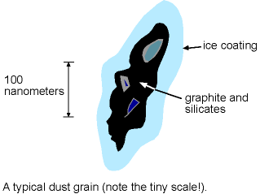
Interstellar Dust
The dust is composed of tiny slivers of graphite and silicates, possibly coated with water ice.
Note that the scale on this diagram is 10⁻⁷ meters!
Image from Nick Strobel’s Astronomy Notes (http://www.astronomynotes.com)

Slide 17
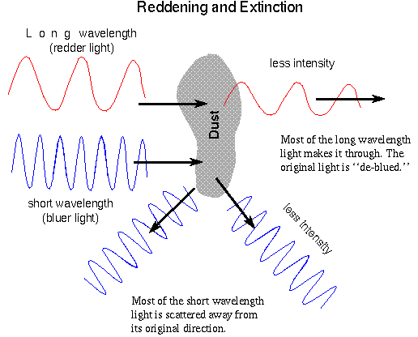
Interstellar Dust
Light passing through an interstellar dust cloud will be dimmed.
However, the amount of dimming depends on the wavelength of the light: blue light is scattered more easily than red light. The object appears redder.
Image from Nick Strobel’s Astronomy Notes (http://www.astronomynotes.com)

Slide 18
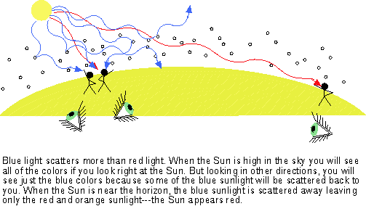
Why is the Sky Blue?
Blue light travels a relatively short distance before it is scattered by molecules in the air. Red light goes much further before being scattered.
Image from Nick Strobel’s Astronomy Notes (http://www.astronomynotes.com)

Slide 19
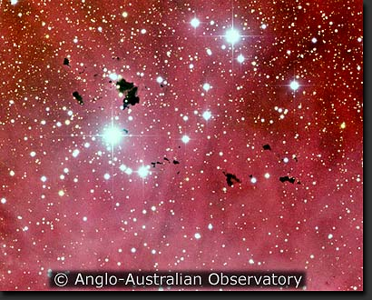
Intersteller Dust
Interstellar dust makes a star appear dimmer and redder if that star is behind a cloud of dust.
This will complicate matters when we try to judge the structure of our galaxy…

Slide 20
Finding the Structure
From the star counting observations and other observations, we know the galaxy is a flattened structure.
However, interstellar dust obscures the distant parts of it, leading to severe observational biases.
Is there another way to probe the structure? There are several: the earliest alternative was a study of globular clusters…

Slide 21
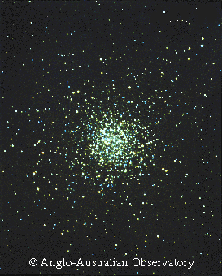
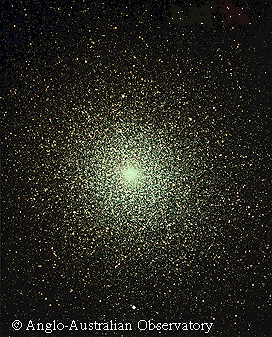
Finding the Structure
In 1918 Harlow Shapley estimated the distances to 93 globular clusters. Shapley found a strong concentration of globular clusters in the direction of Sagittarius.

Slide 22
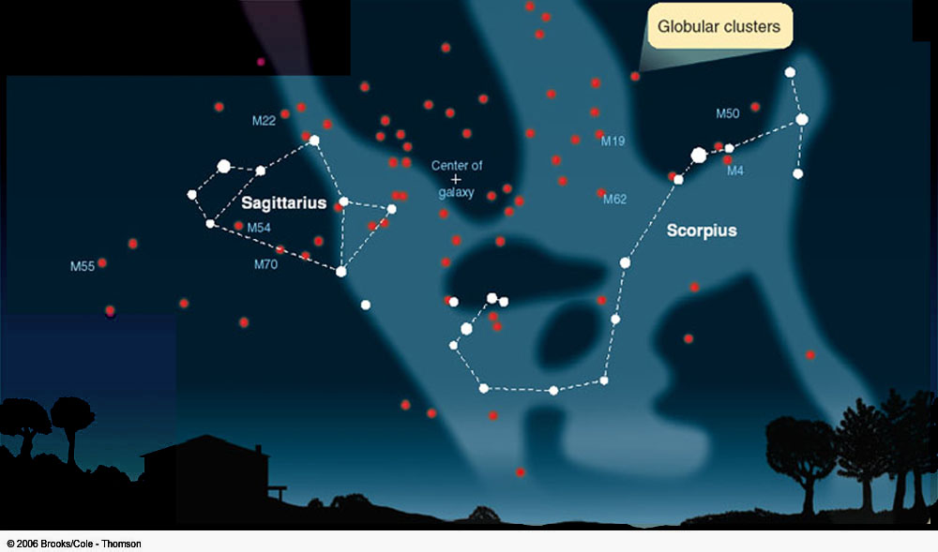

Finding the Structure
In 1918 Harlow Shapley estimated the distances to 93 globular clusters. Shapley found a strong concentration of globular clusters in the direction of Sagittarius.
If the GC’s are uniformly distributed through the galaxy, then the Sun is well off the center!

Slide 23
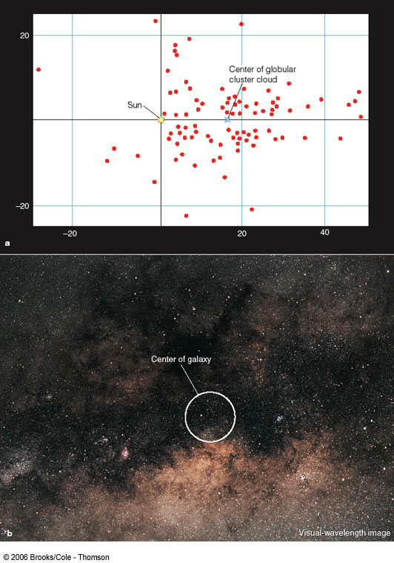
Finding the Structure
In 1918 Harlow Shapley estimated the distances to 93 globular clusters. Shapley found a strong concentration of globular clusters in the direction of Sagittarius.
If the GC’s are uniformly distributed through the galaxy, then the Sun is well off the center!

Slide 24
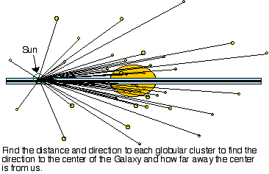
Finding the Structure
Image from Nick Strobel’s Astronomy Notes (http://www.astronomynotes.com)
In 1918 Harlow Shapley estimated the distances to 93 globular clusters. Shapley found a strong concentration of globular clusters in the direction of Sagittarius.
If the GC’s are uniformly distributed through the galaxy, then the Sun is well off the center!

Slide 25
Finding the Structure
Counting individual stars in the optical leads to biases if interstellar dust is not accounted for. One has the illusion that we are at the center.
The globular clusters give a much more unbiased view. The center of the galaxy is roughly 25,000 light years away in the direction of Sagittarius.

Slide 26
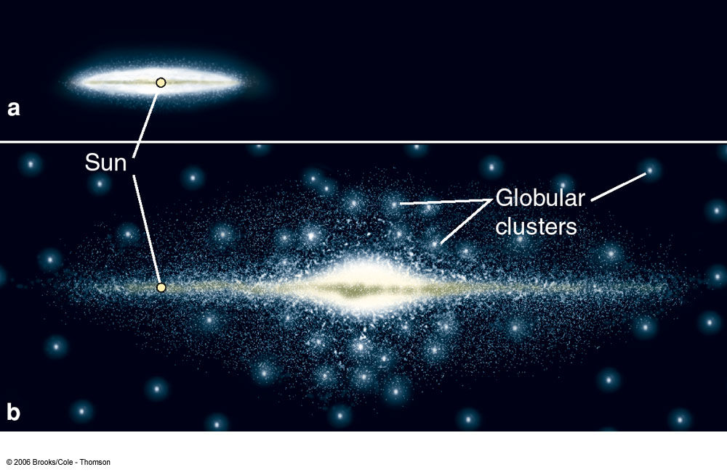
Finding the Structure
In 1918 Harlow Shapley estimated the distances to 93 globular clusters. Shapley found a strong concentration of globular clusters in the direction of Sagittarius.
If the GC’s are uniformly distributed through the galaxy, then the Sun is well off the center!

Slide 27
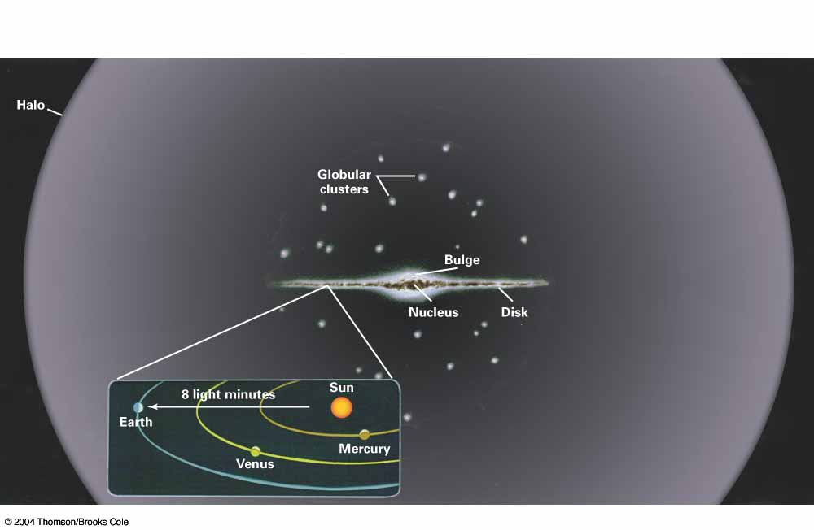
Finding the Structure
There are three main parts:
  The bulge/nucleus at the center (roughly spherical with a radius of about 3000 light years).

Slide 28
Finding the Structure
There are three main parts:
  The disk which is about 100,000 light years across and about 2000 light years thick. It contains the young stars, the gas, and the dust. The Sun is in the disk about 2/3 the way out.

Slide 29
Finding the Structure
There are three main parts:
  The halo, which is a roughly spherical and relatively diffuse region a few hundred thousand light years across. The halo contains very old stars and the globular clusters.

Slide 30
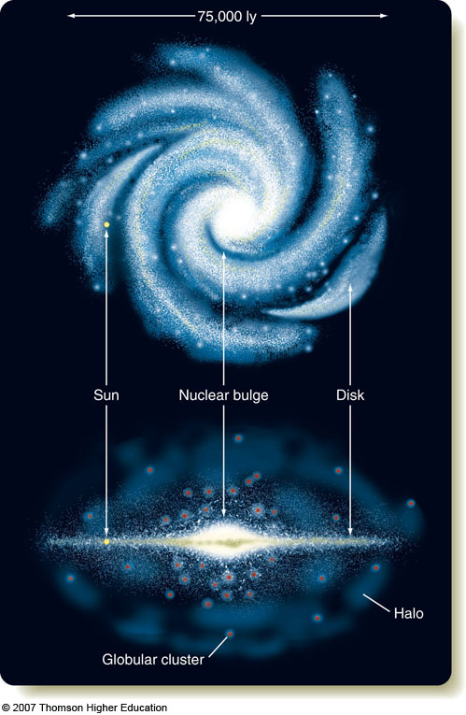
Finding the Structure

Slide 31
Stellar Groupings
To understand how stars evolve, one must study groups of stars since an individual star takes a very long time to change.

Slide 32
Stellar Groupings
To understand how stars evolve, one must study groups of stars since an individual star takes a very long time to change.
One must choose samples of stars very carefully to avoid bias and to eliminate “variables”.

Slide 33
An Example of Bias
Suppose we had two samples of stars, one with the nearest stars, and one with the apparently brightest stars. What to the CMDs look like?

Slide 34
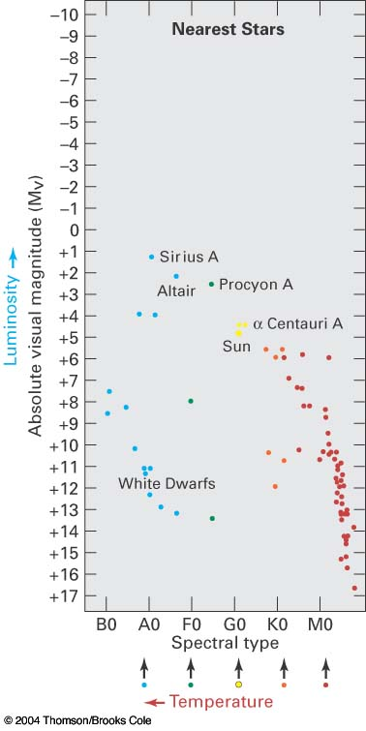
An Example of Bias
Suppose we had two samples of stars, one with the nearest stars, and one with the apparently brightest stars. What to the CMDs look like?
Here are the nearest stars.

Slide 35
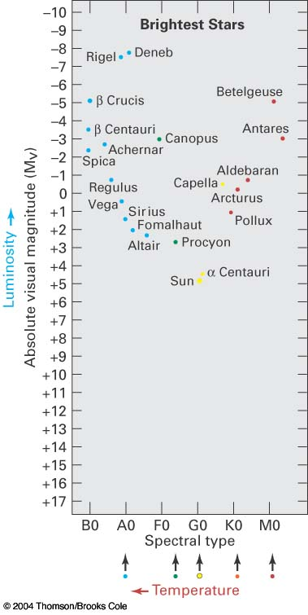
An Example of Bias
Suppose we had two samples of stars, one with the nearest stars, and one with the apparently brightest stars. What to the CMDs look like?
Here are the nearest stars.
Here are the brightest stars.

Slide 36
An Example of Bias
Suppose we had two samples of stars, one with the nearest stars, and one with the apparently brightest stars. What spectral types do the stars have?

Slide 37
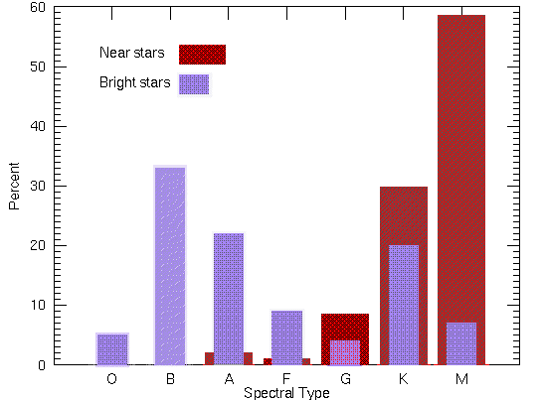
An Example of Bias
Suppose we had two samples of stars, one with the nearest stars, and one with the apparently brightest stars. What spectral types do the stars have?
The nearby stars tend to be cooler, whereas the bright stars are hotter.
Image from Nick Strobel’s Astronomy Notes
(http://www.astronomynotes.com)

Slide 38
An Example of Bias
Suppose we had two samples of stars, one with the nearest stars, and one with the apparently brightest stars. What spectral types do the stars have?
Which sample is more representative?
Image from Nick Strobel’s Astronomy Notes
(http://www.astronomynotes.com)

