Slide 1




ACADEMIC PROJECT — JURY PRESENTATION
WIGMS
Wedding Invitation & Guest Management System
C Language + GTK
Windows Desktop Application
Complete Software Engineering Project

Slide 2

Problem Statement & Objectives
02
❌ Without WIGMS
✅ With WIGMS
• Guest information scattered everywhere
• Centralized guest database
• Seating plan confusing and manual
• Automatic table assignment
• Gifts forgotten or poorly recorded
• Full gift tracking + thank-you notes
• Parking disorganized
• Parking space management
• Event schedule hard to follow
• Integrated event schedule
• Frequent errors and wasted time
• User-friendly interface, zero errors
1. Analysis
›
2. Design
›
3. Coding
›
4. Testing
›
5. Documentation
›
6. Deployment

Slide 3








Architecture & Modules
03
8 independent modules — each with its own dedicated .c / .h files
Person
Category
person.c / person.h
category.c / category.h
Name, phone, address, email, RSVP — full CRUD
Family, Friends, Colleagues, VIP — guest classification
Gift
Seating
gift.c / gift.h
seating.c / seating.h
Gift, value, linked guest — tracking & thank-you notes
Table number, seat number — organized placement
Parking
Schedule
parking.c / parking.h
schedule.c / schedule.h
Vehicle details, allocated spot — parking management
Arrival, ceremony, dinner, cake cutting, dancing
Priority
UI GTK
priority.c / priority.h
ui_gtk.c / ui_gtk.h
VIP, close family, special guests — priority levels
Forms, buttons, tables, navigation — GTK interface

Slide 4
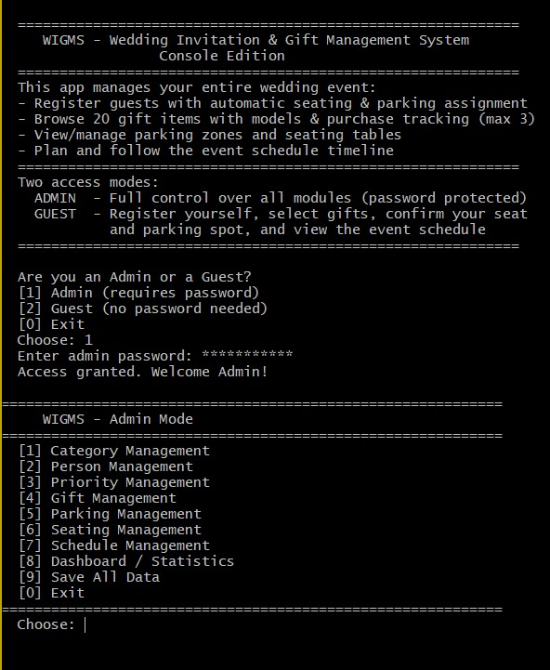
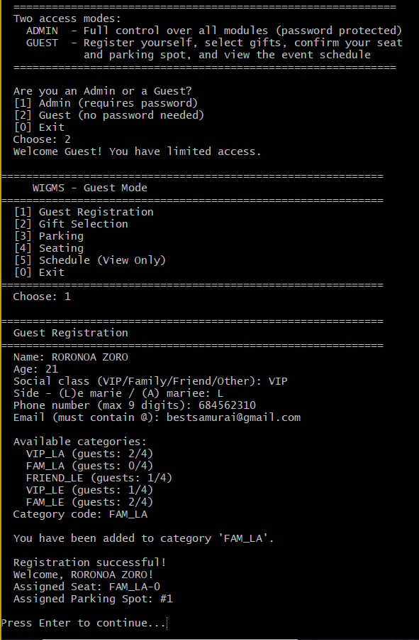





CLI Output
04
Tech Stack
Project Structure
C Language
📁 WIGMS/
System programming, structures, pointers, memory management
📂 src/
person.c category.c gift.c
GTK (GUI)
seating.c parking.c schedule.c
Windows, forms, buttons, tables, events
priority.c ui_gtk.c
📂 include/
.dat / .csv Files
*.h (one header per module)
Local persistence: guests_access.csv + *.dat
📂 data/
guests_access.csv *.dat
HTML / CSS
📂 web/
Web site: index, person, gift, parking, schedule pages
index.html person.html gift.html…
📂 Report/
Makefile
Full report .docx + .pdf
Automated compilation — generates wigms.exe
⚙️ Makefile + ▶️ wigms.exe

Slide 5

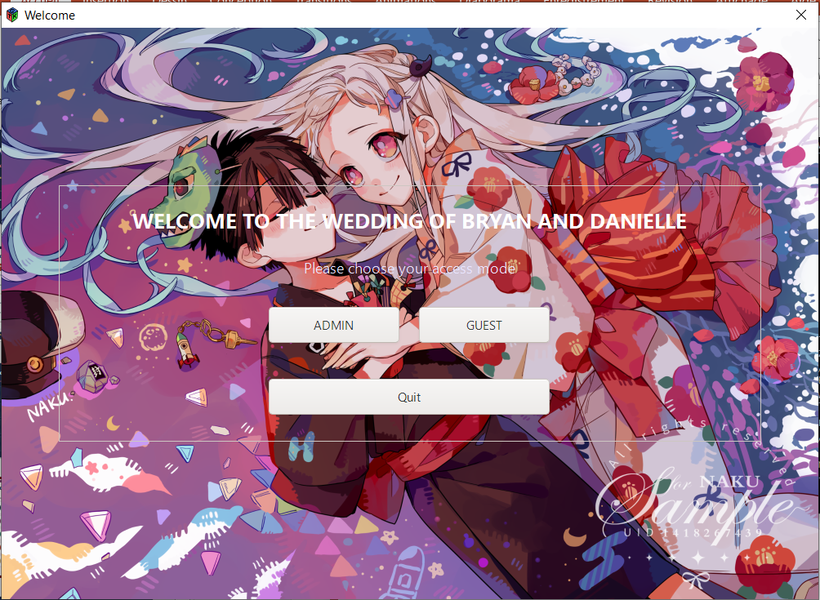




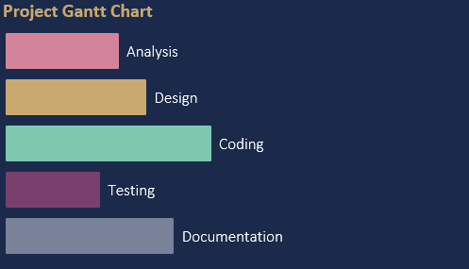
Technical Documentation
05
UML Diagrams
Use Case Diagram
User interactions with the system — 7 use cases identified: manage guests, RSVP, gifts, seating, parking, schedule, priorities
Class Diagram
8 classes: Person, Category, Gift, Seating, Parking, Schedule, Priority, UI — with attributes, methods and associations
Project Gantt Chart
Analysis
Sequence Diagram
Interaction flow: User → GTK UI → business module → data file — for each CRUD operation
Design
Coding
Gantt & Reports
Testing
Documentation
Reports Included
Full project report (.docx + .pdf)
Build and deployment guide
Detailed UML documentation
Progress reports

Slide 6
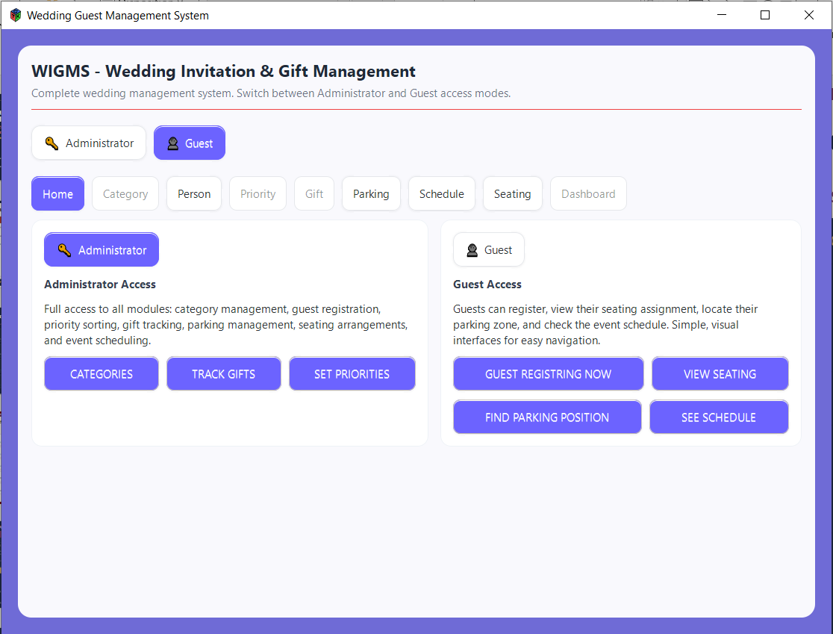




06
Results & Conclusion
8
5
6
3
Modules
Technologies
Data Files
UML
Diagrams
Fully functional desktop application, wigms.exe delivered and tested
8 complete business modules with file persistence (.dat / .csv)
Full documentation: UML (Use Case, Class, Sequence) + Gantt charts
Multi-page HTML/CSS presentation website included
Usable by any wedding organizer no technical background required
WIGMS · Built with C + GTK · Software Engineering · Thank you for your attention

