Slide 1
Explainable Detection of COVID-19 from Chest X-Ray Images
Franco Ruggeri
Fredrik Danielsson
Muhammad Tousif Zaman
Milan Jolić

Slide 2
Introduction
Effects of Chest X-ray (CXR) on prevention of COVID-19
Deep learning combined with CXR
Our goal

Slide 3
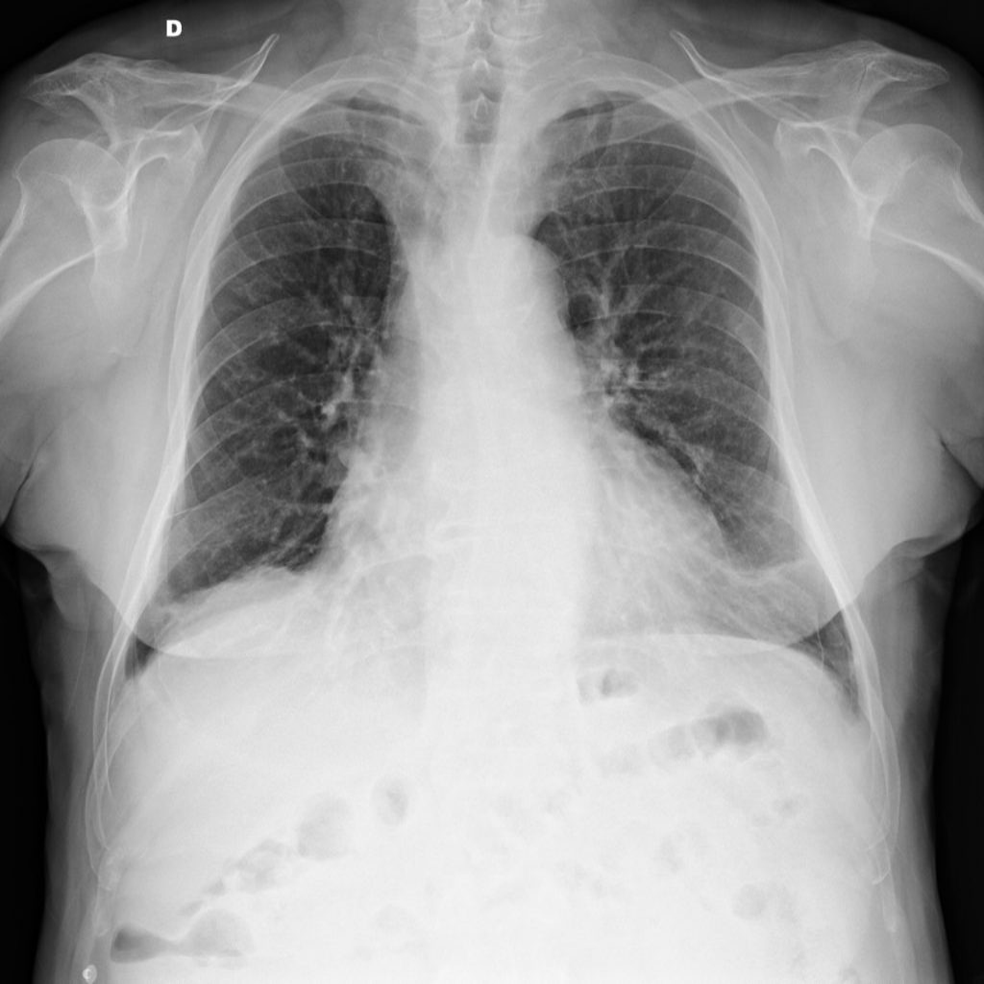
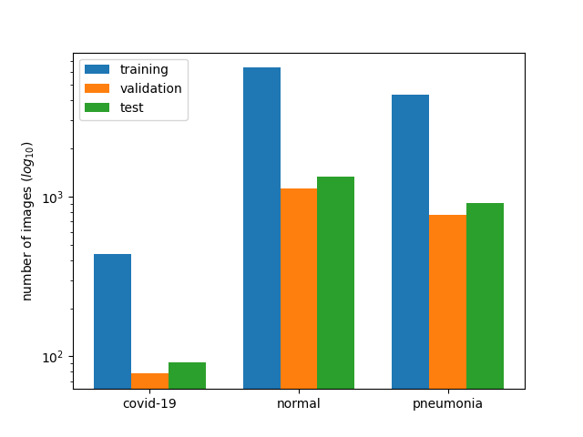
Data (I) – COVIDx

Slide 4
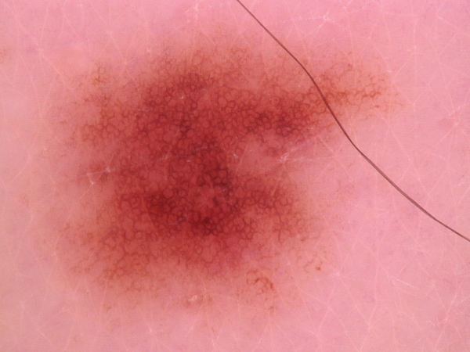
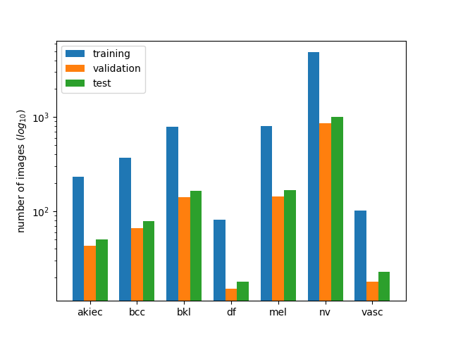
Data (II) – HAM10000

Slide 5

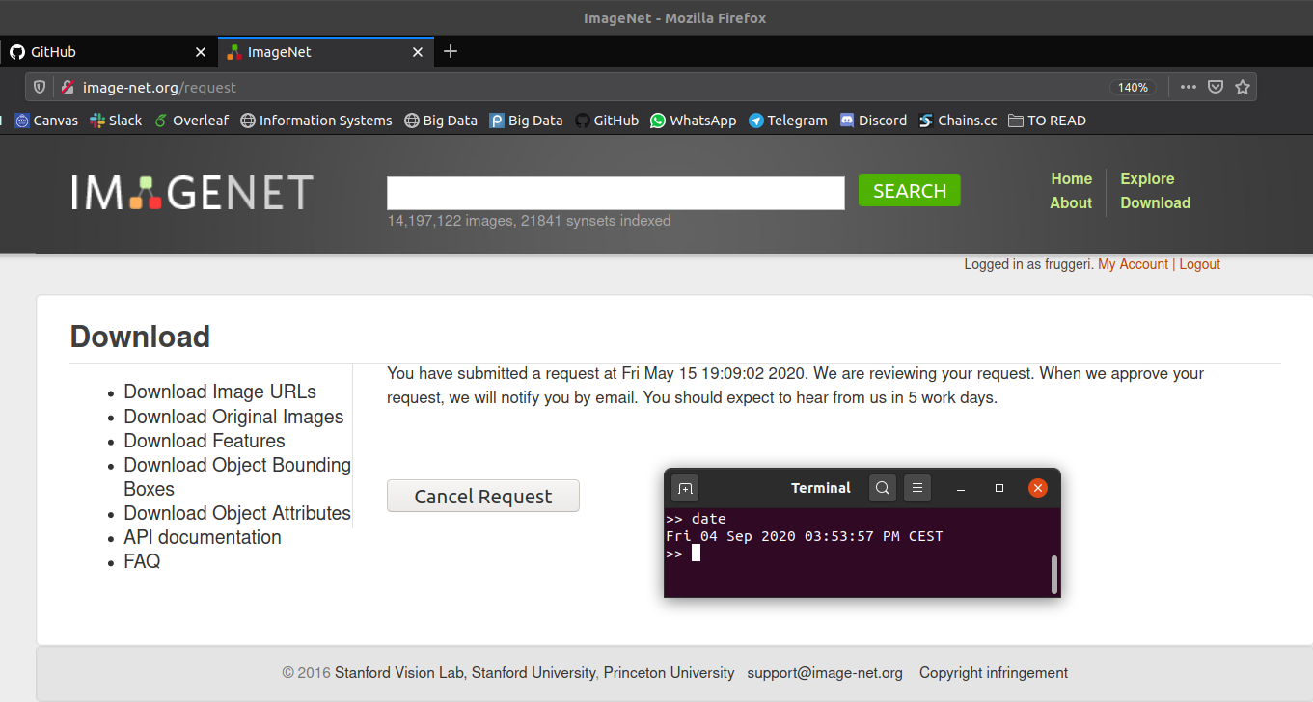
Data (III) – ImageNet

Slide 6
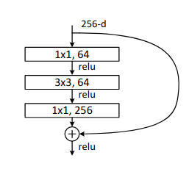
Architetures (I) – ResNet50
Skip connections
Batch normalization
Bottleneck structures
Top:
Global max pooling layer
1 fully connected layer
See lecture 7 or [1] for more details.

Slide 7
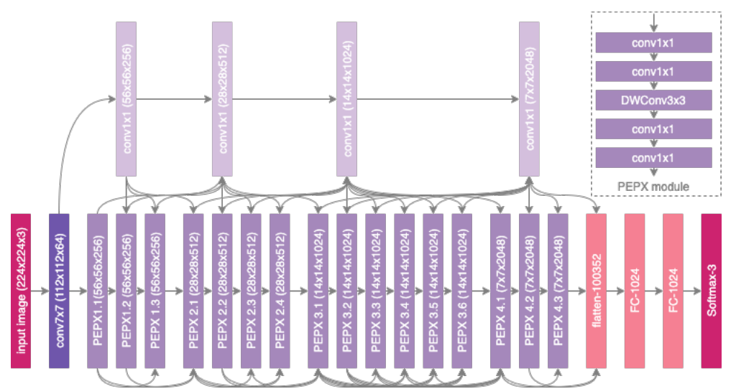
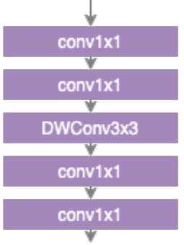
Architetures (I) – COVID-Net
Skip connections
PEPX blocks
Top:
Flatten
3 fully connected layers
See [2] for more details.
NEW

Slide 8
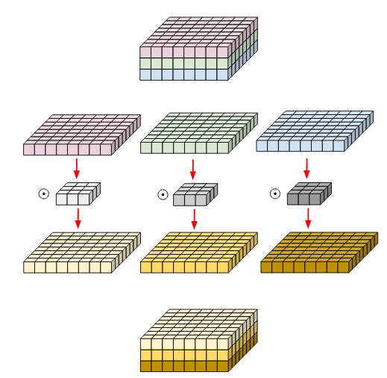
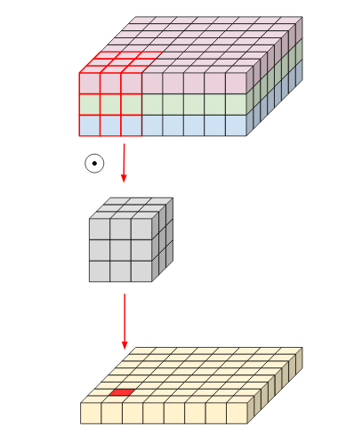
Depth-wise Convolution
Normal convolution
Depth-wise convolution
With Keras:
…
x = tf.keras.layers.DepthwiseConv2D(kernel_size=3)(x)
...
Source: https://medium.com/@zurister/depth-wise-convolution-and-depth-wise-separable-convolution-37346565d4ec

Slide 9
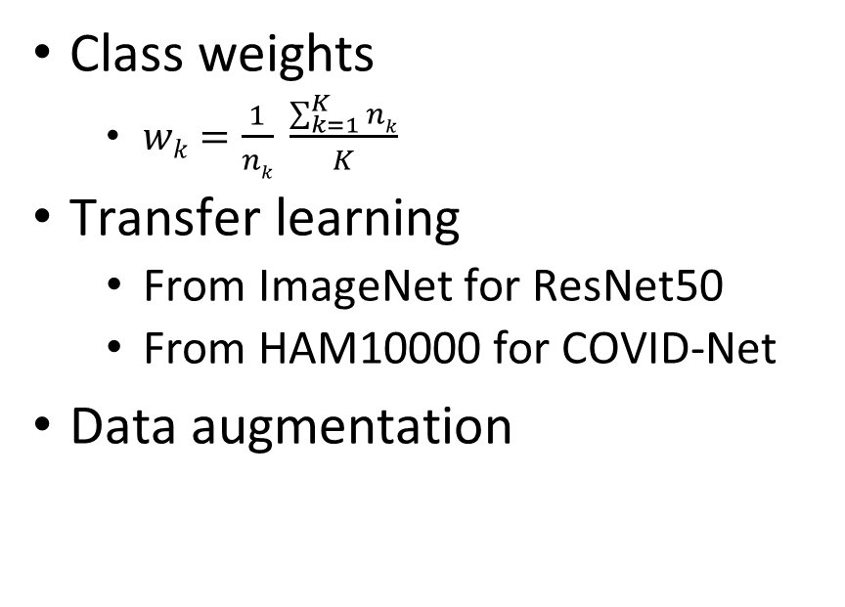
Training and evaluation
Techniques
Metrics
NEW
Class weights
$wk=\frac{1}{nk} \frac{\sum_{k=1}^{K}{nk}}{K}$
Transfer learning
From ImageNet for ResNet50
From HAM10000 for COVID-Net
Data augmentation
Macro-averaged F1-Score
Precision, recall, ROC for COVID-19
Data binarized on COVID-19
Cross-validation with the first one

Slide 10
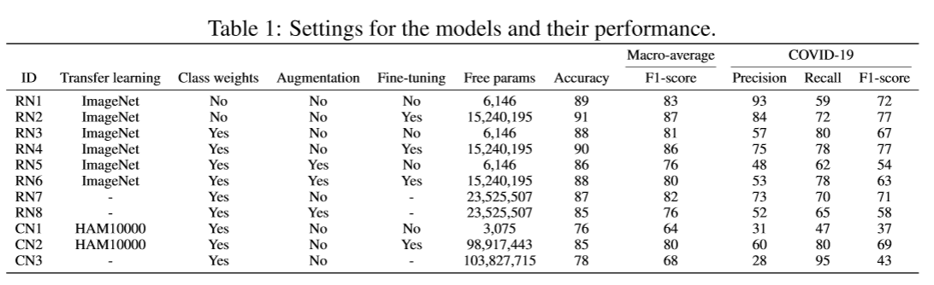
Experiments – Performance (I)
Transfer learning from ImageNet 👍
Class weights👍
Fine-tuning 👍
Data augmentation 😶
Transfer learning from HAM10000 👍

Slide 11
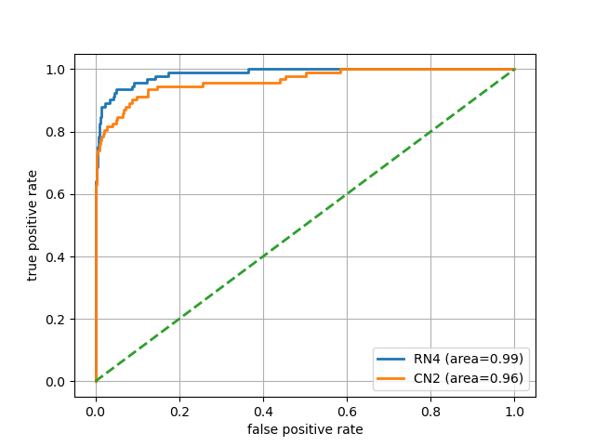
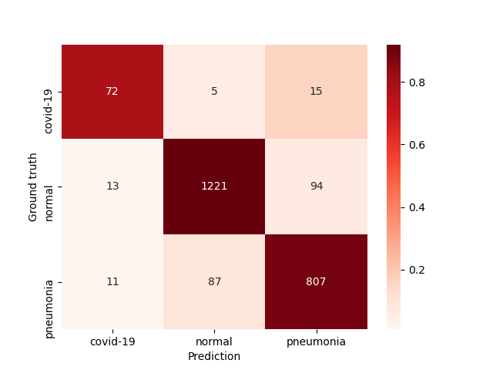
Experiments – Performance (II)
ResNet50 (RN4) vs COVID-Net (CN2)
Best model (RN4)
ROC curve on data binarized for the COVID-19 class

Slide 12
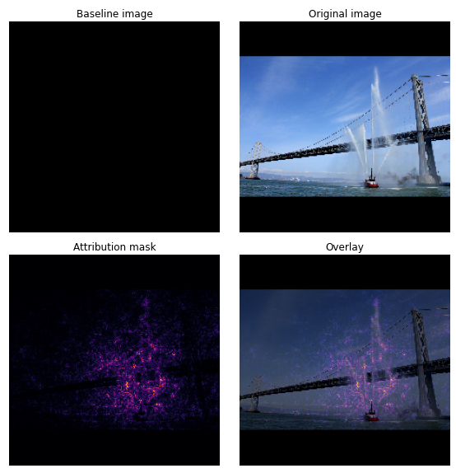
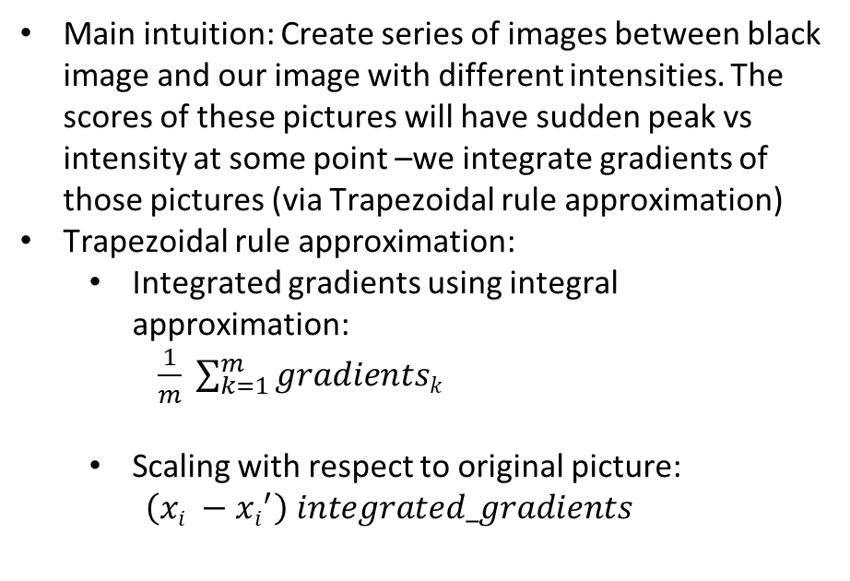
Integrated Gradients (IG)
Main intuition: Create series of images between black image and our image with different intensities. The scores of these pictures will have sudden peak vs intensity at some point –we integrate gradients of those pictures (via Trapezoidal rule approximation)
Trapezoidal rule approximation:
Integrated gradients using integral approximation: $\frac{1}{m} \sum_{k=1}^{m}{gradientsk}$
Scaling with respect to original picture:
$$\left(xi −xi^{′}\right) integrated_gradients$$
Source: https://www.tensorflow.org/tutorials/interpretability/integrated_gradients

Slide 13
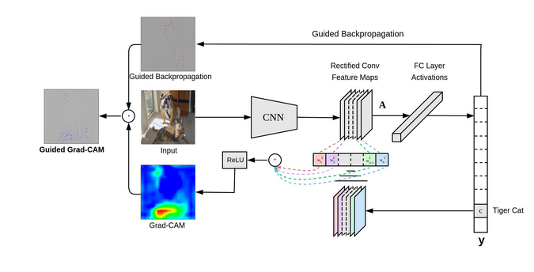
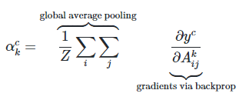

Grad-CAM (Gradient-weighted Class Activation Mapping)
Main intuition: The last convolutional layer of the network offers a good trade-off between high-level information in an image and detailed spatial information
Source: https://medium.com/@mohamedchetoui/grad-cam-gradient-weighted-class-activation-mapping-ffd72742243a

Slide 14
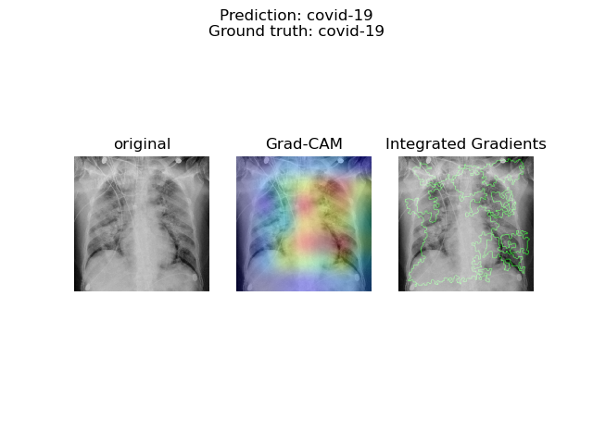
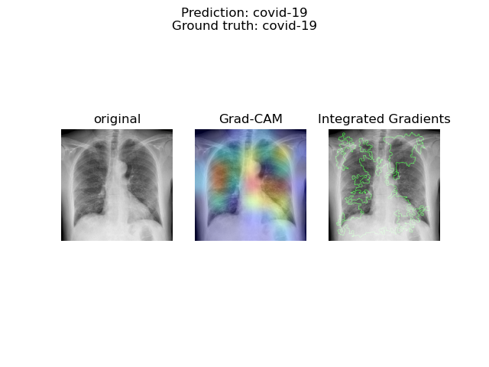
Explainability – Results

Slide 15
Conclusion
Learning experience
Future additions
Questions?

Slide 16
References
[1] Kaiming He, Xiangyu Zhang, Shaoqing Ren, and Jian Sun. Deep residual learning for image recognition, 2015.
[2] Linda Wang, Zhong Qiu Li, and Alexander Wong. Covid-net: A tailored deep convolutional
neural network design for detection of covid-19 cases from chest x-ray images. 2020. URL
https://arxiv.org/abs/2003.09871.

