Slide 1
Restricted Boltzmann Machines and Deep Belief Nets
Artificial Neural Networks and Deep Architectures – Lab 4
Franco Ruggeri, Fredrik Danielsson

Slide 2
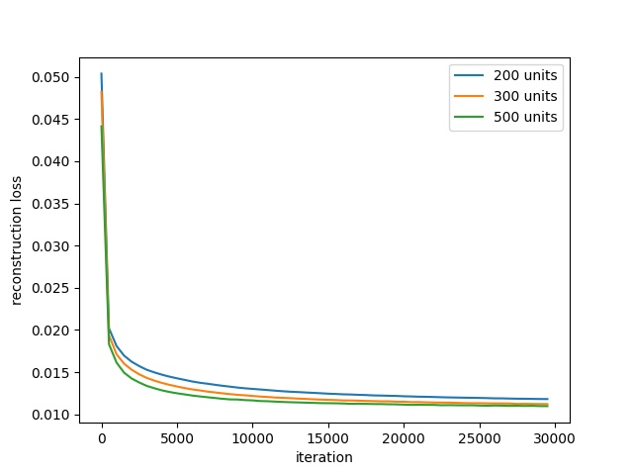
Restricted Boltzmann Machines Number of hidden units
Dataset | # hidden units | Reconstruction loss
Training | 200 | 0.01180 ± 0.00002
Training | 300 | 0.01118 ± 0.00002
Training | 500 | 0.01095 ± 0.00001
Test | 200 | 0.02888 ± 0.00005
Test | 300 | 0.02740 ± 0.00003
Test | 500 | 0.02681 ± 0.00002
More hidden units → more degrees of freedom → the model fits better the data

Slide 3
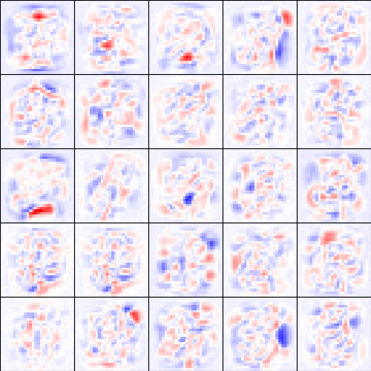
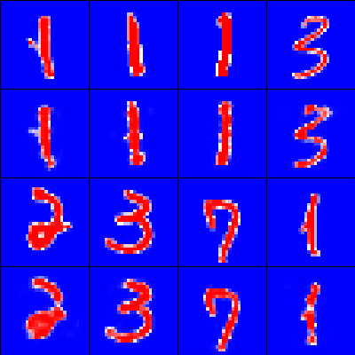
Restricted Boltzmann Machines Receptive fields and reconstructions
Receptive fields (left) show some templates of several digits mixed together
Reconstructions (right) of test images very very good → representation learnt

Slide 4
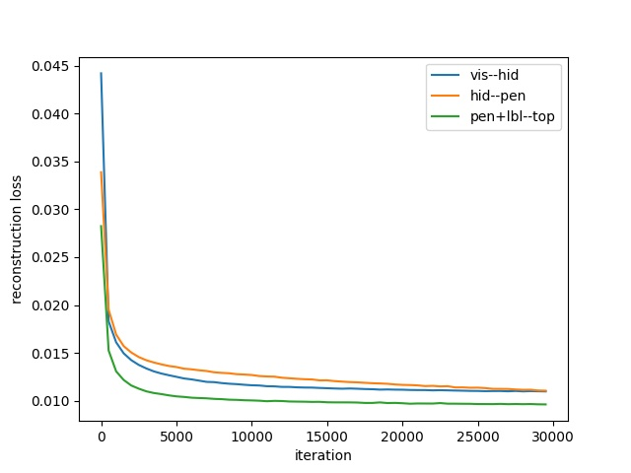
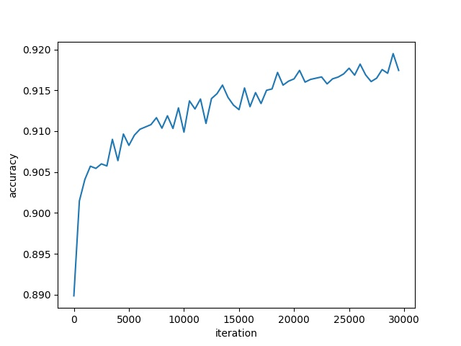
Deep Belief Nets Training - Greedy layer-wise pre-training and fine-tuning
Pre-training (left): each layer (pre-)trained until convergence to build a stack (freezing layers below)
Fine-tuning (right): whole network trained simultaneously, using pre-trained weights as initializations

Slide 5
Deep Belief Nets Evaluation - Recognition mode – Pre-training and fine-tuning
Dataset | Learning step | Accuracy
Training | Pre-training | 0.888 ± 0.006
Training | Fine-tuning | 0.924 ± 0.001
Test | Pre-training | 0.891 ± 0.006
Test | Fine-tuning | 0.925 ± 0.002
Pre-training: very good performance considering the greedy approach
Fine-tuning: improved performance

Slide 6
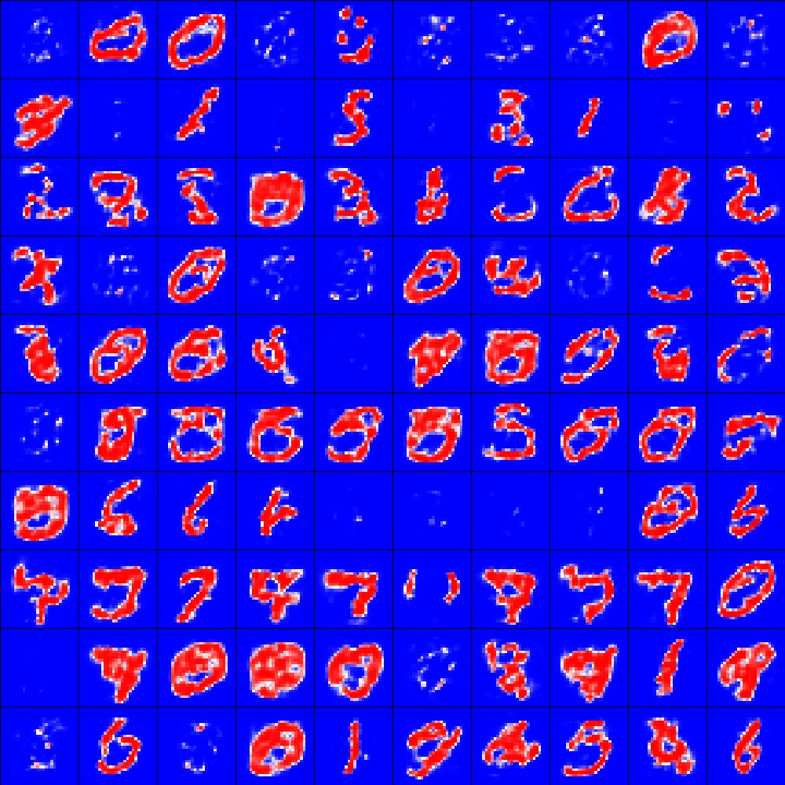
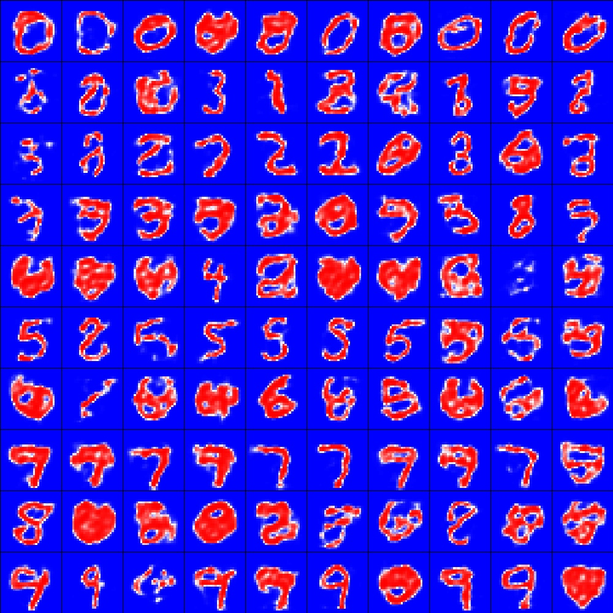
Deep Belief Nets Evaluation - Generative mode – Pre-training and fine-tuning
Pre-training: few good generated images
Fine-tuning: qualitatively high improvement, many good generated images

Slide 7
Deep Belief Nets Simplified architecture
Dataset | Learning step | Accuracy | Accuracy with simplified architecture
Training | Pre-training | 0.888 ± 0.006 | 0.916 ± 0.001
Training | Fine-tuning | 0.924 ± 0.001 | 0.942 ± 0.001
Test | Pre-training | 0.891 ± 0.006 | 0.919 ± 0.003
Test | Fine-tuning | 0.925 ± 0.002 | 0.945 ± 0.002
The simplified architecture outperforms the deeper one
Possible reasons:
Deeper network → more complex landscape of loss function → more local minima
Deeper network → small gradients (vanishing gradients problem)

Slide 8
THANK YOU!

