Slide 1

National University of Engineering
STUDENT: Franco Najarro Mallqui
Code: 20081384c
Teacher: Cecilia Mayorca
Topic: simulation

Slide 2
Simulation is the imitation of the operation of a real-world procces or system over time.
The act of simulating something first requires that a model be developed , this model represent the key characteristics , behaviors and functions of the selected physical or abstract system or procces . The model represent the system itself , whereas the simulation represents the operation of the system over time.

Slide 3
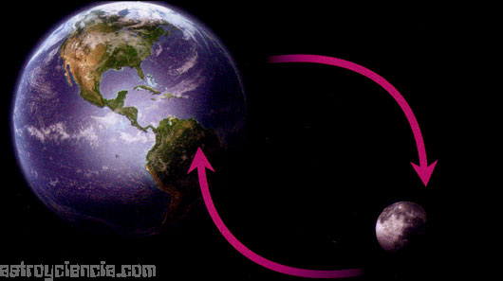
It's fields can be divided into a variety of theoretical and practical disciplines.
Example of simulation: n-bodies
It's example of simulation in physics: the problem two-bodys .

Slide 4
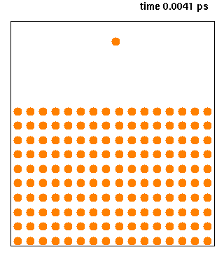
Example of simulation: molecular dynamic in a liquid

Slide 5
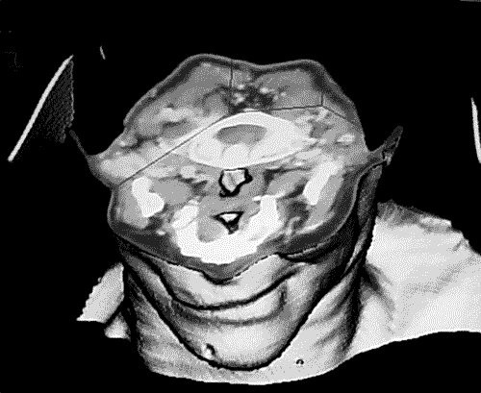
Application of simulation : medicine

