Slide 1
QSGW calculation for Gd. T.kotani 1dec2018
Key setting: IDMOD=1 for f orbitals. Probably, together with PWMODE=1
/home/usr2/h70252a/SWJ/GdTEST/15p5f_pwmode1_66_r33_idmod
ctrl.gd ---------------------------------------------------------------------------------
ITER MIX=A2,b=.2, (smaller b, b=0.2 may give slow but stable convergence for lmf)
APW setting
PWMODE=1
G vectors of APW basis sets is given at the energy cutoff at q=0.
The set of G vectors are q-independent for PWMODE=1
This gives smoother interpolation in BZ. Stable convergence.
SPEC settings
ATOM=Gd Z=64 R=3.3 # we enlarge R (ctrlgen use R=3.0 as upper limit. )-->use lmchk to know MT overlaps
EH=-1 -1 -1 -1 RSMH=1.65 1.65 1.65 1.65
EH2=-2 -2 -2 -2 RSMH2=1.65 1.65 1.65 1.65 # we use 2-MTO’s for f channel.
KMXA={kmxa} LMX=3 LMXA=6 NMCORE=1 # LMXA (charge expanded in MT is up to l=6)
PZ=0,15.9,0,5.5 we add LO for 5p and 5f --- +10.0 for 5p means extended lo (for cores).
MMOM=0 0 0 7 #Initial condition for magnetic moment for s,p,d,f
IDMOD=0 0 0 1 #This fix radial basis for f orbitals. –-> you can use FRZWF=T instead ( this means all IDMOD=1).
Takao found IDMOD is needed to make calculation stable→ too many MTO basis for 4f. Roles of MTO basis can switches-->seesaw like instability).
Type lmfa|grep conf. It shows what MTO basis we use for
6s6p5f4d \times 2 basis + 5p5f as local orbital
(10+5.9=15.9 for 5p is better setting for semicore.15.9 is
'extended local orbital'--it is similar with MTO.)
16X2+ 3+7= 40 MTO for each spin.
It is better to treat 5p (spilt core)-->grep spill llmf
SO setting and nk
% const pwemax=3 nk1=13 nk2=13 nk3=9 nit=150 gmax=15 nspin=2 metal=3 so=2 xcfun=1 ssig=1.0
so=2 is for LdotS case. Not needed for Gd.
Crystal symmetry setting
SYMGRP r4z
Tthis may be needed to have finite orbital moment. (If we set 'find, it means that we use alll the lattice symmetry---we use 'find' for Gd ).
We may need
IDU= 0 0 0 2 UH= 0 0 0 0 JH= 0 0 0 0
in order to to show density matrix for 4f channel (two representations shown-- real harmonics and spherical harmonics).
(occunum.gd is needed for initial condition of “LDA+U” setting. But it is dummy).

Slide 2
GWinput ------------------------------
Product basis setting 1
<PRODUCT_BASIS>
tolerance to remove products due to poor linear-independency
1.0E-02
lcutmx(atom) = maximum l-cutoff for the product basis. =4 is required for atoms with valence d, like Ni Ga
6 6
This gives product basis at atomic sites up to l=6. l=6 is required for 4f systems.
Proabably because 4fx4f gives l up to l=6.
The numbers
1.0E-02
is a cutoff numbers for linear dependency cutoff for all l=0,1,2,3,4,5,6.
>grep nb lbas
shows number of product basis for each l of atomic sites as
*** lx *** Used nb = 0 6 <--(for each l we show numbers of radial functions)
*** lx *** Used nb = 1 5 *** lx *** Used nb = 2 5 *** lx *** Used nb = 3 5 *** lx *** Used nb = 4 4 *** lx *** Used nb = 5 3 *** lx *** Used nb = 6 3 basnfp: BASFP... kmx nblocha= 31 189
189 is total numbers of PB at a site.

Slide 3
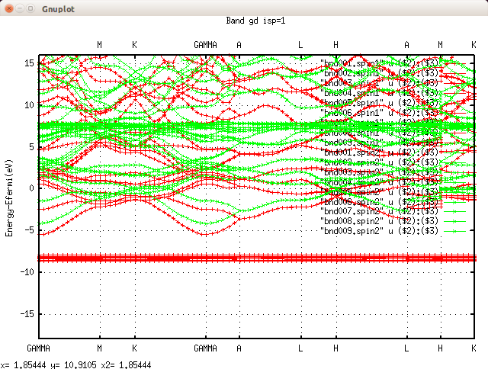
Product basis setting 2
Mixed product basis (caution. we have two atomic sites!)
2 3 1 1 1 ! 4f_p
2 3 2 0 1 ! 4f_d
2 3 3 0 1 ! 5f_l
This is for MixedProductBasis to expand 4fx4f orbitals.
k points
n1n2n3 6 6 4
(probably reasonable.
I recommend 6x6x6 for ZB. for 0.1 eV
level of convergence for band gaps)
Reduce computational efforts.
niw 6
emax_sigm 2
QpGcut_psi 3.0
QpGcut_cou 2.5
RESULT
/home/usr2/h70252a/SWJ/GdTEST/15p5f_pwmode1_66_r33_idmod
45 minutes per iteration with 24core.
mmom=15.60 -8eV,8eV.
/home/usr2/h70252a/SWJ/GdTEST/15p5f_pwmode1_66_r33_idmod_3
is for
QpGcut_psi 4.0 !(See unit_2pioa for unit) |q+G| cutoff for eigenfunction. QpGcut_cou 3.0 !(See unit_2pioa for unit) |q+G| cutoff for Coulomb and W. emax_sigm 3 !(Ry) emax cutoff for Sigma niw 10 ! Number of frequencies along Im axis. Used for integration to get Sigma_c
4f level is 0.1eV shallower.
Use attatched datta for plotting (bandplot.isp. bandplot.isp.comp).

Slide 4
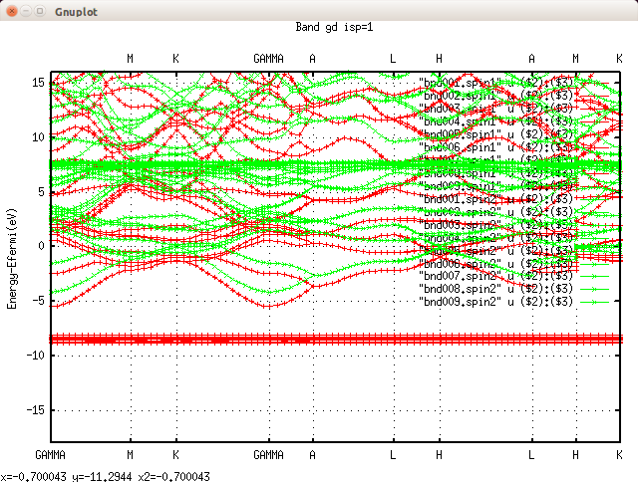
A different settings (large cutoff) at 15p5f_pwmode1_66_r33_idmod_lc -----------------
Changes from 15p5f_pwmode1_66_r33_idmod
Larger setting for
QpGcut_psi 4.0 !(See unit_2pioa for unit) |q+G| cutoff for eigenfunction. QpGcut_cou 3.0 !(See unit_2pioa for unit) |q+G| cutoff for Coulomb and W. emax_sigm 3 !(Ry) emax cutoff for Sigma niw 10 ! Number of frequencies along Im axis. Used for integration to get Sigma_c
lcutmx
1.0E-03 1.0E-03 1.0E-03 1.0E-03 1.0E-02 3.0E-02 3.0E-02
These numbers are cutoff numbers for linear dependency cutoff. Each for l=0,1,2,3,4,5,6.
product basis
Mixed product basis (caution. we have two atomic sites)
3 1 1 1 ! 4f_p
3 2 1 1 ! 4f_d
This is for MixedProductBasis to expand 4fx4f orbitals.
> grep nb lbas
*** lx *** Used nb = 0 8
*** lx *** Used nb = 1 7
*** lx *** Used nb = 2 8
*** lx *** Used nb = 3 6
*** lx *** Used nb = 4 6
*** lx *** Used nb = 5 3
*** lx *** Used nb = 6 3
basnfp: BASFP... kmx nblocha= 41 237
pwemax=3 in ctrl file
RESULT
65 minutes per iteration with 24core.
mmom=15.58 -8eV,8eV. (~0.15eV deeper 4f level).
We see good agreement with
15p5f_pwmode1_66_r33_idmod.

Slide 5
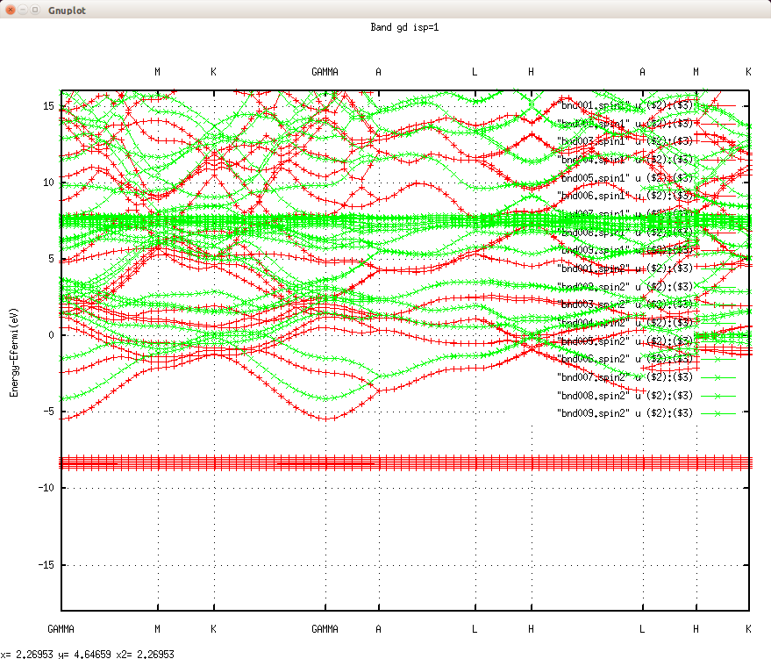
A different settings (large MTO basis) at 7s15p6d5f_pwmode1_pz7555_66
Changes from 15p5f_pwmode1_66_r33_idmod
mixbeta 0.2
mixing parameter of self-energy → not effective.
Larger setting for
QpGcut_psi 4.0 !(See unit_2pioa for unit) |q+G| cutoff for eigenfunction. QpGcut_cou 3.0 !(See unit_2pioa for unit) |q+G| cutoff for Coulomb and W. emax_sigm 2 !(Ry) emax cutoff for Sigma niw 10 ! Number of frequencies along Im axis. Used for integration to get Sigma_c
lcutmx
1.0E-03 1.0E-03 1.0E-03 1.0E-03 1.0E-02 3.0E-02 3.0E-02
product basis
Mixed product basis (caution. we have two atomic sites)
3 1 1 1 ! 4f_p
3 2 1 1 ! 4f_d
This is for MixedProductBasis to expand 4fx4f orbitals.
> grep nb lbas
*** lx *** Used nb = 0 9 *** lx *** Used nb = 1 8 *** lx *** Used nb = 2 10 *** lx *** Used nb = 3 8 *** lx *** Used nb = 4 7 *** lx *** Used nb = 5 3 *** lx *** Used nb = 6 3 basnfp: BASFP... kmx nblocha= 48 274
pwemax=3, PZ=7.5,15.9,6.5,5.5, and FRZWF=T (instead of IDMOD).
Thus we tread 7s, 5p, 6d, 5f as local orbitals.
RESULT
65 minutes per iteration with 24core.
mmom=15.56 -8eV,8eV. (~0.01ejV agreement for 4f level).
We see good agreement with 15p5f_pwmode1_66_r33_idmod.
Energy bands can be slightly diffrent for higher energy above >10 eV or so.

