Slide 1
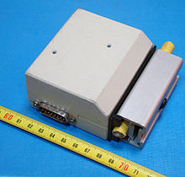
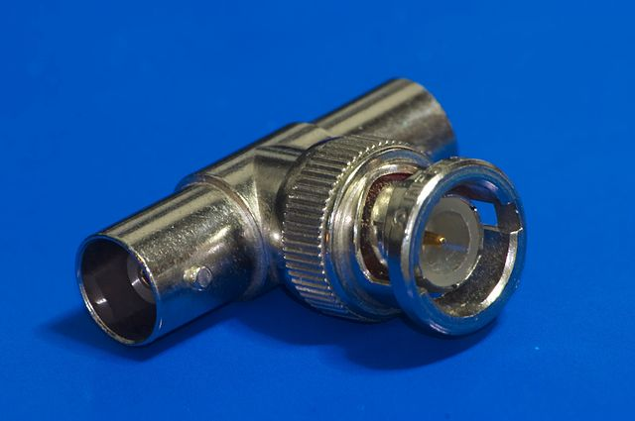
Ethernet
Estandarizada por IEEE802.3
Originalmente, topología de bus
  Implementada sobre coaxil
  10Base5, 10Base2 (1982-1985)

Slide 2
Ethernet
10Base-T (1990)
100Base-F
100Base-TX, 100Base-T4, 100Base-FX
1000Base-T (1999)
10GBase-T (2003-2006)
Topología en estrella
Cableado UTP, RJ45

Slide 3
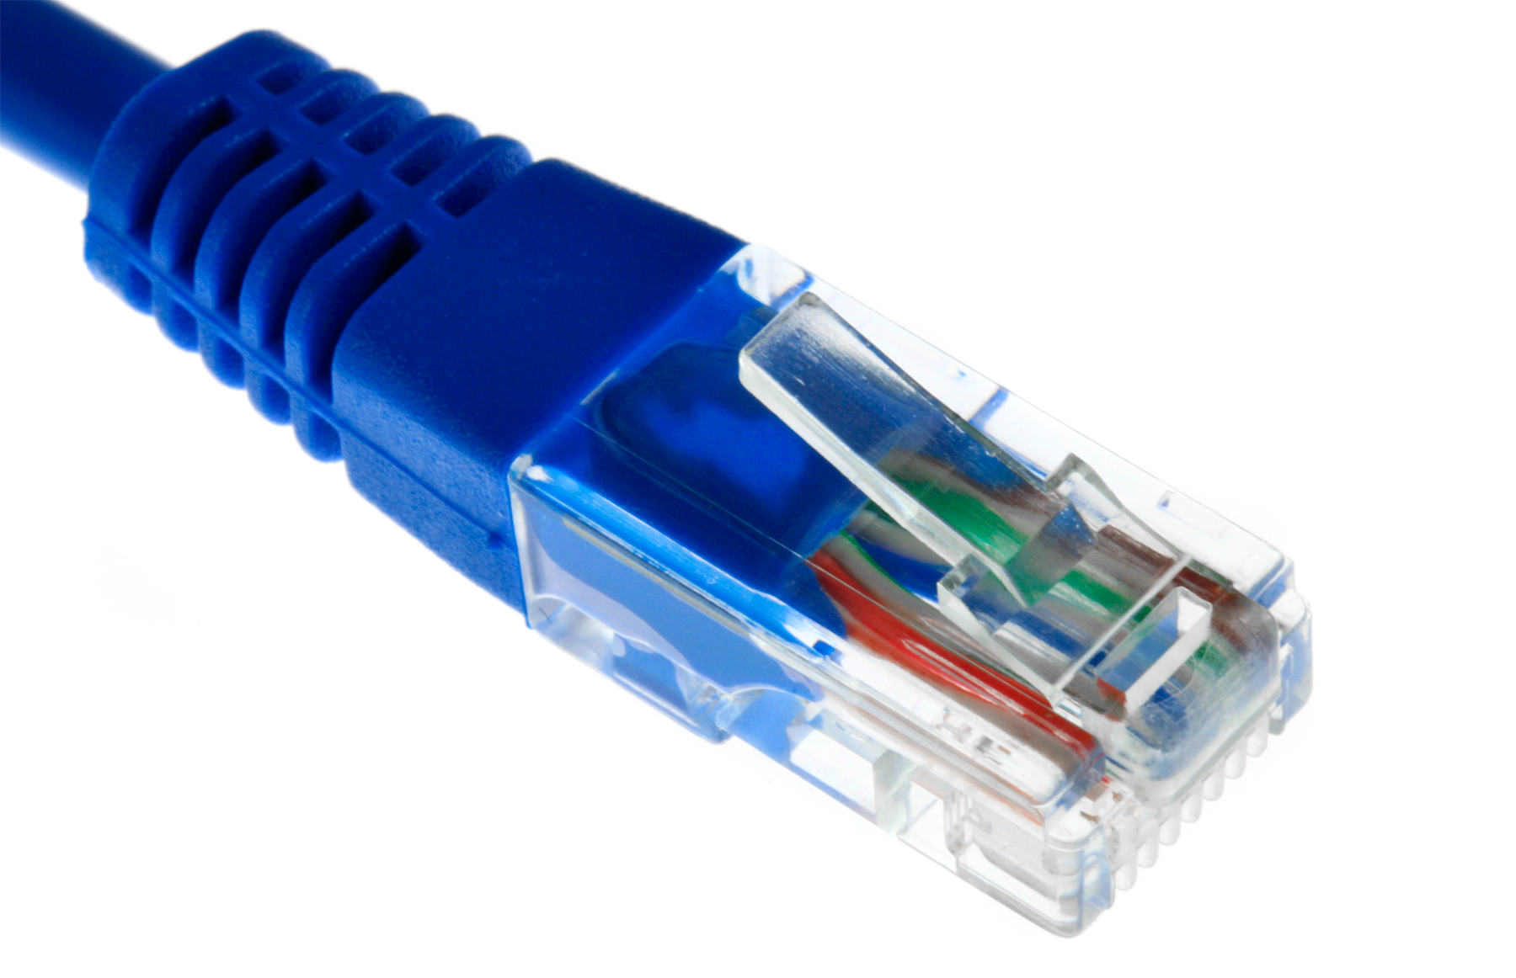
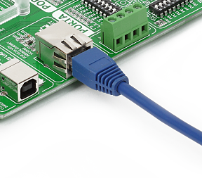
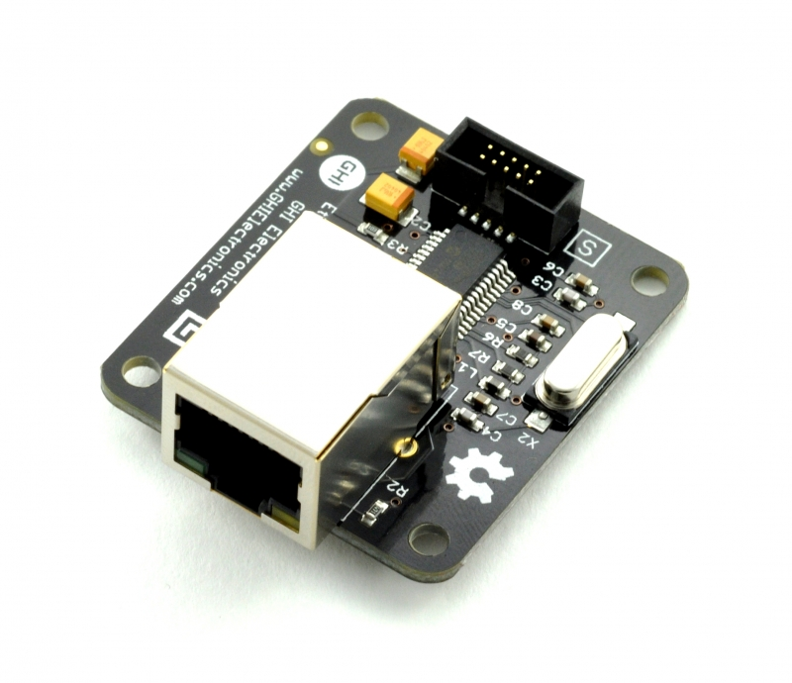
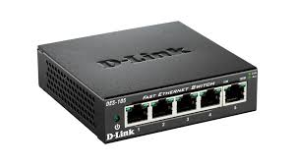
Ethernet

Slide 4
Interfaces
oso@betsyrc ~ $ lspci
00:00.0 Host bridge: Intel Corporation 3rd Gen Core processor DRAM Controller (rev 09)
00:01.0 PCI bridge: Intel Corporation Xeon E3-1200 v2/3rd Gen Core processor PCI Express Root Port (rev 09)
00:02.0 VGA compatible controller: Intel Corporation 3rd Gen Core processor Graphics Controller (rev 09)
00:14.0 USB controller: Intel Corporation 7 Series/C210 Series Chipset Family USB xHCI Host Controller (rev 04)
...
03:00.0 Ethernet controller: Realtek Semiconductor Co., Ltd. RTL8111/8168/8411 PCI Express Gigabit Ethernet Controller (rev 06)

Slide 5
Interfaces
oso@betsyrc ~ $ lspci
00:00.0 Host bridge: Intel Corporation 3rd Gen Core processor DRAM Controller (rev 09)
00:01.0 PCI bridge: Intel Corporation Xeon E3-1200 v2/3rd Gen Core processor PCI Express Root Port (rev 09)
00:02.0 VGA compatible controller: Intel Corporation 3rd Gen Core processor Graphics Controller (rev 09)
00:14.0 USB controller: Intel Corporation 7 Series/C210 Series Chipset Family USB xHCI Host Controller (rev 04)
...
03:00.0 Ethernet controller: Realtek Semiconductor Co., Ltd. RTL8111/8168/8411 PCI Express Gigabit Ethernet Controller (rev 06)
oso@betsyrc ~ $ lspci -n
00:00.0 0600: 8086:0154 (rev 09)
00:01.0 0604: 8086:0151 (rev 09)
00:02.0 0300: 8086:0166 (rev 09)
00:14.0 0c03: 8086:1e31 (rev 04)
00:16.0 0780: 8086:1e3a (rev 04)
00:1a.0 0c03: 8086:1e2d (rev 04)
00:1b.0 0403: 8086:1e20 (rev 04)
00:1c.0 0604: 8086:1e10 (rev c4)
00:1c.3 0604: 8086:1e16 (rev c4)
00:1d.0 0c03: 8086:1e26 (rev 04)
00:1f.0 0601: 8086:1e59 (rev 04)
00:1f.2 0106: 8086:1e03 (rev 04)
00:1f.3 0c05: 8086:1e22 (rev 04)
01:00.0 0300: 10de:0de9 (rev ff)
02:00.0 0280: 8086:088e (rev 24)
03:00.0 0200: 10ec:8168 (rev 06)

Slide 6
Direcciones
betsyrc ~ # ifconfig eth0
eth0 Link encap:Ethernet HWaddr 50:b7:c3:04:5d:06
inet addr:10.0.2.226 Bcast:10.0.2.255 Mask:255.255.255.0
inet6 addr: fe80::52b7:c3ff:fe04:5d06/64 Scope:Link
UP BROADCAST RUNNING MULTICAST MTU:1500 Metric:1
RX packets:402483 errors:0 dropped:0 overruns:0 frame:0
TX packets:168545 errors:0 dropped:1 overruns:0 carrier:0
collisions:0 txqueuelen:1000
RX bytes:95016681 (90.6 MiB) TX bytes:155432538 (148.2 MiB)
betsyrc ~ # ip addr show dev eth0
2: eth0: <BROADCAST,MULTICAST,UP,LOWER_UP> mtu 1500 qdisc pfifo_fast state UP group default qlen 1000
link/ether 50:b7:c3:04:5d:06 brd ff:ff:ff:ff:ff:ff
inet 10.0.2.226/24 brd 10.0.2.255 scope global eth0
valid_lft forever preferred_lft forever
inet6 fe80::52b7:c3ff:fe04:5d06/64 scope link
valid_lft forever preferred_lft forever

Slide 7
Frames, paquetes, segmentos
Frame Ethernet
Encapsulamiento
Paquete IP
Encapsulamiento
Segmento TCP o UDP

Slide 8
Frames, paquetes, segmentos
Destino
6 bytes
Origen
6 bytes
Tipo
2 B
Paquete IP
Entre 46 y 1500 bytes
Encapsulamiento
Paquete IP
Encapsulamiento
Segmento TCP o UDP

Slide 9
Frames, paquetes, segmentos
Destino
6 bytes
Origen
6 bytes
Tipo
2 B
Paquete IP
Entre 46 y 1500 bytes
Encapsulamiento
Cabecera IP
Desde 20 B
Segmento TCP o UDP
Encapsulamiento
Segmento TCP o UDP

Slide 10
Frames, paquetes, segmentos
Destino
6 bytes
Origen
6 bytes
Tipo
2 B
Paquete IP
Entre 46 y 1500 bytes
Encapsulamiento
Cabecera IP
Desde 20 B
Segmento TCP o UDP
Encapsulamiento
Cabecera TCP
Desde 20 B
Datos de la aplicación

Slide 11
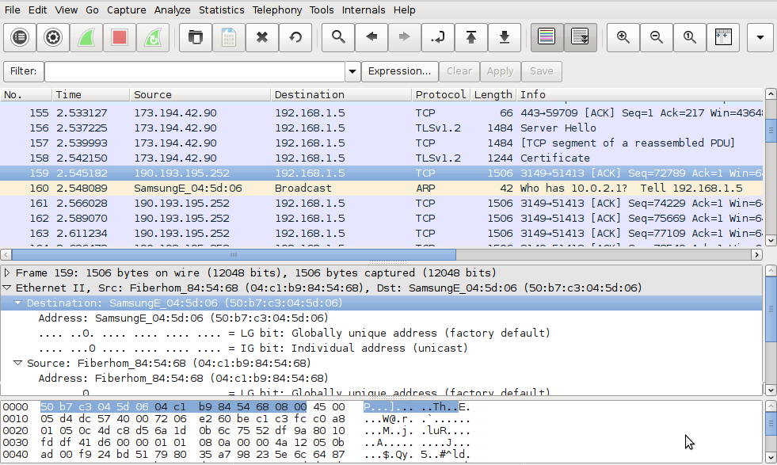
Dirección destino

Slide 12
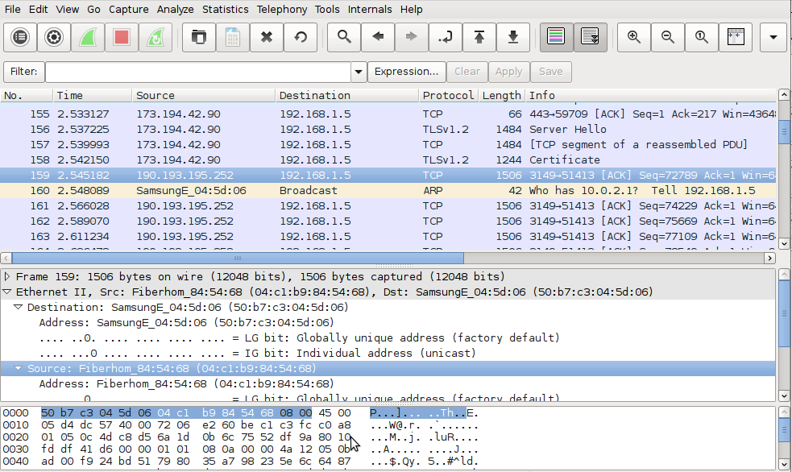
Dirección origen

Slide 13
ARP
betsyrc ~ # ping 192.168.1.111
PING 192.168.1.111 (192.168.1.111) 56(84) bytes of data.
64 bytes from 192.168.1.111: icmp_seq=2 ttl=64 time=0.690 ms
64 bytes from 192.168.1.111: icmp_seq=3 ttl=64 time=0.642 ms
64 bytes from 192.168.1.111: icmp_seq=4 ttl=64 time=0.728 ms
¿Quién tiene IP = 192.168.1.111?

Slide 14
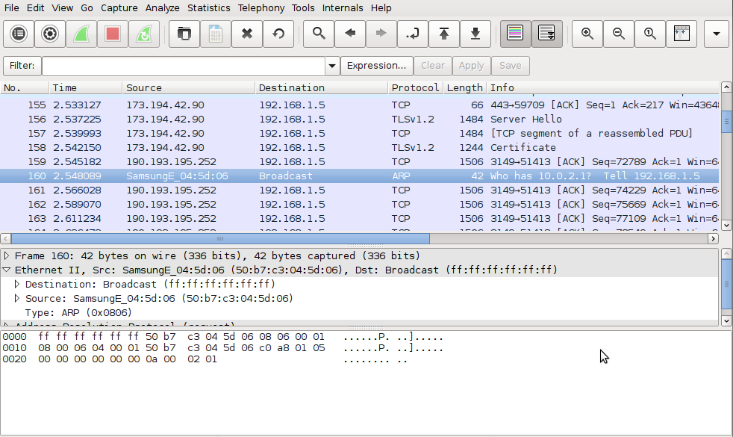
Broadcast

Slide 15
Bridges
A
B
C
D

Slide 16
Bridges: inundación
Destino
D
Origen
A
Tipo
2 B
Paquete IP
Entre 46 y 1500 bytes
A
B
C
D

Slide 17
Bridges: aprendizaje
A = 53:FF:82:01:22:15
A
B
C
D

Slide 18
Bridges: aprendizaje
A = 53:FF:82:01:22:15
D = 22:01:32:A1:BB:05
A
B
C
D

Slide 19
Bridges: aprendizaje
A = 53:FF:82:01:22:15
B = 33:FA:21:2B:C0:01
D = 22:01:32:A1:BB:05
C = 11:B1:C2:DD:11:54
A
B
C
D

Slide 20
Bridges: filtrado
A = 53:FF:82:01:22:15
B = 33:FA:21:2B:C0:01
D = 22:01:32:A1:BB:05
C = 11:B1:C2:DD:11:54
A
B
C
D

Slide 21
Bridges: broadcasts
Destino
FF:FF:FF:FF:FF:FF
Origen
A
Tipo
2 B
Paquete IP
Entre 46 y 1500 bytes
A
B
C
D

Slide 22
Switches: bridges multivía
A
B
C
D

Slide 23
Switches: bridges multivía
A = 53:FF:82:01:22:15
C = 11:B1:C2:DD:11:54
B = 33:FA:21:2B:C0:01
D = 22:01:32:A1:BB:05
A
B
C
D

Slide 24
Dominio de broadcast

Slide 25
Broadcast y routers

Slide 26
Broadcast y routers

