Slide 1
IST 782 Applied Portfolio
Francisco Franco Arenas

Slide 2
Introduction
This is a presentation about the final project of the course IST 782 Applied Portfolio.
3 projects presented:
Project 1: IST 719 Information Visualization: Poster on transitions from University to employment in Spain
Project 2: IST 718 Big Data: ML classifier of financial complaints
Project 3: IST 737 Visual Analytic Dashboards: Europe’s quality of life visualization dashboard
These 3 projects are the culmination of the learning objectives of the Applied Data Science program at Syracuse University.

Slide 3
About me
Francisco Franco Arenas
Industrial engineer with background in economics
Economist at the Ministry of Economic Affairs in Spain since 2019
Started the MS in Applied Data Science at Syracuse University in autumn 2023
Passionate about data analysis and visualization

Slide 4
Why Data Science?
Data science stands at the intersection of statistical analysis, computational techniques, and domain-specific knowledge, offering powerful tools for extracting meaningful insights from vast datasets.
As an economist at the Ministry of Economic Affairs in Spain, I recognized the transformative potential of data science to enhance decision-making and policy formulation.
Pursuing a Master of Science in Applied Data Science was a strategic decision to augment my expertise with advanced data analysis skills.
This program has equipped me with the ability to harness complex data, apply sophisticated machine learning algorithms, and develop predictive models, thereby improving my capacity to analyze economic trends, evaluate policies, and make data-driven recommendations.

Slide 5
Learning Objectives
The main learning goals of the program are as follows:
Collect, store, and access data by identifying and leveraging applicable technologies
Create actionable insight across a range of contexts (e.g. societal, business, political), using data and the full data science life cycle
Apply visualization and predictive models to help generate actionable insight
Use programming languages such as R and Python to support the generation of actionable insight
Communicate insights gained via visualization and analytics to a broad range of audiences (including project sponsors and technical team leads)
Apply ethics in the development, use and evaluation of data and predictive models (e.g., fairness, bias, transparency, privacy)
The projects presented in this paper demonstrate how I have met these learning objectives.

Slide 6
Project 1: IST 719 Information Visualization: Poster on transitions from University to employment in Spain
Objective: Create a poster that visualizes the transitions from University to employment in Spain.
Dataset: University Placement Survey of Spain
Tools: R, ggplot2, Adobe Illustrator
Techniques: Alluvial plot, Ridgeline plot, Cleveland dot plot, etc.
Learning: Advanced visualization techniques, effective data communication

Slide 7
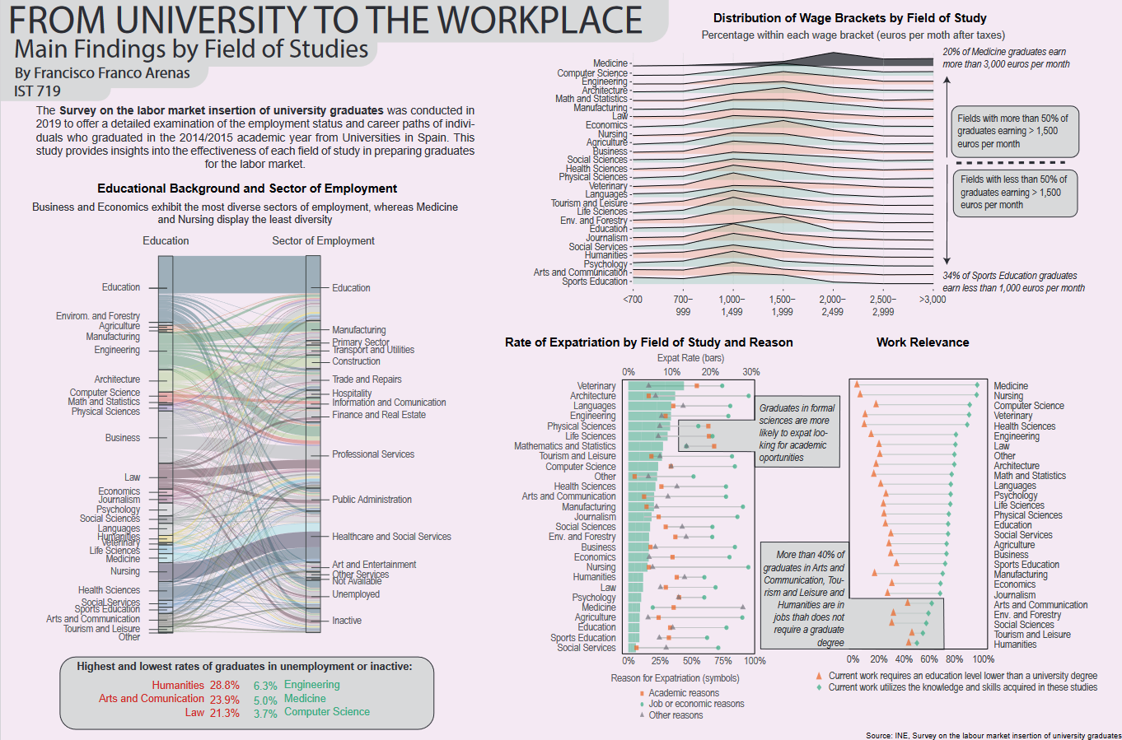

Slide 8
Project 2: IST 718 Big Data: ML classifier of financial complaints
Objective: Develop a machine learning classifier to predict the outcome of financial complaints.
Dataset: Consumer Financial Protection Bureau (CFPB) complaints
Tools: PySpark, Google Colab
Techniques: Text preprocessing, feature extraction, machine learning
Learning: Big data processing, machine learning on large datasets, text classification

Slide 9


Overview: problems and objectives
Problems:
Financial consumer complaint texts are
1) of large volume,
2) unstructured,
3) inefficient for manual processing.
Objectives: to better understand consumer financial issues and improve complaint handling
Understand consumer financial issues
Improve complaint handling
Analyze the complaint data to identify key pain points and issues consumers face with financial services
Leverage insights from complaint analysis to improve complaint resolution processes

Slide 10
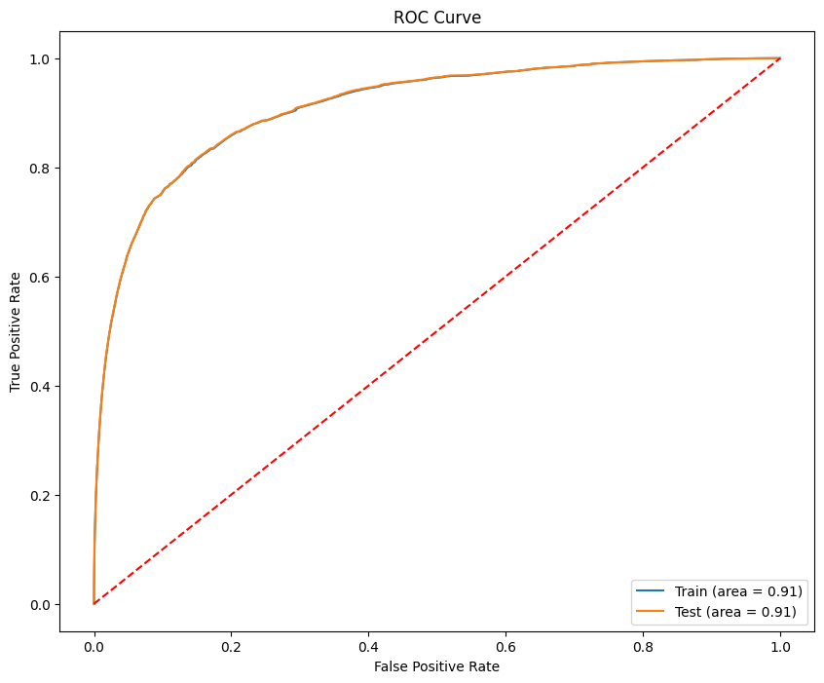
First stage - binary classification
Train ROC AUC: 0.9108343913287731
Test ROC AUC: 0.911446990344491
Confusion Matrix:
[[184582. 2443.]
[ 60407. 40769.]]
For the Majority Class (0):
Recall: 0.9869
Specificity: 0.9869
For the Minority Class (1):
Recall: 0.4029
specificity: 0.9434

Slide 11
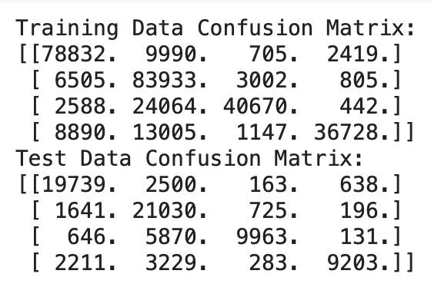
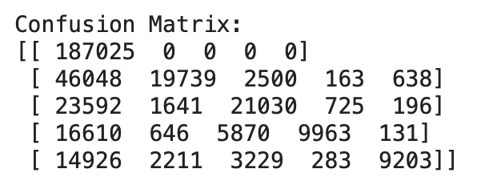
second stage classification
Overall results
Train F1 Score: 0.763486814657958
Test F1 Score: 0.7645873783466283
Total F1 Score: 0.6276493957707988

Slide 12
Project 3: IST 737 Visual Analytic Dashboards: Europe’s quality of life visualization dashboard
Objective: Develop an interactive dashboard to visualize the quality of life in the European Union.
Dataset: Eurostat data on quality of life indicators
Tools: Tableau, R
Techniques: Data collection, data preparation, interactive dashboard design
Learning: Data visualization, interactive dashboards, storytelling with data

Slide 13
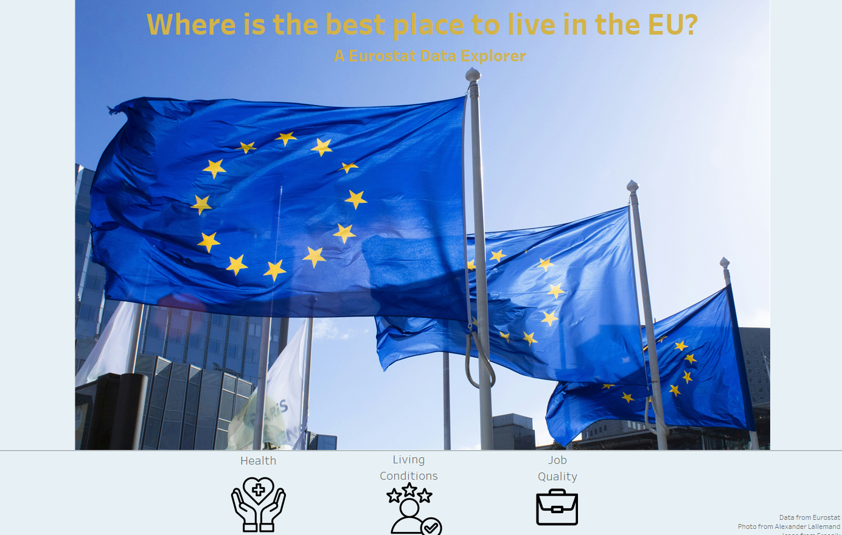

Slide 14
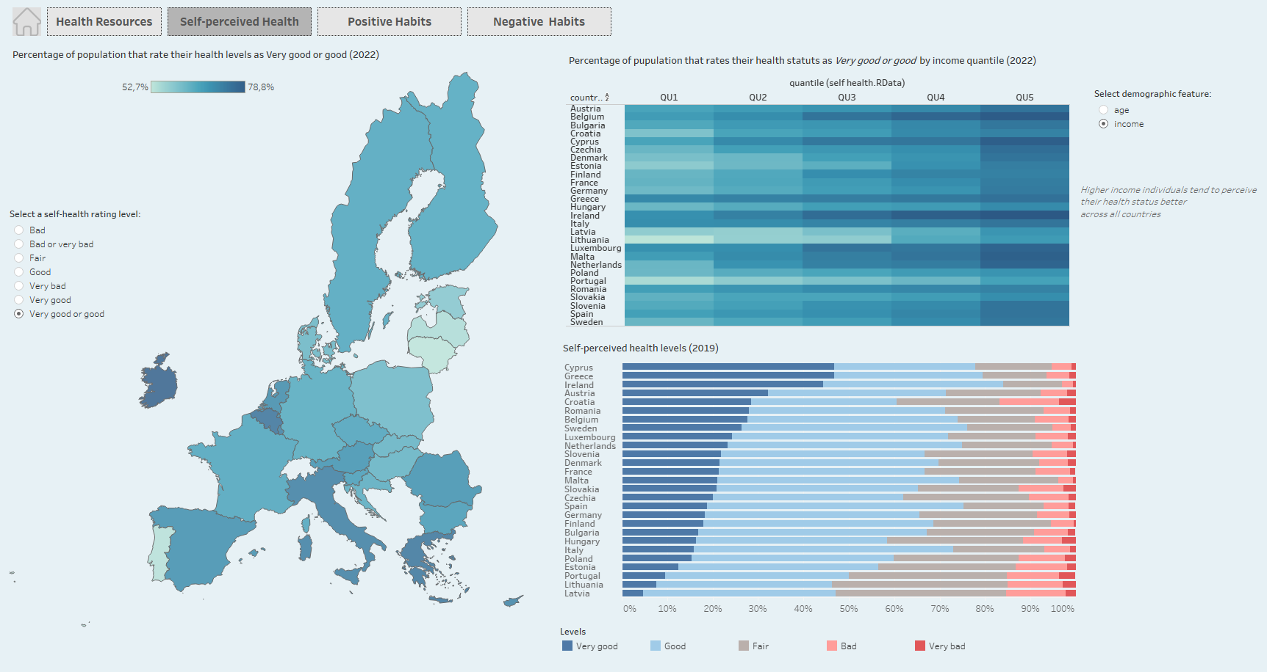

Slide 15
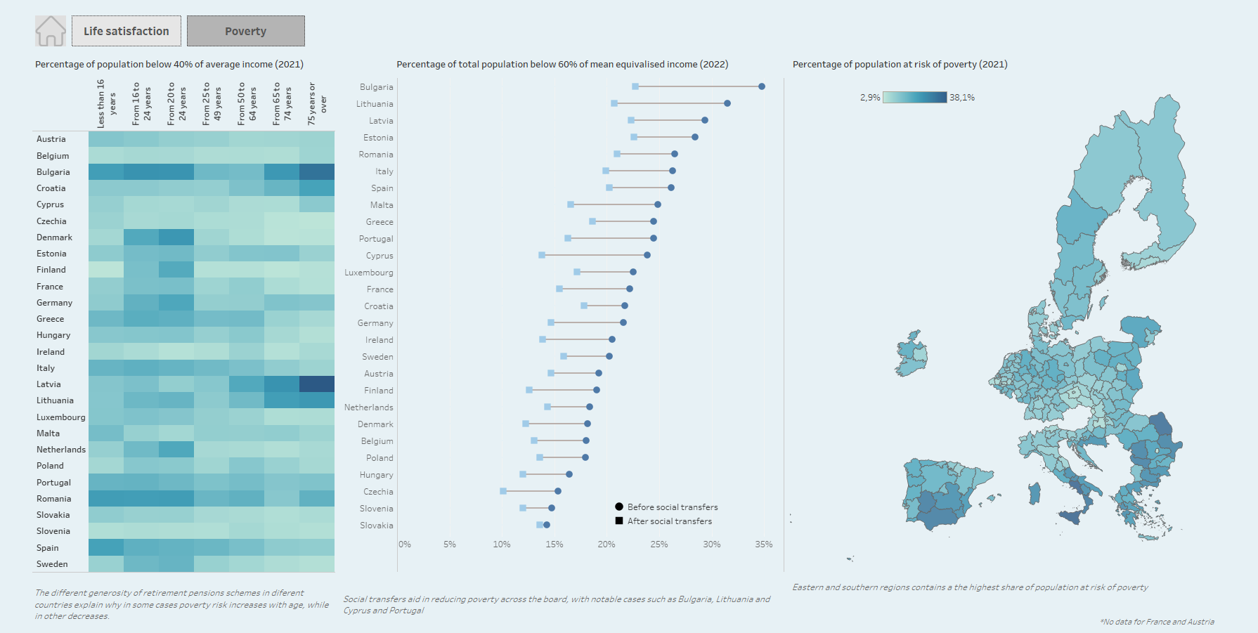

Slide 16
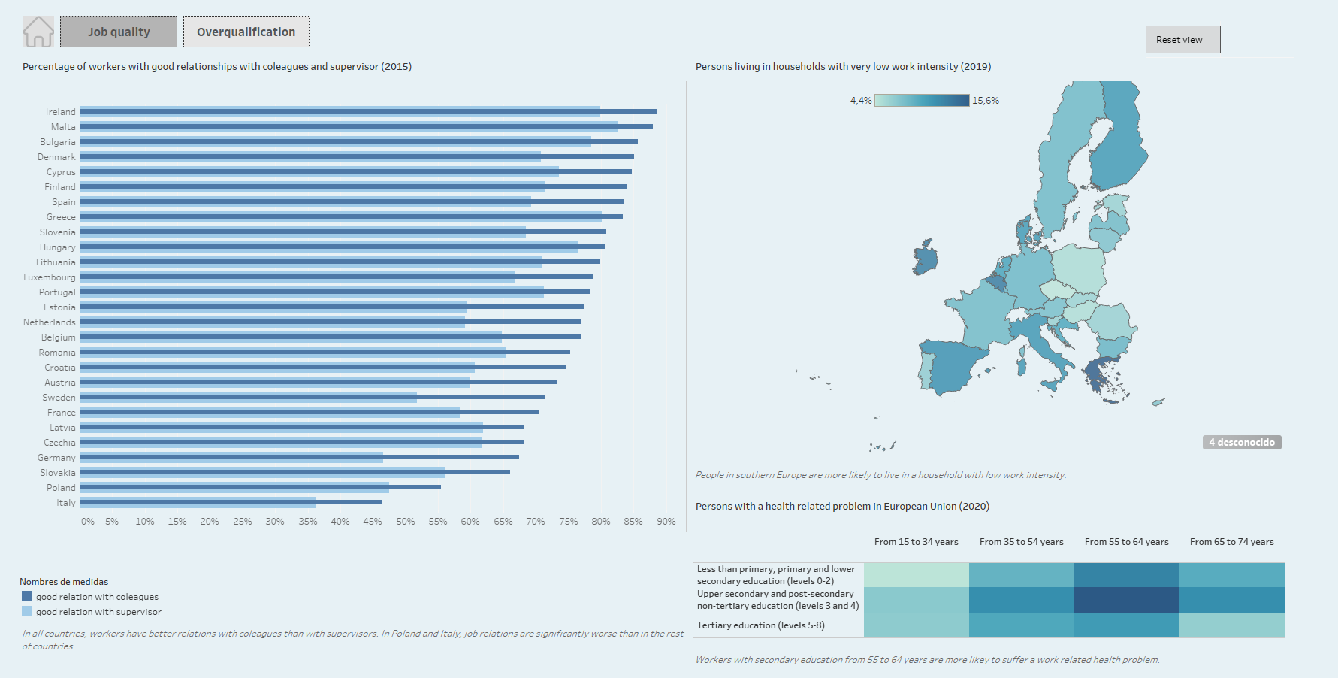

Slide 17
Conclusion
The projects presented in this paper demonstrate my ability to collect, analyze, and visualize data to generate actionable insights.
Through these projects, I have developed a diverse set of skills, including data collection, data cleaning, data analysis, machine learning, and data visualization.-
I have also honed my ability to communicate complex data insights to a broad range of audiences, using a variety of visualization techniques and tools.
The projects have provided me with a solid foundation in data science and have equipped me with the skills necessary to succeed in a data-driven world.

