Slide 1
SOFTWARE QUALITY EVALUATION

Slide 2
Requirements
Selection of the dataset from the e-learning pages: ant-1.7.csv
Selection of the dependent variable: software faultiness, i.e., the presence of at least one fault in a module
Selection of the independent variables: select four variables in the dataset
Visualization of the dataset via diagrams for single variables (e.g., histograms, pie charts) and diagrams for pairs of variables (e.g., scatterplots)
Computation of descriptive statistics for the dependent and the independent variables
Selection of one or more data analysis techniques
Building of a set of univariate and multivariate statistically significant models.
a. Make sure that their assumptions are satisfied, otherwise carry out outlier analysis and removal
b. Whenever possible, use both parametric (e.g., Pearson's correlation coefficient) and nonparametric (e.g., Spearman's rho, Kendall's tau) techniques
Description of the results obtained and the limitation to their use (e.g., threats to validity)
Notes:
QuickStarter has created an outline to help you get started on your presentation. Some slides include information here in the notes to provide additional topics for you to research.

Slide 3
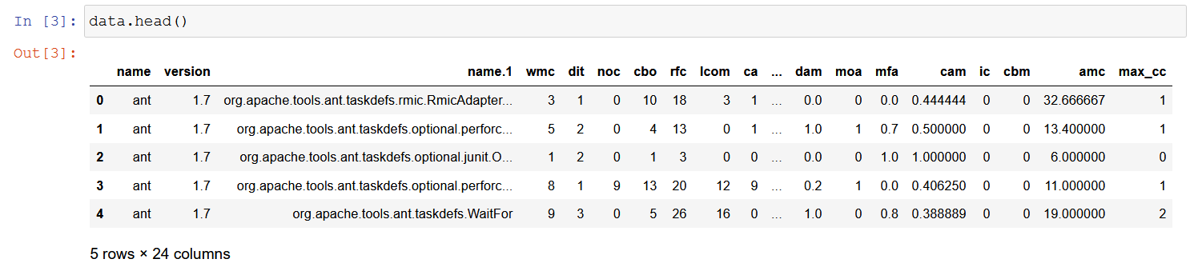
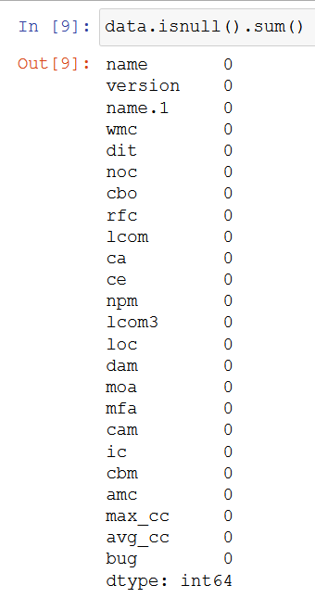


Understand the data

Slide 4
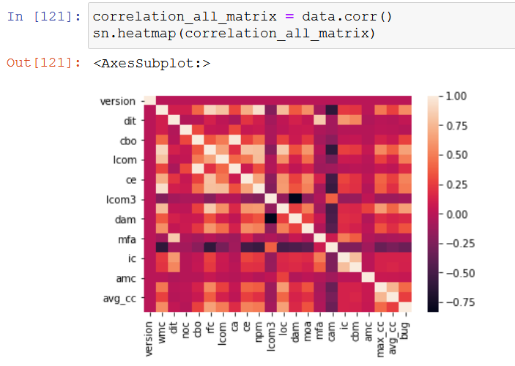
Selection of the independent variables

Slide 5
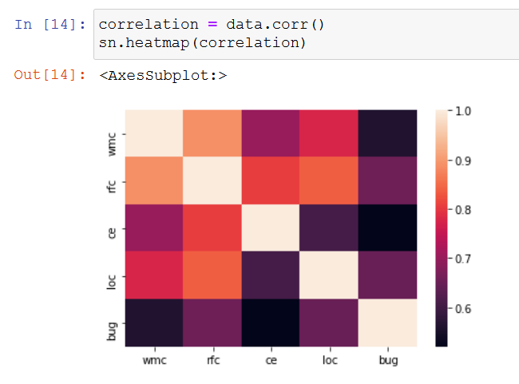
Drop columns

Slide 6
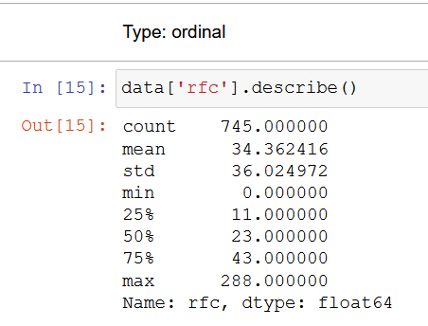
RFC
Response For a Class (RFC)
cardinality of the set of methods that can potentially be executed in response to a message received by an object of the class

Slide 7
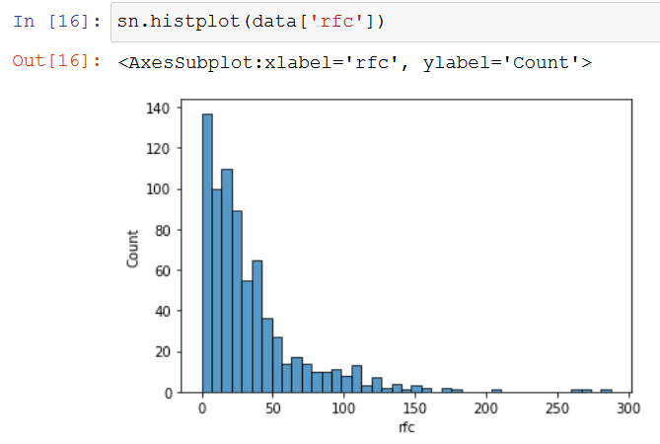
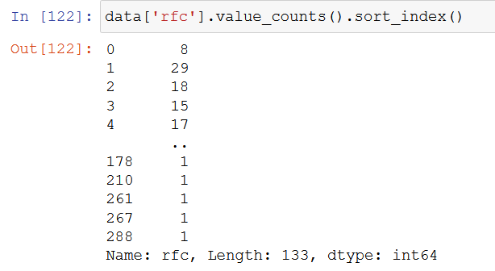
histogram

Slide 8
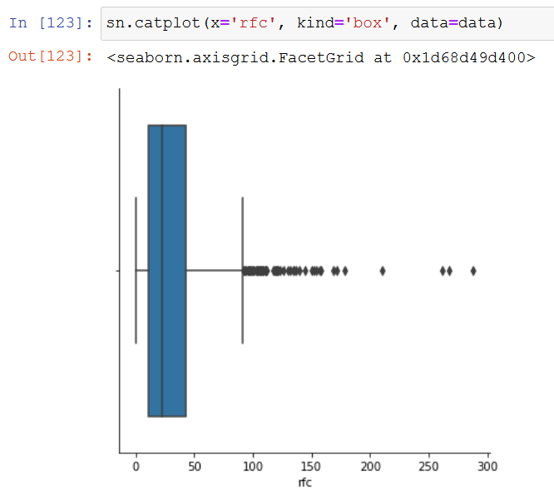
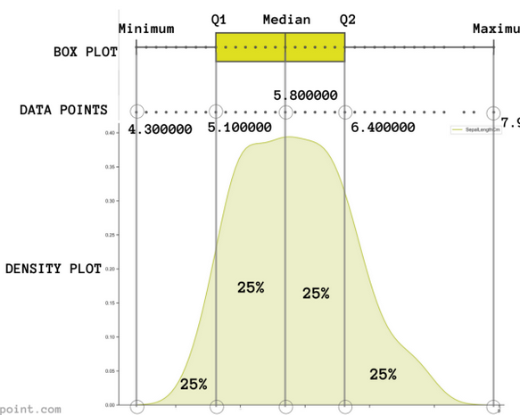
Box Plot

Slide 9
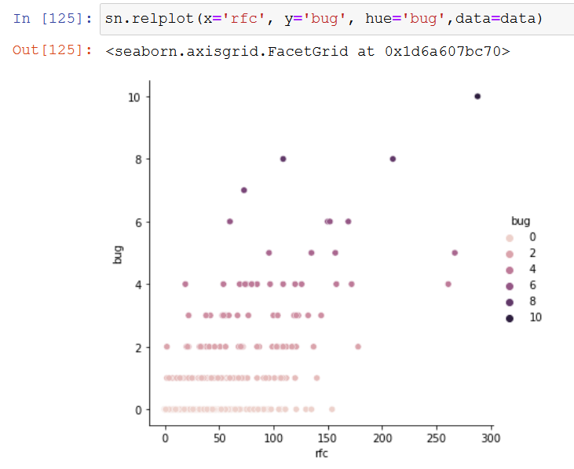
Scatterplots

Slide 10
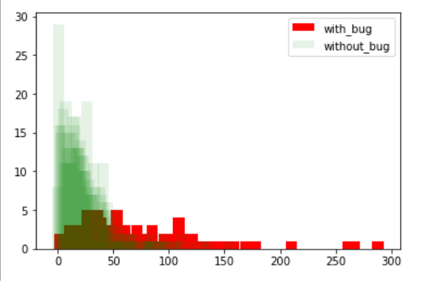
Bar

Slide 11
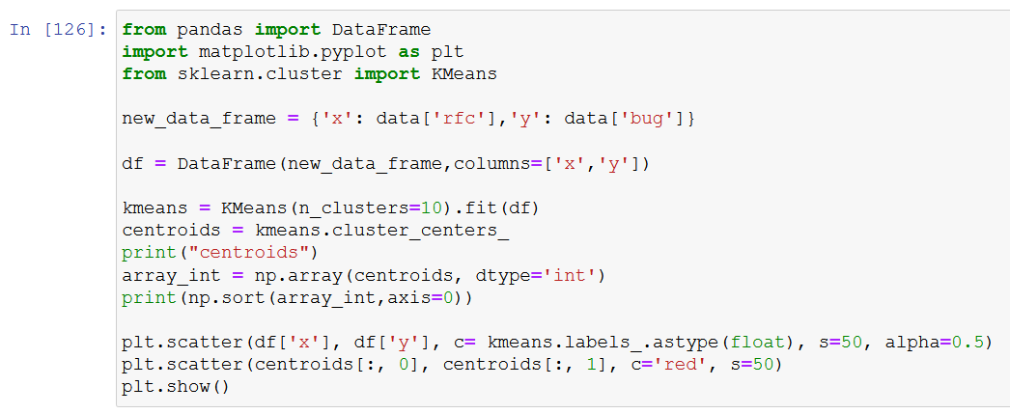
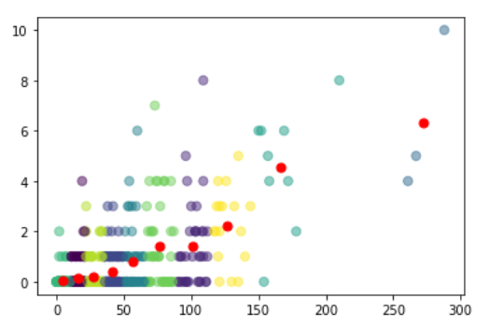
KMeans

Slide 12
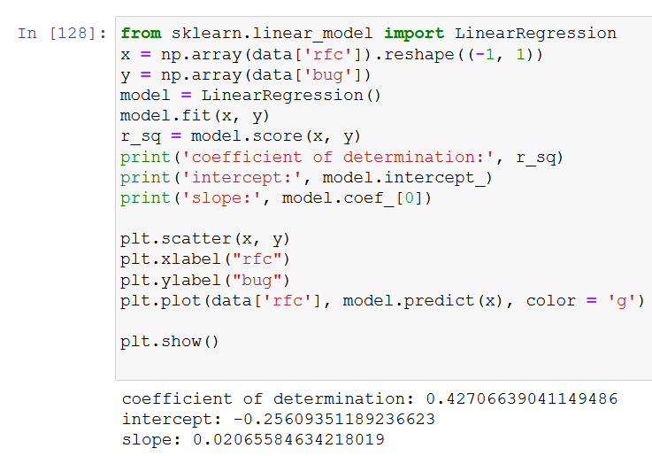
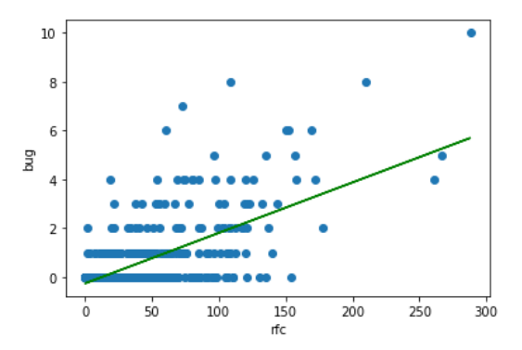
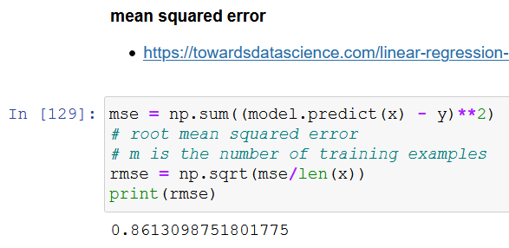
Linear Regression

Slide 13
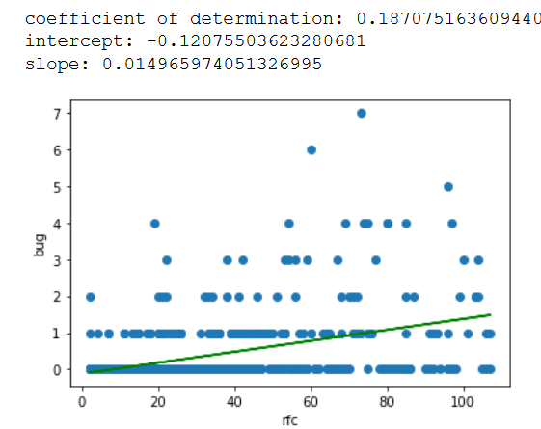
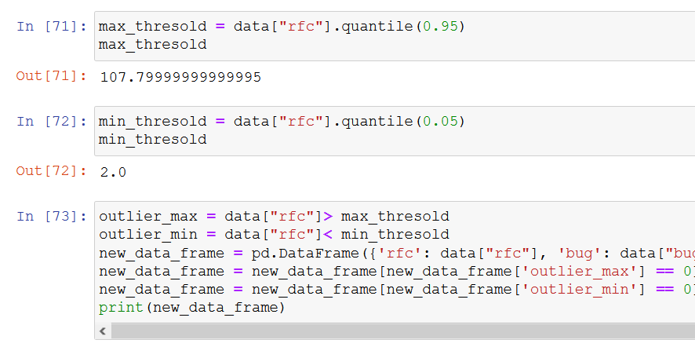
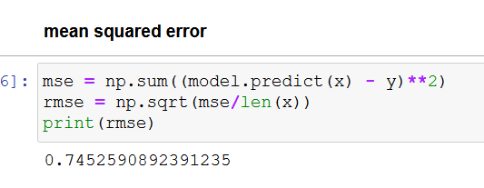
Outlier detection - percentile

Slide 14
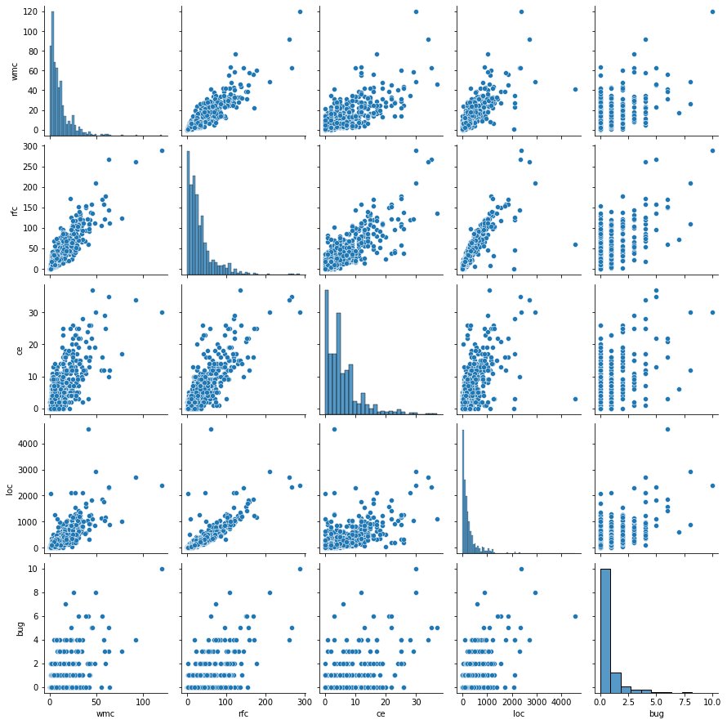
pairplot

Slide 15
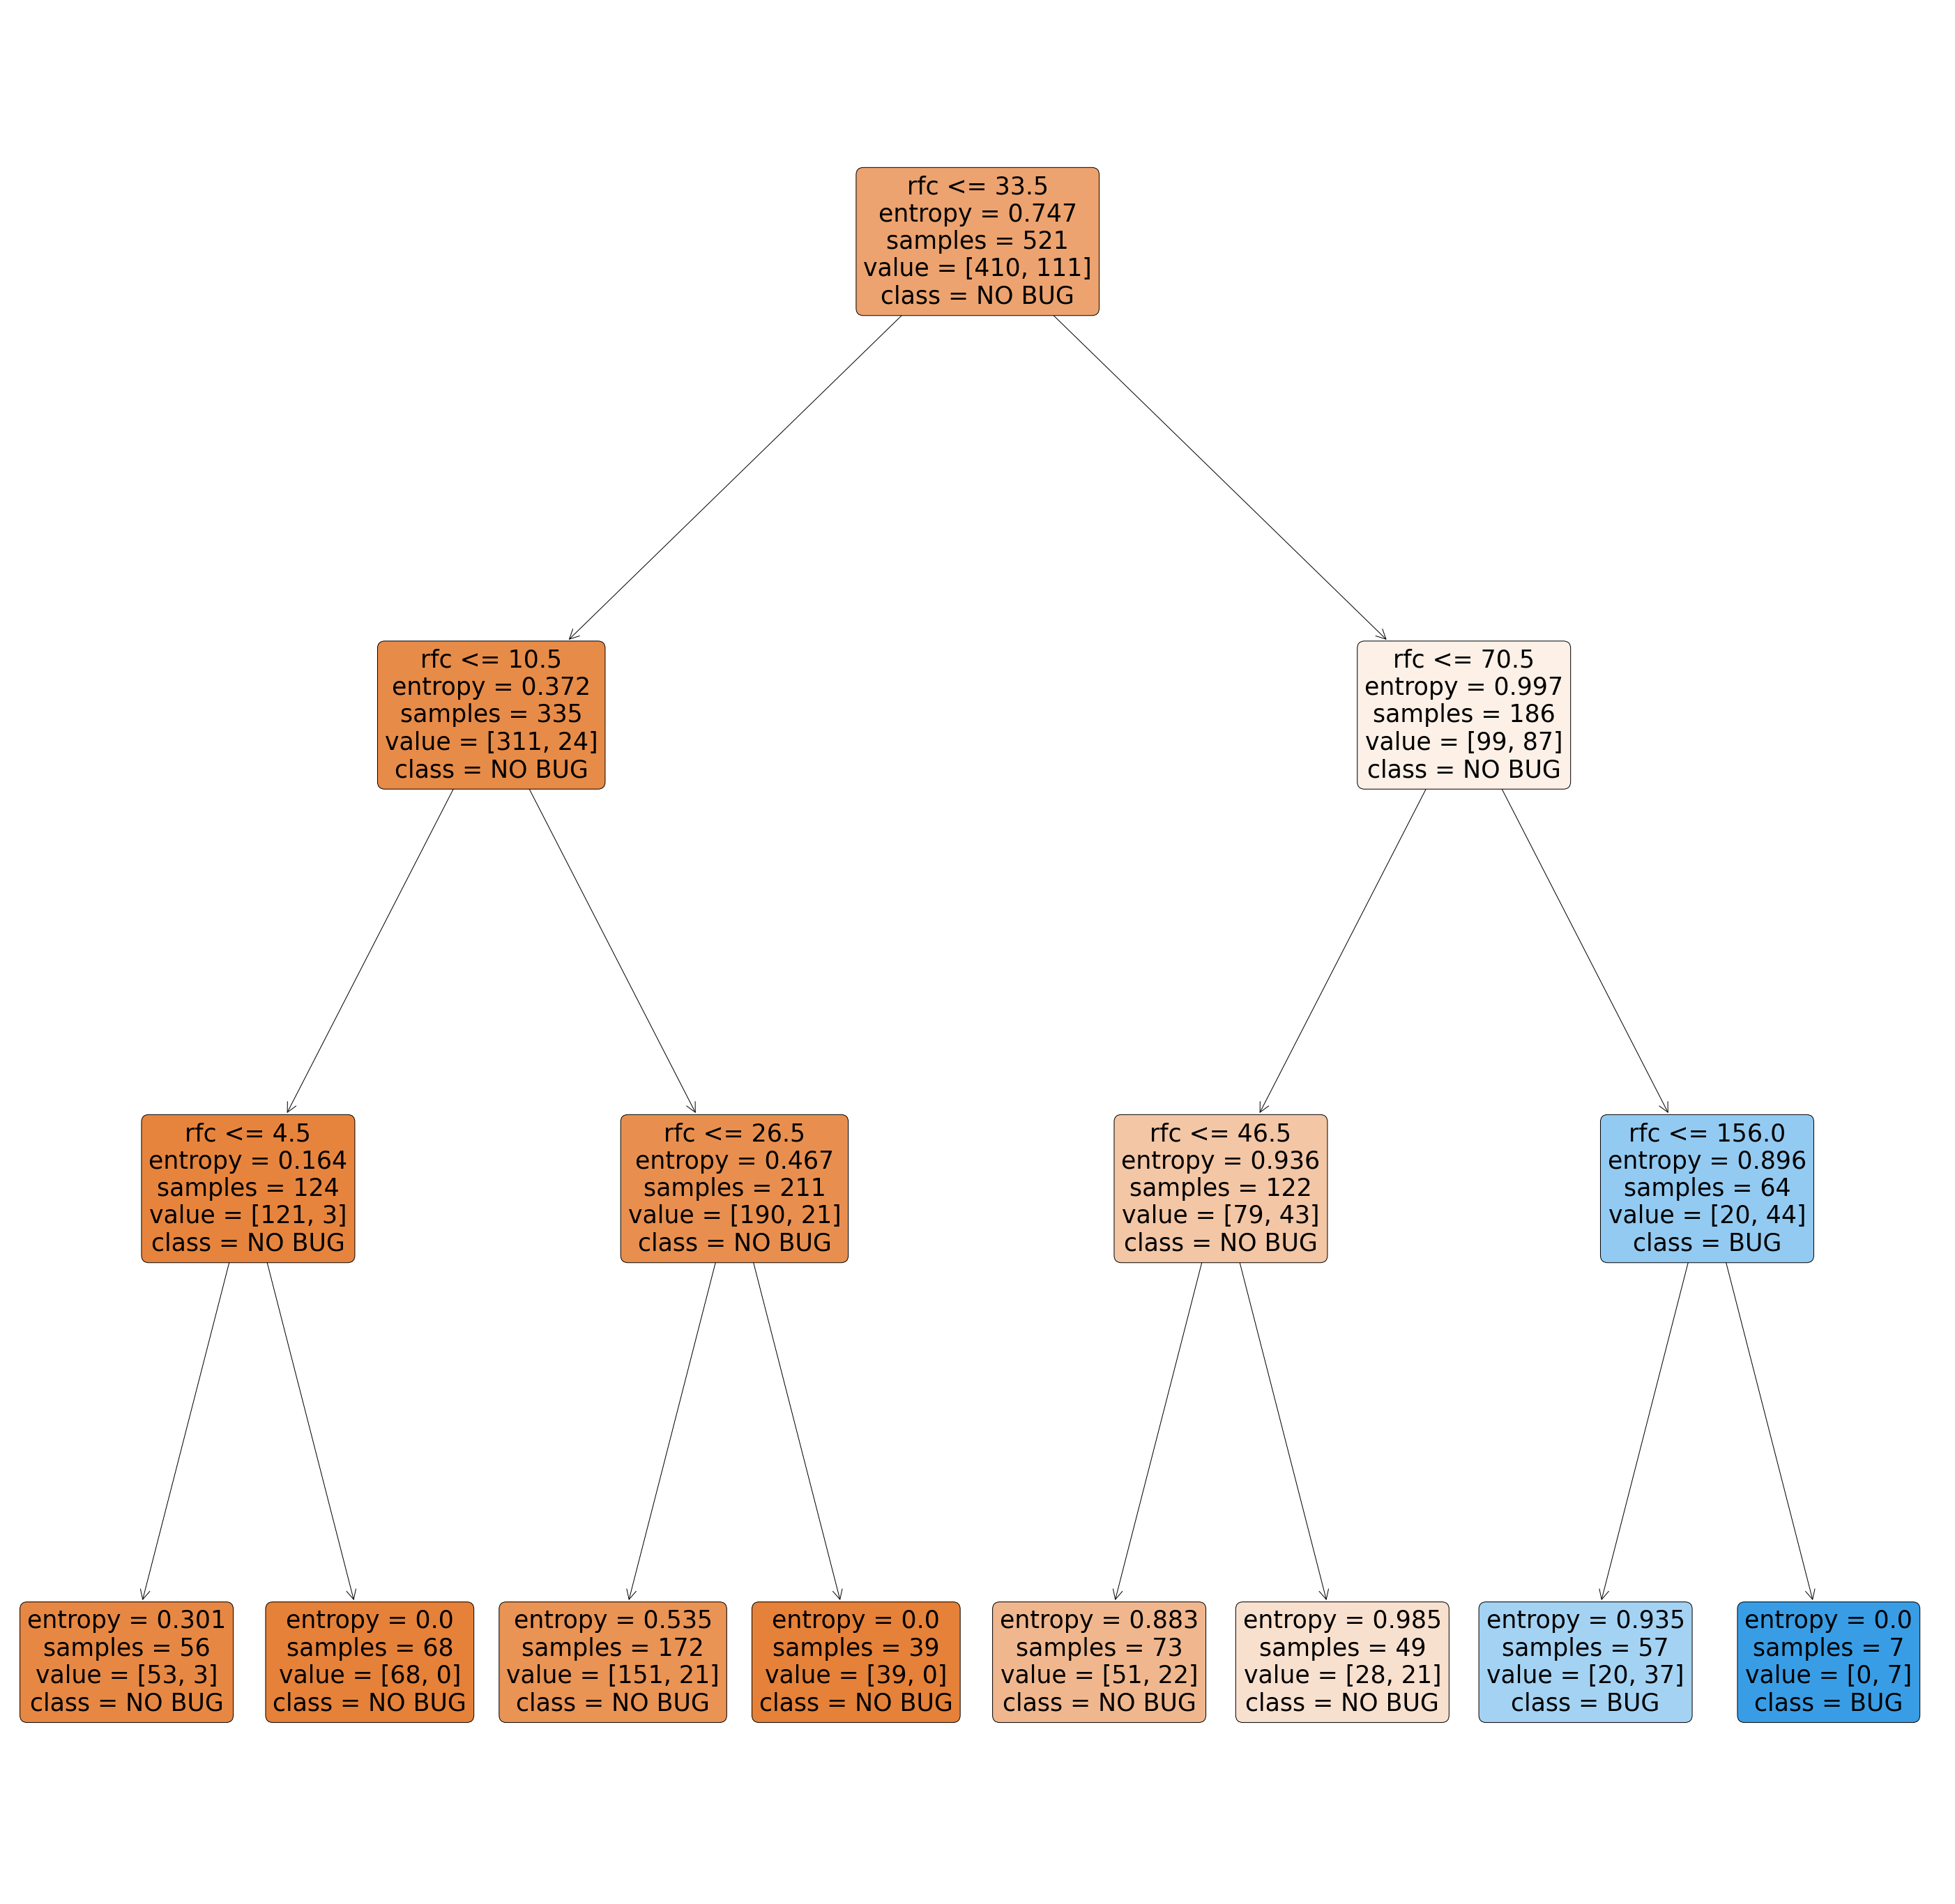
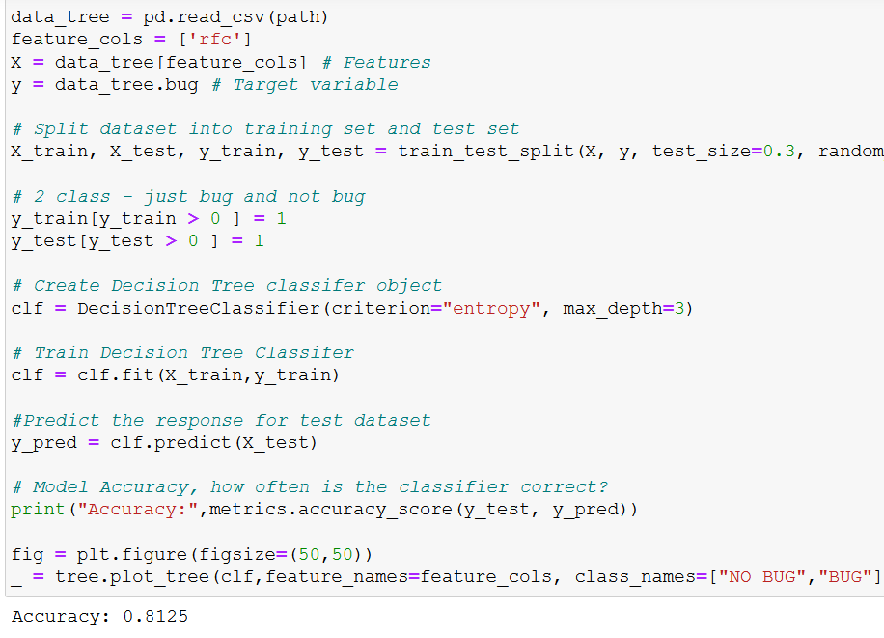
Decision Tree Classifier Building – 1 features max depth=3

Slide 16
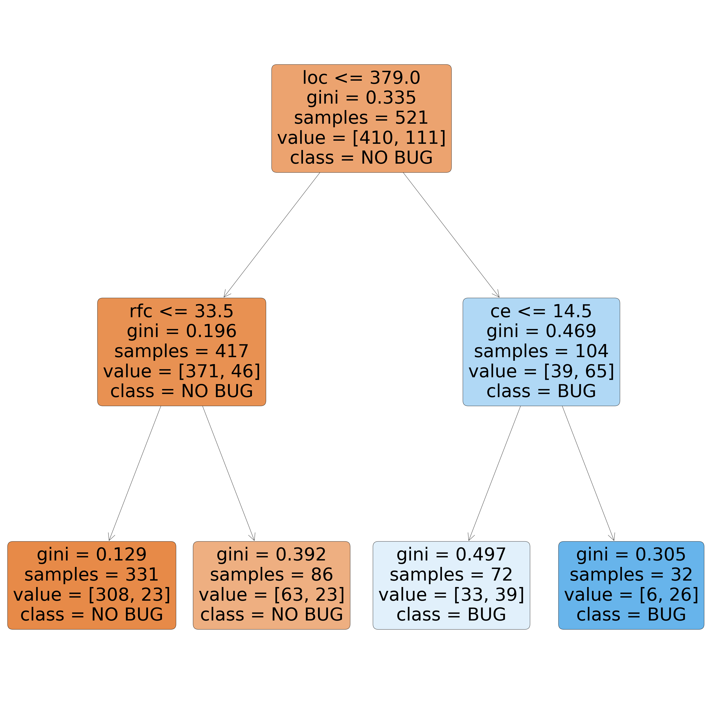
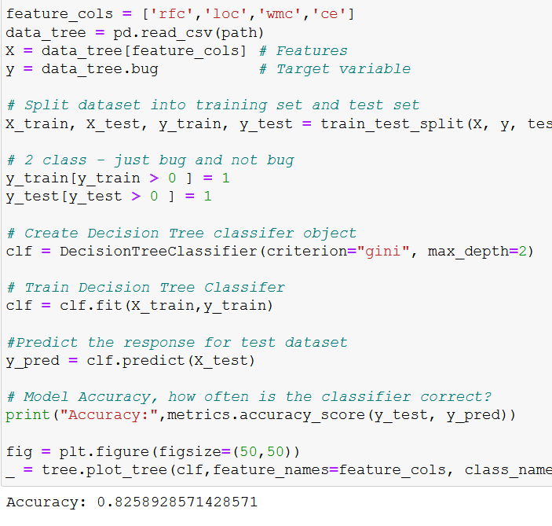
Decision Tree Classifier Building – 1 features max depth=2

Slide 17
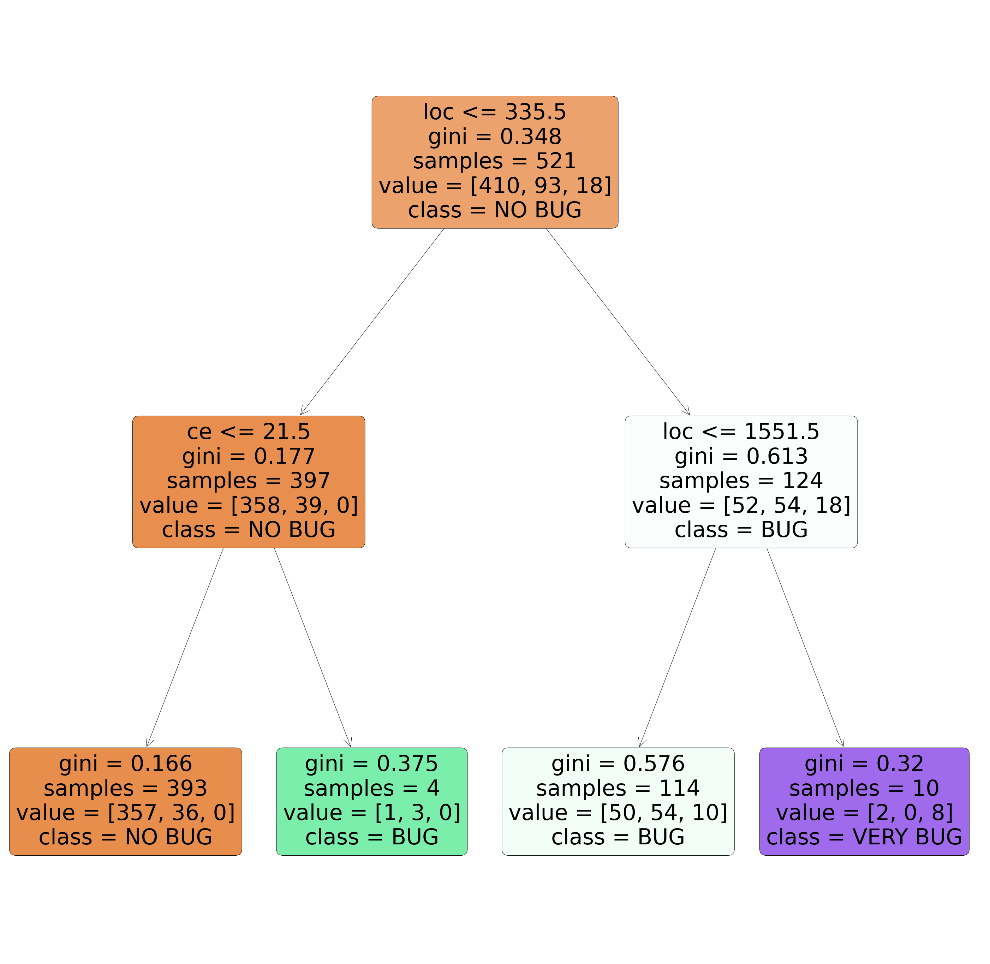
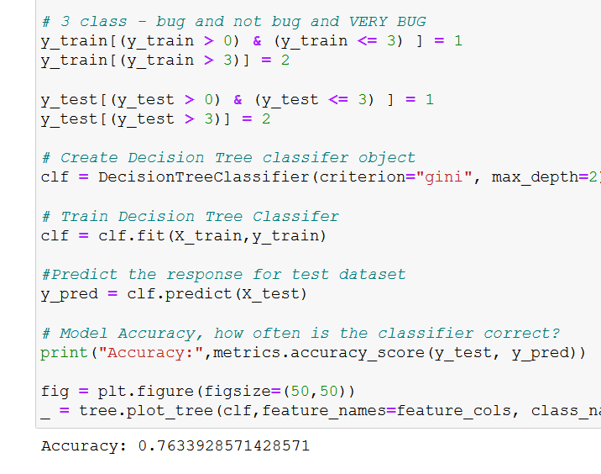
Decision Tree Classifier Building features= 4, max depth=2, classified=3

Slide 18
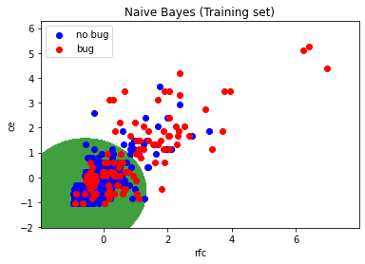
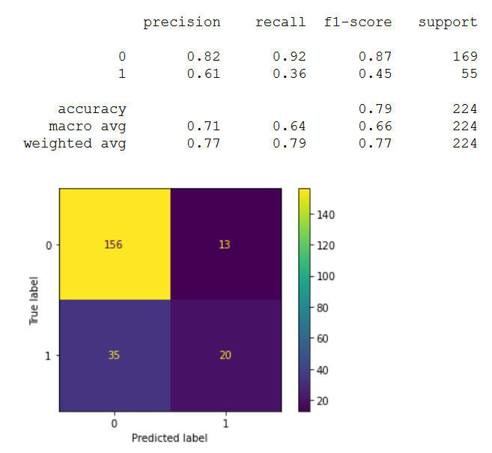
Naive Bayes

Slide 19
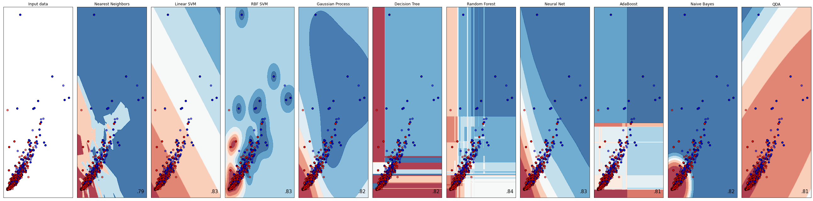
Classifier comparison

