Slide 1
SOFTWARE QUALITY EVALUATION

Slide 2
Requirements
Selection of the dataset from the e-learning pages: ant-1.7.csv
Selection of the dependent variable: software faultiness, i.e., the presence of at least one fault in a module
Selection of the independent variables: select four variables in the dataset
Visualization of the dataset via diagrams for single variables (e.g., histograms, pie charts) and diagrams for pairs of variables (e.g., scatterplots)
Computation of descriptive statistics for the dependent and the independent variables
Selection of one or more data analysis techniques
Building of a set of univariate and multivariate statistically significant models.
a. Make sure that their assumptions are satisfied, otherwise carry out outlier analysis and removal
b. Whenever possible, use both parametric (e.g., Pearson's correlation coefficient) and nonparametric (e.g., Spearman's rho, Kendall's tau) techniques
Description of the results obtained and the limitation to their use (e.g., threats to validity)
Notes:
QuickStarter has created an outline to help you get started on your presentation. Some slides include information here in the notes to provide additional topics for you to research.

Slide 3
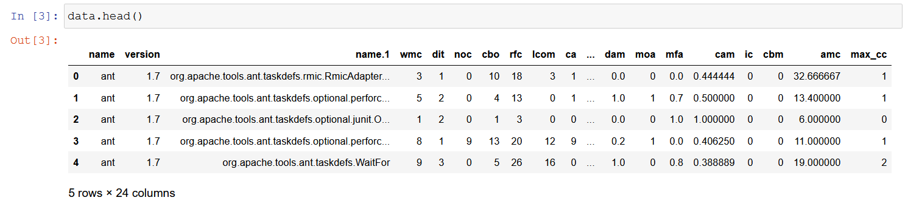
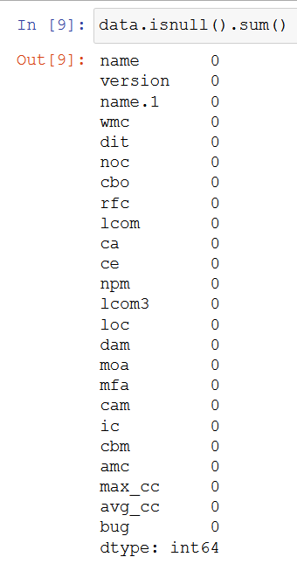


Understand the data

Slide 4
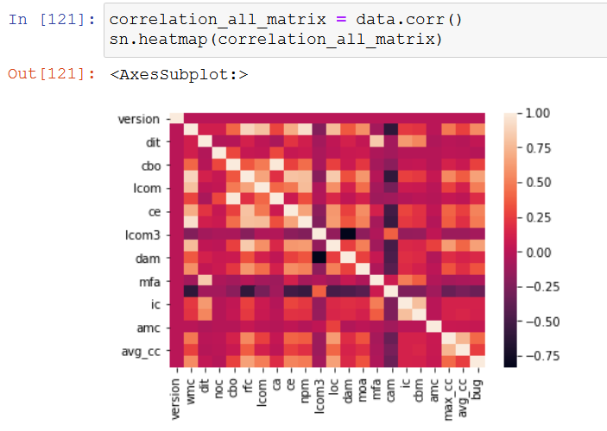
Selection of the independent variables

Slide 5
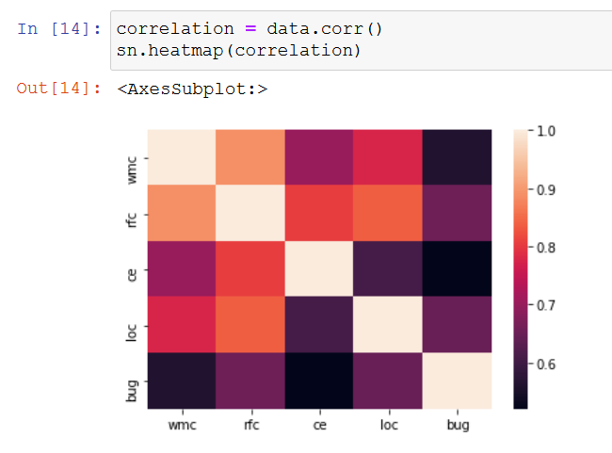
Drop columns
Response For a Class (RFC) cardinality of the set of methods that can potentially be executed in response to a message received by an object of the class
EF -> measures the number of data types a class knows about. This includes inheritance, interface implementation, parameter types, variable types, and exceptions. Type: ordinal
Source lines of code (LOC) is a software metric used to measure the size of a computer program by counting the number of lines in the text of the program's source code Type: ordinal
Weighted Methods per Class (WMC) sum of the complexities of the methods of the class Type: ordinal

Slide 6
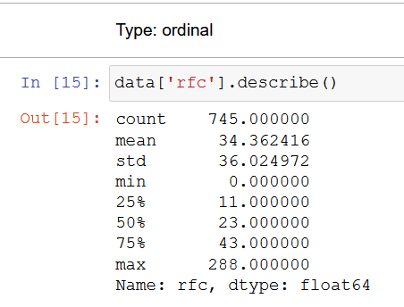
RFC
Response For a Class (RFC)
cardinality of the set of methods that can potentially be executed in response to a message received by an object of the class

Slide 7
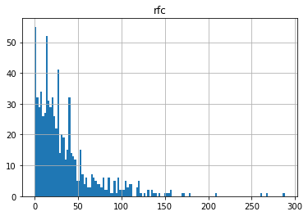
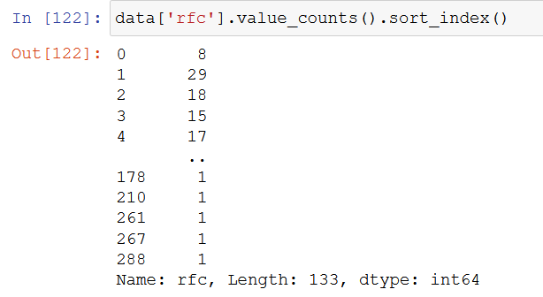
histogram
A histogram is an approximate representation of the distribution of numerical data.

Slide 8
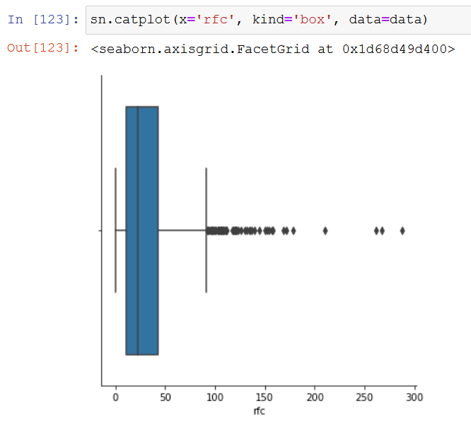
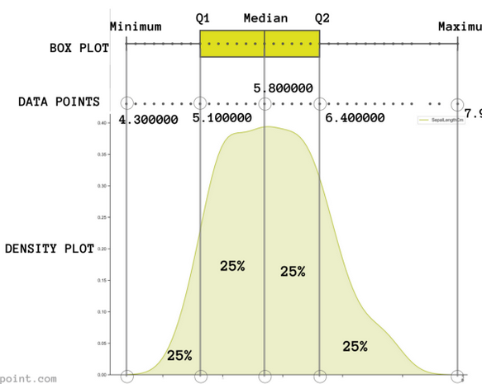
Box Plot

Slide 9
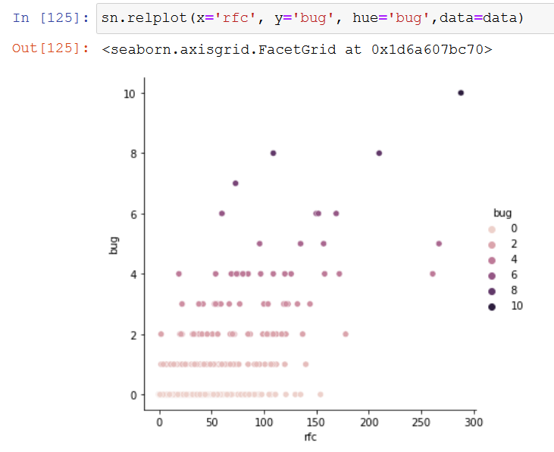
Scatterplots

Slide 10
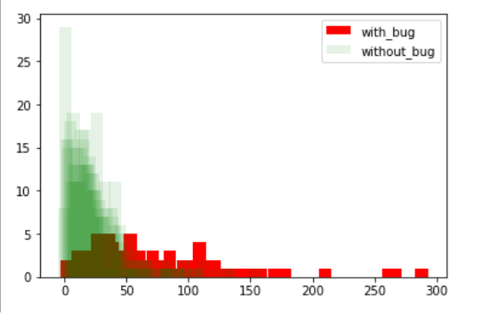
Bar

Slide 11
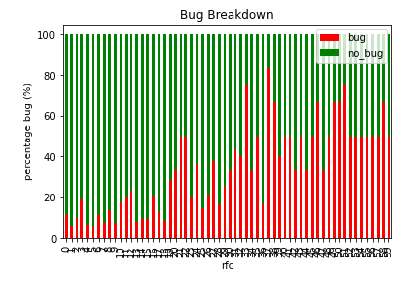
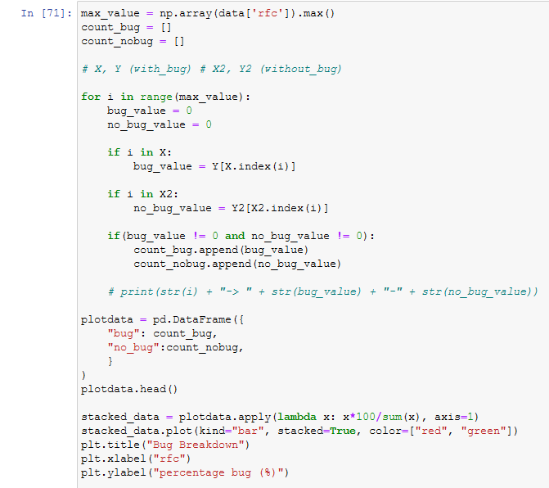
Stacked bar plots

Slide 12
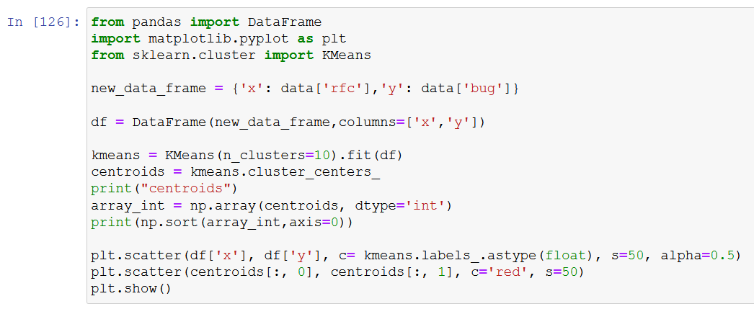
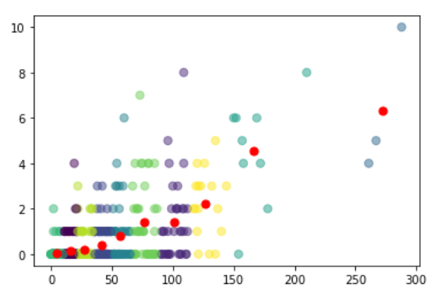
KMeans

Slide 13
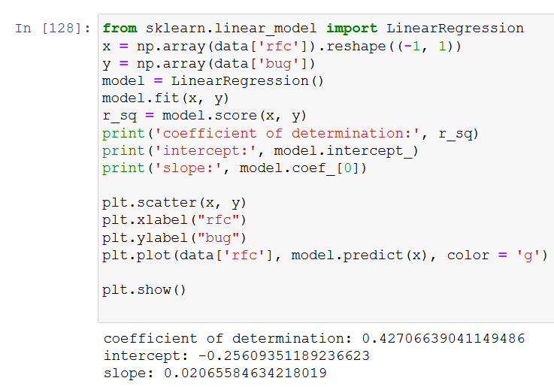
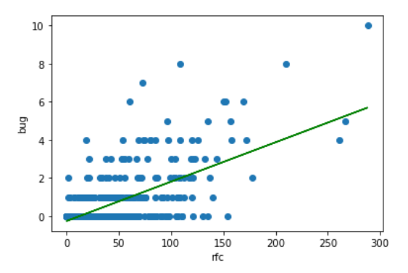
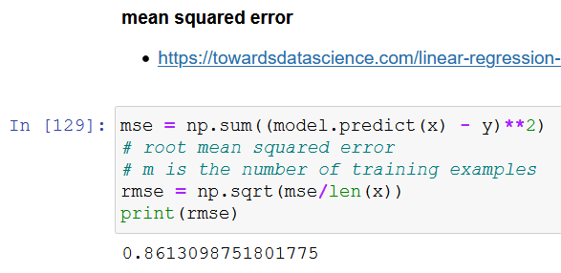
Linear Regression

Slide 14
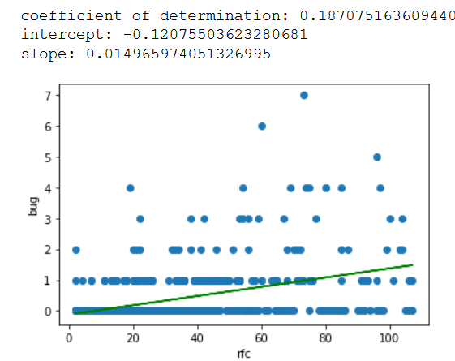
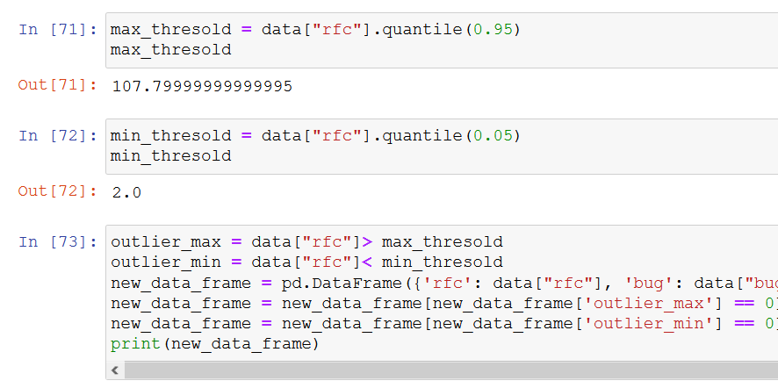
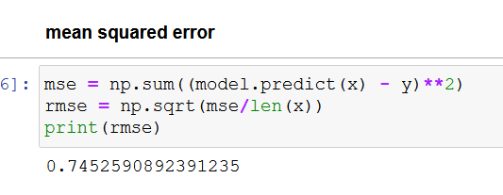
Outlier detection - percentile

Slide 15
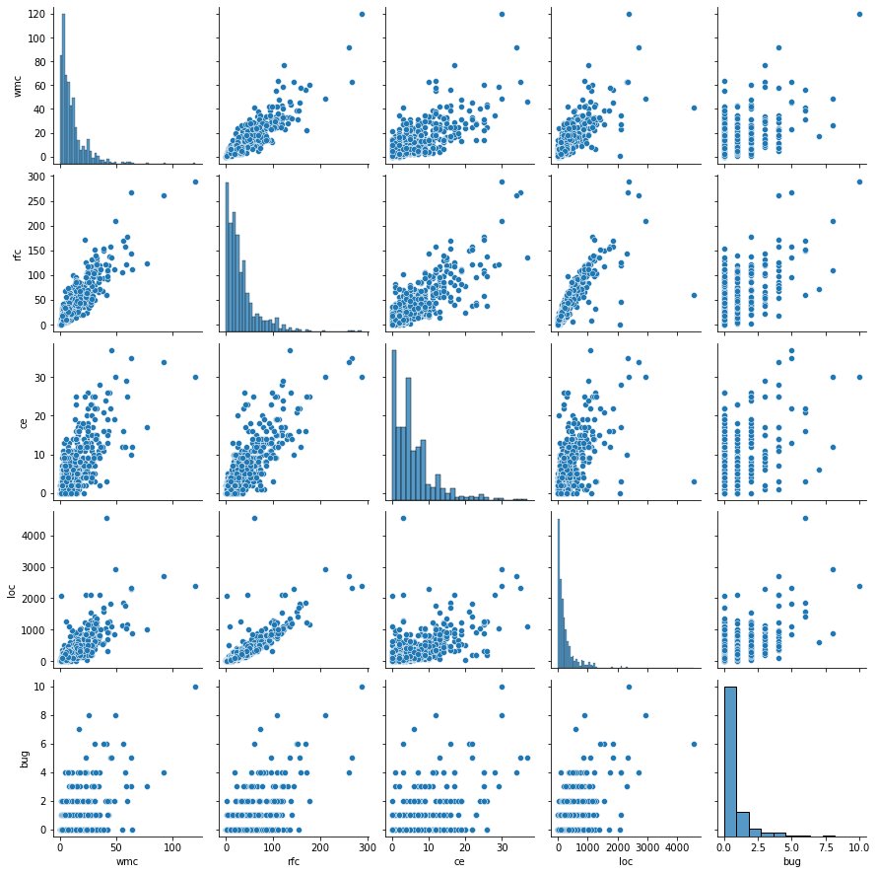
pairplot

Slide 16
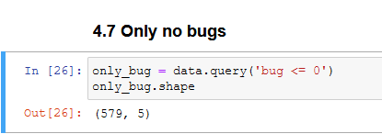
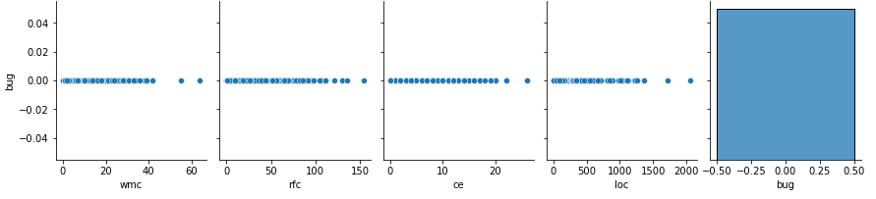
Only no bugs

Slide 17
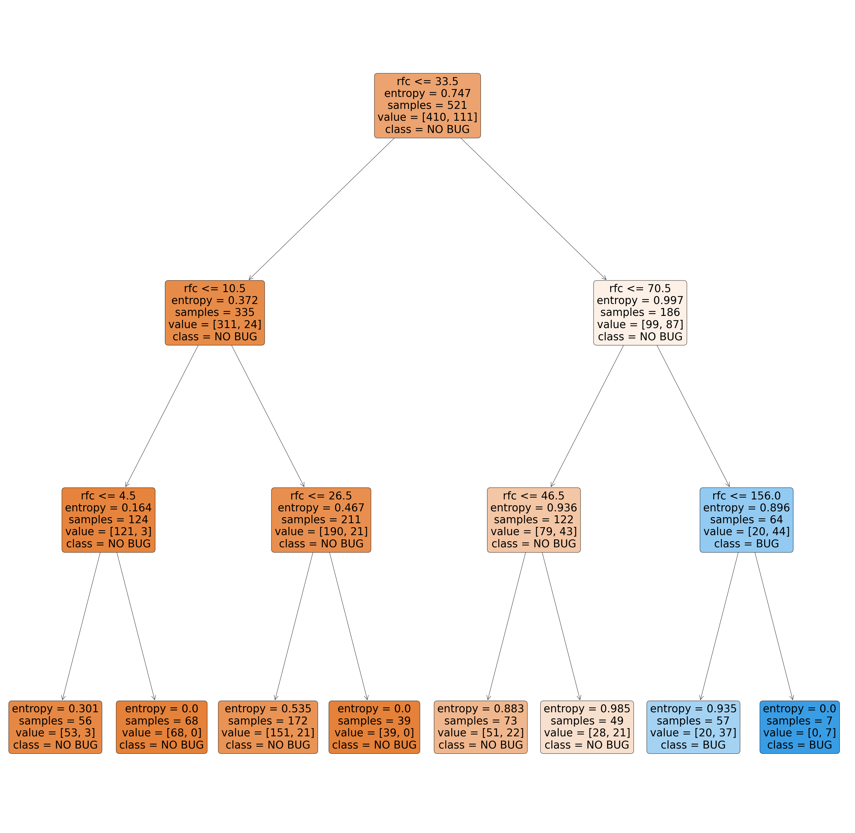
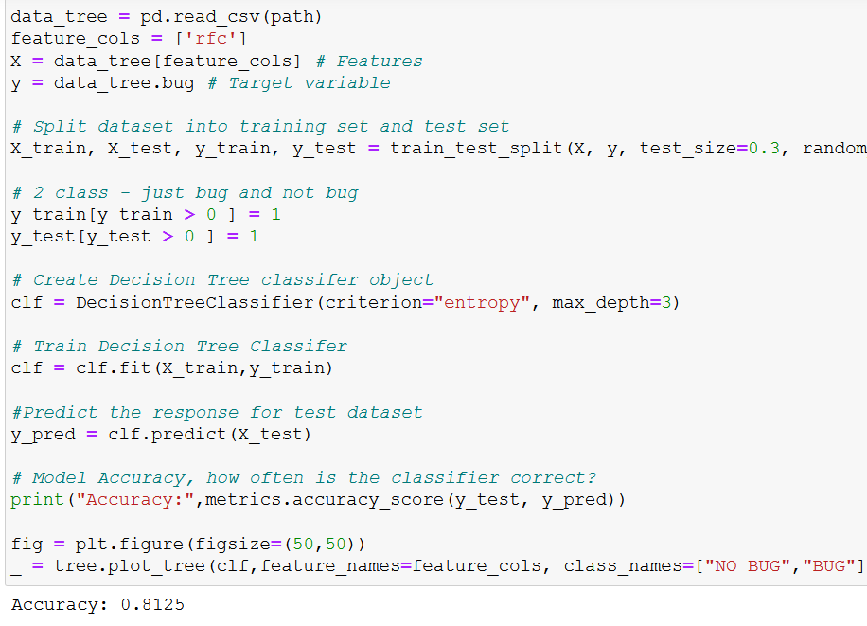
Decision Tree Classifier Building – 1 features max depth=3

Slide 18
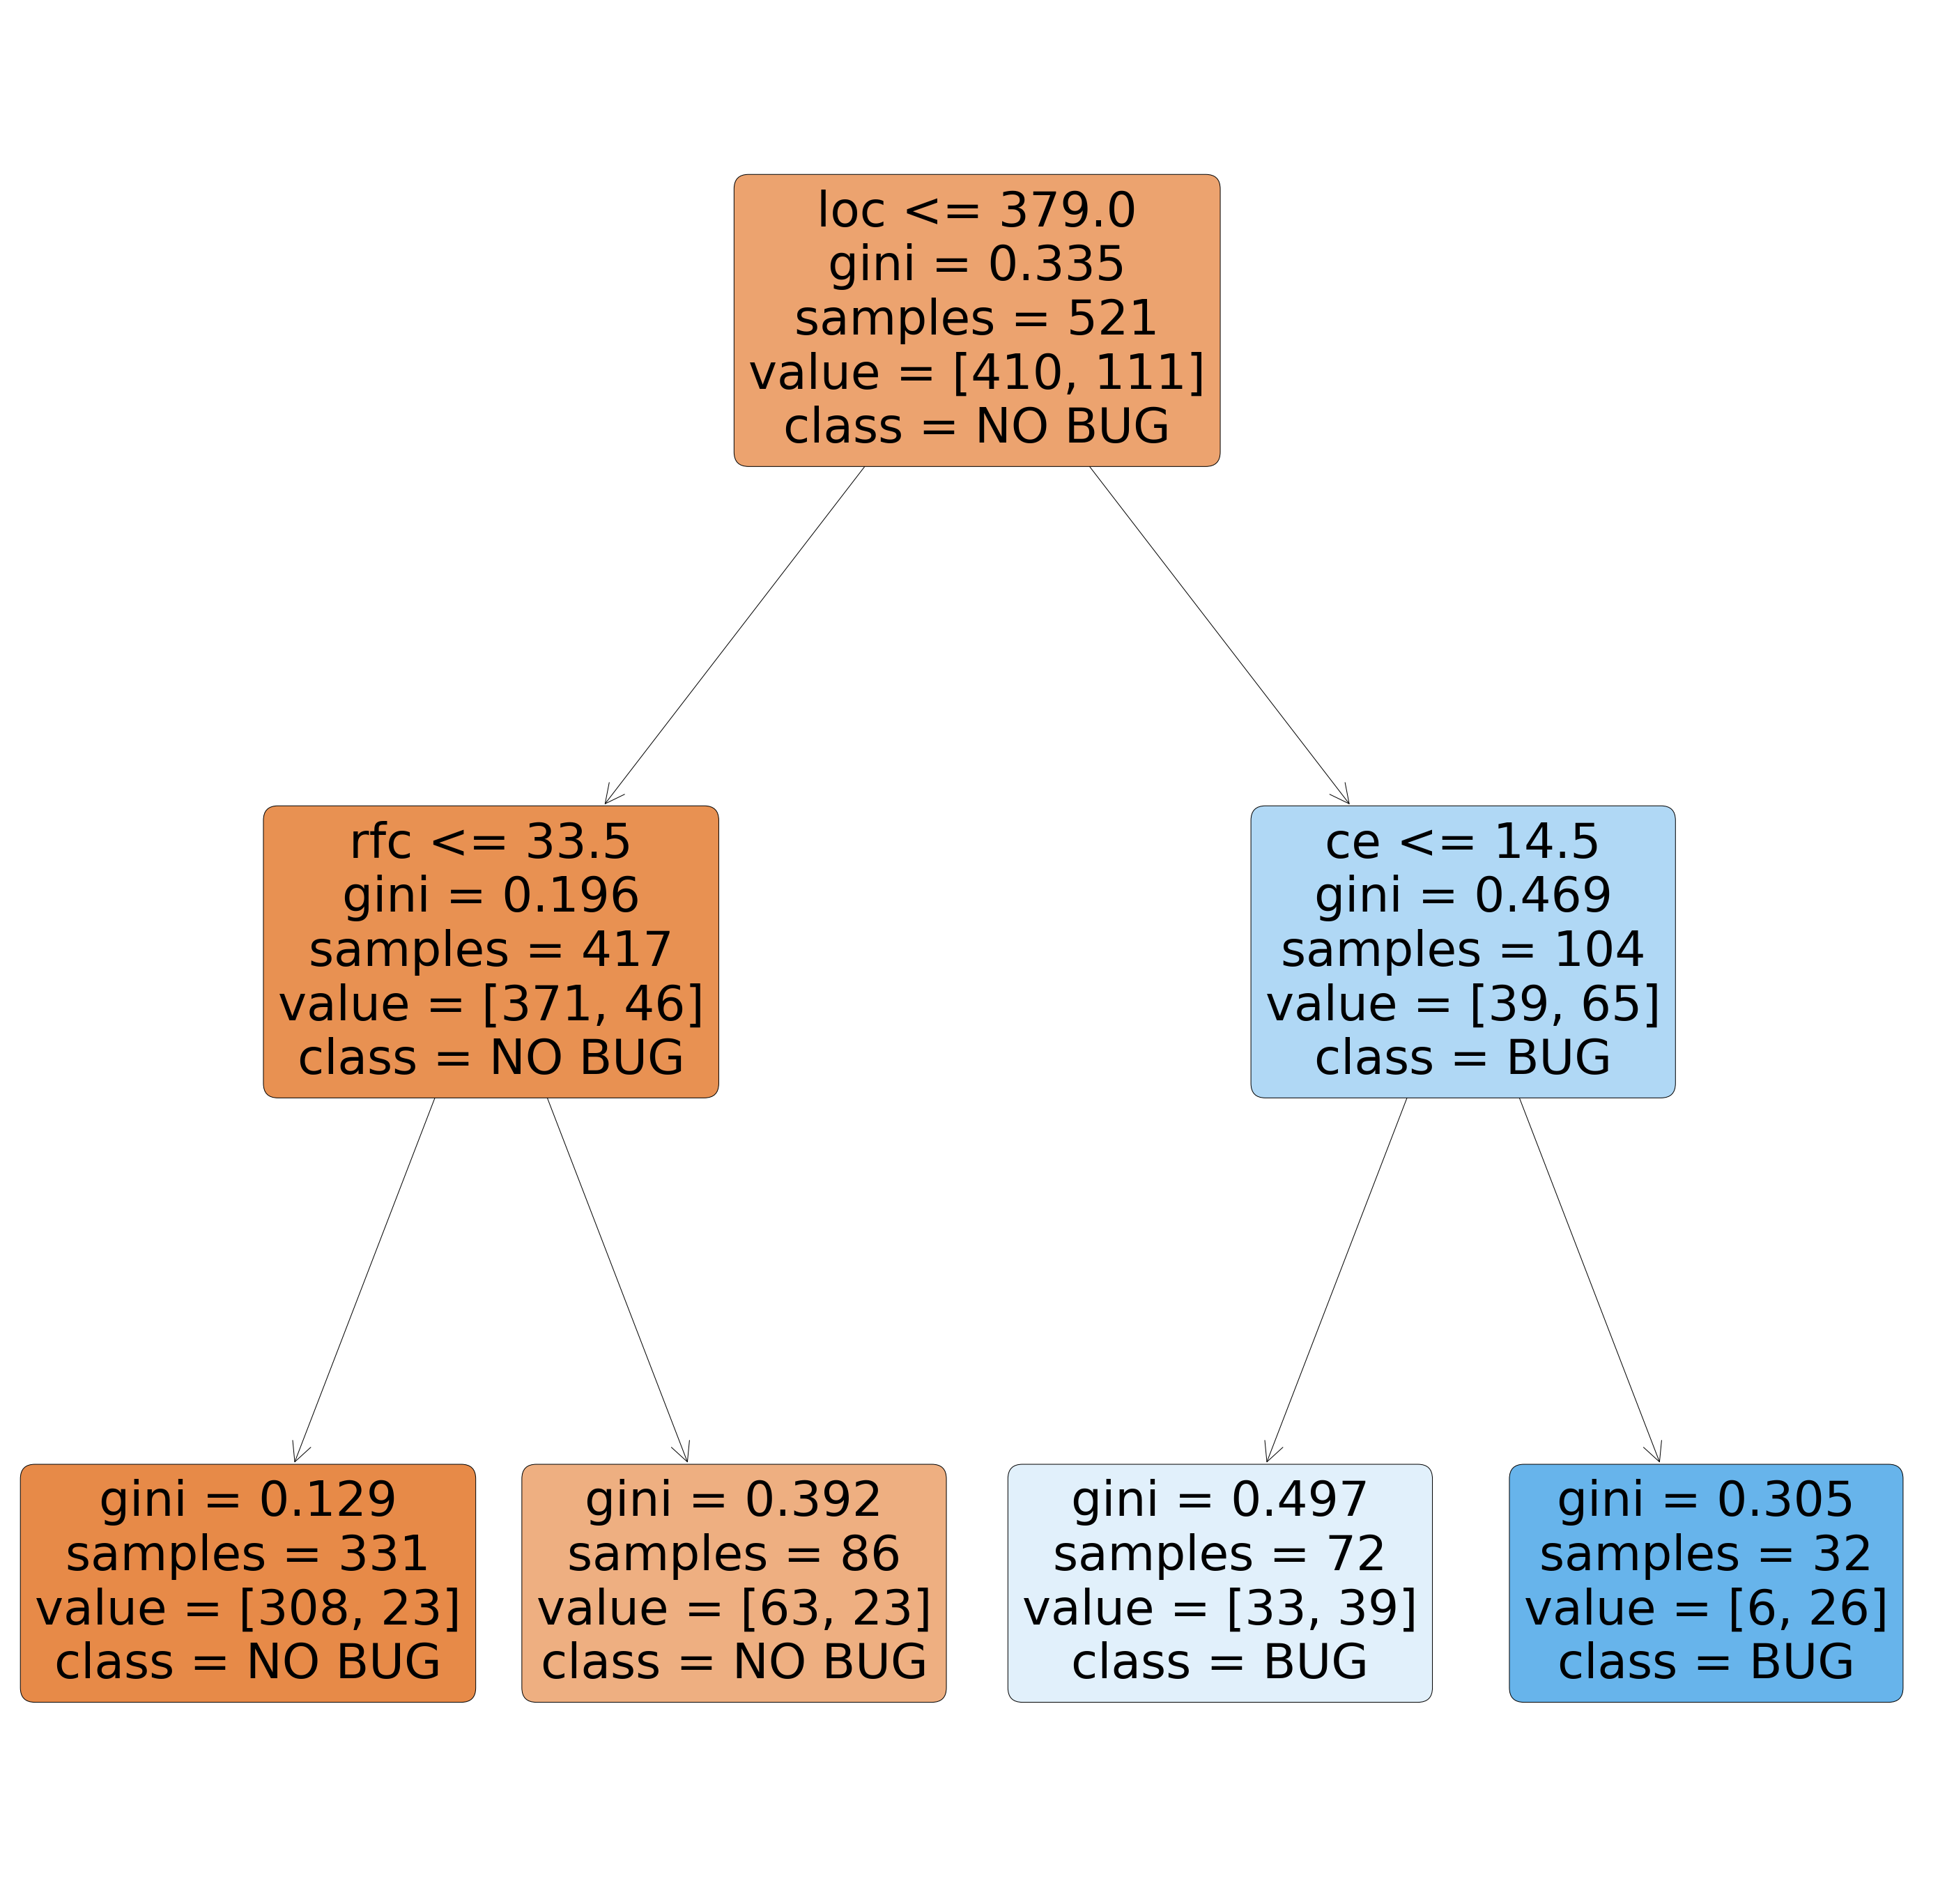
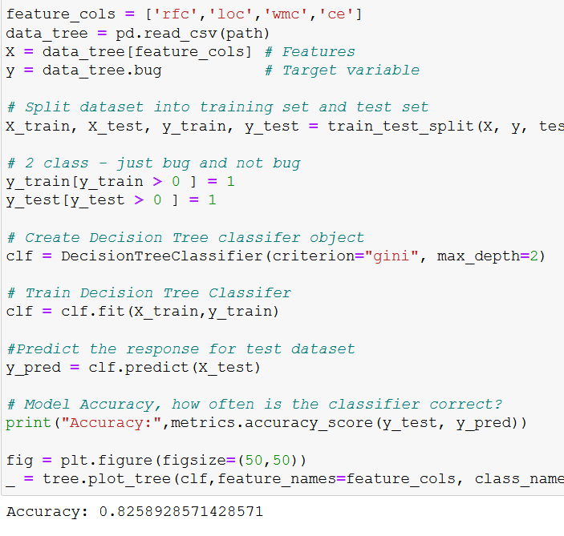
Decision Tree Classifier Building – 1 features max depth=2

Slide 19
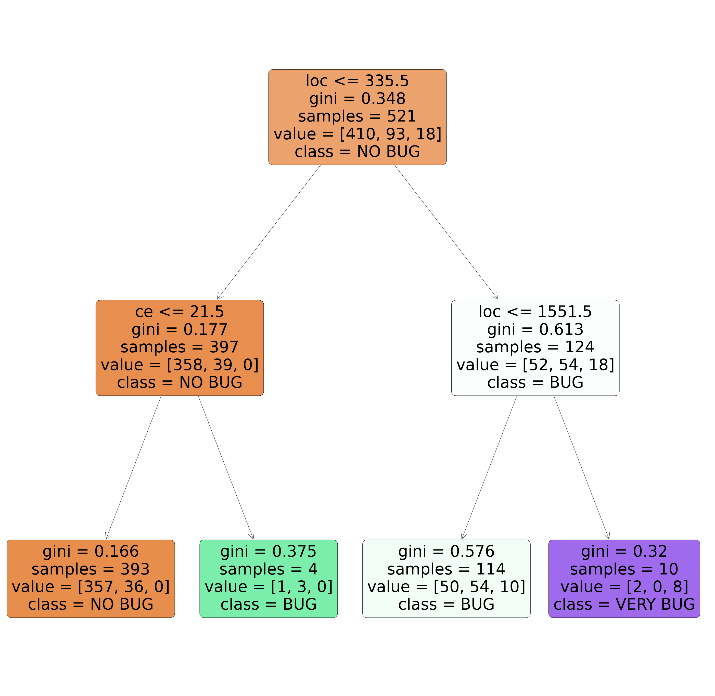
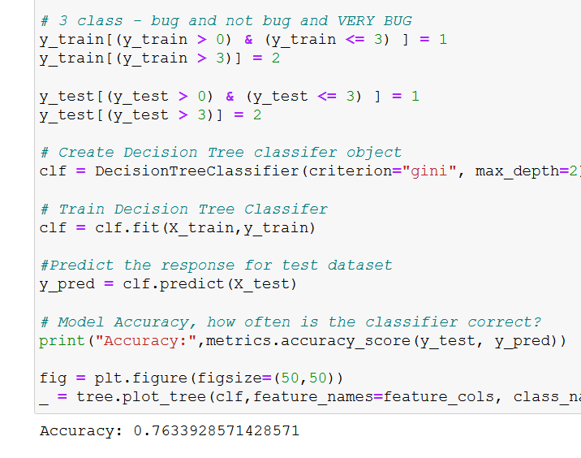
Decision Tree Classifier Building features= 4, max depth=2, classified=3

Slide 20
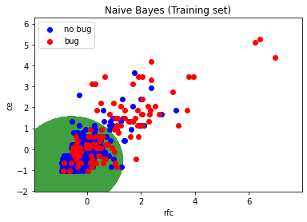
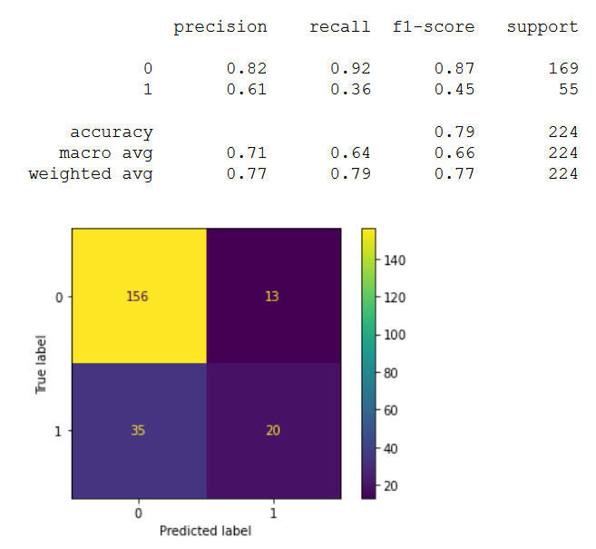
Naive Bayes

Slide 21
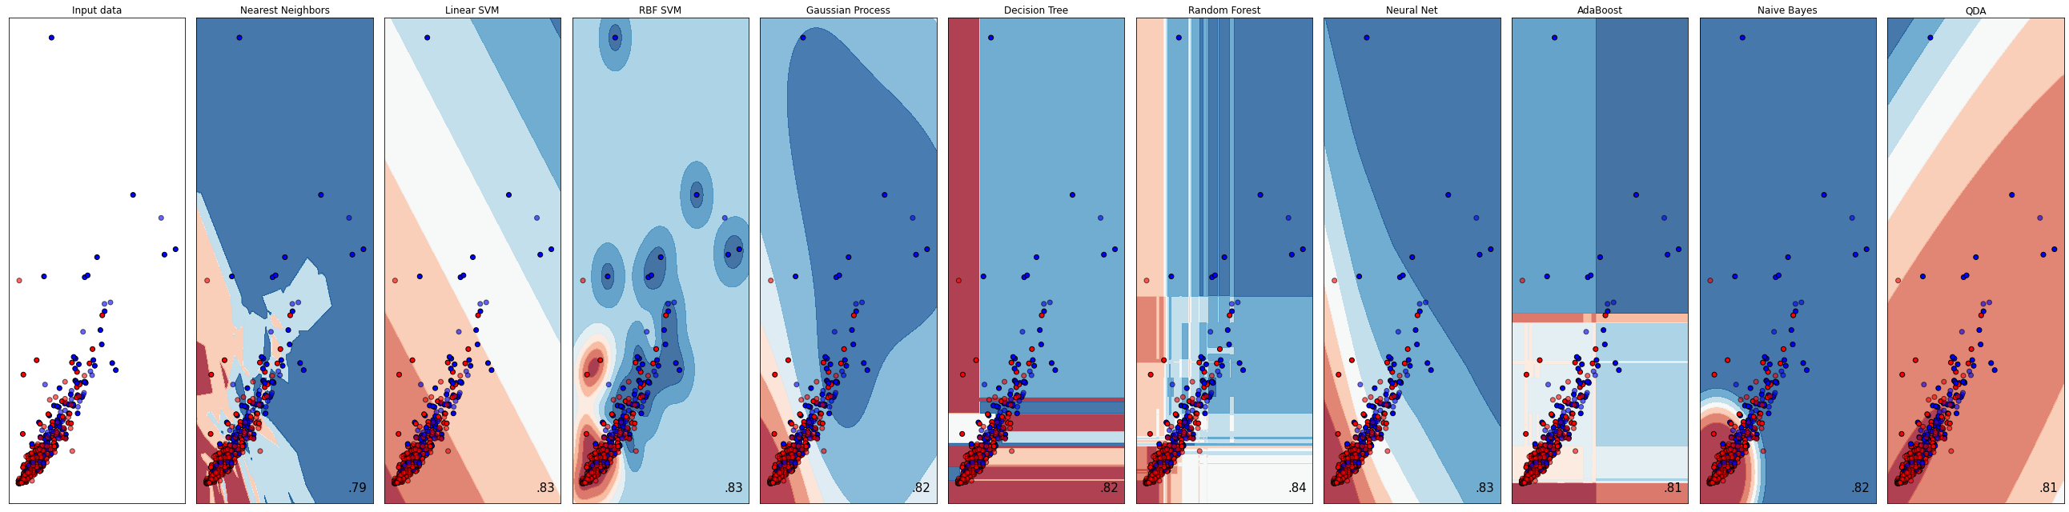
Classifier comparison

