Slide 1
Eric Franco Carlos Maqueda Lee Taylor
xxxx

Slide 2
Project Objectives
Explore real estate prices and relevant pricing variables
Databases used:
Zillow
Census
IRS
Variables explored:
Mortgage Rates
Yield Curve
Average Income
Price Per Square Foot
Median Listing Price
Zillow Size Rank

Slide 3
Project Summary
We collected, cleaned and transformed data.
We collected the data and grouped it by year and zip code.
We investigated what improved accuracy of our predictive models, threw out the hogwash.
Developed a model that has an R^2 of 0.95

Slide 4
Limitations
Length of the data we have been able to use.
Income data was limited to buckets provided by the IRS
Incomplete datasets accounted for approximately 30% of all collected data.
This is for average housing prices in zip codes, not used for individual houses.
We did not create geographic tags to account for location.

Slide 5
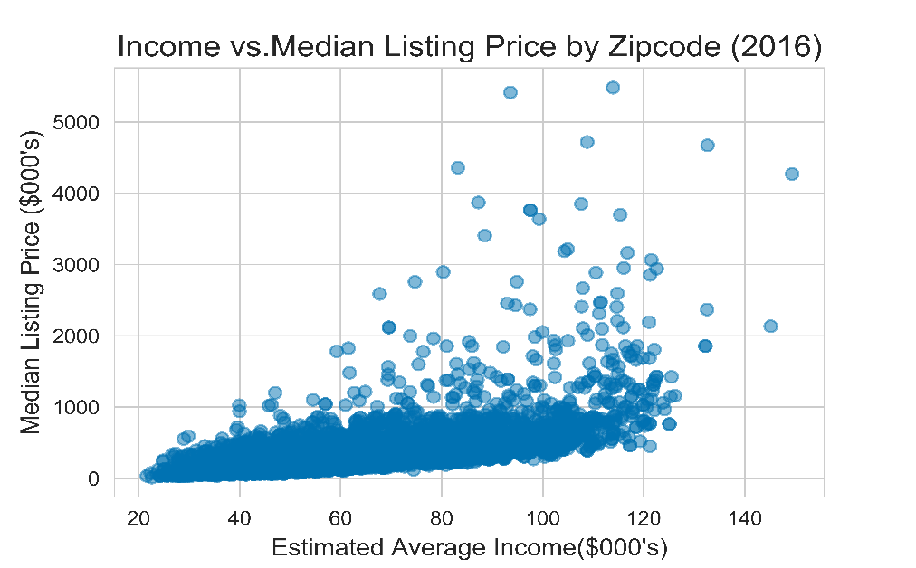
Exploratory Analysis Summary
Income was a large driver of real estate prices

Slide 6
Data Transformation Summary

Slide 7
Model Selection Summary

Slide 8
Model Explaination

Slide 9
Awesome Sauce Charts

