Slide 1
Eric Franco Carlos Maqueda Lee Taylor
xxxx

Slide 2
Project Objectives
Explore real estate prices and relevant pricing variables
Databases used:
Zillow
Census
IRS
Variables explored:
Mortgage Rates
Yield Curve
Average Income
Price Per Square Foot
Median Listing Price
Zillow Size Rank

Slide 3
Project Summary
We collected, cleaned and transformed data.
We collected the data and grouped it by year and zip code.
We investigated what improved accuracy of our predictive models, threw out the hogwash.
Developed a model that has an R^2 of 0.95

Slide 4
Limitations
Length of the data we have been able to use.
Income data was limited to buckets provided by the IRS
Incomplete datasets accounted for approximately 30% of all collected data.
This is for average housing prices in zip codes, not used for individual houses.
We did not create geographic tags to account for location.

Slide 5
Data Transformation Summary
Collect
Zillow Housing Data
BLS Employment Data
Merge
Converted data to annual data
Merge all data sets into a Master Data Frame
Clean
We removed all rows that had incomplete data for that year.
Output the data for analysis to CSVs.
IRS Income Data
We then merged on year and zip code

Slide 6
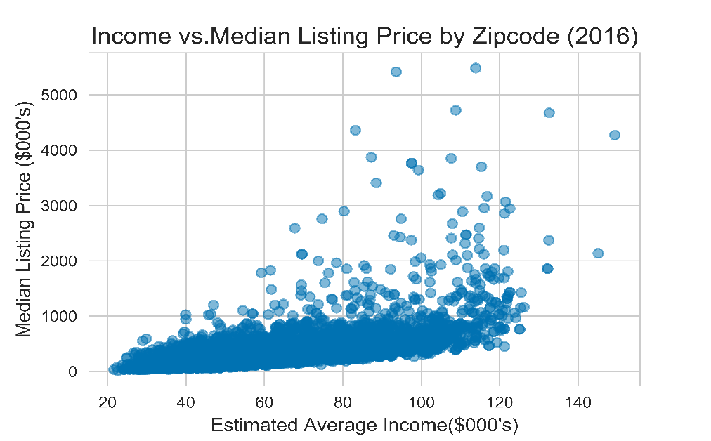
Exploratory Analysis Summary
Income was a large driver of real estate prices

Slide 7
Model Selection Summary
We tried Lasso Regression
This was horrible
We tried Neural Networks
This made me want to cry
We tried Random Forest Linear Regression
This worked gloriously!

Slide 8
Model Explanation
We fed in 4 variables:
Zillow Size Rank
Incomes
Unemployment rate
30 Year Mortgage Rate
This gage us a training set of over 45,000 observations
Random Forest Parameters
We used a max depth of 30
A sample size of 500
Importance Levels
Size Rank = 22.5%
Unemployment = 8.5%
Mortgage Rates = 25%
Incomes = 66.5%

Slide 9
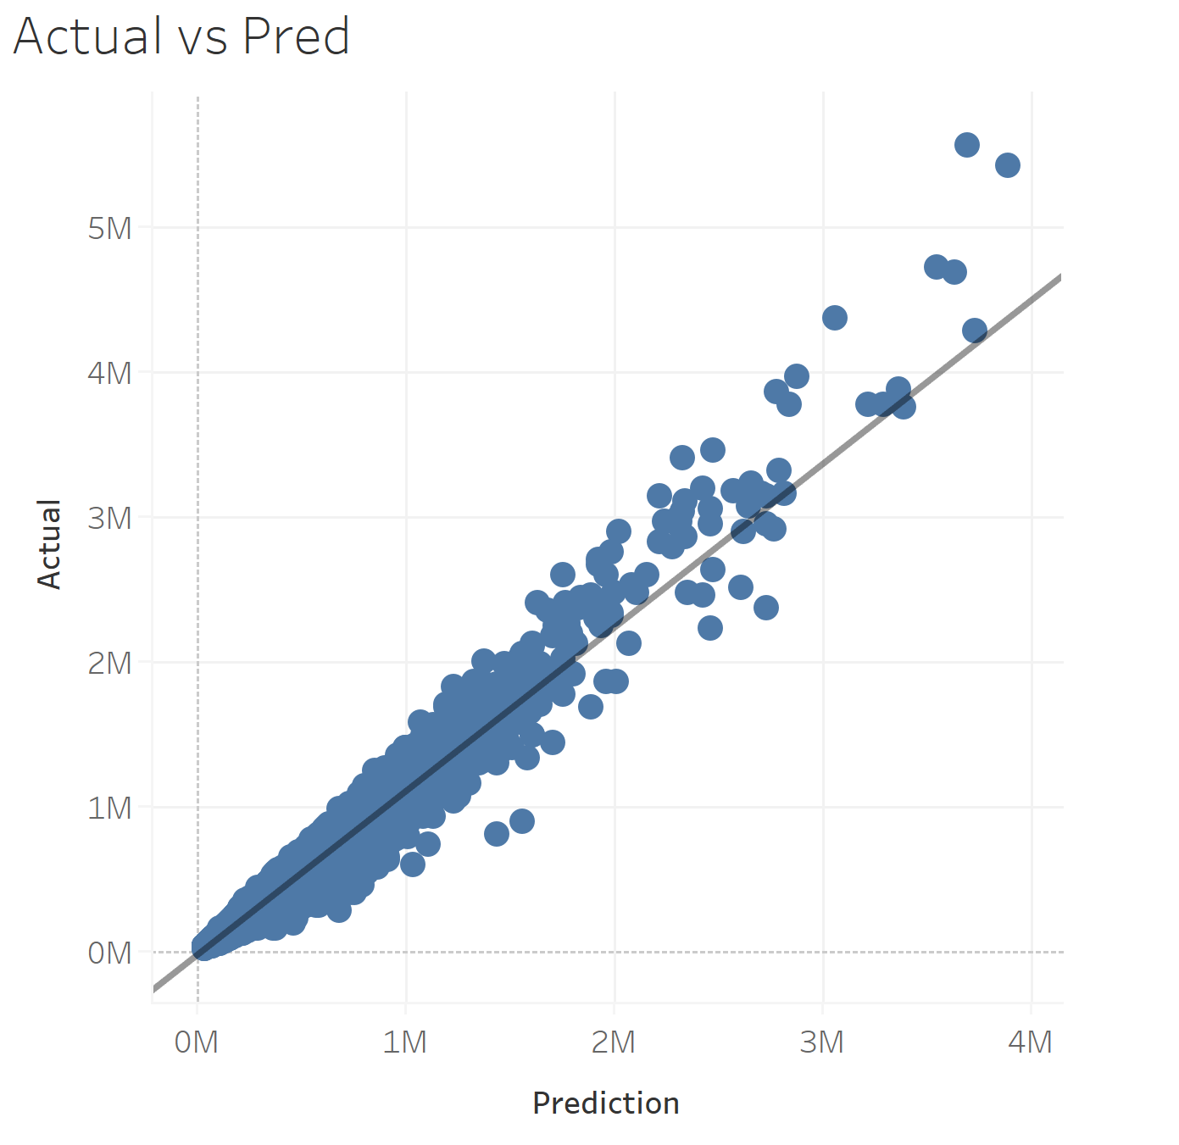
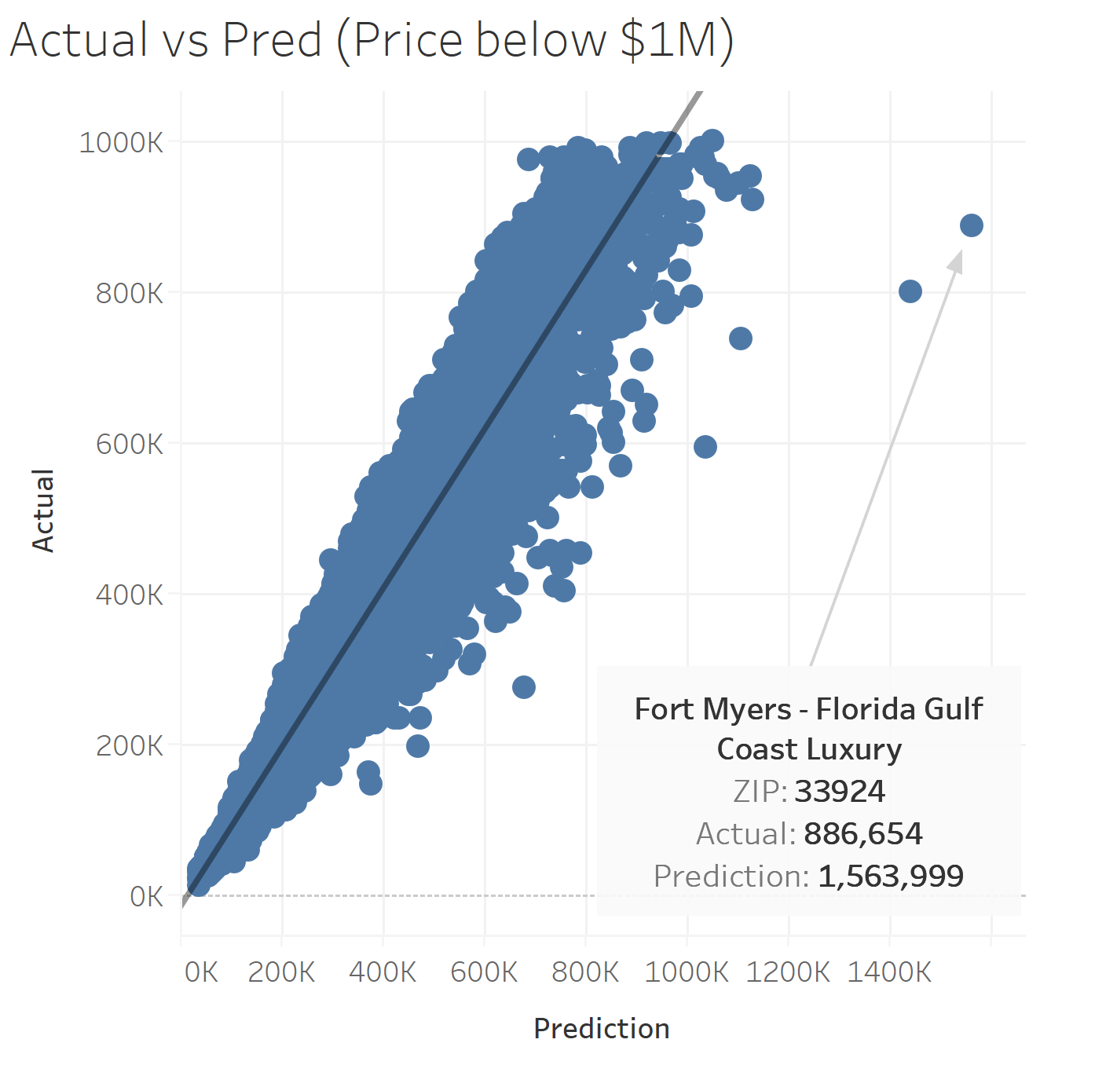
Accuracy Charts

Slide 10
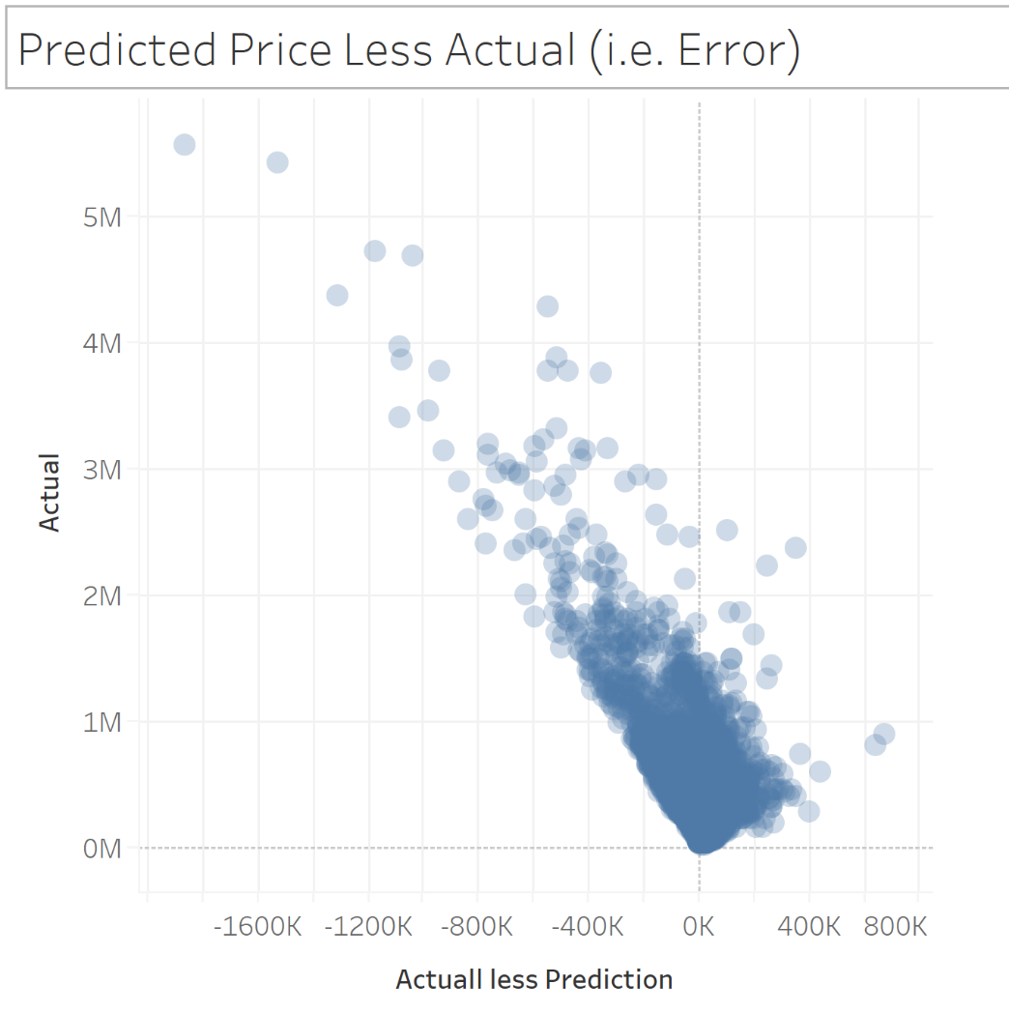
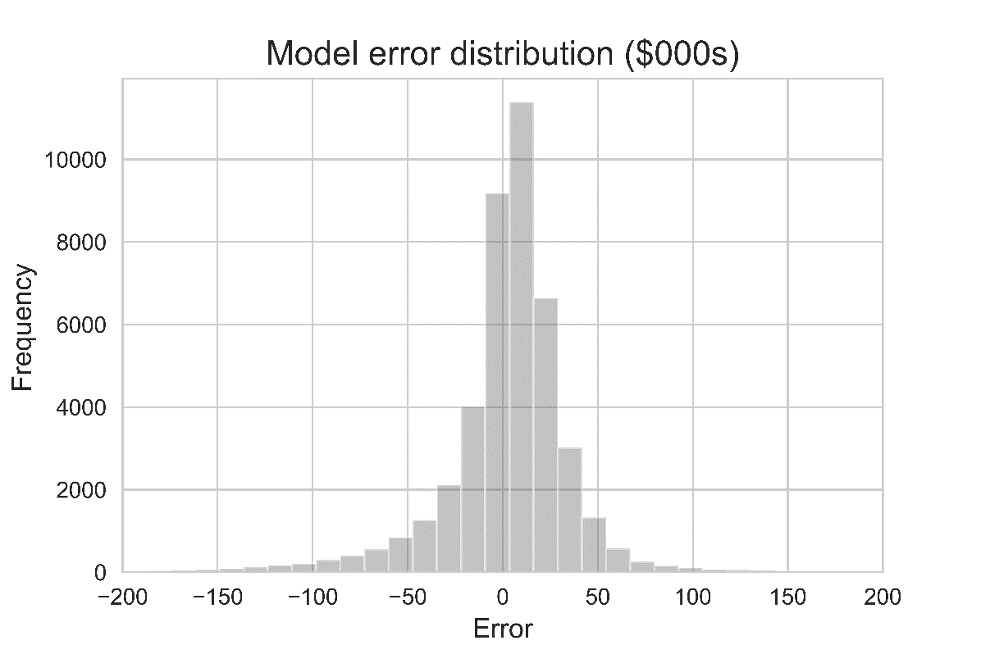
Error Analysis

Slide 11
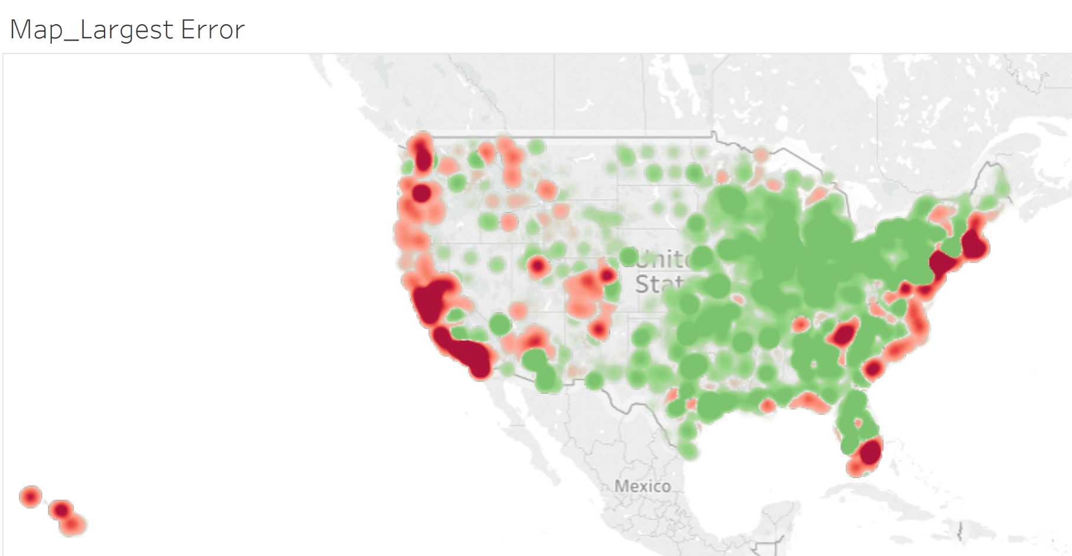
Analysis

Slide 12

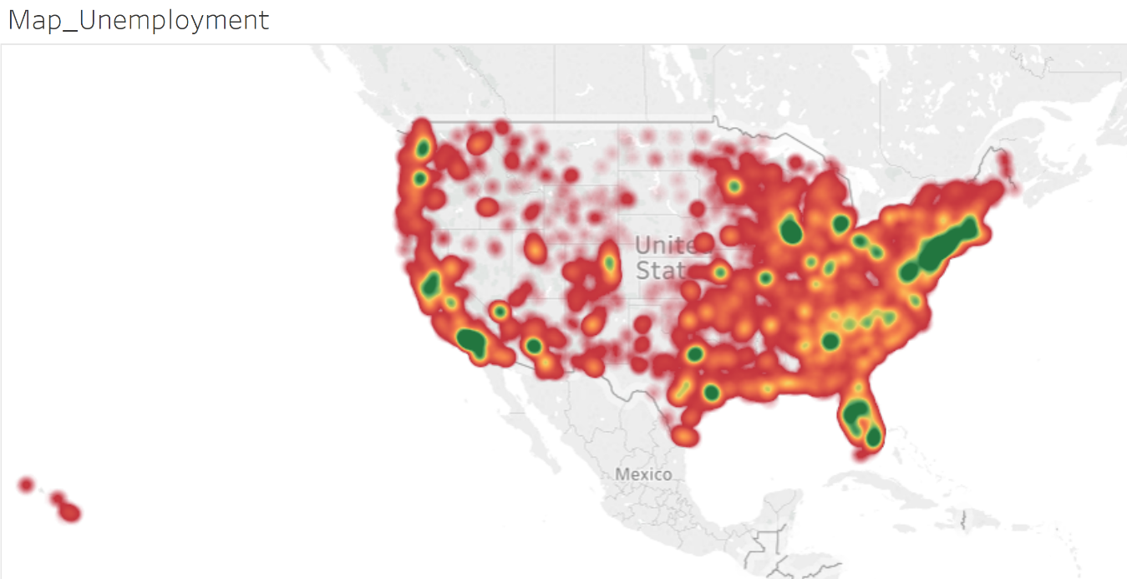
Relationships

Slide 13

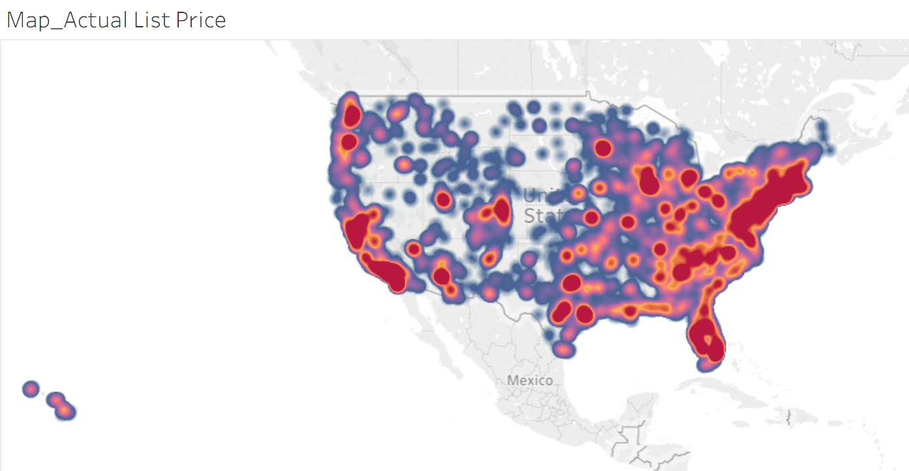
Relationships

