Slide 1
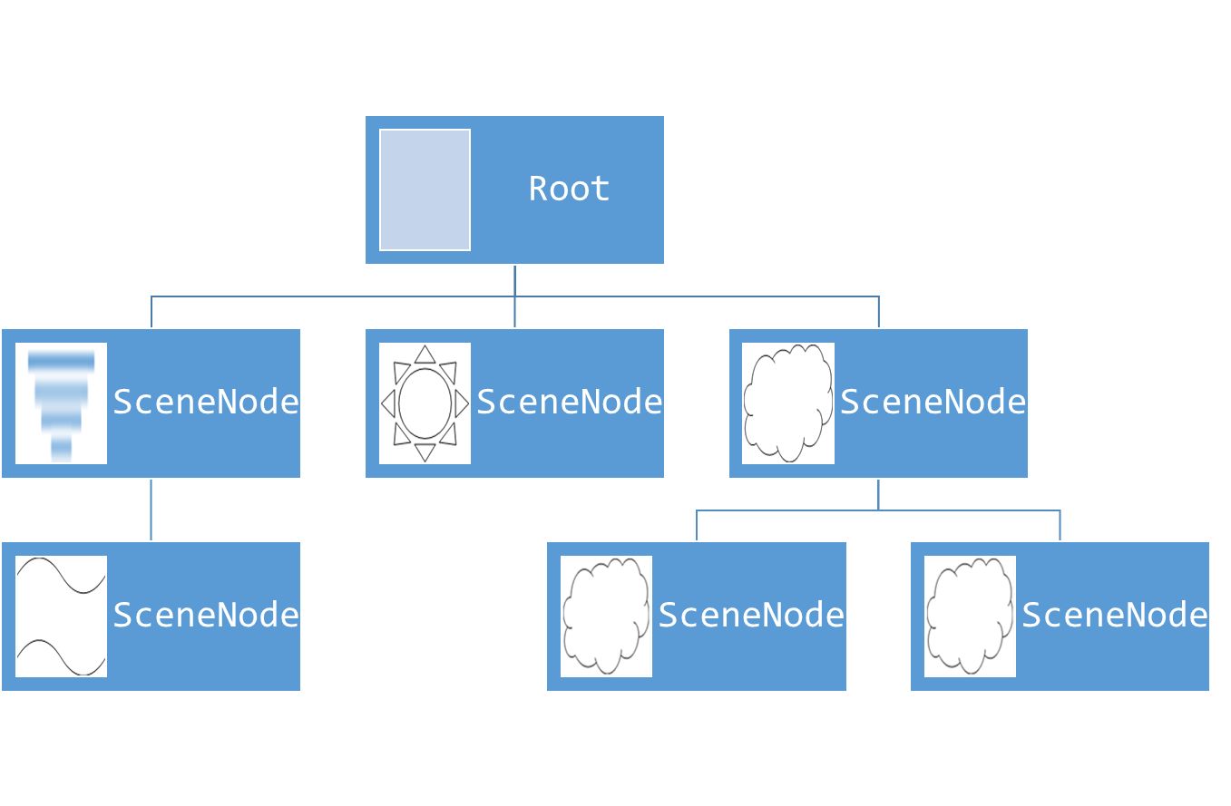
High-Level
GameLogic
GameScene
GameView(s)
0110101 0010101 1011010
GameView
GameView
Output
GameCommand
GameCommand
GameCommand
Input
Input
Input

Slide 2
Root
SceneNode
SceneNode
SceneNode
SceneNode
SceneNode
SceneNode
Notes:
Images: Visio -> calendar shapes (search “tree”)
UML Use Case: actor

Slide 3
Low-Level
GameLogic
GameScene
SceneRenderer
GameView(s)
0110101 0010101 1011010
GameView
GameView
Build
Converted
Output
GameCommand Event
Low-Level GameCommand
GameCommand
GameCommand
GameCommand
GameCommand
Control
Mapped
Input
Control
Mapped
Input
Control
Mapped
Input

