Slide 1

Magnetic Vibrations
Universidad Nacional de Cuyo
Franco Gassibe and Tomas Corteggiano

Slide 2
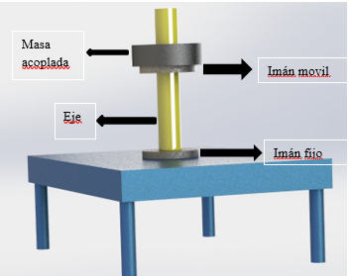
Diagram of our system
Here you can see the magnets in light grey been aligned by a yellow axis. The dark gray body is just an extra mass

Slide 3

Physical model
We started by finding all the forces actuating on the mass of the system to find a differential equation witch could describe the dynamics of our system by using newton's law.
Weight = mg
Dissipation forces: viscosity, Foucault (both proportional to speed) and friction (opposite to instantaneous velocity)
Magnetic Force: proportional to the inverse of the distance squared
Differential Equation:
$m\ddot{x}+c\dot{x}±Fr−\frac{k}{x^{2}}$+Weight =0
Where k was determinate by an static essay

Slide 4
Numeric Simulation
After measuring the parameters of our system we proceeded to simulate our systems to some initial conditions x(0) v(0) and with no external forces.
Vertical position
Time

Slide 5
Lab test
Before going any further on our analysis we validated our simulation in the lab measuring the instantaneous position of our mas with a high precision laser.
Vertical position
You can go see the test video of the actual test in the project folder
Time

Slide 6
Observations
The system is non linear and we can see that in the bouncing behavior when the magnets approach each other
The simulation match almost perfectly to the test in time of stabilisation and number of peaks
The simulation match almost perfectly the test final state of equilibrium

Slide 7
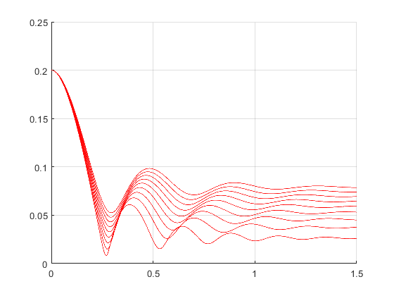
Parametric analysis
Having validation on our model we proceeded to make diferent parametric analysis.
Magnetic force as parameter
Viscosity as parameter
Mass as parameter

Slide 8
Frequency domain analysis
We can see in the Fourier frequency spectrum that there is (beside a continuous component) a peak in some non zero frequency

Slide 9
Periodic Perturbations
If we put a periodic perturbation (external force) with its frequence matching the peak of the spectrum we see a high amplitud output response of our mass similar to what hapends to a linear system.

Slide 10
Linearization
As we know we can linearize any non linear system near an equilibrium point and if we change the initial conditions of our simulation to be nearby those equilibrium points we can see that the bouncing disappears and we have a classic 2nd degree system

Slide 11
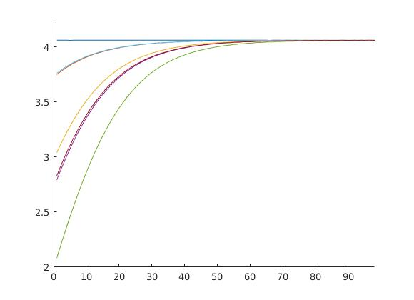
Frequency
As we can see in the time response the frequency its NOT CONSTANT when the system behaves in a non linear way (away of equilibrium point) but it IS CONSTANT when we are near our equilibrium point and the systems starts behaving linearly
We plotted frequency between peaks of the time response as times passes and the system converge to its linearity
Also each color represents different initial conditions
This frequency of convergence is of course the frequency of the equivalent 2nd degree linear system

Slide 12
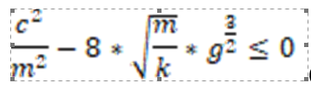
Type of response
Making use of the theorem in page 25 of the ‘Dynamic systems and differential equations’ (Perko and Lawrence) we can know the type of response of a non linear system analyzing its Jacobean matrix and its determinant
This expression is analogous to the discriminant of the linear 2nd order systems but it only works four our system
The changing of these behaviors can be observed in the phase diagram plotted in the main matlab project also

Slide 13
Thank you

