Slide 1
WeldBot
In the next presentation I will informally and quickly explain what I did on the robotics project. What was done in terms of the existing tools and what was my personal contribution

Slide 2
The task
The robot is a 5 degrees of freedom welding machine
We choosed 5 degrees of freedom because in most welding application the welding tool is often symmetric so there was no need of the rotation along his longitudinal axis (known as ROLL).
In order to do the task the robot has to be able to position and orient his tool in space.

Slide 3
Configuration
5
5
4
4
3
3
2
2
1
1
1
Rotational
Rotational
Longitudinal (telescopic)
4
Rotational
Rotational
2
5
3

Slide 4
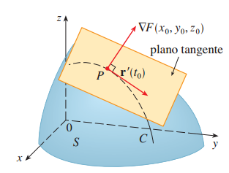
Description of the task
In welding the orientation of the tool its often expressed in function of 2 angles. The angle between the axis of the tool and the tangent plane to the trajectory C at some point P. And the angle of the projection of the tool’s axis in that plane*.
S is the surface of the object we want to weld
C is the curve to be welded
We are modeling two different scenarios:
In the first one the robot is welding in a plane. And in the second the robot is welding a tube so the surface is a cylinder
*We usually want the projection of the tool in the plane to be aliened in the r direction (tangent of C). But this is not a rule.

Slide 5
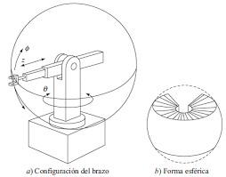
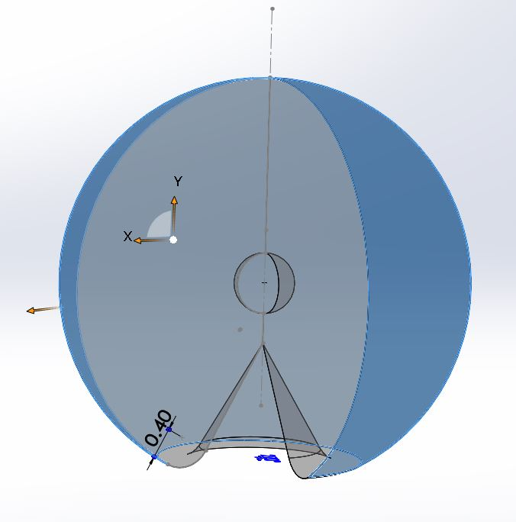
Workspace and reach
Considering the physical constrains on the joints we can plot the workspace (all points in space where the robot can position and fully orient himself).
As this is a simulation we have kind of arbitrary choosed the length of each link. But we don’t forget this lengths are restrained in real life by constructive possibilities and budget
We also developed a function that identifies if a point is inside de workspace or not and in case it isn’t it tells you the nearest point who IS inside the workspace.

Slide 6


Direct kinematic
The problem of the direct cinematic answers the following question:
If I have my robot in a known configuration q (means I know the position of each joint) where is the end-effector of my tool and which is his orientation?
As is usually done we build for each coordinated system (one on each joint) a homogeneous matrix and we multiply them all to get a new homogeneous matrix that represents the position and orientation of the tool referred to the external coordinated system (in this case on the base of the robot).
This was done by utilizing the functions on the peter Core library. This can be calculated in a symbolic way also to get the position and orientation as a function of the joints coordinates q.
Where $x$, $y$ and $z$ are the coordinates of the end-effector of the tool
Were $n,m$ and k are the axis of the coordinated system on the tool expressed in the external coordinated system (that’s why each one has 3 components).
T_sym =$\left[\begin{matrix}{nx}_{\left(q\right)} & {mx}_{\left(q\right)} & \begin{matrix}{kx}_{\left(q\right)} & x_{\left(q\right)}\end{matrix} \\ {ny}_{\left(q\right)} & {my}_{\left(q\right)} & \begin{matrix}{ky}_{\left(q\right)} & y_{\left(q\right)}\end{matrix} \\ \begin{matrix}{nz}_{\left(q\right)} \\ 0\end{matrix} & \begin{matrix}{mz}_{\left(q\right)} \\ 0\end{matrix} & \begin{matrix}\begin{matrix}{kz}_{\left(q\right)} & z_{\left(q\right)}\end{matrix} \\ \begin{matrix}0 & 1\end{matrix}\end{matrix}\end{matrix}\right]$

Slide 7
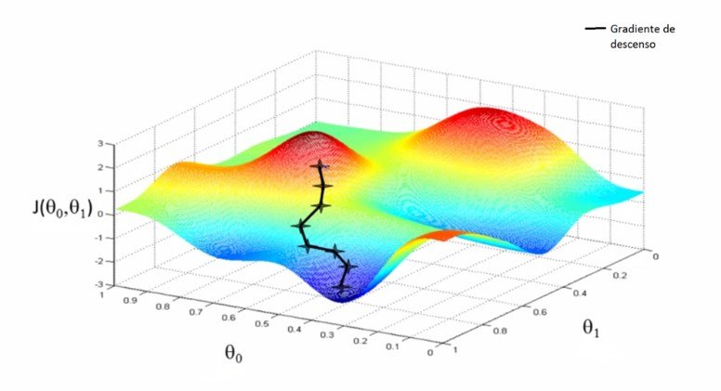
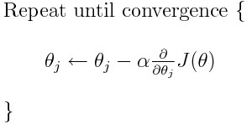
Inverse kinematic
The inverse kinematic problem answers a different question: what are the joint coordinates that I need if I want to position and orientate my tool in a desired way?
To solve this problem we choosed to use our own method inspired on the gradient descent method usually used in machine learning and AI. So we will solve this problem on three steps.
1.We find an error function J (a symbolic one) that can tell us how far is the robot from our desired position and orientation
2. We calculate its gradient
3.From a seed vector q0 we iterate and actualize its value on the direction of its gradient until convergence.

Slide 8

How to find J?
So as we already have an expression of the position and orientation of our end-effector (found on the direct kinematic problem) it would be very reasonable to think our error function J as the quadratic difference between the desired position-orientation and the elements of T_sym (symbolic transformation).
T_sym =$\left[\begin{matrix}{nx}_{\left(q\right)} & {mx}_{\left(q\right)} & \begin{matrix}{kx}_{\left(q\right)} & x_{\left(q\right)}\end{matrix} \\ {ny}_{\left(q\right)} & {my}_{\left(q\right)} & \begin{matrix}{ky}_{\left(q\right)} & y_{\left(q\right)}\end{matrix} \\ \begin{matrix}{nz}_{\left(q\right)} \\ 0\end{matrix} & \begin{matrix}{mz}_{\left(q\right)} \\ 0\end{matrix} & \begin{matrix}\begin{matrix}{kz}_{\left(q\right)} & z_{\left(q\right)}\end{matrix} \\ \begin{matrix}0 & 1\end{matrix}\end{matrix}\end{matrix}\right]$
J(q)$=({x_{d}−x_{\left(q\right)})}^{2}+({y_{d}−y_{\left(q\right)})}^{2}+({z_{d}−z_{\left(q\right)})}^{2}+({{nx}_{d}−{nx}_{\left(q\right)})}^{2}+({{ny}_{d}−ny)}^{2}+({{nz}_{d}−{nz}_{(q)})}^{2}$+ …
Been the subscript d a designation for ‘desired’
In a 6 DOF robot, all the elements of the T_sym matrix must be included on the J function but since in our application (because we cant roll) we can only orientate our longitudinal axis n. We don’t need to include the other terms.

Slide 9
Its important to observe that as the orientation elements in the T_sym matrix represent a dextrogyre coordinate system then the desired n, m and k orientation elements have to be dextrogyre too. Otherwise the algorithm will try to minimize a function that it’s never zero resulting in potential errors on the q solution.
Its worth mentioning that in the Peter’s core libraries there is no way to define restrictions from the frame of reference of the tool like this method does. They are defined from the external frame of reference using masks witch its not so useful in this kind of cases.
The method gets slower around singularity points but this could be fixed by adjusting the value of alpha in our gradient descent algorithm based on the value of the Jacobian.
While the time to calculate the symbolic gradient of the error function is considerable, it should only be done once, in addition, while the convergence time of the method is high for the calculation of a first point due to the distance of the seed vector from the solution vector, in the case of a trajectory the value of articular variables calculated in the previous iteration can be used as seed vector of the current iteration, decreasing the calculation time of all points following the firstone.

Slide 10
Generating the trajectories
Having now a function that can calculate the inverse kinematic then we only have to generate the points and orientations in space (maybe interpolate them with some polynomio) and give those to our function. We also added a jacobian calculation on each point of the trajectory to keep track of possible singularities.
For the application of circular welding the points parameterized by their tita angle were defined as well as the normal orientation to it, the weld contained in the plane was placed to simplify the generation of points with equations. For the application of welding in a plane values were discretized in x, a function was defined y(x) and the height of that plane (parallel to xy) was determined, then an orientation analysis was made using the tangent of that path and the angle of attack with respect to the normal

Slide 11
By running the programs ‘intento2_trayectoria’ and ‘tray_plana’ you can see a simulation of the task. Welding circular tubes or welding a sine wave in a plane
Thanks

