Slide 1
Refinement of low occupancy hits
22/09/2020
Tobias

Slide 2
XCE: routes from MTZ to PDB
“high occupancy” hits
Dimple (REFMAC)
Phenix.ligand_pipeline (phenix.refine)
Pipedream (BUSTER)
BUSTER
REFMAC
BUSTER
PanDDA
“low occupancy” hits
export
giant.quick_refine (REFMAC)

Slide 3
Refinement of PanDDA models
low occupancy: export & giant.quick_refine
PanDDA directory
ground-state.pdb
Project directory
pandda.inspect
pandda.export
ensemble.pdb
giant.quick_refine
(REFMAC)
bound-state.pdb
ground-state.pdb
bound-state.pdb
All modelling must be done in pandda.inspect, refinement is only for weight adjustment and review
COOT

Slide 4
Refinement of PanDDA models
low occupancy: export & giant.quick_refine

Slide 5
Recommendations
PanDDA is great for uncovering weakly bound ligands and sparsely populated protein conformations
But what happens if the fragments are strongly bound?
In most cases (>80%), there is only a single ligand and protein conformation visible in event and 2fofc maps
ensemble models then get unnecessarily complex
We typically deposit the bound state only, but we have occasionally seen problems during splitting
Why not refine them the ‘usual’ way

Slide 6


Refinement of PanDDA models
high occupancy: BUSTER
ground-state.pdb
pandda.inspect
bound-state.pdb
BUSTER
bound-state.pdb
COOT
You can manipulate model as you want

Slide 7





Recommendations
Run PanDDA and build all events with pandda.inspect
refine with Buster:
Examine models with XCE-COOT (Buster) interface
continue refining them if all looks good
If not, export selected model and refine with REFMAC :
Deposit ensemble model

Slide 8
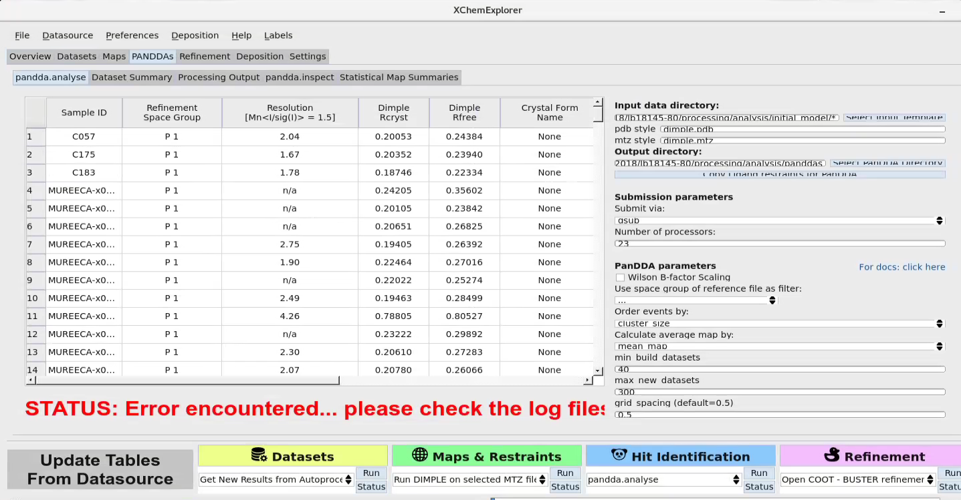
Work in progress
☑️
☑️
☑️
☑️
Need to develop new function:
Export selected PanDDA models

