Slide 1

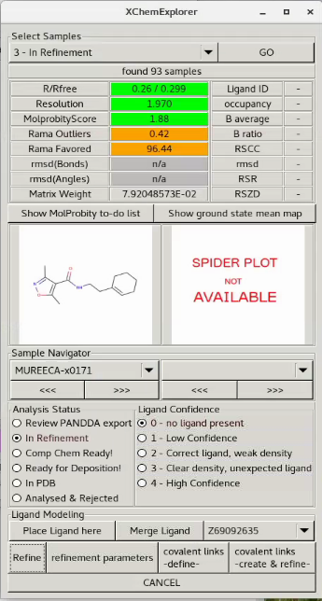
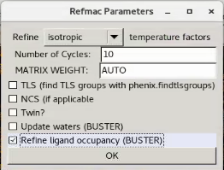
XCE v1.7.14 (24/09/2020)
Ligand occupancy refinement in BUSTER
Note: any hydrogens which are part of the ligand will be removed before the ligand is merged with the model, because ligand occupancy refinement with ligands containing hydrogens did not work.

Slide 2

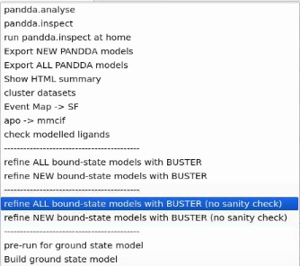
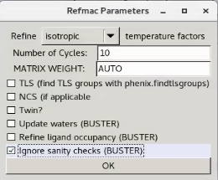
XCE v1.7.15 (25/09/2020)
BUSTER: StopOnGellySanityCheckError

Slide 3
XCE v1.7.16 (08/10/2020)
Reset to last successful non-pandda refinement
Limitations:
The script cannot be called as part of the XCE gui (see below)
It works only for non-pandda refinement at the moment
Usage (at Diamond):
module load ccp4
export XChemExplorer_DIR="/dls/science/groups/i04-1/software/XChemExplorer_new/XChemExplorer"
$CCP4/bin/ccp4-python $XChemExplorer_DIR/helpers/reset_to_last_successful_refinement.py <project_directory>
e.g.
$CCP4/bin/ccp4-python $XChemExplorer_DIR/helpers/reset_to_last_successful_refinement.py /dls/labxchem/data/2020/lb18145-23/processing/analysis/model_building

Slide 4
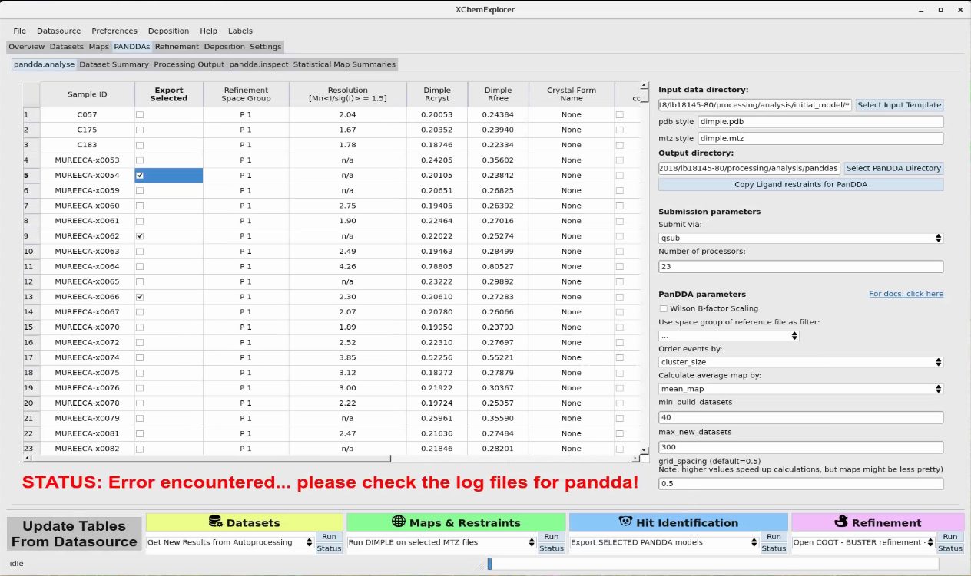

XCE v1.7.16 (08/10/2020)
pandda.export of selected datasets
Limitations:
It does not work if you have already ran buster refinement in the respective sample directory, because any Refine_<n>buster-report sub-directories causes problems for giant.quick_refine. Hence, you will have to manually remove these subdirectories before you can re-export them.
select
datasets

