Slide 1
Quick preparation of an XCE project
Example:
cd /dls/i03/data/2020/mx19301-125/processing/will
mkdir test
cd test
mkdir refine
mkdir database
mkdir reference
cd database
Copy reference PDB file into reference subfolder
Start XCE

Slide 2
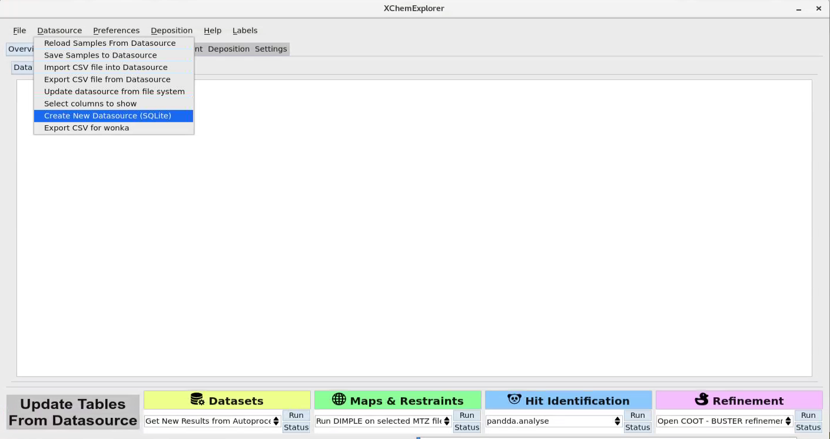
create empty database

Slide 3
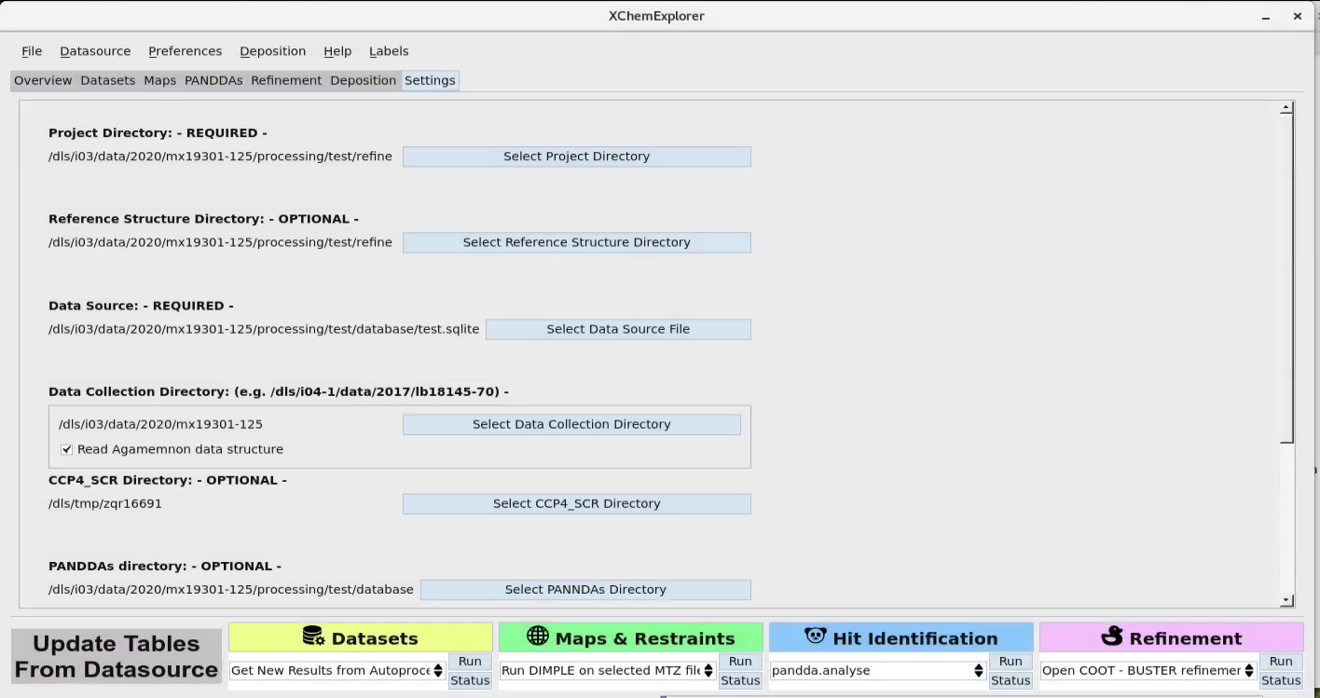
set directories
check if automated data collection

Slide 4
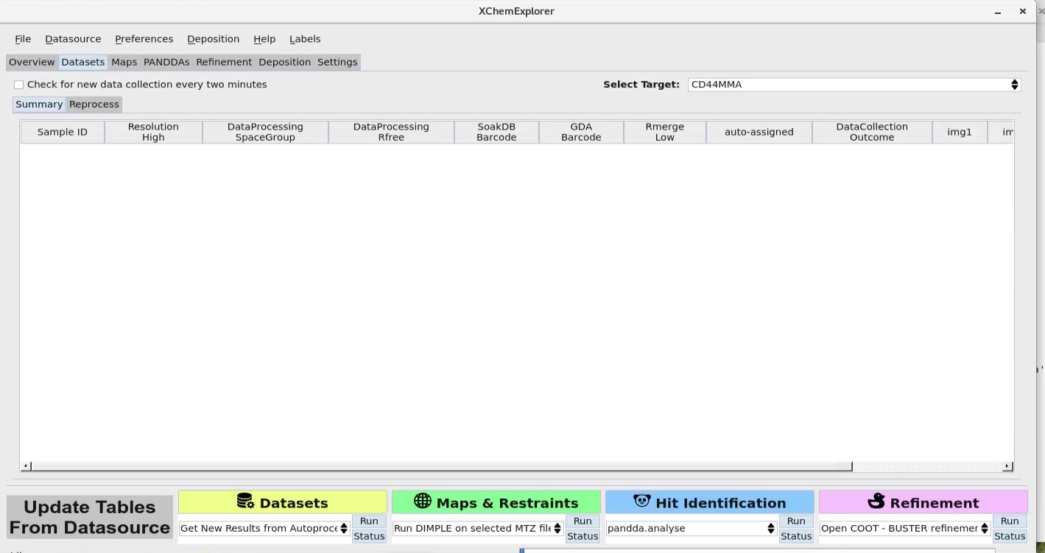
Get results from autoprocessing
Continue as usual…

