Slide 1

Piston
  An intro to Piston for Rails developers

Slide 2
What is Piston ?
A tool for

Slide 3
What is Piston ?
  Easy

Slide 4
What is Piston ?
  Vendor Branch

Slide 5
What is Piston ?
  Management

Slide 6

What is Piston ?
http://www.staples.com/sbd/img/cat/enl/s0105150_enl.jpg

Slide 7
What is Vendor Branch Mgmt ?
  Copy

Slide 8
What is Vendor Branch Mgmt ?
  Foreign

Slide 9
What is Vendor Branch Mgmt ?
  Code

Slide 10
What is Vendor Branch Mgmt ?
  within your repository

Slide 11
What's in it for me ?
  Story Time !

Slide 12
What's in it for me ?
  Based on a
  True Story

Slide 13


What's in it for me ?
  vendor/plugins/
  acts_as_attachment

Slide 14
What's in it for me ?
  svn:externals

Slide 15
What's in it for me ?
  $ cap deploy

Slide 16
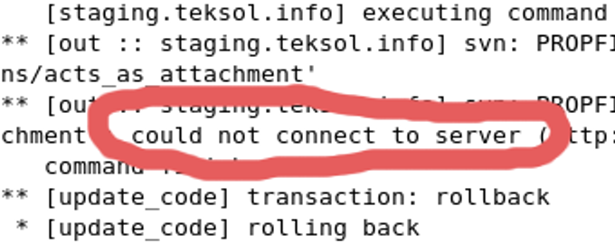
What's in it for me ?

Slide 17
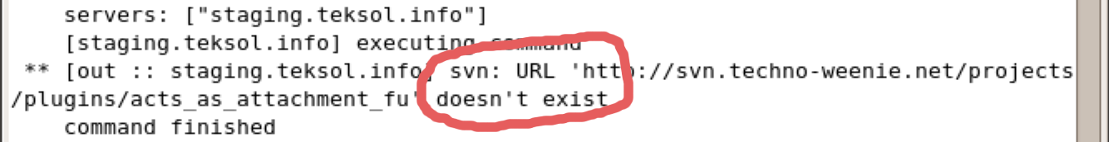
What's in it for me ?

Slide 18
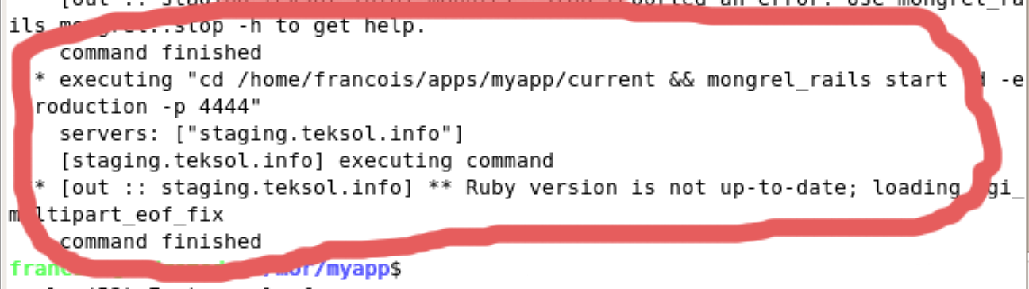
What's in it for me ?

Slide 19
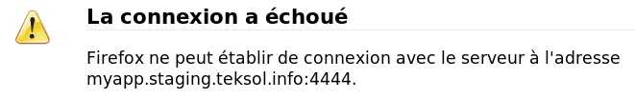
What's in it for me ?
Duh ?

Slide 20
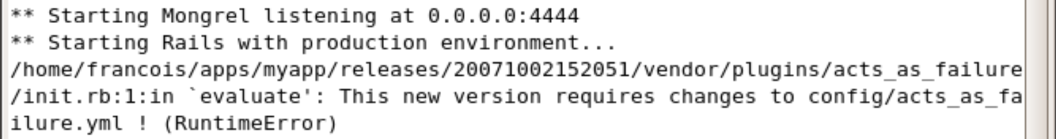
What's in it for me ?
Oops…

Slide 21
The Solution ?
  Piston

Slide 22
What is Piston ?
  Easy

Slide 23
What is Piston ?
  Vendor Branch

Slide 24
What is Piston ?
  Management

Slide 25
The Solution ?
  Piston

Slide 26
Which problems does it solve ?
  Makes common
  $ svn
  operations

Slide 27
Which problems does it solve ?
  Faster

Slide 28
Which problems does it solve ?
  update
  status
  update

Slide 29
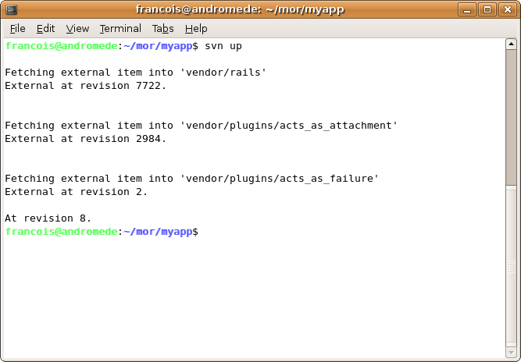
Which problems does it solve ?

Slide 30
The Solution ?
  Piston

Slide 31
Which problems does it solve ?
  Enables

Slide 32
Which problems does it solve ?
  Local
  bugfixes

Slide 33
Which problems does it solve ?
  Local
  extensions

Slide 34
The Solution ?
  Piston

Slide 35
Which problems does it solve ?
  Isolates the developers

Slide 36
Which problems does it solve ?
  from unwanted upstream changes

Slide 37
The Solution ?
  Piston

Slide 38
Which problems does it solve ?
  Automates

Slide 39
Which problems does it solve ?
  Code importing & merging

Slide 40
How does it do it ?
  $ piston import

Slide 41
How does it do it ?
$ svn export http://svn.yourplugin.com/trunk \
vendor/plugins/yourplugin
$ svn add vendor/plugins/yourplugin

Slide 42
How does it do it ?
  $ piston update
  (no local changes)

Slide 43
How does it do it ?
$ svn checkout http://svn.yourplugin.com/trunk \
vendor/plugins/yourplugin.tmp
$ svn diff –revision X:Y vendor/plugins/yourplugin.tmp | patch \
vendor/plugins/yourplugin

Slide 44
How does it do it ?
  $ piston update
  (with local changes)

Slide 45
How does it do it ?
$ svn checkout http://svn.yourplugin.com/trunk \
vendor/plugins/yourplugin.tmp
$ svn diff –revision X:Y vendor/plugins/yourplugin.tmp | patch \
vendor/plugins/yourplugin
$ svn merge –revision N:M vendor/plugins/yourplugin \
vendor/plugins/yourplugin

Slide 46
Other commands
  $ piston status

Slide 47
How do I start ?
  $ piston convert
  $ piston import

Slide 48
Caveat
  Piston is not
  script/plugin

Slide 49
When not to use Piston
  Single repository
  (use svnmerge.py)

Slide 50

Who is this Piston guy ?
  François Beausoleil

Slide 51
Who is this Piston guy ?
  http://blog.teksol.info/

Slide 52
Who is this Piston guy ?
  francois@xlsuite.com

Slide 53
How do I start ?
  $ gem install piston
  http://piston.rubyforge.org/

