Slide 1

Volume Estimation Constantin Dragancea David Buzatu
François Costa
Roxana Stiuca
TexPoint fonts used in EMF.
Read the TexPoint manual before you delete this box.: AAAAA

Slide 2
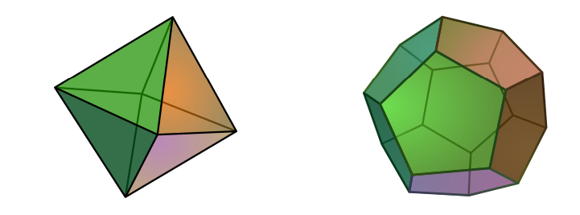
Algorithm
Input: convex polytope P = {Ax <= b}, A matrix MxN, b vector of length M.
Output: volume.
https://ti.inf.ethz.ch/ew/courses/Geo20/lecture/gca20-9.pdf

Slide 3
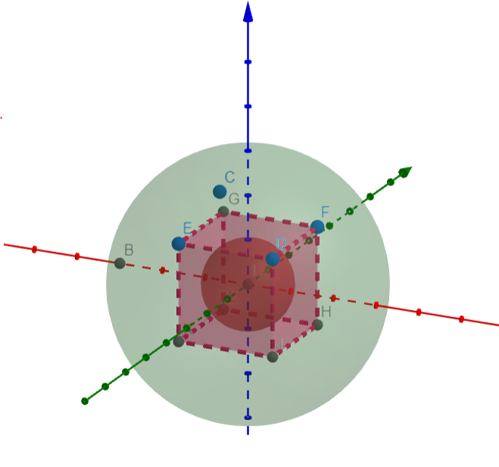
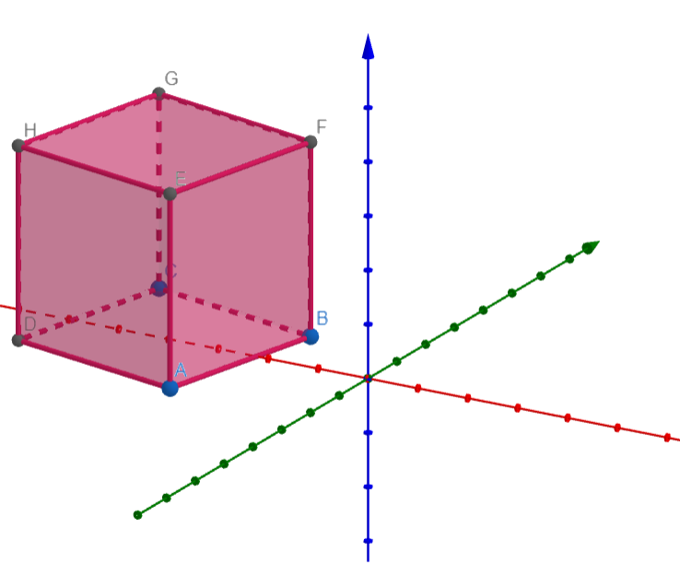
Algorithm - Preprocess
Affine transformation T
Notes:
Find affine transformation such that the polytope is between B(O, 1) and B(O, r)

Slide 4
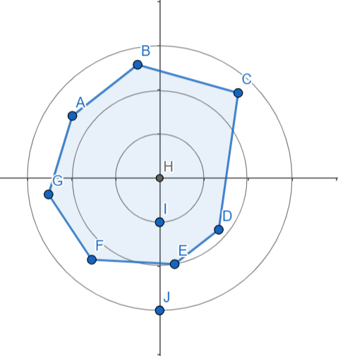
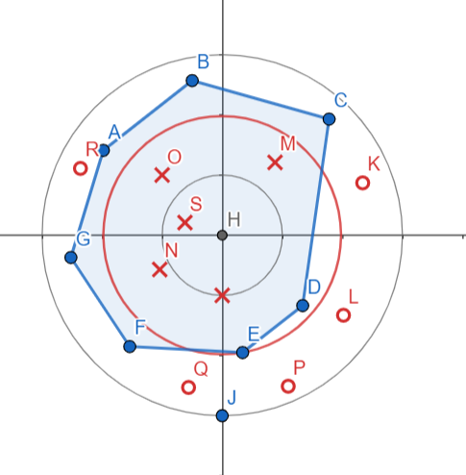


Algorithm - Estimate Volume

Slide 5
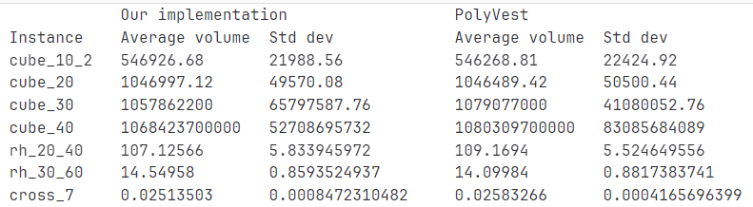
Experimental Setup
Machine: Intel(R) Core(™) i7-10750H CPU@2.60GHz
Compiler: GCC 13.1.1. Flags: -O3 -ffast-math -mfma
Correctness checks: using C++ test suite & statistical results.

Slide 6
Baseline implementation
Preprocess - O(N^3)
Estimate Volume - O(N^4 (logN)^2)
Walk - O(N^2) called 1600*(N*logN)^2 times
Bottleneck: Walk!

Slide 7
Basic optimizations
Inline functions
Remove repeated operations (eg. memory allocations on every function call)
Pre-compute constants
Simplify mathematical expressions
Scalar replacement (eg. n instead of p->n)
Replace matrix-matrix operations with matrix-vector, in Preprocess
Use xoshiro random number generator

Slide 8
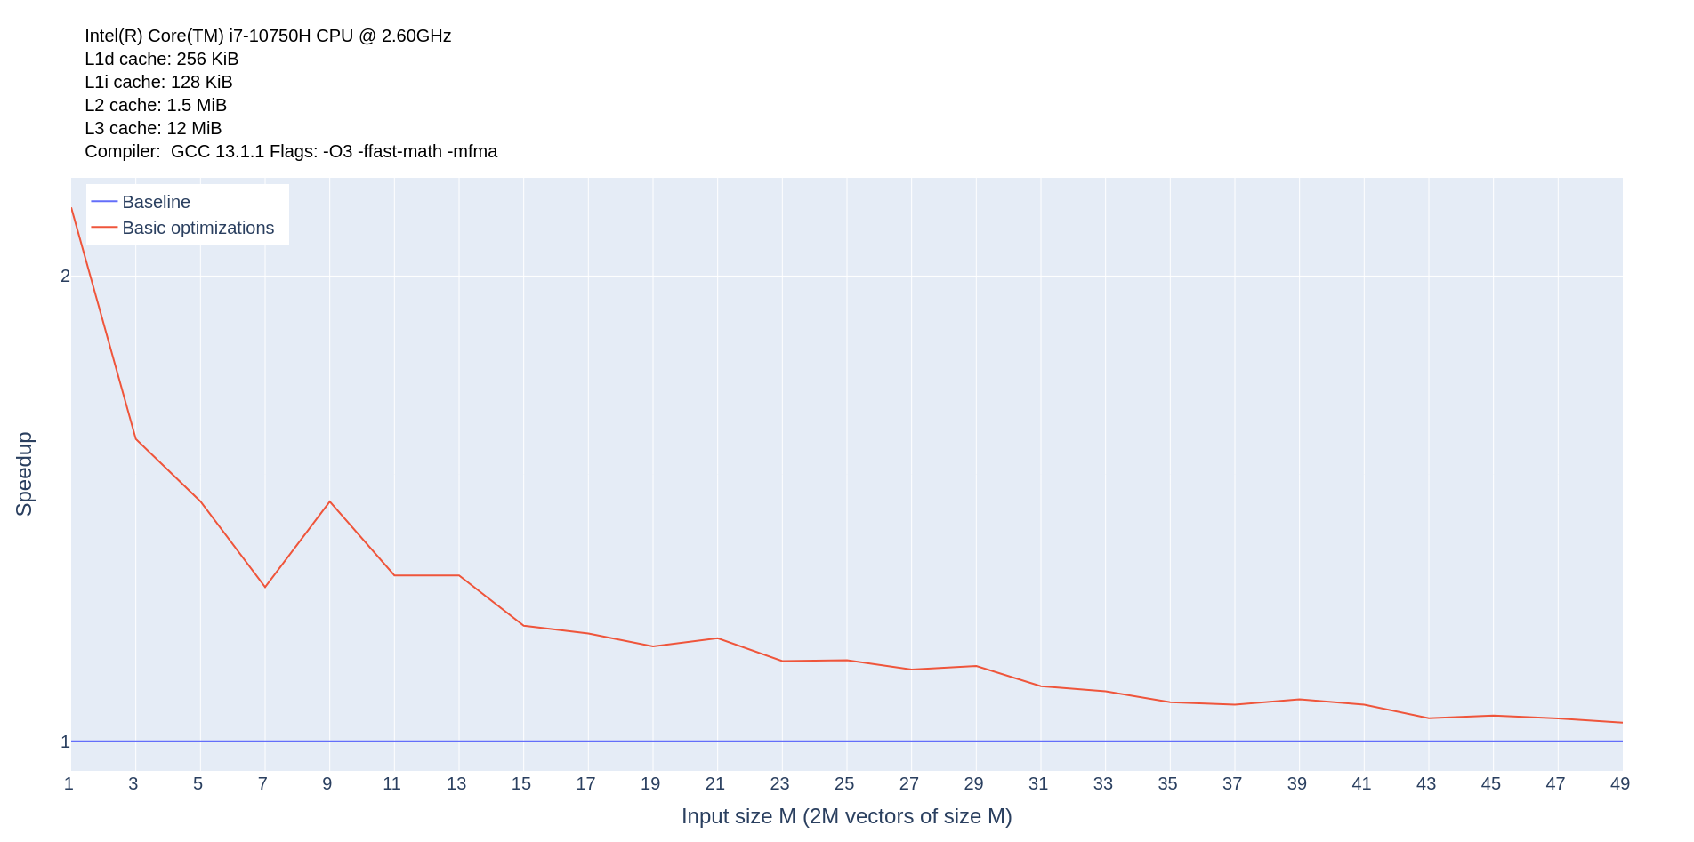
Basic optimizations

Slide 9
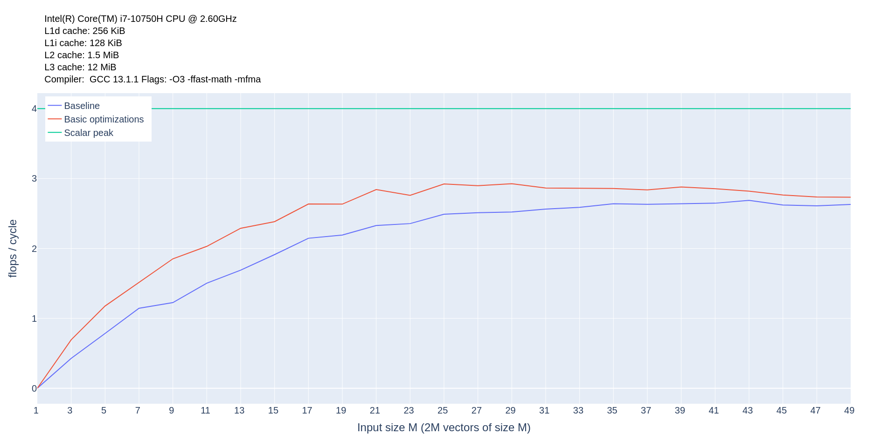
Basic optimizations

Slide 10
Algorithmic optimization
The walk functions computes the matrix-vector product (A / A.col(rand_dir)) * sampling_points in O(N^2)
Idea: pre-compute A * sampling_points once, take the division as a common factor. The result can be updated in O(N)
Overall, reduce complexity from O*(N^4) to O*(N^3).

Slide 11
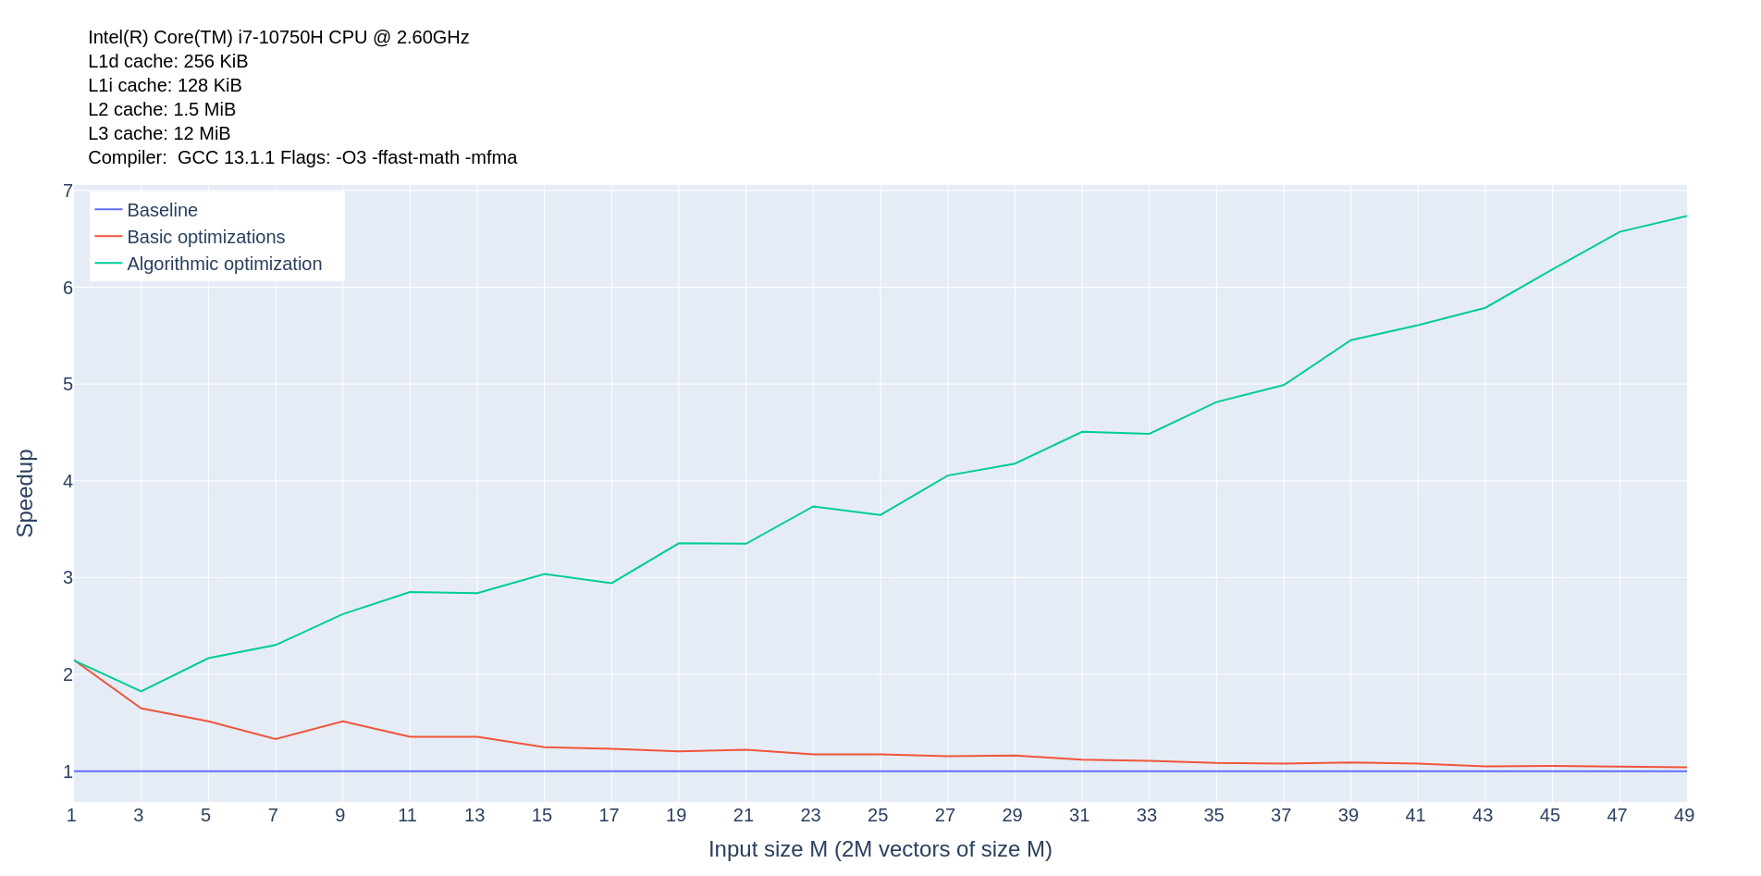
Algorithmic optimization

Slide 12
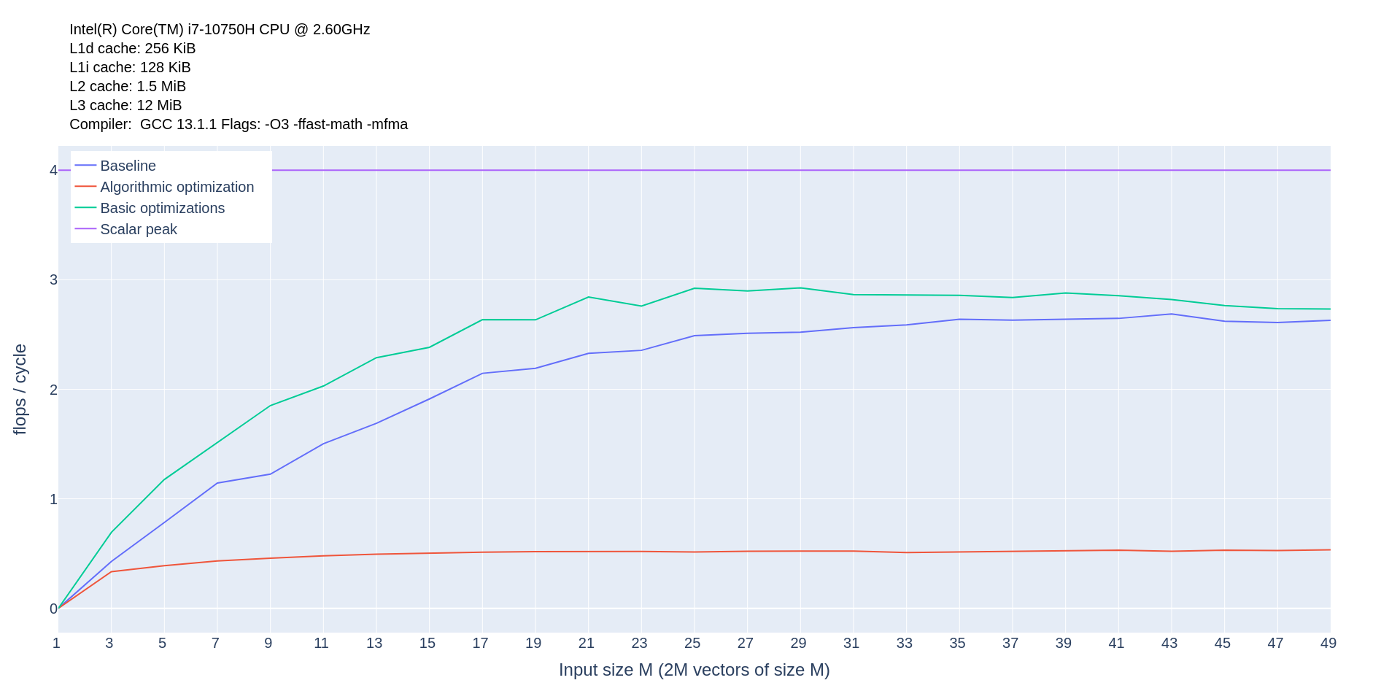
Algorithmic optimization

Slide 13
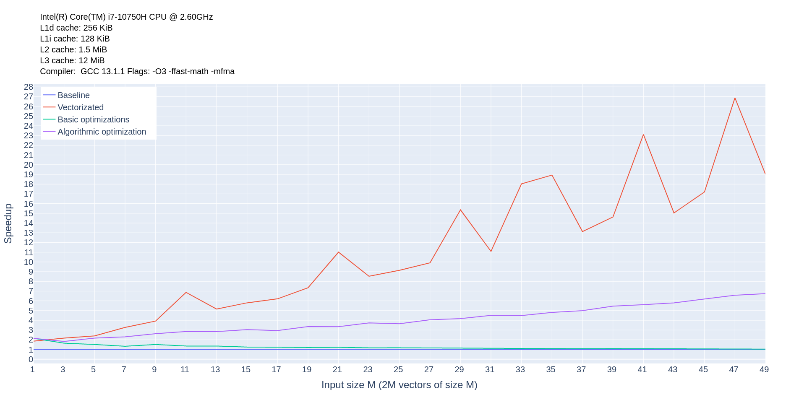
Vectorization

Slide 14
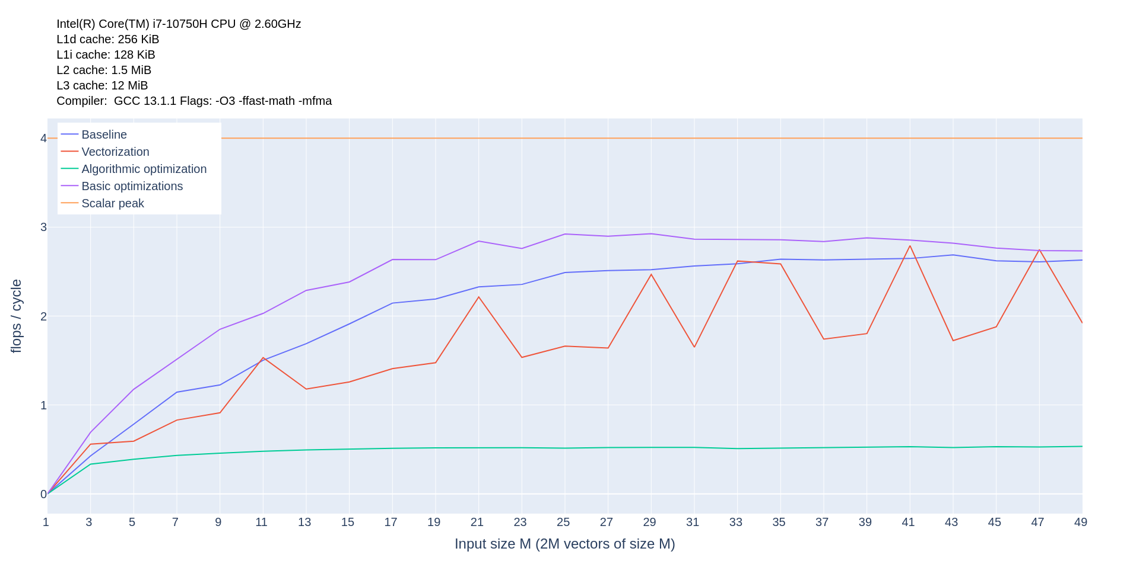
Vectorization

Slide 15
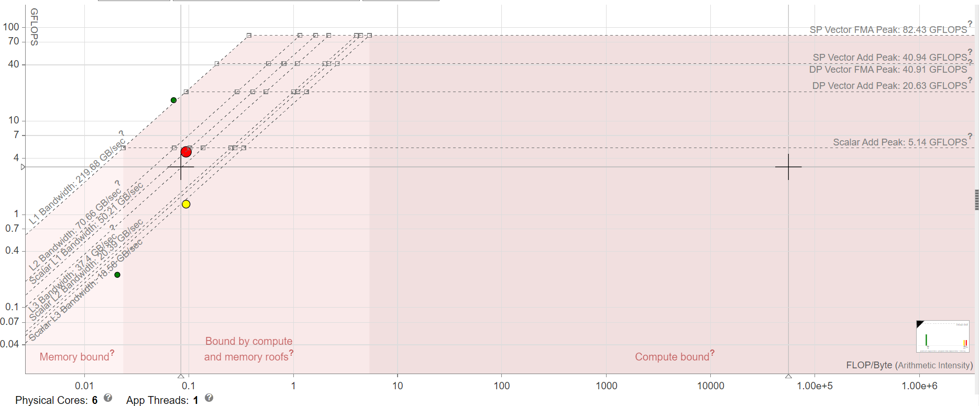
Roofline plot

Slide 16
Thank you! Questions?

