Slide 1
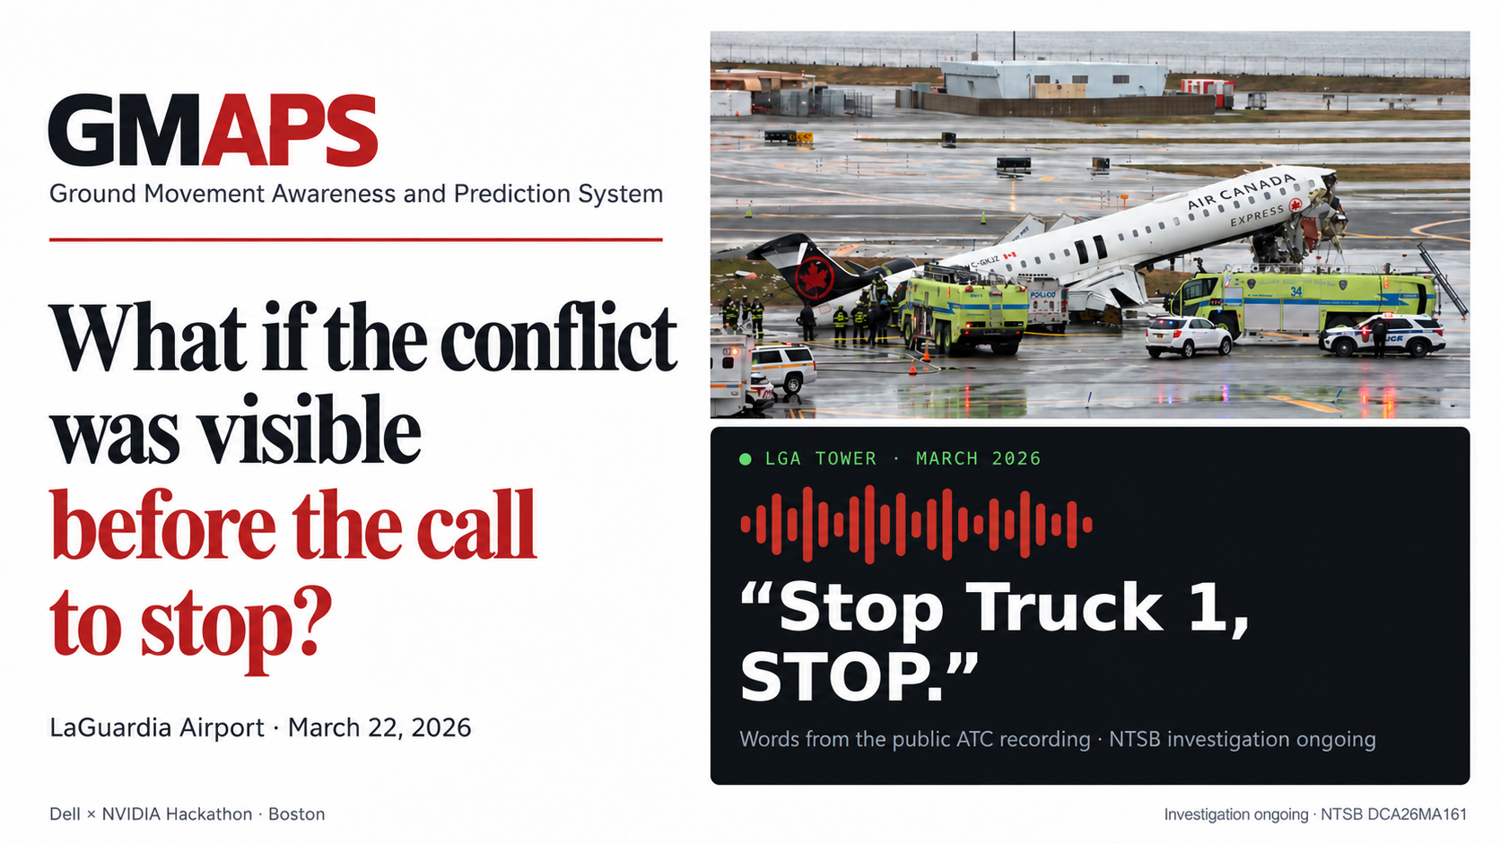
Fireworks: Deploy with Microsoft & NVIDIA · Nov 2, 2026
Notes:
Open on the question. Then the quote. The rest of the deck is the proof that the conflict could have been on a screen eight seconds before that call.

Slide 2
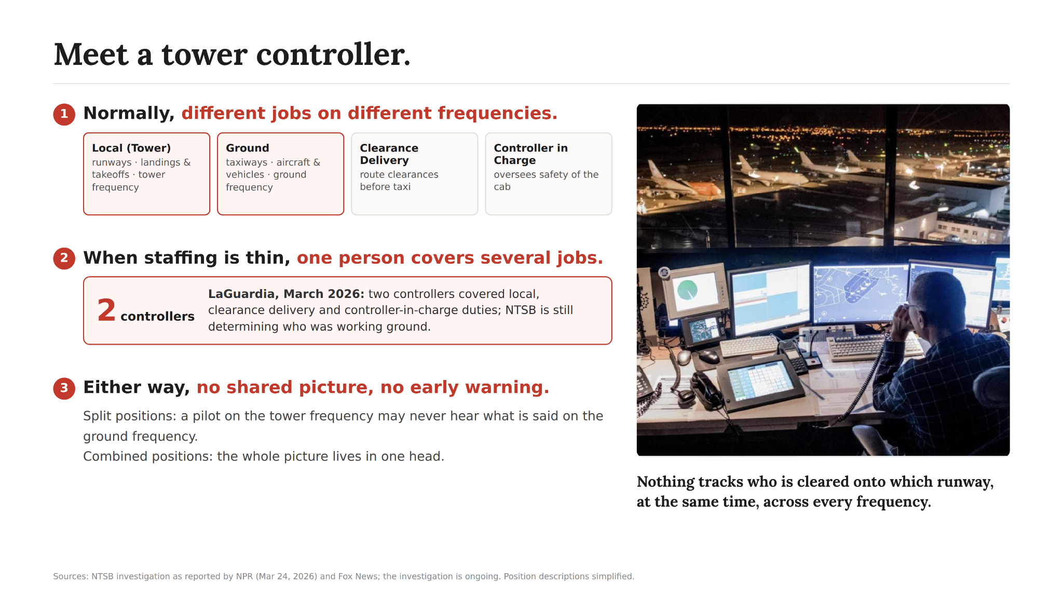

Slide 3
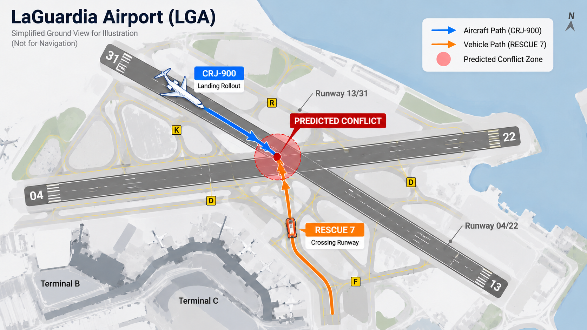
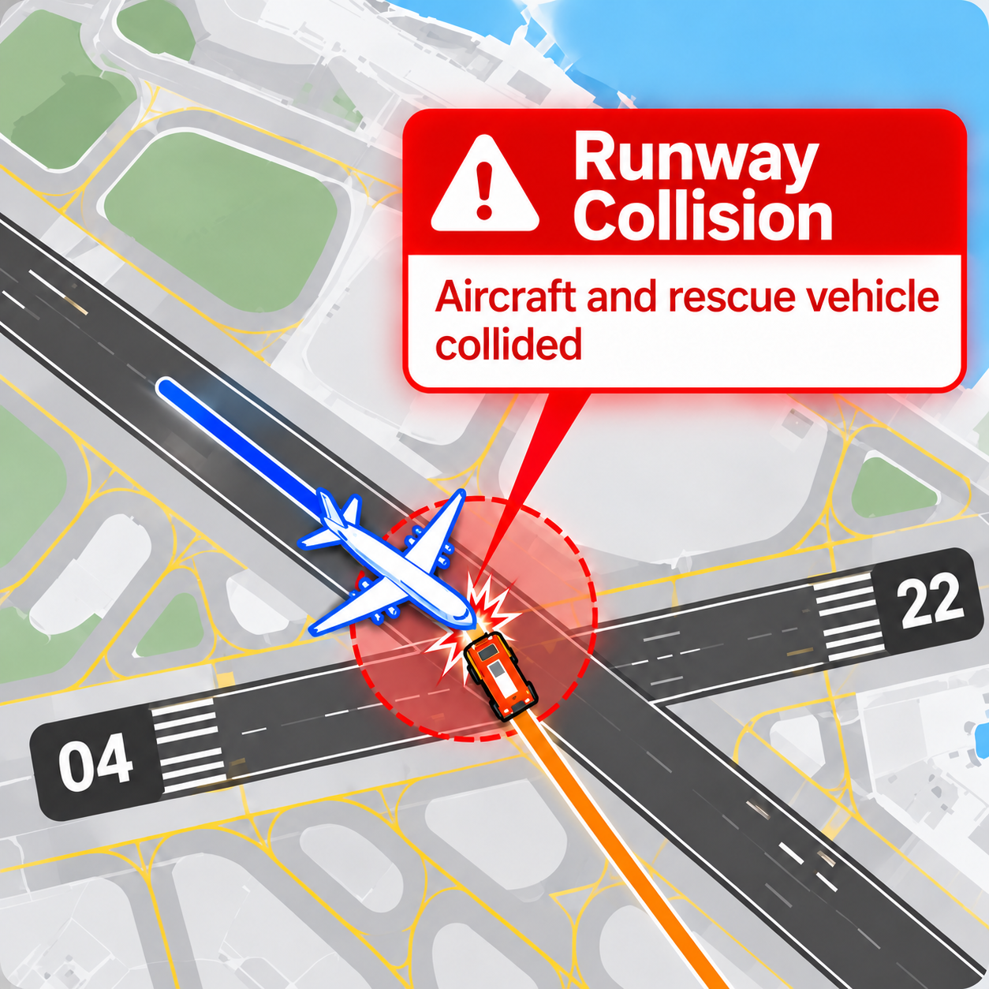
As-is
23:35:07
23:37:04
23:37:12
23:37:22
cleared to land, RWY 4
Truck 1: cross RWY 4 at D
“stop”
Truck 1 on the runway
NTSB preliminary report DCA26MA161 · ASDE-X raised no alert · investigation ongoing

Slide 4
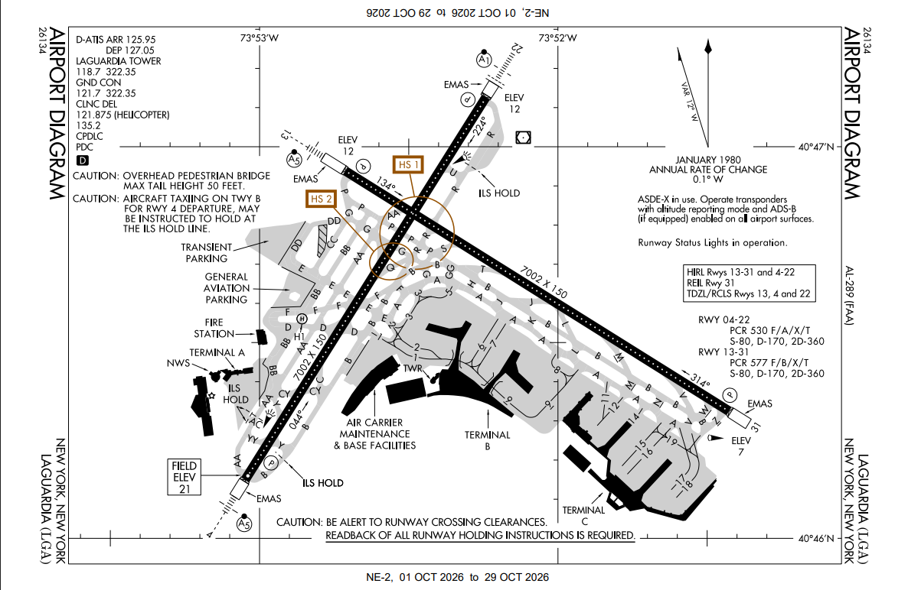

Slide 5
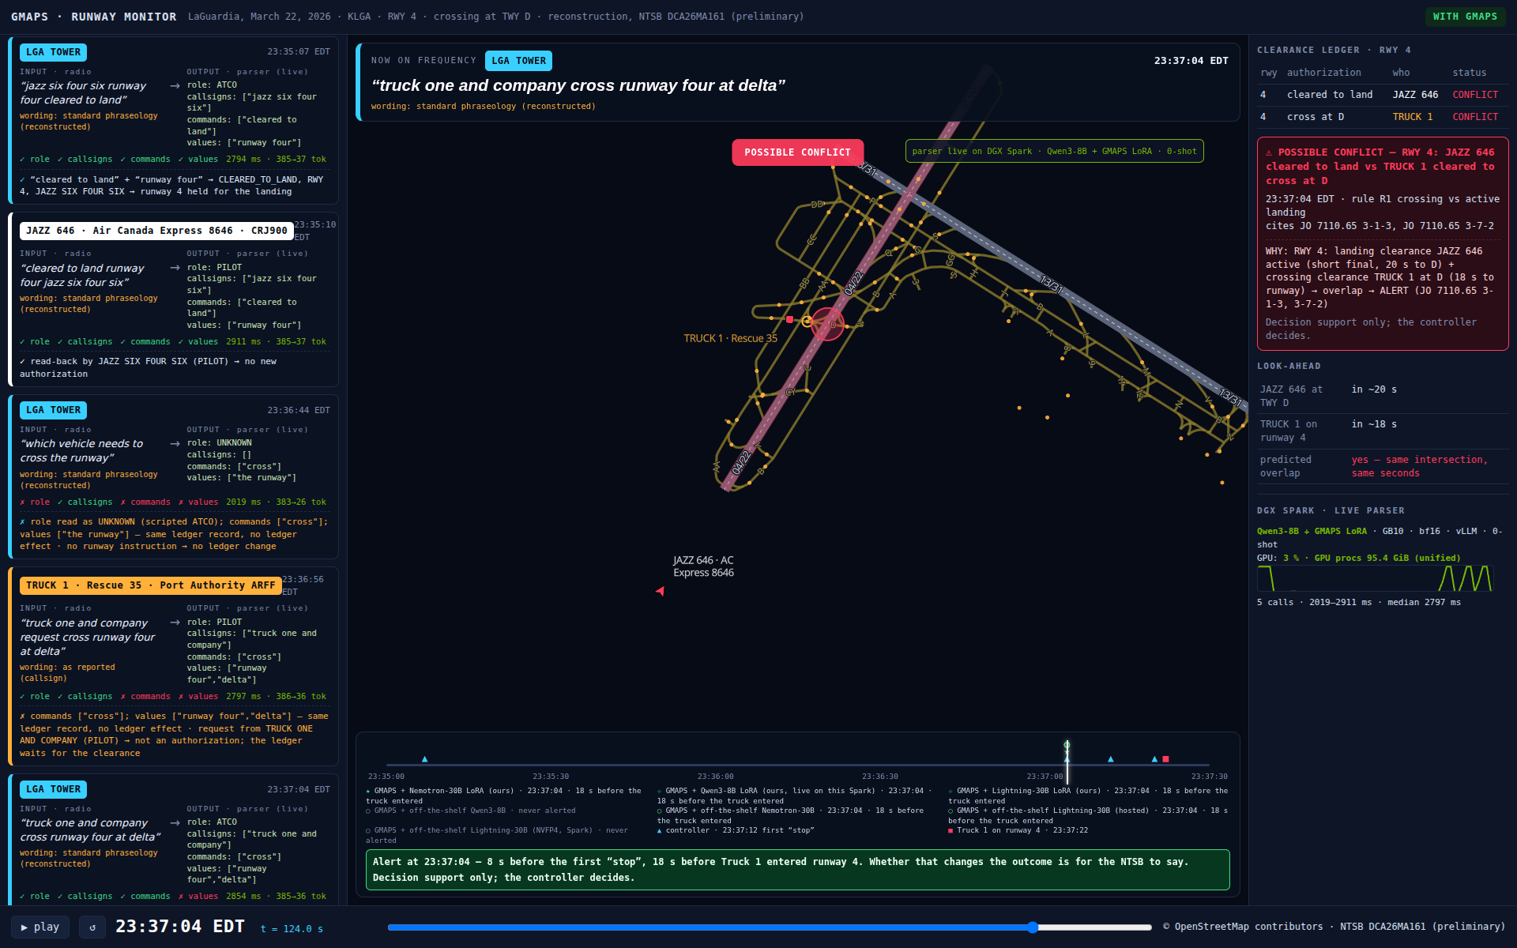
23:37:04 — the second the crossing clearance is parsed, the ledger holds two authorizations for runway 4 and says so. 8 s before the first “stop”, 18 s before the truck.
Notes:
Same radio. The parser runs live on the DGX Spark (right-hand panel, real latencies). The alert names both sides and the rule. Do not say it would have prevented it — say it would have been on the screen.

Slide 6
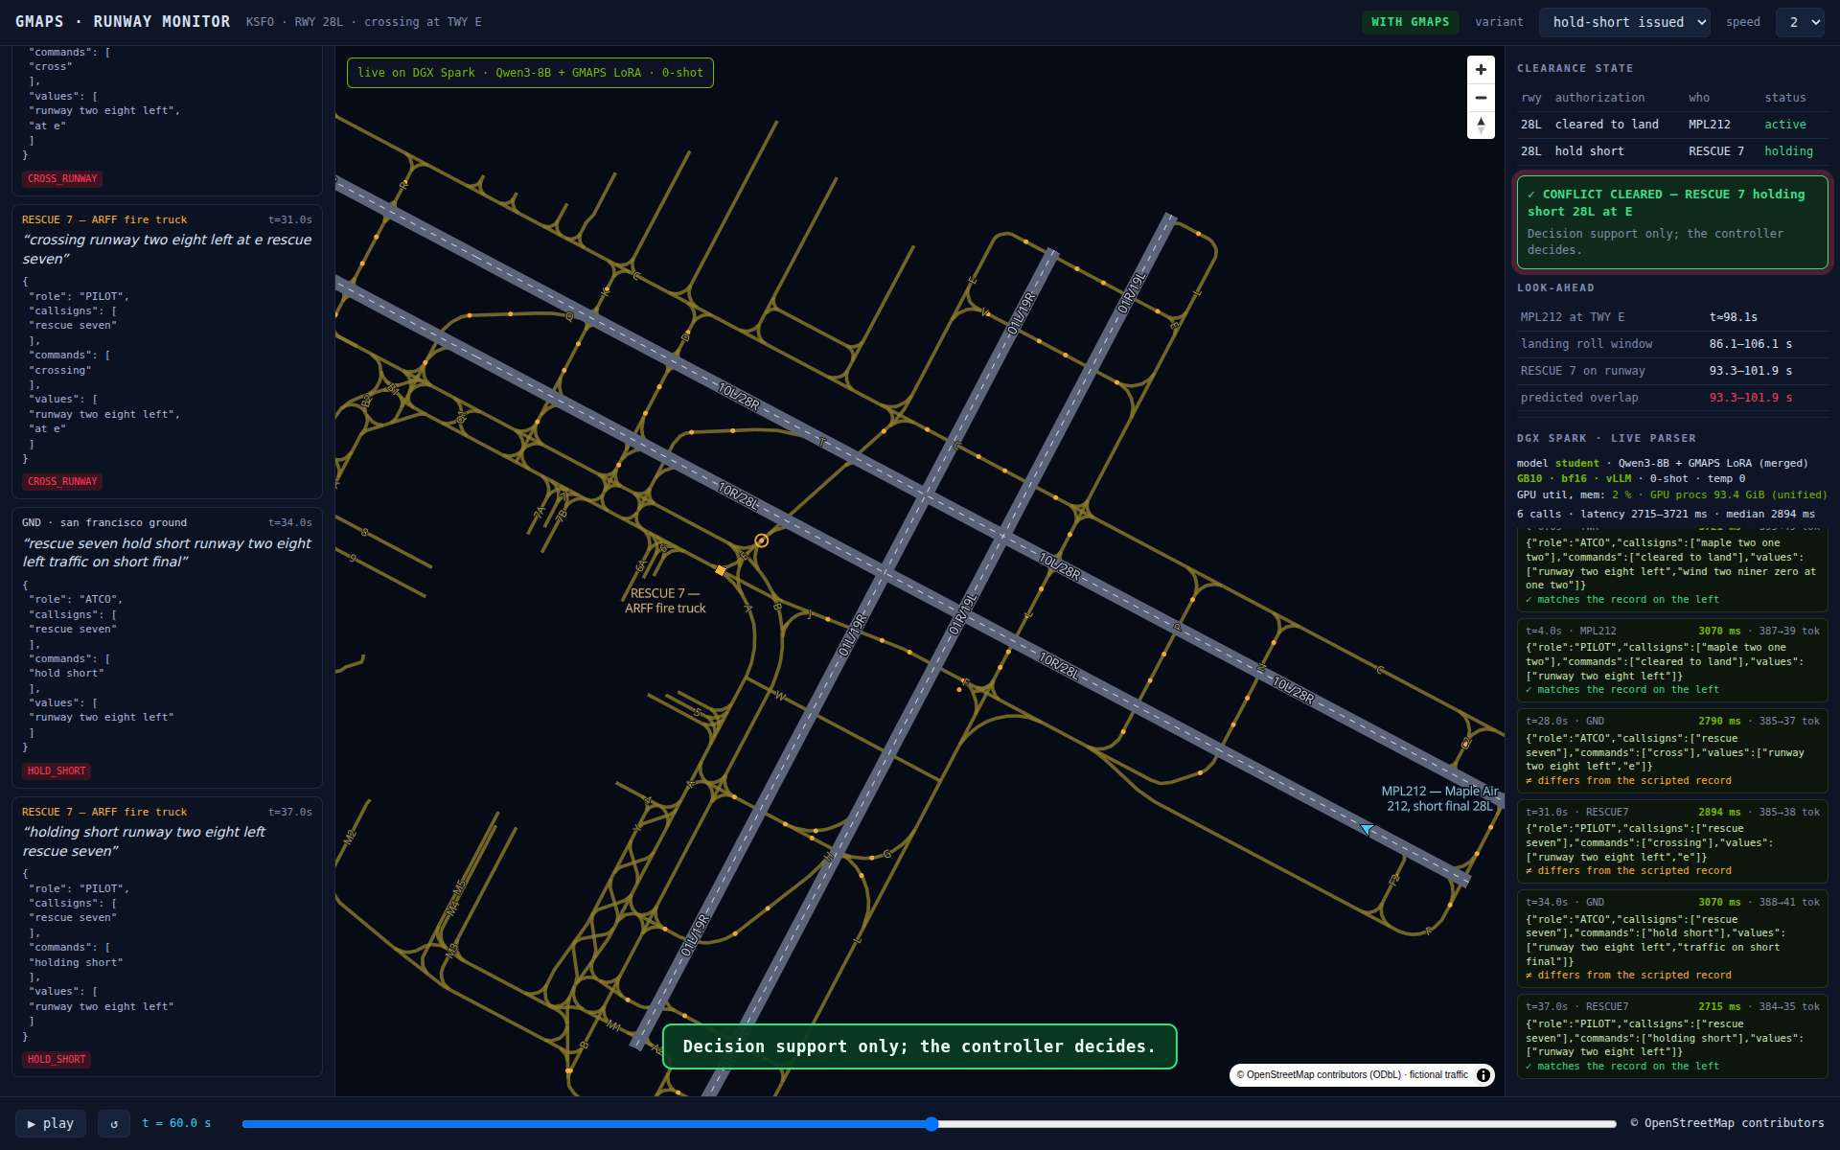
Solution
RADIO
PARSER
LEDGER
LOOK-AHEAD
tower + ground
→
fine-tuned open model
the only learned part
→
who holds which runway
→
will the two movers meet
In the tower: DGX Spark GB10 · vLLM · Nemotron-3.5-Lightning NVFP4 at 1.5 s / transmission · audio never leaves the building
Trained on Fireworks: 5 LoRA jobs, 2 Nemotron bases + Qwen3-8B, 7,857 real + validated examples, $6–30 each
Decision support only. The controller decides.

Slide 7
288
Idiap
Oct 31
real tower transmissions
3 airports never seen in training
gold labels by the dataset authors
not by us, not by a model
test hash frozen before the event
pre-registered, 4 dated addenda
Same prompt, same scorer, same rows for every model. A gap counts only if it passes both McNemar and a recording-level bootstrap — the organizers’ own two tests.

Slide 8
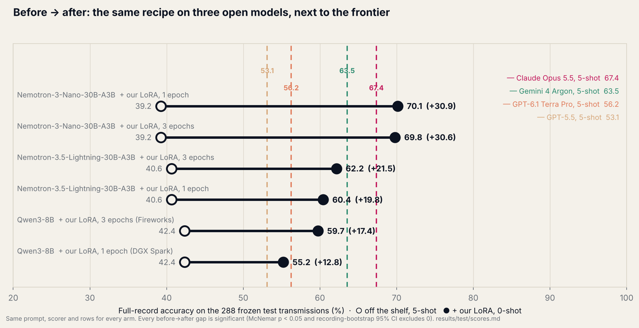
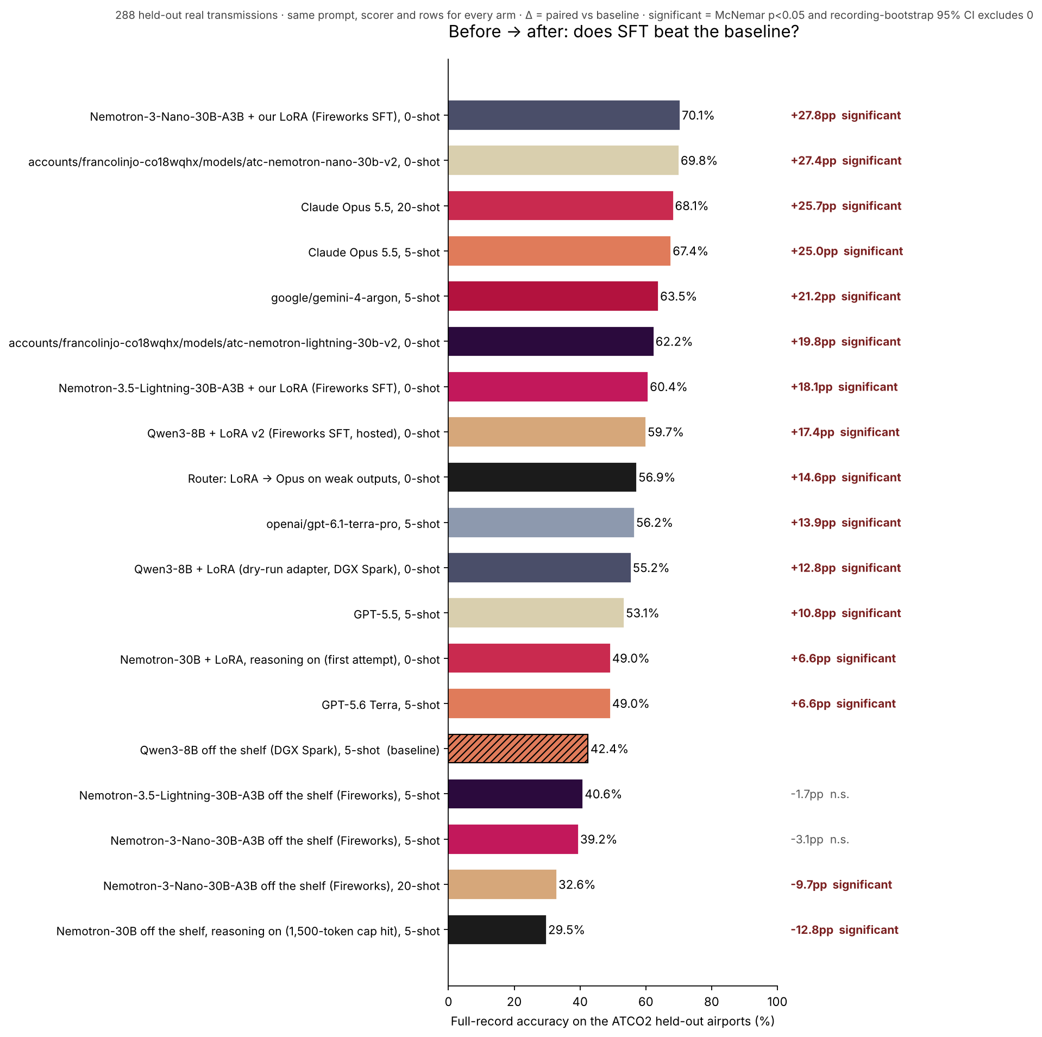
70.1%
Nemotron-30B + our LoRA, one epoch, $10 of training
67.4%
Claude Opus 5.5 — a statistical tie (p = 0.30), replicated at 3 epochs. Gemini 4 Argon 63.5 — beaten, p = 0.02. GPT-6.1 56.2.
Every one of the 21 arms, including the ones that did not help, is in the README leaderboard.
42 → 60
Qwen3-8B before → after the same recipe. 20 examples instead of 5 made the base Nemotron worse. The fine-tune is the effect.

Slide 9
1/45
0.7 s
the cost of Opus per transmission
$0.22 vs $9.92 per 1,000
hosted on Fireworks, p50
Opus 5.3 s · GPT-6.1 4.1 s
1.5 s
0
Nemotron Lightning NVFP4
on a DGX Spark in the tower
bytes of tower audio
leaving the building
List prices Nov 2, 2026 × measured tokens · results/test/scores.md

Slide 10
On the LaGuardia radio, who would have stepped in — and when
GMAPS + fine-tuned parser (Nemotron, Qwen)
23:37:04
Controller: first “stop”
23:37:12
Truck 1 enters runway 4
23:37:22
GMAPS + off-the-shelf Qwen3-8B / Lightning
never — reads the clearance as a pilot read-back
23:36:40
23:37:04
:12
:22
23:37:30
Eight transmissions from the NTSB timeline, each parsed by seven models, each parse replayed through the ledger. viz/lga/stepped_in.json. Whether an alert at 23:37:04 changes the outcome is for the NTSB to say.

Slide 11
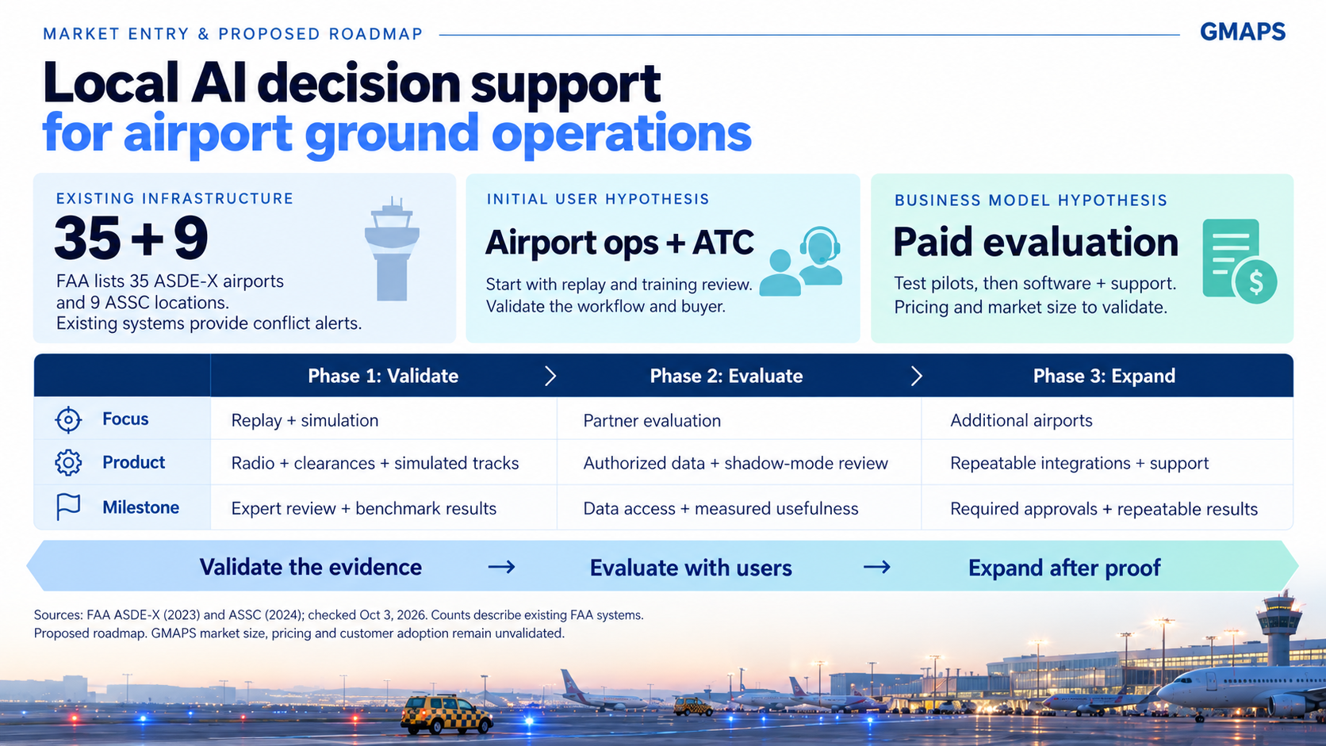

Slide 12

Notes:
Today the controller hears everything and reconstructs the picture alone, under time pressure. GMAPS organizes the radio into a structured picture and flags where paths may cross. The human still makes every decision. Audio is continuous. Understanding should be structured. Thank you.

Slide 13


