Slide 1
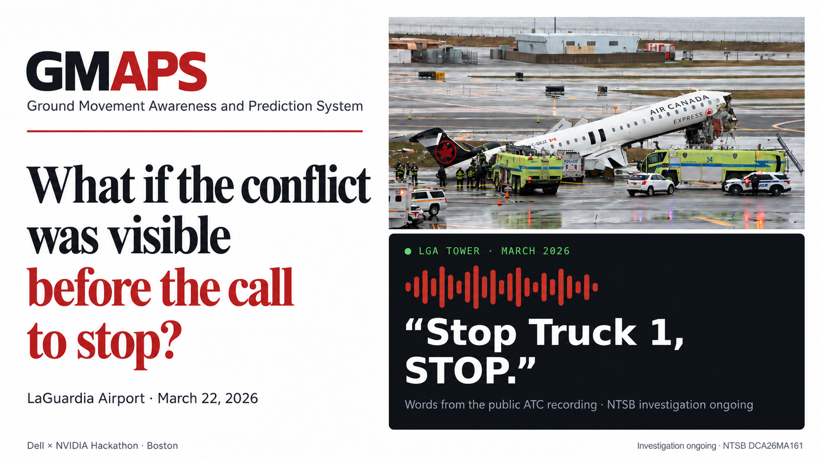

Slide 2
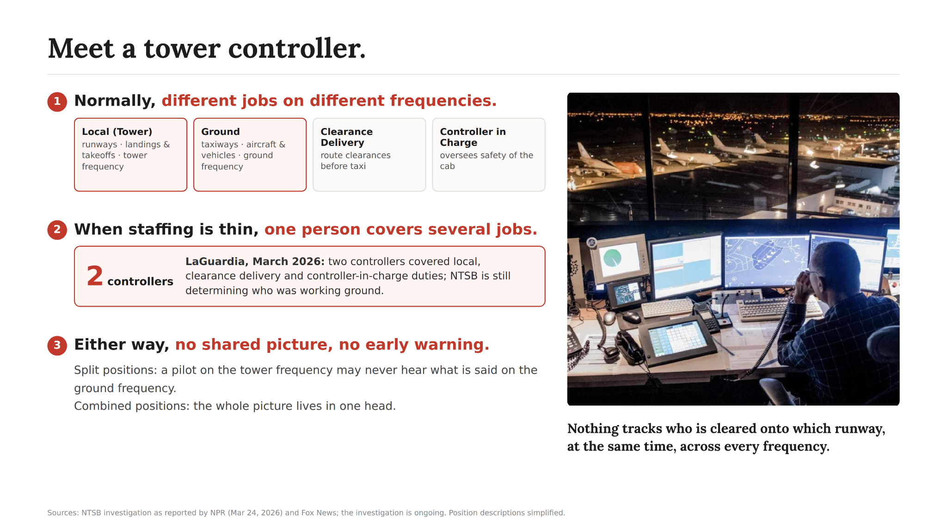

Slide 3
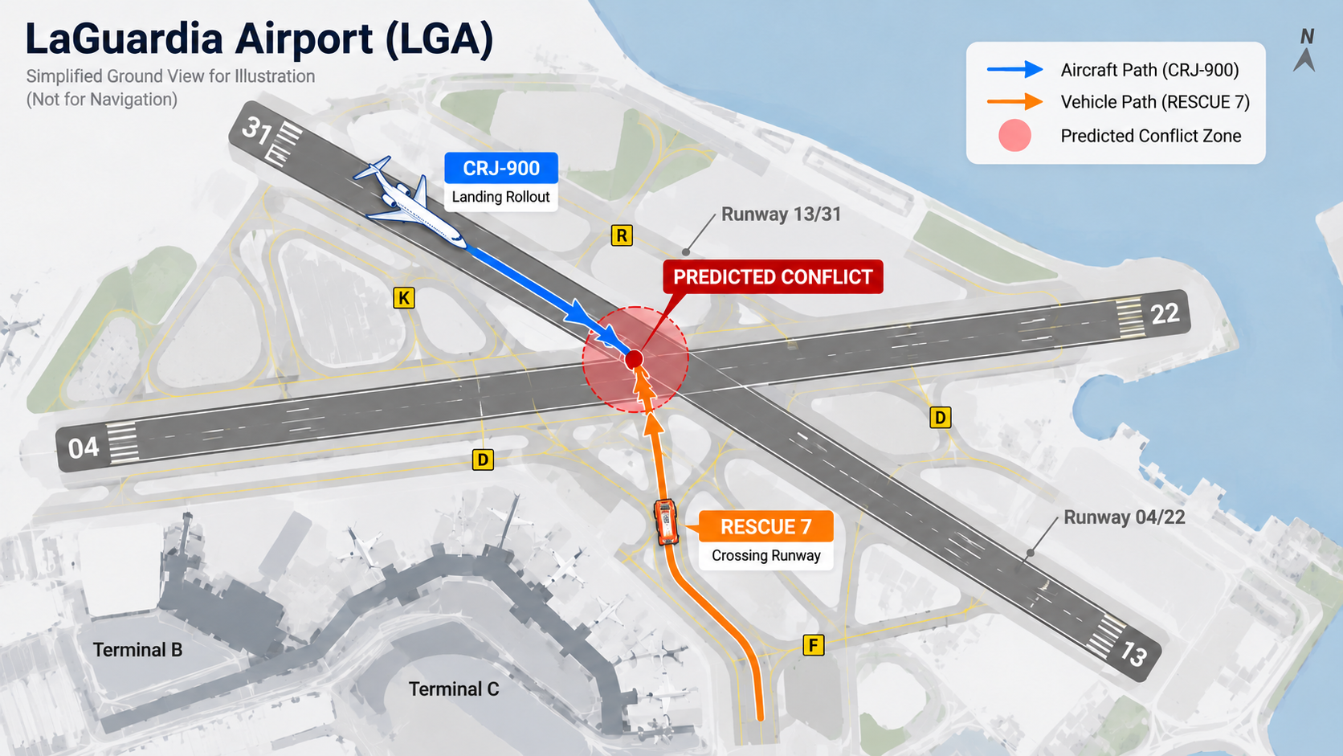
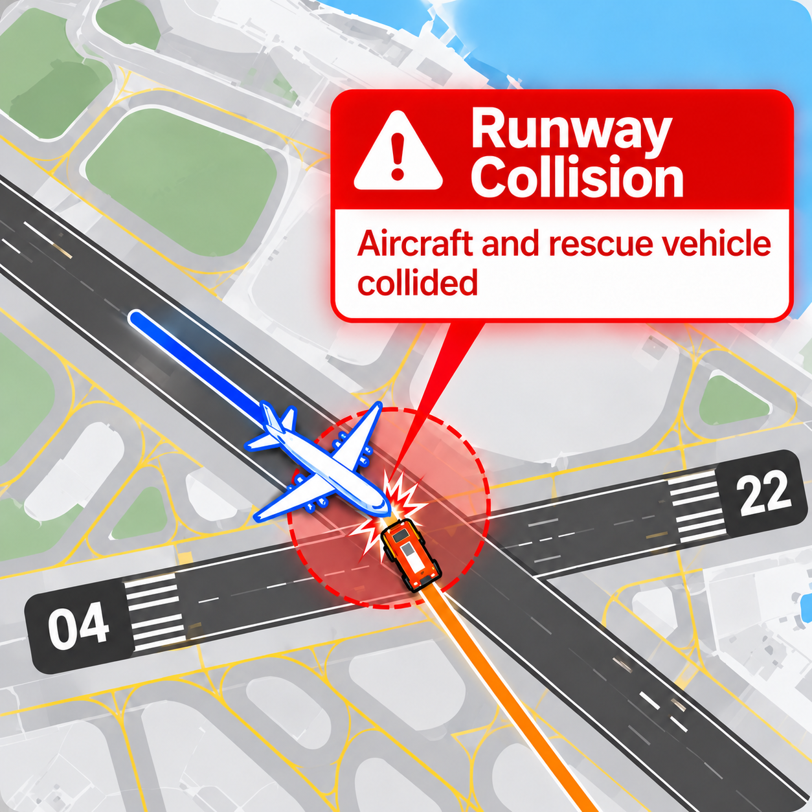
As- Is Process

Slide 4
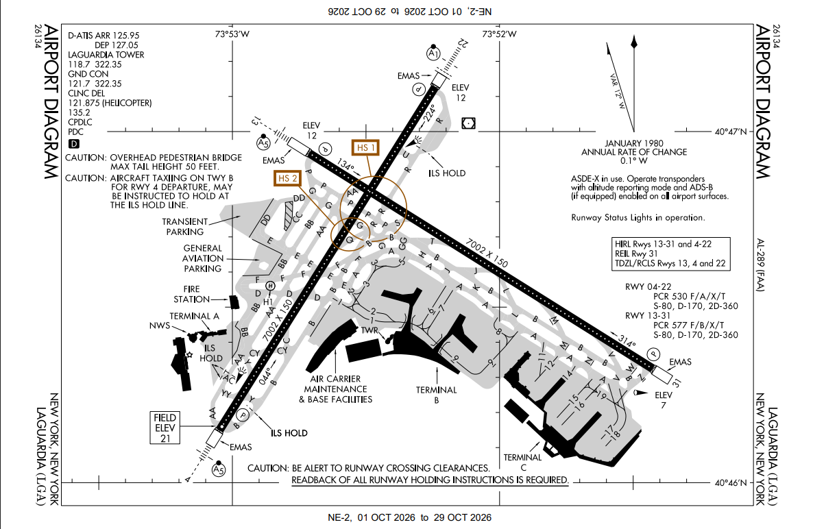

Slide 5
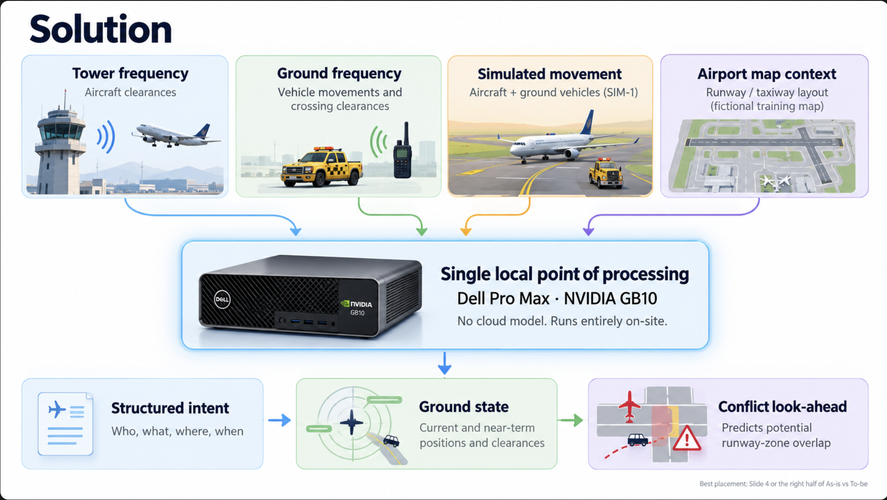





Solution
Tower frequency
Ground frequency
Vehicle ops
Airport map
↓
Single local point of processing
Dell Pro Max · NVIDIA GB10
No cloud connection required.
↓
Structured intent
→
Ground state
→
Conflict look-ahead
Notes:
Point top to bottom. "We ingest the tower, ground and vehicle frequencies, plus a reviewed airport map. Everything runs on one Dell GB10 on site, no cloud. Out comes structured intent: who was told what, where. That updates the ground state, and our deterministic layer checks whether two intended paths overlap in space and time, and alerts the controller with the evidence." The language model reads language; the geometry is plain code, so it cannot hallucinate a taxiway.

Slide 6
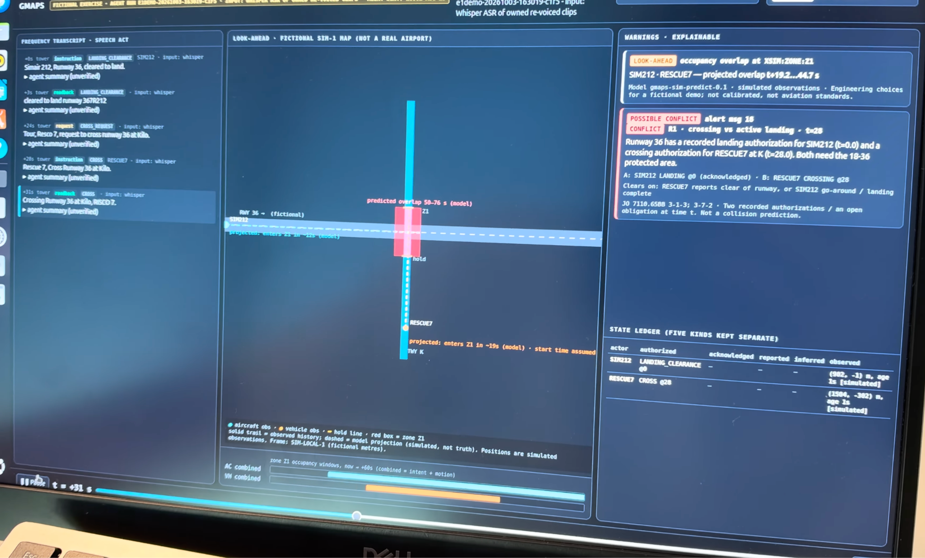

Slide 7
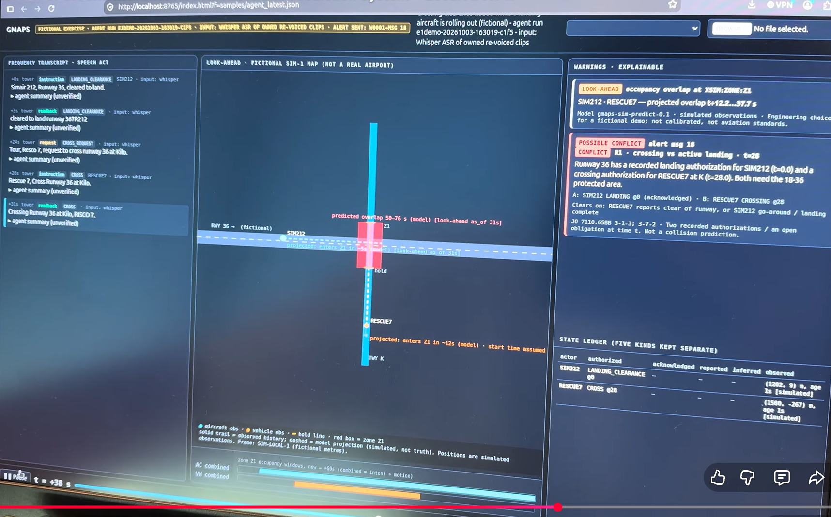
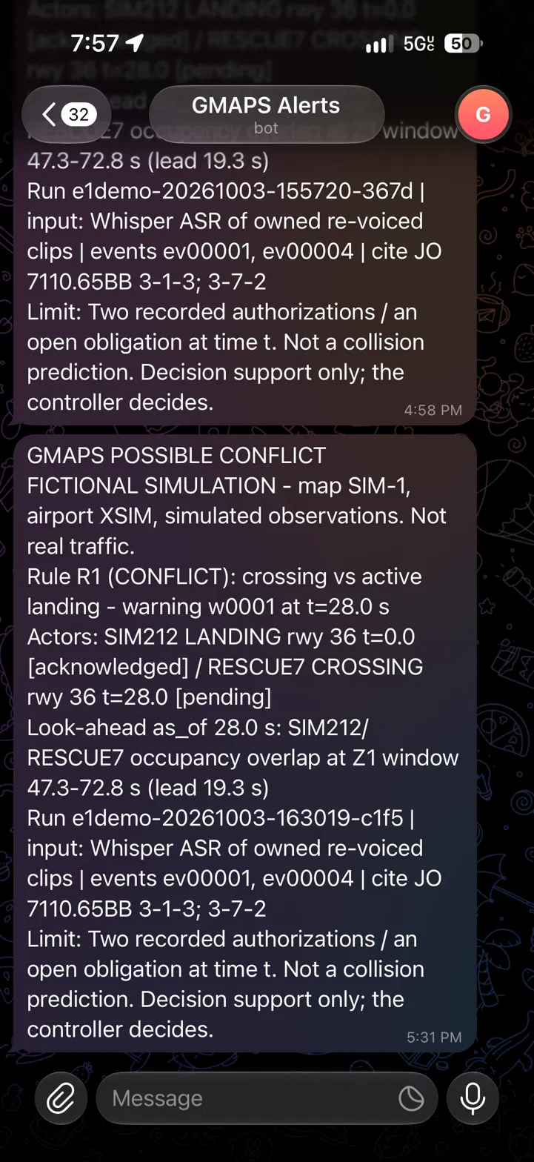
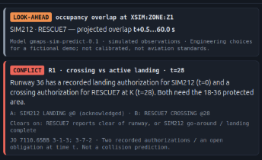
Live prototype · fictional exercise · simulated movement observations
Notes:
Switch to the live app. Narrate: audio, transcript, structured data, map, alert. Prompts: Who is moving? Where are they going? What instruction was given? Will paths intersect? The zoomed card shows the two warnings: a look-ahead overlap at zone Z1, and a crossing authorization issued while a landing is still active, each with its sources. If the live demo fails, stay on this slide.

Slide 8
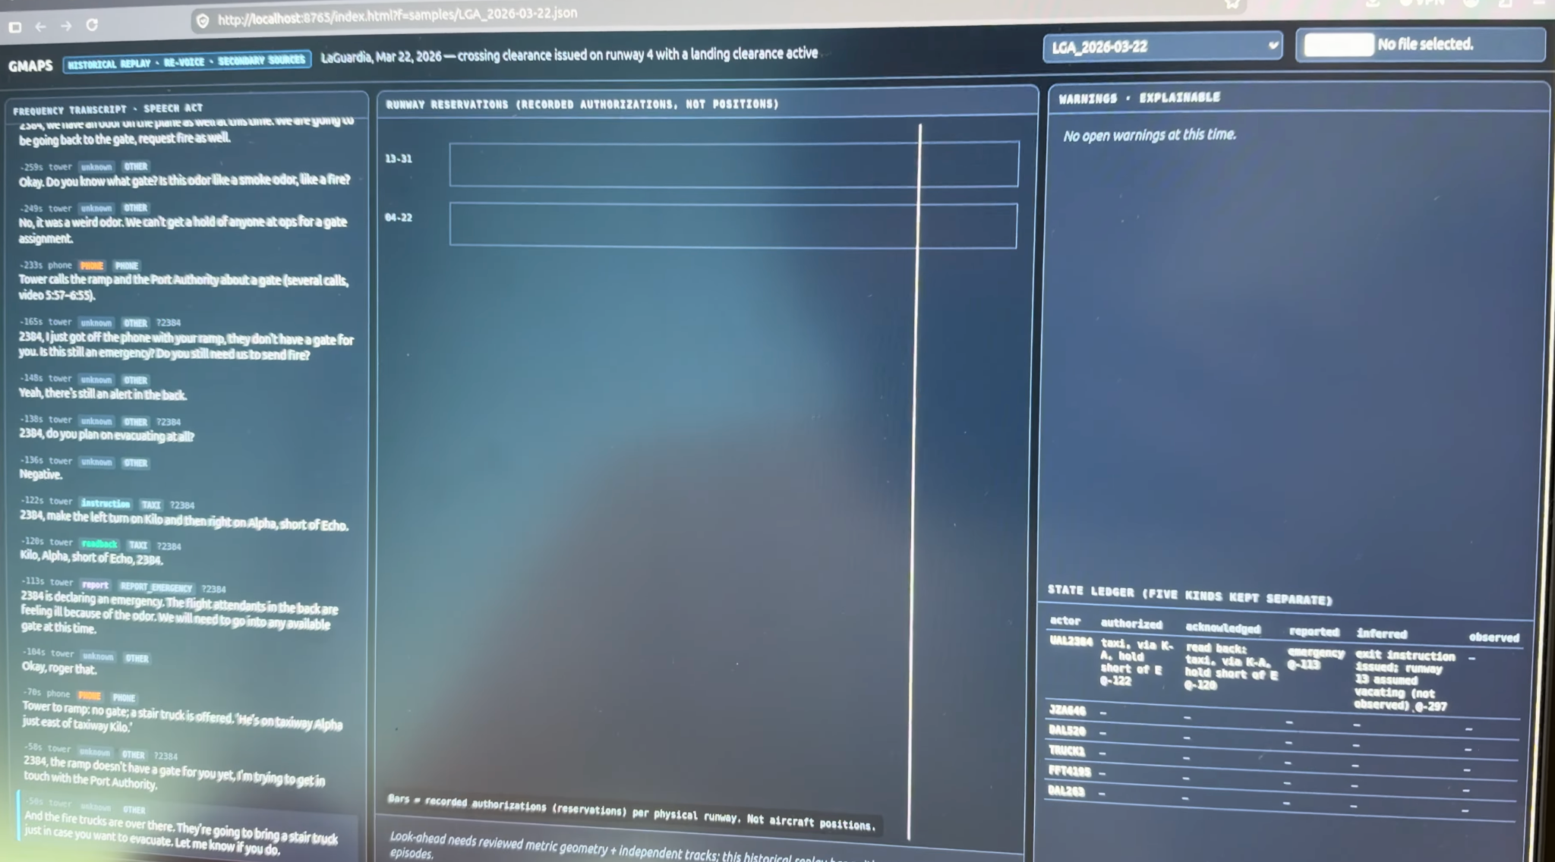

Slide 9

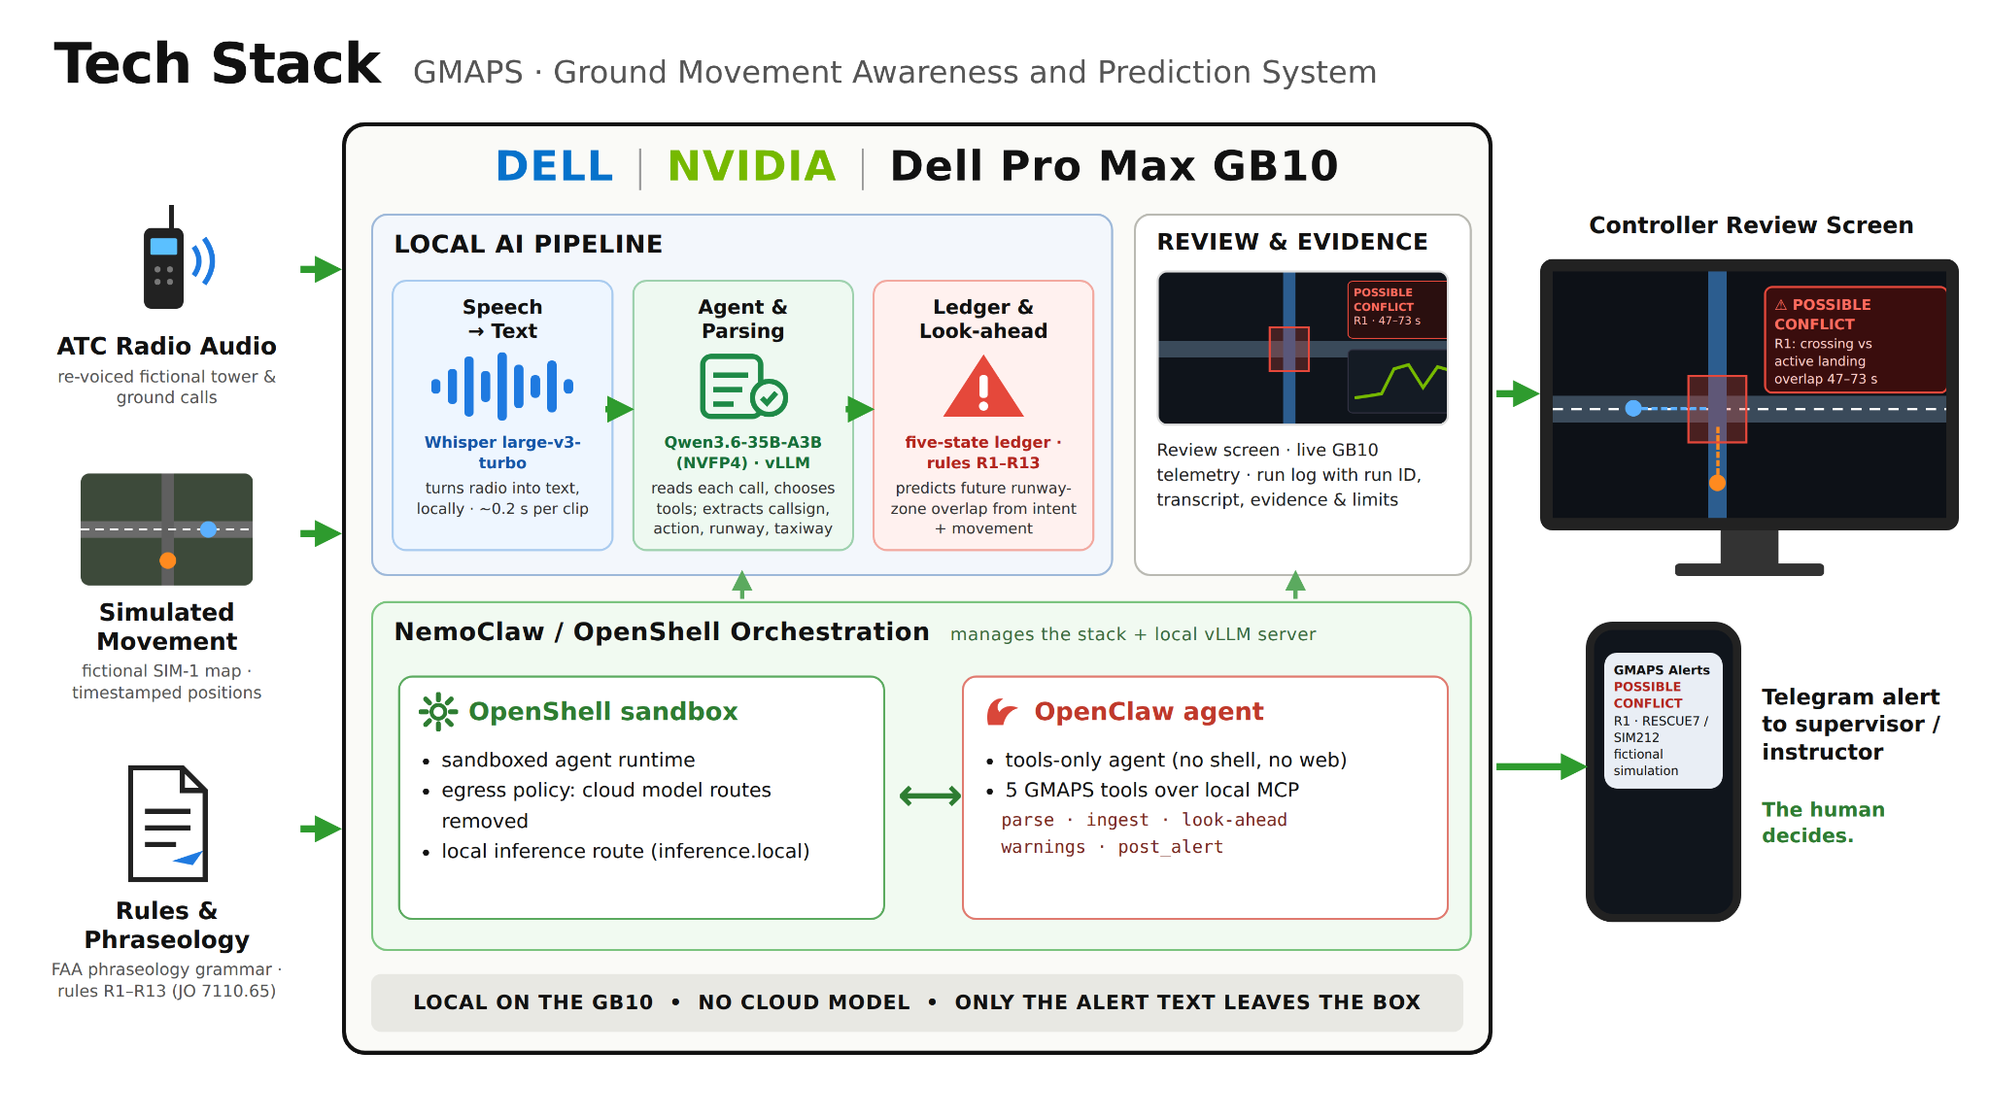


Slide 10
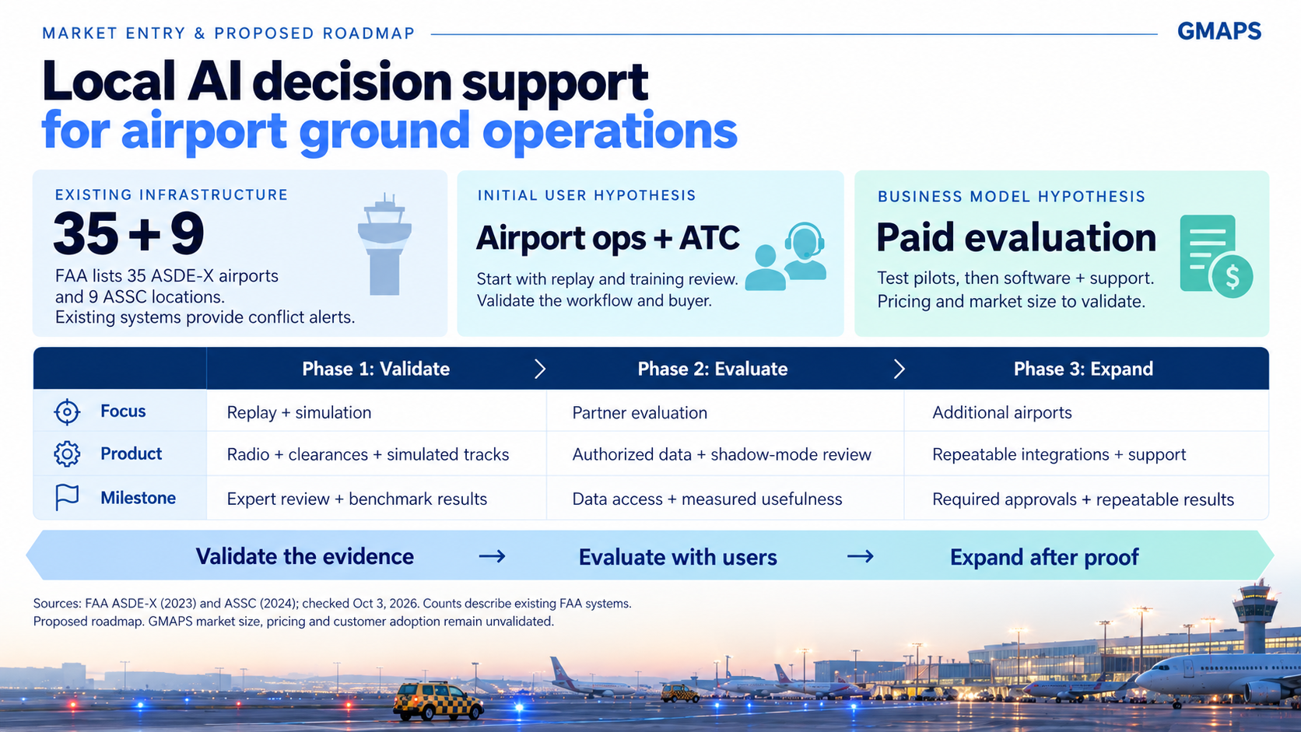

Slide 11

Notes:
Today the controller hears everything and reconstructs the picture alone, under time pressure. GMAPS organizes the radio into a structured picture and flags where paths may cross. The human still makes every decision. Audio is continuous. Understanding should be structured. Thank you.

Slide 12
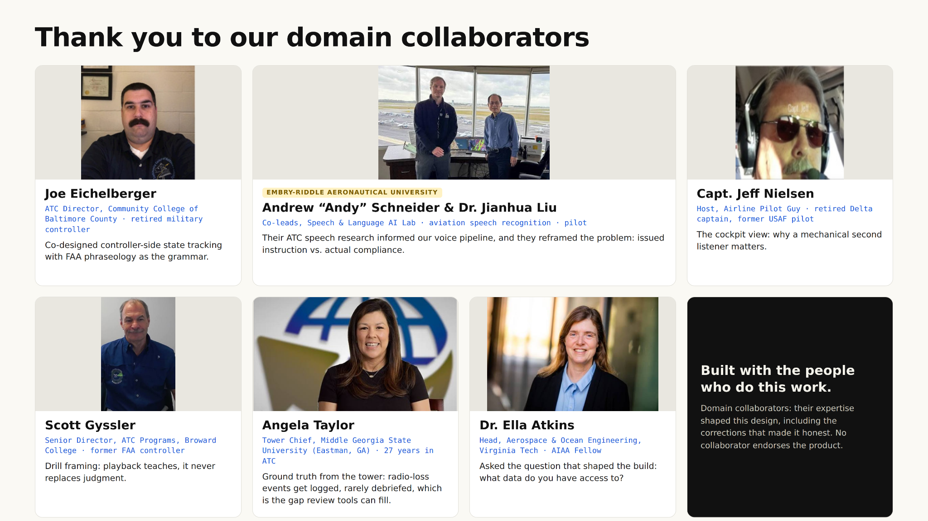

Slide 13
OPEN AGENT HACKATHON 2026 · WILDCARD [TINKERER]
New this hackathon: an agent loop with roles that check each other
Planner grammar first; what the grammar cannot type goes to Nemotron; look-ahead only for a shared zone.
Executor bounded tools only: parse, ledger, look-ahead, explain, alert. No shell.
Evaluator grounding rule on every model answer; one retry with the airport vocabulary; then escalate "needs readback".
Explainer + Critic Nemotron drafts two sentences; a second Nemotron call critiques them against the facts; one revision, else labelled ledger text.
Risk SIM-1 look-ahead; stale positions give "prediction unavailable", not "no conflict".
Traces one JSON line per step: role, provider, model_reported, latency, outcome (logs/, tools/show_trace.py).
Run it python3 run.py · POST /run · SAMPLE_MODE=true with no credentials · 3 input/output examples · 21 new tests passing.

Slide 14
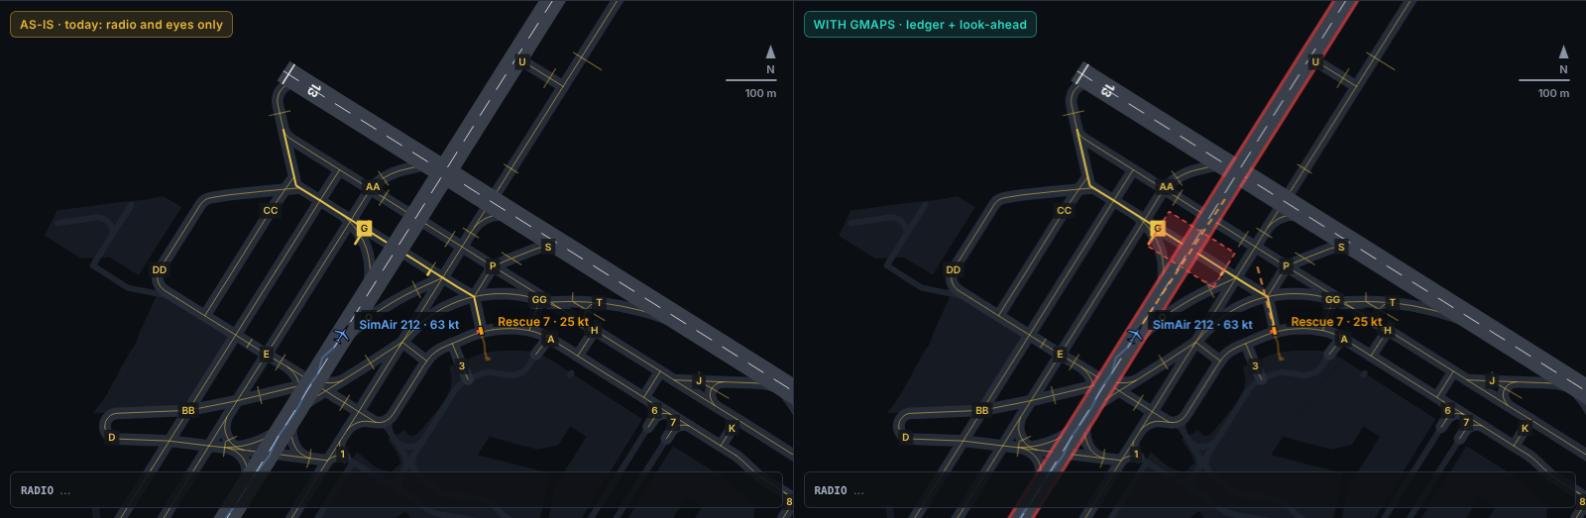
NEW · SIMULATED · FICTIONAL TRAFFIC ON THE REAL KLGA LAYOUT
LaGuardia view: AS-IS vs WITH GMAPS, side by side

Slide 15
HONEST STATUS
Sponsor technology: what is real at submission time
NVIDIA Nemotron: nemotron-3-nano-30b-a3b-nvfp4 served locally by vLLM on the DGX Spark (GB10). It runs the explainer and critic roles.
Meterless Nightshift: provider client built (OpenAI-compatible, Console URL and runtime key, meterless headers, retry, typed "unavailable"). Live run through Nightshift: not run (Nightshift was not running at submission time).
Meterless Engine (H-MEM): not integrated. A local runway memory with the same role runs in its place, with a passing test.
Zetaris: not integrated. The table design and an idempotent loader are ready; the agent uses a local store with the same interface.
Local-execution proof: tools/local_proof.py audits every connect() and charts GPU use from nvidia-smi during a run.

Slide 16
DECLARATION
Pre-existing vs new
Pre-existing (commit e97a9a1 and earlier): grammar parser, ledger and rules, SIM-1 simulator and look-ahead, airport data, fine-tuned Qwen3-4B LoRA parser (record exact 0.254 → 0.652 on 138 held-out Whisper-text lines), vLLM / DGX Spark runtime, original demo page.
New (e97a9a1..HEAD): agent loop with critic, Nightshift provider, traces, sample-mode replay, run.py API, LaGuardia animated view, local-execution proof, Nemotron-vs-4B comparison runner, deck and docs.
Limits: simulated traffic and positions, synthetic phraseology; decision support only; GMAPS never transmits, the controller decides.

