Slide 1


Reasoning Agents Project
Policy Networks for Non Markovian Deep RL
Faculty of Information Engineering, Informatics, and Statistics
Department of Computer, Control, and Management Engineering “Antonio Ruberti”
Master’s Degree in Artificial Intelligence and Robotics
Federica Coppa
Francesca Cardia
Andrea Del Vecchio

Slide 2
Introduction
Goal: develop a non-Markovian agent that solves a navigation task with non-Markovian rewards:
Combination of RL agent with an automaton: PPO + DFA.
non-Markovian agent
Sapientino case environment
sequence of actions that a standard RL agent could not solve.
solves
goal

Slide 3
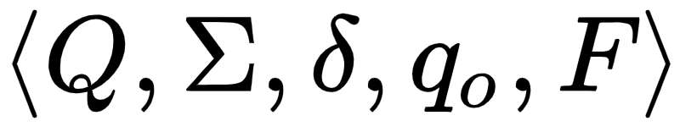
Deterministic Finite Automata (DFA)
DFA
mathematical model
maps an input sequence to an output
final states
states
symbols
initial state
transition
function

Slide 4
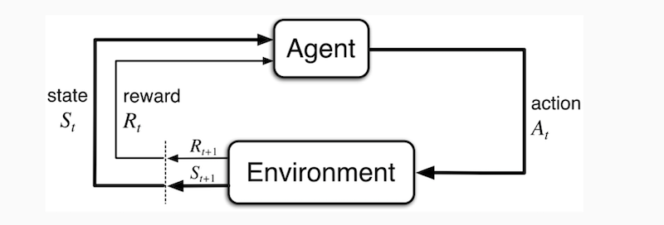
RL general setting

Slide 5
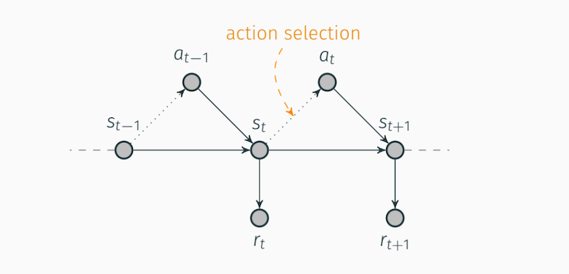
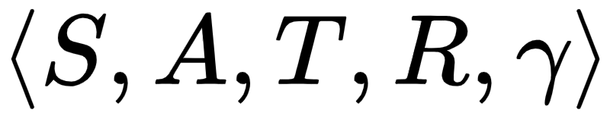
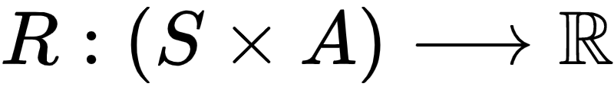
Markov Decision Processes (MDPs)
states
discount factor
actions
transition function
reward function

Slide 6
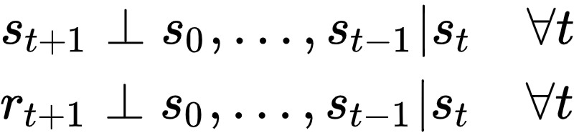
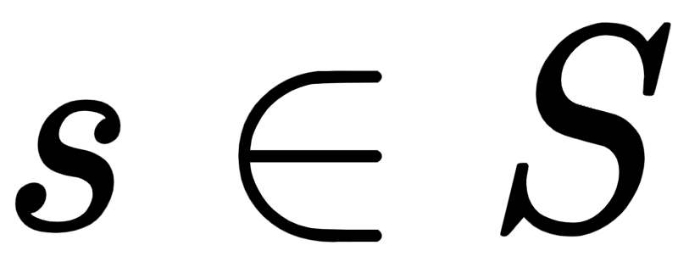
Properties of MDPs
A policy is a solution for a MDP which assigns an action to each state. Moreover each MDP has an optimal policy able to maximizes the expected rewards for every starting state

Slide 7
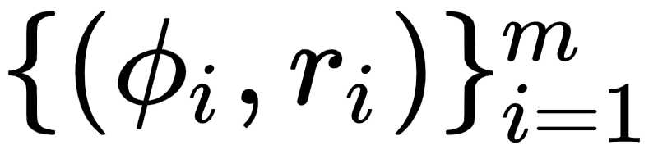
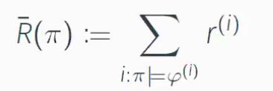

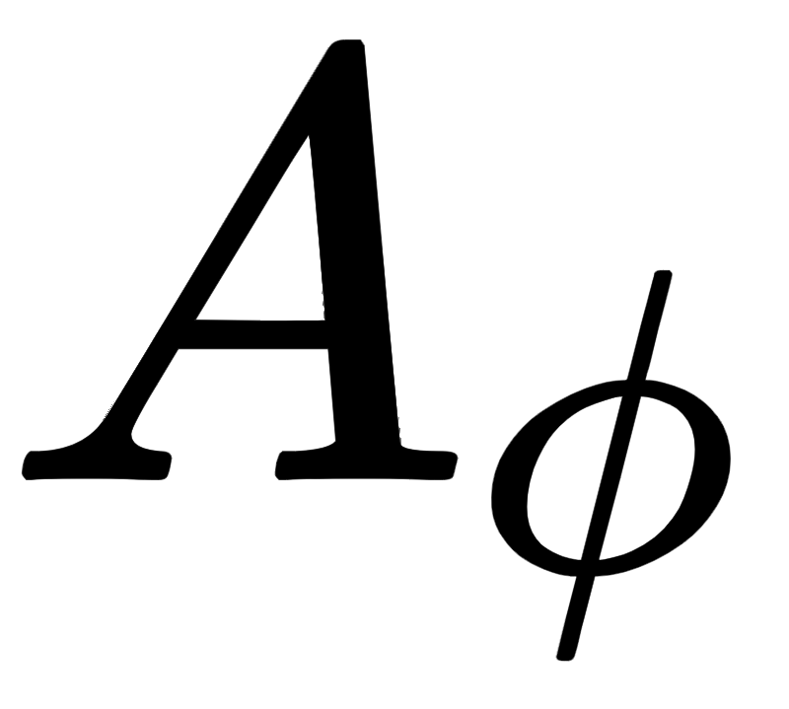

Non Markovian Rewards Decision Processes
(NMRDPs)
The reward are the real valued function over finite state-action sequences (according to a specific history):
Temporal Rewards Specification (given )
Rewarding with automata

Slide 8
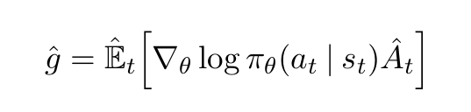

Proximal Policy Optimization (PPO)
A policy gradient algorithm for Deep RL.
Advantage is a measure of how remunerative a certain action was in a determined time instant.
Difference between the action value in a state and the average value of that state

Slide 9
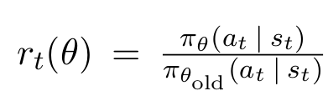
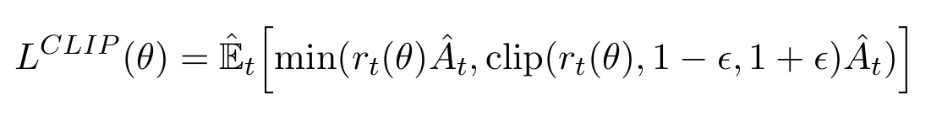
Proximal Policy Optimization (PPO)
Problem: “too big” policy updates often lead to unstable behaviour
Solution: policy gradient objective is replaced with clipped surrogate loss.

Slide 10
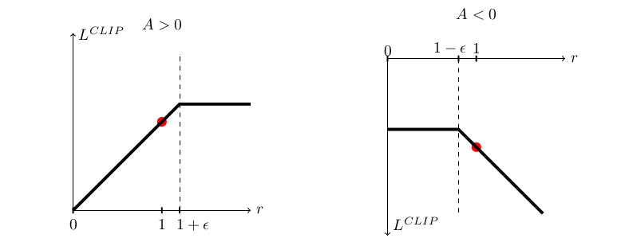
Proximal Policy Optimization (PPO)
Clipping forces the policy updates to be conservative: the updated policy not “too far away” from the older policy

Slide 11
Gym-Sapientino environment
It is a RL discrete action environment
The actions continuous on the state.
Observations:
Angular Velocity
Position
Linear
Velocity

Slide 12
Temporal Goals on Gym-Sapientino
The agent can reach temporal goals characterized by a visited sequence of colors:
When the agent reaches a temporal goal it receives a reward from the environment.
It is possible to specify which colors are included in the temporal goal. SINK state is signed as 2 to indicate failure .

Slide 13
Temporal Goals on Gym-Sapientino (contd.)
Actions: LEFT, RIGHT, FORWARD, NULL, BEEP.
Double BEEP problem: in order to test the temporal goal satisfaction, we have interfaced with this problem. In fact we have controlled, during the training, that the previous visited automaton state was different from the current visited automaton state.

Slide 14
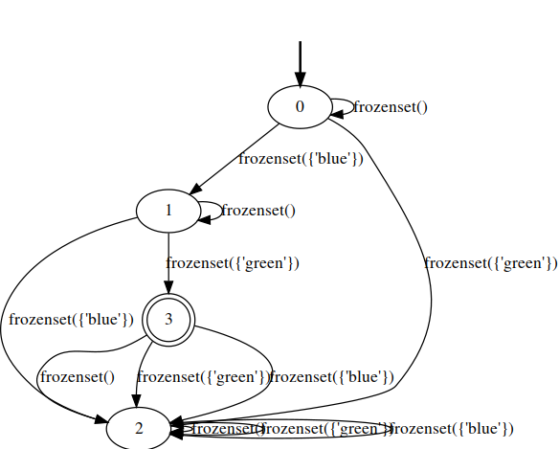
Automaton example (considering only 2 colors, blue and green ):
right sequence to visit: {0,1,3}
no memoryless property

Slide 15
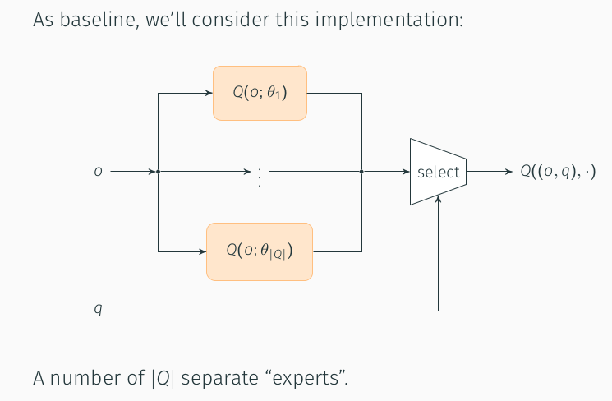
The non markovian agent
different sub-problems division (markovian sub-problems), given the non markovian task.
according to the state of the automaton, it is possible to select one of the |Q| separate experts for the action selection phase.

Slide 16
Non markovian agent: implementation details
We use a single policy network for the non markovian agent.
The core part of the network is divided amongst the different color expert.
Select the expert, the network portion which contributes to action selection we multiply a binary vector to the output of each hidden layer.

Slide 17
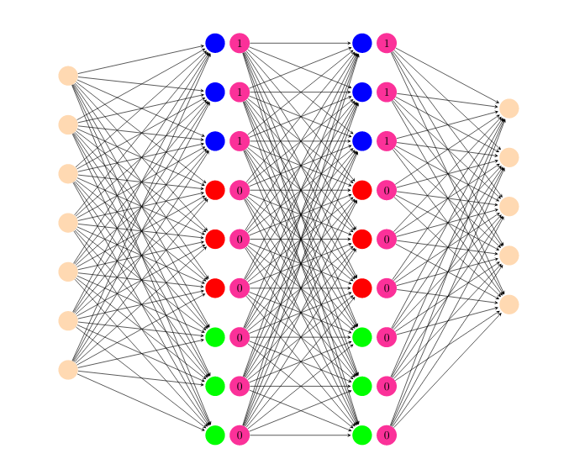
Non markovian agent: implementation details

Slide 18
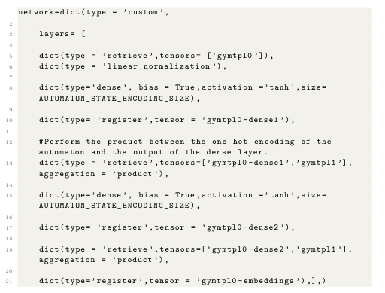
Network Description: implementation details
Retrieve
Linear normalization
Dense
Custom Network
Register

Slide 19
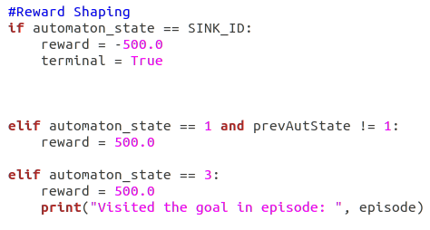
Reward shaping : implementation details
This method is useful to incorporate domain knowledge in the RL agents. In reward shaping, the domain knowledge is represented as a supplementary reward that allows the RL agent to learn more efficiently.

Slide 20
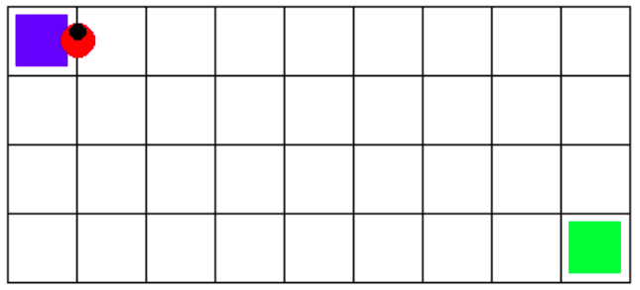
Experiments with two colors
Gym-Sapientino 4x9 map for the experiment {blue ,green}, initial position [2,4] :

Slide 21
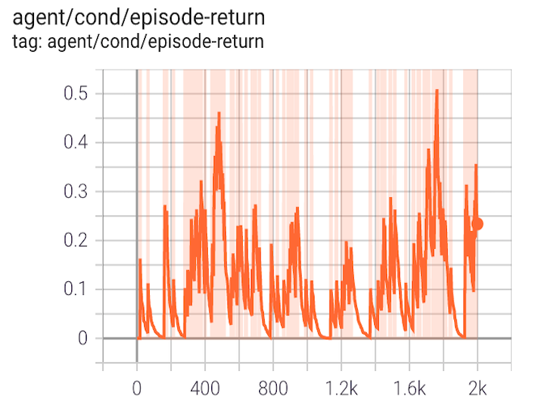
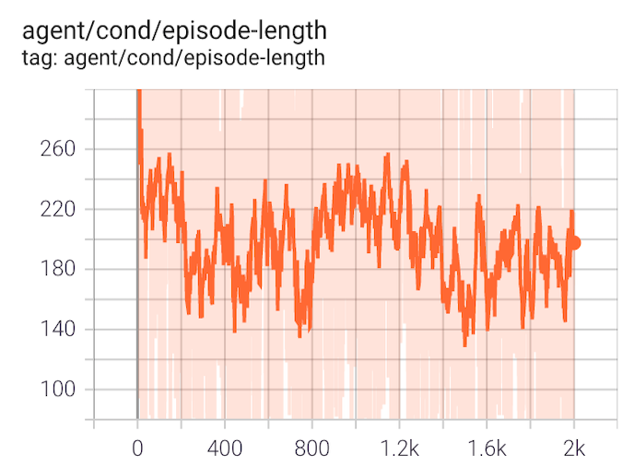
Trial 1 -Plots-

Slide 22
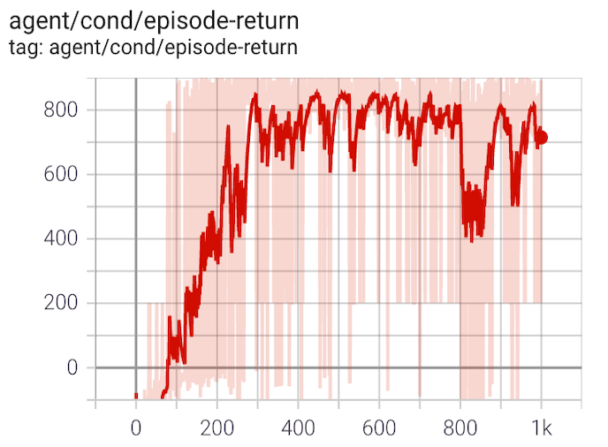
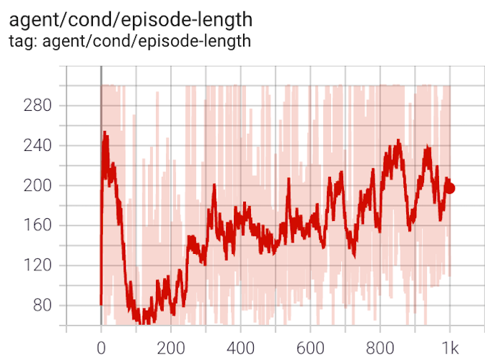
Trial 2 -Plots-

Slide 23
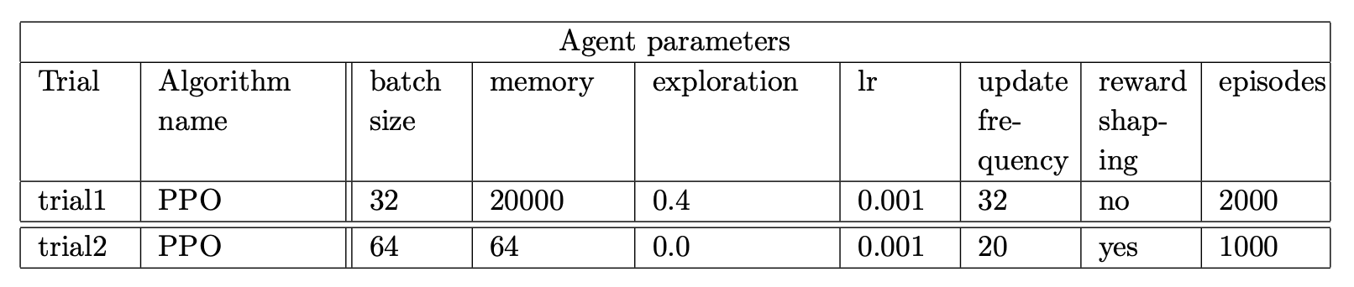
Trial 1 vs Trial 2 -Comparison-

Slide 24
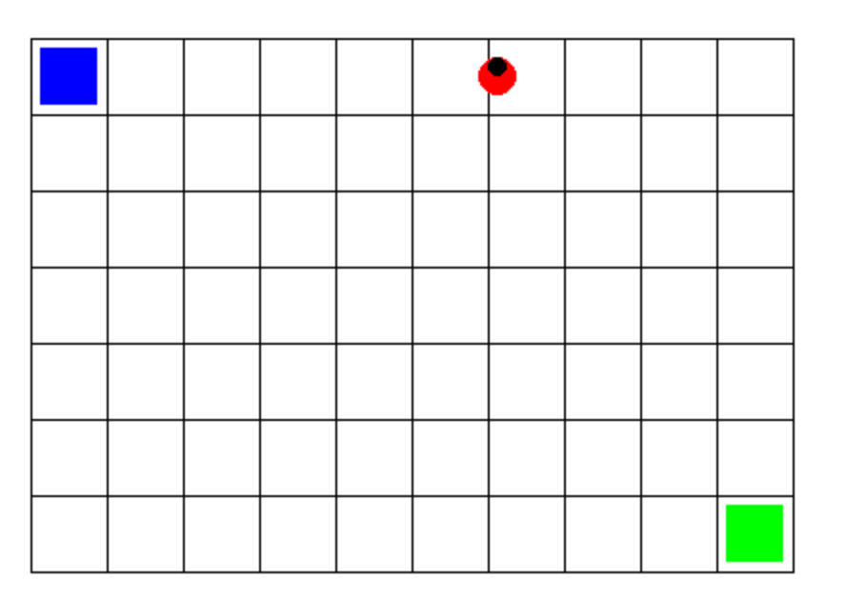
First experiment with two colors with a bigger map
(slightly worse behaviour)
Gym-Sapientino 7x10 map for the first experiment {blue, green}, initial position [4,6] :

Slide 25
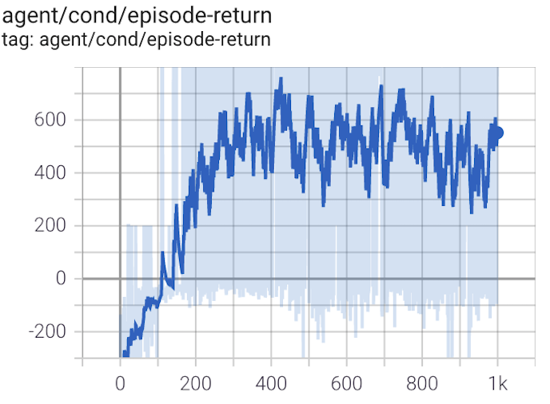
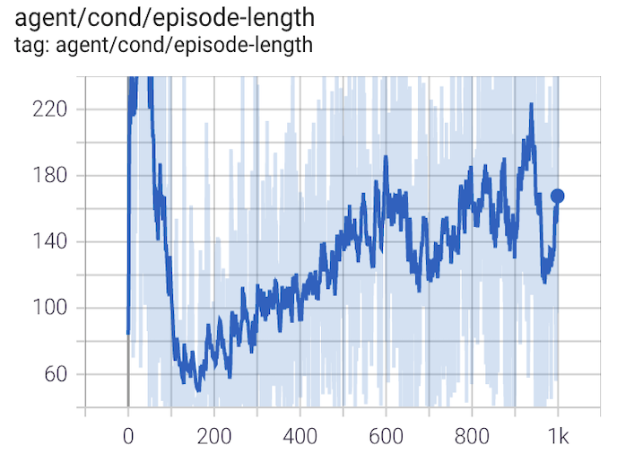
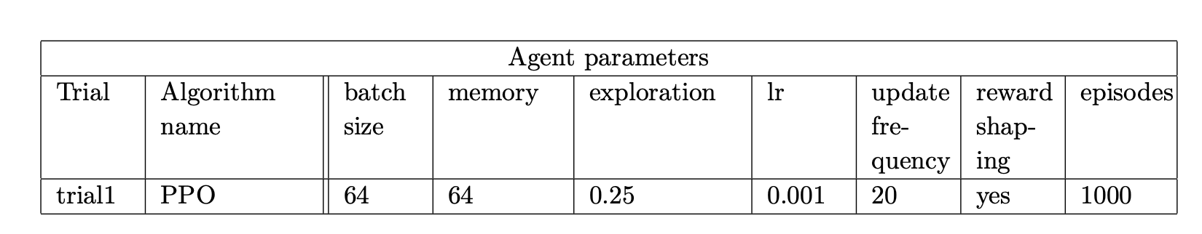
Plots and Table -First experiment-

Slide 26
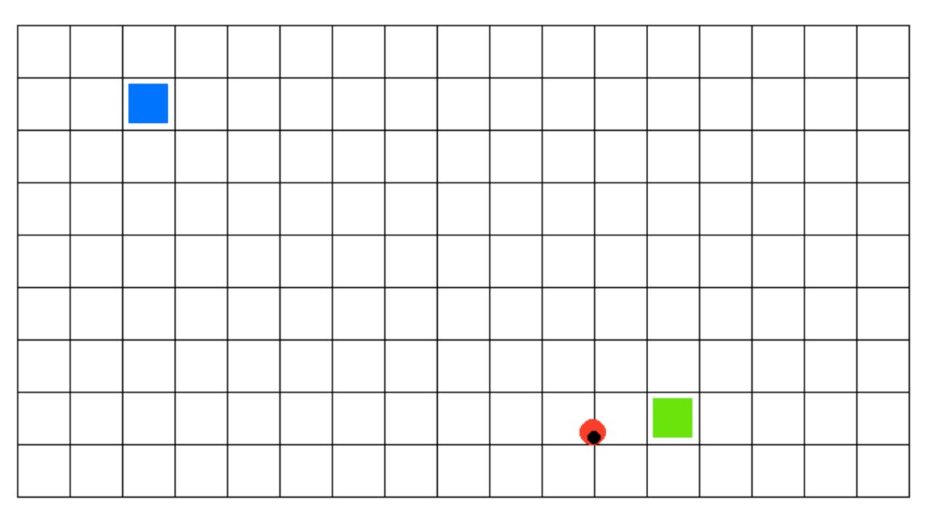
Second experiment with two colors with a bigger map
(worse behaviour)
Gym-Sapientino 9x17 map for this experiment {blue, green}, initial position [4,8] :

Slide 27
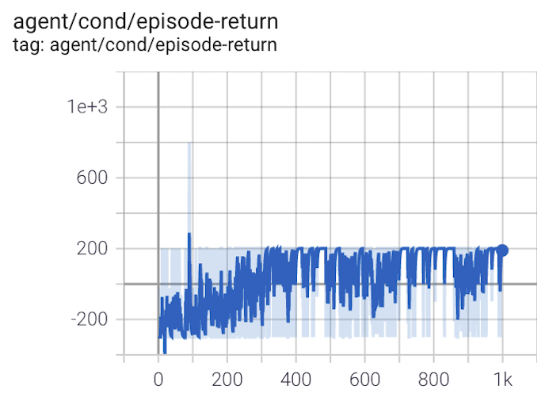
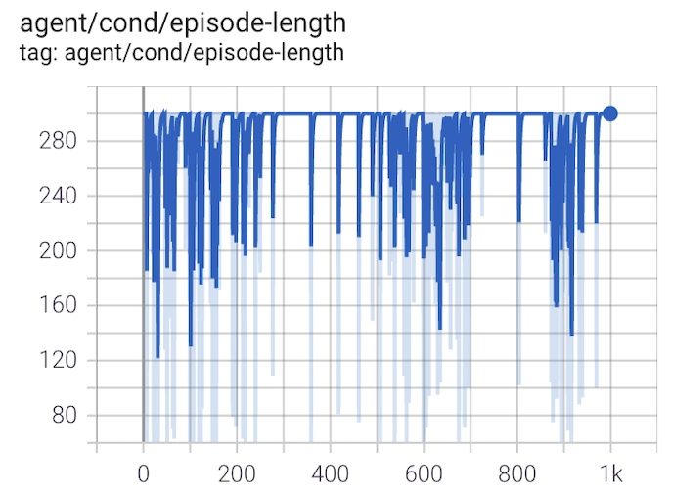
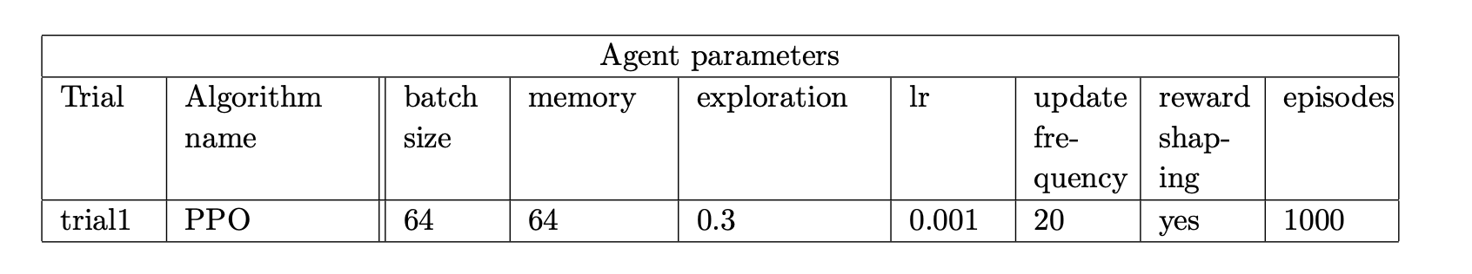
Plots and Table -Second experiment-

Slide 28
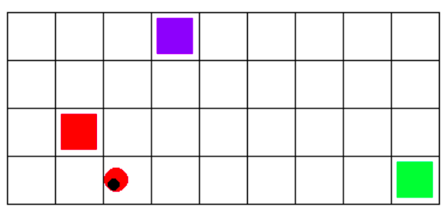
Experiments with three colors
Gym Sapientino 4x9 map for the experiment {blue, red, green}, initial position [4,4]:

Slide 29
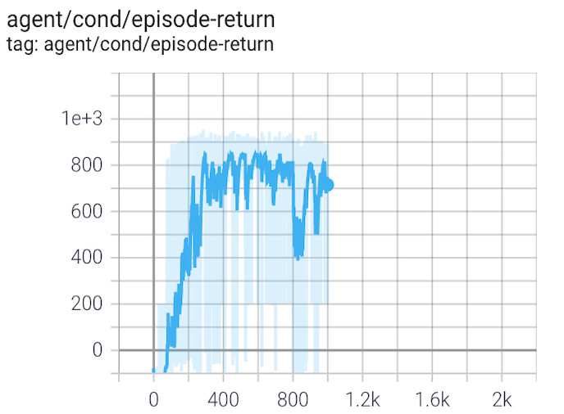
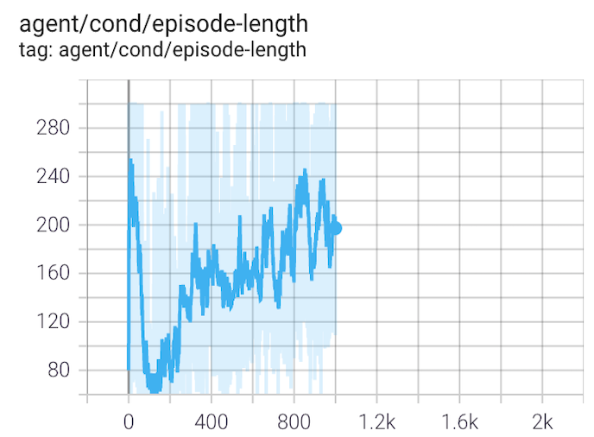
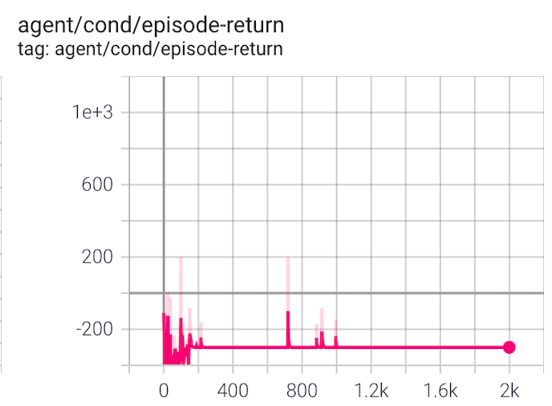
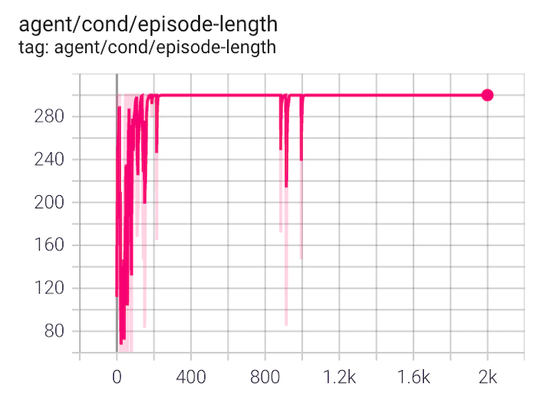
Trials (custom network vs auto network) -Plots-

Slide 30
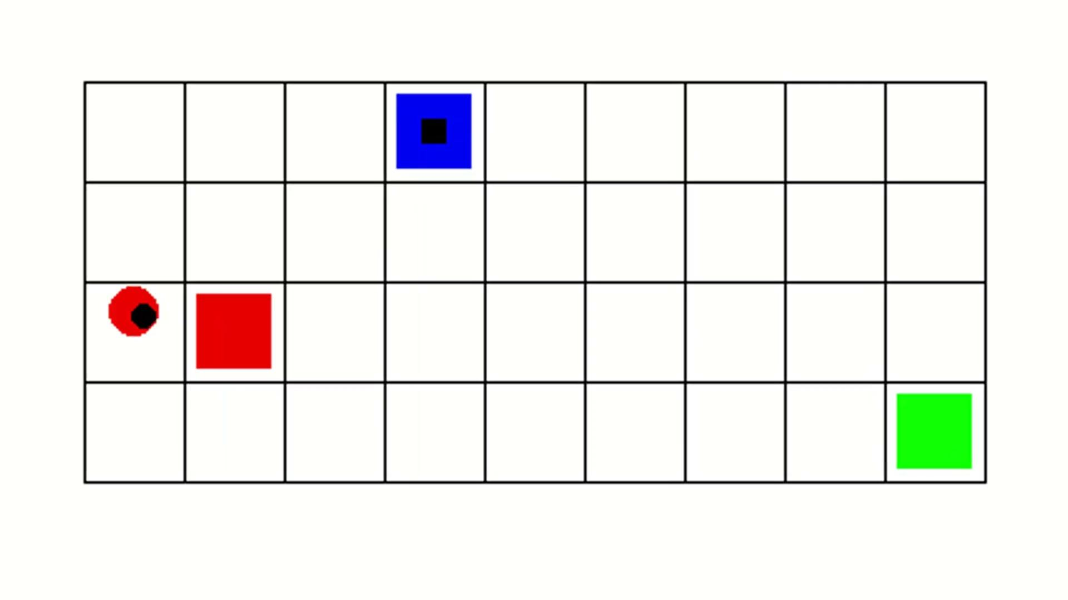
Three colors: convergence

Slide 31
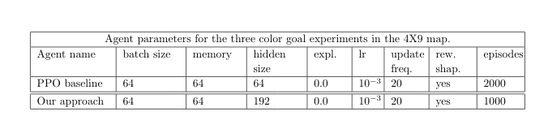
Trial 1 vs Trial 2 -Comparison-

Slide 32
Conclusion
Problems with larger maps: the agent does not frequently sample the goal.
Solution: Adding exploration, the agent can probe better the action space.
Sparse rewards suboptimal convergence negative reward action selection.
Solution: Reward shaping.

Slide 33
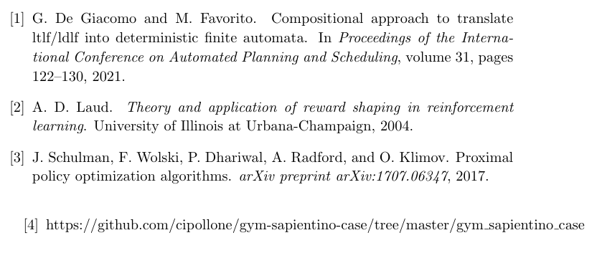
References:

