Slide 2
ChibiOS & PWM
How to use PWM in ChibiOS

Slide 3
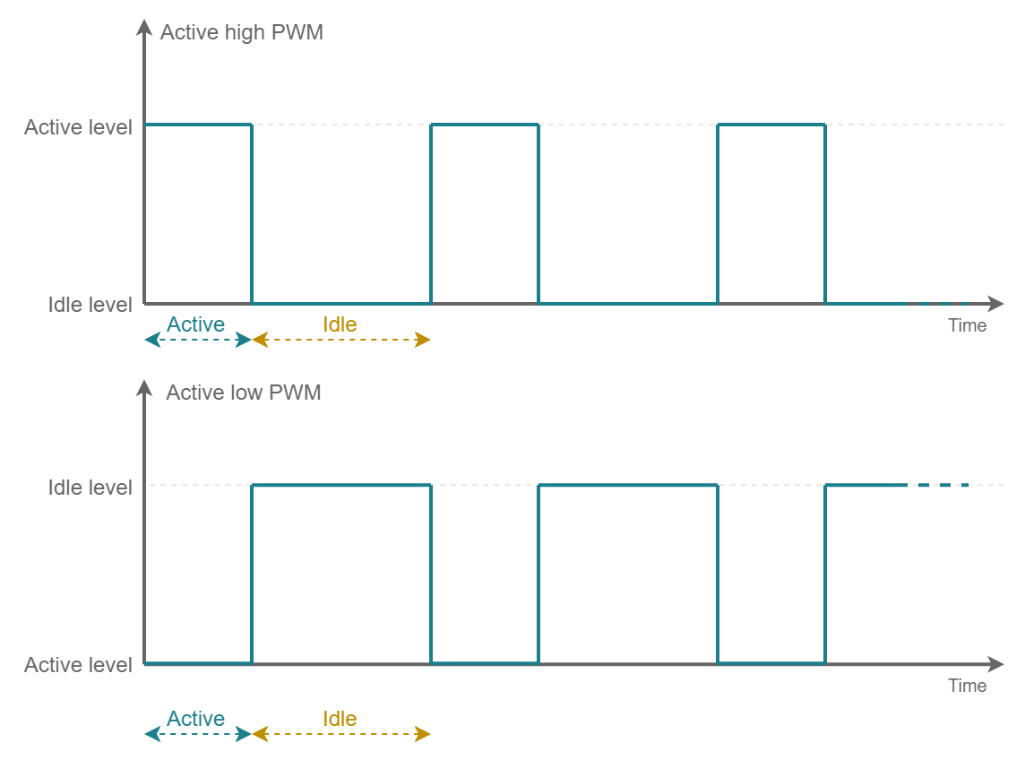
PWM – What is PWM?
Pulse Width Modulation is a digital modulation in which the waveform switch between two states with a negligible raise/fall time and a constant period.
In a general sense the two possible states can be named active and idle.
The period can be thus defined as

Slide 4
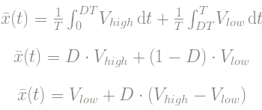

PWM – What is PWM?
The average value of voltage (and current) depends from the ratio between the duration of the positive pulse and the entire period (Duty Cycle). In fact
The Duty Cycle is defined as:
It is often indicated in the form of a percentage: to obtain the percentage simply multiply by 100

Slide 5
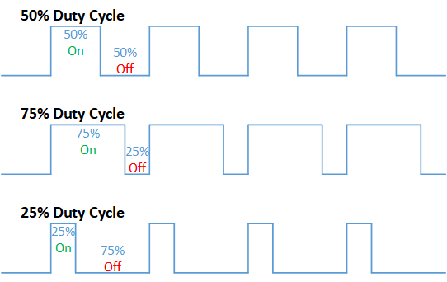
PWM – Duty Cycle examples

Slide 6
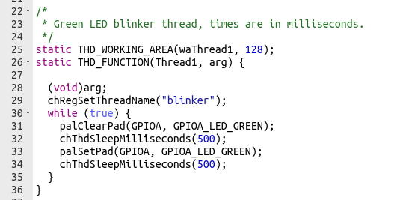
PWM – What is PWM?
A practical example is the «blinker» thread.
In fact for a period of 500 ms the GPIOA linked to the led is setted as HIGH and for a period of 500 ms the GPIOA linked to the led is setted as LOW.
The total period is 1000 ms = 1 s, so the duty cycle is 0.5 or 50%.

Slide 7
PWM – How it works
In ChibiOS there is a smarter and powerful way to use a driver to generate a PWM signal.
This driver abstracts a generic PWM timer composed of:
A clock prescaler.
A main up counter.
A comparator register that resets the main counter to zero when the limit is reached. An optional callback can be generated when this happens.
An array of PWM_CHANNELS struct, each channel has an output, a comparator and it is able to invoke an optional callback when happens that a comparator matches with the main counter.

Slide 8
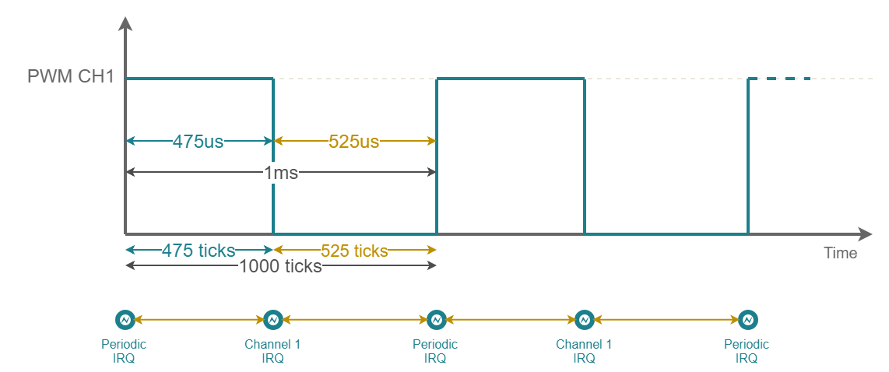


PWM – Prescaler
Each PWM on the board is associated with a Timer (16 or 32 bits). Each timer works with a predetermined frequency.
Defining the frequency of the timer, the OS calculates the factor of the clock prescaler.
Timer frequency defines counter resolution: a higher frequency gives an higher resolution, but the maximum amount of time will be lower.

Slide 9
PWM – Counter
Defined the frequency of the timer, we have passed from time in ticks.
The main counter sets the time:
when it matches with the CHANNEL’s active time, it will change the status (and optionally invokes a callback defined by the user)
when it matches with the ticks of the PERIOD, it will be resetted by the OS (and eventually invokes a callback defined by the user).
In the exemple above, the ACTIVE’S TIME is to 475 ticks.
The period of PWM is equal to 1000 ticks

Slide 10
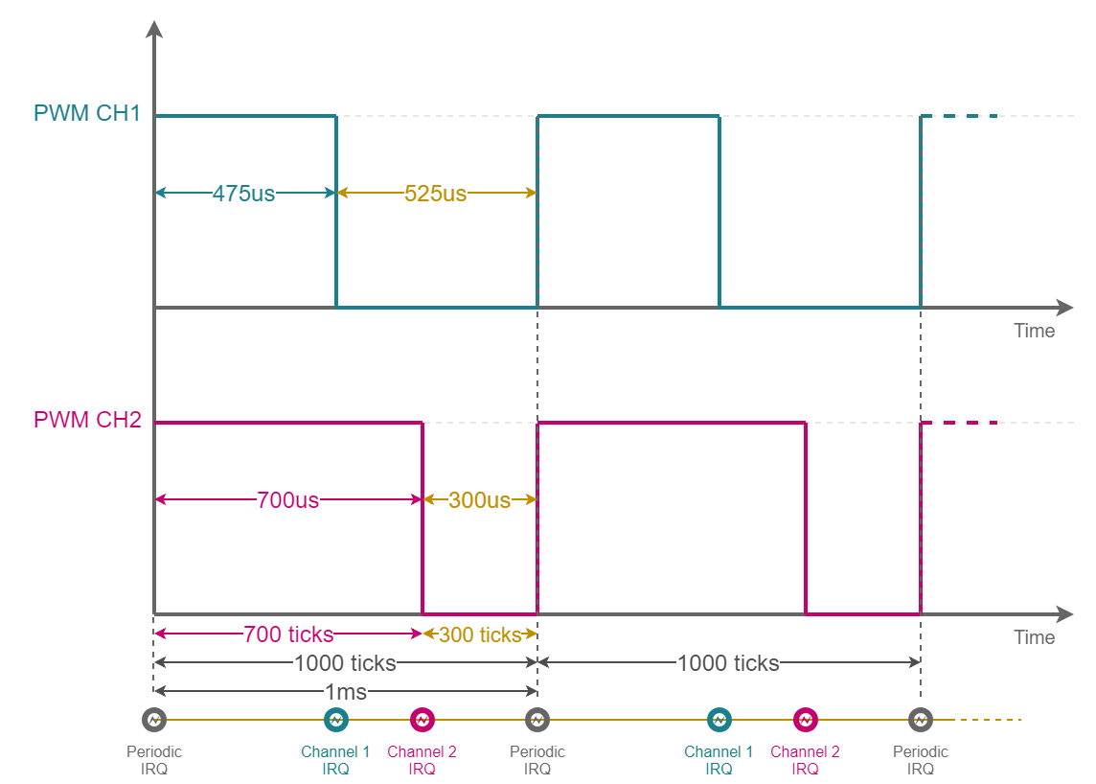
PWM – Channel
Each PWM driver can use almost 4 channels, and each channel is associated to a pin of the board.
Each channel can works with a different duty cycle, but PWM period will be the same for all channels.
On the right is shown one of the possible configuration of PWM.

Slide 11
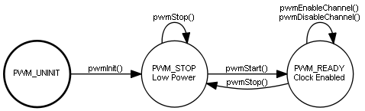
PWM – State Machine
PWM unity works as a state machine, with the following transition function:
pwmInit( )
pwmStart( ) / pwmStop( )
pwmEnableChannel ( ) / pwmDisableChannel ( )
pwmEnablePeriodicNotification ( ) / pwmDisablePeriodicNotification ( )
pwmEnableChannelNotification ( ) / pwmDisableChannelNotification( )

Slide 12
PWM – State Machine
To enable a channel must be defined a width (in ticks) that obviously must be tinier then PWM period).
A useful macro is:
PWM_PERCENTAGE_TO_WIDTH(pwmp, percentage)
Be careful: percentage must be defined with a value from 0 to 10000 where 10000 means 100%.
For a complete list of all available functions and their implementation, see: PWM Driver API

Slide 13
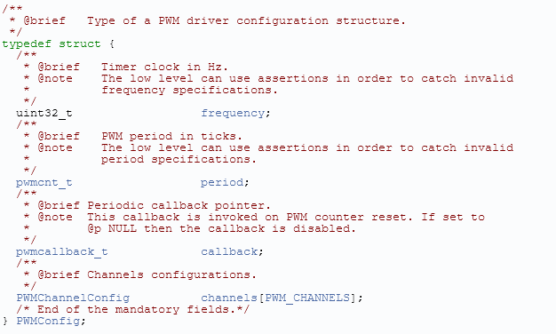
PWM – How to configure it
To configure a PWM driver is necessary to initialize a structure PWMConfig with the following parameters:
frequency defines the frequency of TIMER.
period defines PWM period. IT IS EXPRESSED AS TICK, NOT IN SECOND;
callback defines a function that is called at the start of each period of PWM signal;
channels is the vector used to configure the mode and callback of the channels.

Slide 14
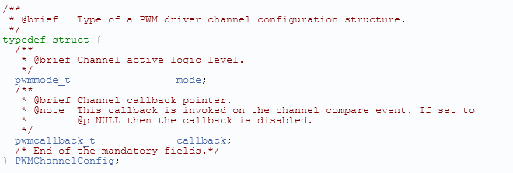
PWM – How to configure it
The vector to configure the channels of PWM must contains structs with this parameters:
mode defines which is the active level: it can have the value PWM_OUTPUT_ACTIVE_HIGH or PWM_OUTPUT_ACTIVE_LOW
callback defines a function that is called at the end of the active period;

Slide 15
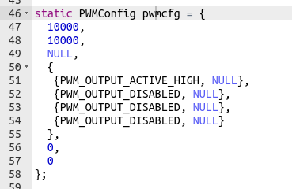
PWM – How to configure it
This is a possible configuration of a PWM. In this example:
Timer frequency has been setted to 10 kHz. This implies that each tick last 100 microseconds.
PWM period has been setted to 10000 ticks, so it lasts 10000 * 0.0001 = 1 s.
Only the first channel is enabled.

Slide 16


PWM – More information
For more info read “PWM in hardware with STM32 Timer and ChibiOS” on www.playembedded.org
For detailed information about drives, macros and function read the “API of HAL/PWM_Driver” on http://chibios.sourceforge.net/docs3/hal

Slide 17
Any questions?
Raise your hand or write in the chat.

Slide 18
Hands on
Control a servo motor with PWM

Slide 19
Hands on - SG90
In this exercise we will control a SG90 Servo with a PWM signal:
We will start a PWM on PWM Driver number 3, at the first CHANNEL ( pin PB4 / ARD D5 ) with the active time HIGH;
We will start a thread that will follow a sequence: -90° -> 0 ° -> 90° -> 0°, and each position will be changed after 1 s.
At the beginning of the period will be started a callback that set to HIGH the green led on board
At the end of the ACTIVE STATE will be started a callback that set to LOW the green led on board
Which is the result?
The SG90 will turn from -90° to 90°
The led will blink with three level of intensity.

Slide 20
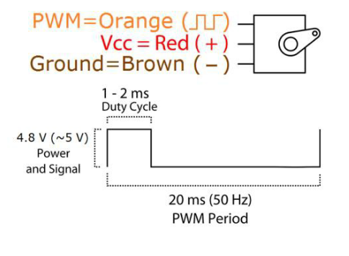
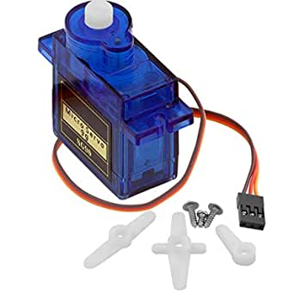
Hands on - SG90
Position "-90" is 0.5 ms pulse
Position "0" is 1.5 ms pulse
Position "90” is 2.4 ms pulse
DATASHEET

Slide 21
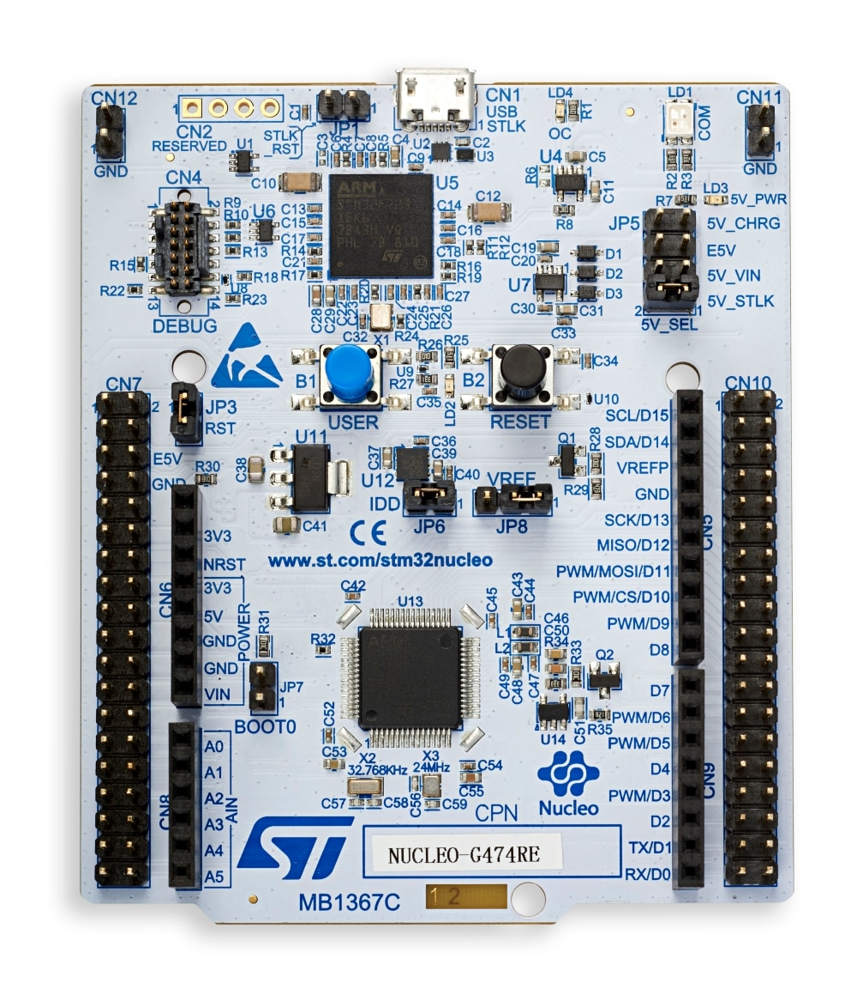
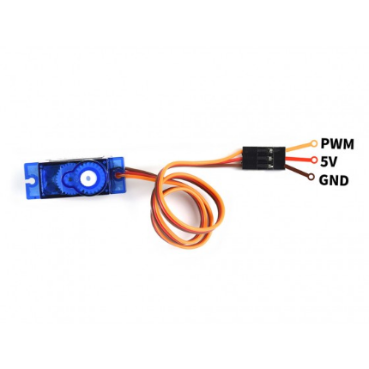
Hands on - Wiring

Slide 22
Any questions?
Raise your hand or write in the chat.

Slide 23
Recap of code

Slide 24
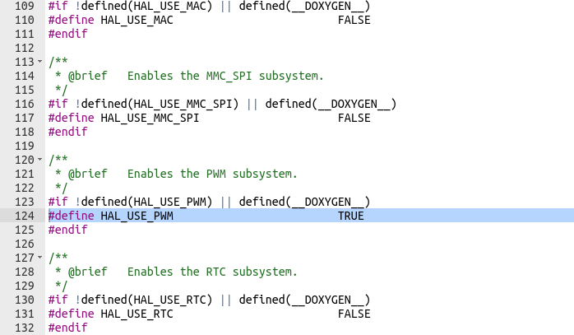
PWM – How to configure it
First of all, we need to enable in HAL the use of high level API for access to PWM.
So, we need to open the halconfig.h and set TRUE the #define HAL_USE_PWM

Slide 25
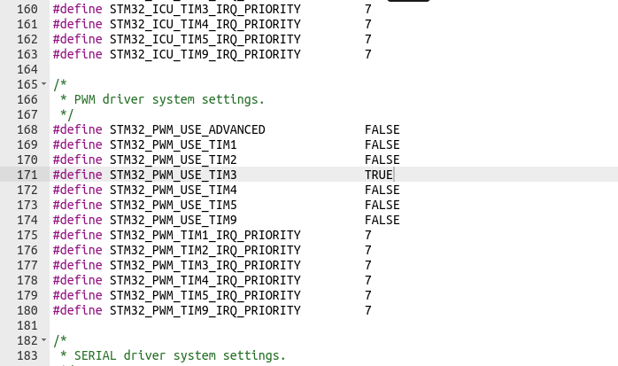
PWM – How to configure it
After this, we need to associate TIMER 3 to PWM. So, we need to open the mcuonfig.h and set TRUE the #define STM32_PWM_USE_TIM3. This gives us the possibility to use the pointer PWD3.

Slide 26
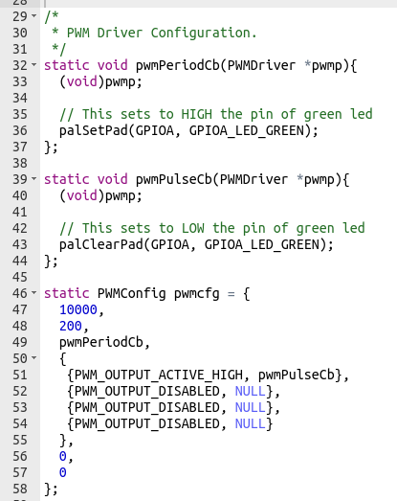
PWM – Code examination
Now we can work on the main file: in the right has been reported the configuration of PWM.
The period of PWM must be 20 ms, so can use a timer with a tick equal to 0.1 ms. As a consequence the frequency for our timer have to be equal to 10 kHz. If 1 tick = 0.1 ms, the number of ticks for one period are 200 ticks.
Furthermore:
pwmPeriodCb is the callback the will be called at the beginning of period
Only the first channel is enabled and the ACTIVE level is HIGH.
pwmPulseCb is the callback the will be called at the end of each pulse

Slide 27
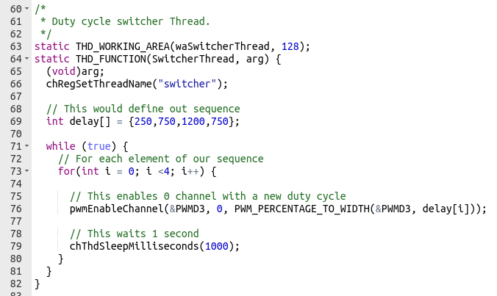
PWM – Code examination
After the definition of PWM configuration, we can work on the thread that changes the duty cycle.
To this scope, it has been defined a sequence with values of the duty cycle, and each second it enables the channel 0 of PWM 3 through the struct pointed by PWD3.
Notice that we are using PWM_PERCENTAGE_TO_WIDTH to pass from duty cycle to ticks.

Slide 28
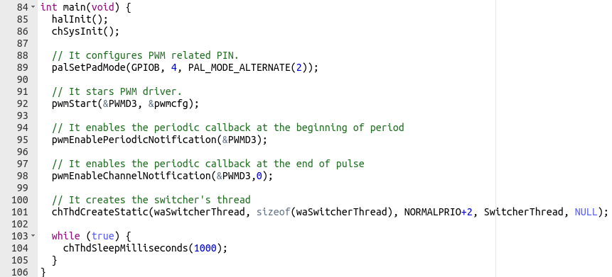
PWM – Code examination
Now we can work on the main function.
with palSetPadMode we are setting the pin PB4 to work with the PWM Driver
with pwmStart we are starting the PWM Driver 3 with the configuration written before
with pwmEnablePeriodNotification we are enabling the use of callback at the beginning of PWM signal
with pwmEnableChannelNotification we are enabling the use of callback at the end of ACTIVE LEVEL signal
with chThdCreatStatic we are creating the thread that will change the duty cycle

Slide 29
Any questions?
Raise your hand or write in the chat.

