Slide 2
Embedded Applications Development
with ST Nucleo Board & ChibiOS & ChibiStudio

Slide 3
Introduction to STM32 Family
STM32 is a wide family of ARM Cortex-M based 32-bit microcontrollers by STMicroelectronics.
The STM32 microcontrollers are grouped into subfamilies.
Each subfamily is based on a specific ARM Cortex-M architecture and has some specific peripherals.
STM32 counts hundreds of different MCUs and continues to grow up.
Notes:
the communication is simultaneously bi-directional, data can flow from master to slave and from slave to master at the same time on two separate wires at the same time
3

Slide 4
Introduction to STM32 Family
Grouped into subfamilies:
Based on a specific Cortex-M architecture
Has its own set of peripherals
IDENTIFIER OF SUBFAMILY
STM32XNMMOO
Letter which indicates the series:
F-line
L-Line
H-Line
G-Line
Additional letters which encode information about package and memory sizes
Chip ID which specifies a sub-subfamily
Notes:
the communication is simultaneously bi-directional, data can flow from master to slave and from slave to master at the same time on two separate wires at the same time
4

Slide 5
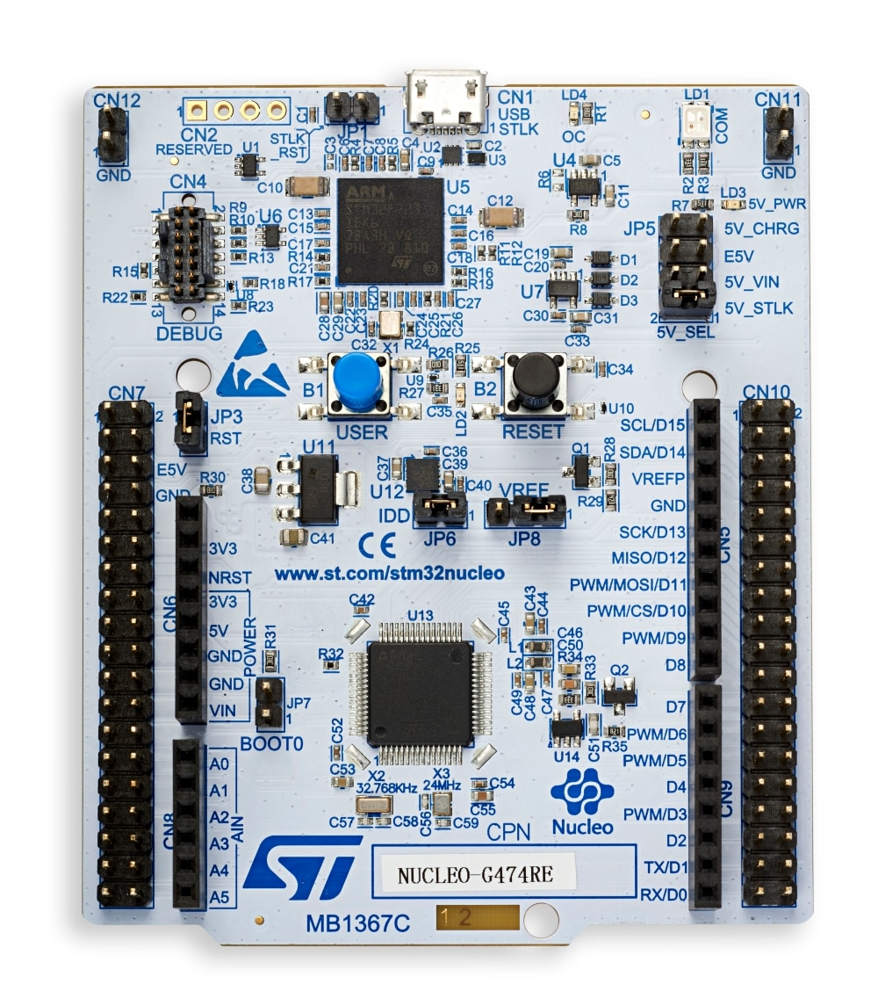
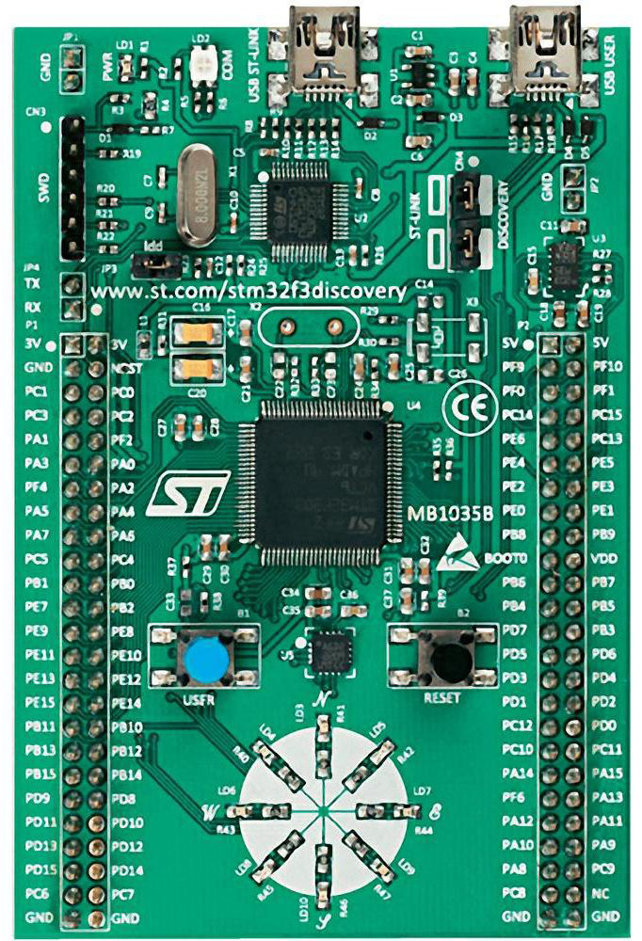
Official Development Kits
STMicroelectronics produce some development kits to help developers to getting started with STM32:
Development board are extremely cheap
Each board has an embed on-chip debugger
There are a lot of official and non-official resources
The STM32 community is growing thanks to this development boards
Notes:
the communication is simultaneously bi-directional, data can flow from master to slave and from slave to master at the same time on two separate wires at the same time
5

Slide 6
STM32 Nucleo Boards
STM32 Nucleo-32 board
pin compatible UFQFPN32 MCUs
equipped with the Arduino Nano connector
STM32 Nucleo-64 board
pin compatible LQFP64 MCUs
equipped with the Arduino Uno Rev-3 connector
has an extended proprietary connector named ST Morpho
STM32 Nucleo-144 board
pin compatible LQFP144 MCUs
equipped with the Arduino Uno Rev-3 connector
has a extended proprietary connector named ST Zio
Notes:
the communication is simultaneously bi-directional, data can flow from master to slave and from slave to master at the same time on two separate wires at the same time
6

Slide 7
STM32 Nucleo Boards
Each one is PIN compatible with other Nucleo boards belonging to the same line.
Each one is ARM mbed Enabled.
The price is around 10$ for Nucleo-32 and Nucleo-64 and around 20$ for Nucleo-144.
Equipped with Embed ST-Link V2-1.
Can be expanded stacking STM32 Nucleo Expansion boards which are equipped with external devices like:
MEMS
Bluetooth Low Energy
Wi-Fi
Etc
Notes:
the SPI could be used to…
the communication starts with the master lowering the chip select…
7

Slide 8
STM32 Nucleo-64 Board
Connection & Debugger LED
External Power
Jumper
USER Button
(B1)
RESET Button
(B2)
USER Green LED
(LD2)
Microcontroller
Current Jumper
Target Microcontroller
STM32G474RE
Notes:
the SPI could be used to…
the communication starts with the master lowering the chip select…
8

Slide 9



Documentation
There are three documents required to develop with STM32 development kits:
STM32G474xB/C/E
Datasheet
STM32G4
Reference Manual
Nucleo-64 Board
User Manual

Slide 10
ChibiStudio – What is it?
ChibiStudio is an Eclipse-based toolchain for ChibiOS
A toolchain is a set of distinct software development tools linked (chained) together to perform a complex software development
ChibiStudio is composed of free and open source software
Eclipse IDE
GNU GCC ARM Compiler & Tools
Open OCD Tool & scripts
ChibiOS

Slide 11
!! ATTENTION !!
Do NOT confuse between ChibiStudio and ChibiOS
ChibiStudio is a toolchain which includes the latest available two stable versions of ChibiOS
ChibiOS is the embedded library: a collection of folder and text files
Notes:
The next parameters are used to identify the chip select of the slave.
Those are used in software chip select mode. As said chip select can be controlled in hardware as well as in software. When chip select is controlled by software the driver need to know which pin or mask of pins is the chip select. SPI_SELECT_MODE can be configured in halconf.h. By default, it is set as SPI_SELECT_MODE_PAD.
it can be useful to take a look to SPI demo under testhal folder
11

Slide 12

ChibiStudio - Workspaces
It is possible to switch workspace in use through the menu File->Switch Workspace:
you can choose a workspace from the history
you can select “Other…” to browse a new workspace
The workspace in use would not be in the list: in this case Workspace User

Slide 13
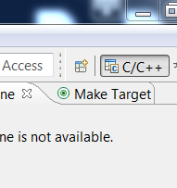
ChibiStudio - Perspectives
Workbench could be saved to be quickly recalled at proper moment: this take the name of perspective
ChibiStudio comes with two separate perspectives:
C/C++ (Development)
Debug
You can switch them using the proper button in the top right corner of you Workbench
You can add other perspectives, save or reset the current one to default through the drop-down menu “Window”
Notes:
The SPI driver offers both synchronous and asynchronous communication functions. We already introduced these concepts but let me recall them.
A blocking function blocks the execution of the calling thread until the operation is completed (synchronous functions like spiStartSend).
A non-blocking function launches the operation and returns to the calling thread which continues to be executed. Such operation is executed in the background, usually in hardware,
(asynchronous functions like spiSend).
The driver offers also a couple of API to acquire and release the bus: spiAcquireBus and spiReleaseBus. (mutex)
13

Slide 14
ChibiStudio - C/C++ Development perspective
The perspective C/C++ is oriented to software development, hence to:
Projects creation and management
Code editing
Code compiling
Resolution of syntax errors
Resolution of syntax warnings
Because of this, the largest amount of workbench area is dedicated to text editor area.

Slide 15
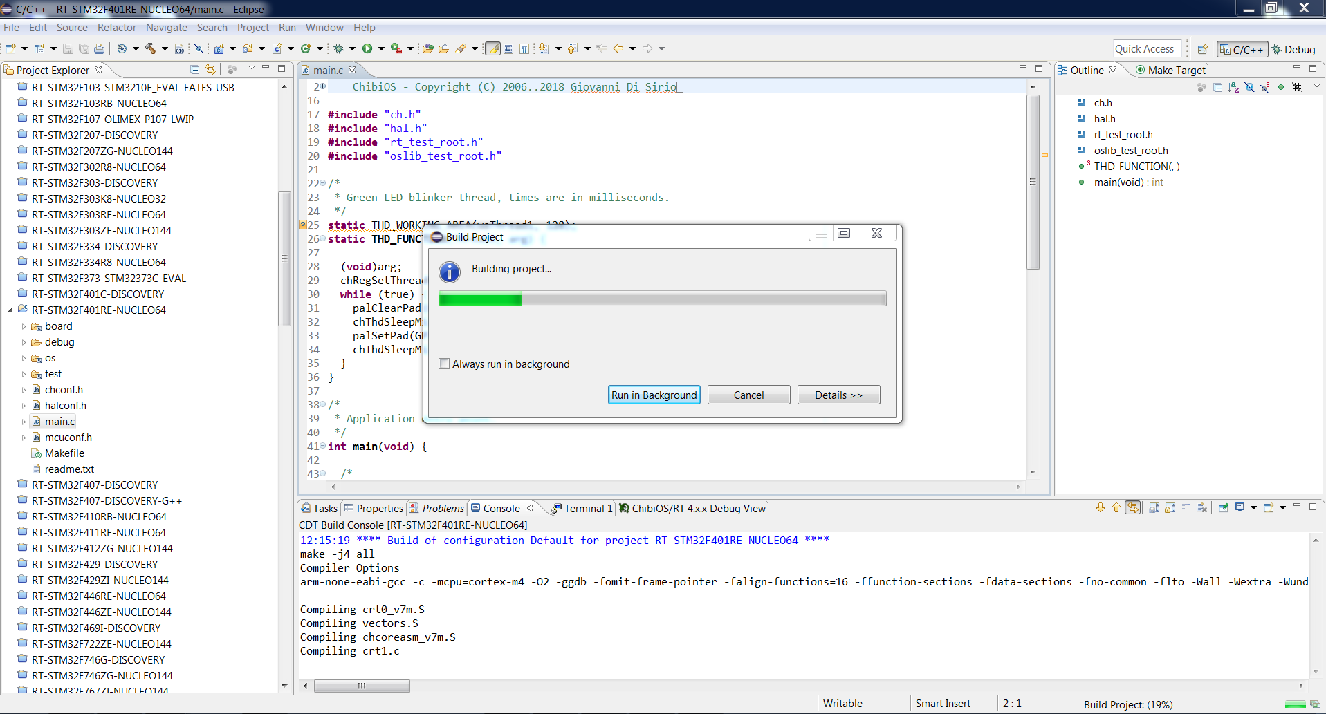
ChibiStudio - C/C++ Development perspective

Slide 16
ChibiStudio - Debug perspective
The Debug perspective is oriented to debugging, hence to:
Test of code functionality and detection of unexpected behaviours
Resolution of functional error
Evaluation of software performances and consistency.
This perspective offers a lot of additional windows to explore MCU memory and variables, to evaluate expressions, a terminal and so on.
Notes:
Open drain (pull up) to avoid short circuits.
Each I2C transaction begins with a Start condition (SCL high and SDA moves from high to low) and ends with a Stop condition.
A transaction is composed by one or more messages where each message is 1 byte word (8-bit) plus an addition for synchronization: Acknowledge/Not acknowledge (ACK/NACK) bit.
16

Slide 17
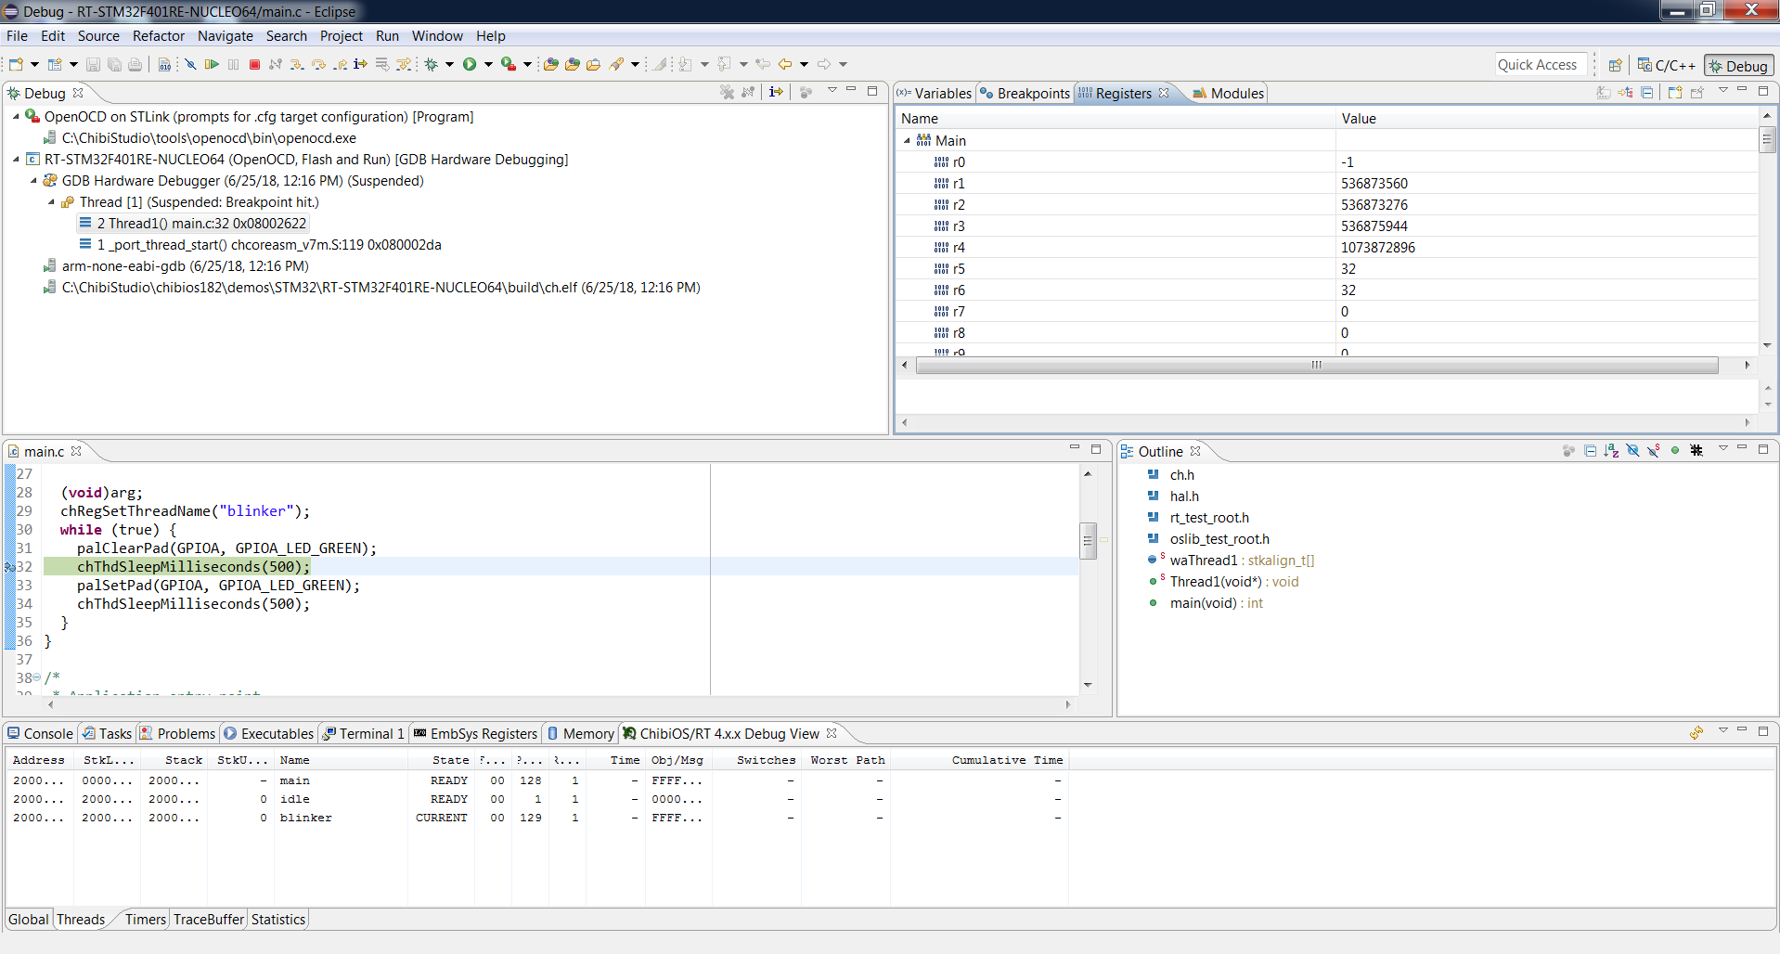
ChibiStudio - Debug perspective
Notes:
Open drain (pull up) to avoid short circuits.
Each I2C transaction begins with a Start condition (SCL high and SDA moves from high to low) and ends with a Stop condition.
A transaction is composed by one or more messages where each message is 1 byte word (8-bit) plus an addition for synchronization: Acknowledge/Not acknowledge (ACK/NACK) bit.
17

Slide 18
ChibiStudio - Importing a Project
The demos we need to import are under the folder C:\ChibiStudio\chibios2111\demos\STM32 because we are going to use ChibiOS 2111
There are similar folders also under ChibiOS 203 and ChibiOS Trunk directories
In the demos\STM32 directory there are a lot of folders each of which represent a standalone project
Each project is named following the same pattern KERNEL-MCU-BOARD
RT-STM32G474RE-NUCLEO64
KERNEL
MCU
BOARD

Slide 19
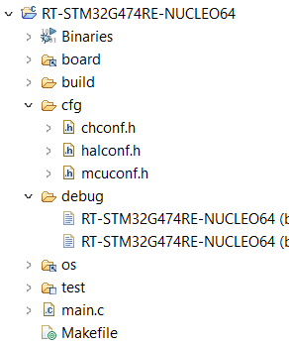
ChibiOS – Demo Anatomy
All ChibiOS demos have a similar anatomy:
Some linked folder like board, os and test
The debug folder which contains the Launch Configuration
The configuration headers
chconf.h contains mainly setting related to kernel
halconf.h contains all the configuration related to ChibiOS/HAL drivers
mcuconf.h contains all the configuration strictly related to our MCU
The makefile which is a script file which contains a series of directives used by GCC make to build our code
The main.c which is the main source file containing the application entry point
Notes:
19

