Slide 2
Using STM32 GPIO
General Purpose Input Output Peripheral

Slide 3
General Purpose Input Output
GPIO stands for General Purpose Input Output
STM32’s I/O pins are organised in groups of 16 elements (from 0 to 15)
GPIO allows to configure each pin as Input/Output independently
Each group is named Port and identified by a letter (GPIOA, GPIOB, GPIOC, …)
Pins are identified by the combination of the letter P, the port identifier (A, B, C,…) and the pin identifier (0, 1, 2,..)
PF 12
PORT
PIN ID
PORT ID

Slide 4
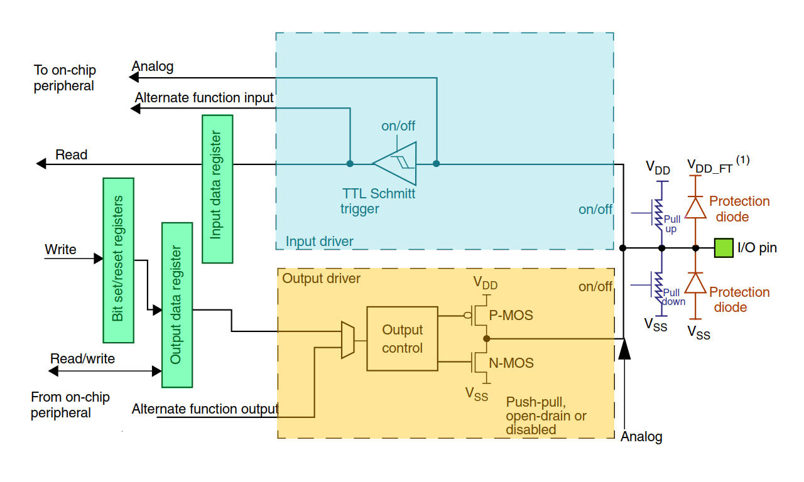
GPIO – Block Diagram

Slide 5
GPIO – Working Modes
STM32’s GPIO allows to configure each pin in different working modes independently
It is possible to program a pin in four different modes acting on GPIOx_MODER
Input mode, which allow to sample the logic level of a pin
Output mode, which allow to set the logic level of a pin
Analog mode, which allow to use ADC or DAC
Alternate mode, which allow to assign a pin to a STM32’s peripheral

Slide 6
GPIO – Output Mode
The output buffer is enabled
The TTL Schmitt trigger is turned on
It is possible to activate the Pull-Up/Pull-Down resistor acting on GPIOx_PUPDR
It is possible to switch between Push-Pull or Open Drain action on GPIOx_OTYPER
It is possible to configure the output slew rate action on GPIOx_OSPEEDR
Output speeds are usually labeled as Low, Medium, High and Highest
The value of each speed label is reported in Input Output AC Characteristic chapter of the STM32 Datasheet
The pin status can be changed acting on GPIOx_ODR
It is possible to check the electrical status of the pin accessing GPIOx_IDR

Slide 7
GPIO – Input Mode
The output buffer is disabled
The TTL Schmitt trigger is turned on
It is possible to activate the Pull-Up/Pull-Down resistor acting on GPIOx_PUPDR
Pin status is continuously sampled and stored inside the GPIOx_IDR which can be accessed and read to get the PIN status

Slide 8
GPIO – Analog Mode
The output buffer is turned off
The TTL Schmitt trigger is bypassed on
Pull-Up/Pull-Down are disabled
A read access to GPIOx_IDR gives “0”
Each PIN can be configured as Analog but not every PIN is connected to an internal ADC/DAC channel

Slide 9
GPIO – Alternate Function Mode
STM32 is equipped with a big number of peripherals
Peripherals IO are connected to GPIO through multiplexers
Acting on GPIOx_AFHR and GPIOx_AFLR is possible to change multiplexers selector and reroute peripherals IO
Rerouting is limited and it is not possible to assign any peripheral to any pin
Each peripheral is mapped on more than a pin to ensure an higher flexibility
The alternate function map is reported in the STM32 Datasheet under the Chapter Pinouts and pin description in a table named Alternate function mapping
In this mode is possible to choose output type, activate/deactivate weak pulls, configure the output speed

Slide 10
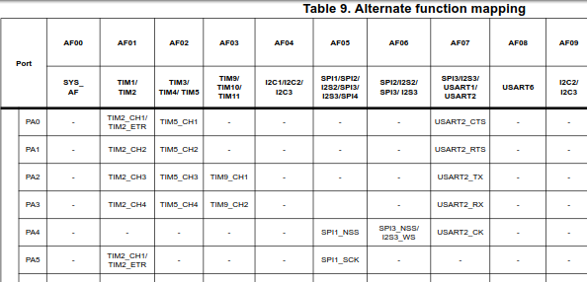
GPIO – Alternate Function Mapping

Slide 11
GPIO – Maximum Ratings
The GPIO electrical characteristics are reported in the Electrical Characteristics chapter of the STM32 datasheet
On many STM32 development board the microcontroller is supplied with a 3.3V
The GPIO high status is 3.3V while low is 0V
STM32 GPIOs are 5 V tolerant and they are compatible with the TTL logic levels.
The maximum current that a single pin is able to source/sink is about 20 mA per pin
Anyway the total current sourced/sunk by all the pins which must not exceed 100 mA
Notes:
I valori limite per le correnti sono nella tabella 14,15 del datasheet.

Slide 12
ChibiOS PAL Driver - Naming conventions
The Port Abstraction Layer is a driver from ChibiOS/HAL which uses GPIO
Each API of PAL driver starts with the “pal” prefix
Function names are camel-case, pre-processor constants uppercase and variable lowercase
Prefix is useful for auto-completion feature offered by Eclipse (CTRL+SPACE)
Auto-completion requires that project have been built at least once
Each port is identified by a C macro (GPIOA, GPIOB, GPIOC, GPIOD, …)
Each pad is an unsigned integer (from 0 to 15)
Several identification methods exist and each with its own set of functions
Pad related which act on a single I/O (port, pad)
Group related which act on a group of I/O (port, mask, offset)
Port related which act on the whole port (port)
Line related which are an alternative to Pad related (line)

Slide 13
ChibiOS PAL Driver – Pins Configuration
Changing pin configuration
Possibles modes
palSetPadMode(port, pad, mode)
palSetLineMode(line, mode)
palSetGroupMode(port, mask, offset, mode)
palSetPortMode(port, mode)
PAL_MODE_RESET : the after reset state
PAL_MODE_UNCONNECTED :, a safe state for unconnected pads
PAL_MODE_INPUT, PAL_MODE_INPUT_PULLUP, / PAL_MODE_INPUT_PULLDOWN : input without weak pulls / with pull-up / with pull-down resistor
PAL_MODE_INPUT_ANALOG, input suitable for analog sampling
PAL_MODE_OUTPUT_PUSHPULL, PAL_MODE_OUTPUT_OPENDRAIN : output with a push-pull / open-drain network
PAL_MODE_ALTERNATE(n) : alternate function number “n”

Slide 14
ChibiOS PAL Driver – Write Output
Set And Clear a GPIO Pad or Line
palWritePad(port, pad, bit)
palWritePad(GPIOA, 14, PAL_HIGH)
palWritePad(GPIOC, 0, PAL_LOW)
palWriteLine(line)
palWriteLine(LINE_LED_GREEN, PAL_HIGH)
Set an Output Pin High
Set an Output Pin Low
Toggle a Pin
palSetPad(port, pad)
palSetPad(GPIOA, 5)
palSetPad(GPIOB, 14)
palSetLine(line)
palSetLine(LINE_LED_GREEN)
palClearPad(port, pad)
palClearPad(GPIOB, 8)
palClearPad(GPIOF, 0)
palClearLine(line)
palClearLine(LINE_LED_GREEN)
palTogglePad(port, pad)
palTogglePad(GPIOC, GPIOC_PIN2)
palTogglePad(GPIOD, 15)
palToggleLine(line)
palToggleLine(LINE_LED_GREEN)

Slide 15
ChibiOS PAL Driver – Read Input
Reading a Pad or a Line
Reading a Whole Port
Reading a Group
palReadPad(port, pad)
status = palReadPad(GPIOA, 14)
palReadLine(line)
status = palReadLine(LINE_BUTTON)
palReadPort(port)
palReadGroup(port, mask, offset)

Slide 16
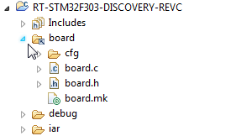
ChibiOS PAL Driver – Startup Configuration
Each pad must be properly configured before being used
The configuration for each Pad is bonded by the board schematics
ChibiOS PAL driver pre-configures GPIO according to board schematics
Configurations are stored in the board files which could be explored as quick reference.
Pad and Line are redefined in board files
The pre-initialization is executed in halInit()

Slide 17

Learn by doing
For more info read “Using STM32’s GPIO with ChibiOS PAL Driver” on www.playembedded.org

