Slide 2
GPIO Examples

Slide 3
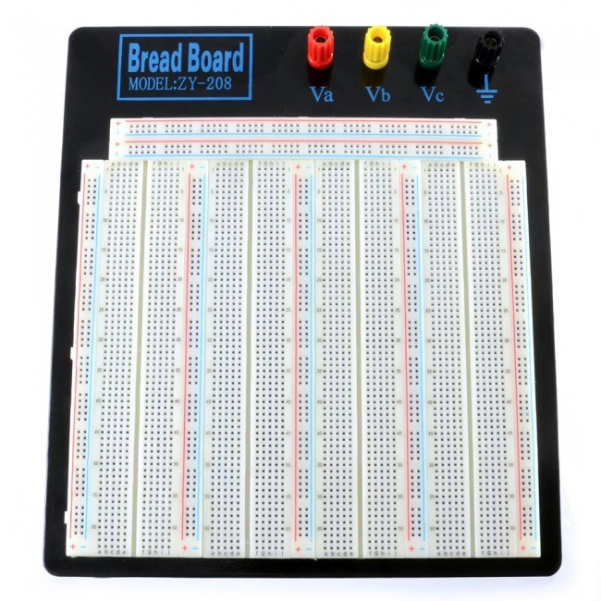
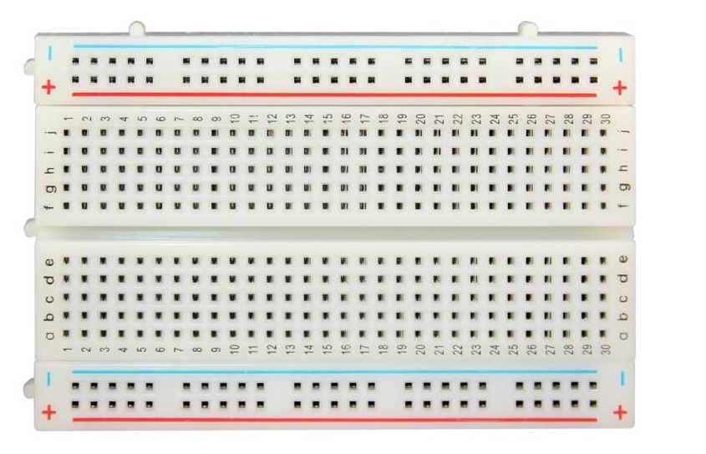
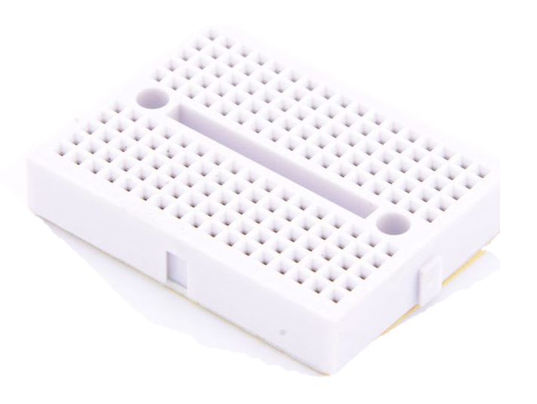
Breadboard
It’s a board used for fast prototyping of small and simple circuits
Allows the interconnection of components by rows or by columns

Slide 4
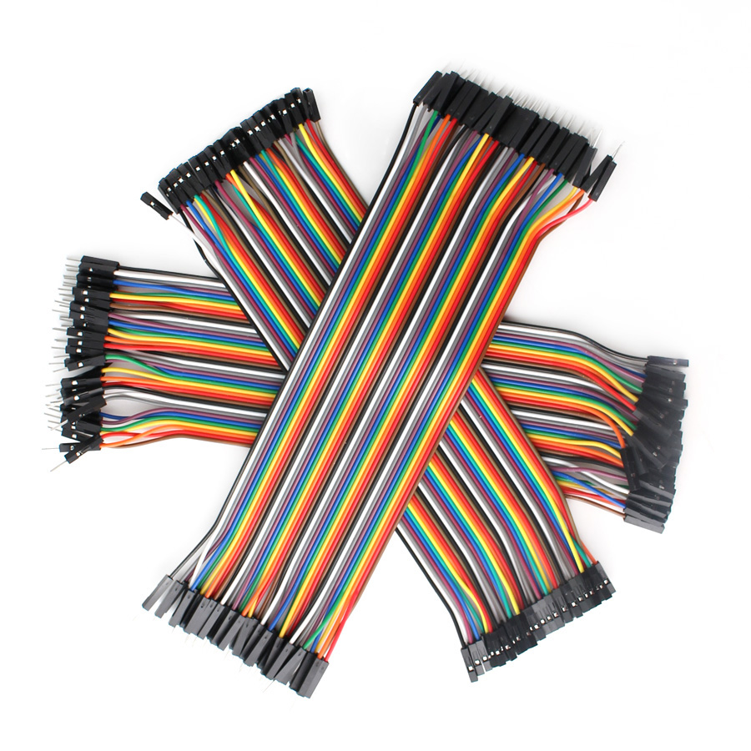
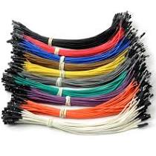
Dupont Cables
Are pre-terminated cables used in prototyping
Are divided by the gender of the connectors to the extremity of the cable:
Male to Male
Female to Male
Female to Female
Can be used to interconnect components or components to breadboard and more

Slide 5
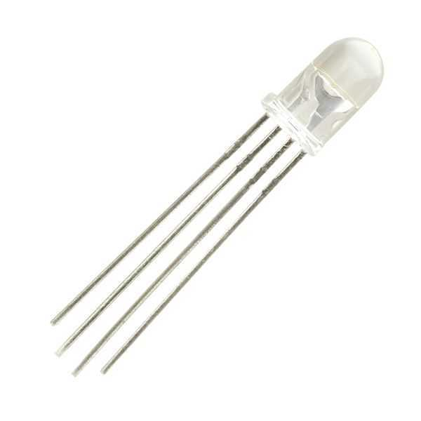
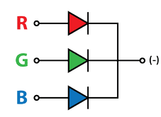
RGB Led
It’s formed by 3 different color LED in the same package
One lead is in common to the 3 LED
Common Anode
Common Cathode
To obtain light emission from a LED you need to directly polarize it with voltage source and a resistor.
Common Cathode

Slide 6
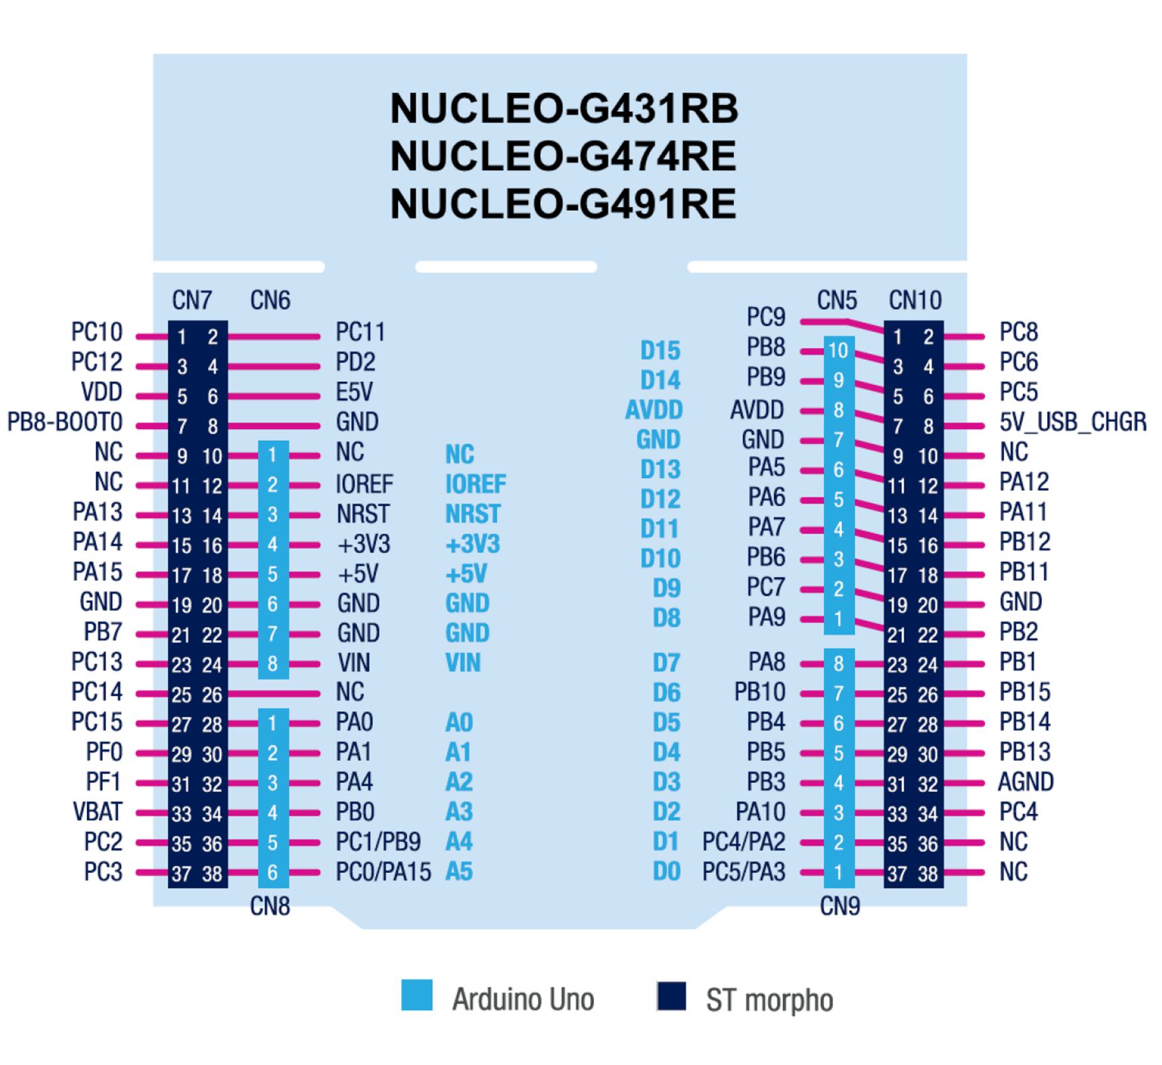
Nucleo 64 Pinout

Slide 7
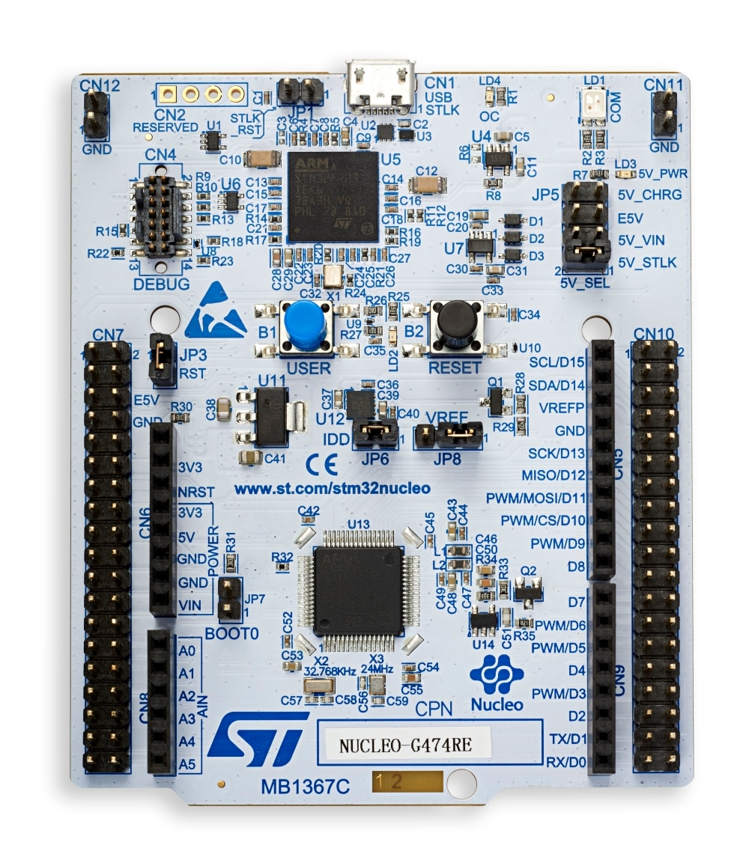
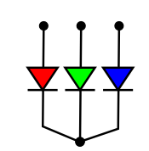
RGB Led connection to Nucleo 64
R
R
R
+
GND
PA5
-
PA6
PA7

Slide 8
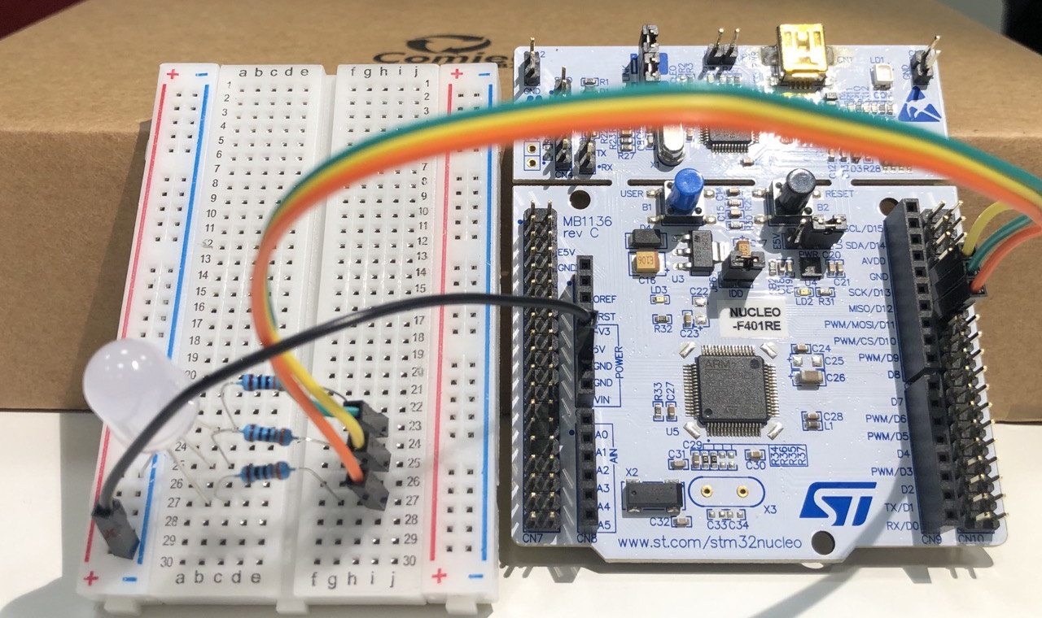
RGB Led connection to Nucleo 64

Slide 9
Example 04
How to use a runtime configured thread to control 2 different LED with LINES and different timings.

Slide 10
Exercise 04
Modify the thread thdLed of the previous example to allow a configurable asymmetric blinking.

Slide 11
Example 05
Use the USER Button to read the user input and change the state of a LED.

Slide 12
Example 05B
Use an external Button to read the user input and change the state of a LED.

Slide 13
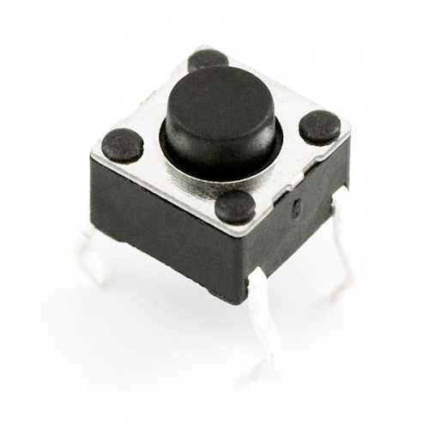
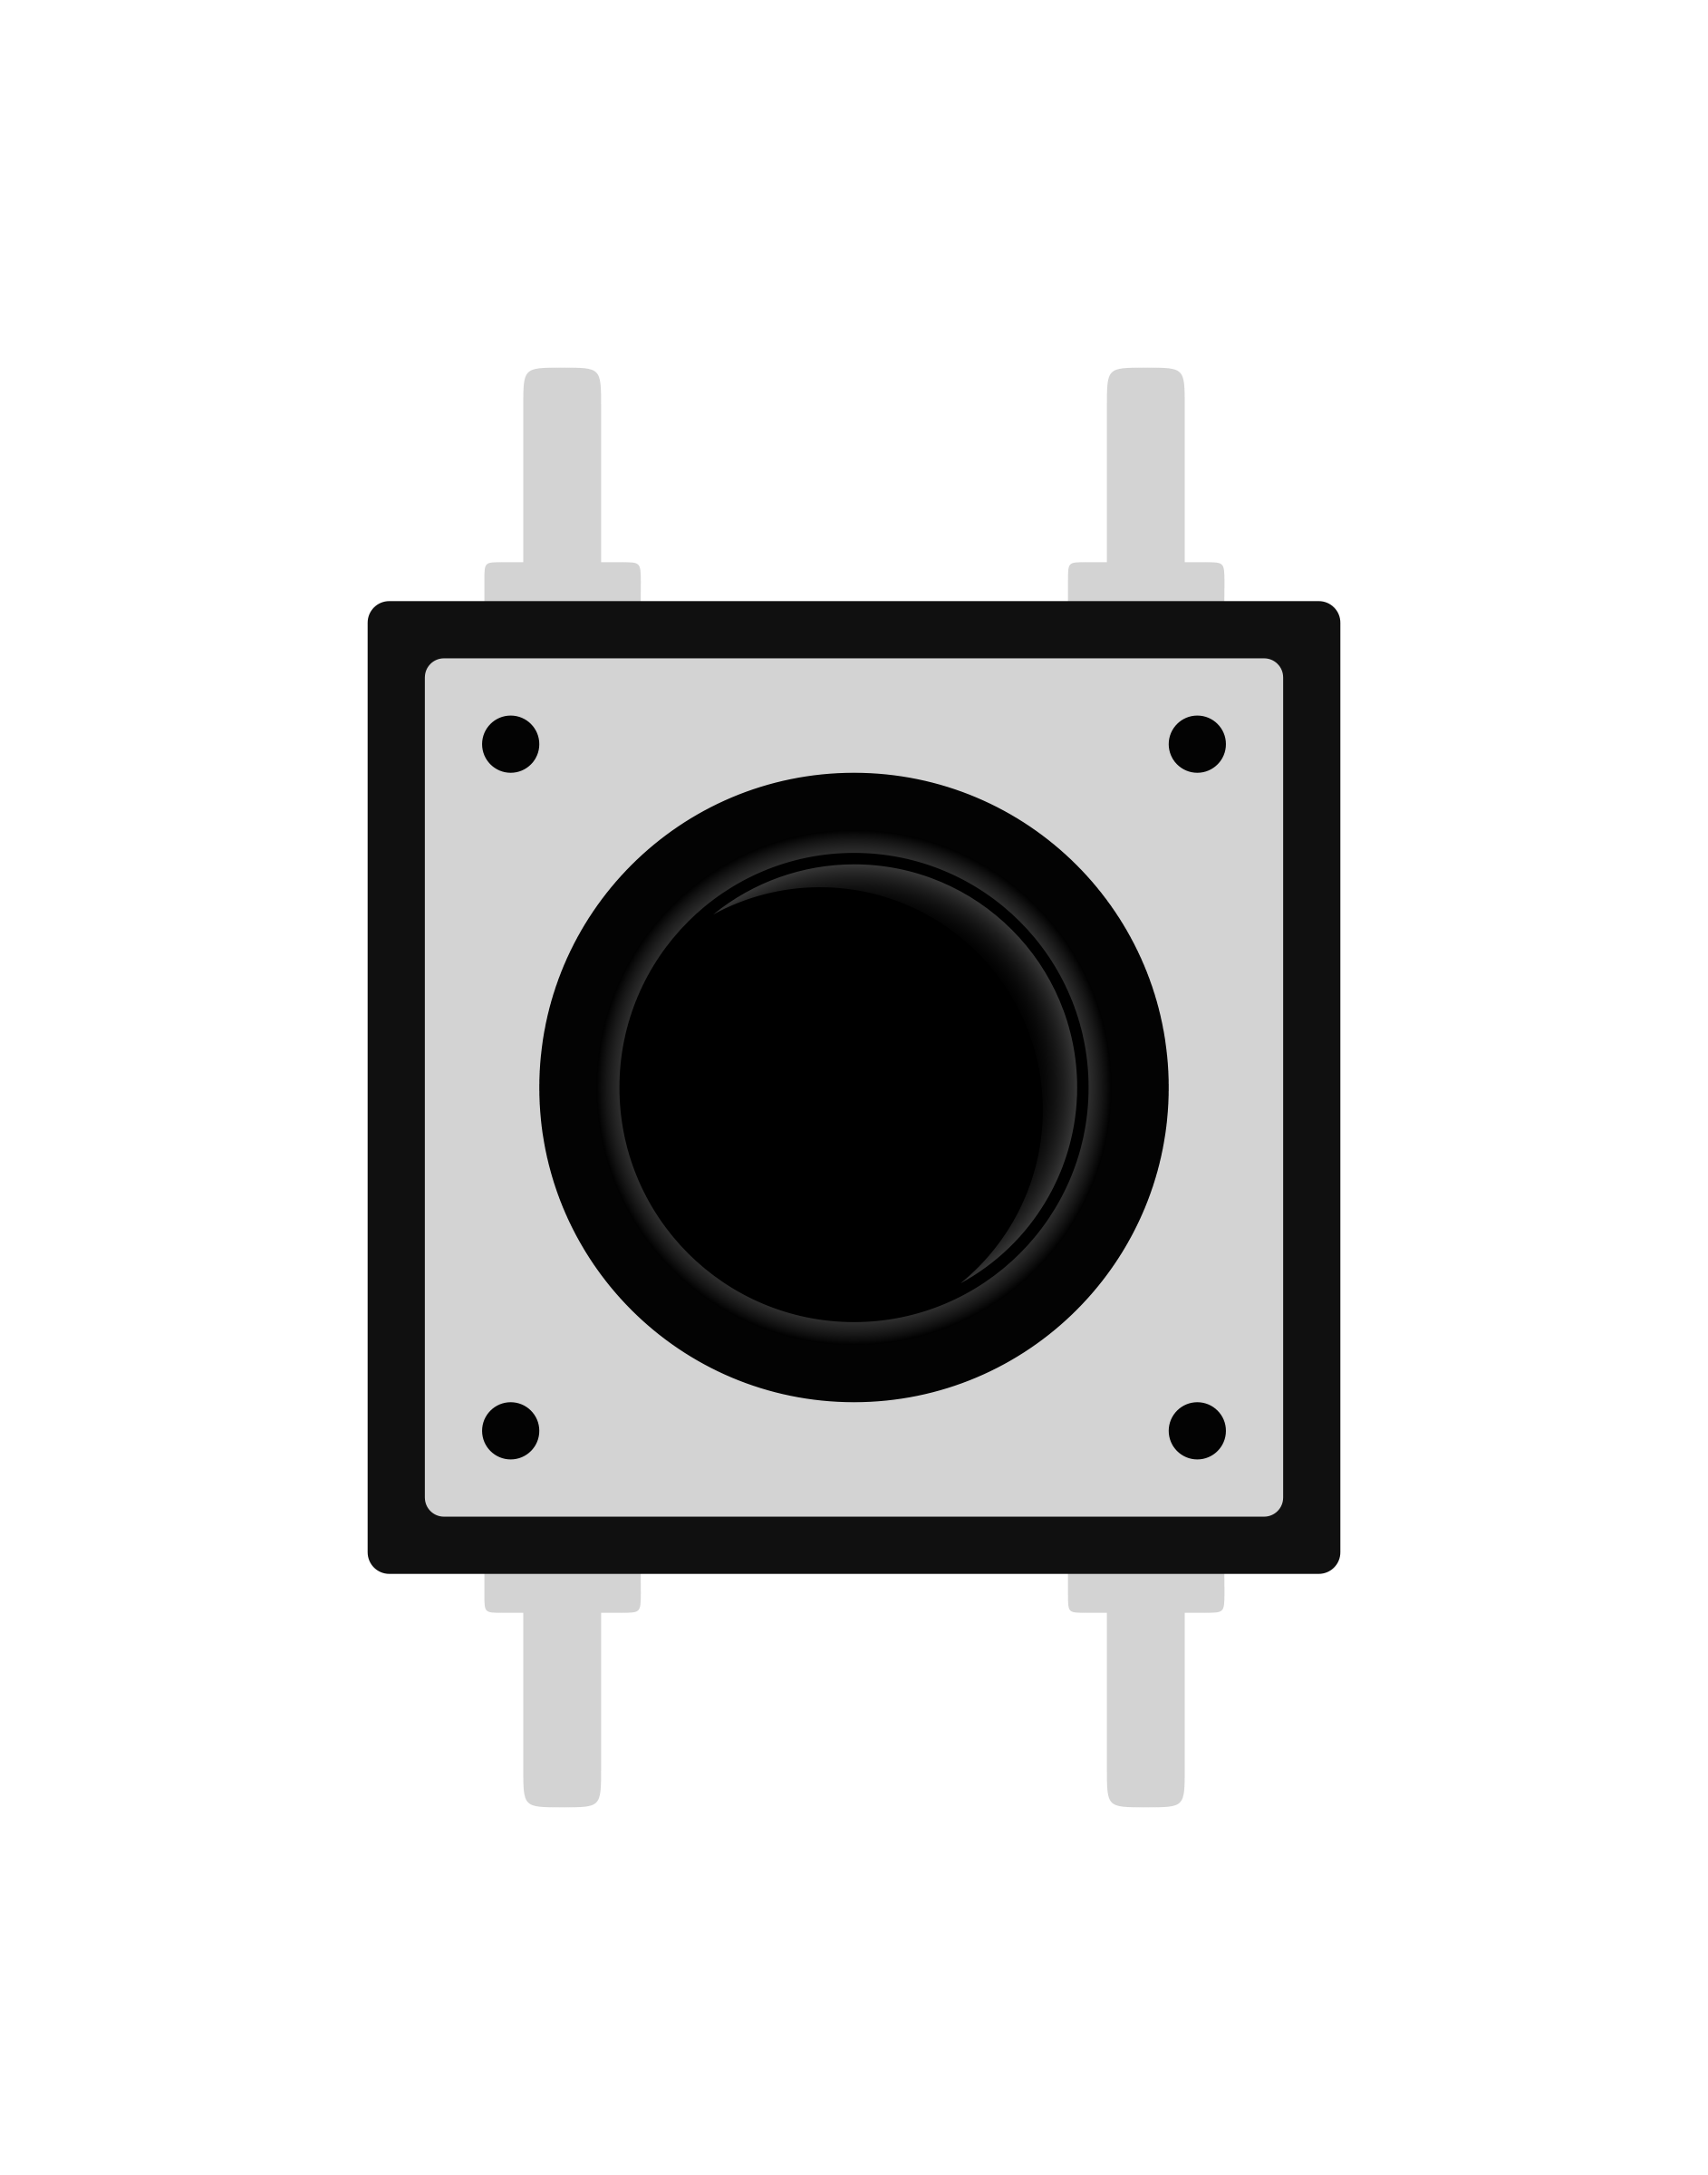
Push Button connection to Nucleo 64
R
GND
PC7

Slide 14
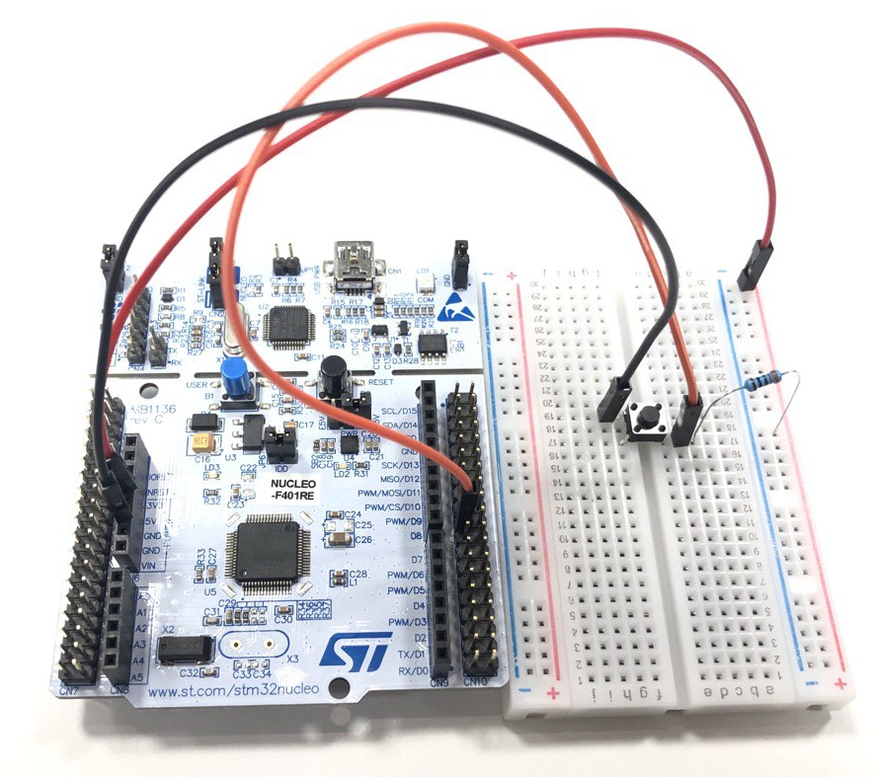
Push Button connection to Nucleo 64

Slide 15
Example 06
Apply a debouncing strategy to your code!

Slide 16
Example 07
Use a thread to read the user input and a thread to manage the LED.

Slide 17
Exercise 07
Use a thread to read the user input and a different one to manage the LED. Try to find and construct a synchronization schema between the two threads.

Slide 18
Exercise 08
Use a thread to read the user input and a thread to manage the color of LED.

