Slide 2
First Approach To Textual Interface
CREATING A SHELL IN CHIBISTUDIO

Slide 3
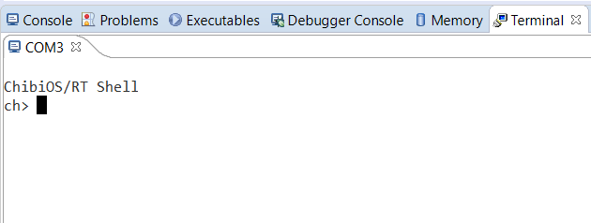
Introduction
A shell is a textual interface which relies on an I/O stream, in this case offered by the serial driver.
It is a powerful tool, because it allows to create asynchronous events by entering keyboard commands in the terminal.
Thanks to the shell, for example, It can be use to enter the inputs for a plant, simulated through a thread present in the same program, or It can be use to send an interrupt command for a specific task.
Be careful! If a thread uses chprintf or SdWrite, it will conflict with the shell

Slide 4

Files changes
To use the Shell it is needed to edit the halconf, mcuconf and Makefile files in the same way as for USART Serial Driver, because the shell will exploit it. It is also necessary to select alternate function 7 for A2 and A3 pins.
Also it is necessary to add the shell library path to the Makefile,
and include it in the main.
After that all the prerequisites for setting the shell are satisfied.

Slide 5
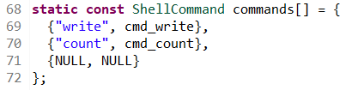
Creating the Shell
Before starting to use the Shell it is needed to manage the following primitives:
Allocating memory This line defines the memory heap area where the Shell will be allocated, it will useful for the next step.
Commands List It is an array containing the names of the commands that Shell expects to receive from the keyboard and the names of their related C functions.

Slide 6

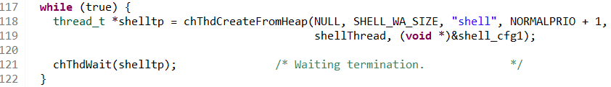
Creating the Shell
Configuration Struct
It is a struct containing the poiner to Serial Driver and the Commands Vector.
Shell Thread
Primitive that creates a new thread allocating the memory from the heap. The parameters in order are: heap pointer (NULL for the default one); size of the working area; thread identifier; priority level; thread function (the shell function is defined in the shell.c file); argument passed to the function.
The memory allocated for the thread is not released automatically, it is responsibility of the creator thread to call chThdWait() and then release the allocated memory.

Slide 7
Creating Commands
Custom Command
The first parameter is a pointer to the Serial stream, the second one is the maximum number of strings the Shell can recive from this command, and the last one is a vector containing the strings, separated by one space, typed from the keyboard. There is no limits to the number of commands It is possible to create, but each must have a different name. A command can expolit loops, but it have to insert sleeps just like a Thread. Using commands is the only way to print on screen without going in conflict with Shell.

Slide 8
Default Commands
By typing the command «help», on the terminal will be shown the list of all the available commands, also it is possible to notice that there are already some default commands. Exit: reset the Shell;
Info: print the informations about the OS and the board;
Echo: repeat the string separated by one space from the command call;
Systime: get the absolute system time;
Mem: print the memory status;
Threads: print the list of the active threads.
Test: call the Test suite.
TRY IT BY YOURSELF!

Slide 9

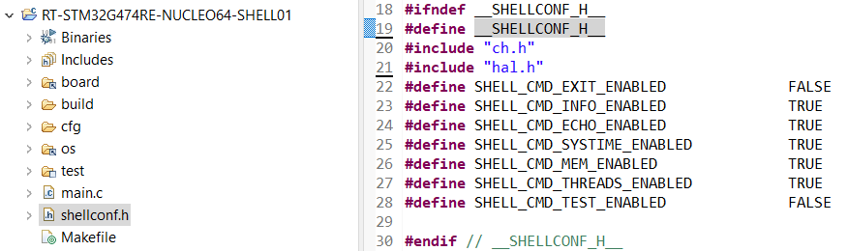
Customizing the shell
The shell can be tweaked, for example removing some of the default commands,.
A constant definition is required in the makefile:
After that a custom configuration can be provided in a file named shellconf.h in the main project folder.

Slide 10

Learn by doing
For more info read “Printing strings on a virtual COM port on STM32” on www.playembedded.org

