Slide 2
Using STM32 USART
CHIBIOS SERIAL DRIVER

Slide 3
Outline
Parallel vs Serial communication
Serial communication: from standard RS-232 to standard USB-CDC
STM32 USART
Encoding, payload length, dedicated I/O
The Serial Driver
Enabling driver, peripheral allocation, Serial Driver Object, initialization and configuration, serial operation
The BaseSequentialStream
Printing formatted strings using chprintf

Slide 4
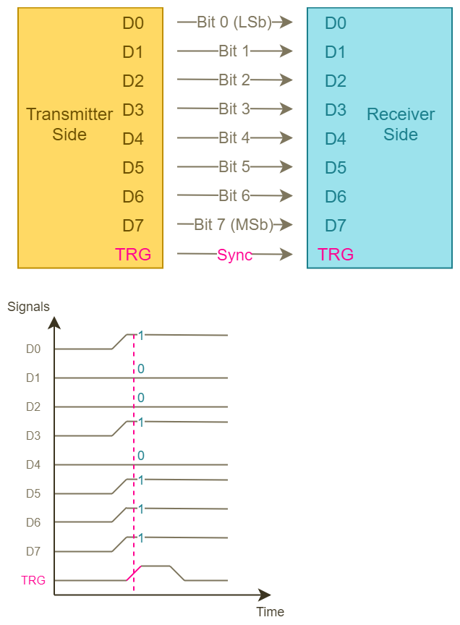
Parallel communication
Each bit is transmitted over a dedicated line
Requires a line per each bit plus a synchronization line
Reliable and fast
Not so practical

Slide 5
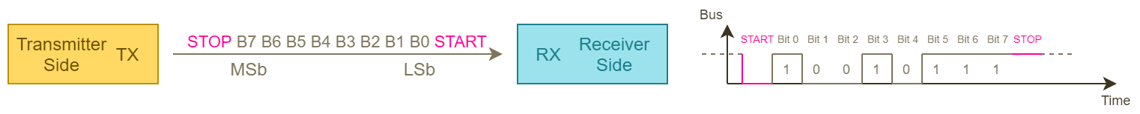
Serial communication
Bit are transmitted over a single line know as bus
More complex synchronization mechanism
Complex hardware design
Simple wiring

Slide 6
Serial communication classification
From a synchronization point of view:
Synchronous Serial, whereas a clock signal is generated by one of the endpoint's interface and provided to the others through a specific clock line.
Asynchronous Serial, whereas the synchronization is performed sending additional bits over the data line and baud-rate is known to all the parties.
From the communication point of view:
Simplex Communication, whereas the communication is one way.
Half-duplex Communication, whereas the communication is bidirectional on a single wire.
Full-duplex Communication, whereas the communication is bidirectional on two separate wires.

Slide 7
RS-232
Is a standard introduced in 1960
It formally defines connection between a Data Terminal Equipment (or DTE) and a Data Communication Equipment (DCE).
It have been used for a long time to connect PC to peripherals using computer serial ports.
It has been gradually replaced by more functional Universal Serial Bus and TCP/IP
It remains still largely used in embedded system and it is implemented through the USART peripheral.

Slide 8
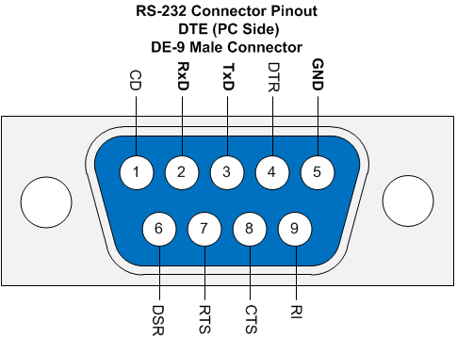
RS-232 Communication Frame
RS232 can be implemented with only two referenced lines.
It allows hardware flow control but requires additional extra signal
It has a data size of 8-bit where bits are encoded as Non Return To Zero Level (Bipolar NRZL)
Each data frame begins with a Start bit and Ends with a Stop bit
Stop bit can is configurable as 0.5, 1, 1.5 or 2 bit times
Baud rate is know by both receiver and transmitter and there are some standard values
It is possible to add an additional bit to do a parity check

Slide 9
From RS-232 to USB CDC
The Universal Serial Bus has superseded the RS-232
USB provides a specific profile known as Communication Device Class (or CDC)
In USB-CDC RX and TX are encapsulated in the protocol
A USB-CDC device appears as a traditional RS-232 port usually named as Virtual COM Port.

Slide 10
STM32 USART
STM32 is equipped with both USART and UART, the first is a superset of the second: USART is an UART equipped with an additional clock
STM32 USART is a peripheral designed to implement many serial protocol thus more feature that those required to implement RS-232
Is able to encode data using both Unipolar NRZL and Manchester Code (used in IrDA protocol)
Has a selectable payload length (8 or 9-bit) where the ninth is used in single master - multiple slaves architectures like RS-485 for slave addressing purposes
Offers a configurable oversampling (8/16 bit oversampling) to reduce errors due to timing misalignment
Offers a fractional baud rate generator
Offers dedicated I/O lines to implement hardware flow control

Slide 11
ChibiOS Serial driver
The Serial is a driver from ChibiOS/HAL which uses USART
The Serial Driver buffers input and output streams using I/O Queues
Each API (Application Programming Interface) of Serial driver starts with the “sd” prefix
Prefix is useful for auto-completion feature offered by Eclipse (CTRL+SPACE)
Auto-completion requires that project have been built at least once

Slide 12

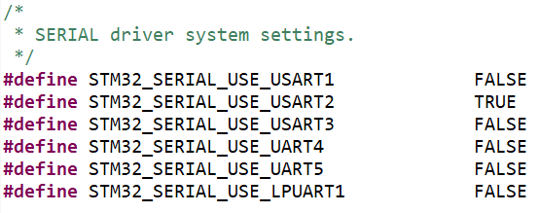
DRIVER ENABLING AND PERIPHERAL ALLOCATION
To use Serial it shall be enabled in halconf.h setting HAL_USE_SERIAL as TRUE
To use the driver we have to assign it a peripheral in mcuconf.h

Slide 13
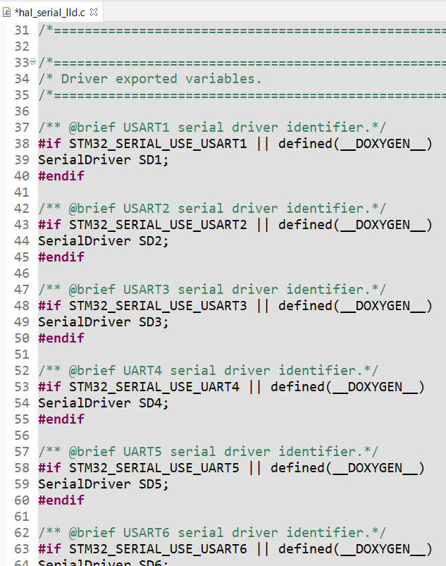
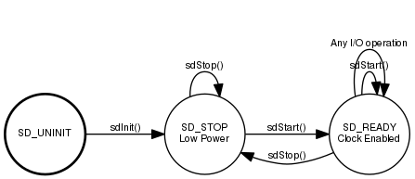
SERIAL DRIVER OBJECT
A Serial Driver is represented by a structure
Assigning a peripheral to the driver a new Serial Driver instance becomes available
SD1 on USART 1 assignation, SD2 on USART 2 and so on
The SD driver can be implemented as a Finite State Machine

Slide 14
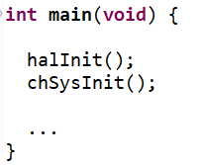

SERIAL DRIVER INITIALIZATION AND CONFIGURATION
Before to use it, the serial driver shall be properly initialized and configured
The initialization is automatically performed calling the function halInit() inside the main of our project
The configuration shall be performed by user through the function sdStart()
The sdStart() needs two input parameters:
a pointer to the serial driver object we want to start
a pointer to a configuration structure

Slide 15
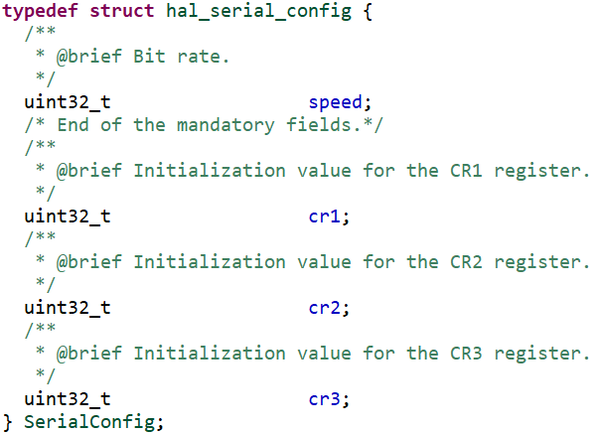
SERIAL DRIVER CONF STRUCTURE
The configuration structure depends on hardware in use
In case of STM32G4 the structure has 4 fields:
speed (uint32_t), the value of serial baudrate
cr1 (uint32_t), the value of USART Control Register 1
cr2 (uint32_t), the value of USART Control Register 2
cr3 (uint32_t), the value of USART Control Register 3
Passing NULL as second parameter to sdStart, the serial will be configured with the default config (38400bps, 8-bit, no parity, 1 stop bit, no crc, no hardware flow control)

Slide 16
START, DO, STOP
Once started, the SD does not perform any operation but it is enabled and ready to use
Peripheral can be as well stopped using the sdStop which receives in input only the pointer to the driver to be stopped
To reduce power consumption usually ChibiOS drivers operate using the paradigm START-DO-STOP

Slide 17
SERIAL OPERATION
Operation related to Serial Driver are those easily associable to characters handling
sdPut(sdp, char)
sdPut(&SD2, 'a')
sdWrite(sdp, string, size)
sdWrite(&SD4, "Hohoho\r\n", 8)
char token = sdGet(sdp)
char token = sdGet(&SD1)
sdRead(sdp, buf, size)
sdRead(&SD3, buf, 5)

Slide 18
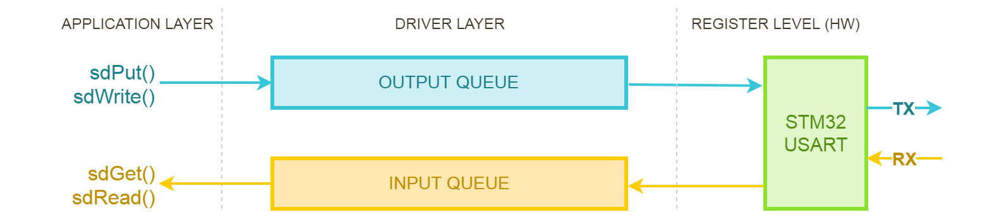
SERIAL COMMUNICATION: I/O QUEUE
Serial driver operation relies on I/O queue
The data is buffered in I/O queue and user application has not to continuously serve interrupt
Queue size can be configured in your project’s HAL Configuration file and the default value is 16 bytes

Slide 19
SERIAL OPERATION WITH TIMEOUT
Serial operation are blocking function
To avoid critical scenarios the driver offers functions with timeout
sdPutTimeout(sdp, char, timeout)
sdPutTimeout(&SD2, ‘a’, TIME_MS2I(50))
sdWriteTimeout(sdp, string, size, timeout)
sdWriteTimeout(&SD4, “Try\r\n", 5, TIME_IMMEDIATE)
char token = sdGetTimeout(sdp, timeout)
char token = sdGetTimeout(&SD1, TIME_INFINITE)
sdReadTimeout(sdp, buf, size, timeout)
sdReadTimeout(&SD3, buf, 5, TIME_S2I(1)))

Slide 20
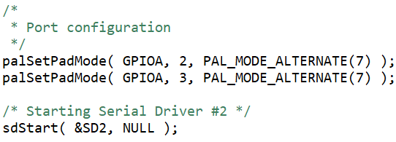
GPIO RELATED CONFIGURATION
To use Serial Driver we need to reroute GPIO connections assigning them to UART through PAL driver. To do that we have to:
Check on datasheet the reroute map
Check if those IO are already configured in board files
If not, use the palSetPadMode to reconfigure them

Slide 21
BASESEQUENTIALSTREAM
The BaseSequentialStream is an abstraction interface which allows to print formatted strings
BaseSequentialStream defines 4 methods: get, put, read and write
Serial Driver implements a BaseSequentialStream interface
Using Streams module it is possible to print formatted strings over the SerialDriver using chprintf

Slide 22
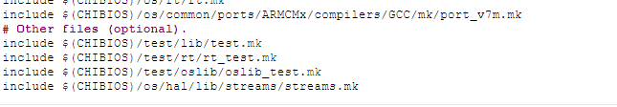

CHPRINTF
To use chPrintf we have to add streams library to our project acting on makefile
Then we have to include “chprintf.h” in our main, start the serial driver properly and use it as a BaseSequentialStream

Slide 23
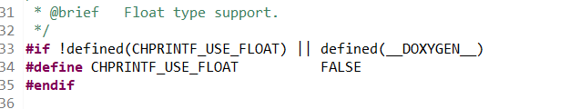
Printing Float data type
By default chPrintf does not allow to print float data type
If needed, it’s possible to change this
We can see from “chprintf.h” that we need to define the constant CHPRINTF_USE_FLOAT.
From «os/hal/lib/streams/chprintf.h»

Slide 24
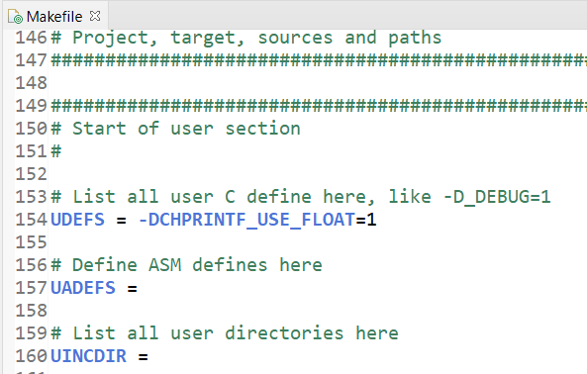
Printing Float data type
We need to add an instruction in the Makefile
UDEFS = -DCHPRINTF_USE_FLOAT=1 tells the compiler to define the constant CHPRINTF_USE_FLOAT and set it to 1.

Slide 25

Learn by doing
For more info read “Using STM Usart with Chibios Serial Driver”
on www.playembedded.org

