Slide 1
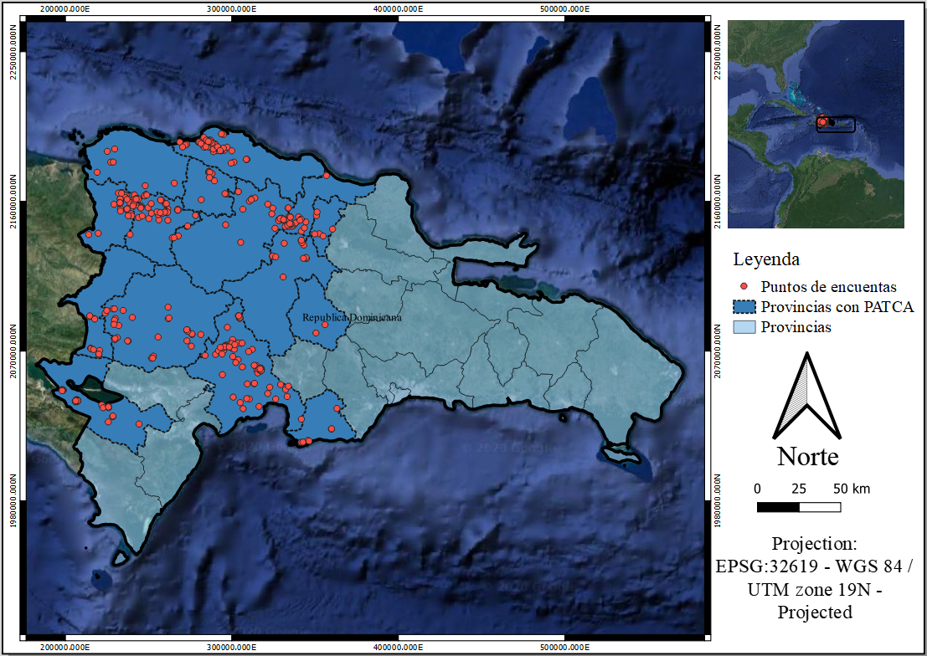
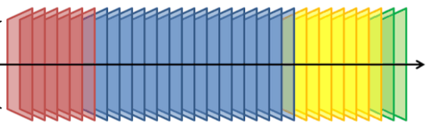
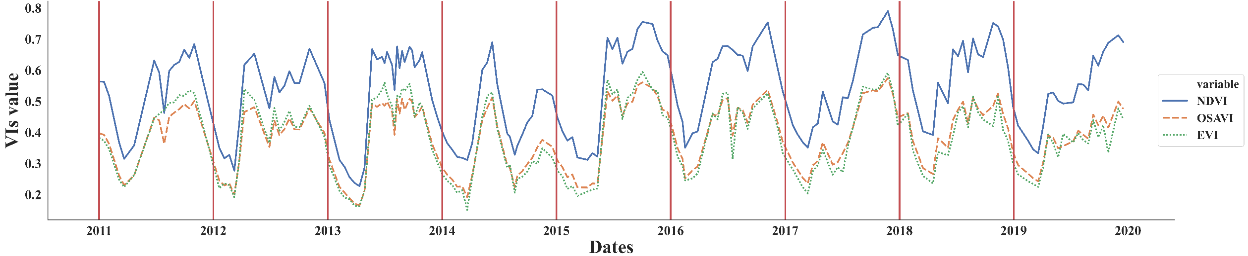
Trends images satellite in Republic Dominican
Images Landsat
2011
2019
ID | time | crop | Temporary crop
386511 | 0. Baseline 2011 | Grass | 0
386511 | 1. Follow-up 2014 | guandul | 1
permanent crop
permanent crop
Time series
temporary crop

Slide 2
Trends images satellite in Republic Dominican
Images Landsat
2011
2019

Slide 3
Trends images satellite in Republic Dominican
Images Landsat
2011
2019
permanent crop
permanent crop
temporary crop
ID | time | crop | Temporary crop
386511 | 0. Baseline 2011 | Grass | 0
386511 | 1. Follow-up 2014 | Guandul | 1

