Slide 1
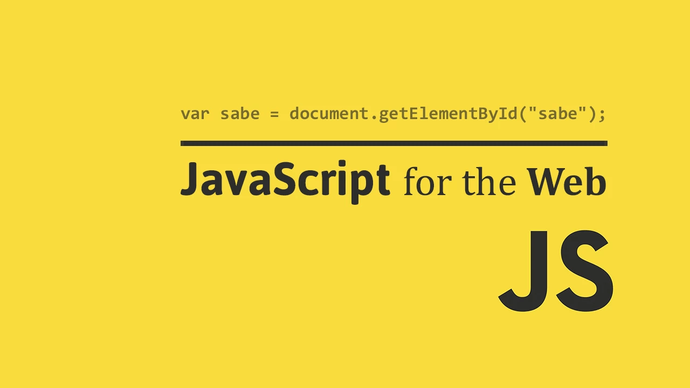
JAVA SCRIPT

Slide 2
Client-Side Programming
HTML is good for developing static pages
  can specify text/image layout, presentation, links, …
  Web page looks the same each time it is accessed
  in order to develop interactive/reactive pages, must integrate programming in some form or another
client-side programming
  programs are written in a separate programming (or scripting) language
    e.g., JavaScript, JScript, VBScript
  programs are embedded in the HTML of a Web page, with (HTML) tags to identify the program component
    e.g., <script type="text/javascript"> … </script>
  the browser executes the program as it loads the page, integrating the dynamic output of the program with the static content of HTML
  could also allow the user (client) to input information and process it, might be used to validate input before it’s submitted to a remote server

Slide 3
Scripts vs. Programs
a scripting language is a simple, interpreted programming language
  scripts are embedded as plain text, interpreted by application
  simpler execution model: don't need compiler or development environment
  saves bandwidth: source code is downloaded, not compiled executable
  platform-independence: code interpreted by any script-enabled browser
  but: slower than compiled code, not as powerful/full-featured
  JavaScript: the first Web scripting language, developed by Netscape in 1995
  syntactic similarities to Java/C++, but simpler, more flexible in some respects,
  limited in others
      (loose typing, dynamic variables, simple objects)
  JScript: Microsoft version of JavaScript, introduced in 1996
    same core language, but some browser-specific differences
    fortunately, IE, Netscape, Firefox, etc. can (mostly) handle both
    JavaScript & JScript
    JavaScript 1.5 & JScript 5.0 cores both conform to ECMAScript standard
  VBScript: client-side scripting version of Microsoft Visual Basic

Slide 4
Common Scripting Tasks
adding dynamic features to Web pages
  validation of form data (probably the most commonly used application)
  image rollovers
  time-sensitive or random page elements
  handling cookies
defining programs with Web interfaces
  utilize buttons, text boxes, clickable images, prompts, etc
limitations of client-side scripting
  since script code is embedded in the page, it is viewable to the world
  for security reasons, scripts are limited in what they can do
    e.g., can't access the client's hard drive
  since they are designed to run on any machine platform, scripts do not contain platform specific commands
  script languages are not full-featured
    e.g., JavaScript objects are very crude, not good for large project development

Slide 5
JavaScript
JavaScript code can be embedded in a Web page using <script> tags
  the output of JavaScript code is displayed as if directly entered in HTML
<html>
<!–- COMP519 js01.html 16.08.06 -->
<head>
<title>JavaScript Page</title>
</head>
<body>
<script type="text/javascript">
// silly code to demonstrate output
document.write("<p>Hello world!</p>");
document.write(" <p>How are <br/> " +
" <i>you</i>?</p> ");
</script>
<p>Here is some static text as well.</p>
</body>
</html>
document.write displays text in the page
  text to be displayed can include HTML tags
  the tags are interpreted by the browser when the text is displayed
as in C++/Java, statements end with ;
but a line break might also be interpreted as the end of a statement (depends upon browser)
JavaScript comments similar to C++/Java
  // starts a single line comment
  /*…*/ enclose multi-line comments
view page

Slide 6
JavaScript Data Types & Variables
JavaScript has only three primitive data types
  String : "foo" 'how do you do?' "I said 'hi'." ""
  Number: 12 3.14159 1.5E6
  Boolean : true false *Find info on Null, Undefined
assignments are as in C++/Java
  message = "howdy";
  pi = 3.14159;
variable names are sequences of letters, digits, and underscores that start with a letter or an underscore
variables names are case-sensitive
you don't have to declare variables, will be created the first time used, but it’s better if you use var statements
var message, pi=3.14159;
variables are loosely typed, can be assigned different types of values (Danger!)
<html>
<!–- COMP519 js02.html 16.08.06 -->
<head>
<title>Data Types and Variables</title>
</head>
<body>
<script type="text/javascript">
var x, y;
x= 1024;
y=x; x = "foobar";
document.write("<p>x = " + y + "</p>");
document.write("<p>x = " + x + "</p>");
</script>
</body>
</html>
view page

Slide 7
JavaScript Operators & Control Statements
standard C++/Java operators & control statements are provided in JavaScript
  +, -, *, /, %, ++, --, …
  ==, !=, <, >, <=, >=
  &&, ||, !,===,!==
  if , if-else, switch
  while, for, do-while, …
PUZZLE: Suppose you took a piece of paper and folded it in half, then in half again, and so on.
How many folds before the thickness of the paper reaches from the earth to the sun?
*Lots of information is available online
<html>
<!–- COMP519 js03.html 08.10.10 -->
<head>
<title>Folding Puzzle</title>
</head>
<body>
<script type="text/javascript">
var distanceToSun = 93.3e6*5280*12;
var thickness = .002;
var foldCount = 0;
while (thickness < distanceToSun) {
thickness *= 2;
foldCount++;
}
document.write("Number of folds = " +
foldCount);
</script>
</body>
</html>
view page

Slide 8
JavaScript Math Routines
<html>
<!–- COMP519 js04.html 08.10.10 -->
<head>
<title>Random Dice Rolls</title>
</head>
<body>
<div style="text-align:center">
<script type="text/javascript">
var roll1 = Math.floor(Math.random()*6) + 1;
var roll2 = Math.floor(Math.random()*6) + 1;
document.write("<img src='http://www.csc.liv.ac.uk/"+
"~martin/teaching/comp519/Images/die" +
roll1 + ".gif‘ alt=‘dice showing ‘ + roll1 />");
document.write("&nbsp;&nbsp;");
document.write("<img src='http://www.csc.liv.ac.uk/"+
"~martin/teaching/comp519/Images/die" +
roll2 + ".gif‘ alt=‘dice showing ‘ + roll2 />");
</script>
</div>
</body>
</html>
the built-in Math object contains functions and constants
  Math.sqrt
  Math.pow
  Math.abs
  Math.max
  Math.min
  Math.floor
  Math.ceil
  Math.round
  Math.PI
  Math.E
Math.random function returns a real number in [0..1)
view page

Slide 9
Interactive Pages Using Prompt
crude user interaction can take place using prompt
  1st argument: the prompt message that appears in the dialog box
  2nd argument: a default value that will appear in the box (in case the user enters nothing)
  the function returns the value entered by the user in the dialog box (a string)
  if value is a number, must use parseFloat (or parseInt) to convert
forms will provide a better interface for interaction (later)
<html>
<!-- COMP519 js05.html 08.10.10 -->
<head>
<title>Interactive page</title>
</head>
<body>
<script type="text/javascript">
var userName = prompt("What is your name?", "");
var userAge = prompt("Your age?", "");
var userAge = parseFloat(userAge);
document.write("Hello " + userName + ".")
if (userAge < 18) {
document.write(" Do your parents know " +
"you are online?");
}
else {
document.write(" Welcome friend!");
}
</script>
<p>The rest of the page...</p>
</body>
</html>
view page

Slide 10
User-Defined Functions
function definitions are similar to C++/Java, except:
  no return type for the function (since variables are loosely typed)
  no variable typing for parameters (since variables are loosely typed)
  by-value parameter passing only (parameter gets copy of argument)
function isPrime(n)
// Assumes: n > 0
// Returns: true if n is prime, else false
{
if (n < 2) {
return false;
}
else if (n == 2) {
return true;
}
else {
for (var i = 2; i <= Math.sqrt(n); i++) {
if (n % i == 0) {
return false;
}
}
return true;
}
}
Can limit variable scope to the function.
if the first use of a variable is preceded with var, then that variable is local to the function
for modularity, should make all variables in a function local

Slide 11
Function Example
<html>
<!–- COMP519 js06.html 16.08.2006 -->
<head>
<title>Prime Tester</title>
<script type="text/javascript">
function isPrime(n)
// Assumes: n > 0
// Returns: true if n is prime
{
// CODE AS SHOWN ON PREVIOUS SLIDE
}
</script>
</head>
<body>
<script type="text/javascript">
testNum = parseFloat(prompt("Enter a positive integer", "7"));
if (isPrime(testNum)) {
document.write(testNum + " <b>is</b> a prime number.");
}
else {
document.write(testNum + " <b>is not</b> a prime number.");
}
</script>
</body>
</html>
Function definitions (usually) go in the <head> section
<head> section is loaded first, so then the function is defined before code in the <body> is executed (and, therefore, the function can be used later in the body of the HTML document)
view page

Slide 12
Another Example
<html>
<!–- COMP519 js07.html 11.10.2011 -->
<head>
<title> Random Dice Rolls Revisited</title>
<script type="text/javascript">
function randomInt(low, high)
// Assumes: low <= high
// Returns: random integer in range [low..high]
{
return Math.floor(Math.random()*(high-low+1)) + low;
}
</script>
</head>
<body>
<div style="text-align: center">
<script type="text/javascript">
roll1 = randomInt(1, 6);
roll2 = randomInt(1, 6);
document.write("<img src='http://www.csc.liv.ac.uk/"+
"~martin/teaching/comp519/Images/die" +
roll1 + ".gif'/>");
document.write("&nbsp;&nbsp;");
document.write("<img src='http://www.csc.liv.ac.uk/"+
"~martin/teaching/comp519/Images/die" +
roll2 + ".gif'/>");
</script>
</div>
</body>
</html>
recall the dynamic dice page
could define a function for generating random numbers in a range, then use whenever needed
easier to remember, promotes reuse
view page

Slide 13
JavaScript Libraries
better still: if you define functions that may be useful to many pages, store in a separate library file and load the library when needed
the file at http://www.csc.liv.ac.uk/~martin/teaching/comp519/JS/random.js
contains definitions of the following functions:
  randomNum(low, high) returns random real in range [low..high)
  randomInt(low, high) returns random integer in range [low..high)
  randomChar(string) returns random character from the string
  randomOneOf([item1,…,itemN]) returns random item from list/array
  Note: as with external style sheets, do not put <script> tags in the external JavaScript library file
load a library using the SRC attribute in the SCRIPT tag (put nothing between the beginning and ending tags)
  <script type="text/javascript"
  src="http://www.csc.liv.ac.uk/~martin/teaching/comp519/JS/random.js">
  </script>

Slide 14
Library Example
<html>
<!–- COMP519 js08.html 11.10.2011 -->
<head>
<title> Random Dice Rolls Revisited</title>
<script type="text/javascript"
src="http://www.csc.liv.ac.uk/~martin/teaching/comp519/JS/random.js">
</script>
</head>
<body>
<div style="text-align: center">
<script type="text/javascript">
roll1 = randomInt(1, 6);
roll2 = randomInt(1, 6);
document.write("<img src='http://www.csc.liv.ac.uk/"+
"~martin/teaching/comp519/Images/die" +
roll1 + ".gif'/>");
document.write("&nbsp;&nbsp;");
document.write("<img src='http://www.csc.liv.ac.uk/"+
"~martin/teaching/comp519/Images/die" +
roll2 + ".gif'/>");
</script>
</div>
</body>
</html>
view page

Slide 15
JavaScript Objects
an object defines a new type (formally, Abstract Data Type)
  encapsulates data (properties) and operations on that data (methods)
a String object encapsulates a sequence of characters, enclosed in quotes
  properties include
    length : stores the number of characters in the string
  methods include
    charAt(index) : returns the character stored at the given index
    (as in C++/Java, indices start at 0)
    substring(start, end) : returns the part of the string between the start
    (inclusive) and end (exclusive) indices
    toUpperCase() : returns copy of string with letters uppercase
    toLowerCase() : returns copy of string with letters lowercase
  to create a string, assign using new or (in this case) just make a direct assignment (new is implicit)
  word = new String("foo"); word = "foo";
  properties/methods are called exactly as in C++/Java
    word.length word.charAt(0)

Slide 16
String example: Palindromes
function strip(str)
// Assumes: str is a string
// Returns: str with all but letters removed
{
var copy = "";
for (var i = 0; i < str.length; i++) {
if ((str.charAt(i) >= "A" && str.charAt(i) <= "Z") ||
(str.charAt(i) >= "a" && str.charAt(i) <= "z")) {
copy += str.charAt(i);
}
}
return copy;
}
function isPalindrome(str)
// Assumes: str is a string
// Returns: true if str is a palindrome, else false
{
str = strip(str.toUpperCase());
for(var i = 0; i < Math.floor(str.length/2); i++) {
if (str.charAt(i) != str.charAt(str.length-i-1)) {
return false;
}
}
return true;
}
suppose we want to test whether a word or phrase is a palindrome
  noon Radar
  Madam, I'm Adam.
  A man, a plan, a canal:
  Panama!
must strip non-letters out of the word or phrase
make all chars uppercase in order to be case-insensitive
finally, traverse and compare chars from each end

Slide 17
<html>
<!–- COMP519 js09.html 11.10.2011 -->
<head>
<title>Palindrome Checker</title>
<script type="text/javascript">
  function strip(str)
  {
// CODE AS SHOWN ON PREVIOUS SLIDE
  }
  function isPalindrome(str)
  {
  // CODE AS SHOWN ON PREVIOUS SLIDE
  }
</script>
</head>
<body>
<script type="text/javascript">
text = prompt("Enter a word or phrase", "Madam, I'm Adam");
if (isPalindrome(text)) {
document.write("'" + text + "' <b>is</b> a palindrome.");
}
else {
document.write("'" + text + "' <b>is not</b> a palindrome.");
}
</script>
</body>
</html>
view page

Slide 18
JavaScript Arrays
arrays store a sequence of items, accessible via an index
  since JavaScript is loosely typed, elements do not have to be the same type
  to create an array, allocate space using new (or can assign directly)
    items = new Array(10); // allocates space for 10 items
    items = new Array(); // if no size given, will adjust dynamically
    items = [0,0,0,0,0,0,0,0,0,0]; // can assign size & values []
  to access an array element, use [] (as in C++/Java)
    for (i = 0; i < 10; i++) {
    items[i] = 0; // stores 0 at each index
    }
  the length property stores the number of items in the array
    for (i = 0; i < items.length; i++) {
    document.write(items[i] + "<br>"); // displays elements
    }

Slide 19
Array Example
<html>
<!–- COMP519 js10.html 11.10.2011 -->
<head>
<title>Die Statistics</title>
<script type="text/javascript"
src="http://www.csc.liv.ac.uk/~martin/teaching/comp519/JS/random.js">
</script>
</head>
<body>
<script type="text/javascript">
numRolls = 60000;
dieSides = 6;
rolls = new Array(dieSides+1);
for (i = 1; i < rolls.length; i++) {
rolls[i] = 0;
}
for(i = 1; i <= numRolls; i++) {
rolls[randomInt(1, dieSides)]++;
}
for (i = 1; i < rolls.length; i++) {
document.write("Number of " + i + "'s = " +
rolls[i] + "<br />");
}
</script>
</body>
</html>
suppose we want to simulate die rolls and verify even distribution
keep an array of counters:
  initialize each count to 0
  each time you roll X, increment rolls[X]
  display each counter
view page

Slide 20
Arrays (cont.)
Arrays have predefined methods that allow them to be used as stacks, queues, or other common programming data structures.
var stack = new Array();
stack.push("blue");
stack.push(12); // stack is now the array ["blue", 12]
stack.push("green"); // stack = ["blue", 12, "green"]
var item = stack.pop(); // item is now equal to "green"
var q = [1,2,3,4,5,6,7,8,9,10];
item = q.shift(); // item is now equal to 1, remaining
// elements of q move down one position
// in the array, e.g. q[0] equals 2
q.unshift(125); // q is now the array [125,2,3,4,5,6,7,8,9,10]
q.push(244); // q = [125,2,3,4,5,6,7,8,9,10,244]

Slide 21
Date Object
String & Array are the most commonly used objects in JavaScript
  other, special purpose objects also exist
the Date object can be used to access the date and time
  to create a Date object, use new & supply year/month/day/… as desired
    today = new Date(); // sets to current date & time
    newYear = new Date(2002,0,1); //sets to Jan 1, 2002 12:00AM
  methods include:
    newYear.getYear() can access individual components of a date
    newYear.getMonth()
    newYear.getDay()
    newYear.getHours()
    newYear.getMinutes()
    newYear.getSeconds()
    newYear.getMilliseconds()

Slide 22
Date Example
<html>
<!–- COMP519 js11.html 16.08.2006 -->
<head>
<title>Time page</title>
</head>
<body>
Time when page was loaded:
<script type="text/javascript">
now = new Date();
document.write("<p>" + now + "</p>");
time = "AM";
hours = now.getHours();
if (hours > 12) {
hours -= 12;
time = "PM"
}
else if (hours == 0) {
hours = 12;
}
document.write("<p>" + hours + ":" +
now.getMinutes() + ":" +
now.getSeconds() + " " +
time + "</p>");
</script>
</body>
</html>
by default, a date will be displayed in full, e.g.,
  Sun Feb 03 22:55:20 GMT-0600 (Central Standard Time) 2002
can pull out portions of the date using the methods and display as desired
  here, determine if "AM" or "PM" and adjust so hour between 1-12
  10:55:20 PM
view page

Slide 23
Another Example
<html>
<!–- COMP519 js12.html 12.10.2012 -->
<head>
<title>Time page</title>
</head>
<body>
<p>Elapsed time in this year:
<script type="text/javascript">
now = new Date();
newYear = new Date(2012,0,1);
secs = Math.round((now-newYear)/1000);
days = Math.floor(secs / 86400);
secs -= days*86400;
hours = Math.floor(secs / 3600);
secs -= hours*3600;
minutes = Math.floor(secs / 60);
secs -= minutes*60
document.write(days + " days, " +
hours + " hours, " +
minutes + " minutes, and " +
secs + " seconds.");
</script>
</p>
</body>
</html>
you can add and subtract Dates:
the result is a number of milliseconds
  here, determine the number of seconds since New Year's day
  (note: January is month 0)
  divide into number of days, hours, minutes and seconds
view page

Slide 24
document Object
Internet Explorer, Firefox, Opera, etc. allow you to access information about an HTML document using the document object
<html>
<!–- COMP519 js13.html 2.10.2012 -->
<head>
<title>Documentation page</title>
</head>
<body>
<table width="100%">
<tr>
<td><i>
<script type="text/javascript">
document.write(document.URL);
</script>
</i></td>
<td style="text-align: right;"><i>
<script type="text/javascript">
document.write(document.lastModified);
</script>
</i></td>
</tr>
</table>
</body>
</html>
document.write(…)
  method that displays text in the page
document.URL
  property that gives the location of the HTML document
document.lastModified
  property that gives the date & time the HTML document was last changed
view page

Slide 25
navigator Object
<html>
<!–- COMP519 js14.html 16.08.2006 -->
<head>
<title>Dynamic Style Page</title>
<script type="text/javascript">
if (navigator.appName == "Netscape") {
document.write('<link rel=stylesheet '+
'type="text/css" href="Netscape.css">');
}
else {
document.write('<link rel=stylesheet ' +
'type="text/css" href="MSIE.css">');
}
</script>
</head>
<body>
Here is some text with a
<a href="javascript:alert('GO AWAY')">link</a>.
</body>
</html>
navigator.appName property that gives the browser name
navigator.appVersion property that gives the browser version
<!-- MSIE.css -->
a {text-decoration:none;
font-size:larger;
color:red;
font-family:Arial}
a:hover {color:blue}
<!-- Netscape.css -->
a {font-family:Arial;
color:white;
background-color:red}
view page

Slide 26
User-Defined Objects
can define new objects, but the notation can be somewhat awkward
  simply define a function that serves as a constructor
  specify data fields & methods using this
  no data hiding: can't protect data or methods
// COMP519 Die.js 11.10.2011 //
// Die class definition
////////////////////////////////////////////
function Die(sides)
{
this.numSides = sides;
this.numRolls = 0;
this.roll = roll; // define a pointer to a function
}
function roll()
{
this.numRolls++;
return Math.floor(Math.random()*this.numSides) + 1;
}
define Die function (i.e., the object's constructor)
initialize data fields in the function, preceded with "this"
similarly, assign method to separately defined function (which uses this to access data)

Slide 27
Object Example
<html>
<!–- COMP519 js15.html 11.10.2011 -->
<head>
<title>Dice page</title>
<script type="text/javascript"
src="Die.js">
</script>
</head>
<body>
<script type="text/javascript">
die6 = new Die(6);
die8 = new Die(8);
roll6 = -1; // dummy value to start loop
roll8 = -2; // dummy value to start loop
while (roll6 != roll8) {
roll6 = die6.roll();
roll8 = die8.roll();
document.write("6-sided: " + roll6 +
"&nbsp;&nbsp;&nbsp;&nbsp;" +
"8-sided: " + roll8 + "<br />");
}
document.write("<br />Number of rolls: " +
die6.numRolls);
</script>
</body>
</html>
create a Die object using new (similar to String and Array)
here, the argument to Die initializes numSides for that particular object
each Die object has its own properties (numSides & numRolls)
Roll(), when called on a particular Die, accesses its numSides property and updates its NumRolls
view page

Slide 28
JavaScript and HTML validators
In order to use an HTML validator, and not get error messages from the JavaScript portions, you must “mark” the JavaScipt sections in a particular manner. Otherwise the validator will try to interpret the script as HTML code.
To do this, you can use a markup like the following in your inline code (this isn’t necessary for scripts stored in external files).
<script type=“text/javascript”>
// <![CDATA[
document.write(“<p>The quick brown fox jumped over the lazy dogs.</p>”);
// **more code here, etc.
// ]]>
</script>

Slide 29
Since the (new) XHTML standard is written as an XML application, validators such as the one from the W3C are actually attempting to check an XML document for the correct structure.
The two tags <![CDATA[ and ]]> together form an XML directive, meaning to interpret the data between them as literal (non-parsed) “character data”. An XML validator will effectively ignore the data between these two tags, meaning that any symbols that would result in an invalid document structure are ignored and do not result in an error message from the validator.
Because we are using these tags inside of a JavaScript block, and they are not JavaScript commands, we precede each of them with a (JavaScript) comment marker, hence the two forward slashes before each tag.

Slide 30
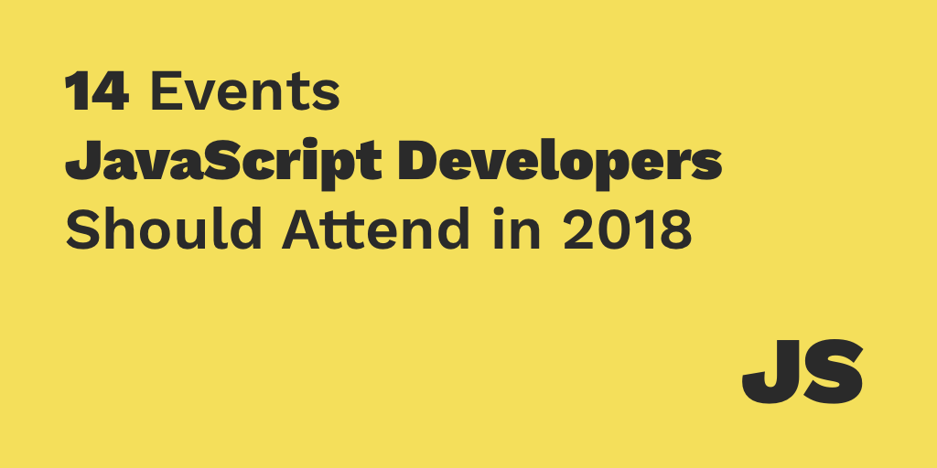

Slide 31
1 Introduction
JavaScript events
  allow scripts to respond to user interactions and modify the page accordingly
Events and event handling
  help make web applications more responsive, dynamic and interactive

Slide 32
2 Registering Event Handlers
Functions that handle events
Assigning an event handler to an event on a DOM node is called registering an event handler
Two models for registering event handlers
  Inline model treats events as attributes of XHTML elements
  Traditional model assigns the name of the function to the event property of a DOM node
In the inline model, the value of the XHTML attribute is a JavaScript statement to be executed when the event occurs
In the traditional model, the value of the event property of a DOM node is the name of a function to be called when the event occurs
Traditional registration of event handlers enables quick and easy assignment of event handlers to many elements using repetition statements, instead of adding an inline event handler to each XHTML element

Slide 33
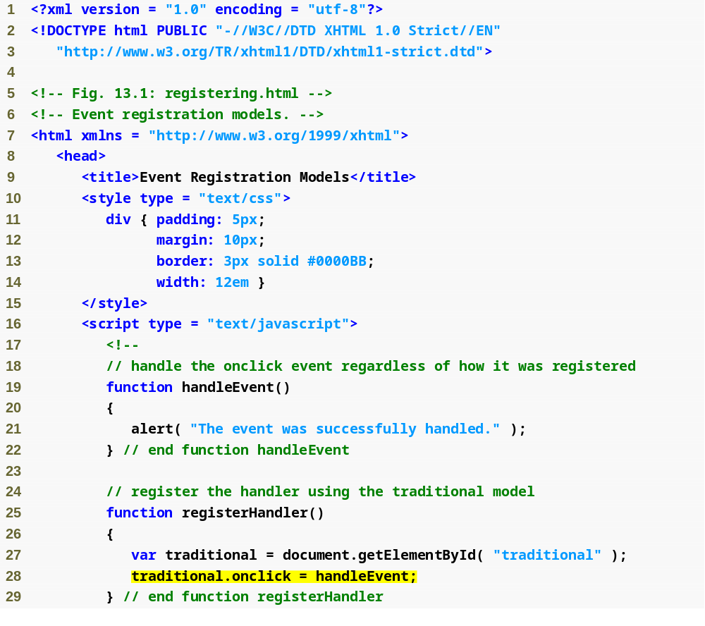
Outline
registering.html
(1 of 3)
Function to handle the onclick event
Registers the event handler using the traditional model

Slide 34
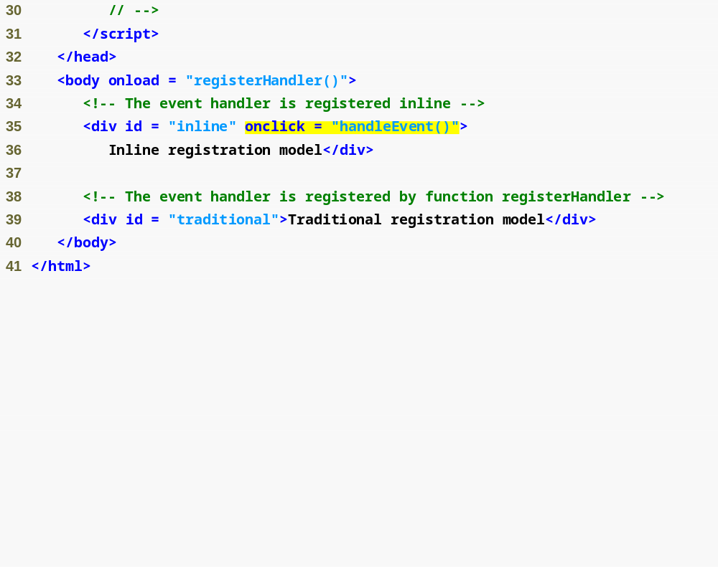
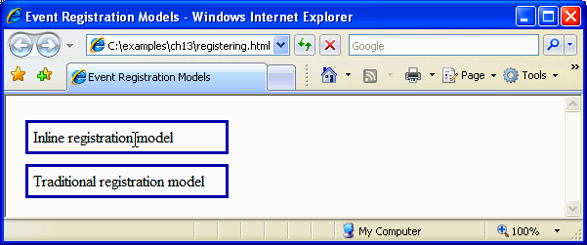
Outline
Registers the event handler using the inline model
registering.html
(2 of 3)

Slide 35


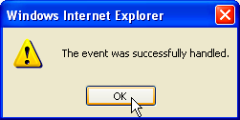
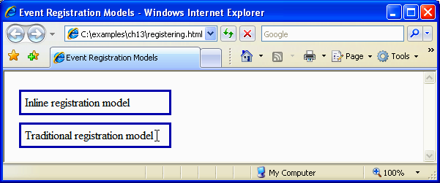

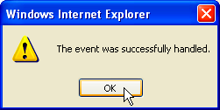
Outline
registering.html
(3 of 3)

Slide 36
Common Programming Error
Putting quotes around the function name when registering it using the inline model would assign a string to the onclick property of the node—a string cannot be called.

Slide 37
Common Programming Error 13.2
Putting parentheses after the function
name when registering it using the inline model would call the function immediately and assign its return value to the onclick property.

Slide 38
Event onload
onload event fires whenever an element finishes loading successfully
If a script in the head attempts to get a DOM node for an XHTML element in the body, getElementById returns null because the body has not yet loaded

Slide 39
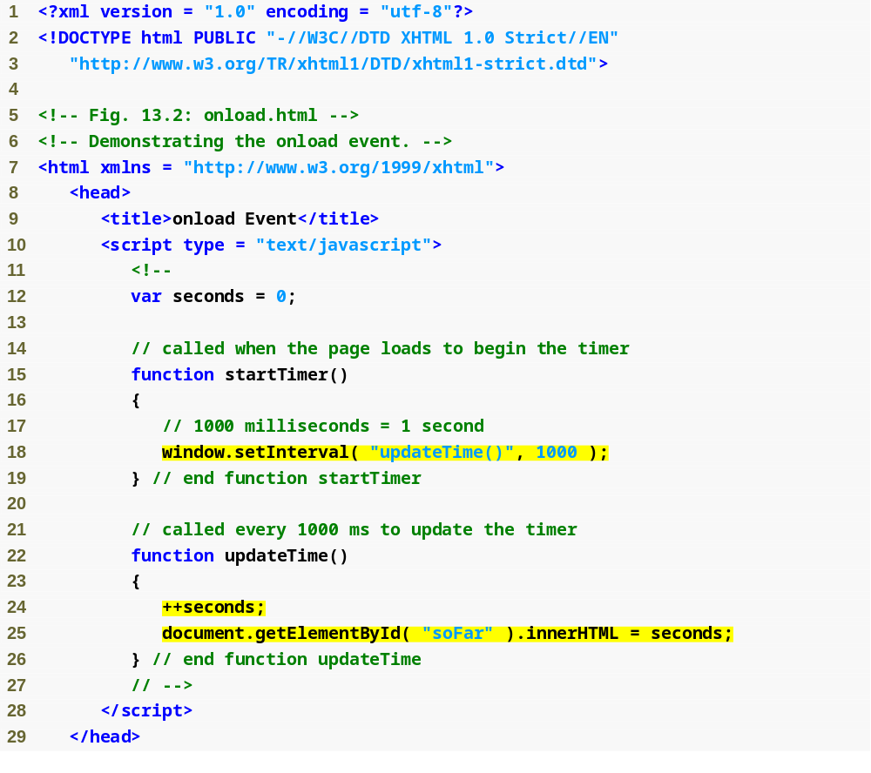
Outline
onload.html
(1 of 2)
Calls function updateTime every second
Updates the timer display in the soFar element of the document

Slide 40
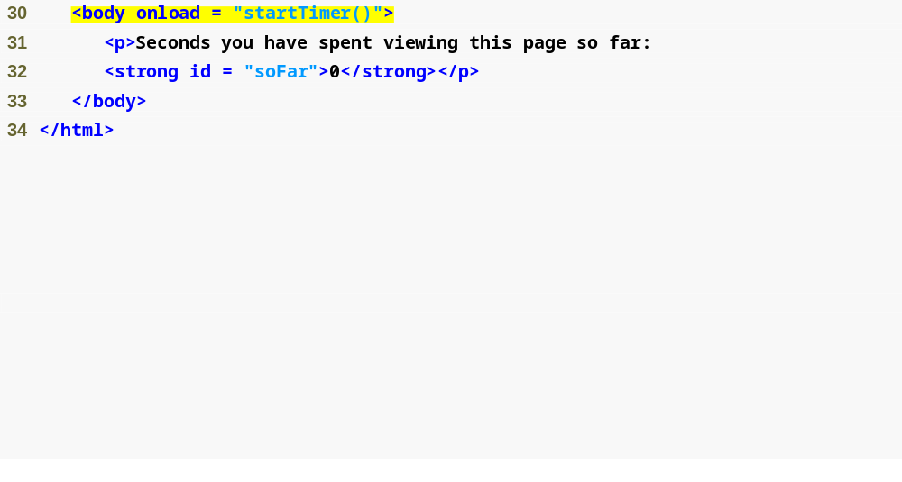
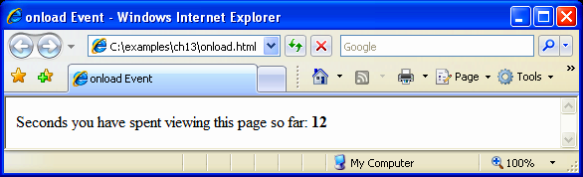
Outline
As soon as the body has loaded, startTimer is called
onload.html
(2 of 2)

Slide 41
Common Programming Error
Trying to get an element in a page before the page has loaded is a common error. Avoid this by putting your script in a function using the onload event to call the function.

Slide 42
Event onmouseMove, the event Object and this
onmousemove event fires whenever the user moves the mouse
event object stores information about the event that called the event-handling function
  ctrlKey property contains a boolean which reflects whether the Ctrl key was pressed during the event
  shiftKey property reflects whether the Shift key was pressed during the event
In an event-handling function, this refers to the DOM object on which the event occurred
this keyword enables one event handler to apply a change to one of many DOM elements, depending on which one received the event

Slide 43
Event onmouseMove, the event Object and this (Cont.)
Internet Explorer and Firefox do not implement the same event models
Firefox and other W3C-compliant browsers (e.g., Safari, Opera) pass the event object as an argument to the event-handling function
Internet Explorer, on the other hand, stores the event object in the event property of the window object

Slide 44
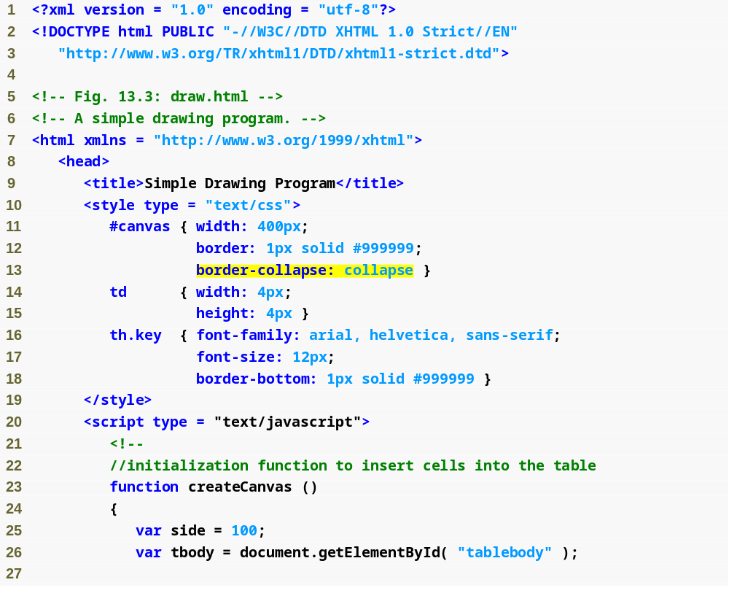
Outline
draw.html
(1 of 5)
Sets the dimensions of a table of cells that will act as a canvas
Eliminates space between table cells
Creates table of cells for the canvas

Slide 45
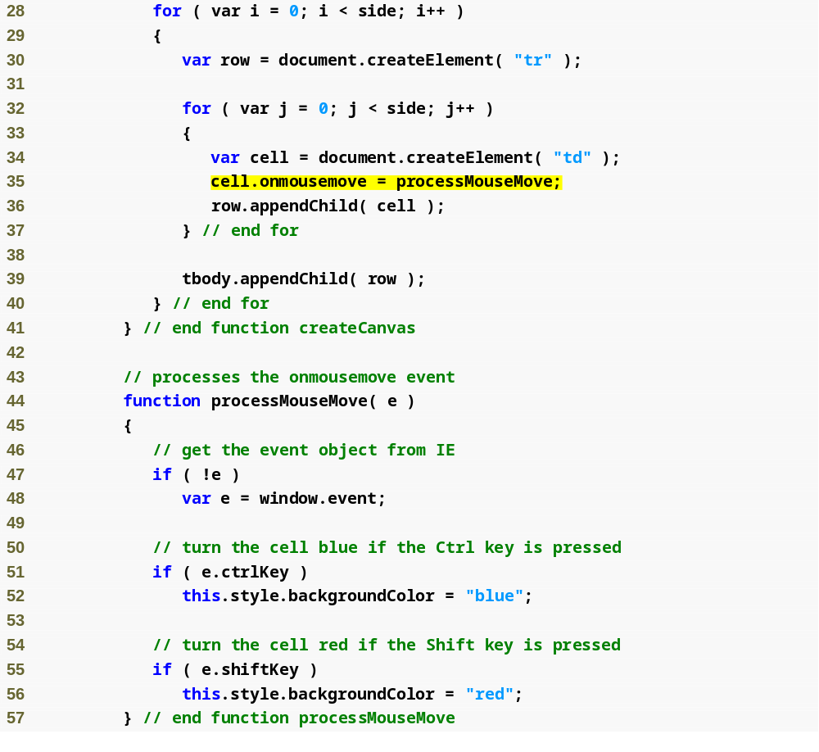
Outline
draw.html
(2 of 5)
Assigns processMouseMove as the event handler for the cell’s onmousemove event
Gets the event object in Firefox
Gets the event object in IE
Determines which key is pressed and colors the cell accordingly
this refers to the cell that received the event

Slide 46
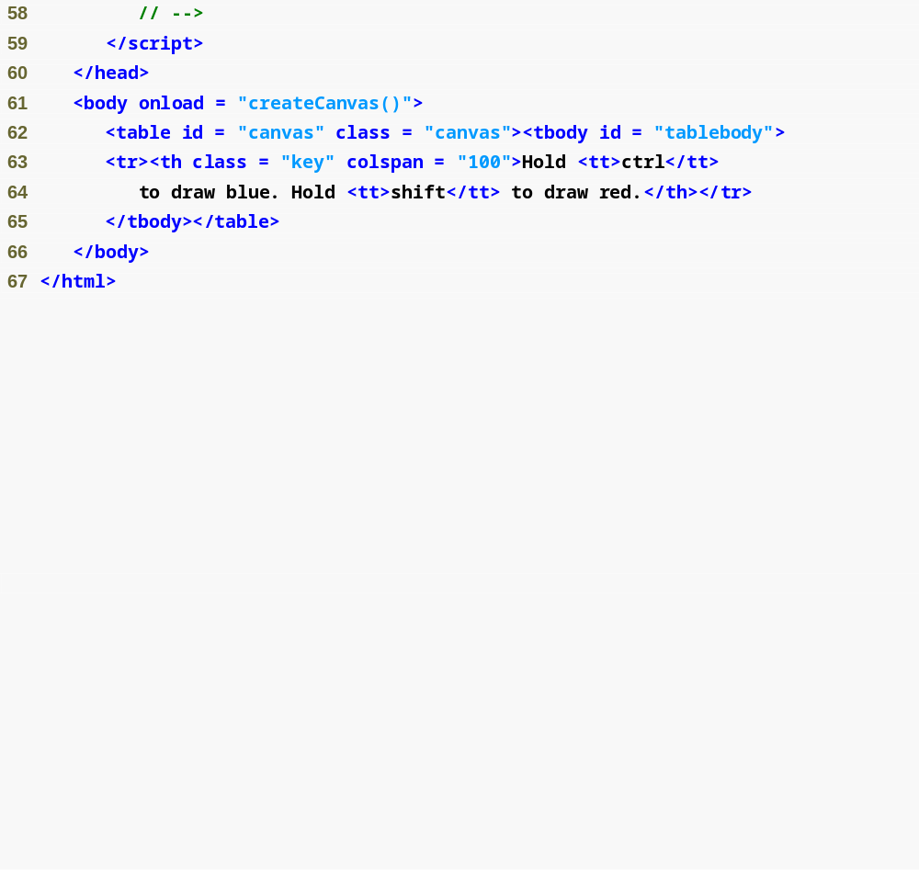
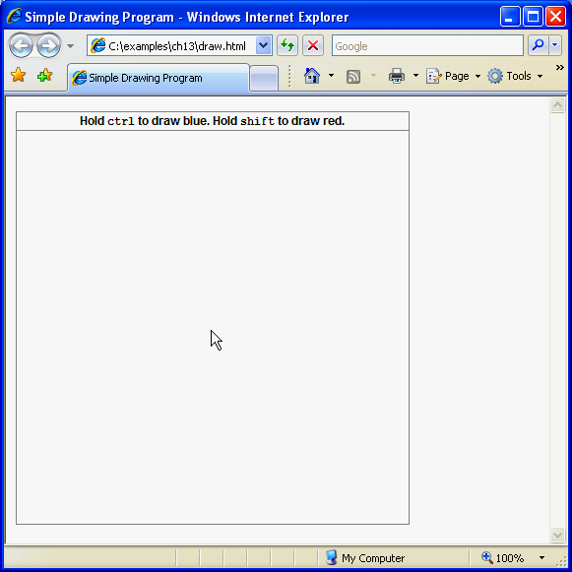
Outline
draw.html
(3 of 5)

Slide 47
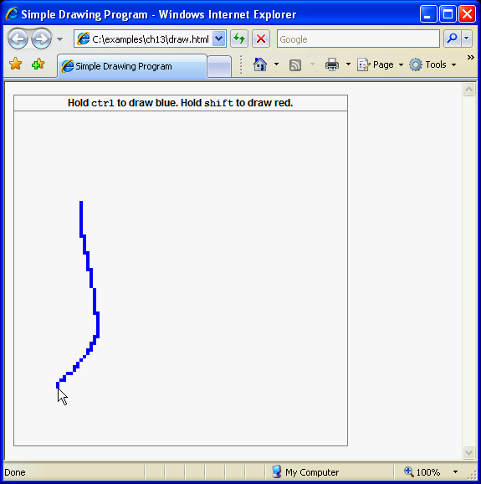
Outline
draw.html
(4 of 5)

Slide 48
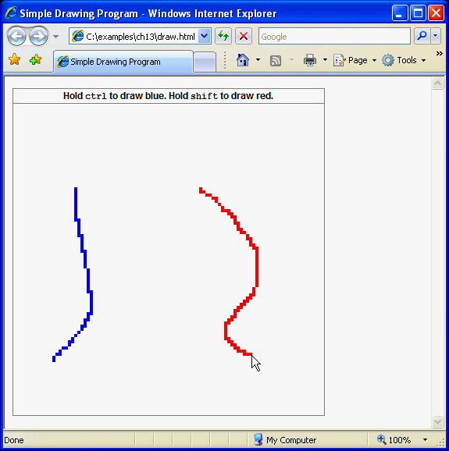
Outline
draw.html
(5 of 5)

Slide 49
Common Programming Error
Although you can omit the tbody element in an XHTML table, without it you cannot append tr elements as children of a table using JavaScript. While Firefox treats appended rows as members of the table body, Internet Explorer will not render any table cells that are dynamically added to a table outside a thead, tbody or tfoot element.

Slide 50
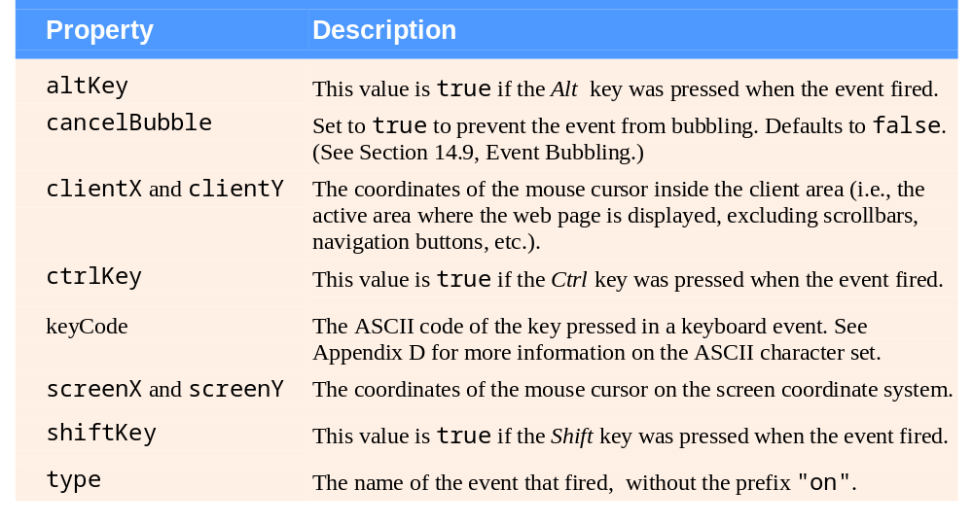
Fig. | Some event object properties.

Slide 51
Rollovers with onmouseover and onmouseout
When the mouse cursor enters an element, an onmouseover event occurs for that element
When the mouse cursor leaves the element, an onmouseout event occurs for that element
Creating an Image object and setting its src property preloads the image
The event object stores the node on which the action occurred
  In Internet Explorer, this node is stored in the event object’s srcElement property
  In Firefox, it is stored in the event object’s target property

Slide 52
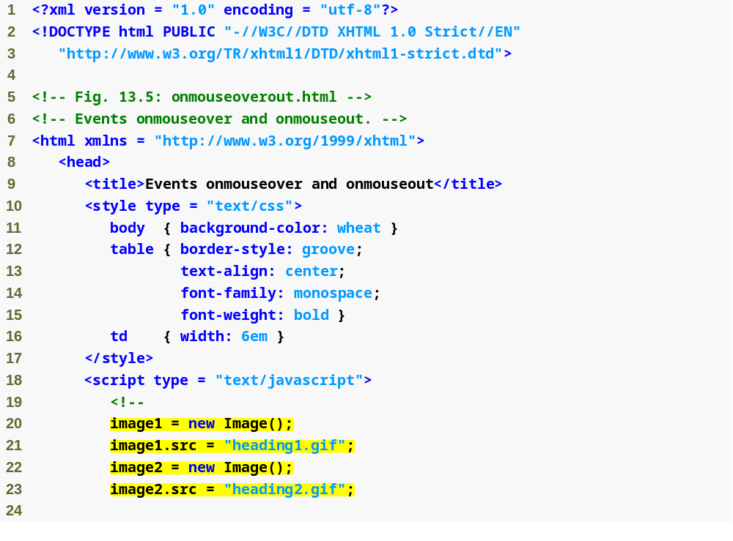
Outline
Onmouseoverout
.html
(1 of 8)
Preloads the heading images

Slide 53
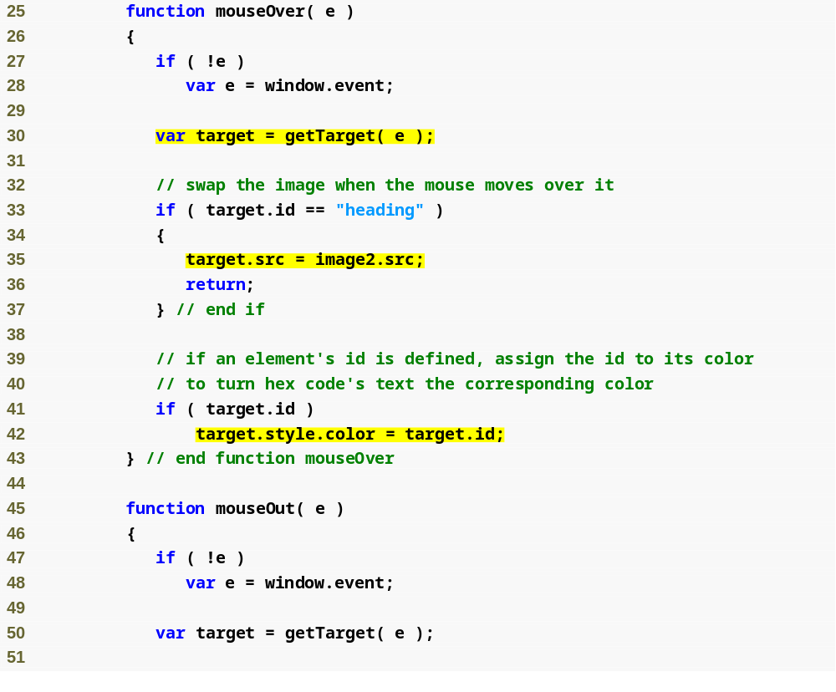
Stores the return value of getTarget to variable target—we can’t use this because we have not defined an event handler for each element in the document
Outline
Onmouseoverout
.html
(2 of 8)
Changes the heading’s image to image2
If target has a defined id (true of table cells and the heading), changes its color to that id

Slide 54
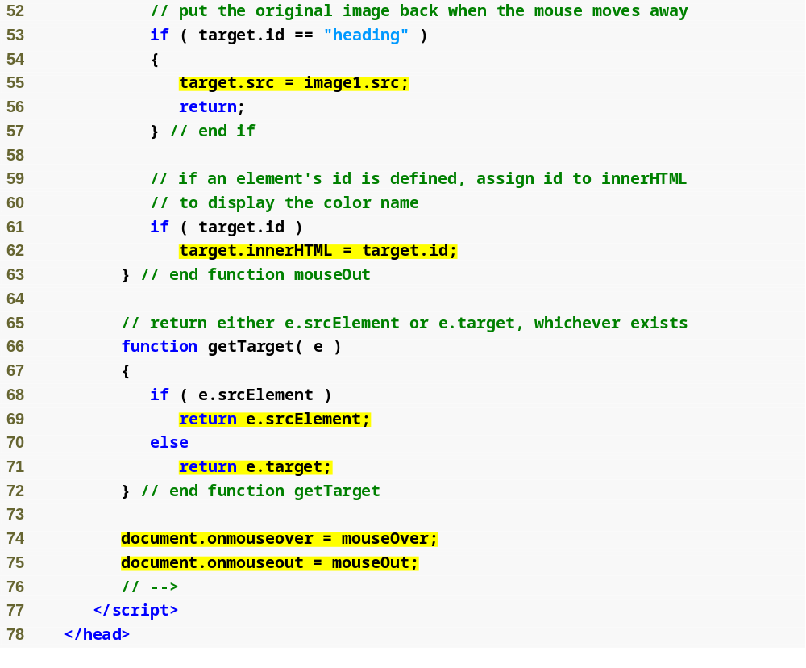
Outline
Replaces image2 with image1
Onmouseoverout
.html
(3 of 8)
If the element’s id is defined, makes the displayed text equal to the id
Returns the targeted node in both Internet Explorer and Firefox
Registers the onmouseover and onmouseout events in the document object

Slide 55
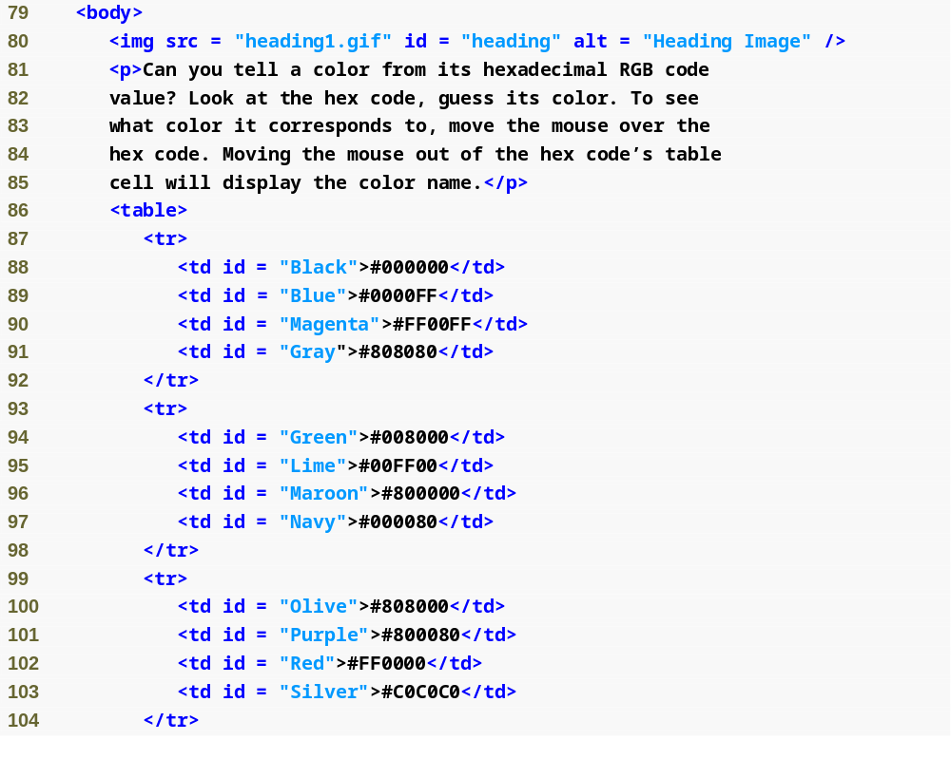
Outline
Onmouseoverout
.html
(4 of 8)

Slide 56
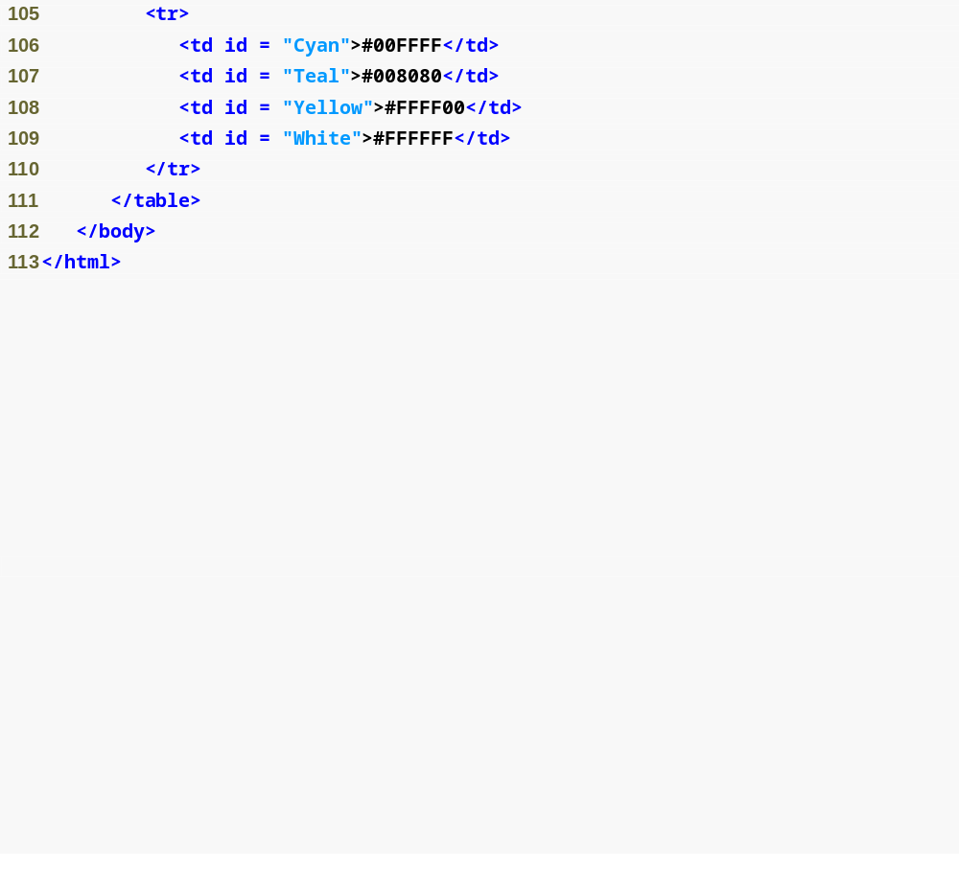
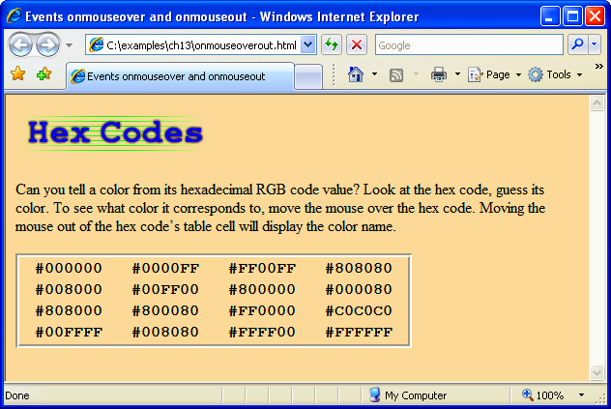
Outline
Onmouseoverout
.html
(5 of 8)

Slide 57

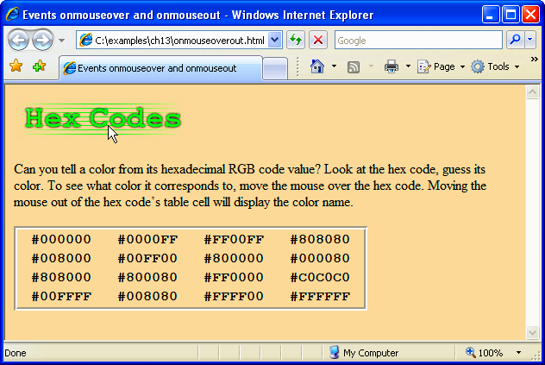
Outline
Onmouseoverout
.html
(6 of 8)

Slide 58

Outline
Onmouseoverout
.html
(7 of 8)

Slide 59
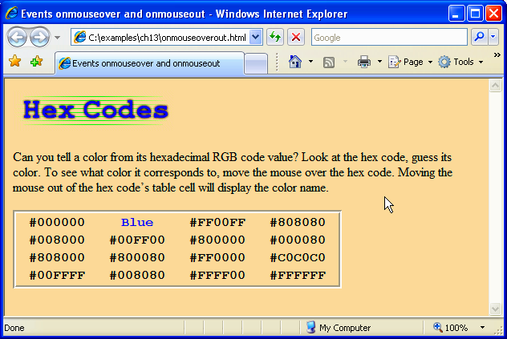
Outline
Onmouseoverout
.html
(8 of 8)

