Slide 1


Slide 2

Python Data Statements

Slide 3
if … else …

Slide 4
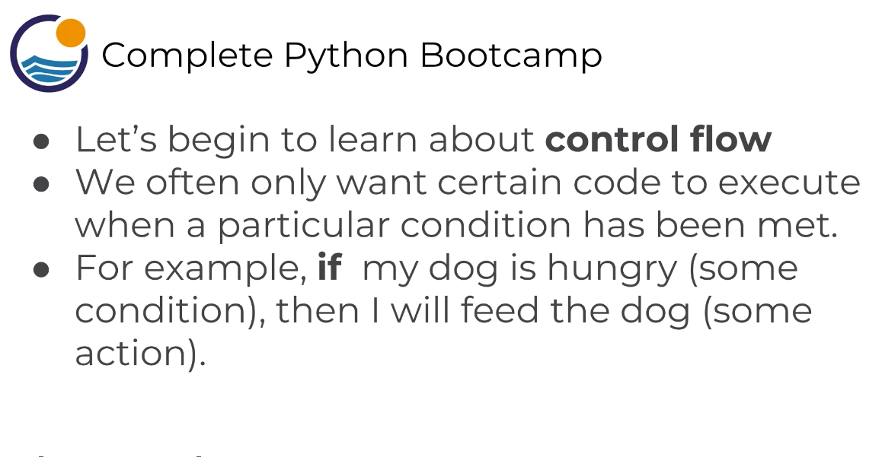
python if else statements
if … else …

Slide 5
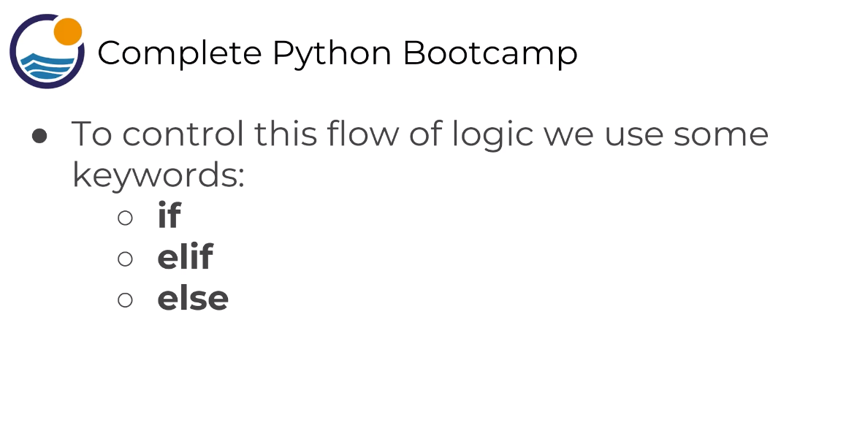
python if else statements
if … else …

Slide 6
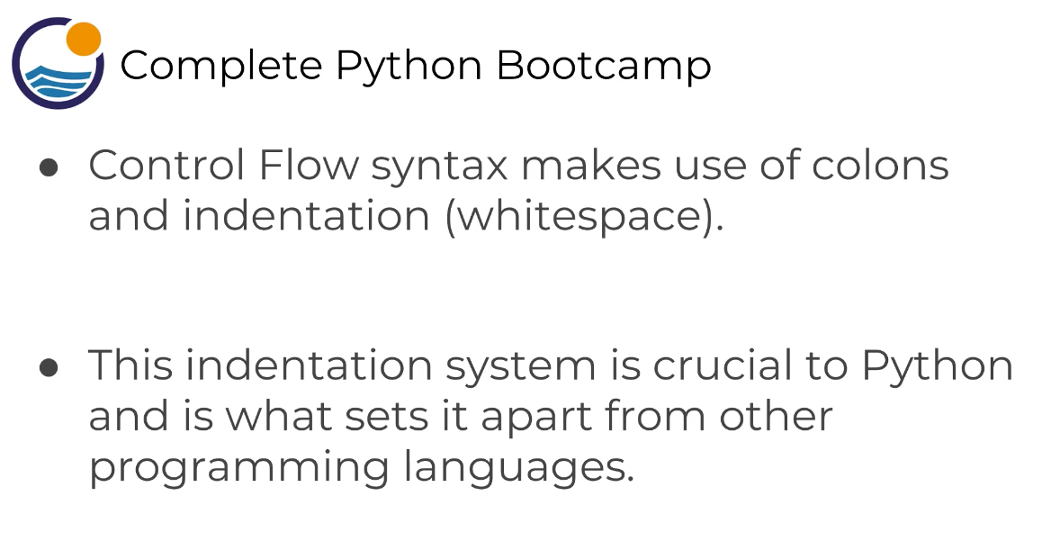
python if else statements
if … else …

Slide 7
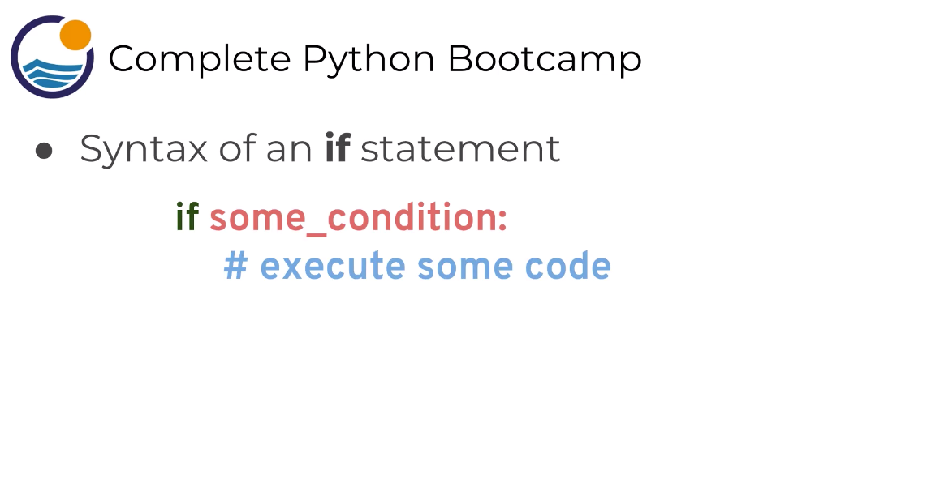
python if else statements
if … else …

Slide 8
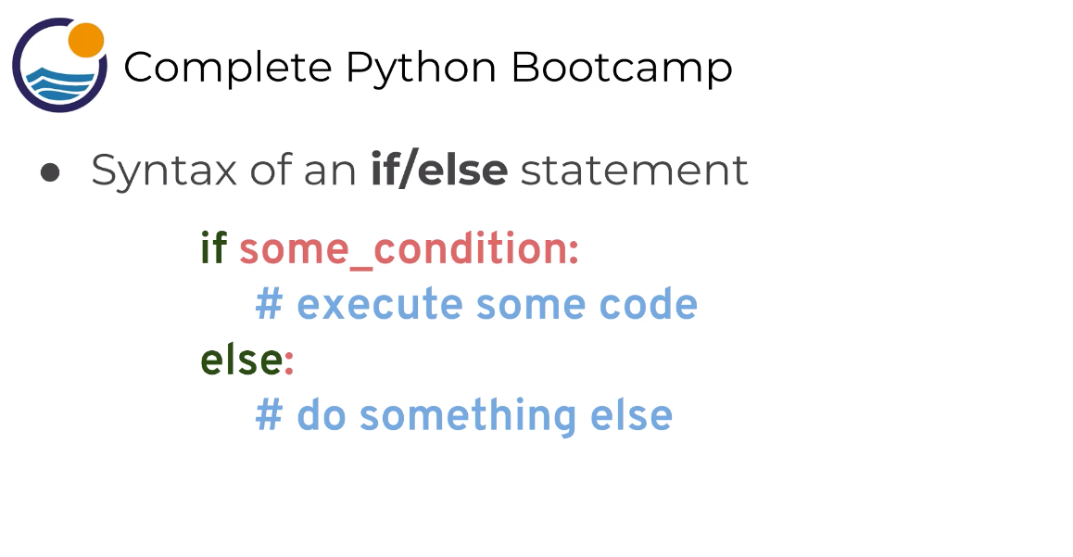
python if else statements
if … else …

Slide 9
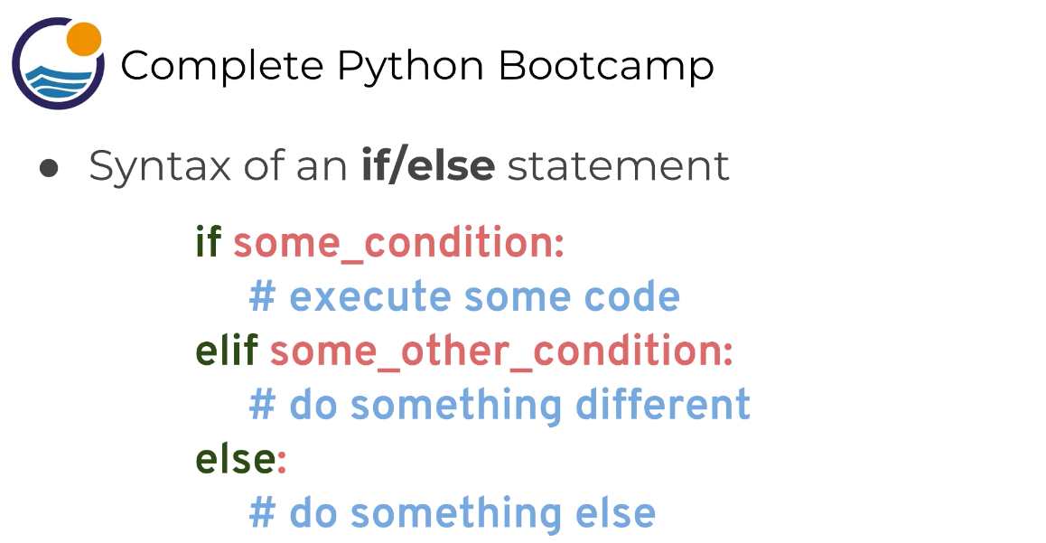
python if else statements
if … else …

Slide 10
if … else …

Slide 11


Slide 12
for loops

Slide 13
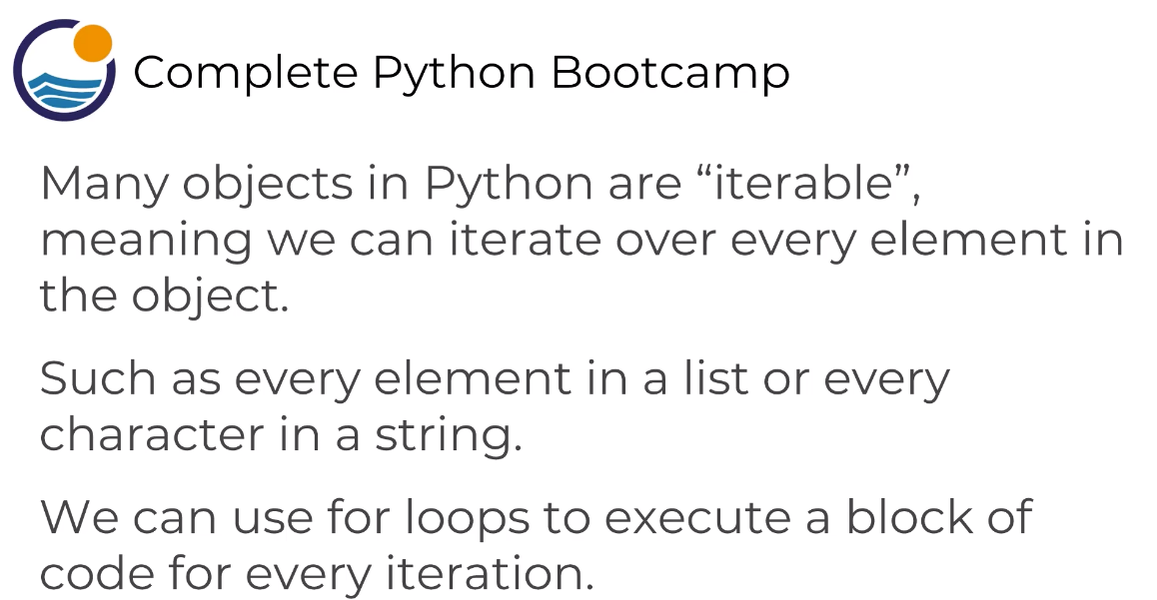
python for loops
for loops

Slide 14
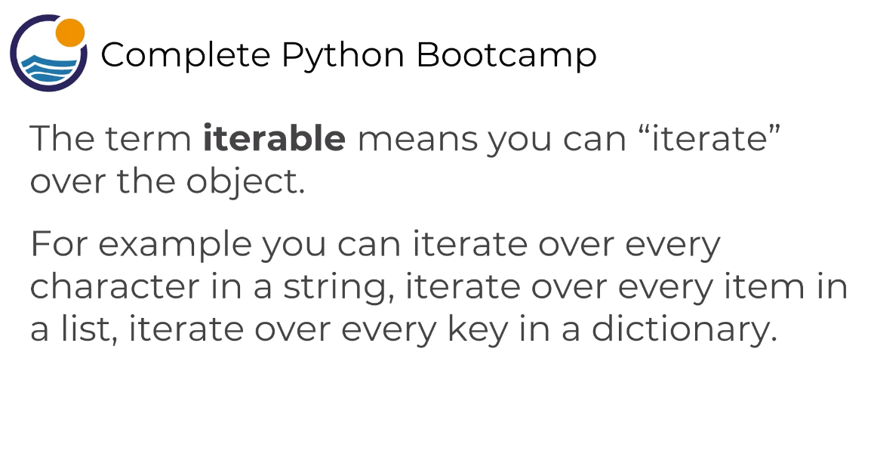
python for loops
for loops

Slide 15
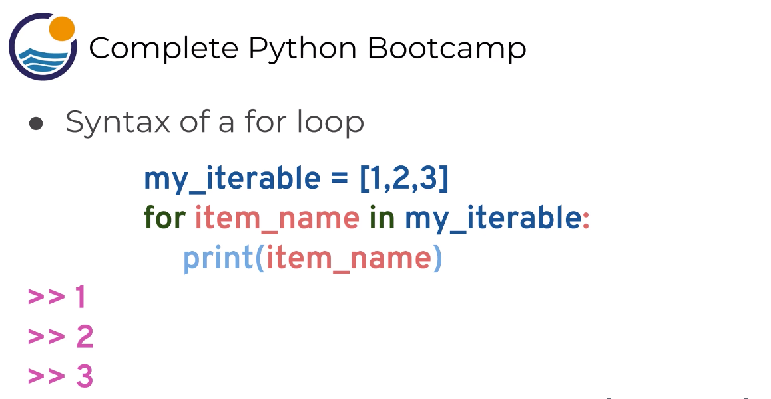
python for loops
for loops

Slide 16
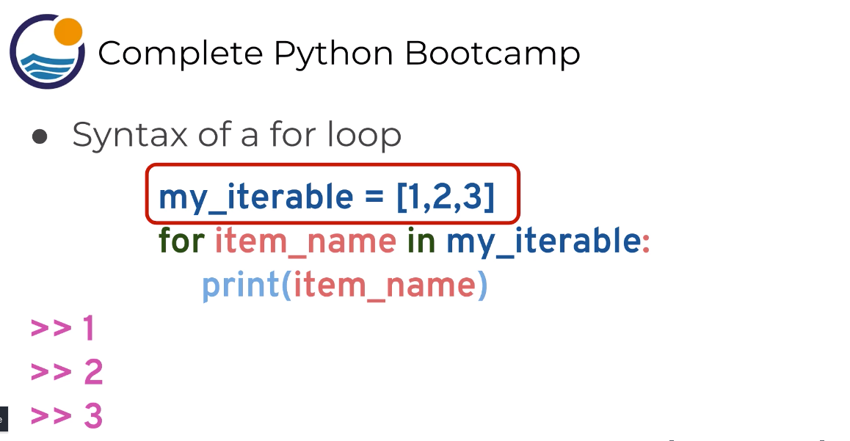
python for loops
for loops

Slide 17
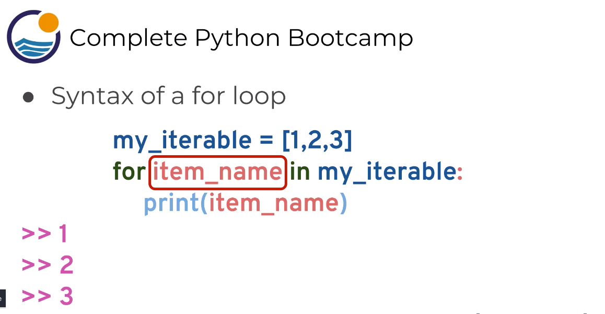
python for loops
for loops

Slide 18
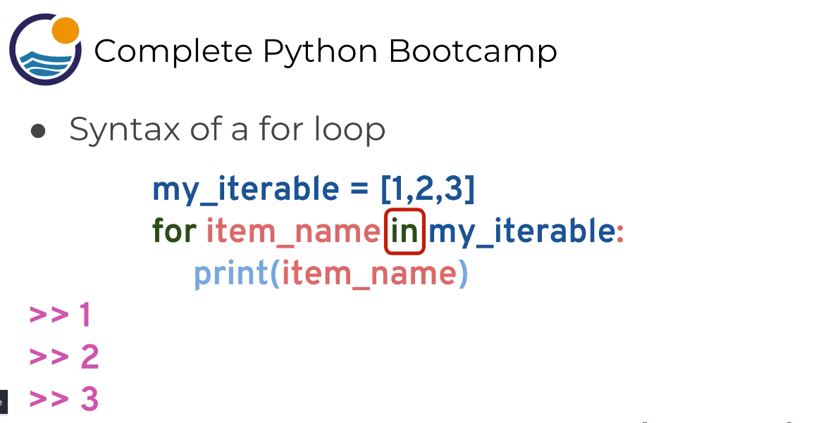
python for loops
for loops

Slide 19
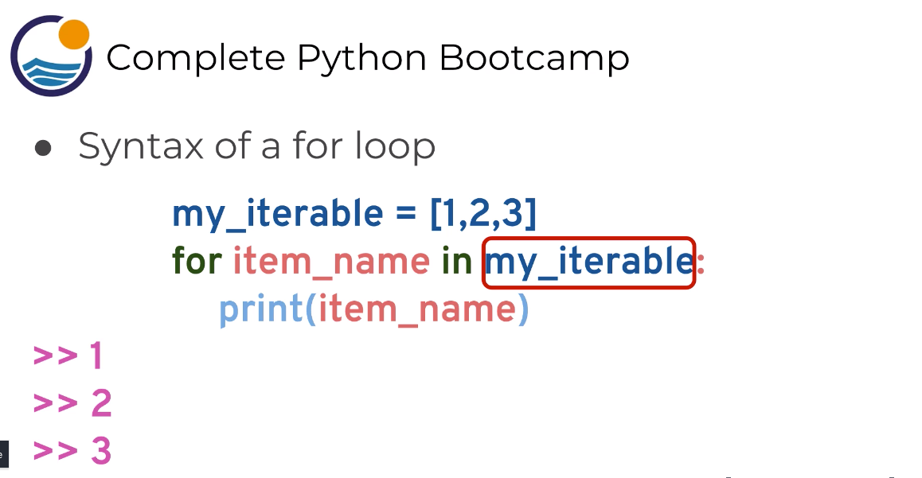
python for loops
for loops

Slide 20
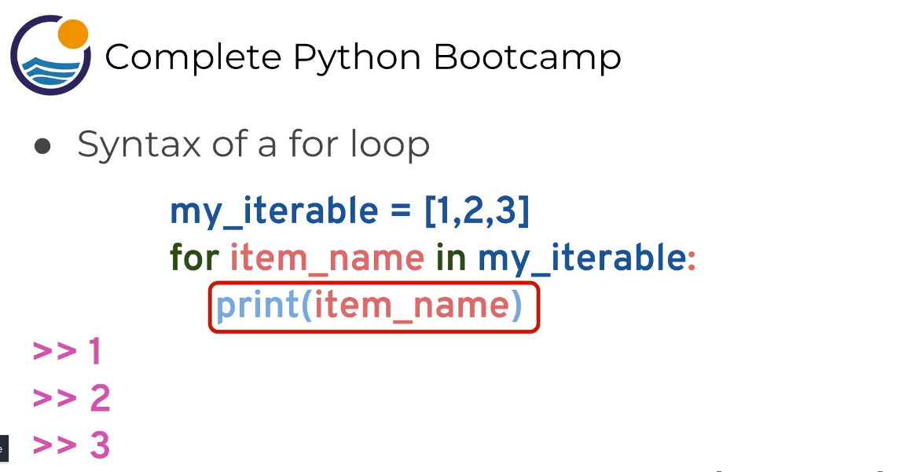
python for loops
for loops

Slide 22
while loops
while loops

Slide 23
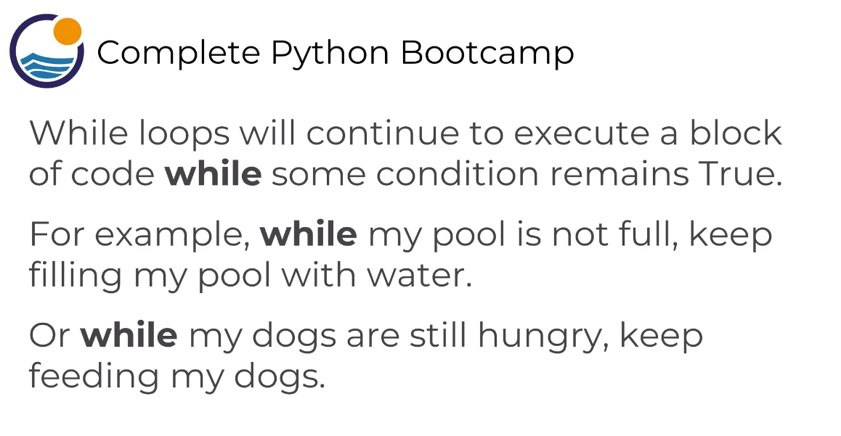
python while loops
while loops

Slide 24

python while loops
while loops

Slide 25
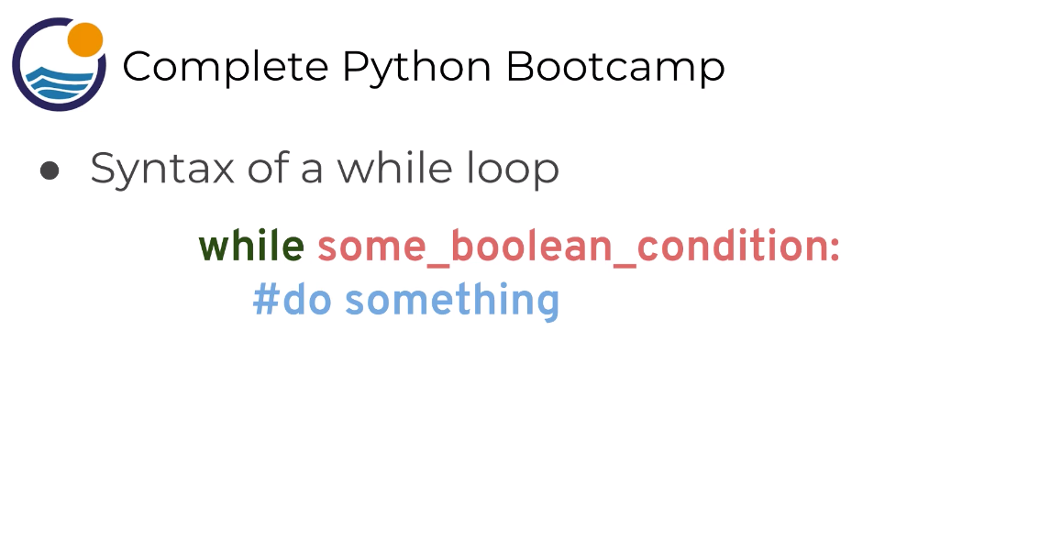
python while loops
while loops

Slide 26
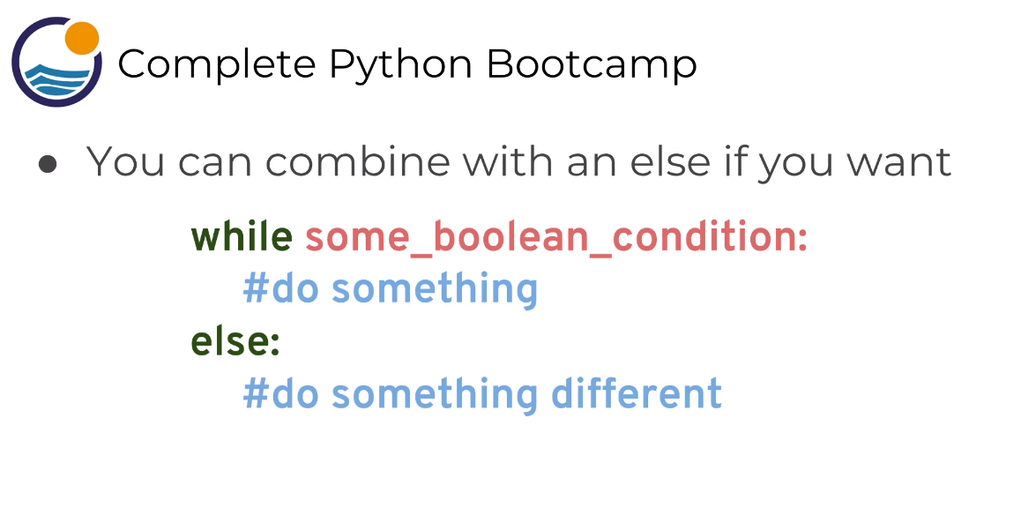
python while loops
while loops

Slide 28
list comprehensions

Slide 29

python list comprehension
list comprehensions

Slide 30
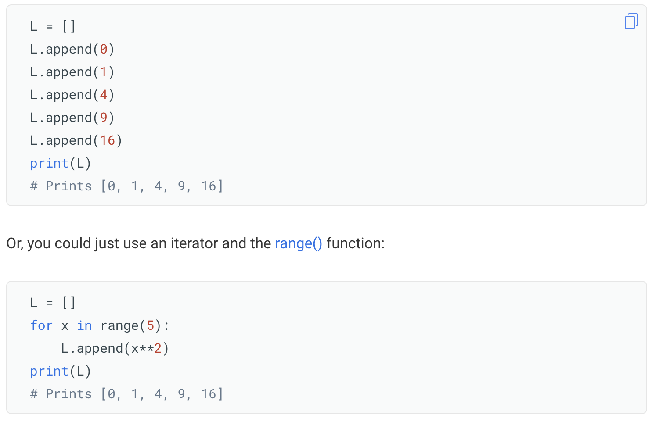
python list comprehension
list comprehensions

Slide 31
python list comprehension
list comprehensions

Slide 32
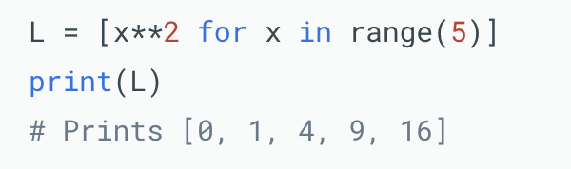
python list comprehension
list comprehensions

Slide 33
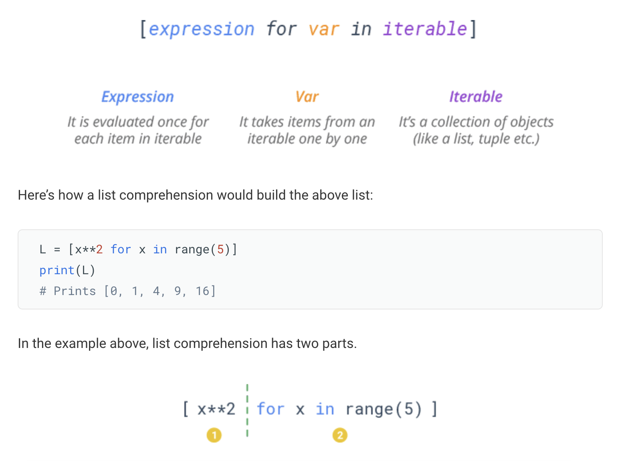
python list comprehension
list comprehensions

Slide 34
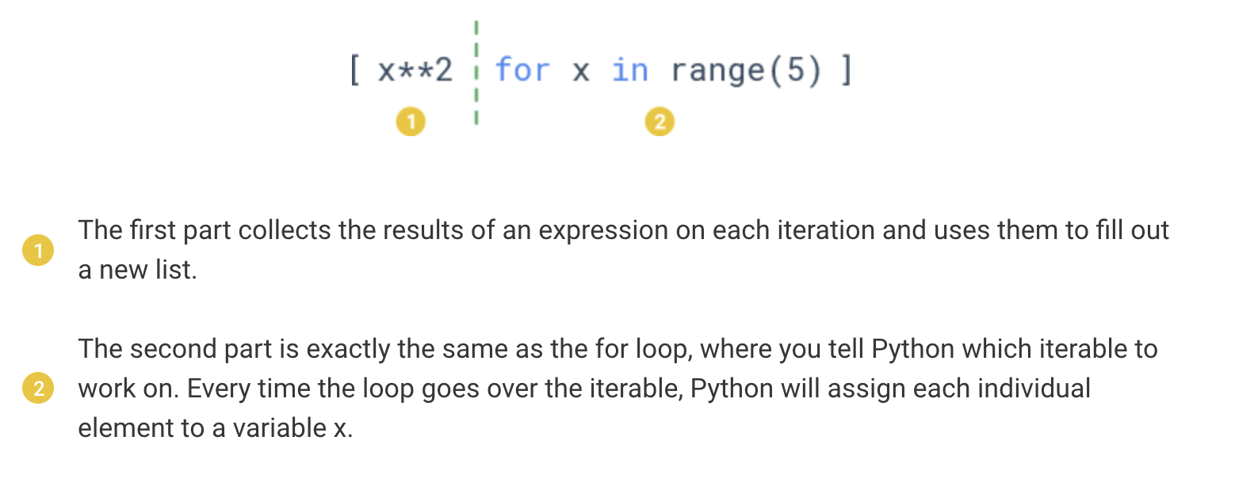
python list comprehension
list comprehensions

Slide 35
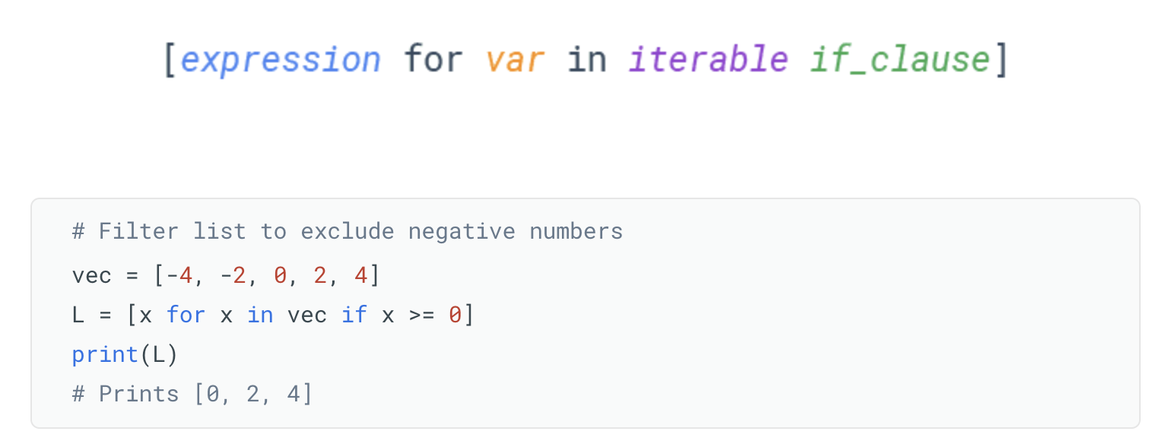
python list comprehension
list comprehensions + if else

Slide 36
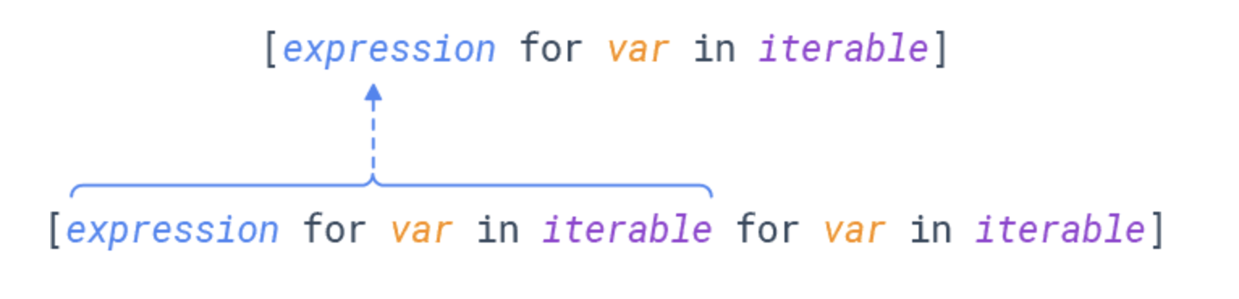
python list comprehension
list comprehensions + if else

Slide 37
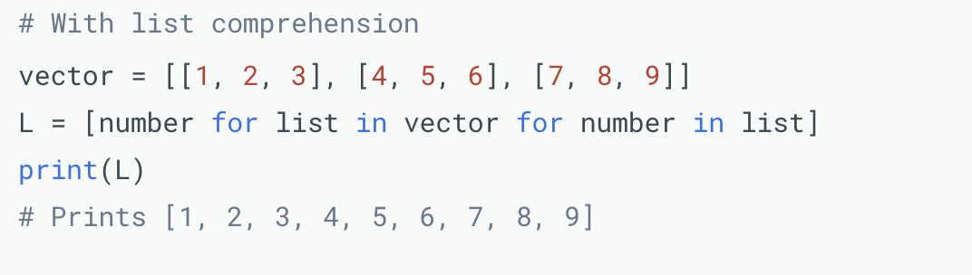
python list comprehension
list comprehensions + if else

Slide 39
dict comprehensions

Slide 40
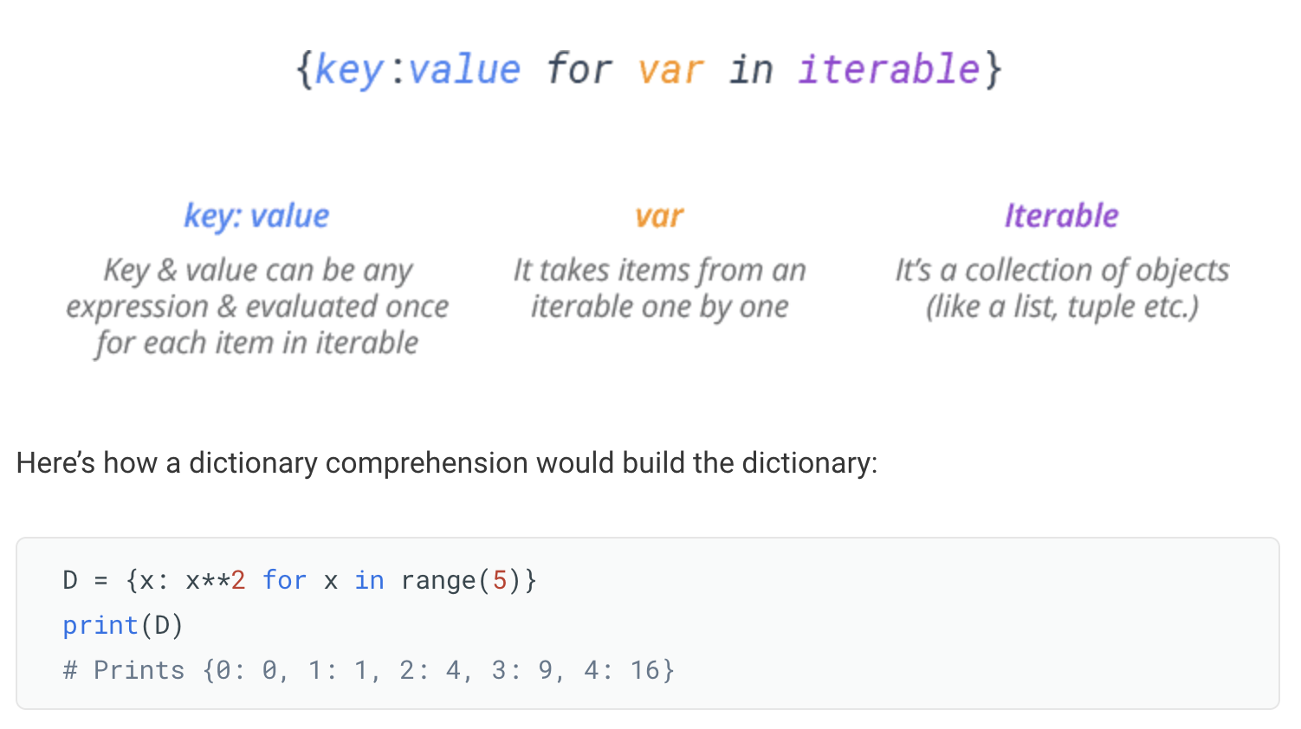
python dict comprehension
dict comprehensions

Slide 41
python dict comprehension
dict comprehensions

Slide 42
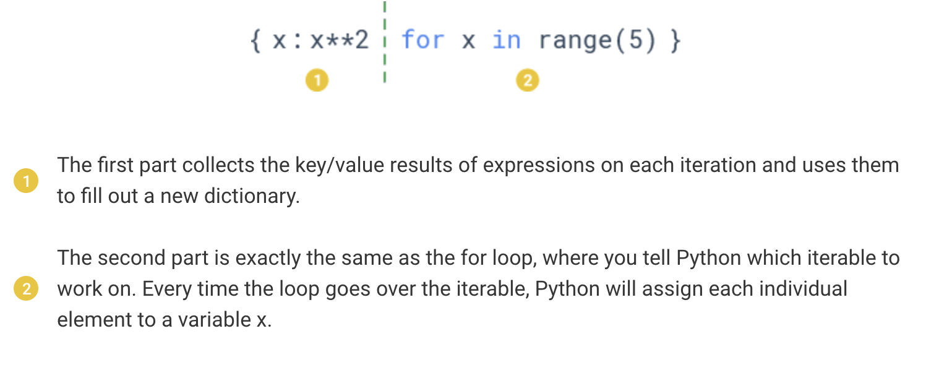
python dict comprehension
dict comprehensions

Slide 43
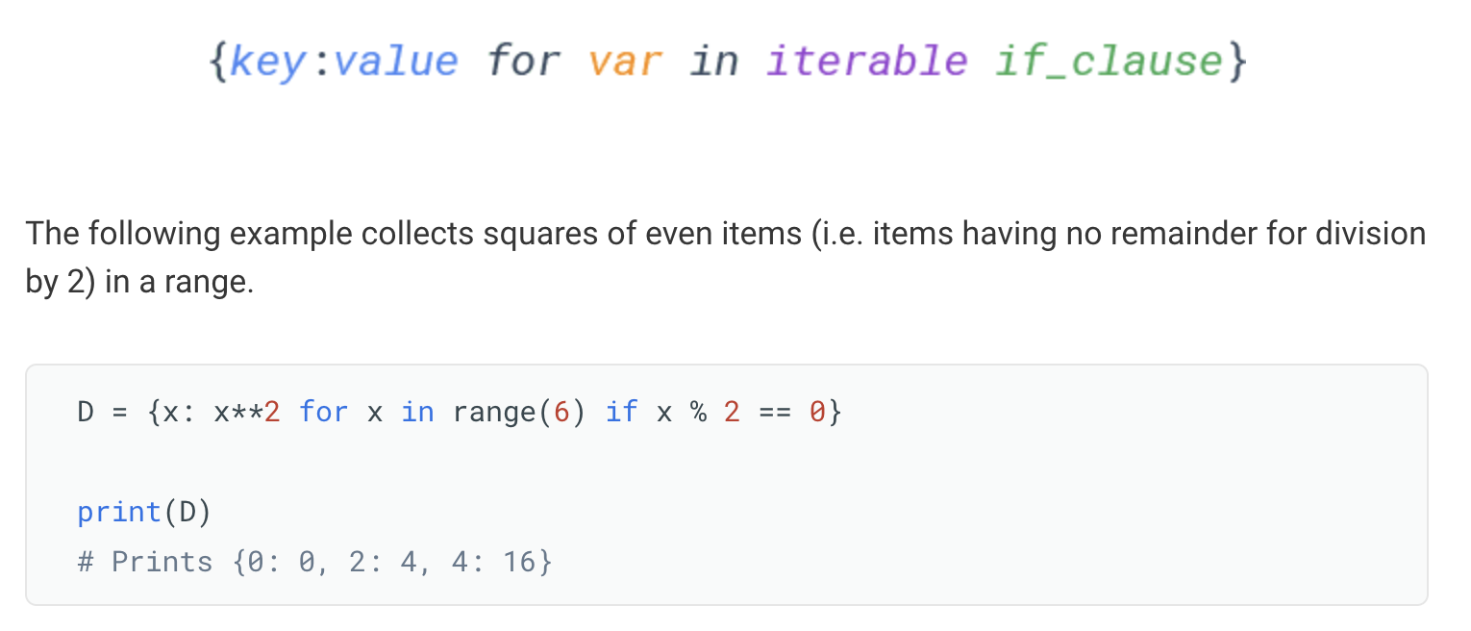
python dict comprehension
dict comprehensions + if else

Slide 44
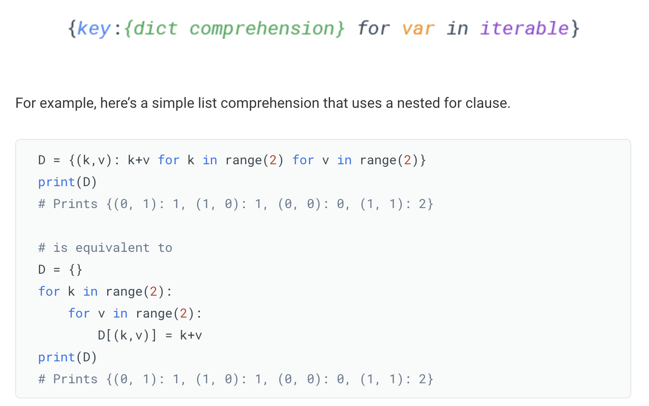
python dict comprehension
dict comprehensions + if else

Slide 45


