Slide 1


Slide 2

Python Pandas

Slide 3
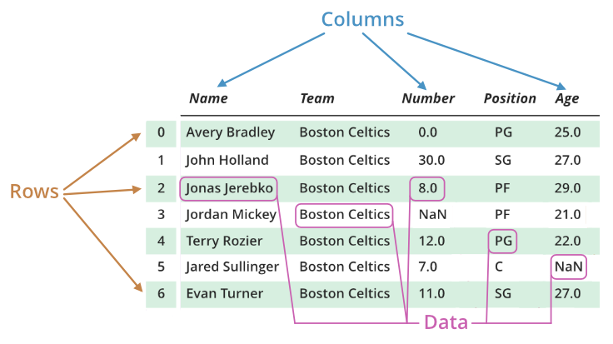
python if else statements
pandas

Slide 4
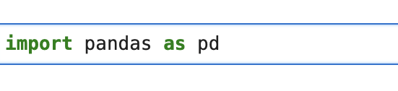
python if else statements
pandas

Slide 5
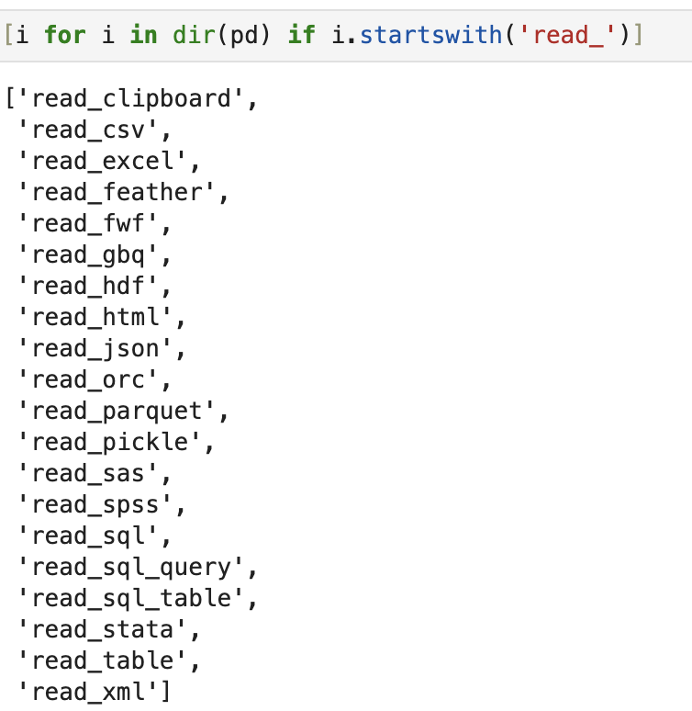
python if else statements
pandas read data

Slide 6
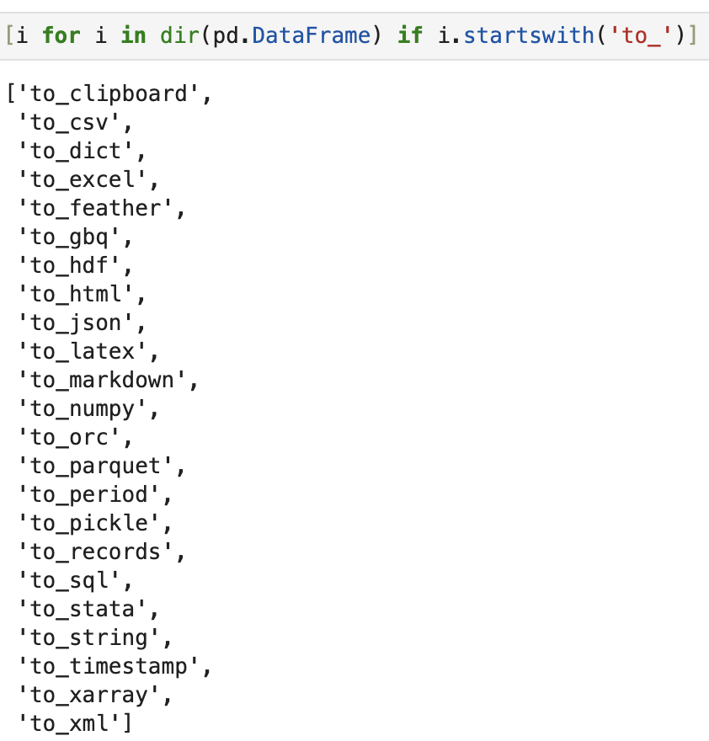
python if else statements
pandas write data

Slide 7
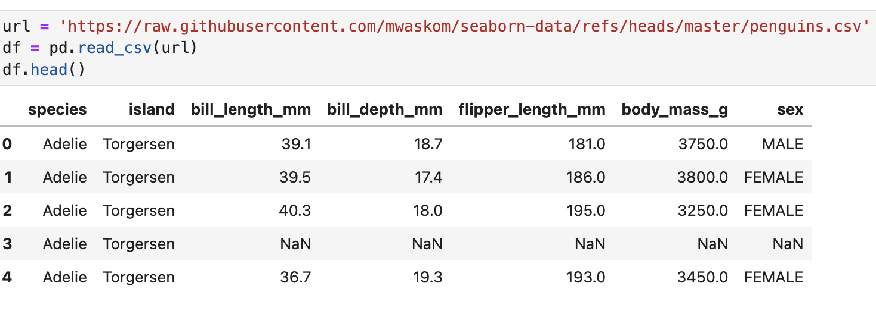
python if else statements
read data

Slide 8

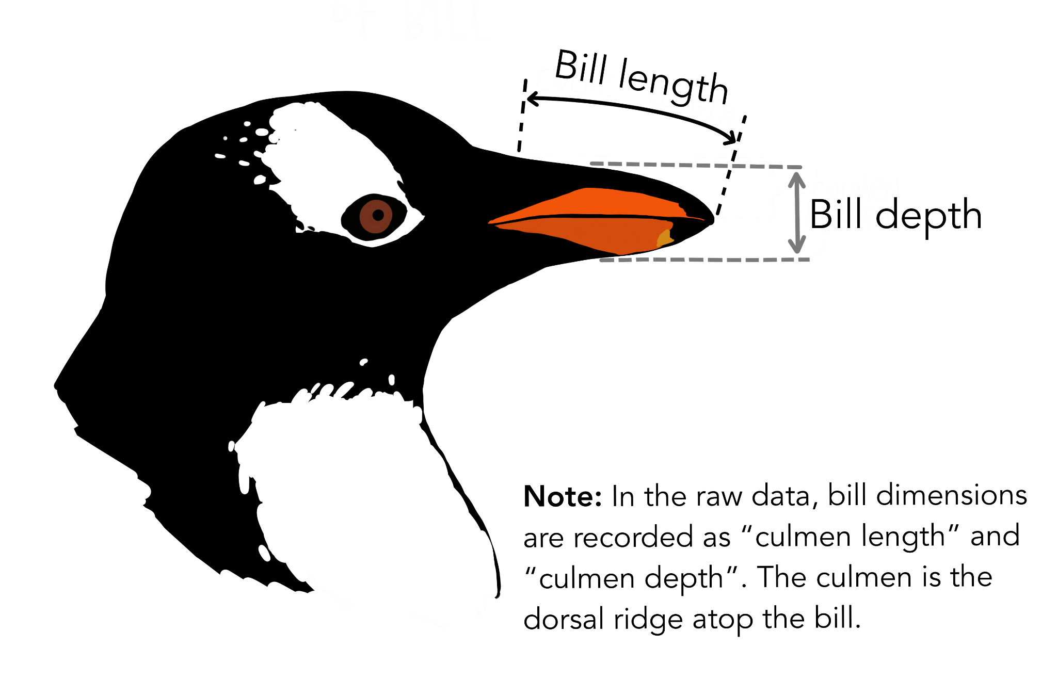
python if else statements
read data

Slide 9
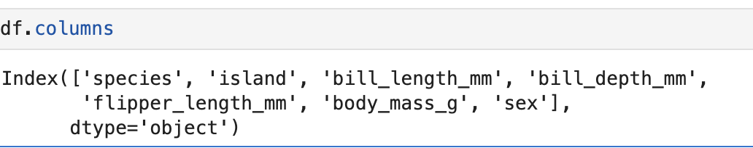
python if else statements
analyze data

Slide 10
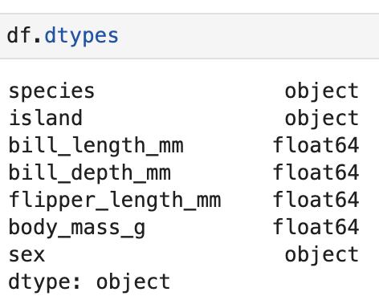
python if else statements
analyze data

Slide 11
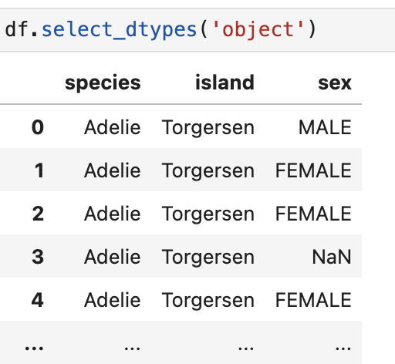
python if else statements
analyze data
select only object (string) data

Slide 12
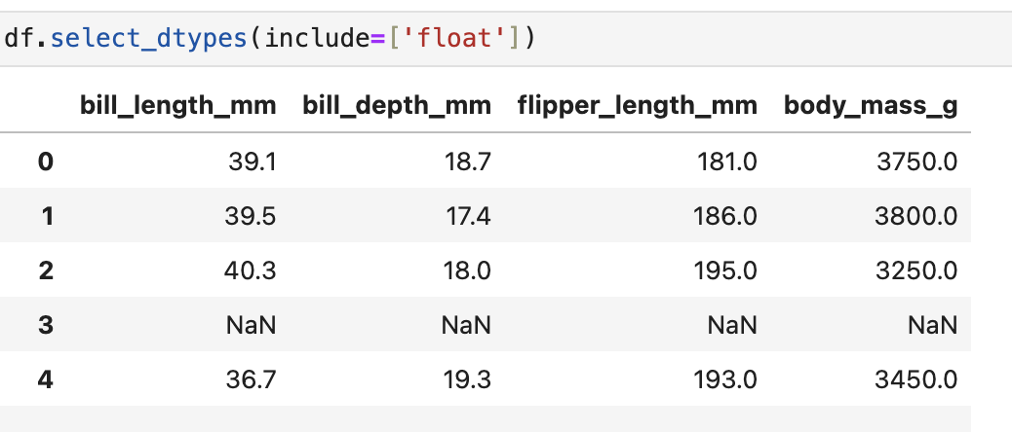
python if else statements
analyze data
select only float (numeric) data

Slide 13
python if else statements
analyze data
Question
how do I know that the rows correspond to each other?

Slide 14
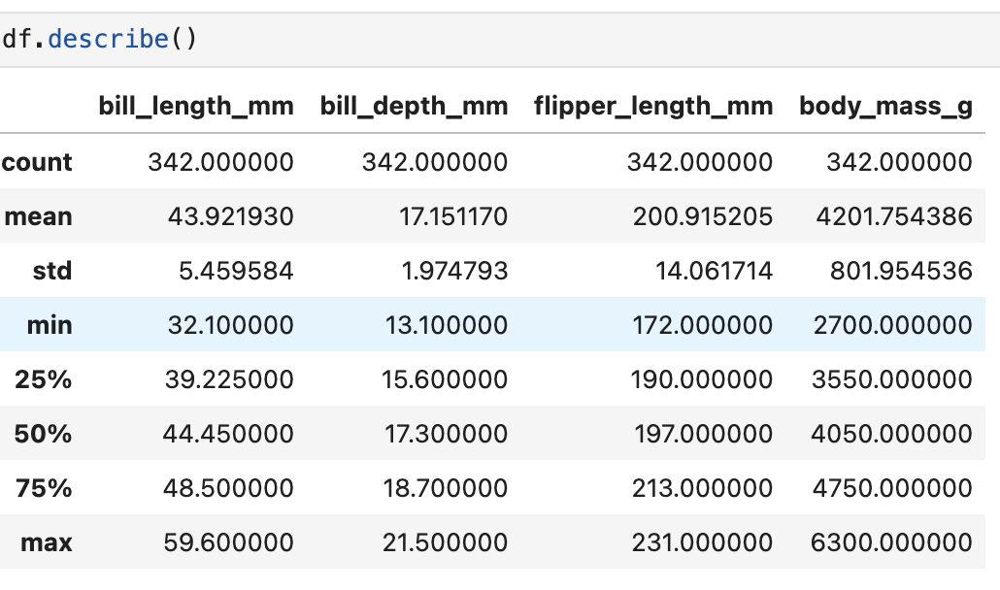
python if else statements
analyze data
description of numeric data

Slide 15
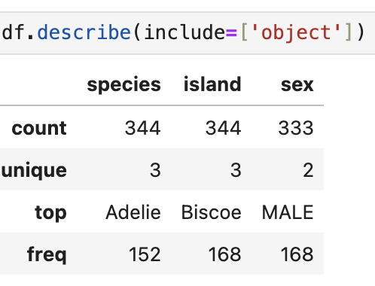
python if else statements
analyze data
description of object data

Slide 16
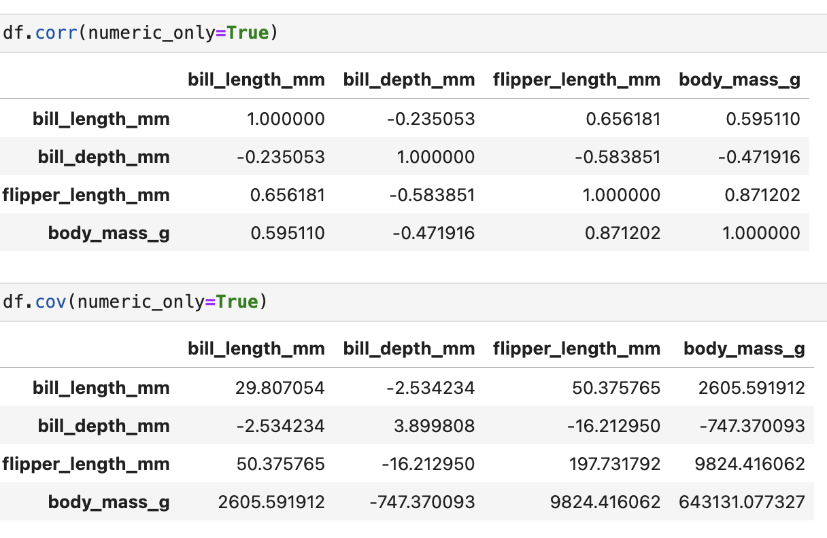
python if else statements
analyze data
covariance of numerical data

Slide 17
python if else statements
analyze data
correlation of numerical data

Slide 18
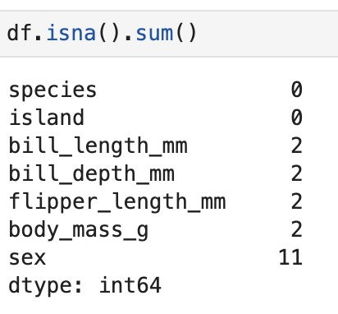
python if else statements
missing data
count missing data

Slide 19
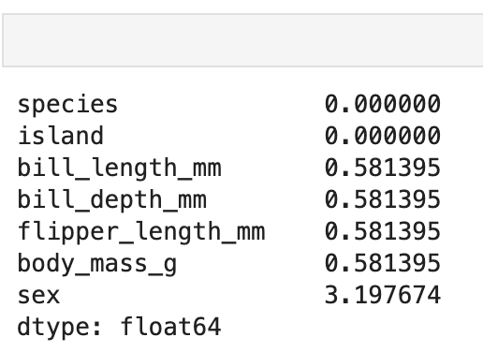
python if else statements
missing data
Exercise
want to know the percentage of missing data per column

Slide 20
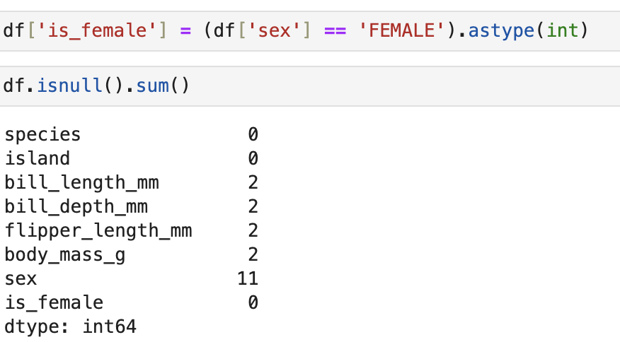
python if else statements
missing imputation
Let’s make a column with no NA named `is_female`

Slide 21
python if else statements
missing imputation
Let’s make a column with no NA named `is_female`

Slide 22

python if else statements
missing imputation
Let’s make a column with no NA named `is_female`

Slide 23
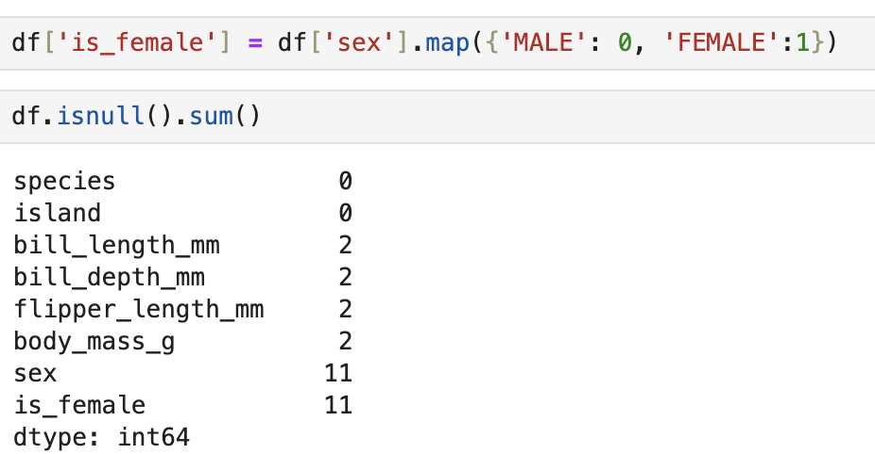

python if else statements
missing imputation
Let’s make a column with no NA named `is_female`

Slide 24
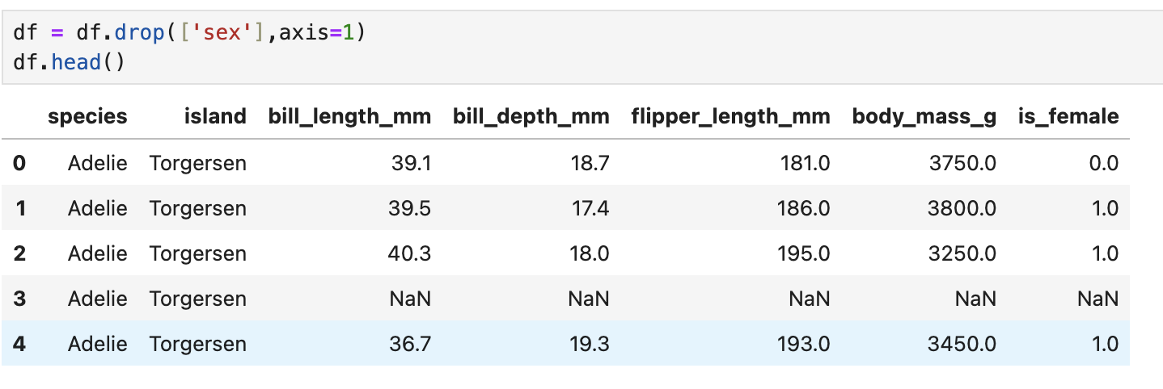
python if else statements
missing imputation
drop the column `sex`

Slide 25
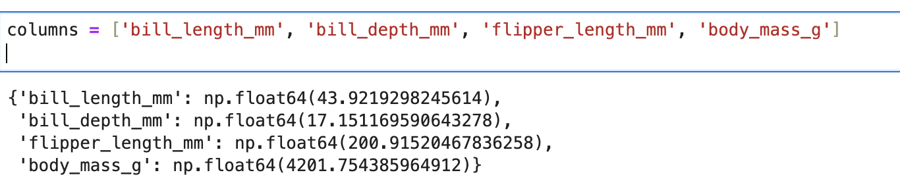
python if else statements
missing imputation
Exercise: Create a dictionary with the mean values of
these columns and named it numeric means

Slide 26
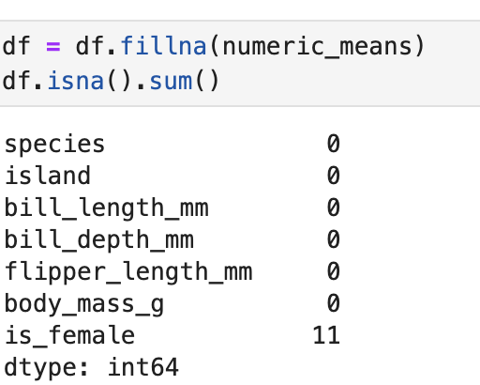
python if else statements
missing imputation
Exercise: Create a dictionary with the mean values of
these columns and named it numeric means

Slide 27
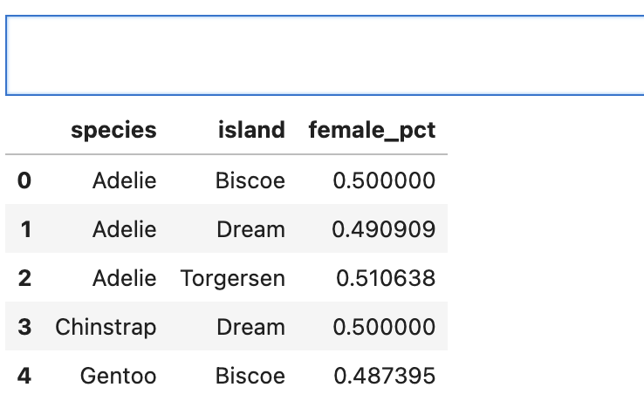
python if else statements
missing imputation
Create a pandas with the pct of female penguins per specie and island (name this pandas aux)

Slide 28
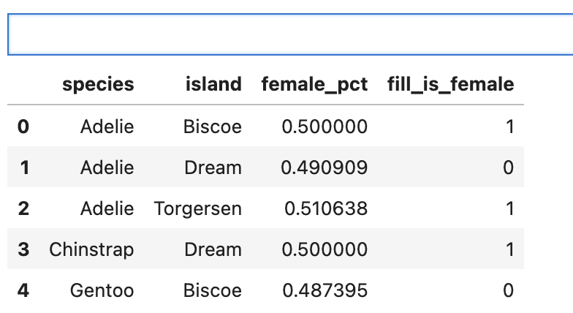
python if else statements
missing imputation
Now add a column ‘fill_is_female’ (1 if `female_pct` >= 0.5 else 0) this new column should be integer

Slide 29
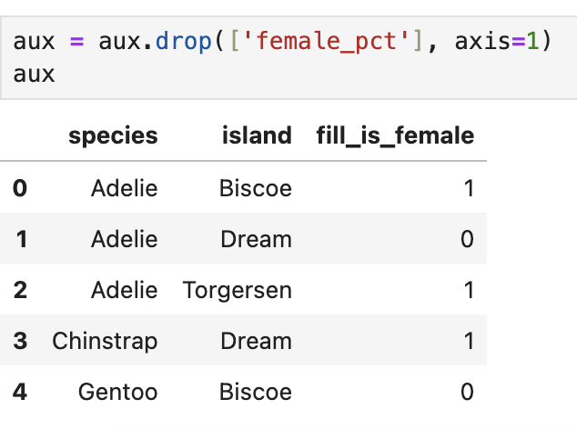
python if else statements
missing imputation
remove column `female_pct`

Slide 30
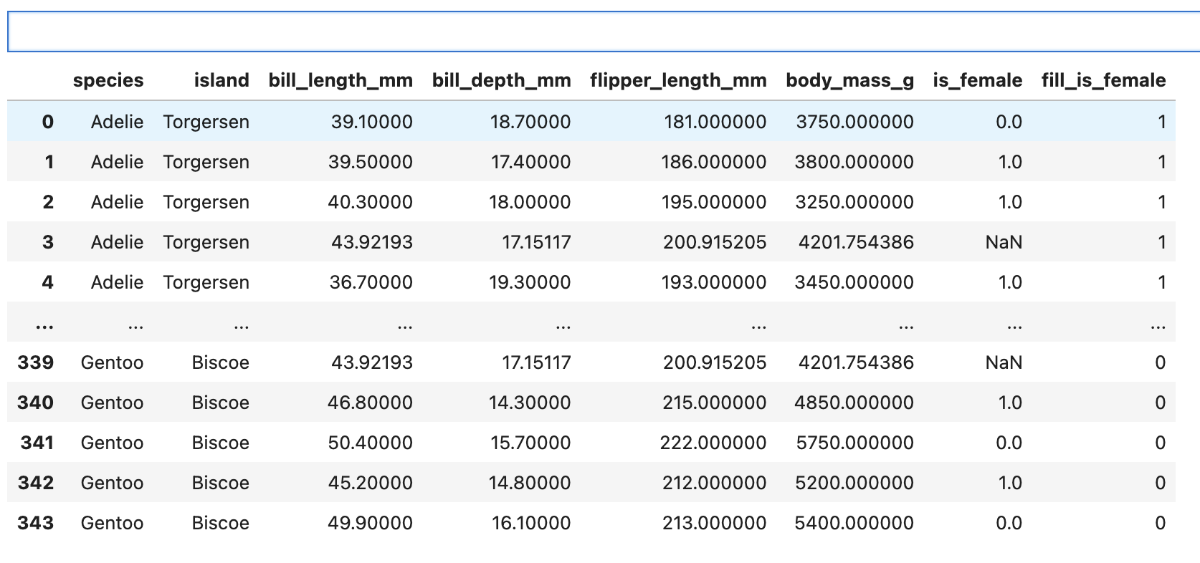
python if else statements
missing imputation
merge df and aux by `species` and `island`

Slide 31
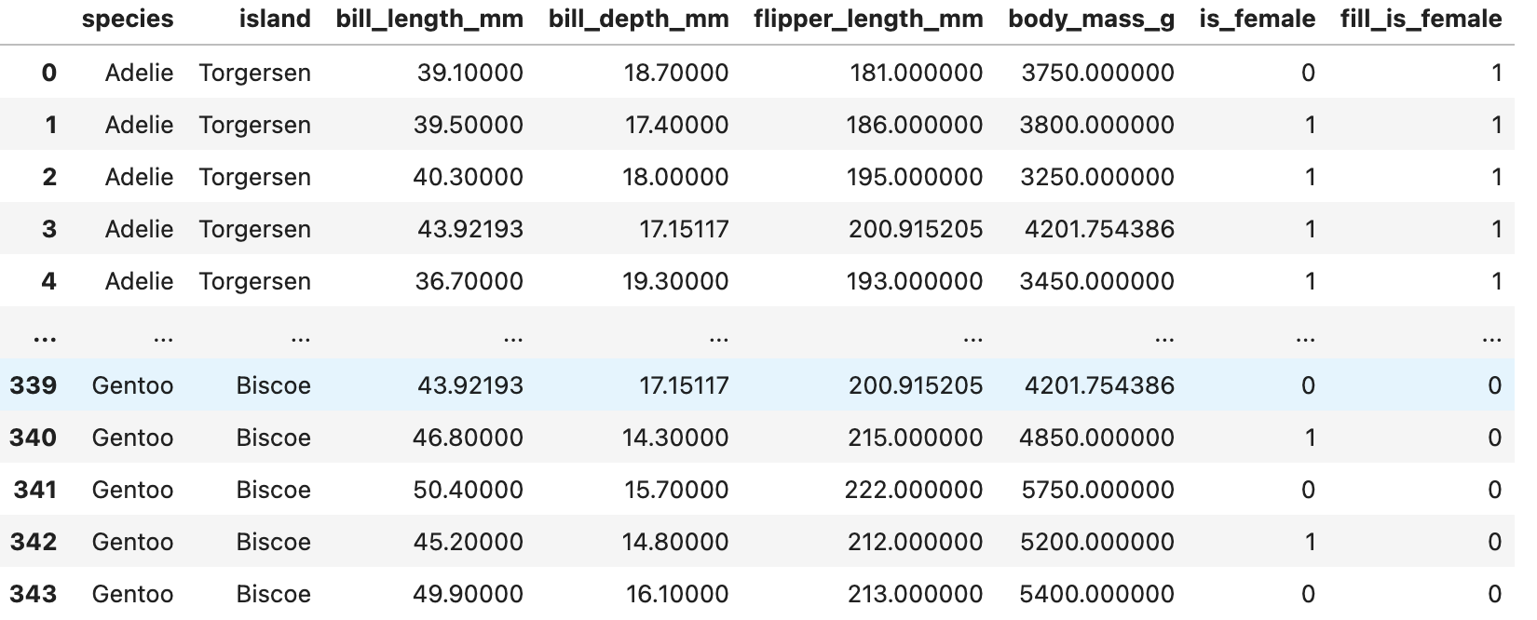
python if else statements
missing imputation
fill na of `is_female`columns with `fill_is_female` values

Slide 32
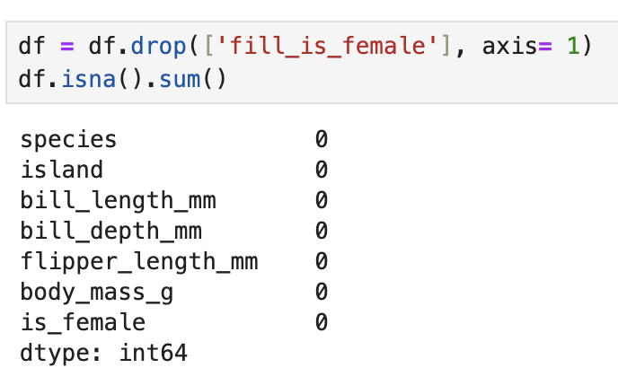
python if else statements
missing imputation
drop`fill_is_female` and check missing values

Slide 33


