Slide 1


Slide 2
GIT

Slide 3
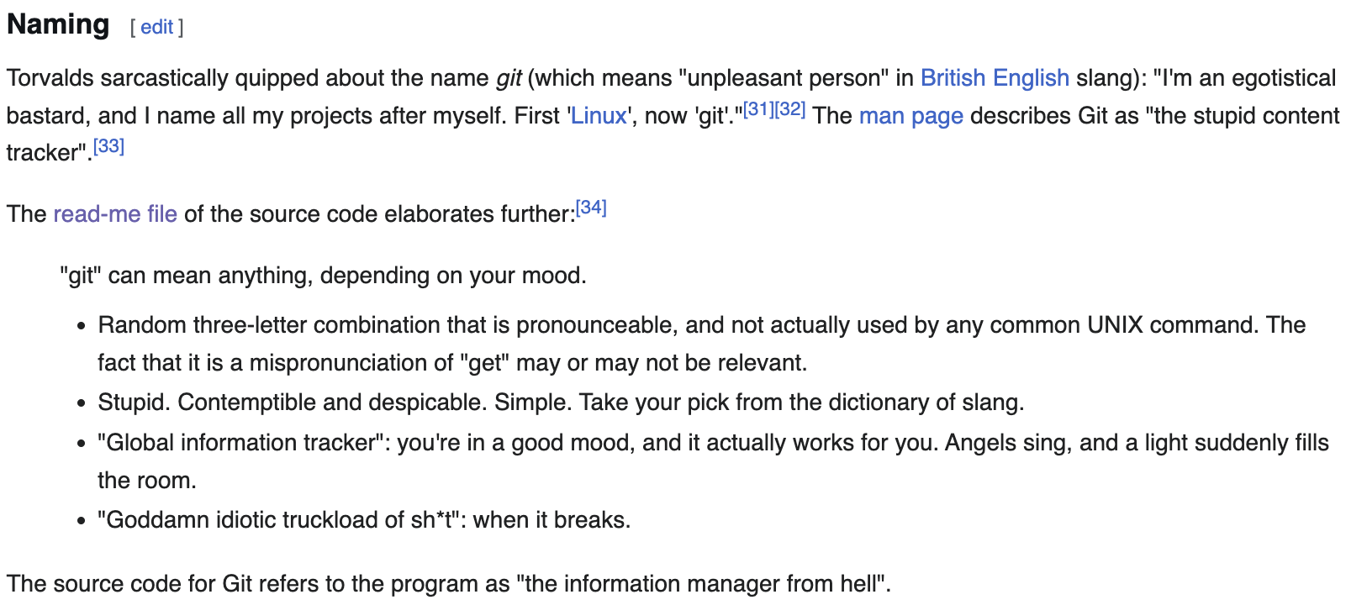
GIT … STANDS FOR …
https://en.wikipedia.org/wiki/Git

Slide 4
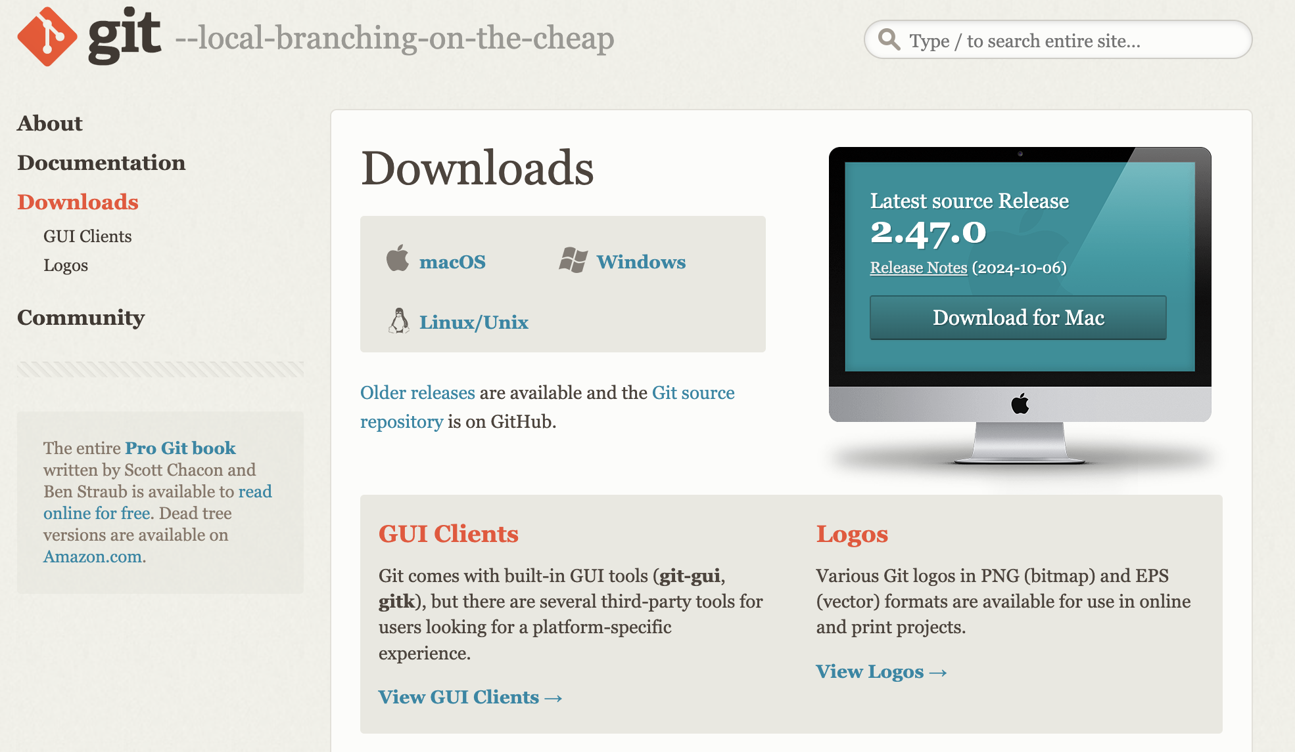
GIT DOWNLOAD

Slide 5

GITHUB
CREATE A GITHUB USER

Slide 6
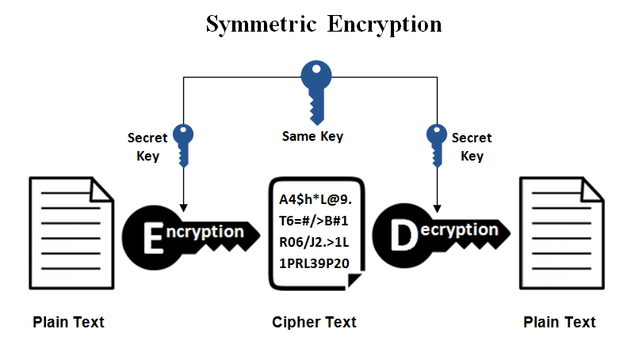
SSH KEY

Slide 7
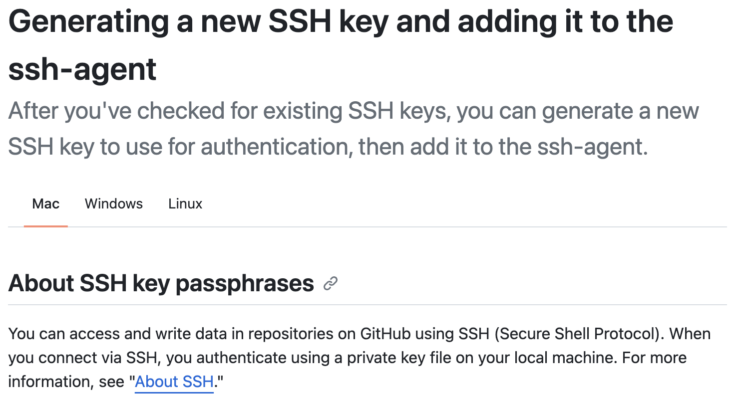
CREATE A SSH KEY
https://docs.github.com/en/authentication/connecting-to-github-with-ssh/generating-a-new-ssh-key-and-adding-it-to-the-ssh-agent

Slide 8
GIT INIT
CREATE A NEW REPOSITORY
create a new directory, open it and perform
git init
to create a new git repository.

Slide 9
GIT CLONE
CLONE A REPOSITORY
git clone /path/to/repository

Slide 10
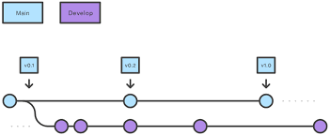
GIT FLOW

Slide 11
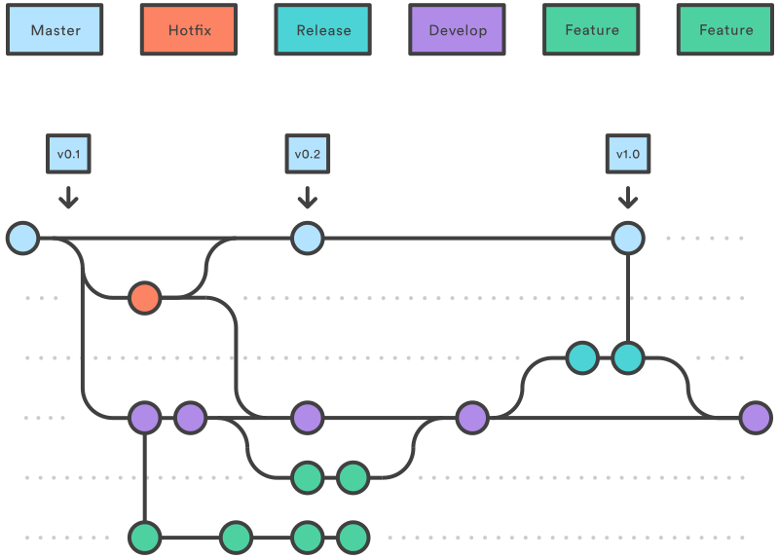
GIT FLOW

Slide 12
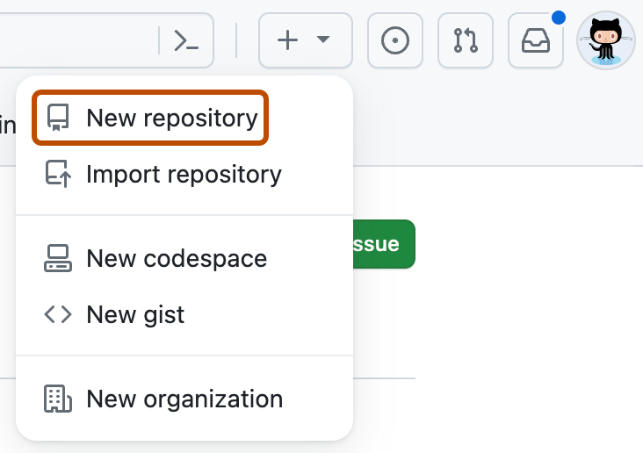
CREATE A REPO AND CLONE IT

Slide 13
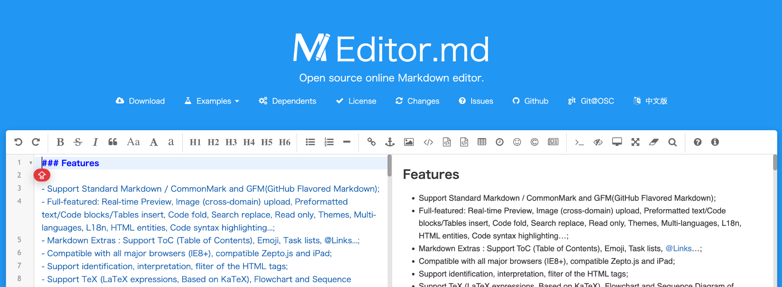
ADD A README FILE
https://pandao.github.io/editor.md/en.html

Slide 14
PUSH TO MAIN
git add README.MD
git commit -m ‘:tada: first commit’
git push origin main

Slide 15
CREATE A NEW BRANCH
git checkout -b develop
git add any.ipynb
git add . . .
git commit -m ‘:arrow_up: new notebooks’
git push

Slide 16
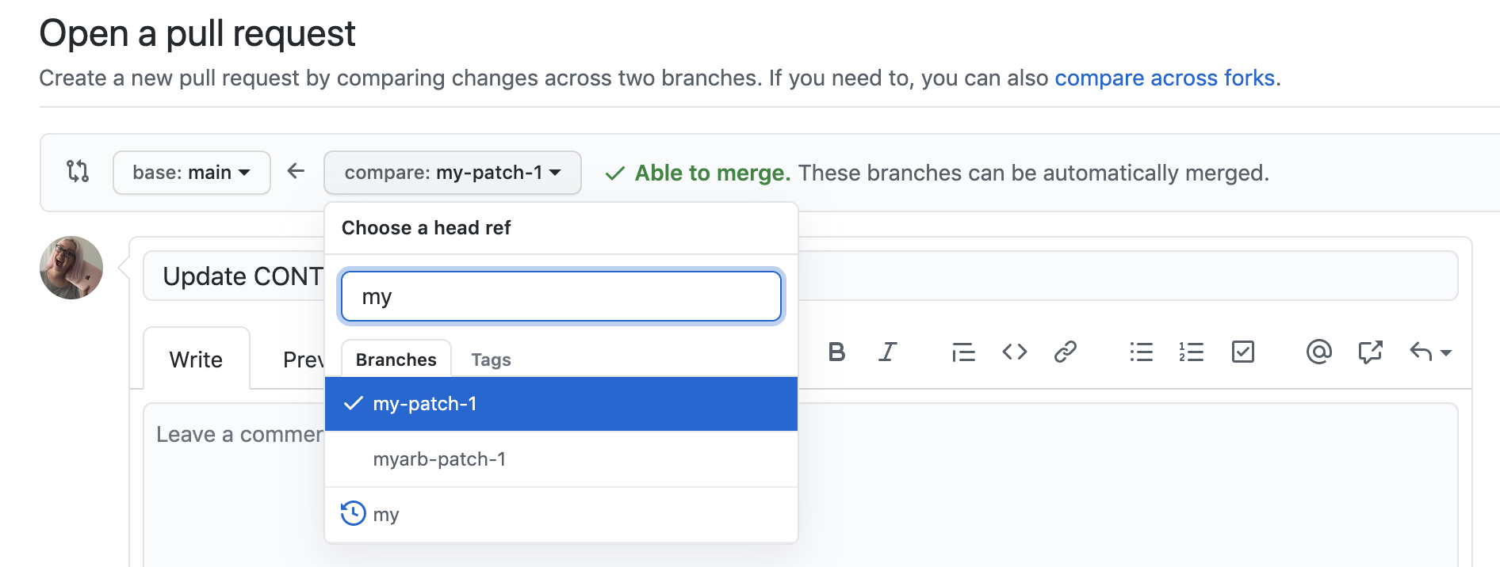
OPEN A PULL REQUEST

Slide 17


