Slide 1
Data Visualization
in R.

Slide 2
What is data visualization?
Notes:
Ok so, what is Data Visualization and why do we do it? Simply put, Data Visualization is using pictures to represent data. Is the representation of quantitative information in a graphical form, in other words, data visualization is the only way that a human have to be able to understand data, to understand what is inside a dataset,because a picture is worth a thousand words or in our cases a picture is worth a thousand rows.
>> There are a lot of different ways to describe the information in a plot but I want you to understand that each kind of graph is a piece of design, and at the same time is an statistical representation of data. Because the only way we have to understand statistics is by using something visual, by designing plots. So it’s quite important to think carefully what is the nature of the data we are going to visualize to select the most appropriate design, the most suitable plot. If we want to visualize the relevante of a categorical variable in a dataset we can use barplot, if we want to describe the distribution of a continuous variable we can use a histogram, If we want to describe the relation between to variables we can use a scatter plot, if we need to visualize the evolution of a variable over time we can use a time series or a line graph, we can also plot a funnel, maps
>> Data Visualization has nothing to do with Big Data because it is not something from the recent years, it is something that has exists for a long time. For example this is a famous visualization called “carte figurative” and this is one the most famous data visualization ever because this is simply great. The illustrations depicts Napoleon’s army departing from the Polish-Russian border to invade moscow. You can see here how to plot six dimension, in a paper, which means, in in two dimensions: the number of Napoleon's soldiers, the distance traveled, the temperature, latitude and longitude, the direction of travel and the location relative to specific dates.

Slide 3

What is Data Visualization?
Notes:
What is Data Visualization?
Ok so, what is Data Visualization and why do we do it? Simply put, Data Visualization is using pictures to represent data. Is the representation of quantitative information in a graphical form, in other words, data visualization is the only way that a human have to be able to understand data, to understand what is inside a dataset,because a picture is worth a thousand words or in our cases a picture is worth a thousand rows.
>> There are a lot of different ways to describe the information in a plot but I want you to understand that each kind of graph is a piece of design, and at the same time is an statistical representation of data. Because the only way we have to understand statistics is by using something visual, by designing plots. So it’s quite important to think carefully what is the nature of the data we are going to visualize to select the most appropriate design, the most suitable plot. If we want to visualize the relevante of a categorical variable in a dataset we can use barplot, if we want to describe the distribution of a continuous variable we can use a histogram, If we want to describe the relation between to variables we can use a scatter plot, if we need to visualize the evolution of a variable over time we can use a time series or a line graph, we can also plot a funnel, maps
>> Data Visualization has nothing to do with Big Data because it is not something from the recent years, it is something that has exists for a long time. For example this is a famous visualization called “carte figurative” and this is one the most famous data visualization ever because this is simply great. The illustrations depicts Napoleon’s army departing from the Polish-Russian border to invade moscow. You can see here how to plot six dimension, in a paper, which means, in in two dimensions: the number of Napoleon's soldiers, the distance traveled, the temperature, latitude and longitude, the direction of travel and the location relative to specific dates.

Slide 4

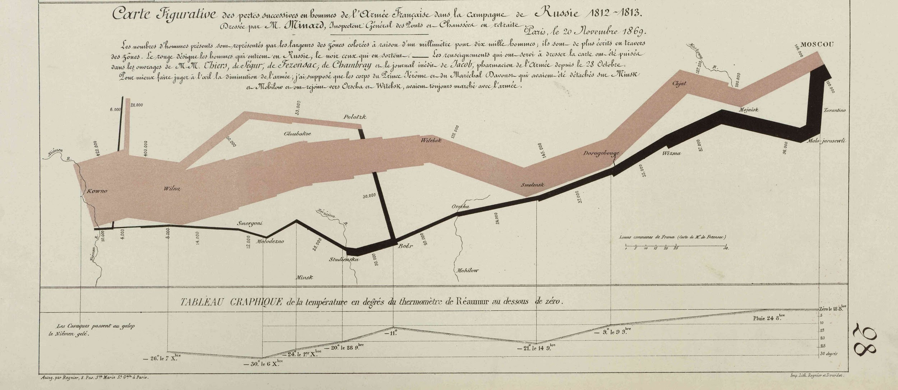
What is Data Visualization?
Charles Joseph Minard's Carte Figurative illustrates facts related to French Invasion of Russia 1812. (1869)
Notes:
>> Data Visualization has nothing to do with Big Data because it is not something from the recent years, it is something that has exists for a long time. For example this is a famous visualization called “carte figurative” and this is one the most famous data visualization ever because this is simply great. The illustrations depicts Napoleon’s army departing from the Polish-Russian border to invade moscow. You can see here how to plot six dimension, in a paper, which means, in in two dimensions: the number of Napoleon's soldiers, the distance traveled, the temperature, latitude and longitude, the direction of travel and the location relative to specific dates.
By watching this data visualization you can grasp how was that war, you can visualize the number of soldiers who went to invade Moscow, the number of soldiers who died as the invasion progressed and how was the retirement, so you can easily imagine the percentage of soldiers who left Poland to invade Moscow and the number of soldiers who returned. Nowadays this is called Sankey diagram which is a type of flow diagram.
By the way, for Edward Tufte which is a superb Data Visualization theorist, this is the best statistical graphic ever drawn. Because this is in essence an statistical graph, you can see here a lot number, dates, names of cities, and rivers, and so on..

Slide 5

What is Data Visualization?
Artwork of the album Unknown Pleasures (Joy Division, 1979)
From “Radio Observations of the Pulse Profiles and Dispersion Measures of Twelve Pulsars,” by Harold D. Craft, Jr. (September 1970)
https://www.youtube.com/watch?v=reEQye0EOAw
Notes:
But sometimes the picture of a data visualization is more important than the meaning itself. Like this example, who knows what’s that?? This is a very famous artwork of Joy Division (a rock band) of the album unknown pleasures and this is an example of how a data visualization has become more important that what it means, because I think that a lot of people know Joy Division because of the T-shirt with this picture, and I’m sure that most of people who have bought a T-Shirt with this picture have never heard a song of Joy Division and of course the don’t know that this a data visualization of the distributions of the frequency of a pulsar. But who cares about the meaning. It is so cool innit? You have here a link of a video in which the designer of this picture explain how Joy Division becomes famous partly thanks to that picture (Unknown Pleasures was the first studio album of Joy Division).
Because in essence, this is design, nobody cares that this is a data visualization to the frequency of the first observed pulsar.
>> So the previous one was mainly an statistical graph with a lot dates, names and letters … and this one is in essence a piece of art, a piece of design and data visualization is something in the middle.
Data visualization is statistics and design combined in meaning and appropriate ways. That means that on the one hand data vis is a form of graphical data analysis emphasizing accurate representation and interpretation of data. But on the other hand data vis relies on good design principles to not only make our plot attractive, but also meaningful. By meaningful, I mean that good design aids in both the understanding and communication of results.
But a data visualization can be nearer to an statistical graph or closer to a design plot, and what it’s the best option?? Do you prefer to make a graph with a lot of data or a very beautiful and attractive plot?? obviously it depends on the audience.

Slide 6
What is Data Visualization?
STATISTICS
DV
DESIGN
Notes:
But sometimes the picture of a data visualization is more important than the meaning itself. Like this example, who knows what’s that?? This is a very famous artwork of Joy Division (a rock band) of the album unknown pleasures and this is an example of how a data visualization has become more important that what it means, because I think that a lot of people know Joy Division because of the T-shirt with this picture, and I’m sure that most of people who have bought a T-Shirt with this picture have never heard a song of Joy Division and of course the don’t know that this a data visualization of the distributions of the frequency of a pulsar. But who cares about the meaning. It is so cool innit? You have here a link of a video in which the designer of this picture explain how Joy Division becomes famous partly thanks to that picture (Unknown Pleasures was the first studio album of Joy Division).
Because in essence, this is design, nobody cares that this is a data visualization to the frequency of the first observed pulsar.
>> So the previous one was mainly an statistical graph with a lot dates, names and letters … and this one is in essence a piece of art, a piece of design and data visualization is something in the middle.
Data visualization is statistics and design combined in meaning and appropriate ways. That means that on the one hand data vis is a form of graphical data analysis emphasizing accurate representation and interpretation of data. But on the other hand data vis relies on good design principles to not only make our plot attractive, but also meaningful. By meaningful, I mean that good design aids in both the understanding and communication of results.
But a data visualization can be nearer to an statistical graph or closer to a design plot, and what it’s the best option?? Do you prefer to make a graph with a lot of data or a very beautiful and attractive plot?? obviously it depends on the audience.

Slide 7
What is Data Visualization?
STATISTICS
DV
DESIGN
EXPLORATORY PLOTS
Notes:
>> When you are making graphs to understand the dataset you are working with, you have to do exploratory plots. Exploratory visualization are easy to do, they are very data dense, which means that you are trying to visualize a lot of dimension in one plot, and they are intended for a small and specialist audience, for example yourself, your coworkers, your fellows… So the main purpose of a exploratory plot is, as it’s name suggests, to explore the data.
>> On the other side, explanatory visualizations are made to communicate your findings, or the results of your model, but , I mean , to explain something not just to explore data. So explanatory data visualizations are labor-intense, you spend much more time (except if your are a master in ggplot), they are data-specific, because you've already explore your data and know you know what you have to plot, and those plots are intended for a broader audience, for example, in publications, presentations, your bosses, a conference, a class, etc and they used to take part of a storytelling process.
As a data scientist your job involves exploring your data, quickly and without taking care about the design or the beauty of the graph but also you have to explain your results to a specific audience. So a good data visualization begins thinking about your audience, the background of your audience, what they know about the problem, their knowledge about the business so if the audience is yourself, your future self, your fellows or your college you might do a exploratory plot with some descriptions but if the audience if broader, people from different companies, ceos, clients, investors.. You have to make a explanatory plot to make them easier to pick up quickly you want to communicate

Slide 8
What is Data Visualization?
STATISTICS
DV
DESIGN
EXPLORATORY PLOTS
EASILY-GENERATED
DATA-HEAVY
INTENDED FOR SPECIALIST AUDIENCE
Notes:
>> When you are making graphs to understand the dataset you are working with, you have to do exploratory plots. Exploratory visualization are easy to do, they are very data dense, which means that you are trying to visualize a lot of dimension in one plot, and they are intended for a small and specialist audience, for example yourself, your coworkers, your fellows… So the main purpose of a exploratory plot is, as it’s name suggests, to explore the data.
>> On the other side, explanatory visualizations are made to communicate your findings, or the results of your model, but , I mean , to explain something not just to explore data. So explanatory data visualizations are labor-intense, you spend much more time (except if your are a master in ggplot), they are data-specific, because you've already explore your data and know you know what you have to plot, and those plots are intended for a broader audience, for example, in publications, presentations, your bosses, a conference, a class, etc and they used to take part of a storytelling process.
As a data scientist your job involves exploring your data, quickly and without taking care about the design or the beauty of the graph but also you have to explain your results to a specific audience. So a good data visualization begins thinking about your audience, the background of your audience, what they know about the problem, their knowledge about the business so if the audience is yourself, your future self, your fellows or your college you might do a exploratory plot with some descriptions but if the audience if broader, people from different companies, ceos, clients, investors.. You have to make a explanatory plot to make them easier to pick up quickly you want to communicate

Slide 9
What is Data Visualization?
STATISTICS
DV
DESIGN
EXPLORATORY PLOTS
EXPLANATORY PLOTS
EASILY-GENERATED
DATA-HEAVY
INTENDED FOR SPECIALIST AUDIENCE
Notes:
>> When you are making graphs to understand the dataset you are working with, you have to do exploratory plots. Exploratory visualization are easy to do, they are very data dense, which means that you are trying to visualize a lot of dimension in one plot, and they are intended for a small and specialist audience, for example yourself, your coworkers, your fellows… So the main purpose of a exploratory plot is, as it’s name suggests, to explore the data.
>> On the other side, explanatory visualizations are made to communicate your findings, or the results of your model, but , I mean , to explain something not just to explore data. So explanatory data visualizations are labor-intense, you spend much more time (except if your are a master in ggplot), they are data-specific, because you've already explore your data and know you know what you have to plot, and those plots are intended for a broader audience, for example, in publications, presentations, your bosses, a conference, a class, etc and they used to take part of a storytelling process.
As a data scientist your job involves exploring your data, quickly and without taking care about the design or the beauty of the graph but also you have to explain your results to a specific audience. So a good data visualization begins thinking about your audience, the background of your audience, what they know about the problem, their knowledge about the business so if the audience is yourself, your future self, your fellows or your college you might do a exploratory plot with some descriptions but if the audience if broader, people from different companies, ceos, clients, investors.. You have to make a explanatory plot to make them easier to pick up quickly you want to communicate

Slide 10
What is Data Visualization?
STATISTICS
DV
DESIGN
EXPLORATORY PLOTS
EXPLANATORY PLOTS
EASILY-GENERATED
DATA-HEAVY
INTENDED FOR SPECIALIST AUDIENCE
LABOR-INTENSE
DATA-SPECIFIC
INTENDED FOR A BROAD AUDIENCE
Notes:
>> When you are making graphs to understand the dataset you are working with, you have to do exploratory plots. Exploratory visualization are easy to do, they are very data dense, which means that you are trying to visualize a lot of dimension in one plot, and they are intended for a small and specialist audience, for example yourself, your coworkers, your fellows… So the main purpose of a exploratory plot is, as it’s name suggests, to explore the data.
>> On the other side, explanatory visualizations are made to communicate your findings, or the results of your model, but , I mean , to explain something not just to explore data. So explanatory data visualizations are labor-intense, you spend much more time (except if your are a master in ggplot), they are data-specific, because you've already explore your data and know you know what you have to plot, and those plots are intended for a broader audience, for example, in publications, presentations, your bosses, a conference, a class, etc and they used to take part of a storytelling process.
As a data scientist your job involves exploring your data, quickly and without taking care about the design or the beauty of the graph but also you have to explain your results to a specific audience. So a good data visualization begins thinking about your audience, the background of your audience, what they know about the problem, their knowledge about the business so if the audience is yourself, your future self, your fellows or your college you might do a exploratory plot with some descriptions but if the audience if broader, people from different companies, ceos, clients, investors.. You have to make a explanatory plot to make them easier to pick up quickly you want to communicate

Slide 11
Example
Notes:
Let's make a example to show the difference between exploratory and explanatory data analysis. You can find the code of this example in the script code/01_exploratory_vs_explanatory_plot.R .
>> So imagine we have a dataset with data about the weather of Madrid during last year, ok so we have information about the date, the hour, a summary of the weather during this hour written in words, the name of a icon (because this dataset comes from an API we use at Nextail which is designed to create an app so we have here the name of the icon to easily communicate the weather) and also we have numerical data like temperature, apparent temperature, the intensity of rain, the probability of precipitation, the dew point, the cloud cover and things like that.
>> Now let’s make a quick check of the data types of the dataset by using the function str.
And now imagine we want to describe the apparent temperature per month.
So we can do something like this using some tricks from the package data.table (I think that Maria has taught you how to make those tricks) So in just one line of code we can create a table with the information of the minimum and maximum apparent Temperature, with the first and third quartile, and with the mean and the median. But this is quite useless because we have to think a lot the reach a conclusion, we have to read numbers, to think if a number is higher or lower.. Come on! I don’t want to think that much.

Slide 12
Example
# read data
library(data.table)
dt <- fread('data/weather_madrid_2017.csv')
Notes:
Let's make a example to show the difference between exploratory and explanatory data analysis. You can find the code of this example in the script code/01_exploratory_vs_explanatory_plot.R .
So imagine we have a dataset with data about the weather of Madrid during last year, ok so we have information about the date, the hour, a summary of the weather during this hour written in words, the name of a icon (because this dataset comes from an API we use at Nextail which is designed to create an app so we have here the name of the icon to easily communicate the weather) and also we have numerical data like temperature, apparent temperature, the intensity of rain, the probability of precipitation, the dew point, the cloud cover and things like that.
Now let’s make a quick check of the data types of the dataset by using the function str.
And now imagine we want to describe the apparent temperature per month. +
So we can do something like this using some tricks from the package data.table (I think that Maria has taught you how to make those tricks) So in just one line of code we can create a table with the information of the minimum and maximum apparent Temperature, with the first and third quartile, and with the mean and the median. But this is quite useless because we have to think a lot the reach a conclusion, we have to read numbers, to think if a number is higher or lower.. Come on! I don’t want to think that much.

Slide 13
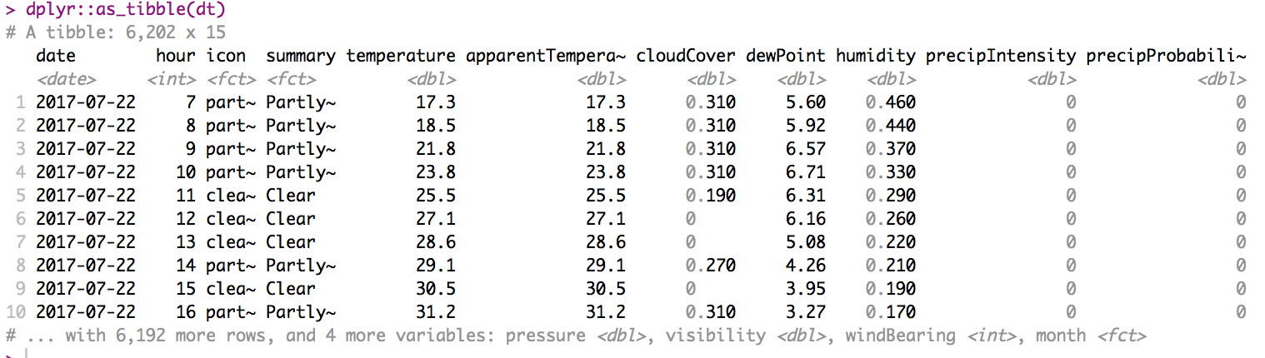
Example
Notes:
Let's make a example to show the difference between exploratory and explanatory data analysis. You can find the code of this example in the script code/01_exploratory_vs_explanatory_plot.R .
>> So imagine we have a dataset with data about the weather of Madrid during last year, ok so we have information about the date, the hour, a summary of the weather during this hour written in words, the name of a icon (because this dataset comes from an API we use at Nextail which is designed to create an app so we have here the name of the icon to easily communicate the weather) and also we have numerical data like temperature, apparent temperature, the intensity of rain, the probability of precipitation, the dew point, the cloud cover and things like that.
>> Now let’s make a quick check of the data types of the dataset by using the function str.
And now imagine we want to describe the apparent temperature per month.
>> So we can do something like this using some tricks from the package data.table (I think that Maria has taught you how to make those tricks) So in just one line of code we can create a table with the information of the minimum and maximum apparent Temperature, with the first and third quartile, and with the mean and the median. But this is quite useless because we have to think a lot the reach a conclusion, we have to read numbers, to think if a number is higher or lower.. Come on! I don’t want to think that much.

Slide 14
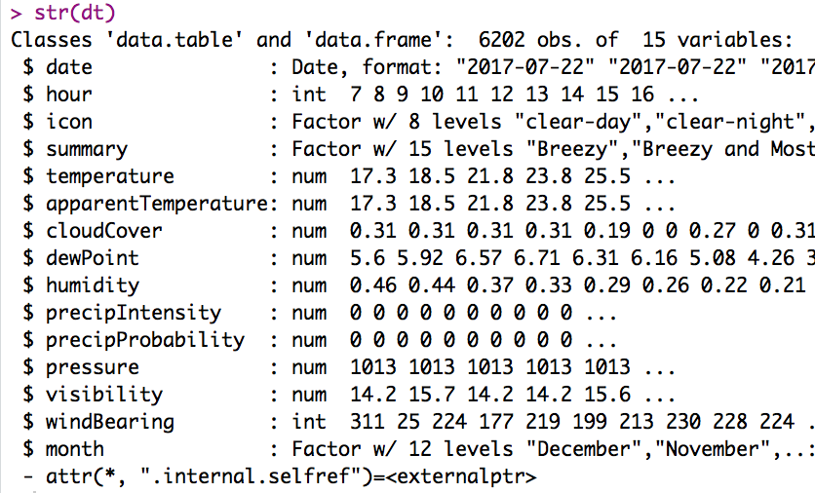
Example
Notes:
Let's make a example to show the difference between exploratory and explanatory data analysis. You can find the code of this example in the script code/01_exploratory_vs_explanatory_plot.R .
>> So imagine we have a dataset with data about the weather of Madrid during last year, ok so we have information about the date, the hour, a summary of the weather during this hour written in words, the name of a icon (because this dataset comes from an API we use at Nextail which is designed to create an app so we have here the name of the icon to easily communicate the weather) and also we have numerical data like temperature, apparent temperature, the intensity of rain, the probability of precipitation, the dew point, the cloud cover and things like that.
>> Now let’s make a quick check of the data types of the dataset by using the function str.
And now imagine we want to describe the apparent temperature per month.
>> So we can do something like this using some tricks from the package data.table (I think that Maria has taught you how to make those tricks) So in just one line of code we can create a table with the information of the minimum and maximum apparent Temperature, with the first and third quartile, and with the mean and the median. But this is quite useless because we have to think a lot the reach a conclusion, we have to read numbers, to think if a number is higher or lower.. Come on! I don’t want to think that much.

Slide 15
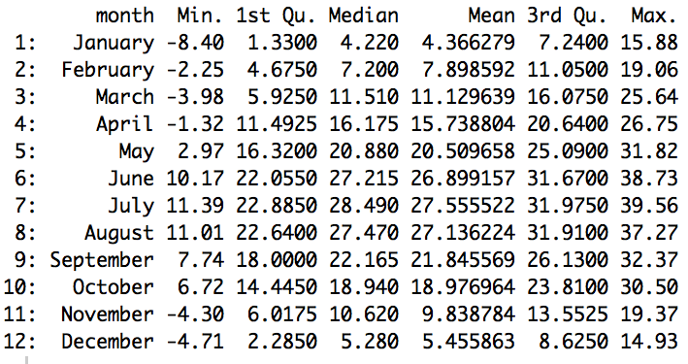
Example
# quick descriptive analysis
dt[,as.list(summary(apparentTemperature)), by=month][order(-month)]
Notes:
Let's make a example to show the difference between exploratory and explanatory data analysis. You can find the code of this example in the script code/01_exploratory_vs_explanatory_plot.R .
>> So imagine we have a dataset with data about the weather of Madrid during last year, ok so we have information about the date, the hour, a summary of the weather during this hour written in words, the name of a icon (because this dataset comes from an API we use at Nextail which is designed to create an app so we have here the name of the icon to easily communicate the weather) and also we have numerical data like temperature, apparent temperature, the intensity of rain, the probability of precipitation, the dew point, the cloud cover and things like that.
>> Now let’s make a quick check of the data types of the dataset by using the function str.
And now imagine we want to describe the apparent temperature per month.
>> So we can do something like this using some tricks from the package data.table (I think that Maria has taught you how to make those tricks) So in just one line of code we can create a table with the information of the minimum and maximum apparent Temperature, with the first and third quartile, and with the mean and the median. But this is quite useless because we have to think a lot the reach a conclusion, we have to read numbers, to think if a number is higher or lower.. Come on! I don’t want to think that much.

Slide 16
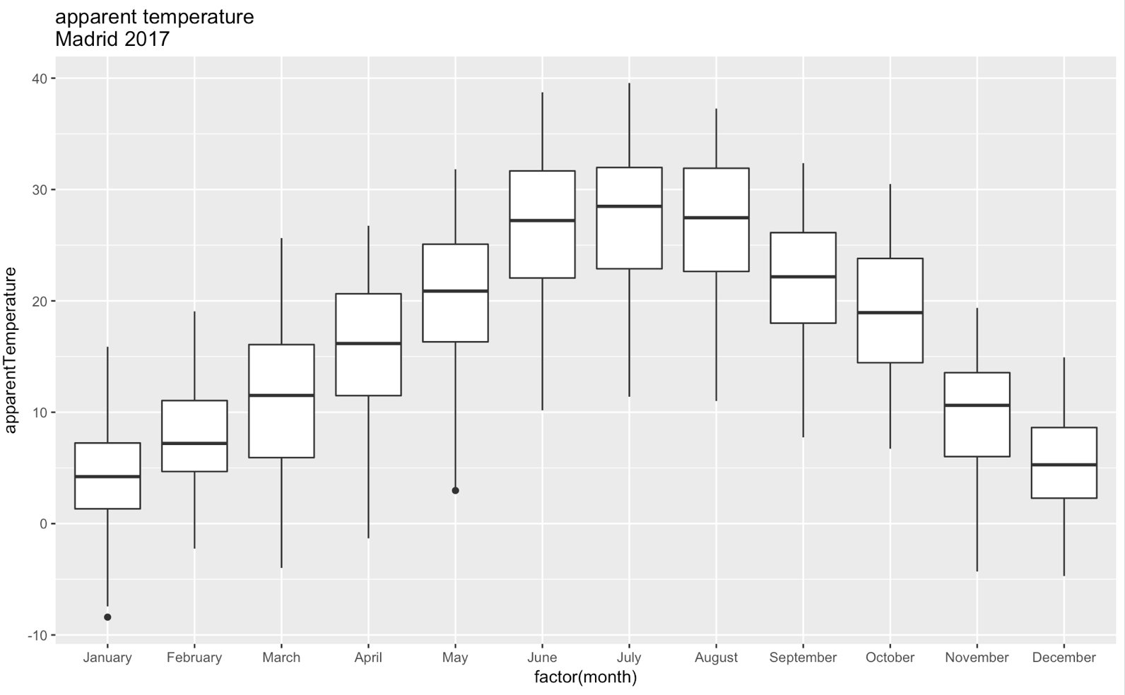
Example
# exploratory plot (boxplots)
ggplot(dt,aes(y = apparentTemperature, x = factor(month))) +
geom_boxplot() + labs(title = 'apparent temperature \nMadrid 2017')
Notes:
So.. how can I plot this data in a picture.. The solution is boxplots! Boxplot is quite useful because it show you the main metrics of a distribution in a very simple way. So here we have the median (which is shown by the black line in the middle of the box, the first and the third quartile which are the width of the box, and we also have information about some outliers, and also the width of the whole distribution, shown with the line.
>> But if we want to watch a little more about the shape of the distributions we can use something called violin plots (which is like boxplots but with the shape of the distribution). And I don’t know why they are called violin plots because I can think of something that is much more similar and it is not a violin… who knows what I’m thinking?? Ok … an what if I add the mean and the standard deviation?? Is it more clear??
>> Ok now that we know what is a violin plot I want you to understand what is a boxplot. So we have here the boxplots picture?? Do you remember what is the meaning of each part, the median, the third and first quartile, the width of the distribution and some outliers.. Ok so now we are going to flip the plot changing the coordinates with just one more line of code.

Slide 17
Example
# exploratory plot (violin plots)
ggplot(dt,aes(y = apparentTemperature, x = factor(month))) +
geom_violin() + labs(title = 'apparent temperature \nMadrid 2017')
Notes:
So.. how can I plot this data in a picture.. The solution is boxplots! Boxplot is quite useful because it show you the main metrics of a distribution in a very simple way. So here we have the median (which is shown by the black line in the middle of the box, the first and the third quartile which are the width of the box, and we also have information about some outliers, and also the width of the whole distribution, shown with the line.
>> But if we want to watch a little more about the shape of the distributions we can use something called violin plots (which is like boxplots but with the shape of the distribution). And I don’t know why they are called violin plots because I can think of something that is much more similar and it is not a violin… who knows what I’m thinking?? Ok … an what if I add the mean and the standard deviation?? Is it more clear??
>> Ok now that we know what is a violin plot I want you to understand what is a boxplot. So we have here the boxplots picture?? Do you remember what is the meaning of each part, the median, the third and first quartile, the width of the distribution and some outliers.. Ok so now we are going to flip the plot changing the coordinates with just one more line of code.

Slide 18
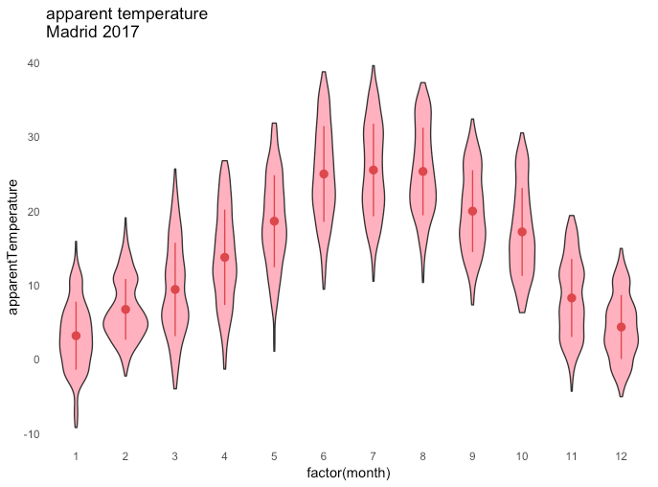
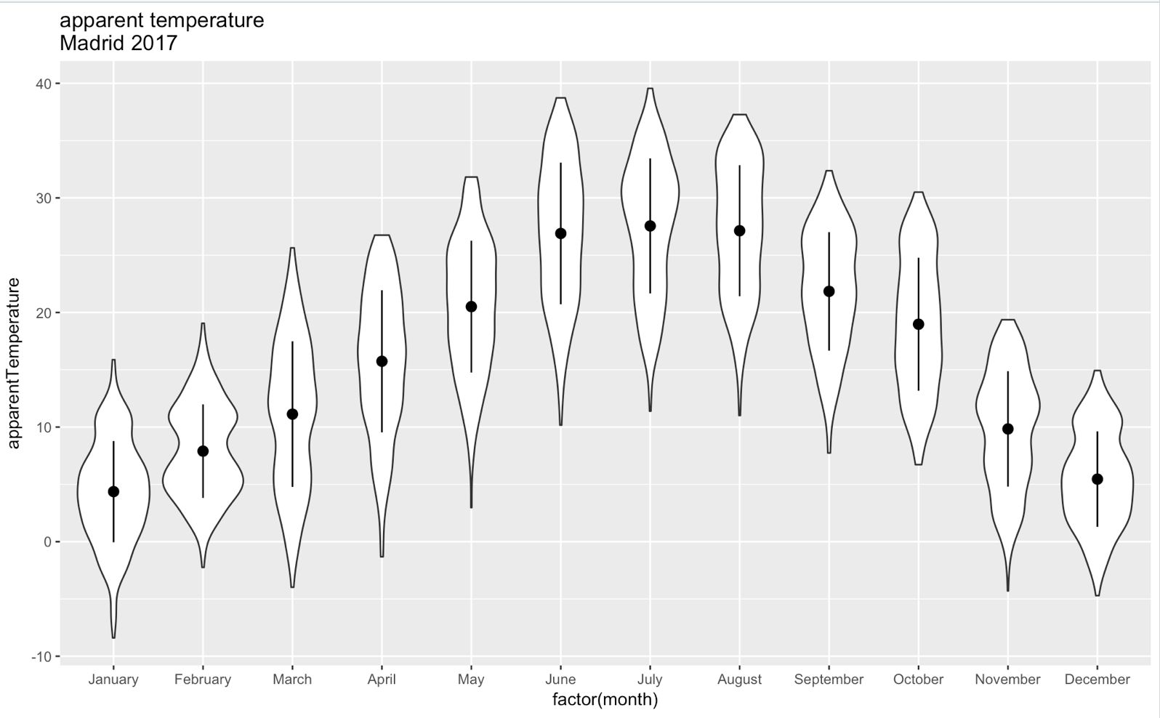
Example
# exploratory plot (violin plots)
ggplot(dt,aes(y = apparentTemperature, x = factor(month))) +
geom_violin() + labs(title = 'apparent temperature \nMadrid 2017')+
stat_summary(fun.data="mean_sdl", fun.args = list(mult=1), geom="pointrange", color = "black")
Notes:
So.. how can I plot this data in a picture.. The solution is boxplots! Boxplot is quite useful because it show you the main metrics of a distribution in a very simple way. So here we have the median (which is shown by the black line in the middle of the box, the first and the third quartile which are the width of the box, and we also have information about some outliers, and also the width of the whole distribution, shown with the line.
>> But if we want to watch a little more about the shape of the distributions we can use something called violin plots (which is like boxplots but with the shape of the distribution). And I don’t know why they are called violin plots because I can think of something that is much more similar and it is not a violin… who knows what I’m thinking?? Ok … an what if I add the mean and the standard deviation?? Is it more clear??
>> Ok now that we know what is a violin plot I want you to understand what is a boxplot. So we have here the boxplots picture?? Do you remember what is the meaning of each part, the median, the third and first quartile, the width of the distribution and some outliers.. Ok so now we are going to flip the plot changing the coordinates with just one more line of code.

Slide 19
Example
# exploratory plot (violin plots)
ggplot(dt,aes(y = apparentTemperature, x = factor(month))) +
geom_violin() + labs(title = 'apparent temperature \nMadrid 2017')+
stat_summary(fun.data="mean_sdl", fun.args = list(mult=1), geom="pointrange", color = "black")
Notes:
So.. how can I plot this data in a picture.. The solution is boxplots! Boxplot is quite useful because it show you the main metrics of a distribution in a very simple way. So here we have the median (which is shown by the black line in the middle of the box, the first and the third quartile which are the width of the box, and we also have information about some outliers, and also the width of the whole distribution, shown with the line.
>> But if we want to watch a little more about the shape of the distributions we can use something called violin plots (which is like boxplots but with the shape of the distribution). And I don’t know why they are called violin plots because I can think of something that is much more similar and it is not a violin… who knows what I’m thinking?? Ok … an what if I add the mean and the standard deviation?? Is it more clear??
>> Ok now that we know what is a violin plot I want you to understand what is a boxplot. So we have here the boxplots picture?? Do you remember what is the meaning of each part, the median, the third and first quartile, the width of the distribution and some outliers.. Ok so now we are going to flip the plot changing the coordinates with just one more line of code.

Slide 20
Example
# exploratory plot (boxplots)
# fct_rev function is used the flip the order of the levels in a factor
ggplot(dt,aes(y = apparentTemperature, x = fct_rev(month))) +
geom_boxplot() + labs(title = 'apparent temperature \nMadrid 2017')+
coord_flip()
Notes:
>> Ok now that we know what is a violin plot I want you to understand what is a boxplot. So we have here the boxplots picture?? Do you remember what is the meaning of each part, the median, the third and first quartile, the width of the distribution and some outliers.. Ok so now we are going to flip the plot changing the coordinates with just one more line of code.
So now I want to show you what is an explanatory plot, imagine you have to describe this information to you boss, to the investors etc.. So why don’t you plot the whole distribution. You can take something like that! And now it’s quite easy to explain that something strange happened in February or March, that we had a heat wave here in June. And obviously we have to add title to explain what we are showing. Perfect.
>> But we can also use ggplot to create the design of a T-shirt like the one of joy division changing just a little part of the code we can create something like that. In fact, the package I have used to this plot and the previous one is called ggjoy (it’s funny).

Slide 21
Example
# explanatory plot
ggplot(dt,aes(x = apparentTemperature, y = factor(month))) +
geom_density_ridges2(fill='black',color = 'white',size = 1,scale=2) + theme_minimal(base_size = 15) +
theme(axis.title = element_blank(), plot.title = element_text(family='Verdana',hjust = 0.5)) +
labs(title = 'Apparent Temperature (Celsius) \nMadrid 2017')
Notes:
>> Ok now that we know what is a violin plot I want you to understand what is a boxplot. So we have here the boxplots picture?? Do you remember what is the meaning of each part, the median, the third and first quartile, the width of the distribution and some outliers.. Ok so now we are going to flip the plot changing the coordinates with just one more line of code.
So now I want to show you what is an explanatory plot, imagine you have to describe this information to you boss, to the investors etc.. So why don’t you plot the whole distribution. You can take something like that! And now it’s quite easy to explain that something strange happened in February or March, that we had a heat wave here in June. And obviously we have to add title to explain what we are showing. Perfect.
>> But we can also use ggplot to create the design of a T-shirt like the one of joy division changing just a little part of the code we can create something like that. In fact, the package I have used to this plot and the previous one is called ggjoy (it’s funny).

Slide 22
Example
# joy division plot
ggplot(dt,aes(x = apparentTemperature, y = factor(month))) +
geom_density_ridges2(fill='black',color = 'white',size = 1,scale=2) +
theme_void(base_size = 15) +
theme(axis.title = element_blank(), plot.background = element_rect(fill='black'))
Notes:
>> Ok now that we know what is a violin plot I want you to understand what is a boxplot. So we have here the boxplots picture?? Do you remember what is the meaning of each part, the median, the third and first quartile, the width of the distribution and some outliers.. Ok so now we are going to flip the plot changing the coordinates with just one more line of code.
So now I want to show you what is an explanatory plot, imagine you have to describe this information to you boss, to the investors etc.. So why don’t you plot the whole distribution. You can take something like that! And now it’s quite easy to explain that something strange happened in February or March, that we had a heat wave here in June. And obviously we have to add title to explain what we are showing. Perfect.
>> But we can also use ggplot to create the design of a T-shirt like the one of joy division changing just a little part of the code we can create something like that. In fact, the package I have used to this plot and the previous one is called ggjoy (it’s funny).

Slide 23
Example
STATS
DESIGN
Notes:
>> Ok now that we know what is a violin plot I want you to understand what is a boxplot. So we have here the boxplots picture?? Do you remember what is the meaning of each part, the median, the third and first quartile, the width of the distribution and some outliers.. Ok so now we are going to flip the plot changing the coordinates with just one more line of code.
So now I want to show you what is an explanatory plot, imagine you have to describe this information to you boss, to the investors etc.. So why don’t you plot the whole distribution. You can take something like that! And now it’s quite easy to explain that something strange happened in February or March, that we had a heat wave here in June. And obviously we have to add title to explain what we are showing. Perfect.
>> But we can also use ggplot to create the design of a T-shirt like the one of joy division changing just a little part of the code we can create something like that. In fact, the package I have used to this plot and the previous one is called ggjoy (it’s funny).
>> This is liek a travel between stats and design, and, in my opinion, those are the perfect exploratory and explanatory plots.

Slide 24
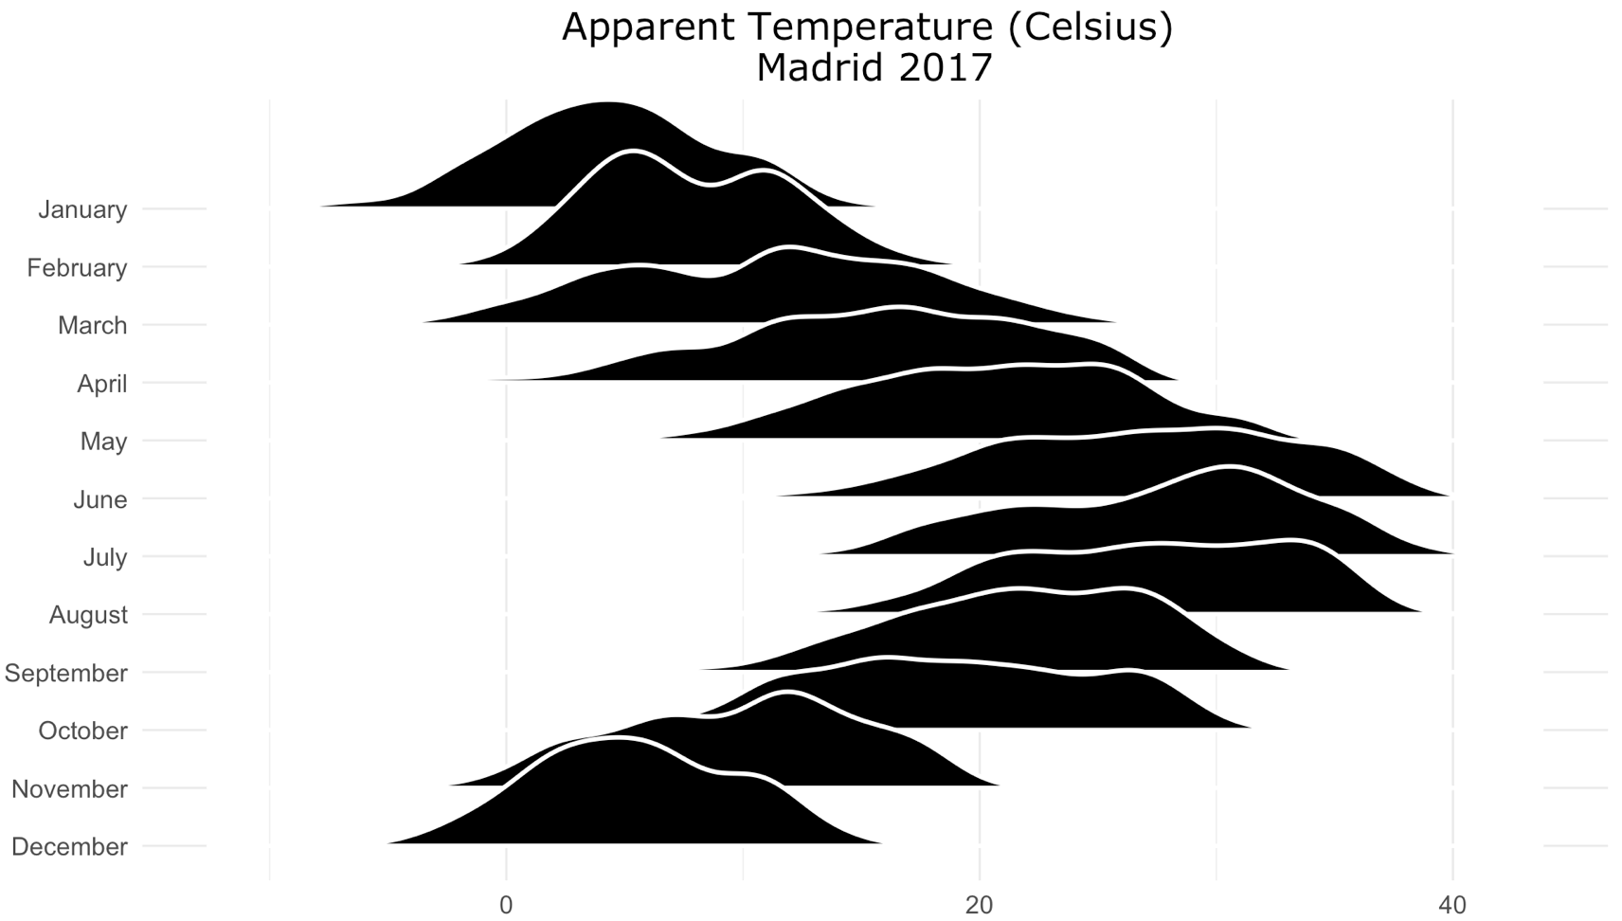
Example
STATS
DESIGN
Notes:
>> Ok now that we know what is a violin plot I want you to understand what is a boxplot. So we have here the boxplots picture?? Do you remember what is the meaning of each part, the median, the third and first quartile, the width of the distribution and some outliers.. Ok so now we are going to flip the plot changing the coordinates with just one more line of code.
So now I want to show you what is an explanatory plot, imagine you have to describe this information to you boss, to the investors etc.. So why don’t you plot the whole distribution. You can take something like that! And now it’s quite easy to explain that something strange happened in February or March, that we had a heat wave here in June. And obviously we have to add title to explain what we are showing. Perfect.
>> But we can also use ggplot to create the design of a T-shirt like the one of joy division changing just a little part of the code we can create something like that. In fact, the package I have used to this plot and the previous one is called ggjoy (it’s funny).

Slide 25
Tidy Data
Notes:
What is tidy data?
I hope that María taught you how to clean a dataset, how to change data types, how to transform a data set from wide format to long format or from long format to wide format. But I don’t know if she told you what is tidy data?? Tidy data is something we need to learn to make data visualization using ggplot. Because ggplot belong to a family of packages called tidyverse which is an environment, a collection of package that works very well together and one of the main principles of tidyverse is the tidy format. Our data need to have and specific format if we want to properly use tidyverse package. So I highly recommend you to read this paper Tidy Data, it’s free, and it has been written by Hadley Wickham, the main developer of tidyverse, the chief data scientist of RStudio, which is also professor at Standord, this is the most important person in the R world right now.
The thing I want to say is that the data in the real world is not like the datasets you have been working with during the bootcamp. The first think you realise once you have the data in your hands, the first thing you realize is that your data is a really mess:
you don’t the meaning of the columns so you don’t really the information you have in your hands
the columns are not properly named, you will finds column columns with dots, with hyphens, with the name written in camelcase, you know, using upper lower case, or what is even worst you will find columns name with information which must be stored in a separate feature.
You will find also columns with more than a feature, for example, a column that stores the name of the film and at the same time the year when the movie was released. (do you remember the column title in the table movies)
You will also find that the data is not properly typed, like, for instance, numeric values in character columns.
So how can we make a clean dataset from a dirty dataset? Today we are going to learn how and I will advance that we are going to use a tidyverse package called tidyr for those who want to search on the internet to start learning how the package works.

Slide 26
Tidy Data
Notes:
What is tidy data?
I hope that María taught you how to clean a dataset, how to change data types, how to transform a data set from wide format to long format or from long format to wide format. But I don’t know if she told you what is tidy data?? Tidy data is something we need to learn to make data visualization using ggplot. Because ggplot belong to a family of packages called tidyverse which is an environment, a collection of package that works very well together and one of the main principles of tidyverse is the tidy format. Our data need to have and specific format if we want to properly use tidyverse package. So I highly recommend you to read this paper Tidy Data, it’s free, and it has been written by Hadley Wickham, the main developer of tidyverse, the chief data scientist of RStudio, which is also professor at Standord, this is the most important person in the R world right now.
The thing I want to say is that the data in the real world is not like the datasets you have been working with during the bootcamp. The first think you realise once you have the data in your hands, the first thing you realize is that your data is a really mess:
you don’t the meaning of the columns so you don’t really the information you have in your hands
the columns are not properly named, you will finds column columns with dots, with hyphens, with the name written in camelcase, you know, using upper lower case, or what is even worst you will find columns name with information which must be stored in a separate feature.
You will find also columns with more than a feature, for example, a column that stores the name of the film and at the same time the year when the movie was released. (do you remember the column title in the table movies)
You will also find that the data is not properly typed, like, for instance, numeric values in character columns.
So how can we make a clean dataset from a dirty dataset? Today we are going to learn how and I will advance that we are going to use a tidyverse package called tidyr for those who want to search on the internet to start learning how the package works.

Slide 27
Tidy Data
real world dataset are not tidy.
Notes:
So how can we make a clean dataset from a dirty dataset? Today we are going to learn how and I will advance that we are going to use a tidyverse package called tidyr for those who want to search on the internet to start learning how the package works.
So in short, real world dataset are not tidy, are not cleaned, are not properly prepared to be analysed. Even in my company we have datasets that are made to make website, to a business app, so those datasets are not made for us, are not made for data scientist, so they are not analytical datasets, and obviouly we have to clean the data we extract to make our analytical datasets before a data exploration, or whatever.
Tidy datasets are all alike but every messy datasets is messy in its own way. This quote comes from Anna Karenina of Leo Tolstoy which says that (Happy families are all alike; every unhappy family is unhappy in its own way). So there is no a unique way to transform a messy dataset into a tidy datasets because each messy dataset is messy in its own way, so we need to create a custom code for every messy dataset. But the other thing is that tidy data is a standard format, and standards are quite useful in data science because it allow us to develop an intuition quicker, because you know your data has an specific format so you can image the pseudocode of the functions you are goint to write faster and better and that’s because the tidy data is a standard.
And the last thing is the manifesto, what’s makes tidy data concepts and standard. So we have only three principles, 1. Each variable forms a column, 2. Each observation forms a row, and 3 each type of observation unit forms a table.

Slide 28
Tidy Data
real world dataset are not tidy.
‘tidy datasets are all alike but every messy dataset is messy in its own way’.(Hadley Wickham, Tidy Data).
Notes:
So how can we make a clean dataset from a dirty dataset? Today we are going to learn how and I will advance that we are going to use a tidyverse package called tidyr for those who want to search on the internet to start learning how the package works.
So in short, real world dataset are not tidy, are not cleaned, are not properly prepared to be analysed. Even in my company we have datasets that are made to make website, to a business app, so those datasets are not made for us, are not made for data scientist, so they are not analytical datasets, and obviouly we have to clean the data we extract to make our analytical datasets before a data exploration, or whatever.
Tidy datasets are all alike but every messy datasets is messy in its own way. This quote comes from Anna Karenina of Leo Tolstoy which says that (Happy families are all alike; every unhappy family is unhappy in its own way). So there is no a unique way to transform a messy dataset into a tidy datasets because each messy dataset is messy in its own way, so we need to create a custom code for every messy dataset. But the other thing is that tidy data is a standard format, and standards are quite useful in data science because it allow us to develop an intuition quicker, because you know your data has an specific format so you can image the pseudocode of the functions you are goint to write faster and better and that’s because the tidy data is a standard.
And the last thing is the manifesto, what’s makes tidy data concepts and standard. So we have only three principles,

Slide 29
Tidy Data
real world dataset are not tidy.
‘tidy datasets are all alike but every messy dataset is messy in its own way’.(Hadley Wickham, Tidy Data).
Tidy data manifesto:
each variable forms a column
each observation forms a row
each type of observational unit forms a table
Notes:
So how can we make a clean dataset from a dirty dataset? Today we are going to learn how and I will advance that we are going to use a tidyverse package called tidyr for those who want to search on the internet to start learning how the package works.
So in short, real world dataset are not tidy, are not cleaned, are not properly prepared to be analysed. Even in my company we have datasets that are made to make website, to a business app, so those datasets are not made for us, are not made for data scientist, so they are not analytical datasets, and obviouly we have to clean the data we extract to make our analytical datasets before a data exploration, or whatever.
Tidy datasets are all alike but every messy datasets is messy in its own way. This quote comes from Anna Karenina of Leo Tolstoy which says that (Happy families are all alike; every unhappy family is unhappy in its own way). So there is no a unique way to transform a messy dataset into a tidy datasets because each messy dataset is messy in its own way, so we need to create a custom code for every messy dataset. But the other thing is that tidy data is a standard format, and standards are quite useful in data science because it allow us to develop an intuition quicker, because you know your data has an specific format so you can image the pseudocode of the functions you are goint to write faster and better and that’s because the tidy data is a standard.
And the last thing is the manifesto, what’s makes tidy data concepts and standard. So we have only three principles, 1. Each variable forms a column, 2. Each observation forms a row, and 3 each type of observation unit forms a table.

Slide 30
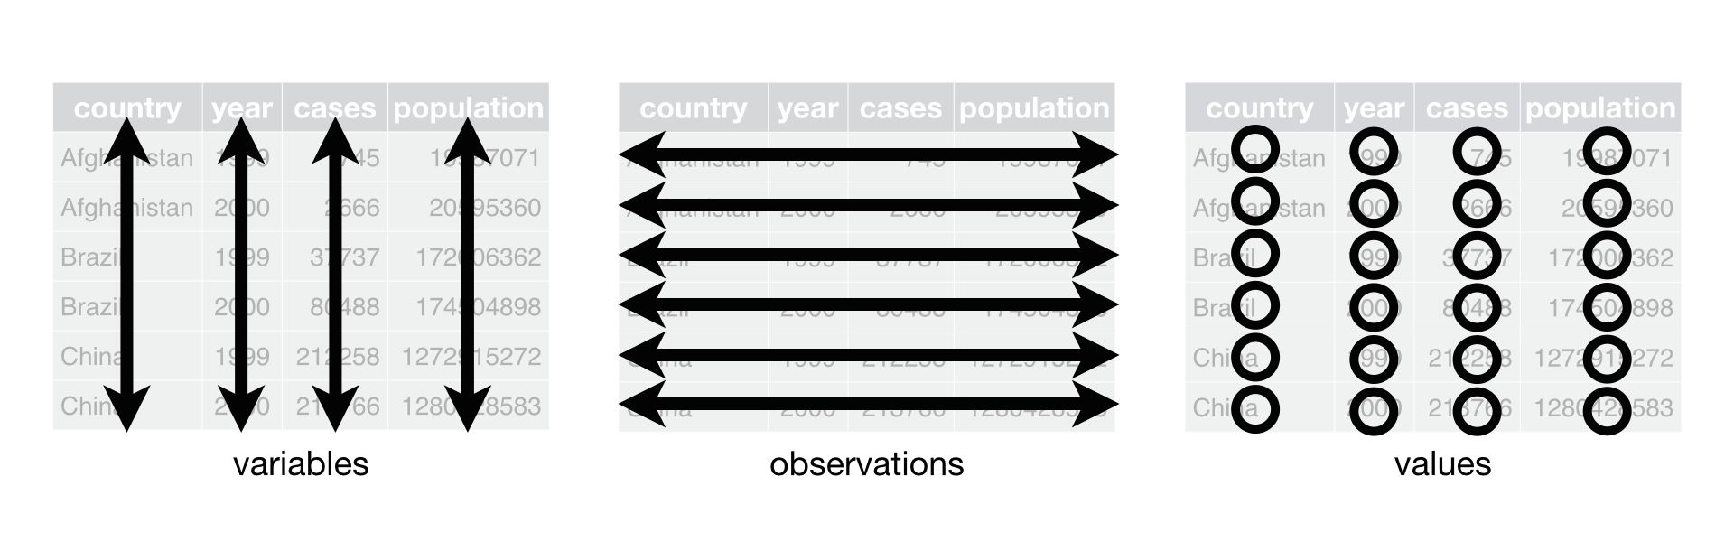
Tidy Data
Tidy data manifesto:
each variable forms a column
each observation forms a row
each type of observational unit forms a table
Notes:
Throughout the paper Tidy Data, Hadley Wickham often repeats some words which are important concepts to understand better the paper. I have made a sum up of those technical words for you to understand jargon of tidy data, the paper of Hadley Wickham and today’s class.
First, what’a dataset? Dataset has to meanings, a table or a collection of tables related to each other, so we are going to take the second aception, a dataset is a set of data, a set of tables with some columns that allow us to relate all the tables in a dataset.
What’s a table? A table is a collection of values, a lot of values sorted in rows and columns, and as we can read in the tidy data manifesto, each row is an observation and each column a variable. So what’s a variable contains all values that measures or indicate the same underlying attribute variable (like height, temperature, population…) and it takes the form of a column. And an observation contains all the values measures on the same unit (like a person in survey, a day in temporal data, a city ect.). So a value or also called data point, is the intersection of a variable and a observation is the height of a person, the temperature of a day or the population of a city.
So ok, now we know the first two principles of the tidy data manifesto, each variable forms a column and each observation forms a row. But the third one, is the most confusin one and the one poeple used to forget: there should be a table for each kind of variable to avoid storing duplicate values.
.

Slide 31
Tidy Data
Notes:
For example, imagine we have this data, the population of spain, france, portugal, and the population of some cities Seville, Madrid, Paris, Lyon, Lisbon and Porto. And a column for country population and another column for cities population. So is that data tidy?? Obviously not! To create a tidy dataset from this we have to create a table for contries, and a table for cities, something like that.

Slide 32
Tidy Data
cities population
countries population

Slide 33
Tidy Data
https://www.billboard.com/charts/hot-100 (2018/04/09)
Notes:
Who knows that. Billboard is a website in which we can find information about pop music, interviews, posts, news… things like that but we can also find this, the billboard dataset. This is a dataset of the most popular songs in the current week.
>> So they have create a dataset like that in which you have information about the artis, the song, the time, the runtime or duration, the genre, the date in which the song entered the top 100 list, the date in which the song reach it peak, and the value of the rank of the song per week, so the first week is the rank of the song when it entered the list, the second week is the rank of the song the next week and so on until the week 76. But if the song leaves the list before the week number 76, they fill values with blanks. So this table is done like that to have a row per song but it is quite inefficient to make data analysis. So I’m going to show you the process of tidying this dataset.

Slide 34
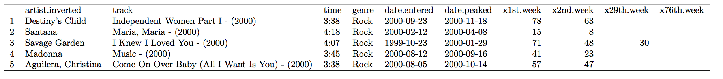
Tidy Data
Notes:
Who knows that. Billboard is a website in which we can find information about pop music, interviews, posts, news… things like that but we can also find this, the billboard dataset. This is a dataset of the most popular songs in the current week.
>> So they have create a dataset like that in which you have information about the artis, the song, the time, the runtime or duration, the genre, the date in which the song entered the top 100 list, the date in which the song reach it peak, and the value of the rank of the song per week, so the first week is the rank of the song when it entered the list, the second week is the rank of the song the next week and so on until the week 76. But if the song leaves the list before the week number 76, they fill values with blanks. So this table is done like that to have a row per song but it is quite inefficient to make data analysis. So I’m going to show you the process of tidying this dataset.

Slide 35
Tidy Data
DESCRIPTION
the name of the artist (artist.inverted)
the name of the song (and the released year) (track)
the date on which the song enters the Billboard Top 100 list (data.entered)
the date on which the song reach it best rank (date.peaked)
the duration of the song (in a character variable) (time)
the genre or the song (genre)
the date of a song first entered the Billboard Top 100 (date.entered)
the date in which this songs reach it best rank (date.peaked)
the rank of the song during the week in which the song enters the Billboard Top 100 list (x1st.week)
the rank of the song during the next week (x2nd.week)
and so on (x3rd.week) … until the 76th week (x76th.week)
In most cases, the song leaves the top 100 list before the week 76, in those cases the cell is filled with a blank (or NA in R)

Slide 36
Tidy Data
Notes:
ho knows that. Billboard is a website in which we can find information about pop music, interviews, posts, news… things like that but we can also find this, the billboard dataset. This is a dataset of the most popular songs in the current week.
>> So they have create a dataset like that in which you have information about the artis, the song, the time, the runtime or duration, the genre, the date in which the song entered the top 100 list, the date in which the song reach it peak, and the value of the rank of the song per week, so the first week is the rank of the song when it entered the list, the second week is the rank of the song the next week and so on until the week 76. But if the song leaves the list before the week number 76, they fill values with blanks. So this table is done like that to have a row per song but it is quite inefficient to make data analysis. So I’m going to show you the process of tidying this dataset.
What are the problems with this datasets: (1) columns header are values instead of column headers. The header of the column with the value of the rank of each song per week are actually a variable informing about the number of the week. (2) multiples variables stored in the same column, like for exammple in the column track we have the song name and the released year, but also the column time has the information of minutes and seconds of the song, but I prefer to create a numeric variable with the duration in minutes or in seconds but in the same magnitude. (3) the name of the columns are not properly formatted we have dots in the name. And obvously the data type, thinks like the column time are forbidden in any kind of data analysis process, but also the genre is a factor, or dates column must have date format.

Slide 37
Tidy Data
PROBLEMS
column header are values, not variable names
  the header of the columns with the value of the rank of each song per week, are actually values of a variable instead of column names.
multiple variables stored in one column
  the column track gives information about the name of the song and the released year.
names of the columns
  the names of the columns are not adequate nor well formatted
data types
  the column time must be numeric
  the columns date.entered and date.peaked must have a date format (not a character)
Notes:
ho knows that. Billboard is a website in which we can find information about pop music, interviews, posts, news… things like that but we can also find this, the billboard dataset. This is a dataset of the most popular songs in the current week.
>> So they have create a dataset like that in which you have information about the artis, the song, the time, the runtime or duration, the genre, the date in which the song entered the top 100 list, the date in which the song reach it peak, and the value of the rank of the song per week, so the first week is the rank of the song when it entered the list, the second week is the rank of the song the next week and so on until the week 76. But if the song leaves the list before the week number 76, they fill values with blanks. So this table is done like that to have a row per song but it is quite inefficient to make data analysis. So I’m going to show you the process of tidying this dataset.
What are the problems with this datasets: (1) columns header are values instead of column headers. The header of the column with the value of the rank of each song per week are actually a variable informing about the number of the week. (2) multiples variables stored in the same column, like for exammple in the column track we have the song name and the released year, but also the column time has the information of minutes and seconds of the song, but I prefer to create a numeric variable with the duration in minutes or in seconds but in the same magnitude. (3) the name of the columns are not properly formatted we have dots in the name. And obvously the data type, thinks like the column time are forbidden in any kind of data analysis process, but also the genre is a factor, or dates column must have date format.

Slide 38
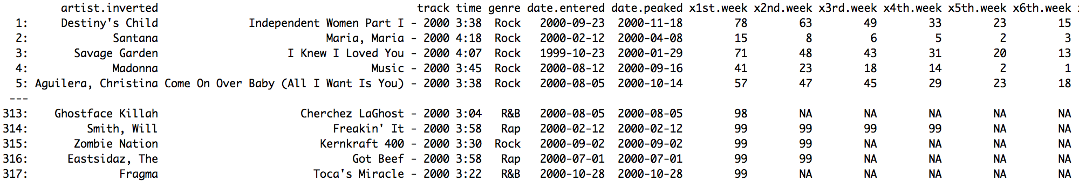
Tidy Data
##### READ DATA
# read the billboard dataset and take a look at it
dt <- fread('dtviz/data/billboard.csv')
dt
Notes:
So ok, the first thing is to read the data. I have stored this data with the name billboard.csv. And now the main task is to melt the data, melt means tranform columsn into rows, or make a long table from a wide table.

Slide 39
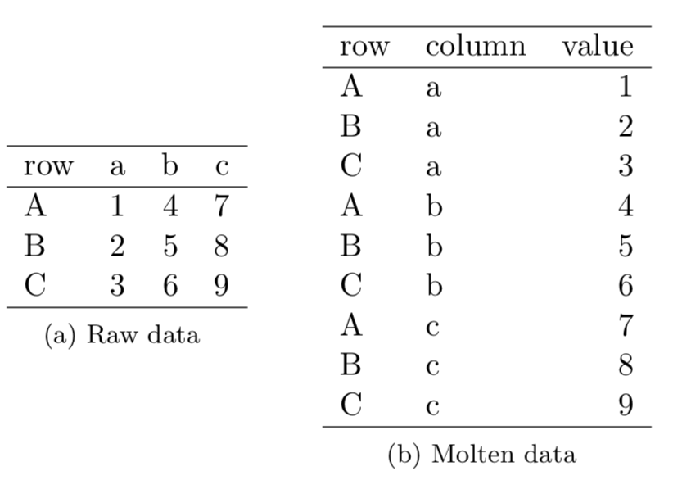
Tidy Data
##### READ DATA
# read the billboard dataset and take a look at it
dt <- fread('dtviz/data/billboard.csv')
dt
melt and cast
melt
Melt
Turn columns into rows
From wide to long
Cast
Turn rows into columns
From long to wide
cast
Notes:
So ok, the first thing is to read the data. I have stored this data with the name billboard.csv. And now the main task is to melt the data, melt means transform columns into rows, or make a long table from a wide table. Melting is the process of creating rows from columns and cast the opposite process, turn rows into columns.

Slide 40
Tidy Data
##### MELT THE DATASET
# take the names of the columns we want to melt
week_column_names <- names(dt)[grepl('.week$',names(dt))]
# store the rest of the column names because they are going to be id.vars
id_column_names <- setdiff(colnames(dt),week_column_names)
# melt the dataset using melt() function from data.table package
dt_melted <- melt(dt,id.vars = id_column_names,measure.vars = week_column_names) week_column_names)
Notes:
So ok, the first thing is to read the data. I have stored this data with the name billboard.csv. And now the main task is to melt the data, melt means transform columns into rows, or make a long table from a wide table. Melting is the process of creating rows from columns and cast the opposite process, turn rows into colum. So here you have the code and you can copy and paste this code. The first thing we have to create is a vector with the names of the column we want to melt. Those are the column with information about the rank of the weeks. So using a little bit of regular expression we can take those names easily. Using the funciton grepl (which is great for regular expression) and this regular expression that match all strings with ends in a dot a the word week, the dollar sign means that this is the end of the word. Now we have to create another vector with the column that are going to say the same which are called the key columns or the id columns, so using the function setdiff which thakes all elements in the first vector that are not in the second vector, so takes all column names which are not stores in the vector week_column_names. An now using the function melt from data.table we can melt quite easy our data. I have forget that there is a package called tidyr, from the tidyverse ecosystem which is specifically made to tidy data but I prefer to use data.table for 2 reasons, data.table is easier and data.table is faster and more robust.

Slide 41
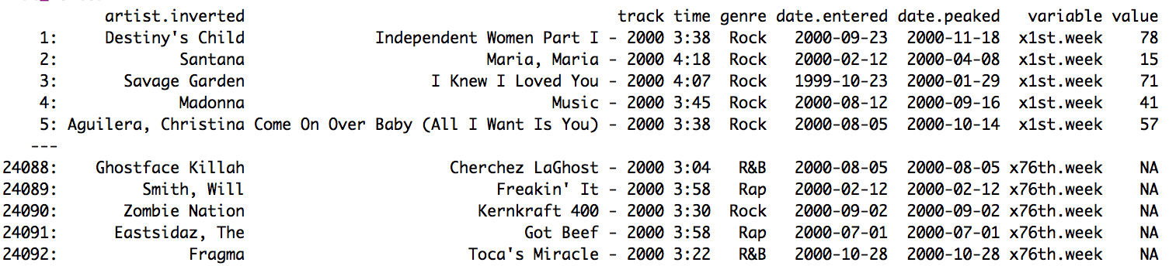
Tidy Data
##### MELT THE DATASET
# take the names of the columns we want to melt
week_column_names <- names(dt)[grepl('.week$',names(dt))]
# store the rest of the column names because they are going to be id.vars
id_column_names <- setdiff(colnames(dt),week_column_names)
# melt the dataset using melt() function from data.table package
dt_melted <- melt(dt,id.vars = id_column_names,measure.vars = week_column_names)
Notes:
So ok, the first thing is to read the data. I have stored this data with the name billboard.csv. And now the main task is to melt the data, melt means transform columns into rows, or make a long table from a wide table. Melting is the process of creating rows from columns and cast the opposite process, turn rows into colum. So here you have the code and you can copy and paste this code. The first thing we have to create is a vector with the names of the column we want to melt. Those are the column with information about the rank of the weeks. So using a little bit of regular expression we can take those names easily. Using the funciton grepl (which is great for regular expression) and this regular expression that match all strings with ends in a dot a the word week, the dollar sign means that this is the end of the word. Now we have to create another vector with the column that are going to say the same which are called the key columns or the id columns, so using the function setdiff which thakes all elements in the first vector that are not in the second vector, so takes all column names which are not stores in the vector week_column_names. An now using the function melt from data.table we can melt quite easy our data. I have forget that there is a package called tidyr, from the tidyverse ecosystem which is specifically made to tidy data but I prefer to use data.table for 2 reasons, data.table is easier and data.table is faster and more robust.

Slide 42
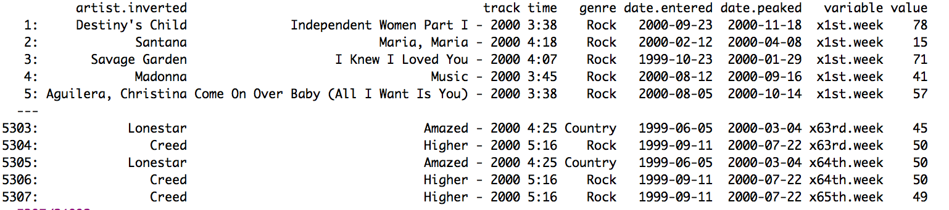
Tidy Data
##### FILTER NAs
# remove those rows with no value (because the song left the list before the week 76)
dt_melted <- dt_melted[!is.na(value)]
dt_melted
# we have removed the 78% of rows
Notes:
So ok, the first thing is to read the data. I have stored this data with the name billboard.csv. And now the main task is to melt the data, melt means transform columns into rows, or make a long table from a wide table. Melting is the process of creating rows from columns and cast the opposite process, turn rows into colum. So here you have the code and you can copy and paste this code. The first thing we have to create is a vector with the names of the column we want to melt. Those are the column with information about the rank of the weeks. So using a little bit of regular expression we can take those names easily. Using the funciton grepl (which is great for regular expression) and this regular expression that match all strings with ends in a dot a the word week, the dollar sign means that this is the end of the word. Now we have to create another vector with the column that are going to say the same which are called the key columns or the id columns, so using the function setdiff which thakes all elements in the first vector that are not in the second vector, so takes all column names which are not stores in the vector week_column_names. An now using the function melt from data.table we can melt quite easy our data. I have forget that there is a package called tidyr, from the tidyverse ecosystem which is specifically made to tidy data but I prefer to use data.table for 2 reasons, data.table is easier and data.table is faster and more robust.
>> Now we are goint to filter out all thos rows without information, all those rows, with a NA in the column value. And by doing that we have removed the 78% of our dataset, this is the perfect example of why tidy data is better for vectorized programming language, we have quite less amount of values to evaluate. We have a small dataset of 5 thousand and 3 hundred rows.

Slide 43
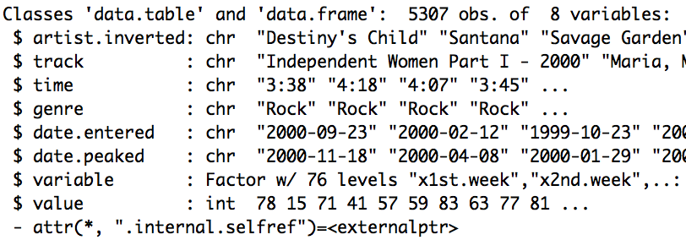
Tidy Data
##### QUICK EXPLORATION
# to know what we have to do next
str(dt_melted)
Notes:
>> Now we are going to quickly analysis what is inside this dataset and the data types. We have a lot of character variables, something so common we are using raw data. And the factor variable and integer variable are those one we have made from the process of melting data.

Slide 44
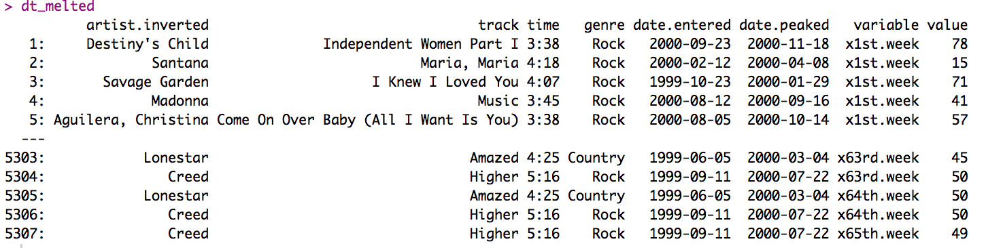
Tidy Data
##### TWO VARIABLE IN THE SAME COLUMN (column 'track')
# separate the track name from the year (using tidyr package)
dt_melted <- tidyr::separate(dt_melted,track,sep=' - ', into = c('track','year'))
# remove year variable (it is redundant)
dt_melted[,year := NULL]
dt_melted
Notes:
>> Now we are goint to filter out all thos rows without information, all those rows, with a NA in the column value. And by doing that we have removed the 78% of our dataset, this is the perfect example of why tidy data is better for vectorized programming language, we have quite less amount of values to evaluate. We have a small dataset of 5 thousand and 3 hundred rows.
>> Now we are going to separate the column track into track (the name of the song) and year (the released year). To do so we are using a funciton from tidyr package called separate which make quite easey the process of separate values from a columns.

Slide 45
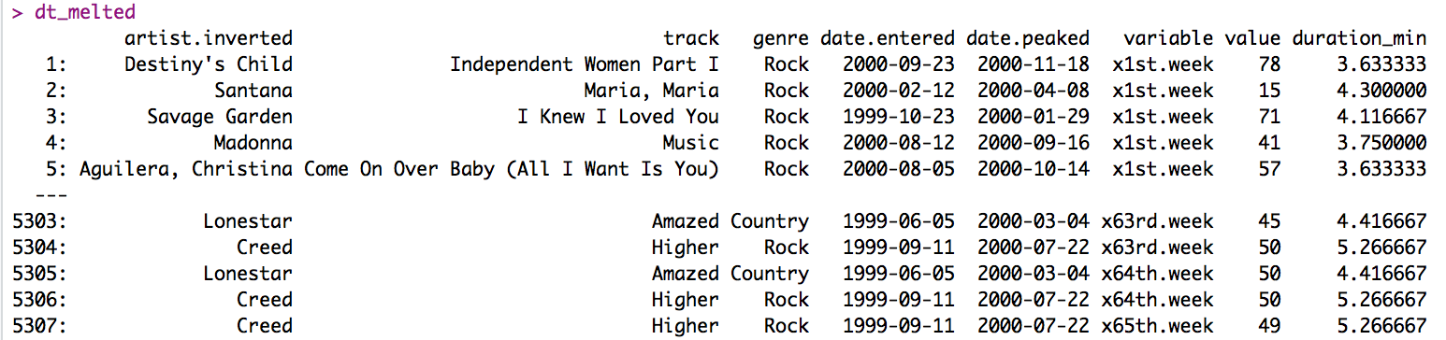
Tidy Data
##### TWO VARIABLE IN THE SAME COLUMN (column 'time')
# separate the track name from the year (using tidyr package)
dt_melted <- tidyr::separate(dt_melted,time,sep=':', into = c('minutes','seconds'))
# create variable duration (we need to know that a minute has 60 seconds)
dt_melted[,duration_min := as.numeric(minutes) + as.numeric(seconds)/60]
# remove redundants variable
dt_melted[,c('time','minutes','seconds') := NULL]
dt_melted
Notes:
>> Now we are going to filter out all those rows without information, all those rows, with a NA in the column value. And by doing that we have removed the 78% of our dataset, this is the perfect example of why tidy data is better for vectorized programming language, we have quite less amount of values to evaluate. We have a small dataset of 5 thousand and 3 hundred rows.
>> Now we are going to separate the column track into track (the name of the song) and year (the released year). To do so we are using a funciton from tidyr package called separate which make quite easey the process of separate values from a columns.
>> Now we are going to do the same thing with the time column. But we also have create a column called duration_min with the duration of the song in minutes. And again, we have remove the redundant columns.

Slide 46
Tidy Data
##### CLEAN VARIABLE WITH THE INFORMATION OF THE NUMBER OF THE WEEK
# using gsub function and regular expressions
dt_melted[,week := gsub('[^0-9]','',variable)]
dt_melted[,week := as.integer(week)]
# remove variable column
dt_melted[,variable := NULL]
dt_melted
Notes:
>> Now we are going to filter out all those rows without information, all those rows, with a NA in the column value. And by doing that we have removed the 78% of our dataset, this is the perfect example of why tidy data is better for vectorized programming language, we have quite less amount of values to evaluate. We have a small dataset of 5 thousand and 3 hundred rows.
>> Now we are going to separate the column track into track (the name of the song) and year (the released year). To do so we are using a function from tidyr package called separate which make quite easey the process of separate values from a columns.
>> Now we are going to do the same thing with the time column. But we also have create a column called duration_min with the duration of the song in minutes. And again, we have remove the redundant columns.
>> To make a variable of values from the columns we have create in the melting process we have to remove everything but the number of the week from the column value. To do so we are going to use another regular expression using the function gsub. We are saying, take everything but a number, and replace it by a empty string, and then coerce this in to an integer.

Slide 47
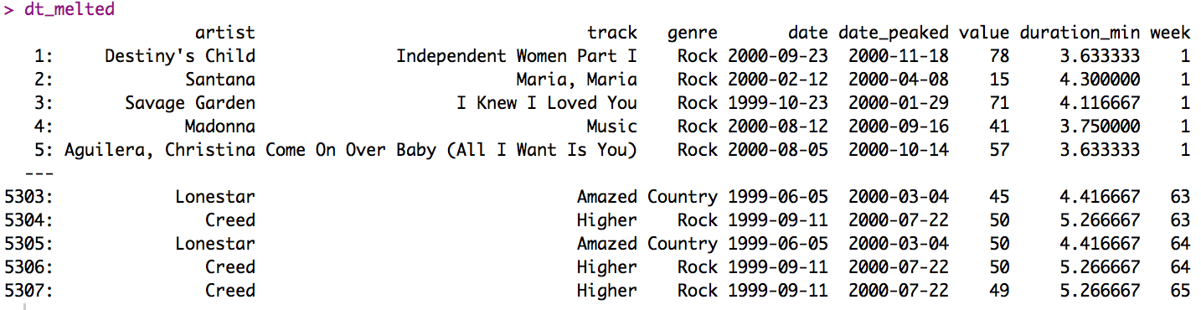
Tidy Data
##### CHANGE THE NAMES OF SOME COLUMNS
setnames(x = dt_melted,
old = c('artist.inverted','date.entered','date.peaked'),
new = c('artist','date','date_peaked'))
dt_melted
Notes:
>> Now we are going to filter out all those rows without information, all those rows, with a NA in the column value. And by doing that we have removed the 78% of our dataset, this is the perfect example of why tidy data is better for vectorized programming language, we have quite less amount of values to evaluate. We have a small dataset of 5 thousand and 3 hundred rows.
>> Now we are going to separate the column track into track (the name of the song) and year (the released year). To do so we are using a function from tidyr package called separate which make quite easey the process of separate values from a columns.
>> Now we are going to do the same thing with the time column. But we also have create a column called duration_min with the duration of the song in minutes. And again, we have remove the redundant columns.
>> To make a variable of values from the columns we have create in the melting process we have to remove everything but the number of the week from the column value. To do so we are going to use another regular expression using the function gsub. We are saying, take everything but a number, and replace it by a empty string, and then coerce this in to an integer.
>> Now we are going to change the names of the columns to use better formatted names.

Slide 48
Tidy Data
##### CHANGE THE DATA TYPES
factor_variables <- c('genre')
character_variables <- c('artist','track')
date_variables <- c('date','date_peaked')
integer_variable <- c('value','week')
numeric_variables <- c('duration_min')
Notes:
>> Now we are going to filter out all those rows without information, all those rows, with a NA in the column value. And by doing that we have removed the 78% of our dataset, this is the perfect example of why tidy data is better for vectorized programming language, we have quite less amount of values to evaluate. We have a small dataset of 5 thousand and 3 hundred rows.
>> Now we are going to separate the column track into track (the name of the song) and year (the released year). To do so we are using a function from tidyr package called separate which make quite easey the process of separate values from a columns.
>> Now we are going to do the same thing with the time column. But we also have create a column called duration_min with the duration of the song in minutes. And again, we have remove the redundant columns.
>> To make a variable of values from the columns we have create in the melting process we have to remove everything but the number of the week from the column value. To do so we are going to use another regular expression using the function gsub. We are saying, take everything but a number, and replace it by a empty string, and then coerce this in to an integer.
>> Now we are going to change the names of the columns to use better formatted names.
>> Now we are going to change the datatypes, to do soy I will teach you a trick of data.table. First, make a vector with the name of factor_variables, character_varaibles, date_variable, integer_variables and numeric_variables. And then, by using data.table and the package purrr (who know the packge purrr?, this is a greate package for functional programming).

Slide 49
Tidy Data
# using a trick of data.table
dt_melted[,c(factor_variables) := map(.SD,as.factor),.SDcols = c(factor_variables)]
dt_melted[,c(character_variables) := map(.SD,as.character),.SDcols = c(character_variables)]
dt_melted[,c(date_variables) := map(.SD,as.Date),.SDcols = c(date_variables)]
dt_melted[,c(integer_variable) := map(.SD,as.integer),.SDcols = c(integer_variable)]
dt_melted[,c(numeric_variables) := map(.SD,as.numeric),.SDcols = c(numeric_variables)]
str(dt_melted)
Notes:
>> Now we are going to filter out all those rows without information, all those rows, with a NA in the column value. And by doing that we have removed the 78% of our dataset, this is the perfect example of why tidy data is better for vectorized programming language, we have quite less amount of values to evaluate. We have a small dataset of 5 thousand and 3 hundred rows.
>> Now we are going to separate the column track into track (the name of the song) and year (the released year). To do so we are using a function from tidyr package called separate which make quite easey the process of separate values from a columns.
>> Now we are going to do the same thing with the time column. But we also have create a column called duration_min with the duration of the song in minutes. And again, we have remove the redundant columns.
>> To make a variable of values from the columns we have create in the melting process we have to remove everything but the number of the week from the column value. To do so we are going to use another regular expression using the function gsub. We are saying, take everything but a number, and replace it by a empty string, and then coerce this in to an integer.
>> Now we are going to change the names of the columns to use better formatted names.
>> Now we are going to change the datatypes, to do soy I will teach you a trick of data.table. First, make a vector with the name of factor_variables, character_varaibles, date_variable, integer_variables and numeric_variables. And then, by using data.table and the package purrr (who know the packge purrr?, this is a greate package for functional programming). So we are going to make that thinks, this is apply as.factor function to each variable in factor_variable and replace the result for each column in factor_variable. This is quite fast and useful, so I recommend to use this code to change the datatype of your datasets.

Slide 50
Tidy Data
##### DATE VARIABLE IS A STATIC VARIABLE
head(dt_melted[artist == 'Santana' & track == 'Maria, Maria'],10)
Notes:
>> Now we are going to filter out all those rows without information, all those rows, with a NA in the column value. And by doing that we have removed the 78% of our dataset, this is the perfect example of why tidy data is better for vectorized programming language, we have quite less amount of values to evaluate. We have a small dataset of 5 thousand and 3 hundred rows.
>> Now we are going to separate the column track into track (the name of the song) and year (the released year). To do so we are using a function from tidyr package called separate which make quite easey the process of separate values from a columns.
>> Now we are going to do the same thing with the time column. But we also have create a column called duration_min with the duration of the song in minutes. And again, we have remove the redundant columns.
>> To make a variable of values from the columns we have create in the melting process we have to remove everything but the number of the week from the column value. To do so we are going to use another regular expression using the function gsub. We are saying, take everything but a number, and replace it by a empty string, and then coerce this in to an integer.
>> Now we are going to change the names of the columns to use better formatted names.
>> Now we are going to change the datatypes, to do soy I will teach you a trick of data.table. First, make a vector with the name of factor_variables, character_varaibles, date_variable, integer_variables and numeric_variables. And then, by using data.table and the package purrr (who know the packge purrr?, this is a greate package for functional programming). So we are going to make that thinks, this is apply as.factor function to each variable in factor_variable and replace the result for each column in factor_variable. This is quite fast and useful, so I recommend to use this code to change the datatype of your datasets.
>> But look at here, don’t you see something strange?? The variable data is a fixed variable. How can we make this a dynamic variable?? We have the week so we can add seven days per week. For example in the first columns how many days we have to add to this date?? 0, and in the next one?? Seven ok?

Slide 51
Tidy Data
##### MAKE DATE A DYNAMIC VARIABLE
# number of days to add
dt_melted[,n_days_to_add := (week -1)*7]
# coerce into date
dt_melted[,date:=date + lubridate::days(n_days_to_add)]
# remove auxiliary variable
dt_melted[,n_days_to_add := NULL]
Notes:
>> Now we are going to change the names of the columns to use better formatted names.
>> Now we are going to change the datatypes, to do soy I will teach you a trick of data.table. First, make a vector with the name of factor_variables, character_varaibles, date_variable, integer_variables and numeric_variables. And then, by using data.table and the package purrr (who know the packge purrr?, this is a greate package for functional programming). So we are going to make that thinks, this is apply as.factor function to each variable in factor_variable and replace the result for each column in factor_variable. This is quite fast and useful, so I recommend to use this code to change the datatype of your datasets.
>> But look at here, don’t you see something strange?? The variable data is a fixed variable. How can we make this a dynamic variable?? We have the week so we can add seven days per week. For example in the first columns how many days we have to add to this date?? 0, and in the next one?? Seven ok?
>> Ok so we are going to create a variable with the number of days to add which is week - 1, times 7. And add those days using lubridate package and the function days. Finally we are going to remove the variable n_days_to_add because we don't need it.

Slide 52
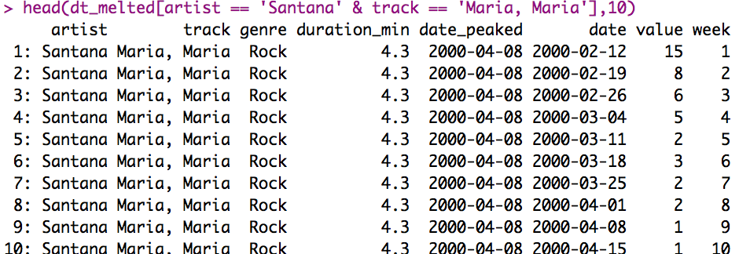
Tidy Data
##### STATIC AND DYNAMIC VARIABLE
static_variables <- c('artist','track','genre','duration_min','date_peaked')
dynamic_variable <- c('date','value','week')
setcolorder(dt_melted,c(static_variables,dynamic_variable))
head(dt_melted[artist == 'Santana' & track == 'Maria, Maria'],10)
Notes:
>> Now we are going to change the names of the columns to use better formatted names.
>> Now we are going to change the datatypes, to do soy I will teach you a trick of data.table. First, make a vector with the name of factor_variables, character_varaibles, date_variable, integer_variables and numeric_variables. And then, by using data.table and the package purrr (who know the packge purrr?, this is a greate package for functional programming). So we are going to make that thinks, this is apply as.factor function to each variable in factor_variable and replace the result for each column in factor_variable. This is quite fast and useful, so I recommend to use this code to change the datatype of your datasets.
>> But look at here, don’t you see something strange?? The variable data is a fixed variable. How can we make this a dynamic variable?? We have the week so we can add seven days per week. For example in the first columns how many days we have to add to this date?? 0, and in the next one?? Seven ok?
>> Ok so we are going to create a variable with the number of days to add which is week - 1, times 7. And add those days using lubridate package and the function days. Finally we are going to remove the variable n_days_to_add because we don't need it.
>> Let’s change the order of the column to highlight the difference of the statics column and the dynamic columns. We are going to do so using the function setcolorder which is a set function , a function made for data.tables.

Slide 53
Tidy Data
##### STATIC AND DYNAMIC VARIABLE
static_variables <- c('artist','track','genre','duration_min','date_peaked')
dynamic_variable <- c('date','value','week')
setcolorder(dt_melted,c(static_variables,dynamic_variable))
head(dt_melted[artist == 'Santana' & track == 'Maria, Maria'],10)
Notes:
>> Now we are going to change the names of the columns to use better formatted names.
>> Now we are going to change the datatypes, to do soy I will teach you a trick of data.table. First, make a vector with the name of factor_variables, character_varaibles, date_variable, integer_variables and numeric_variables. And then, by using data.table and the package purrr (who know the packge purrr?, this is a greate package for functional programming). So we are going to make that thinks, this is apply as.factor function to each variable in factor_variable and replace the result for each column in factor_variable. This is quite fast and useful, so I recommend to use this code to change the datatype of your datasets.
>> But look at here, don’t you see something strange?? The variable data is a fixed variable. How can we make this a dynamic variable?? We have the week so we can add seven days per week. For example in the first columns how many days we have to add to this date?? 0, and in the next one?? Seven ok?
>> Ok so we are going to create a variable with the number of days to add which is week - 1, times 7. And add those days using lubridate package and the function days. Finally we are going to remove the variable n_days_to_add because we don't need it.
>> Let’s change the order of the column to highlight the difference of the statics column and the dynamic columns. We are going to do so using the function setcolorder which is a set function , a function made for data.tables.
>> Now, it’s quite easy to see that we have to tables, a static table with the name of the song and the features related with the song, and another table with the features related of the songs that change over time.

Slide 54
Tidy Data
##### TWO OBSERVATIONAL UNITS IN THE SAME TABLE
head(dt_melted[artist == 'Santana' & track == 'Maria, Maria'],10)
Notes:
>> Now we are going to change the names of the columns to use better formatted names.
>> Now we are going to change the datatypes, to do soy I will teach you a trick of data.table. First, make a vector with the name of factor_variables, character_varaibles, date_variable, integer_variables and numeric_variables. And then, by using data.table and the package purrr (who know the packge purrr?, this is a greate package for functional programming). So we are going to make that thinks, this is apply as.factor function to each variable in factor_variable and replace the result for each column in factor_variable. This is quite fast and useful, so I recommend to use this code to change the datatype of your datasets.
>> But look at here, don’t you see something strange?? The variable data is a fixed variable. How can we make this a dynamic variable?? We have the week so we can add seven days per week. For example in the first columns how many days we have to add to this date?? 0, and in the next one?? Seven ok?
>> Ok so we are going to create a variable with the number of days to add which is week - 1, times 7. And add those days using lubridate package and the function days. Finally we are going to remove the variable n_days_to_add because we don't need it.
>> Let’s change the order of the column to highlight the difference of the statics column and the dynamic columns. We are going to do so using the function setcolorder which is a set function , a function made for data.tables.
>> Now, it’s quite easy to see that we have to tables, a static table with the name of the song and the features related with the song, and another table with the features related of the songs that change over time.

Slide 55
Tidy Data
##### CREATE A DATASET
# first we need an id per track (data.table GRP function)
dt_melted[,track_id := .GRP,by =c('track','artist')]
# create two separate tables
track <- dt_melted[,c('track_id',static_variables),with=F]
rank <- dt_melted[,c('track_id',dynamic_variable),with=F]
Notes:
>> Now we are going to change the names of the columns to use better formatted names.
>> Now we are going to change the datatypes, to do soy I will teach you a trick of data.table. First, make a vector with the name of factor_variables, character_varaibles, date_variable, integer_variables and numeric_variables. And then, by using data.table and the package purrr (who know the packge purrr?, this is a greate package for functional programming). So we are going to make that thinks, this is apply as.factor function to each variable in factor_variable and replace the result for each column in factor_variable. This is quite fast and useful, so I recommend to use this code to change the datatype of your datasets.
>> But look at here, don’t you see something strange?? The variable data is a fixed variable. How can we make this a dynamic variable?? We have the week so we can add seven days per week. For example in the first columns how many days we have to add to this date?? 0, and in the next one?? Seven ok?
>> Ok so we are going to create a variable with the number of days to add which is week - 1, times 7. And add those days using lubridate package and the function days. Finally we are going to remove the variable n_days_to_add because we don't need it.
>> Let’s change the order of the column to highlight the difference of the statics column and the dynamic columns. We are going to do so using the function setcolorder which is a set function , a function made for data.tables.
>> Now, it’s quite easy to see that we have to tables, a static table with the name of the song and the features related with the song, and another table with the features related of the songs that change over time.
>> So we might create a table called, for instance, track with the information of songs, and a table called ranks with information of time-varying ranks. But to do so we first need to create an id per trank.And let’s take a look how quickly and easy it can be done using the function .GRP (group) from data.table.

Slide 56
Tidy Data
##### CREATE A DATASET
# remove duplicates
track <- unique(track)
rank <- unique(rank)
# look at inside
head(track)
head(rank)
Notes:
>> Now we are going to change the names of the columns to use better formatted names.
>> Now we are going to change the datatypes, to do soy I will teach you a trick of data.table. First, make a vector with the name of factor_variables, character_varaibles, date_variable, integer_variables and numeric_variables. And then, by using data.table and the package purrr (who know the packge purrr?, this is a greate package for functional programming). So we are going to make that thinks, this is apply as.factor function to each variable in factor_variable and replace the result for each column in factor_variable. This is quite fast and useful, so I recommend to use this code to change the datatype of your datasets.
>> But look at here, don’t you see something strange?? The variable data is a fixed variable. How can we make this a dynamic variable?? We have the week so we can add seven days per week. For example in the first columns how many days we have to add to this date?? 0, and in the next one?? Seven ok?
>> Ok so we are going to create a variable with the number of days to add which is week - 1, times 7. And add those days using lubridate package and the function days. Finally we are going to remove the variable n_days_to_add because we don't need it.
>> Let’s change the order of the column to highlight the difference of the statics column and the dynamic columns. We are going to do so using the function setcolorder which is a set function , a function made for data.tables.
>> Now, it’s quite easy to see that we have to tables, a static table with the name of the song and the features related with the song, and another table with the features related of the songs that change over time.
>> So we might create a table called, for instance, track with the information of songs, and a table called ranks with information of time-varying ranks. But to do so we first need to create an id per trank.And let’s take a look how quickly and easy it can be done using the function .GRP (group) from data.table.
>> then remove duplicates values with the function unique.

Slide 57
Tidy Data
##### STORE_TABLE IN LIST
billboard <- list()
billboard[['track']] <- track
billboard[['rank']] <- rank
##### WHAT IS INSIDE THE LIST
billboard$track
billboard$rank
Notes:
>> Now we are going to change the names of the columns to use better formatted names.
>> Now we are going to change the datatypes, to do soy I will teach you a trick of data.table. First, make a vector with the name of factor_variables, character_varaibles, date_variable, integer_variables and numeric_variables. And then, by using data.table and the package purrr (who know the packge purrr?, this is a greate package for functional programming). So we are going to make that thinks, this is apply as.factor function to each variable in factor_variable and replace the result for each column in factor_variable. This is quite fast and useful, so I recommend to use this code to change the datatype of your datasets.
>> But look at here, don’t you see something strange?? The variable data is a fixed variable. How can we make this a dynamic variable?? We have the week so we can add seven days per week. For example in the first columns how many days we have to add to this date?? 0, and in the next one?? Seven ok?
>> Ok so we are going to create a variable with the number of days to add which is week - 1, times 7. And add those days using lubridate package and the function days. Finally we are going to remove the variable n_days_to_add because we don't need it.
>> Let’s change the order of the column to highlight the difference of the statics column and the dynamic columns. We are going to do so using the function setcolorder which is a set function , a function made for data.tables.
>> Now, it’s quite easy to see that we have to tables, a static table with the name of the song and the features related with the song, and another table with the features related of the songs that change over time.
>> So we might create a table called, for instance, track with the information of songs, and a table called ranks with information of time-varying ranks. But to do so we first need to create an id per trank.And let’s take a look how quickly and easy it can be done using the function .GRP (group) from data.table.
>> then remove duplicates values with the function unique.
>> and finally please, store a dataset in list. So your code is going to be clearer and easy to read and understand. So we have a table with information of 3 hundred and 17 tracks and another one with more than 5 thousand rows with information of the ranks. This is tidy data, and that is one of the most important thing you are going to learn in this course. Believe me.

Slide 58
Tidy Data
##### STORE_TABLE IN LIST
billboard <- list()
billboard[['track']] <- track
billboard[['rank']] <- rank
##### WHAT IS INSIDE THE LIST
billboard$track
billboard$rank
Notes:
>> Now we are going to change the names of the columns to use better formatted names.
>> Now we are going to change the datatypes, to do soy I will teach you a trick of data.table. First, make a vector with the name of factor_variables, character_varaibles, date_variable, integer_variables and numeric_variables. And then, by using data.table and the package purrr (who know the packge purrr?, this is a greate package for functional programming). So we are going to make that thinks, this is apply as.factor function to each variable in factor_variable and replace the result for each column in factor_variable. This is quite fast and useful, so I recommend to use this code to change the datatype of your datasets.
>> But look at here, don’t you see something strange?? The variable data is a fixed variable. How can we make this a dynamic variable?? We have the week so we can add seven days per week. For example in the first columns how many days we have to add to this date?? 0, and in the next one?? Seven ok?
>> Ok so we are going to create a variable with the number of days to add which is week - 1, times 7. And add those days using lubridate package and the function days. Finally we are going to remove the variable n_days_to_add because we don't need it.
>> Let’s change the order of the column to highlight the difference of the statics column and the dynamic columns. We are going to do so using the function setcolorder which is a set function , a function made for data.tables.
>> Now, it’s quite easy to see that we have to tables, a static table with the name of the song and the features related with the song, and another table with the features related of the songs that change over time.
>> So we might create a table called, for instance, track with the information of songs, and a table called ranks with information of time-varying ranks. But to do so we first need to create an id per trank.And let’s take a look how quickly and easy it can be done using the function .GRP (group) from data.table.
>> then remove duplicates values with the function unique.
>> and finally please, store a dataset in list. So your code is going to be clearer and easy to read and understand. So we have a table with information of 3 hundred and 17 tracks and another one with more than 5 thousand rows with information of the ranks. This is tidy data, and that is one of the most important thing you are going to learn in this course. Believe me.

Slide 59
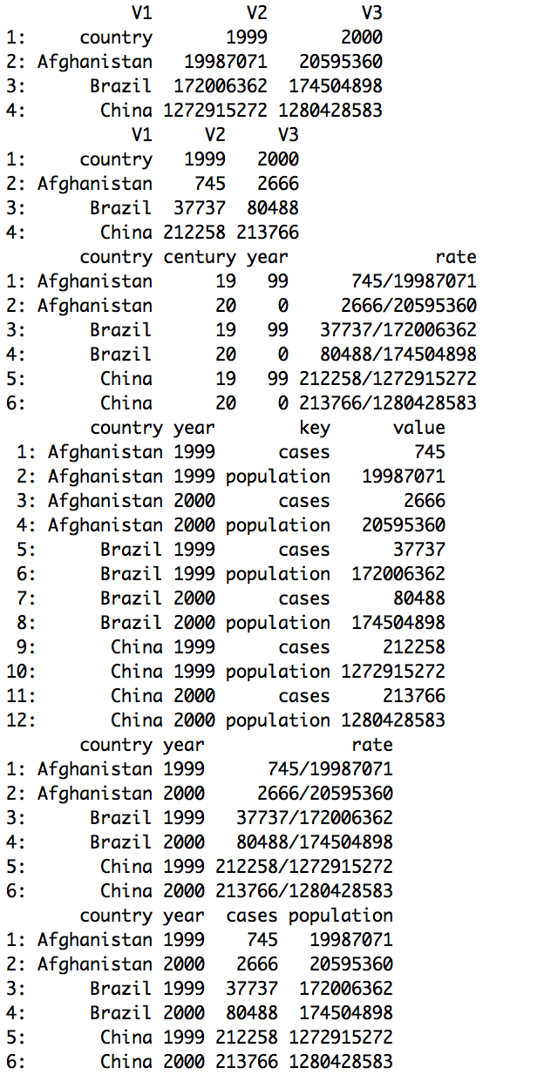
Exercise
Number of tuberculosis cases in Afghanistan, Brazil and China during 1999 and 2000
2
4
1
3
5
Notes:
Exercise 1
Here we have the data of tuberculosis cases in Afghanistan, Brazil and China during 1999 and 2000. All of those datasets has the same data but organised in five different ways. There is just on of them which is tidy data, just one of them has an observation per row, a variable per column and one observational unit per table, who know what is the tidy data?? The tidy data is the second one. What is the problem of the number one??

Slide 60
Exercise
Number of tuberculosis cases in Afghanistan, Brazil and China during 1999 and 2000
Tidy data
4
1
3
5
Notes:
Exercise 1
Here we have the data of tuberculosis cases in Afghanistan, Brazil and China during 1999 and 2000. All of those datasets has the same data but organised in five different ways. There is just on of them which is tidy data, just one of them has an observation per row, a variable per column and one observational unit per table, who know what is the tidy data?? The tidy data is the second one. What is the problem of the number one??

Slide 61
Exercise
Number of tuberculosis cases in Afghanistan, Brazil and China during 1999 and 2000
Tidy data
4
Columns instead of rows
3
5
Notes:
Exercise 1
Here we have the data of tuberculosis cases in Afghanistan, Brazil and China during 1999 and 2000. All of those datasets has the same data but organised in five different ways. There is just on of them which is tidy data, just one of them has an observation per row, a variable per column and one observational unit per table, who know what is the tidy data?? The tidy data is the second one. What is the problem of the number one??

Slide 62
Exercise
Number of tuberculosis cases in Afghanistan, Brazil and China during 1999 and 2000
Tidy data
4
Columns instead of rows
Rows instead of columns
5
Notes:
Exercise 1
Here we have the data of tuberculosis cases in Afghanistan, Brazil and China during 1999 and 2000. All of those datasets has the same data but organised in five different ways. There is just on of them which is tidy data, just one of them has an observation per row, a variable per column and one observational unit per table, who know what is the tidy data?? The tidy data is the second one. What is the problem of the number one?? We have columns instead of rows, in fact, when we read the data using fread function, it assumes that there is no header and that’s why the header has been written like a row and it has create some default column names. What is the problem with the third one?, This is the opposite problem, we have rows instead of columns, the columns key and value must be separate in two columns, cases and population. What is the problem with the fourth one?? This one is easy, we have to variables in the same column. And the fifth one?? Great we have two variables in the same column but we also have two columns with one value, century and year.. What the fuck is that??one??

Slide 63
Exercise
Number of tuberculosis cases in Afghanistan, Brazil and China during 1999 and 2000
Tidy data
Two variables in the same column
Columns instead of rows
Rows instead of columns
5
Notes:
Exercise 1
Here we have the data of tuberculosis cases in Afghanistan, Brazil and China during 1999 and 2000. All of those datasets has the same data but organised in five different ways. There is just on of them which is tidy data, just one of them has an observation per row, a variable per column and one observational unit per table, who know what is the tidy data?? The tidy data is the second one. What is the problem of the number one?? We have columns instead of rows, in fact, when we read the data using fread function, it assumes that there is no header and that’s why the header has been written like a row and it has create some default column names. What is the problem with the third one?, This is the opposite problem, we have rows instead of columns, the columns key and value must be separate in two columns, cases and population. What is the problem with the fourth one?? This one is easy, we have to variables in the same column. And the fifth one?? Great we have two variables in the same column but we also have two columns with one value, century and year.. What the fuck is that??

Slide 64
Exercise
Number of tuberculosis cases in Afghanistan, Brazil and China during 1999 and 2000
Tidy data
Two variables in the same column
Columns instead of rows
Rows instead of columns
Two variables in the same column & One variable in two columns
Notes:
Exercise 1
Here we have the data of tuberculosis cases in Afghanistan, Brazil and China during 1999 and 2000. All of those datasets has the same data but organised in five different ways. There is just on of them which is tidy data, just one of them has an observation per row, a variable per column and one observational unit per table, who know what is the tidy data?? The tidy data is the second one. What is the problem of the number one?? We have columns instead of rows, in fact, when we read the data using fread function, it assumes that there is no header and that’s why the header has been written like a row and it has create some default column names. What is the problem with the third one?, This is the opposite problem, we have rows instead of columns, the columns key and value must be separate in two columns, cases and population. What is the problem with the fourth one?? This one is easy, we have to variables in the same column. And the fifth one?? Great we have two variables in the same column but we also have two columns with one value, century and year.. What the fuck is that??

Slide 65
Exercise
Number of tuberculosis cases in Afghanistan, Brazil and China during 1999 and 2000
tuberculosis_tidy.csv
tuberculosis_mult_values.csv
tuberculosis_col_values_population.csv
tuberculosis_col_values_cases.csv
tuberculosis_mult_rows.csv
tuberculosis_mult_columns.csv
Notes:
Exercise 1
Here we have the data of tuberculosis cases in Afghanistan, Brazil and China during 1999 and 2000. All of those datasets has the same data but organised in five different ways. There is just on of them which is tidy data, just one of them has an observation per row, a variable per column and one observational unit per table, who know what is the tidy data?? The tidy data is the second one. What is the problem of the number one?? We have columns instead of rows, in fact, when we read the data using fread function, it assumes that there is no header and that’s why the header has been written like a row and it has create some default column names. What is the problem with the third one?, This is the opposite problem, we have rows instead of columns, the columns key and value must be separate in two columns, cases and population. What is the problem with the fourth one?? This one is easy, we have to variables in the same column. And the fifth one?? Great we have two variables in the same column but we also have two columns with one value, century and year.. What the fuck is that?? Ok, so those are the names of the csv files in which we have the datasets in the data folder. Ok so know we are going to learn how to clean each piece of messy data.

Slide 66
Exercise Column instead of rows
# COLUMNS INSTEAD OF ROWS -----------------------------------------------
dt_pop <- tub$col_values_population
dt_cas <- tub$col_values_cases
# change the column names. The column names are stored in the firs row.
colnames(dt_pop) <- as.character(dt_pop[1,])
dt_pop <- dt_pop[-1]
colnames(dt_cas) <- as.character(dt_cas[1,])
dt_cas <- dt_cas[-1]

Slide 67
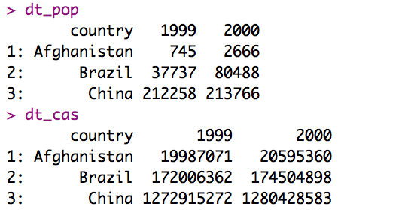
Exercise Column instead of rows
# COLUMNS INSTEAD OF ROWS -----------------------------------------------
dt_pop <- tub$col_values_population
dt_cas <- tub$col_values_cases
# change the column names. The column names are stored in the firs row.
colnames(dt_pop) <- as.character(dt_pop[1,])
dt_pop <- dt_pop[-1]
colnames(dt_cas) <- as.character(dt_cas[1,])
dt_cas <- dt_cas[-1]

Slide 68
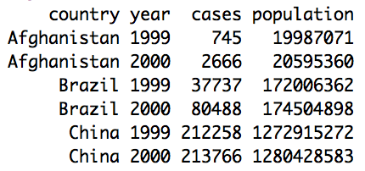
Exercise Column instead of rows
##### tidyverse way
dt_pop %>%
gather(year,value,'1999':'2000') %>%
rename(population = value) -> dt_pop_melted
dt_cas %>%
gather(year,value,'1999':'2000') %>%
rename(cases = value) -> dt_cas_melted
dt_tidy <- dt_pop_melted %>% inner_join(dt_cas_melted,by=c('country','year'))
dt_tidy <- dt_tidy %>% mutate(year = as.integer(year)) %>% arrange(country,year)

Slide 69
Exercise Column instead of rows
##### data.table way
dt_pop_melted <- melt(dt_pop,id.vars = 'country',variable.name = 'year',value.name = 'population')
dt_cas_melted <- melt(dt_cas,id.vars = 'country',variable.name = 'year',value.name = 'cases')
dt_tidy <- merge(dt_pop_melted,dt_cas_melted)

Slide 70
Exercise Column instead of rows
##### data.table way
dt_pop_melted <- melt(dt_pop,id.vars = 'country',variable.name = 'year',value.name = 'population')
dt_cas_melted <- melt(dt_cas,id.vars = 'country',variable.name = 'year',value.name = 'cases')
dt_tidy <- merge(dt_pop_melted,dt_cas_melted)

Slide 71
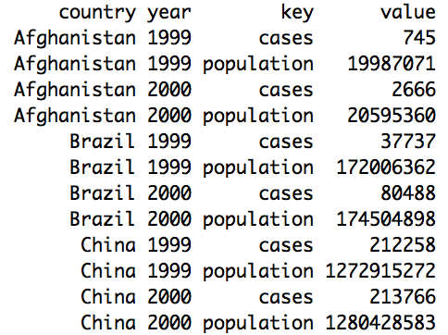
Exercise Rows instead of columns
# ROWS INSTEAD OF COLUMNS -----------------------------------------------
dt <- tub$mult_rows
dt

Slide 72
Exercise Two variables in the same column
##### tidyverse way
dt_tidy <- separate(dt,col='rate',into = c('cases','population'),sep = '/',convert = T)
##### data.table way
dt_tidy <- copy(dt)
dt_tidy[,c('cases','population') := tstrsplit(rate,'/',type.convert = T,fixed=T)]
dt_tidy[,rate:=NULL]

Slide 73
Exercise Rows instead of columns
# ROWS INSTEAD OF COLUMNS -----------------------------------------------
dt <- tub$mult_rows
dt

Slide 74
Exercise Rows instead of columns
##### tidyverse way
dt_tidy <- spread(dt,key,value)
##### data.table way
dt_tidy <- dcast(dt,country+year~key)

Slide 75
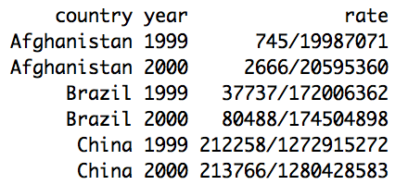
Exercise Two variables in the same column
# MULTIPLES VALUES -----------------------------------------------
dt <- copy(tub$mult_values)
dt

Slide 76
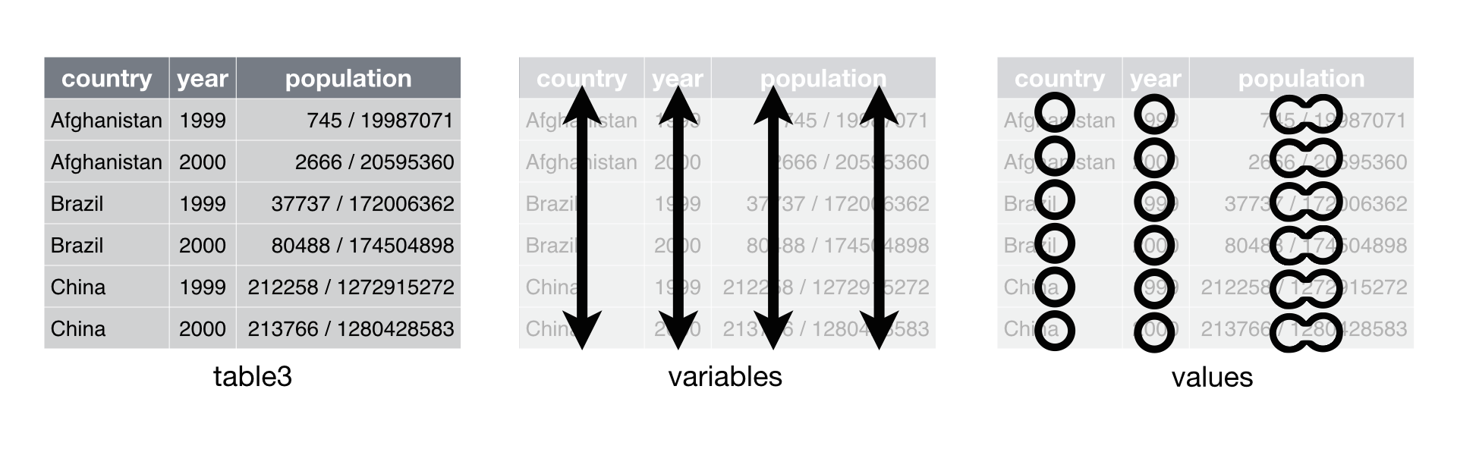
Exercise Two variables in the same column
# MULTIPLES VALUES -----------------------------------------------
dt <- copy(tub$mult_values)
dt

Slide 77
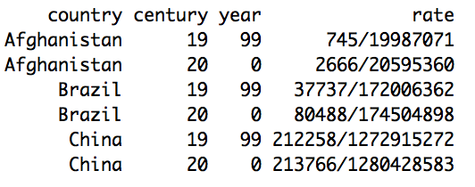
Exercise One variable in two columns
# MULTIPLES COLUMNS -----------------------------------------------
dt <- copy(tub$mult_columns)

Slide 78
Exercise One variable in two columns
##### tidyverse way
dt %>% mutate(year = str_pad(year,width = 2,side='left',pad='0')) %>%
unite('year',c('century','year'),sep='') %>%
mutate(year=as.integer(year)) %>%
separate('rate',c('cases','population'),convert = T) -> dt_tidy
##### data.table way
dt_tidy <- copy(dt)
dt_tidy[,year := paste0(century,str_pad(year,width = 2,side = 'left',pad = '0'))]
dt_tidy[,c('cases','population') := tstrsplit(rate,'/',type.convert = T,fixed=T)]

