Slide 1
Chapter 1:
Sampling and Descriptive Statistics

Slide 2
Why Statistics?
Uncertainty in repeated scientific measurements
Drawing conclusions from data
Designing valid experiments and draw reliable conclusions

Slide 3
Section 1.1: Sampling
Definitions:
A population is the entire collection of objects or outcomes about which information is sought.
A sample is a subset of a population, containing the objects or outcomes that are actually observed.
A simple random sample (SRS) of size n is a sample chosen by a method in which each collection of n population items is equally likely to comprise the sample, just as in the lottery.

Slide 4
Simple Random Sampling
A SRS is not guaranteed to reflect the population perfectly.
SRS’s always differ in some ways from each other, occasionally a sample is substantially different from the population.
Two different samples from the same population will vary from each other as well.
This phenomenon is known as sampling variation.

Slide 5
More on SRS
Definition: A conceptual population consists of all the values that might possibly have been observed.
For example, a geologist weighs a rock several times on a sensitive scale. Each time, the scale gives a slightly different reading.
Here the population is conceptual. It consists of all the readings that the scale could in principle produce.

Slide 6
SRS (cont.)
The items in a sample are independent if knowing the values of some of the items does not help to predict the values of the others.
Items in a simple random sample may be treated as independent in most cases encountered in practice. The exception occurs when the population is finite and the sample comprises a substantial fraction (more than 5%) of the population.

Slide 7
Types of Data
Numerical or quantitative if a numerical quantity is assigned to each item in the sample.
  Height
  Weight
  Age
Categorical or qualitative if the sample items are placed into categories.
  Gender
  Hair color
  Zip code

Slide 8
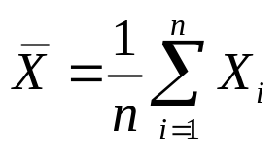
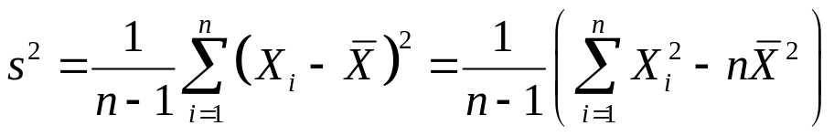


Section 1.2: Summary Statistics
Sample Mean:
Sample Variance:
Sample standard deviation is the square root of the sample variance.
If X₁, …, X_{n} is a sample, and Y_{i} = a + b X_{i} ,where a and b are constants, then
If X₁, …, X_{n} is a sample, and Y_{i} = a + b X_{i} ,where a and b are constants, then

Slide 9
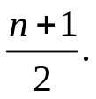
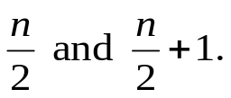
Definition: The median is another measure of center, like the mean. To find it:
If n is odd, the sample median is the number in position
If n is even, the sample median is the average of the numbers in positions
Definitions:
The first quartile is the median of the lower half of the data (include the median in the lower half of the data if n is odd).
The third quartile is the median of the upper half of the data (include the median in the upper half of the data if n is odd).

Slide 10
Percentiles
Definition: The pth percentile of a sample, for a number between 0 and 100, divides the sample so that as nearly as possible p% of the sample values are less than the pth percentile. To find:
Order the sample values from smallest to largest.
Then compute the quantity (p/100)(n+1), where n is the sample size.
If this quantity is an integer, the sample value in this position is the pth percentile. Otherwise, average the two sample values on either side.
Note, the first quartile is the 25th percentile, the median is the 50th percentile, and the third quartile is the 75th percentile.

Slide 11
A Couple More Definitions:
A numerical summary of a sample is called a statistic.
A numerical summary of a population is called a parameter.
Sample statistics are often used to estimate parameters.

Slide 12




Population
Sample
Inference
Parameters
Statistics

Slide 13
Section 1.3: Graphical Summaries
Dotplot
Histogram
Boxplot
Scatterplot

Slide 14
Stem-and-leaf Plot
A simple way to summarize a data set.
Each item in the sample is divided into two parts: a stem, consisting of the leftmost one or two digits, and the leaf, which consists of the next significant digit.
It is a compact way to represent the data.
It also gives us some indication of the shape of our data.

Slide 15
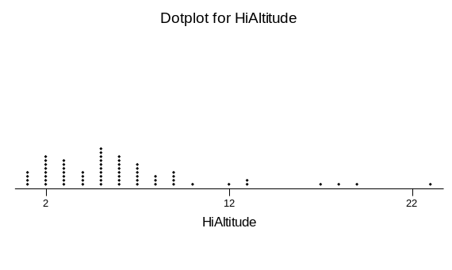
Dotplot
A dotplot is a graph that can be used to give a rough impression of the shape of a sample.
It is useful when the sample size is not too large and when the sample contains some repeated values.
Good method, along with the stem-and-leaf plot to informally examine a sample.
Not generally used in formal presentations.

Slide 16
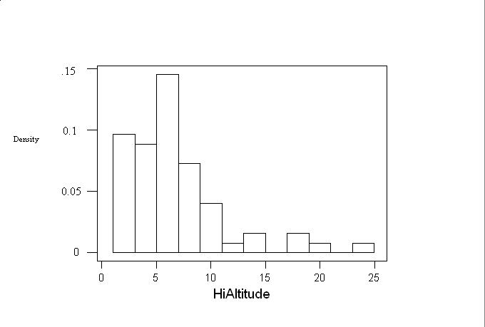
Histogram
Choose boundary points for the class intervals.
Compute the frequencies and relative frequencies for each class.
Compute the density for each class, according to the formula
Density = relative frequency/class width
Draw a rectangle for each class, whose height is equal to the density.

Slide 17
Symmetry and Skewness
A histogram is perfectly symmetric if its right half is a mirror image of its left half.
  Heights of random men
Histograms that are not symmetric are referred to as skewed.
A histogram with a long right-hand tail is said to be skewed to the right, or positively skewed.
  Incomes are right skewed.
A histogram with a long left-hand tail is said to be skewed to the left, or negatively skewed.
  Grades on an easy test are left skewed.

Slide 18
Boxplots
A boxplot is a graphic that presents the median, the first and third quartiles, and any outliers present in the sample.
The interquartile range (IQR) is the difference between the third and first quartile. This is the distance needed to span the middle half of the data.
Steps in the Construction of a Boxplot
  Compute the median and the first and third quartiles of the sample. Indicate these with horizontal lines. Draw vertical lines to complete the box.
  Find the largest sample value that is no more than 1.5 IQR above the third quartile, and the smallest sample value that is not more than 1.5 IQR below the first quartile. Extend vertical lines (whiskers) from the quartile lines to these points.
  Points more than 1.5 IQR above the third quartile, or more than 1.5 IQR below the first quartile are designated as outliers. Plot each outlier individually.

Slide 19
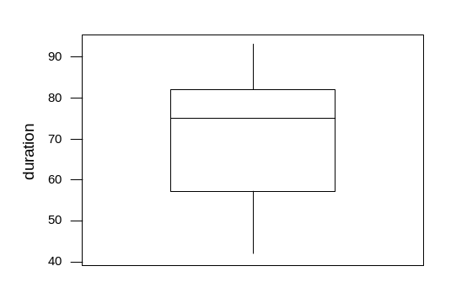
Example: Geyser data again:
Notice there are no outliers in these data.
Looking at the four pieces of the boxplot, we can tell that the sample values are comparatively densely packed between the median and the third quartile.
The lower whisker is a bit longer than the upper one, indicating that the data has a slightly longer lower tail than an upper tail.
The distance between the first quartile and the median is greater than the distance between the median and the third quartile.
This boxplot suggests that the data are skewed to the left.

Slide 20
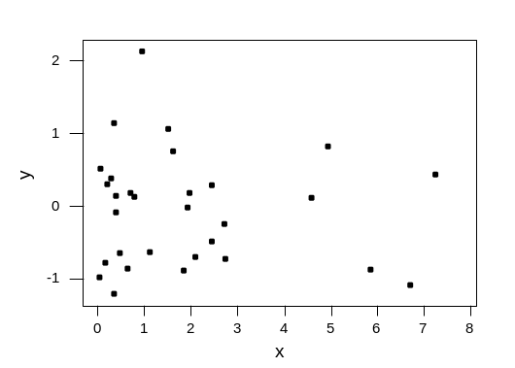
Scatterplot
Data for which item consists of a pair of values is called bivariate.
The graphical summary for bivariate data is a scatterplot.
Display of a scatterplot:

Slide 21
Summary of Chapter 1
We discussed types of data.
We looked at sampling, mostly SRS.
We learned about sample statistics.
We examined graphical displays of data

