Slide 1
Chapter 2:
Probability

Slide 2
Section 2.1: Basic Ideas
Definition: An experiment is a process that results in an outcome that cannot be predicted in advance with certainty.
Examples:
  rolling a die
  tossing a coin
  weighing the contents of a box of cereal.
Definition: The set of all possible outcomes of an experiment is called the sample space for the experiment.
Examples:
For rolling a fair die, the sample space is {1, 2, 3, 4, 5, 6}.
For a coin toss, the sample space is {heads, tails}.
For weighing a cereal box, the sample space is (0, ), a more reasonable sample space is (12, 20) for a 16 oz. box.

Slide 3
More Terminology
Definition: A subset of a sample space is called an event.
A given event is said to have occurred if the outcome of the experiment is one of the outcomes in the event. For example, if a die comes up 2, the events {2, 4, 6} and {1, 2, 3} have both occurred, along with every other event that contains the outcome “2”.

Slide 4
Combining Events
The union of two events A and B, denoted A ∪ B, is the set of outcomes that belong either to A, to B, or to both. In words, A ∪ B means “A or B”. So the event “A or B” occurs whenever either A or B (or both) occurs.
Example: Let A = {1, 2, 3} and B = {2, 3, 4}.
Then A ∪ B = {1, 2, 3, 4}

Slide 5
Intersections
The intersection of two events A and B, denoted by A ∩ B, is the set of outcomes that belong to A and to B. In words, A ∩ B means “A and B”. Thus the event “A and B” occurs whenever both A and B occur.
Example: Let A = {1, 2, 3} and B = {2, 3, 4}.
Then A ∩ B = {2, 3}

Slide 6
Complements
The complement of an event A, denoted A^{c}, is the set of outcomes that do not belong to A. In words, A^{c} means “not A”. Thus the event “not A” occurs whenever A does not occur.
Example: Consider rolling a fair sided die. Let A be the event: “rolling a six” = {6}.
Then A^{c} = “not rolling a six” = {1, 2, 3, 4, 5}.

Slide 7
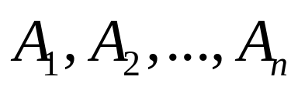
Mutually Exclusive Events
Definition: The events A and B are said to be mutually exclusive if they have no outcomes in common.
More generally, a collection of events
is said to be mutually exclusive if no two of them have any outcomes in common.
Sometimes mutually exclusive events are referred to as disjoint events.

Slide 8
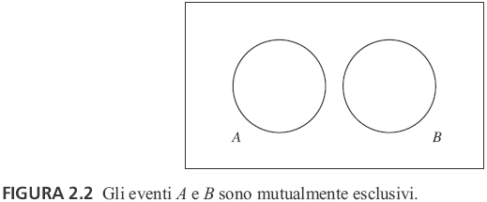
Example
When you flip a coin, you cannot have the coin come up heads and tails.
The following Venn diagram illustrates mutually exclusive events:

Slide 9
Probabilities
Definition: Each event in the sample space has a probability of occurring. Intuitively, the probability is a quantitative measure of how likely the event is to occur.
Given any experiment and any event A:
The expression P(A) denotes the probability that the event A occurs.
P(A) is the proportion of times that the event A would occur in the long run, if the experiment were to be repeated over and over again.

Slide 10
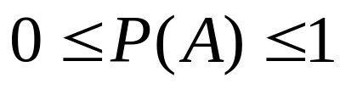

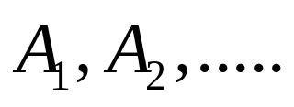

Axioms of Probability
Let S be a sample space. Then P(S) = 1.
For any event A, .
If A and B are mutually exclusive events, then . More generally, if
are mutually exclusive events, then

Slide 11


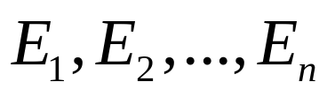
A Few Useful Things
For any event A,
P( ) = 1 – P(A).
Let denote the empty set. Then
P( ) = 0.
If A is an event, and A = { }, then
P(A) = P(E₁) + P(E₂) +….+ P(E_{n}).
Addition Rule (for when A and B are not mutually exclusive):

Slide 12
Section 2.2: Counting Methods
The Fundamental Counting Principle:
Assume that k operations are to be performed. If there are n₁ ways to perform the first operation, and if for each of these ways there are n₂ ways to perform the second calculation, and so on. Then the total number of ways to perform the sequence of k operations is n₁n₂…n_{k}.
A permutation is an ordering of a collection of objects. The number of permutations of n objects is n!.
The number of permutations of k objects chosen from a group of n objects is n!/(n – k)!
The number of permutations of k objects chosen from a group of n objects is n!/[(n – k)!k!]
The number of ways to divide a group of n objects into groups of k₁, … , k_{n} objects where k₁ + … + k_{n} = n, is n!/(k₁!...k_{n}!)

Slide 13
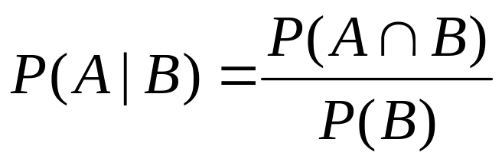
Section 2.3: Conditional Probability and Independence
Definition: A probability that is based on part of the sample space is called a conditional probability.
Let A and B be events with P(B) ≠ 0. The conditional probability of A given B is

Slide 14
More Definitions
Definition: Two events A and B are independent if the probability of each event remains the same whether or not the other occurs.
If P(A) ≠ 0 and P(B) ≠ 0, then A and B are independent if P(B|A) = P(B) or, equivalently, P(A|B) = P(A).
If either P(A) = 0 or P(B) = 0, then A and B are independent.

Slide 15
The Multiplication Rule
If A and B are two events and P(B) ≠ 0, then
P(A ∩ B) = P(B)P(A|B).
If A and B are two events and P(A) ≠ 0, then
P(A ∩ B) = P(A)P(B|A).
If P(A) ≠ 0, and P(B) ≠ 0, then both of the above hold.
If A and B are two independent events, then
P(A ∩ B) = P(A)P(B).
This result can be extended to any number of events.

Slide 16
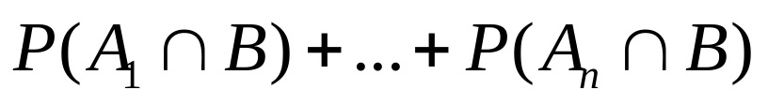
Law of Total Probability
Law of Total Probability:
If A₁,…, A_{n} are mutually exclusive and exhaustive events, and B is any event, then
P(B) =
Equivalently, if P(A_{i}) ≠ 0 for each A_{i},
P(B) = P(B|A₁)P(A₁)+…+ P(B|A_{n})P(A_{n}).

Slide 17
Example
Customers who purchase a certain make of car can order an engine in any of three sizes. Of all the cars sold, 45% have the smallest engine, 35% have a medium-sized engine, and 20% have the largest. Of cars with smallest engines, 10% fail an emissions test within two years of purchase, while 12% of those with the medium size and 15% of those with the largest engine fail. What is the probability that a randomly chosen car will fail an emissions test within two years?

Slide 18
Solution
Let B denote the event that a car fails an emissions test within two years. Let A₁ denote the event that a car has a small engine, A₂ the event that a car has a medium size engine, and A₃ the event that a car has a large engine. Then P(A₁) = 0.45, P(A₂) = 0.35, and P(A₃) = 0.20. Also, P(B|A₁) = 0.10, P(B|A₂) = 0.12, and P(B|A₃) = 0.15. By the law of total probability,
P(B) = P(B|A₁) P(A₁) + P(B|A₂)P(A₂) + P(B|A₃) P(A₃)
= 0.10(0.45) + 0.12(0.35) + 0.15(0.20) = 0.117.

Slide 19
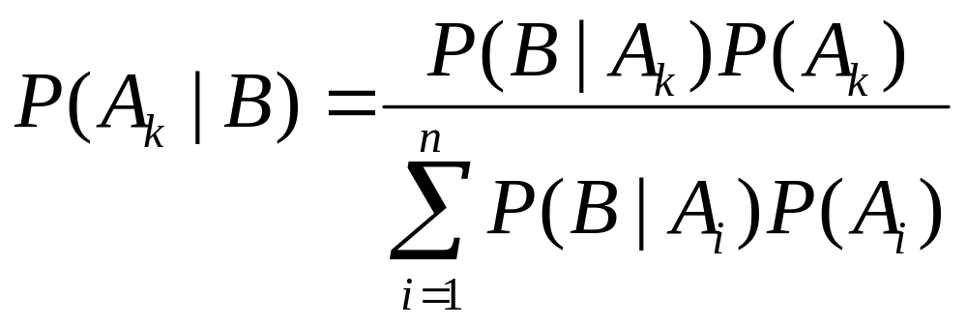
Bayes’ Rule
Bayes’ Rule: Let A₁,…, A_{n} be mutually exclusive and exhaustive events, with P(A_{i}) ≠ 0 for each A_{i}. Let B be any event with P(B) ≠ 0. Then
.

Slide 20
Example
The proportion of people in a given community who have a certain disease is 0.005. A test is available to diagnose the disease. If a person has the disease, the probability that the test will produce a positive signal is 0.99. If a person does not have the disease, the probability that the test will produce a positive signal is 0.01. If a person tests positive, what is the probability that the person actually has the disease?

Slide 21
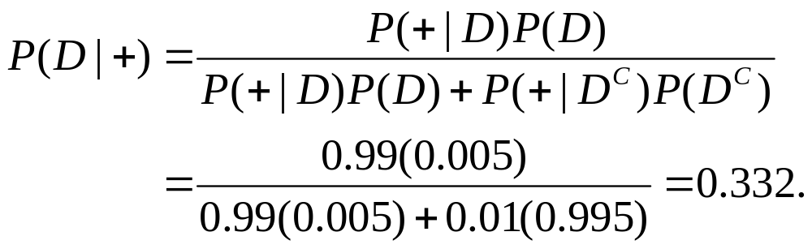
Solution
Let D represent the event that a person actually has the disease, and let + represent the event that the test gives a positive signal. We wish to find P(D|+). We know P(D) = 0.005, P(+|D) = 0.99, and P(+|D^{C}) = 0.01.
Using Bayes’ rule:

Slide 22
Section 2.4: Random Variables
Definition: A random variable assigns a numerical value to each outcome in a sample space.
Definition: A random variable is discrete if its possible values form a discrete set.

Slide 23
Example
The number of flaws in a 1-inch length of copper wire manufactured by a certain process varies from wire to wire. Overall, 48% of the wires produced have no flaws, 39% have one flaw, 12% have two flaws, and 1% have three flaws. Let X be the number of flaws in a randomly selected piece of wire.
Then P(X = 0) = 0.48, P(X = 1) = 0.39, P(X = 2) = 0.12, and P(X = 3) = 0.01. The list of possible values 0, 1, 2, and 3, along with the probabilities of each, provide a complete description of the population from which X was drawn.

Slide 24
Probability Mass Function
The description of the possible values of X and the probabilities of each has a name: the probability mass function.
Definition: The probability mass function (pmf) of a discrete random variable X is the function p(x) = P(X = x). The probability mass function is sometimes called the probability distribution.

Slide 25
Cumulative Distribution Function
The probability mass function specifies the probability that a random variable is equal to a given value.
A function called the cumulative distribution function (cdf) specifies the probability that a random variable is less than or equal to a given value.
The cumulative distribution function of the random variable X is the function F(x) = P(X ≤ x).

Slide 26
Example
Recall the example of the number of flaws in a randomly chosen piece of wire. The following is the pdf: P(X = 0) = 0.48, P(X = 1) = 0.39, P(X = 2) = 0.12, and P(X = 3) = 0.01.
For any value x, we compute F(x) by summing the probabilities of all the possible values of x that are less than or equal to x.
F(0) = P(X ≤ 0) = 0.48
F(1) = P(X ≤ 1) = 0.48 + 0.39 = 0.87
F(2) = P(X ≤ 2) = 0.48 + 0.39 + 0.12 = 0.99
F(3) = P(X ≤ 3) = 0.48 + 0.39 + 0.12 + 0.01 = 1

Slide 27
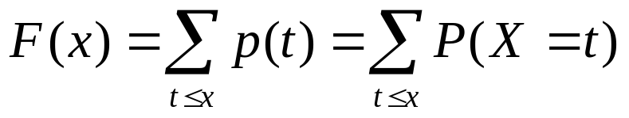
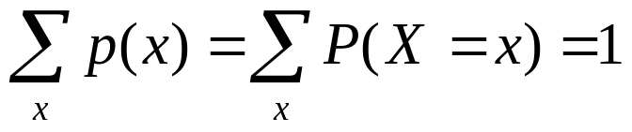
More on a Discrete Random Variable
Let X be a discrete random variable. Then
The probability mass function of X is the function p(x) = P(X = x).
The cumulative distribution function of X is the function F(x) = P(X ≤ x).
.
,where the sum is over all the possible values of X.

Slide 28
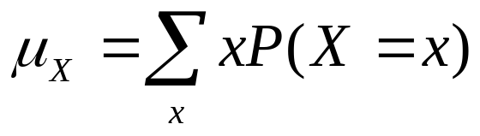
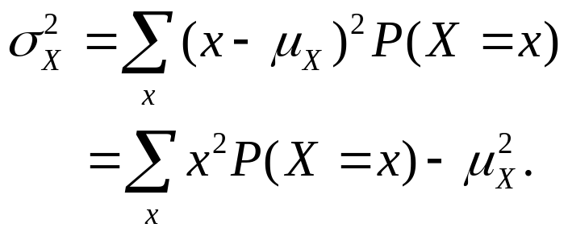
Mean and Variance for Discrete Random Variables
The mean (or expected value) of X is given by
,
where the sum is over all possible values of X.
The variance of X is given by

Slide 29
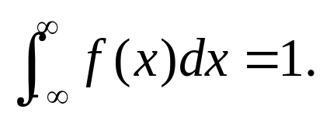
Continuous Random Variables
A random variable is continuous if its probabilities are given by areas under a curve.
The curve is called a probability density function (pdf) for the random variable. Sometimes the pdf is called the probability distribution.
The function f(x) is the probability density function of X.
Let X be a continuous random variable with probability density function f(x). Then

Slide 30
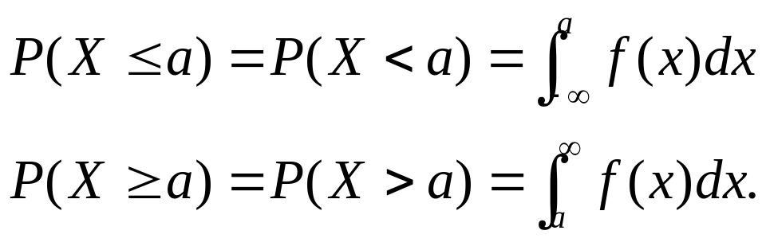
Computing Probabilities
Let X be a continuous random variable with probability density function f(x). Let a and b be any two numbers, with a < b. Then
In addition,

Slide 31
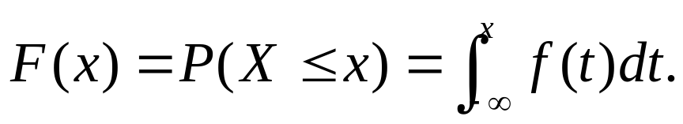
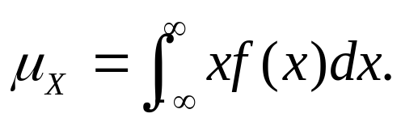
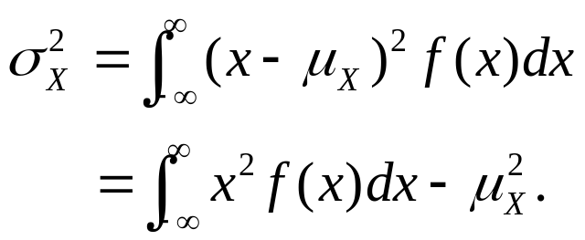
More on Continuous Random Variables
Let X be a continuous random variable with probability density function f(x). The cumulative distribution function of X is the function
The mean of X is given by
The variance of X is given by

Slide 32
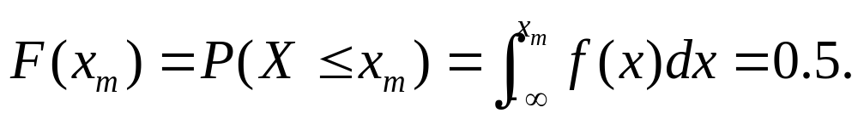
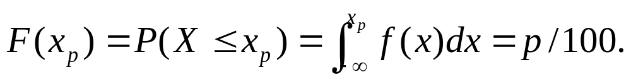
Median and Percentiles
Let X be a continuous random variable with probability mass function f(x) and cumulative distribution function F(x).
The median of X is the point x_{m} that solves the equation
If p is any number between 0 and 100, the pth percentile is the point x_{p} that solves the equation
The median is the 50th percentile.

Slide 33
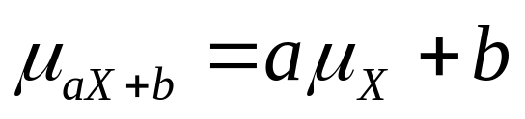
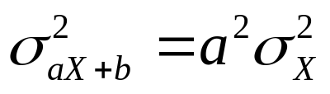
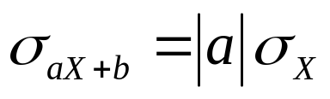
Section 2.5: Linear Functions of Random Variables
If X is a random variable, and a and b are constants, then
      ,
      ,
      .

Slide 34
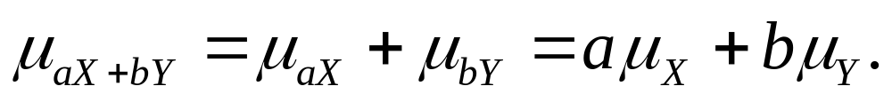
More Linear Functions
If X and Y are random variables, and a and b are constants, then
More generally, if X₁, …, X_{n} are random variables and c₁, …, c_{n} are constants, then the mean of the linear combination c₁ X₁, …, c_{n} X_{n} is given by

Slide 35
Two Independent Random Variables
If X and Y are independent random variables, and S and T are sets of numbers, then
More generally, if X₁, …, X_{n} are independent random variables, and S₁, …, S_{n} are sets, then

Slide 36
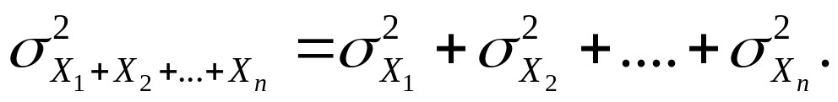
Variance Properties
If X₁, …, X_{n} are independent random variables, then the variance of the sum X₁+ …+ X_{n} is given by
If X₁, …, X_{n} are independent random variables and c₁, …, c_{n} are constants, then the variance of the linear combination c₁ X₁+ …+ c_{n} X_{n} is given by

Slide 37
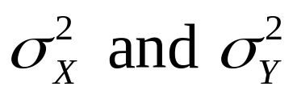
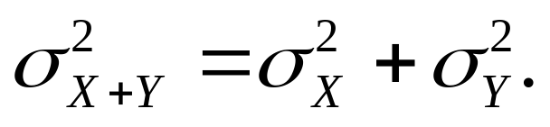
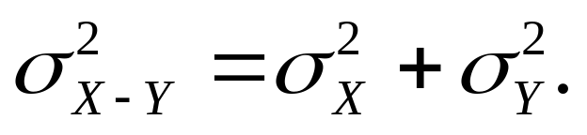
More Variance Properties
If X and Y are independent random variables with variances , then the variance of the sum X + Y is
The variance of the difference X – Y is

Slide 38
Independence and Simple Random Samples
Definition: If X₁, …, X_{n} is a simple random sample, then X₁, …, X_{n} may be treated as independent random variables, all from the same population.

Slide 39
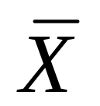
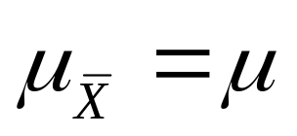
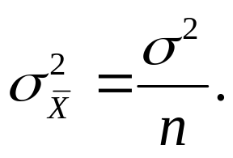
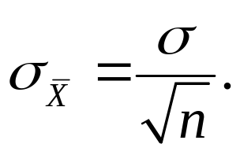
Properties of
If X₁, …, X_{n} is a simple random sample from a population with mean μ and variance σ², then the sample mean is a random variable with
The standard deviation of is

Slide 40

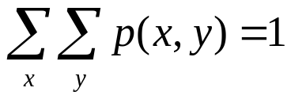
Section 2.6: Jointly Distributed Random Variables
If X and Y are jointly discrete random variables:
The joint probability mass function of X and Y is the function
The marginal probability mass functions of X and Y can be obtained from the joint probability mass function as follows:
where the sums are taken over all the possible values of Y and of X, respectively.
The joint probability mass function has the property that
where the sum is taken over all the possible values of X and Y.

Slide 41
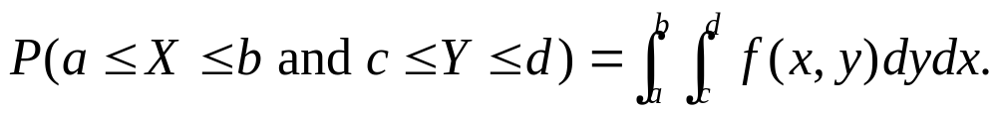
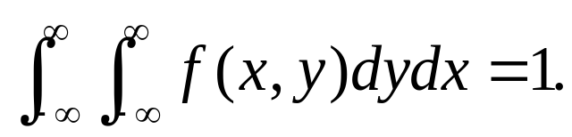
Jointly Continuous Random Variables
If X and Y are jointly continuous random variables, with joint probability density function f(x,y), and a < b, c < d, then
The joint probability density function has the property that

Slide 42
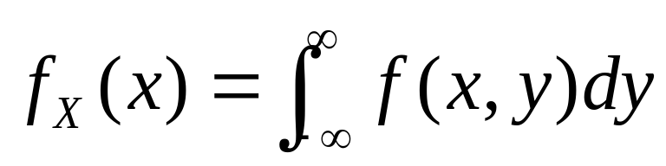
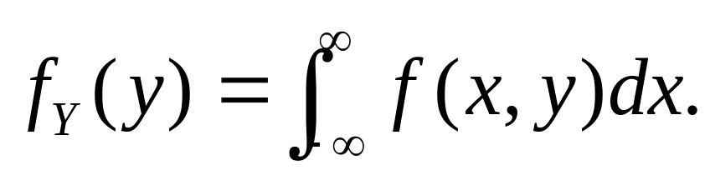
Marginals of X and Y
If X and Y are jointly continuous with joint probability density function f(x,y), then the marginal probability density functions of X and Y are given, respectively, by

Slide 43
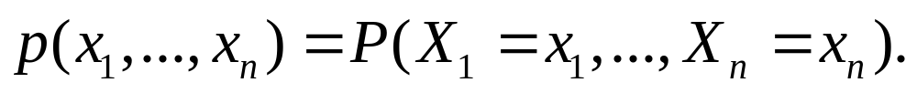
More Than Two Random Variables
If the random variables X₁, …, X_{n} are jointly discrete, the joint probability mass function is
If the random variables X₁, …, X_{n} are jointly continuous, they have a joint probability density function f(x₁, x₂,…, x_{n}), where
for any constants a₁ ≤ b₁, …, a_{n} ≤ b_{n}.

Slide 44
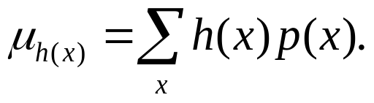
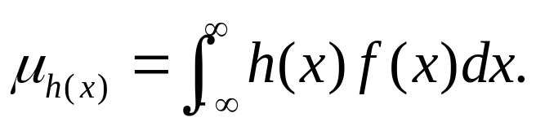
Means of Functions of Random Variables
Let X be a random variable, and let h(X) be a function of X. Then:
  If X is a discrete with probability mass function p(x), then mean of h(X) is given by
where the sum is taken over all the possible values
of X.
  If X is continuous with probability density function f(x), the mean of h(x) is given by

Slide 45
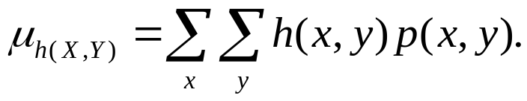
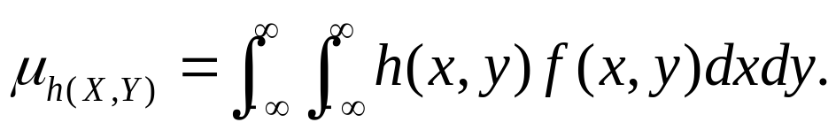
Functions of Joint Random Variables
If X and Y are jointly distributed random variables, and h(X,Y) is a function of X and Y, then
If X and Y are jointly discrete with joint probability mass function p(x,y),
where the sum is taken over all possible values of X and Y.
If X and Y are jointly continuous with joint probability mass function f(x,y),

Slide 46
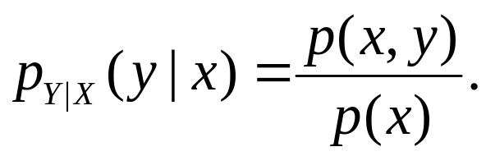
Conditional Distributions
Let X and Y be jointly discrete random variables, with joint probability density function p(x,y), let p_{X}(x) denote the marginal probability mass function of X and let x be any number for which p_{X}(x) > 0.
The conditional probability mass function of Y given X = x is
Note that for any particular values of x and y, the value of p_{Y|X}(y|x) is just the conditional probability P(Y=y|X=x).

Slide 47
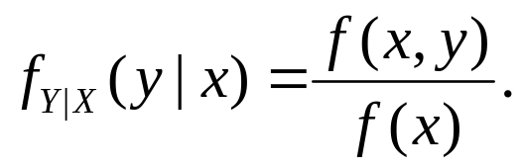
Continuous Conditional Distributions
Let X and Y be jointly continuous random variables, with joint probability density function f(x,y). Let f_{X}(x) denote the marginal density function of X and let x be any number for which f_{X}(x) > 0.
The conditional distribution function of Y given X = x is

Slide 48
Conditional Expectation
Expectation is another term for mean.
A conditional expectation is an expectation, or mean, calculated using the conditional probability mass function or conditional probability density function.
The conditional expectation of Y given X = x is denoted by E(Y|X = x) or μ_{Y|X}.

Slide 49

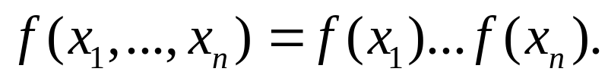
Independence
Random variables X₁, …, X_{n} are independent, provided that:
  If X₁, …, X_{n} are jointly discrete, the joint probability mass function is equal to the product of the marginals:
  If X₁, …, X_{n} are jointly continuous, the joint probability density function is equal to the product of the marginals:

Slide 50
Independence (cont.)
If X and Y are independent random variables, then:
  If X and Y are jointly discrete, and x is a value for which p_{X}(x) > 0, then
p_{Y|X}(y|x)= p_{Y}(y).
  If X and Y are jointly continuous, and x is a value for which f_{X}(x) > 0, then
f_{Y|X}(y|x)= f_{Y}(y).

Slide 51
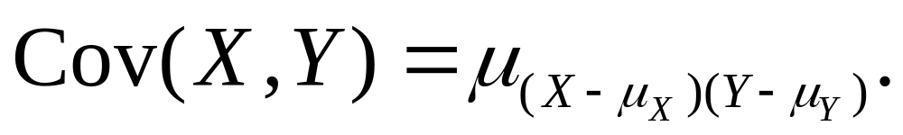

Covariance
Let X and Y be random variables with means μ_{X} and μ_{Y}.
The covariance of X and Y is
An alternative formula is

Slide 52
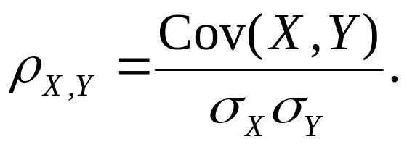
Correlation
Let X and Y be jointly distributed random variables with standard deviations σ_{X} and σ_{Y}.
The correlation between X and Y is denoted ρ_{X,Y} and is given by
For any two random variables X and Y;
-1 ≤ ρ_{X,Y} ≤ 1.

Slide 53
Covariance, Correlation, and Independence
If Cov(X,Y) = ρ_{X,Y} = 0, then X and Y are said to be uncorrelated.
If X and Y are independent, then X and Y are uncorrelated.
It is mathematically possible for X and Y to be uncorrelated without being independent. This rarely occurs in practice.

Slide 54
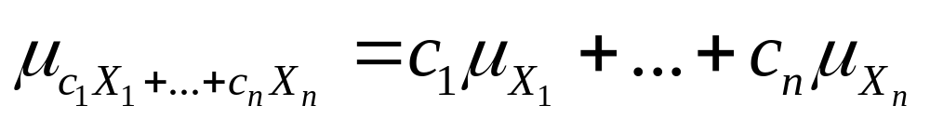
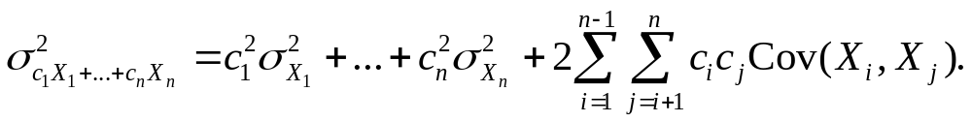
Covariance of Random Variables
If X₁, …, X_{n} are random variables and c₁, …, c_{n} are constants, then

Slide 55
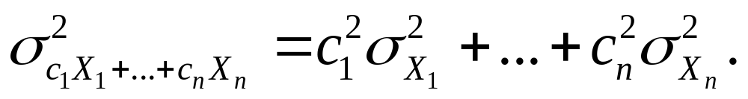

Covariance of Independent Random Variables
If X₁, …, X_{n} are independent random variables and c₁, …, c_{n} are constants, then
In particular,

Slide 56
Summary
Probability and rules
Counting techniques
Conditional probability
Independence
Random variables: discrete and continuous
Probability mass functions

Slide 57
Summary Continued
Probability density functions
Cumulative distribution functions
Means and variances for random variables
Linear functions of random variables
Mean and variance of a sample mean
Jointly distributed random variables

