Slide 1
Chapter 4:
Commonly Used Distributions

Slide 2
Section 4.1:
The Bernoulli Distribution
We use the Bernoulli distribution when we have an experiment which can result in one of two outcomes. One outcome is labeled “success,” and the other outcome is labeled “failure.”
The probability of a success is denoted by p. The probability of a failure is then 1 – p.
Such a trial is called a Bernoulli trial with success probability p.

Slide 3
Examples
The simplest Bernoulli trial is the toss of a coin. The two outcomes are heads and tails. If we define heads to be the success outcome, then p is the probability that the coin comes up heads. For a fair coin, p = 1/2.
Another Bernoulli trial is a selection of a component from a population of components, some of which are defective. If we define “success” to be a defective component, then p is the proportion of defective components in the population.

Slide 4
X ~ Bernoulli(p)
For any Bernoulli trial, we define a random variable X as follows:
If the experiment results in a success, then X = 1. Otherwise, X = 0. It follows that X is a discrete random variable, with probability mass function p(x) defined by
p(0) = P(X = 0) = 1 – p
p(1) = P(X = 1) = p
p(x) = 0 for any value of x other than 0 or 1

Slide 5
Mean and Variance
If X ~ Bernoulli(p), then
  μ_{X} = 0(1- p) + 1(p) = p
  .

Slide 6
Section 4.2:
The Binomial Distribution
If a total of n Bernoulli trials are conducted, and
  The trials are independent.
  Each trial has the same success probability p.
  X is the number of successes in the n trials.
then X has the binomial distribution with parameters n and p, denoted X ~ Bin(n,p).

Slide 7
Another Use of the Binomial
Assume that a finite population contains items of two types, successes and failures, and that a simple random sample is drawn from the population. Then if the sample size is no more than 5% of the population, the binomial distribution may be used to model the number of successes.

Slide 8
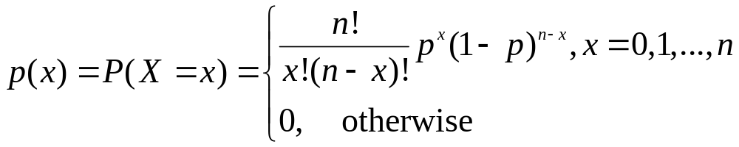

Binomial R.V.: pmf, mean, and variance
If X ~ Bin(n, p), the probability mass function of X is
Mean: μ_{X} = np
Variance:

Slide 9
More on the Binomial
Assume n independent Bernoulli trials are conducted.
Each trial has probability of success p.
Let Y₁, …, Y_{n} be defined as follows: Y_{i} = 1 if the i^{th} trial results in success, and Y_{i} = 0 otherwise. (Each of the Y_{i} has the Bernoulli(p) distribution.)
Now, let X represent the number of successes among the n trials. So, X = Y₁ + …+ Y_{n} .
This shows that a binomial random variable can be expressed as a sum of Bernoulli random variables.

Slide 10



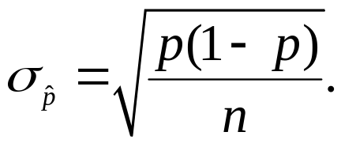
Estimate of p
If X ~ Bin(n, p), then the sample proportion is used to estimate the success probability p.
Note:
Bias is the difference
is unbiased.
The uncertainty in is
In practice, when computing σ, we substitute for p, since p is unknown.

Slide 11
Section 4.3:
The Poisson Distribution
One way to think of the Poisson distribution is as an approximation to the binomial distribution when n is large and p is small.
It is the case when n is large and p is small the mass function depends almost entirely on the mean np, very little on the specific values of n and p.
We can therefore approximate the binomial mass function with a quantity λ = np; this λ is the parameter in the Poisson distribution.

Slide 12
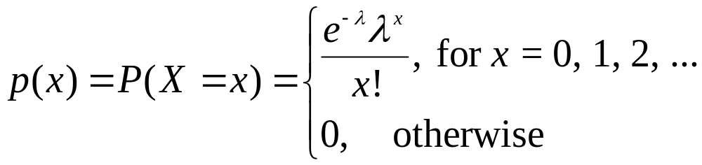
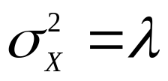
Poisson R.V.: pmf, mean, and variance
If X ~ Poisson(λ), the probability mass function of X is
Mean: μ_{X} = λ
Variance:
Note: X must be a discrete random variable and λ must be a positive constant.

Slide 13
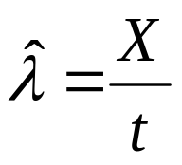

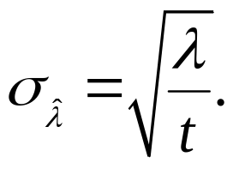
Poisson Distribution to Estimate Rate
Let λ denote the mean number of events that occur in one unit of time or space. Let X denote the number of events that are observed to occur in t unites of time or space.
If X ~ Poisson(λ), we estimate λ with .
Note:
is unbiased.
The uncertainty in is
In practice, we substitute for λ, since λ is unknown.

Slide 14
Section 4.4:
Some Other Discrete Distributions
Consider a finite population containing two types of items, which may be called successes and failures.
A simple random sample is drawn from the population.
Each item sampled constitutes a Bernoulli trial.
As each item is selected, the probability of successes in the remaining population decreases or increases, depending on whether the sampled item was a success or a failure.
For this reason the trials are not independent, so the number of successes in the sample does not follow a binomial distribution.
The distribution that properly describes the number of successes is the hypergeometric distribution.

Slide 15
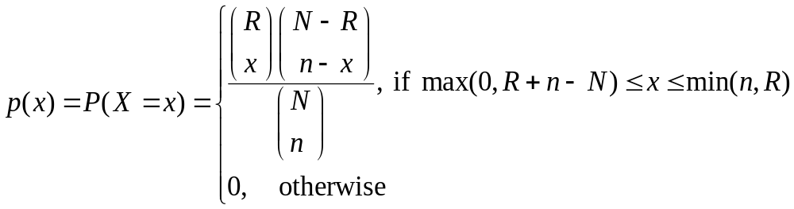
Hypergeometric pmf
Assume a finite population contains N items, of which R are classified as successes and N – R are classified as failures. Assume that n items are sampled from this population, and let X represent the number of successes in the sample. Then X has a hypergeometric distribution with parameters N, R, and n, which can be denoted X ~ H(N,R,n). The probability mass function of X is

Slide 16
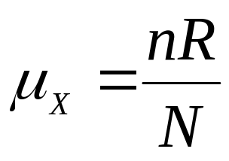
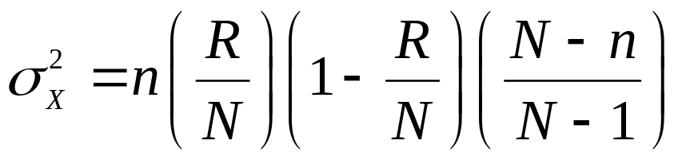
Mean and Variance
If X ~ H(N, R, n), then
Mean of X:
Variance of X:

Slide 17
Geometric Distribution
Assume that a sequence of independent Bernoulli trials is conducted, each with the same probability of success, p.
Let X represent the number of trials up to and including the first success.
Then X is a discrete random variable, which is said to have the geometric distribution with parameter p.
We write X ~ Geom(p).

Slide 18
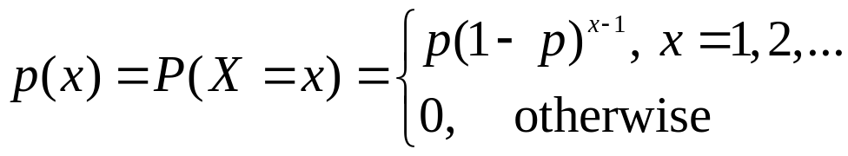
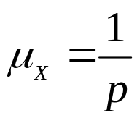
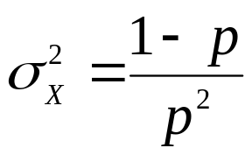
Geometric R.V.: pmf, mean, and variance
If X ~ Geom(p), then
The pmf of X is
The mean of X is
The variance of X is

Slide 19
Negative Binomial Distribution
The negative binomial distribution is an extension of the geometric distribution. Let r be a positive integer. Assume that independent Bernoulli trials, each with success probability p, are conducted, and let X denote the number of trials up to and including the r^{th} success. Then X has the negative binomial distribution with parameters r and p. We write X ~ NB(r,p).
Note: If X ~ NB(r,p), then X = Y₁ + …+ Y_{n} where Y₁,…,Y_{n} are independent random variables, each with Geom(p) distribution.

Slide 20
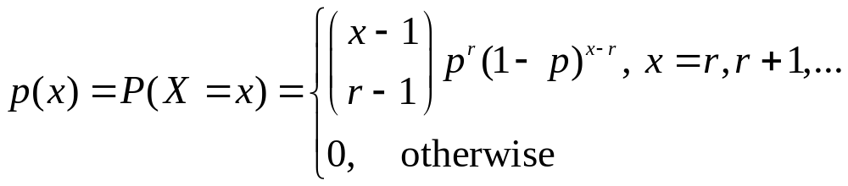
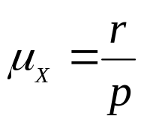
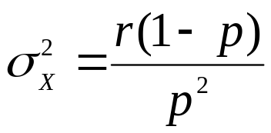
Negative Binomial R.V.: pmf, mean, and variance
If X ~ NB(r,p), then
The pmf of X is
The mean of X is
The variance of X is

Slide 21
Multinomial Distribution
A Bernoulli trial is a process that results in one of two possible outcomes. A generalization of the Bernoulli trial is the multinomial trial, which is a process that can result in any of k outcomes, where k ≥ 2. We denote the probabilities of the k outcomes by p₁,…,p_{k}.
Now assume that n independent multinomial trials are conducted each with k possible outcomes and with the same probabilities p₁,…,p_{k}. Number the outcomes 1, 2, …, k. For each outcome i, let X_{i} denote the number of trials that result in that outcome. Then X₁,…,X_{k} are discrete random variables. The collection X₁,…,X_{k} said to have the multinomial distribution with parameters n, p₁,…,p_{k}. We write X₁,…,X_{k} ~ MN(n, p₁,…,p_{k}).

Slide 22
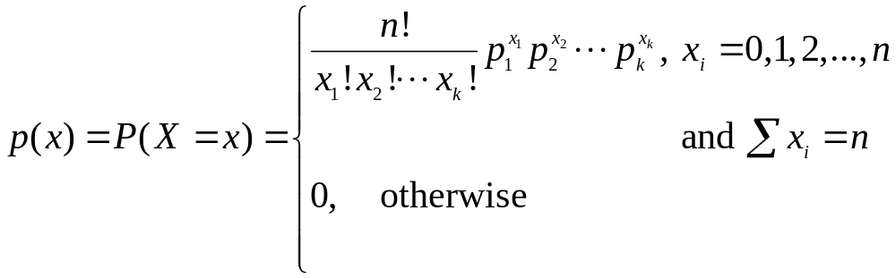
Multinomial R.V.
If X₁,…,X_{k} ~ MN(n, p₁,…,p_{k}), then the pmf of X₁,…,X_{k} is
Note that if X₁,…,X_{k} ~ MN(n, p₁,…,p_{k}), then for each i,
X_{i} ~ Bin(n, p_{i}).

Slide 23
Section 4.5:
The Normal Distribution
The normal distribution (also called the Gaussian distribution) is by far the most commonly used distribution in statistics. This distribution provides a good model for many, although not all, continuous populations.
The normal distribution is continuous rather than discrete. The mean of a normal population may have any value, and the variance may have any positive value.

Slide 24
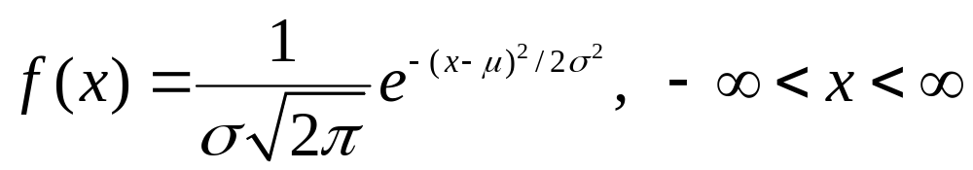
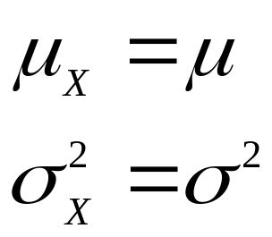
Normal R.V.: pdf, mean, and variance
The probability density function of a normal population with mean μ and variance σ² is given by
If X ~ N(μ, σ²), then the mean and variance of X are given by

Slide 25
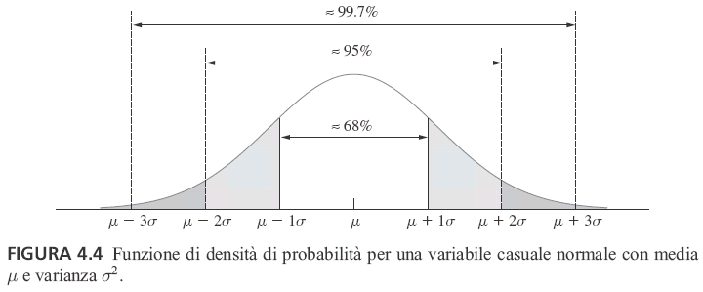
68-95-99.7% Rule
This figure represents a plot of the normal probability density function with mean μ and standard deviation σ. Note that the curve is symmetric about μ, so that μ is the median as well as the mean. It is also the case for the normal population.
About 68% of the population is in the interval μ ± σ.
About 95% of the population is in the interval μ ± 2σ.
About 99.7% of the population is in the interval μ ± 3σ.

Slide 26
Standard Units
The proportion of a normal population that is within a given number of standard deviations of the mean is the same for any normal population.
For this reason, when dealing with normal populations, we often convert from the units in which the population items were originally measured to standard units.
Standard units tell how many standard deviations an observation is from the population mean.

Slide 27
Standard Normal Distribution
In general, we convert to standard units by subtracting the mean and dividing by the standard deviation. Thus, if x is an item sampled from a normal population with mean μ and variance σ², the standard unit equivalent of x is the number z, where
z = (x - μ)/σ.
The number z is sometimes called the “z-score” of x. The z-score is an item sampled from a normal population with mean 0 and standard deviation of 1. This normal distribution is called the standard normal distribution.

Slide 28
Examples
Q: Aluminum sheets used to make beverage cans have thicknesses that are normally distributed with mean 10 and standard deviation 1.3. A particular sheet is 10.8 thousandths of an inch thick. Find the z-score.
A: z = (10.8 – 10)/1.3 = 0.62
Q: Use the same information as in 1. The thickness of a certain sheet has a z-score of -1.7. Find the thickness of the sheet in the original units of thousandths of inches.
A: -1.7 = (x – 10)/1.3 ⇒ x = -1.7(1.3) + 10 = 7.8

Slide 29
Finding Areas Under the Normal Curve
The proportion of a normal population that lies within a given interval is equal to the area under the normal probability density above that interval. This would suggest integrating the normal pdf; this integral would not have a closed form solution.
So, the areas under the curve are approximated numerically and are available in Table A.2. This table provides area under the curve for the standard normal density. We can convert any normal into a standard normal so that we can compute areas under the curve.
The table gives the area in the left-hand tail of the curve. Other areas can be calculated by subtraction or by using the fact that the total area under the curve is 1.

Slide 30
Examples
Q: Find the area under normal curve to the left of z = 0.47.
A: From the z table, the area is 0.6808.
Q: Find the area under the curve to the right of z = 1.38.
A: From the z table, the area to the left of 1.38 is 0.9162. Therefore the area to the right is 1 – 0.9162 = 0.0838.

Slide 31
More Examples
Q: Find the area under the normal curve between z = 0.71 and z = 1.28.
A: The area to the left of z = 1.28 is 0.8997. The area to the left of z = 0.71 is 0.7611. So the area between is 0.8997 – 0.7611 = 0.1386.
Q: What z-score corresponds to the 75th percentile of a normal curve?
A: To answer this question, we use the z table in reverse. We need to find the z-score for which 75% of the area of curve is to the left. From the body of the table, the closest area to 75% is 0.7486, corresponding to a z-score of 0.67.

Slide 32
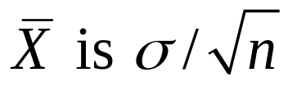
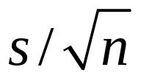
Estimating the Parameters
If X₁,…,X_{n} are a random sample from a N(μ,σ²) distribution, μ is estimated with the sample mean and σ² is estimated with the sample standard deviation.
As with any sample mean, the uncertainty in
which we replace with , if σ is unknown. The mean is an unbiased estimator of μ.

Slide 33
Section 4.6:
The Lognormal Distribution
For data that contain outliers, the normal distribution is generally not appropriate. The lognormal distribution, which is related to the normal distribution, is often a good choice for these data sets.
If X ~ N(μ,σ²), then the random variable Y = e^{X} has the lognormal distribution with parameters μ and σ².
If Y has the lognormal distribution with parameters μ and σ², then the random variable X = lnY has the N(μ,σ²) distribution.

Slide 34
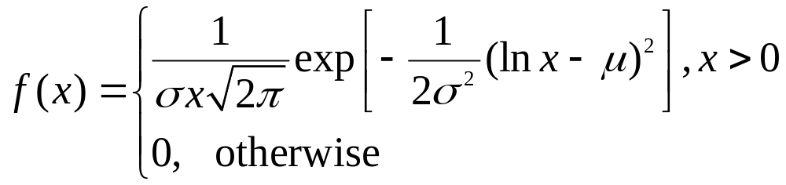
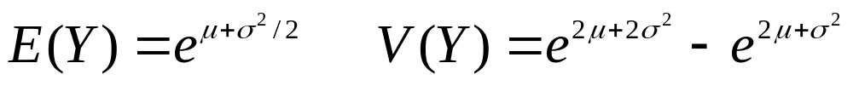
Lognormal pdf, mean, and variance
The pdf of a lognormal random variable with parameters μ and σ² is
The mean E(Y) and variance V(Y) are given by

Slide 35
Section 4.7:
The Exponential Distribution
The exponential distribution is a continuous distribution that is sometimes used to model the time that elapses before an event occurs. Such a time is often called a waiting time.
The probability density of the exponential distribution involves a parameter, which is a positive constant λ whose value determines the density function’s location and shape.
We write X ~ Exp(λ).

Slide 36
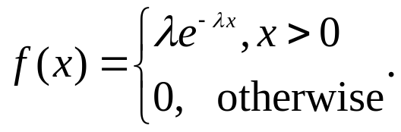
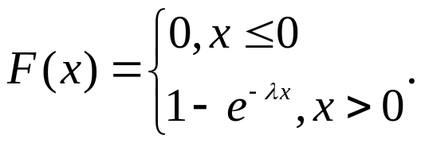
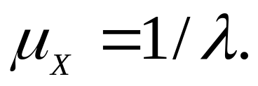
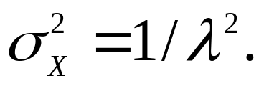
Exponential R.V.: pdf, cdf, mean and variance
The pdf of an exponential r.v. is
The cdf of an exponential r.v. is
The mean of an exponential r.v. is
The variance of an exponential r.v. is

Slide 37

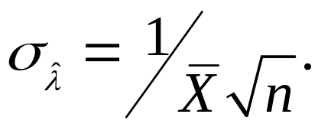
Lack of Memory Property
The exponential distribution has a property known as the lack of memory property: If T ~ Exp(λ), and t and s are positive numbers, then P(T > t + s | T > s) = P(T > t).
If X₁,…,X_{n} are a random sample from Exp(λ), then the parameter λ is estimated with This estimator is biased. This bias is approximately equal to λ/n. The uncertainty in is estimated with
This uncertainty estimate is reasonably good when the sample size is more than 20.

Slide 38
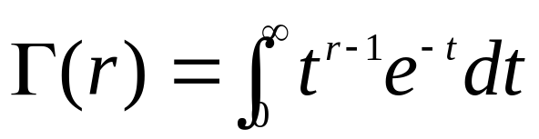

Section 4.8:
The Gamma and Weibull Distributions
First, let’s consider the gamma function:
For r > 0, the gamma function is defined by
.
The gamma function has the following properties:
If r is any integer, then Γ(r) = (r-1)!.
For any r, Γ(r+1) = r Γ(r).
Γ(1/2) = .

Slide 39
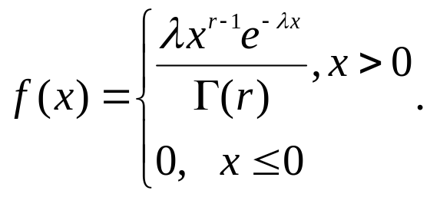
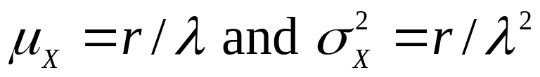
Gamma R.V.
If X₁,…,X_{r} are independent random variables, each distributed as Exp(λ), then the sum X₁+…+X_{r} is distributed as a gamma random variable with parameters r and λ, denoted as Γ(r, λ ).
The pdf of the gamma distribution with parameters r > 0 and λ > 0 is
The mean and variance are given by
, respectively.

Slide 40
The Weibull Distribution
The Weibull distribution is a continuous random variable that is used in a variety of situations. A common application of the Weibull distribution is to model the lifetimes of components. The Weibull probability density function has two parameters, both positive constants, that determine the location and shape. We denote these parameters α and β.
If α = 1, the Weibull distribution is the same as the exponential distribution with parameter λ = β.

Slide 41
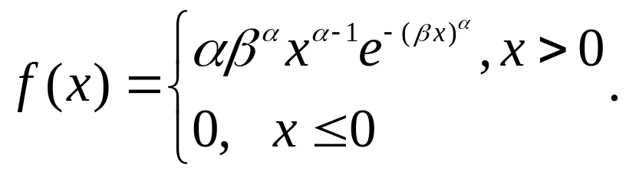
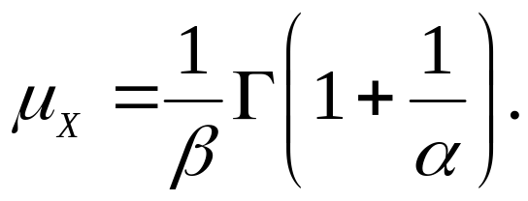
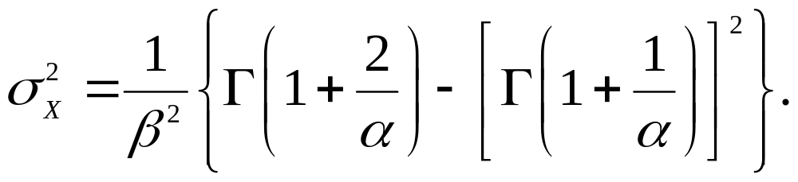
Weibull R.V.
The pdf of the Weibull distribution is
The mean of the Weibull is
The variance of the Weibull is

Slide 42
Section 4.9: Probability Plots
Scientists and engineers often work with data that can be thought of as a random sample from some population. In many cases, it is important to determine the probability distribution that approximately describes the population.
More often than not, the only way to determine an appropriate distribution is to examine the sample to find a sample distribution that fits.

Slide 43
Finding a Distribution
Probability plots are a good way to determine an appropriate distribution.
Here is the idea: Suppose we have a random sample X₁,…,X_{n}. We first arrange the data in ascending order. Then assign a evenly spaced values between 0 and 1 to each X_{i}. There are several acceptable ways to this; the simplest is to assign the value (i – 0.5)/n to X_{i}.
The distribution that we are comparing the X’s to should have a mean and variance that match the sample mean and variance. We want to plot (X_{i}, F(X_{i})), if this plot resembles the cdf of the distribution that we are interested in, then we conclude that that is the distribution the data came from.

Slide 44
Software
When you use a software package, then it takes the (i – 0.5)/n assigned to each X_{i} and calculates the quantile (Q_{i}) corresponding to that number from the distribution of interest. Then it plots each (X_{i}, Q_{i} ). If this plot is a reasonably straight line then you may conclude that the sample came from the distribution that we used to find quantiles.

Slide 45
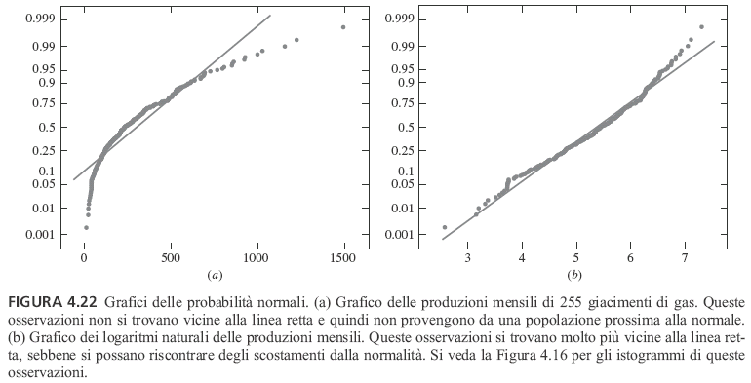

Slide 46
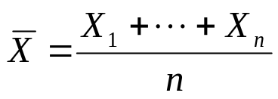
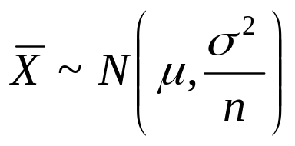
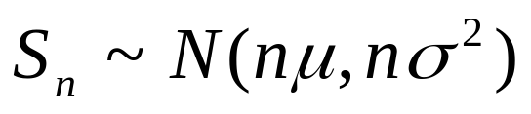
Section 4.10: The Central Limit Theorem
The Central Limit Theorem
Let X₁,…,X_{n} be a random sample from a population with mean μ and variance σ².
Let be the sample mean.
Let S_{n} = X₁+…+X_{n} be the sum of the sample observations. Then if n is sufficiently large,
and approximately.

Slide 47
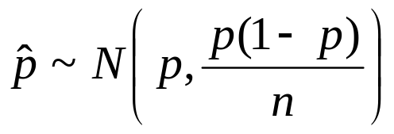
Rule of Thumb
For most populations, if the sample size is greater than 30, the Central Limit Theorem approximation is good.
Normal approximation to the Binomial:
If X ~ Bin(n,p) and if np > 10, and n(1-p) >10, then X ~ N(np, np(1-p)) approximately and
approximately.
Normal Approximation to the Poisson:
If X ~ Poisson(λ), where λ > 10, then X ~ N(λ, λ²).

Slide 48
Continuity Correction
The binomial distribution is discrete, while the normal distribution is continuous.
The continuity correction is an adjustment, made when approximating a discrete distribution with a continuous one, that can improve the accuracy of the approximation.
If you want to include the endpoints in your probability calculation, then extend each endpoint by 0.5. Then proceed with the calculation.
If you want exclude the endpoints in your probability calculation, then include 0.5 less from each endpoint in the calculation.

Slide 49
Section 4.11: Simulation
Simulation refers to the process of generating random numbers and treating them as if they were data generated by an actual scientific distribution. The data so generated are called simulated or synthetic data.

Slide 50
Example
An engineer has to choose between two types of cooling fans to install in a computer. The lifetimes, in months, of fans of type A are exponentially distributed with mean 50 months, and the lifetime of fans of type B are exponentially distributed with mean 30 months. Since type A fans are more expensive, the engineer decides that she will choose type A fans if the probability that a type A fan will last more than twice as long as a type B fan is greater than 0.5. Estimate this probability.

Slide 51


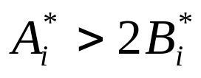
Simulation
We perform a simulation experiment, using samples of size 1000.
Generate a random sample from an exponential distribution with mean 50 (λ = 0.02).
Generate a random sample from an exponential distribution with mean 30 (λ = 0.033).
Count the number of times that .
Divide the number of times that occurred by the total number of trials. This is the estimate of the probability that type A fans last twice as long as type B fans.

Slide 52
Summary
We considered various discrete distributions: Bernoulli, Binomial, Poisson, Hypergeometric, Geometric, Negative Binomial, and Multinomial.
Then we looked at some continuous distributions: Normal, Exponential, Gamma, and Weibull
We learned about the Central Limit Theorem.
We discussed Normal approximations to the Binomial and Poisson distributions.
The last thing we looked at was simulation studies.

